Slide 1

Gold, Lead, and Silicon:
America and the World in the Trump Era
Denver Gold Group, September 16, 2025

Slide 2

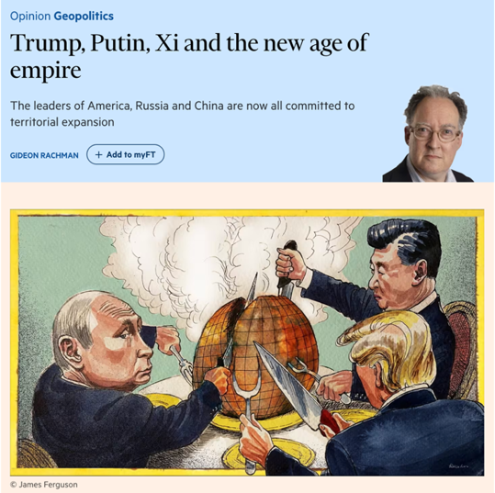
Donald Trump elicits all kinds of historical analogies. Europeans, for example, say he’s a would-be emperor …

Slide 3
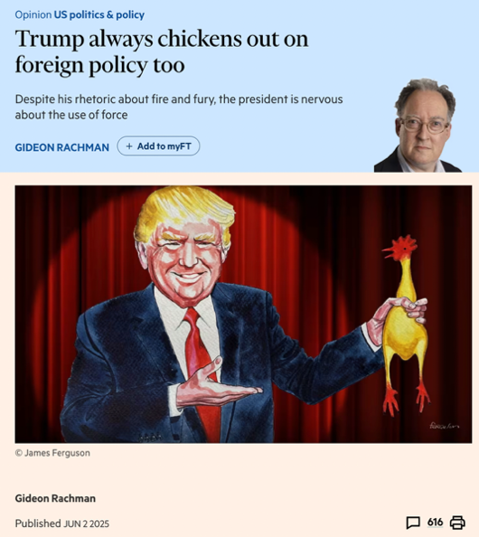
… but then they say he “always chickens out” …

Slide 4
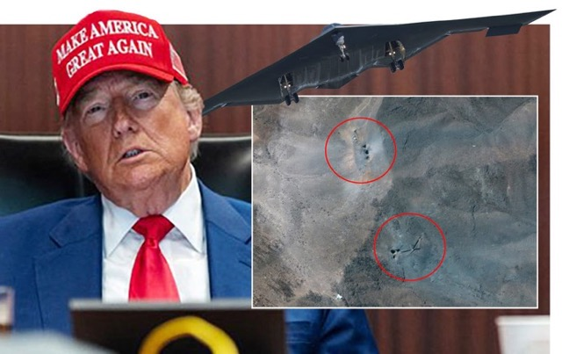
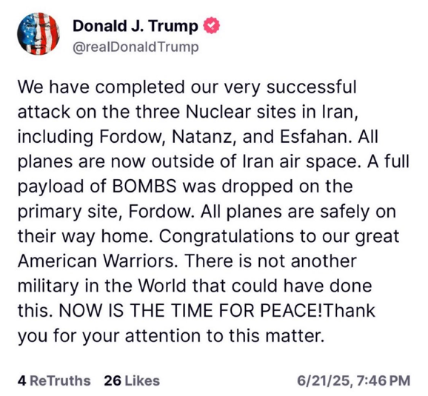
… until he doesn’t.
Donald Trump in the Situation Room, June 21

Slide 5
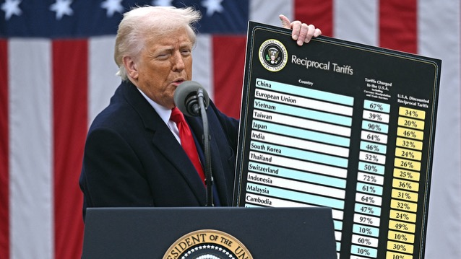
The economists just can’t understand why Trump’s tariffs haven’t done more damage.

Slide 6

Meanwhile, the Democrats keep lurching further to the left.
Zohran Mamdani wins the Democratic primary for NYC mayor

Slide 7
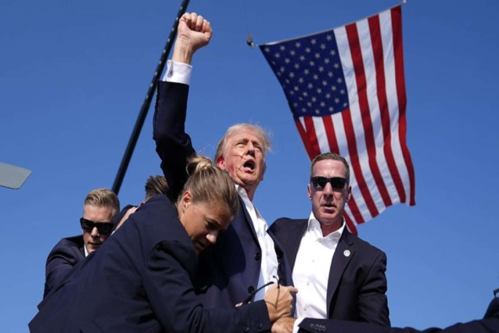

And political assassination returns to U.S. life.

Slide 8
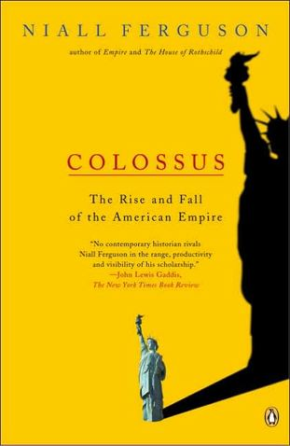
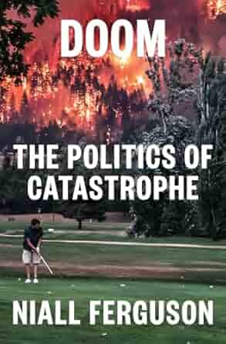
Not too much of this should really surprise us.

Slide 9
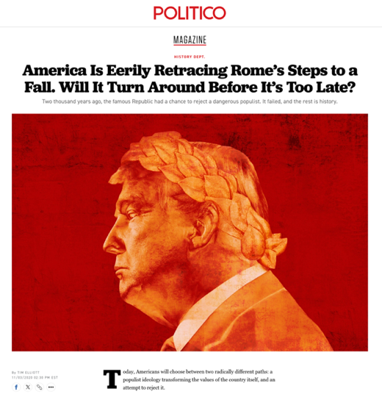
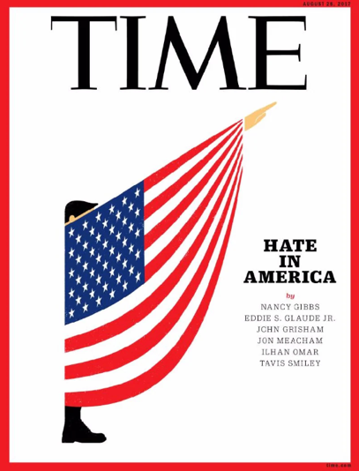
We need to resist facile historical analogies.

Slide 10
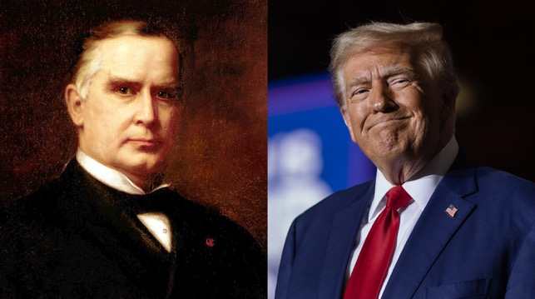
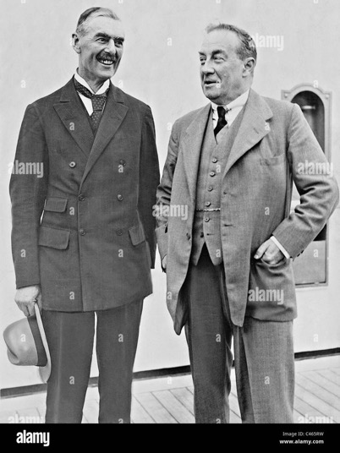
Trump wants to be McKinley, not Caesar or Hitler. But the situation of the U.S. is more like interwar Britain’s than Gilded Age America’s.
Above: William McKinley, Trump’s role model, president 1897-1901. Right: Neville Chamberlain and Stanley Baldwin, British prime ministers, 1935-1940.

Slide 11
The problem is that the U.S. broke “Ferguson’s Law” for the first time since 1934 last year …

Slide 12
… and it’s on an unsustainable path.
CBO

Slide 13
Historically, sustained violation of Ferguson’s law is often followed by currency depreciation.

Slide 14
Meanwhile, China is the most formidable economic rival the U.S. has faced.
In PPP terms, China’s GDP overtook that of the U.S. in 2014. In current USD terms, it is still ~70%. The USSR never got above 44%
IMF

Slide 15
China’s rise to dominate global manufacturing is an astonishing achievement.
In 2004, U.S MVA was 2.6x China’s. In 2022, China’s was 1.97x U.S.

Slide 16

And China now leads an Axis of authoritarians (also known as the CRINKs).
“Potentially, the most dangerous scenario would be a grand coalition of China, Russia, and perhaps Iran, an ‘antihegemonic’ coalition united not by ideology but by complementary grievances.”—Brzezinski, The Grand Chessboard (1997), pp. 55f. (He forgot North Korea.)

Slide 17
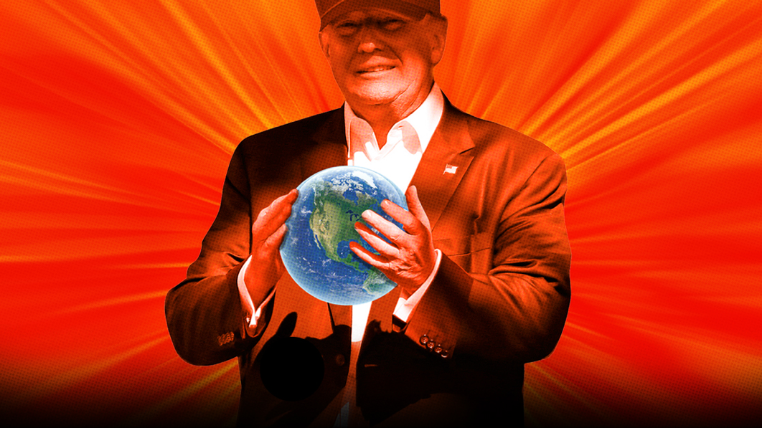
Trump 2.0’s solutions are surprisingly Nixonian.

Slide 18
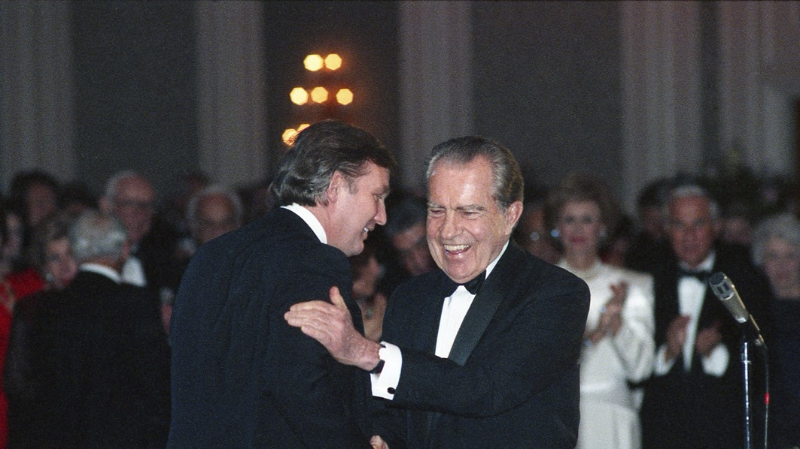
In many ways, Trump is Nixon’s revenge on the liberals.

Slide 19
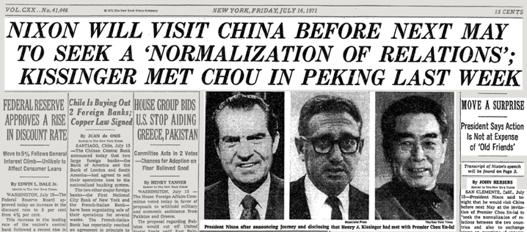
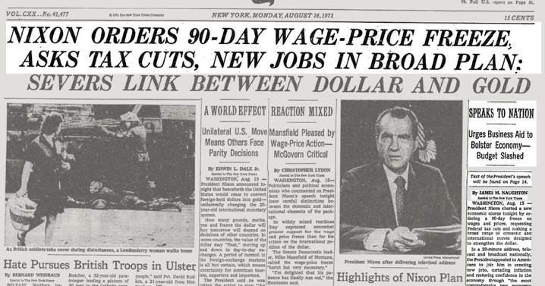
Lessons from the summer of 1971.

Slide 20
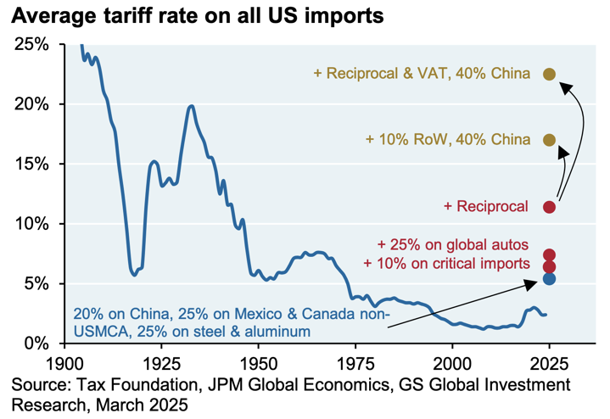
Problem 1: It is doubtful that tariffs will strengthen the U.S. economy.
“Consumers face an overall average effective tariff rate of 18.6%, the highest since 1933. After consumption shifts, the average tariff rate will be 17.7%, the highest since 1934.
“The price level from all 2025 tariffs rises by 1.8% in the short-run … The post-substitution price increase settles at 1.5%.
“US real GDP growth over 2025 and 2026 is -0.5pp lower each year.
“All tariffs to date in 2025 raise $2.7 trillion over 2026-35, with $456 billion in negative dynamic revenue effects, bringing dynamic revenues to $2.2 trillion.”—Yale Budget Lab, July 28.

Slide 21
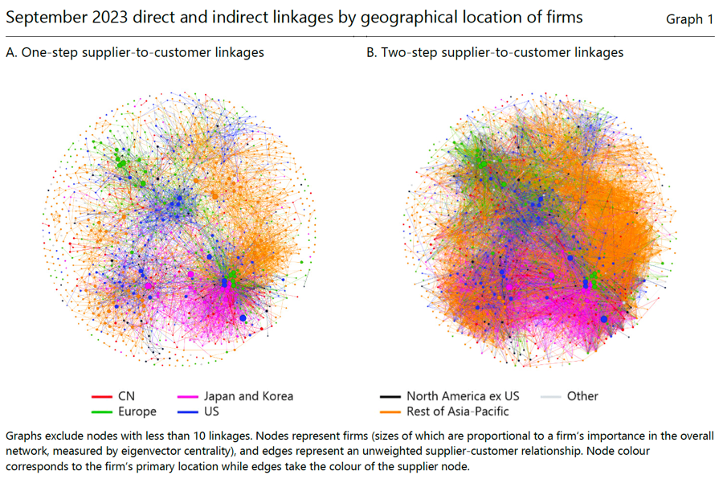
Trump has taken a sledgehammer to a complex network. But it can reconfigure itself.
Qiu, Shin and Zhang, BIS (2023)

Slide 22
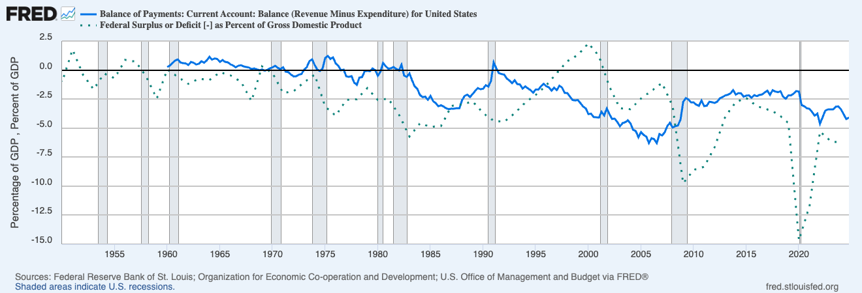
In truth, the current account deficit has more to do with U.S. fiscal profligacy than with other countries’ trade policies.

Slide 23
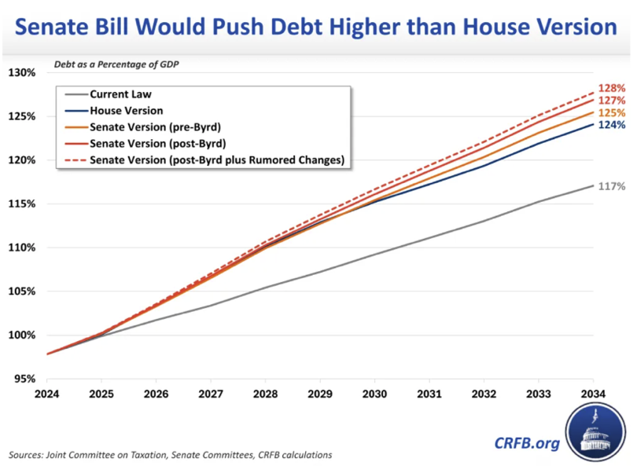
The one big, beautiful bill won’t do anything to fix that. On the contrary.

Slide 24
The main consequence of Trump 2.0 so far has been the weaker dollar (and cheaper oil).

Slide 25
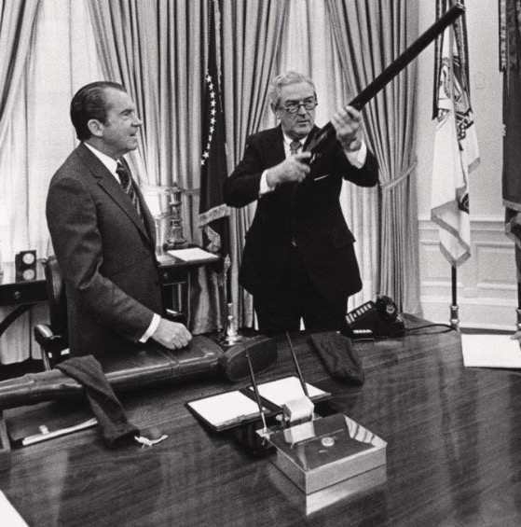
As a previous Treasury Secretary put it: “Our currency, your problem.”
John B. Connally

Slide 26
Though by historical standards the dollars has not fallen all that much. Yet.

Slide 27
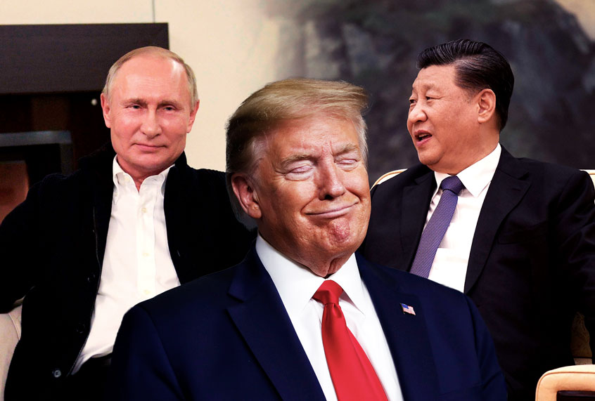
Problem 2: Trump lacks a Nixonian solution to his geopolitical problem.

Slide 28
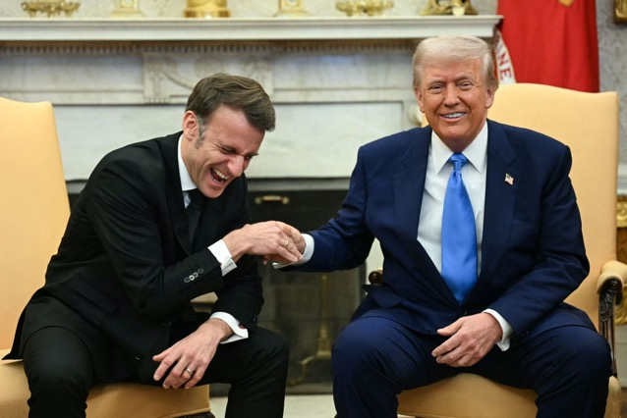
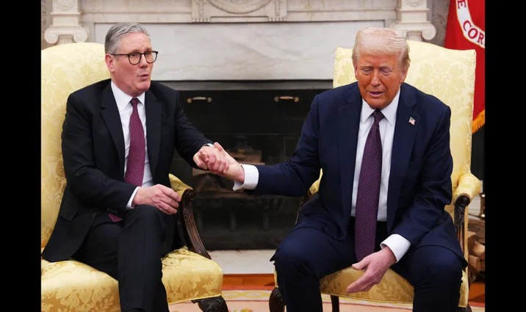
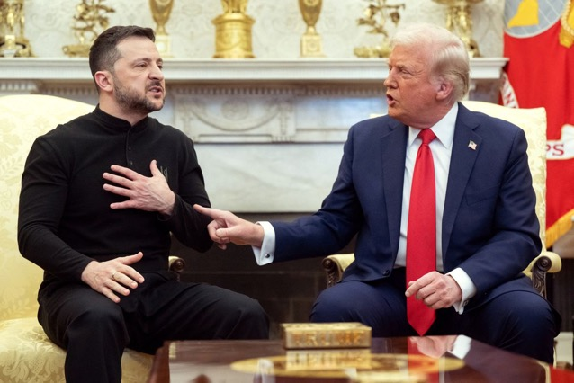
Trump gets to call the shots in Europe, as he tried to make clear in February.
Feb. 28

Slide 29
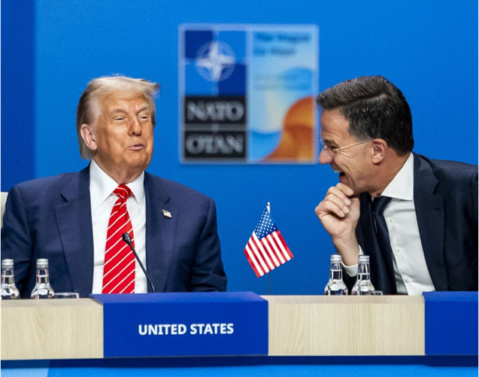
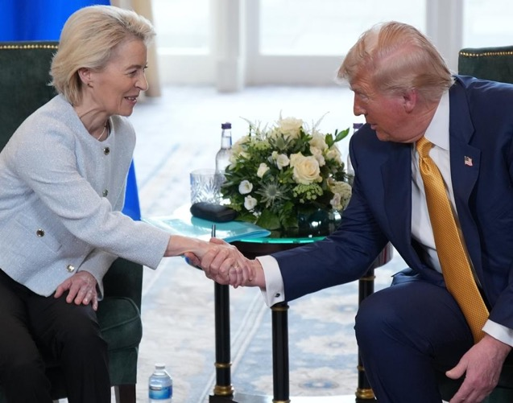
The dominance of “Daddy” was unmistakable at the NATO summit and again in Scotland, when the EU folded on trade.

Slide 30
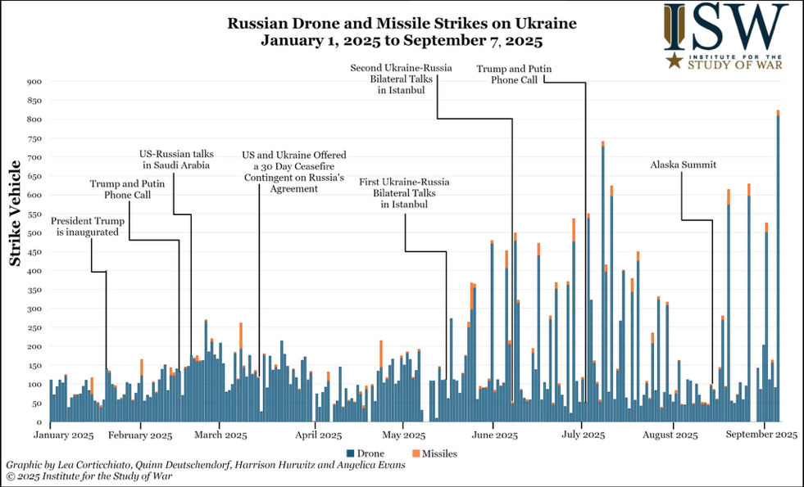
Unfortunately, “Daddy” isn’t any closer to ending the war in Ukraine. And Ukraine cannot hold out indefinitely.
ISW

Slide 31
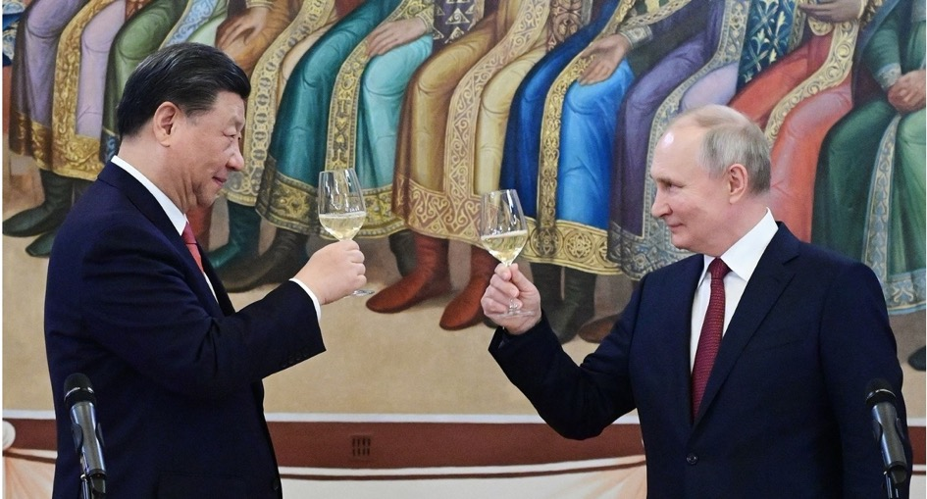
I just don’t see Trump being able to lure Moscow away from Beijing—or Xi from Putin.
In late February 2025, Xi said to Putin that Russia and China are “true friends who have been through thick and thin together.”

Slide 32
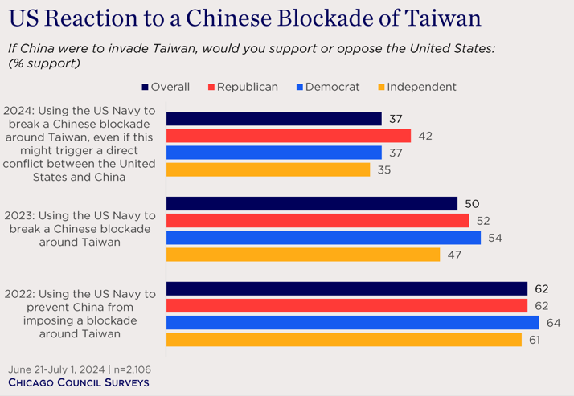
Americans are surprisingly ready to confront China over Taiwan.

Slide 33
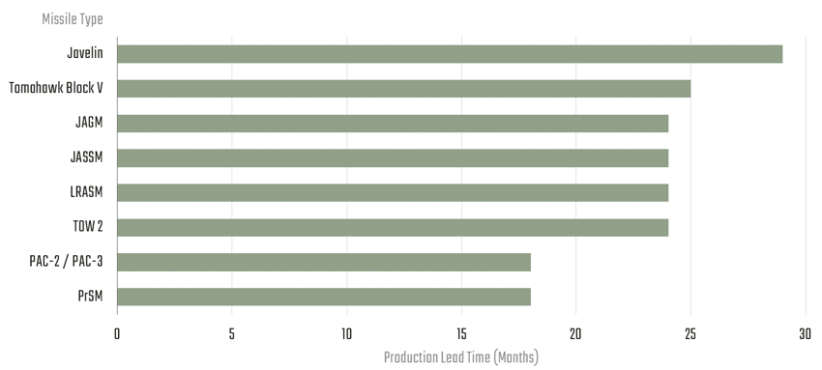
But from a military standpoint such a “Taiwan Semiconductor Crisis” would be extraordinarily dangerous.
“In nearly two dozen iterations of a CSIS war game that examined a U.S.-China war in the Taiwan Strait, the U.S. typically expended more than 5,000 long-range missiles in three weeks of conflict:
  4,000 joint air-to-surfaces standoff missiles (JASSMs),
  450 long-range anti-ship missiles (LRASMs),
  400 Harpoons, and
  400 Tomahawk land-attack missiles (TLAMs).
“In every iteration of the war game, the United States expended its inventory of LRASMs within the first week of the conflict.”

Slide 34
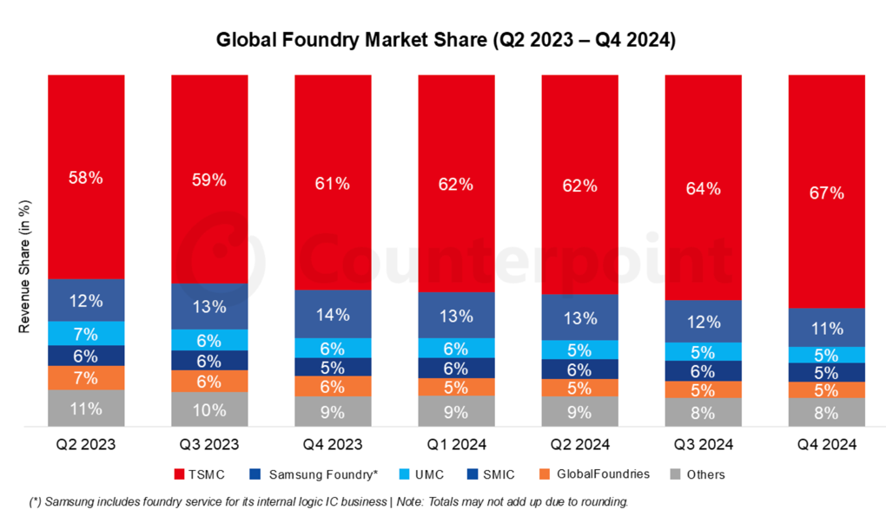
And what would the economic consequences of such a crisis be?
Counterpoint

Slide 35
A return to the 1970s would be very bullish for gold.

Slide 36
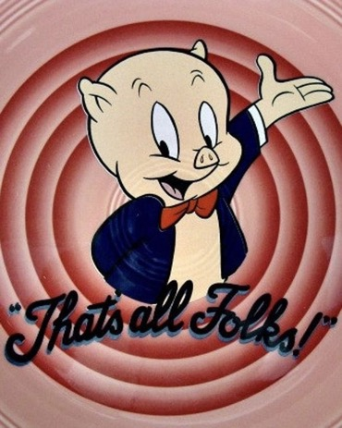
© Niall Ferguson 2025

