Slide 1
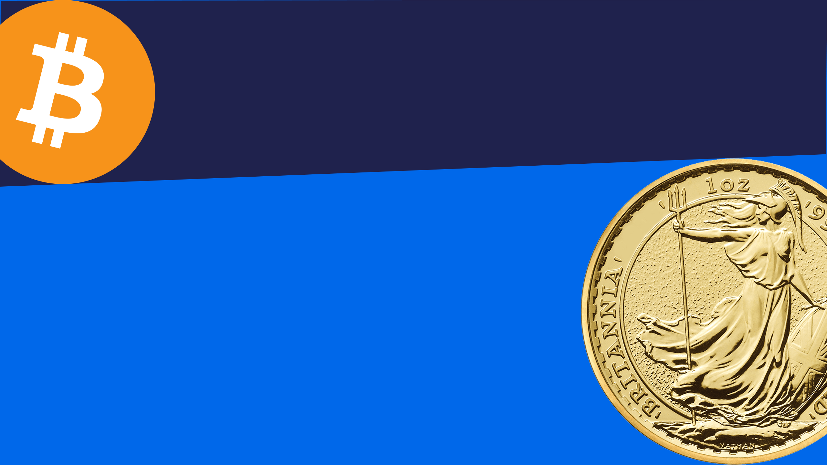
The ByteTree BOLD Index
BOLD combines Bitcoin and Gold
Mining Forum Europe, Zurich, April 2025

Slide 2
Legal Disclaimer
Information in this presentation is intended for use only by professional investors as defined by MiFID II. Any information in this presentation does not constitute an offer or solicitation for investment. The distribution of the information contained in this presentation in certain countries may be restricted by law and accordingly, persons who read it are required to inform themselves and to comply with any such restrictions. The figures shown in this presentation refer to the past. Past performance is not a reliable indicator of future results. Crypto assets are recent and are at a developmental stage with variation in their regulation in different jurisdictions. Investors should be cautious of the risks associated with crypto assets including (without limitation) volatility, total capital loss, and lack of regulation over certain market participants.

Slide 3
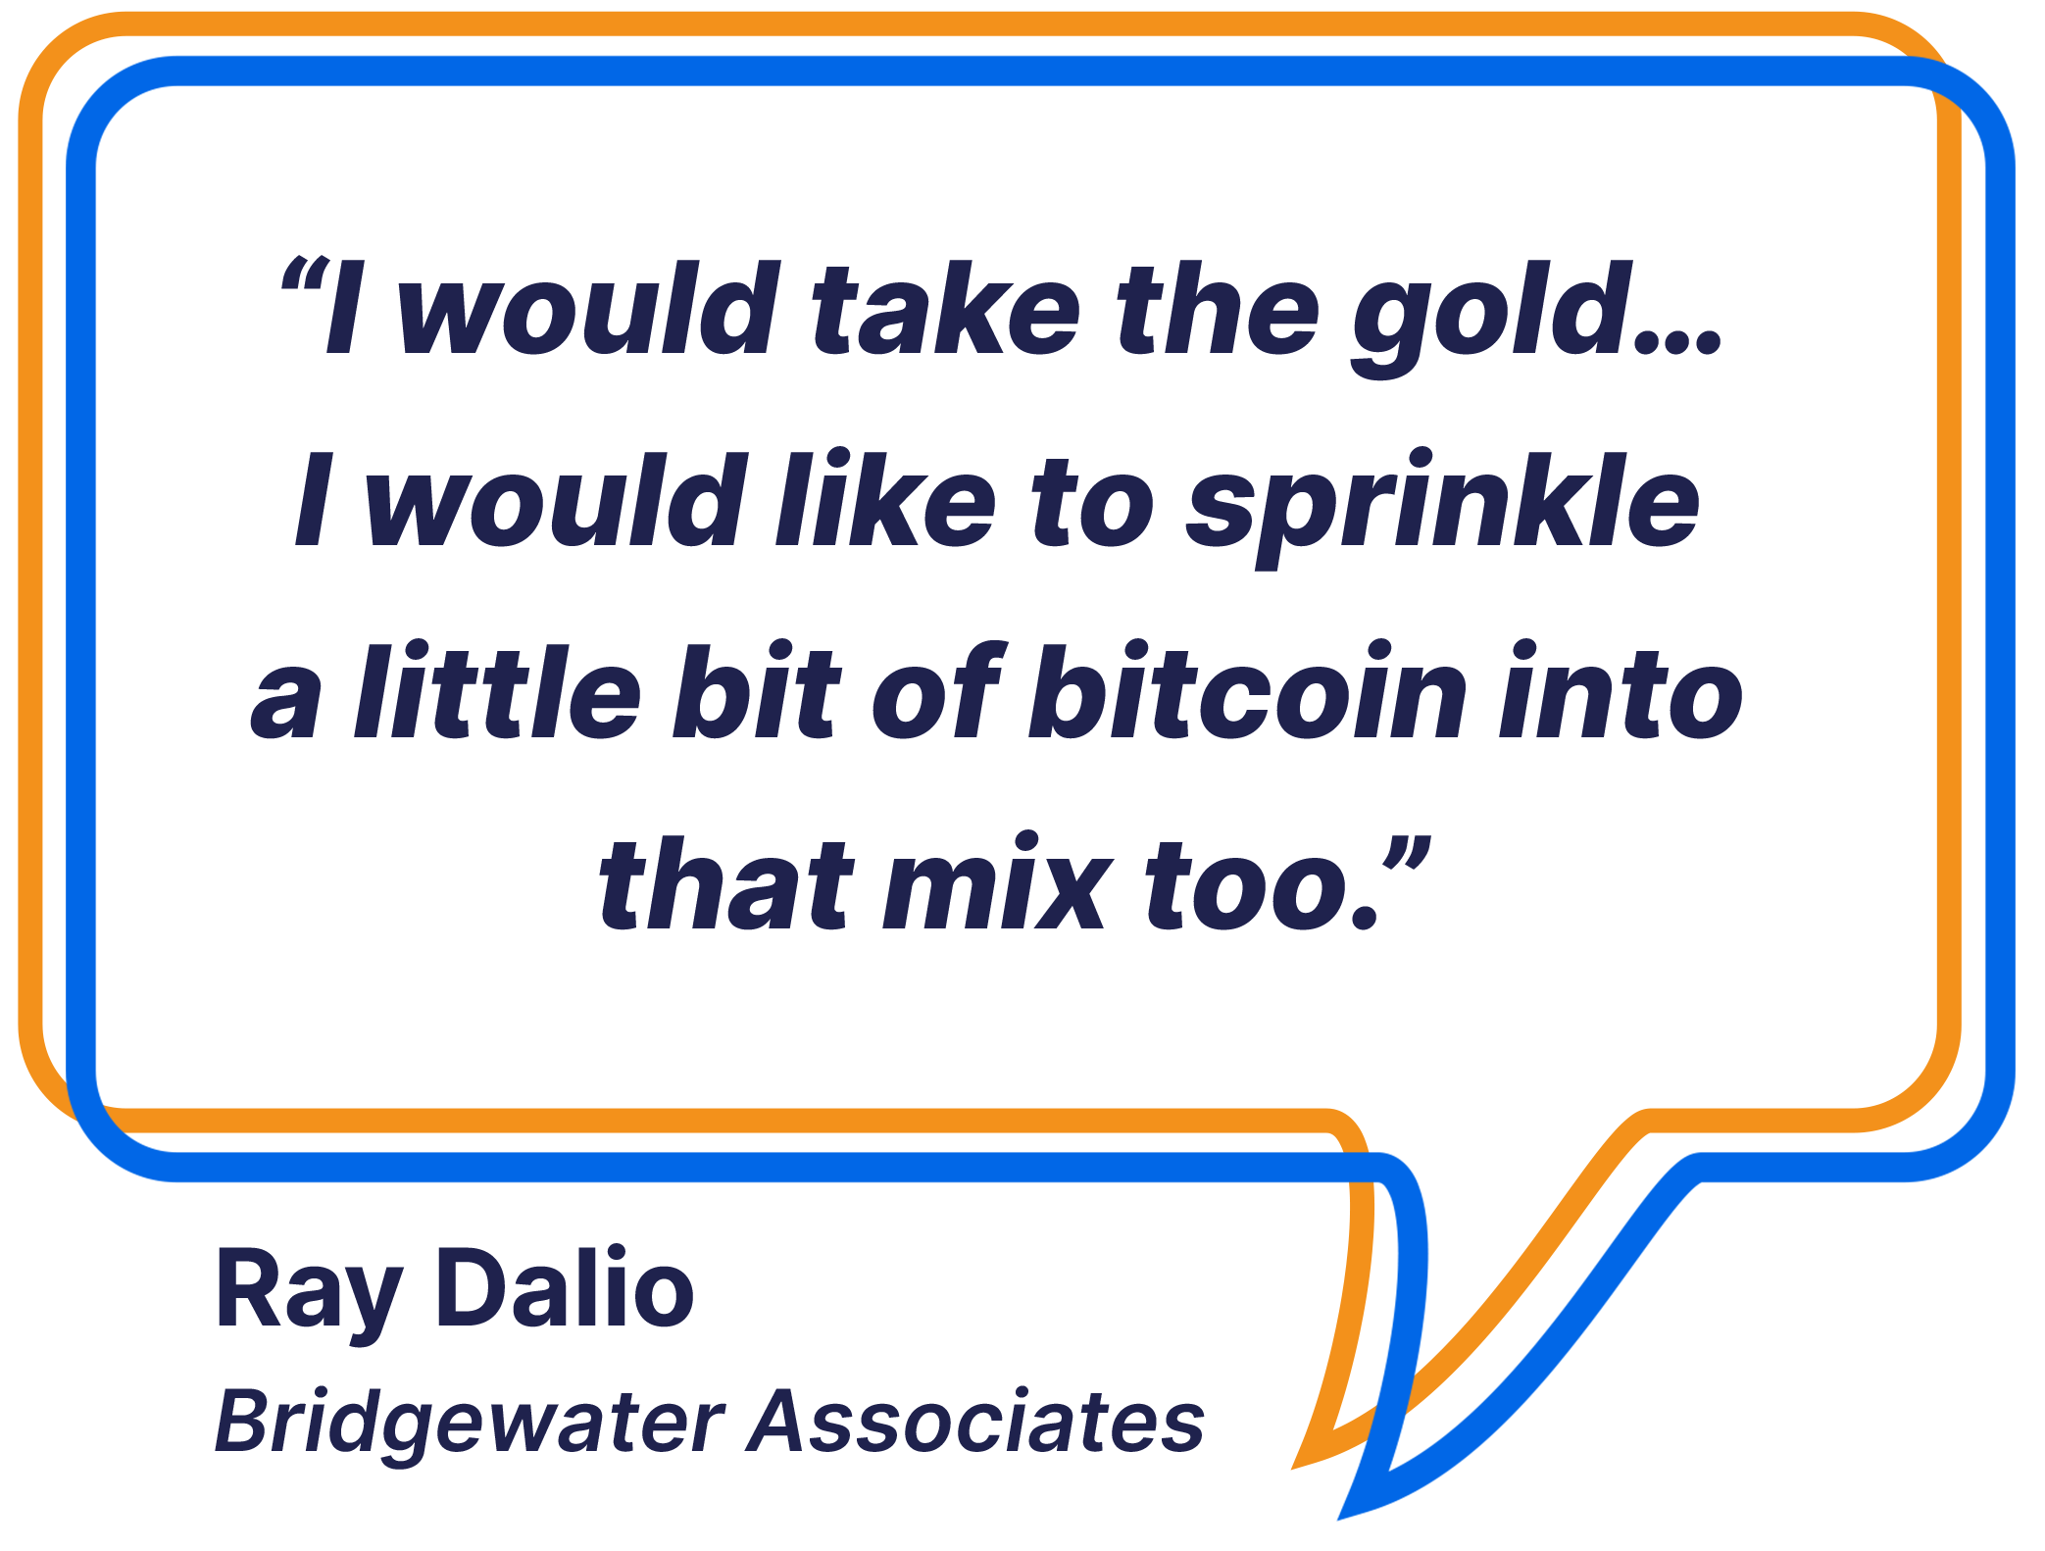
Bitcoin + Gold = BOLD
Limited supply makes Bitcoin and Gold a natural pairing.
Two most liquid alternative assets.
Gold is stable, and Bitcoin is volatile.
Risk- weights using inverse volatility.
Monthly rebalancing transactions can add 5% or more p.a.
Source: Bitcoinexchangeguide.com; ByteTree.com

Slide 4
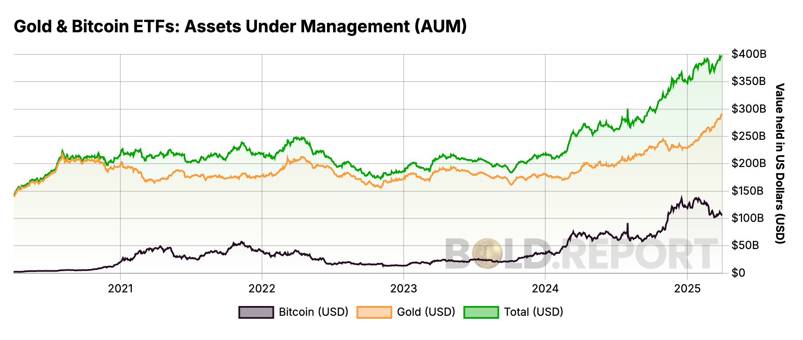
Gold and Bitcoin ETFs – Total Assets

Slide 5
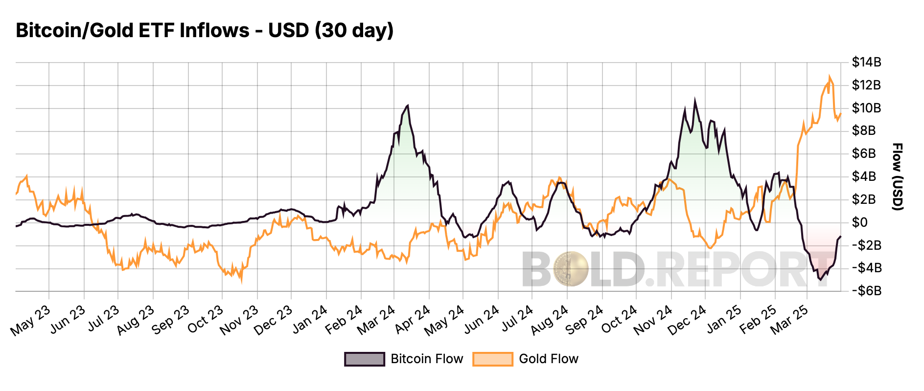
Gold and Bitcoin ETFs – Fund Flows $billions

Slide 6
Asset Allocation in Macro Environments
Risk-OFF
Risk-ON
Bitcoin and Gold are positively correlated with inflation.
Gold outperforms when real interest rates are falling.
Bitcoin outperforms during a risk-on environment, normally when rates are rising.
Gold
Bitcoin
Inflation
Bond Yields
Bonds
Equities
Source: ByteTree

Slide 7
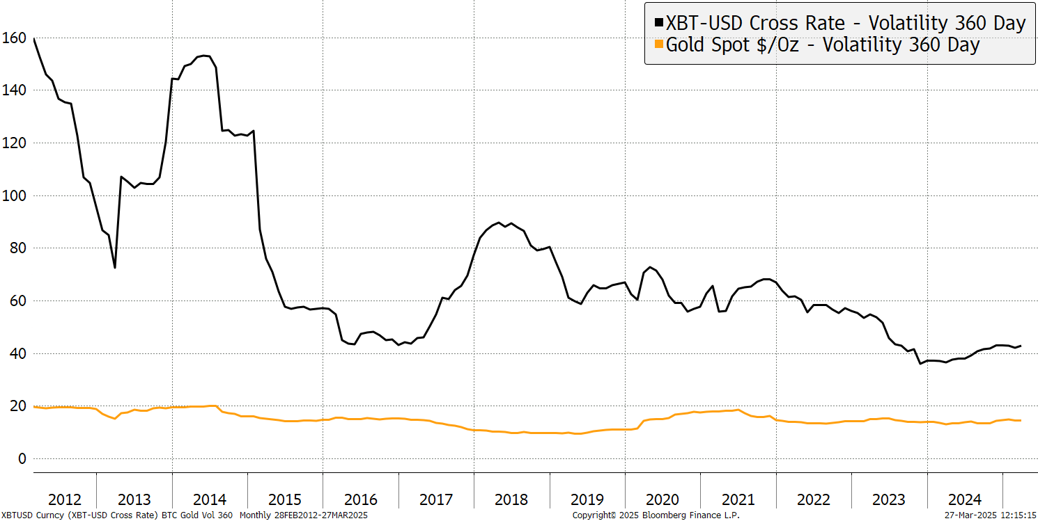
Bitcoin and Gold – Historical Volatility
Source: Bloomberg

Slide 8
Volatility Is the Tool Used to Equalize Risk
360-day realised volatility captures the asset’s risk.
Bitcoin volatility has historically been high but has been structurally falling.
Using inverse volatility, asset allocation is risk-weighed.
Source: Vinter

Slide 9
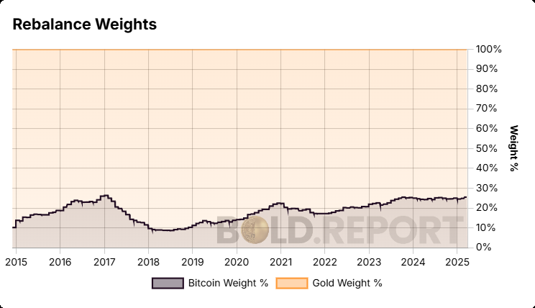
BOLD – Historical Monthly Target Weights
Source: BOLD.report

Slide 10
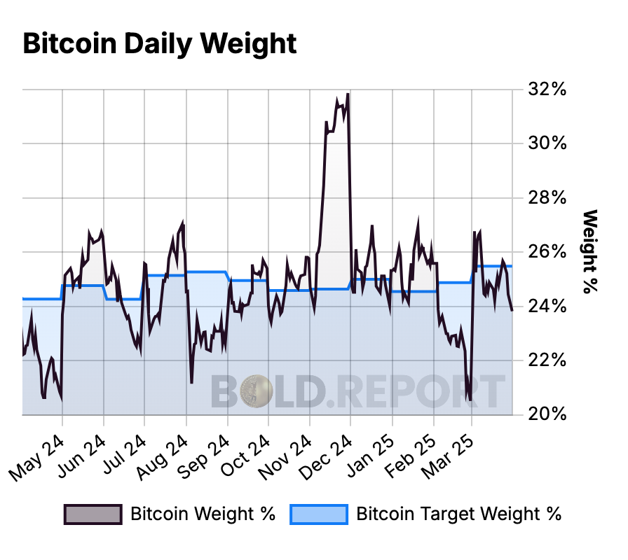
The Power of Rebalancing – Bitcoin Daily Weights
Source: BOLD.report

Slide 11
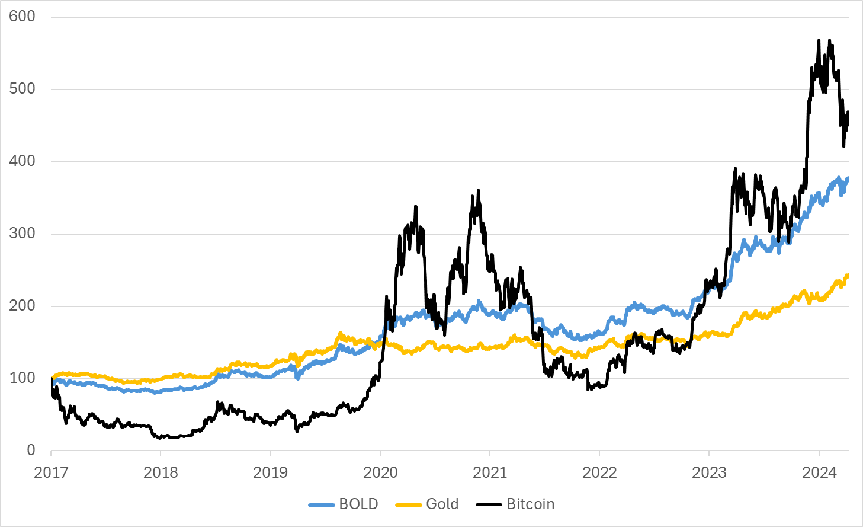
ByteTree BOLD Index vs Bitcoin and Gold

Slide 12
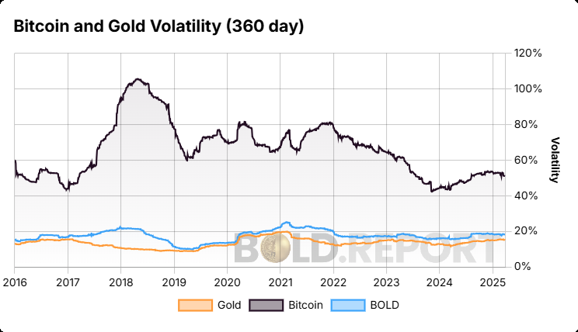
Volatility: Bitcoin and Gold
Source: BOLD.report

Slide 13
Risk-Adjusted Returns
Since 1 Jan 2018 | IRR % | Volatility % | Sharpe
Bitcoin | 32.6% | 61.9% | 0.53
Gold | 10.9% | 14.4% | 0.76
BOLD | 20.5% | 17.4% | 1.18
Global Equities | 10.9% | 14.4% | 0.76
Data 1 Jan 2018 to 31 Dec 2024
Source: BOLD.report, Bloomberg

Slide 14
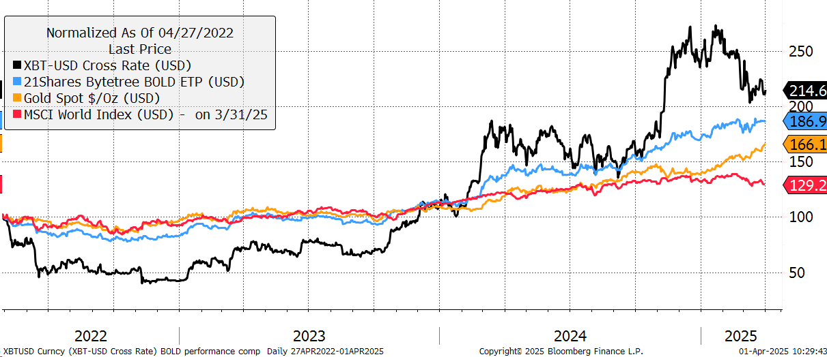
21Shares ByteTree BOLD ETP (9.5% excess return)

Slide 15
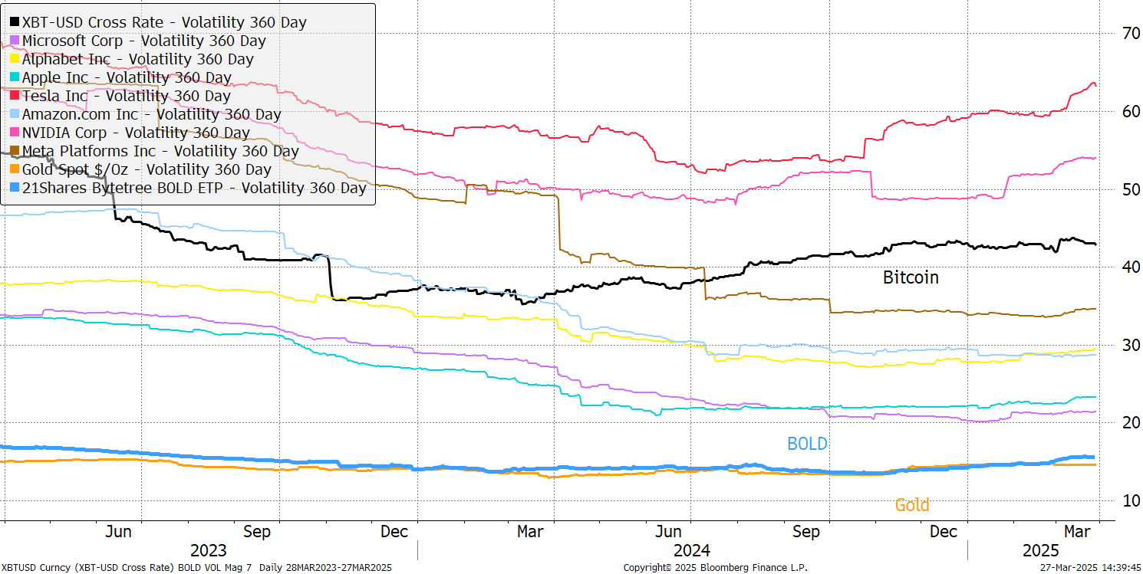
Volatility: Magnificent 7 and BOLD
Source: BOLD.report

Slide 16
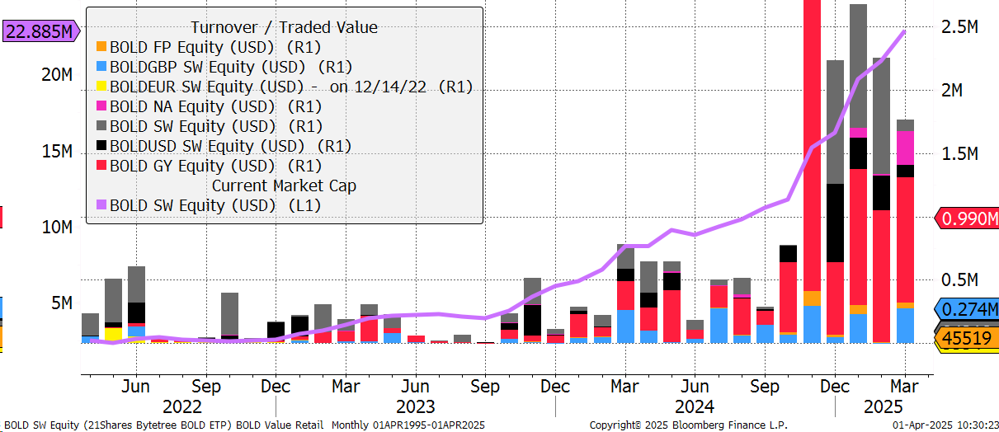
21Shares ByteTree BOLD ETP with Volumes in USD
Source: Bloomberg

Slide 17
BOLD ETF Fund Details
Issuer 21Shares AG, Switzerland
Launch date 27 April 2022
Fee 0.65% per annum
Assets Under Management $22.9 million
Custody Copper Technologies (Swiss) for Bitcoin, JP Morgan for Gold
Investment Objective Risk-weighted Bitcoin and Gold Exposure
Benchmark Kaiko ByteTree BOLD Index
Rebalancing Frequency Monthly
ISIN, SEDOL, WKN CH1146882308, BK81V89 CH, A3GYXW
Tickers SIX BOLD SW, BOLDUSD SW, BOLDEUR SW, BOLDGBP SW
Tickers other BOLD GY, BOLD FP, BOLD NA
Listings Switzerland, Germany, France, Netherlands
Currency USD, EUR, CHF, GBP

Slide 18
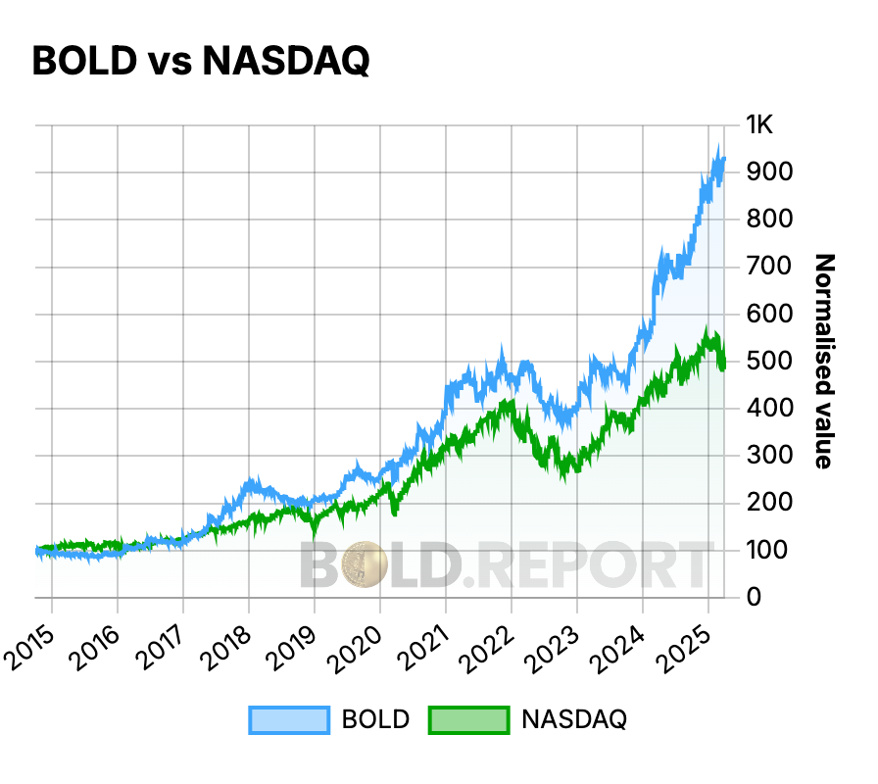
BOLD vs Nasdaq – Since 2015
Source: Bloomberg

Slide 19
More Information and Contact Us
ETF https://www.21shares.com/en-eu/product/bold
Research https://www.bytetree.com/about/
BOLD Data BoldETF.com
Email bold@bytetree.com

Slide 20
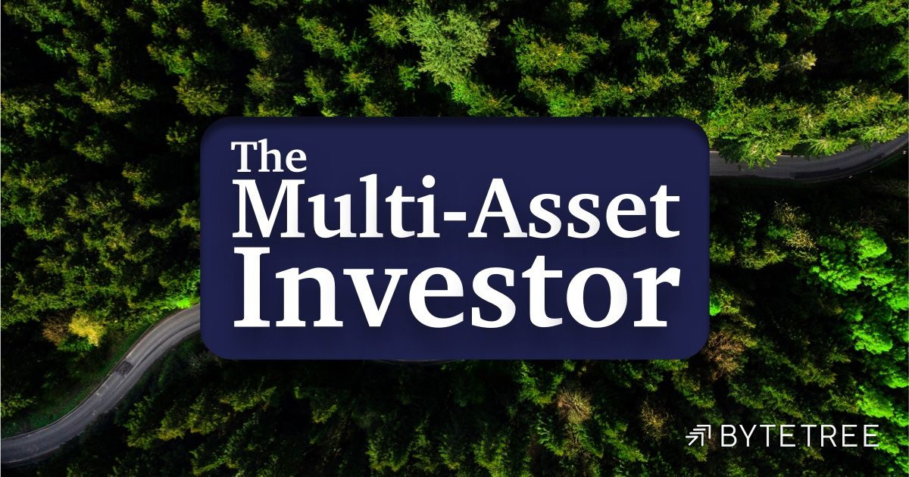
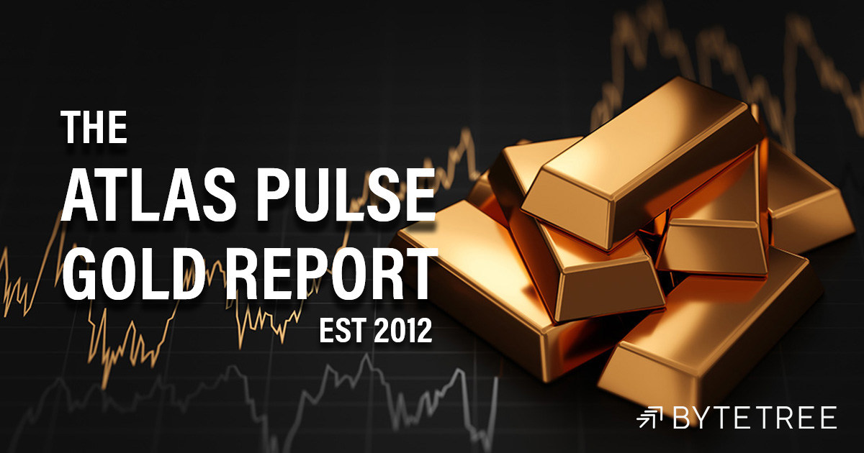

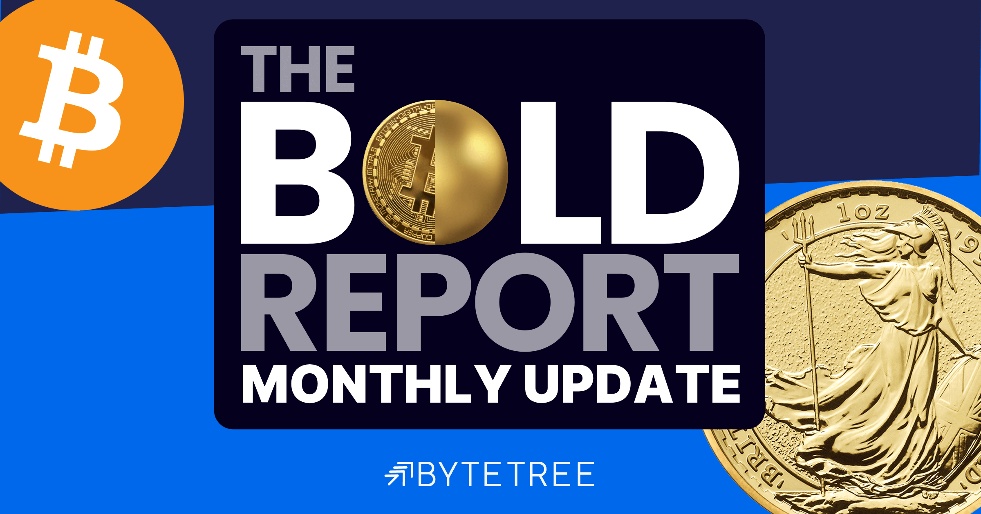
ByteTree Research: Expertise in Multi-Asset Portfolios
ByteTree is an investment research company specialising in multi-asset portfolios.
Top down and bottom up, value-driven approach.
Embraces alternative assets such as commodities and digital.

Slide 21


21Shares -World’s Largest Provider of Digital Asset ETPs
21Shares is a technology company that creates financial on-ramps to invest, trade, and secure digital assets.
Private Investors and institutions can use our products to get exposure to digital assets in a simple, safe, and easy way using your conventional broker and bank.
21Shares AG is based in Zurich, Switzerland. With its traditions of international neutrality, national sovereignty and regulatory stability, we believe this is the best jurisdiction in the financial world. You can count on Switzerland's privacy, neutrality, and stability when making your crypto investments.
Founded 2018.
51 ETPs
Listed on 10+ Exchanges
$10 Billion USD
In Assets Under Management

