Slide 1

Gold market update
April 2025

Slide 2
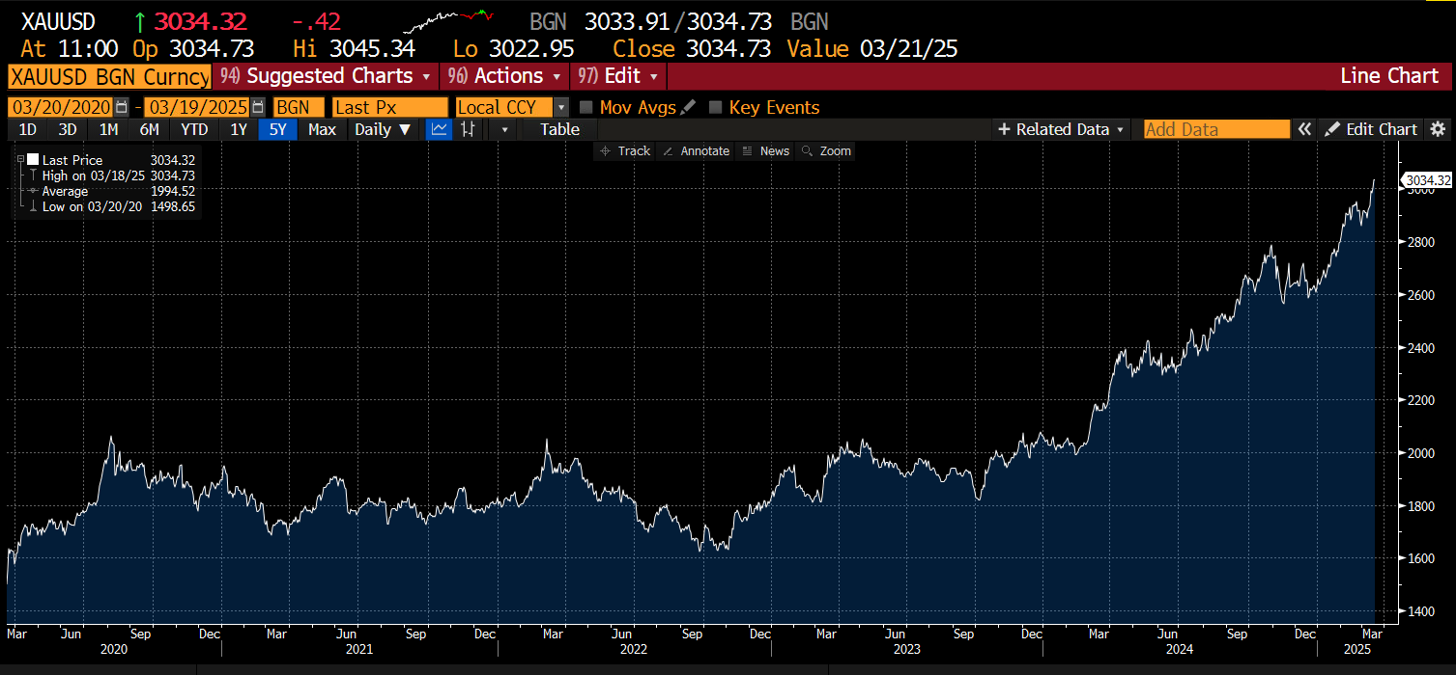
Gold over the past five years
Notes:
JCA (passes to Lou when done)

Slide 3
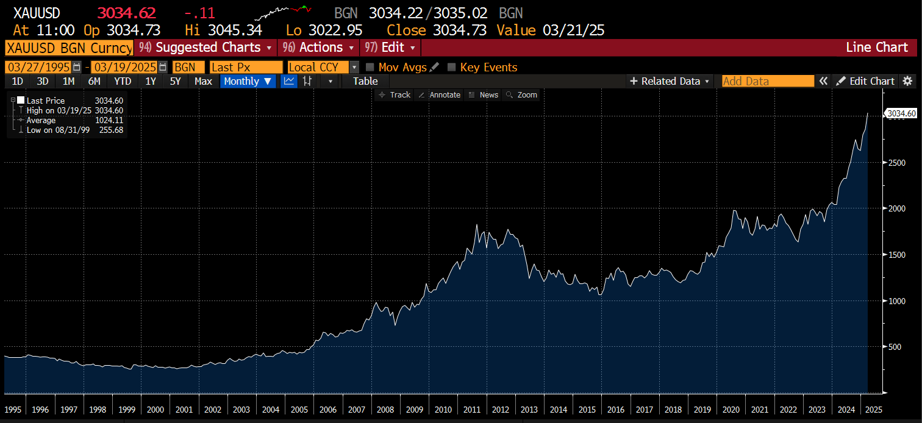
Gold over the past thirty years
Notes:
JCA (passes to Lou when done)

Slide 4
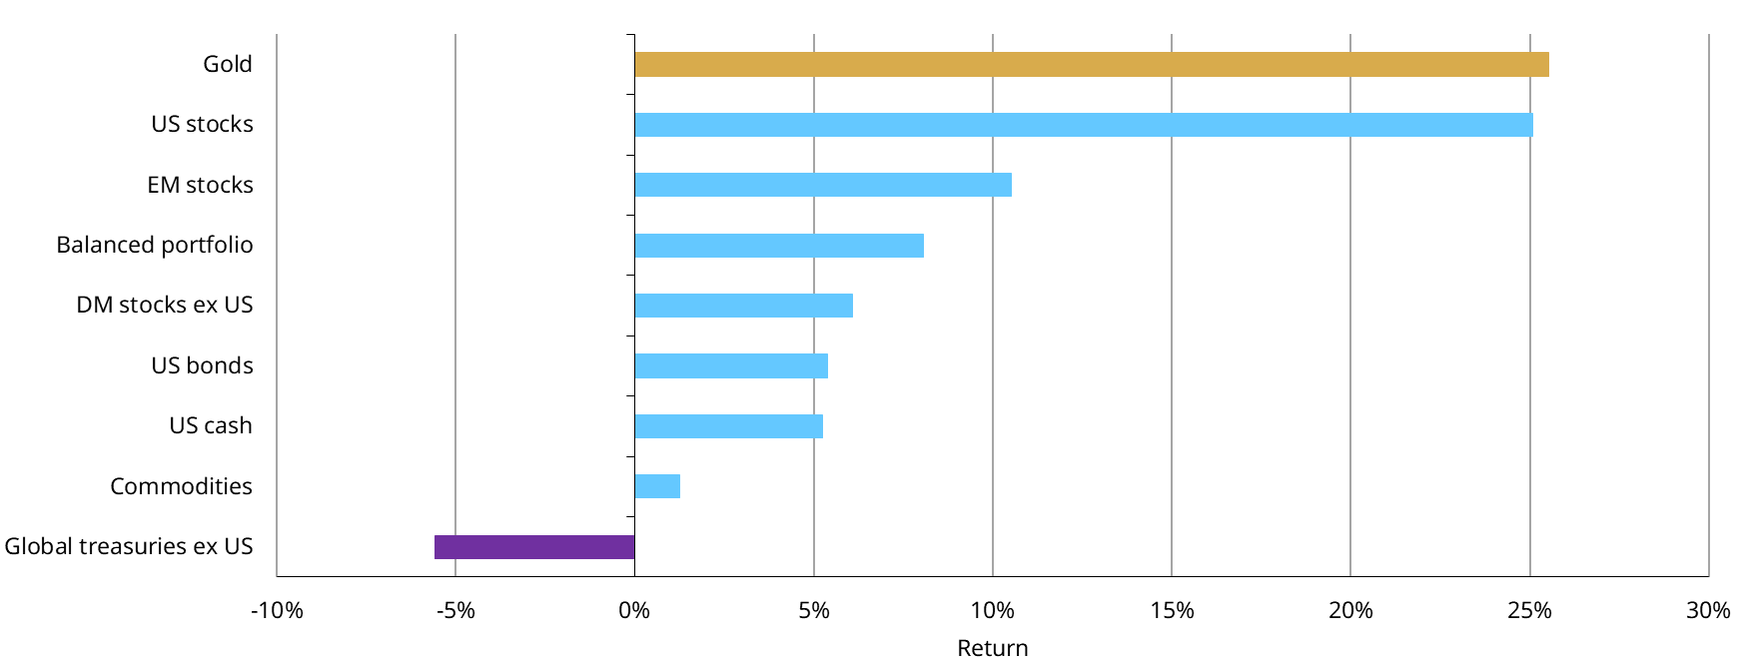
Gold outperformed most major asset classes in 2024
2024 returns for key asset classes
Note: Data as of 31 December 2024. Indices used Bloomberg Barclays Global Treasury ex US, Bloomberg Barclays US Bond Aggregate, ICE BofA US 3-Month Treasury Bills, New Frontier Global Institutional Portfolio Index, MSCI World ex US Total Return Index, Bloomberg Commodity Total Return Index, MSCI EM Total Return Index, LBMA Gold Price PM (USD/oz), MSCI US Total Return Index.
Source: Bloomberg, ICE Benchmark Administration, World Gold Council

Slide 5
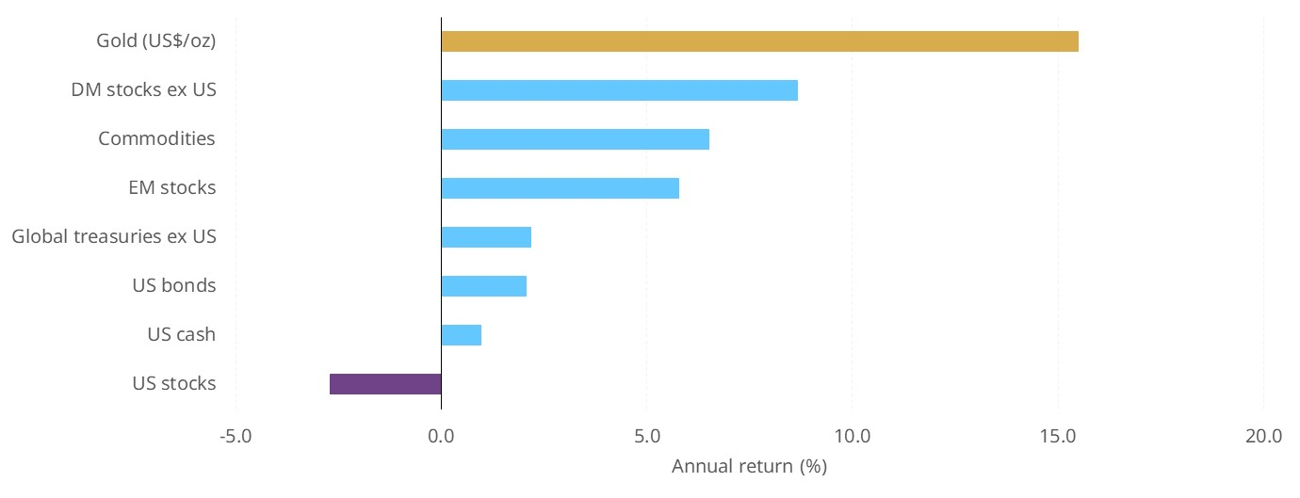
Gold has started strongly in 2025
Note: Data as of 26th March 2025. Indices used Bloomberg Barclays Global Treasury ex US, Bloomberg Barclays US Bond Aggregate, ICE BofA US 3-Month Treasury Bills, New Frontier Global Institutional Portfolio Index, MSCI World ex US Total Return Index, Bloomberg Commodity Total Return Index, MSCI EM Total Return Index, LBMA Gold Price PM (USD/oz), MSCI US Total Return Index.
Source: Bloomberg, ICE Benchmark Administration, World Gold Council

Slide 6

Supply and Demand trends

Slide 7
Gold demand hits record levels
Total gold demand (incl. OTC) gained 1% y/y to 4,974t & reached a record high in value terms
Gold ETFs: holdings were unchanged, in contrast to 3 consecutive years of outflows
Central banks: exceeded 1,000t for third year in a row
OTC: A slowdown in Q4 resulted in a slight annual decline
Bar and coin: reached 1,186t, in line with 2023
Jewellery: tonnage down 11% y/y but spend higher
Technology: 7% y/y increase, driven by AI growth
Supply: total supply of 4,974t equates to a new all-time-high
Annual total gold demand by sector, tonnes
Chart note: Data as of 31 December 2024. For an explanation of gold market sectors, please see the Notes and definitions download: http://www.gold.org/goldhub/research/gold-demand-trends/gold-demand-trends-q3-2024/notes-and-definitions
Source: Metals Focus, Refinitiv GFMS, World Gold Council
Notes:
And now, I’ll give the floor to the team who will go over all of this in more detail, starting with Lou

Slide 8
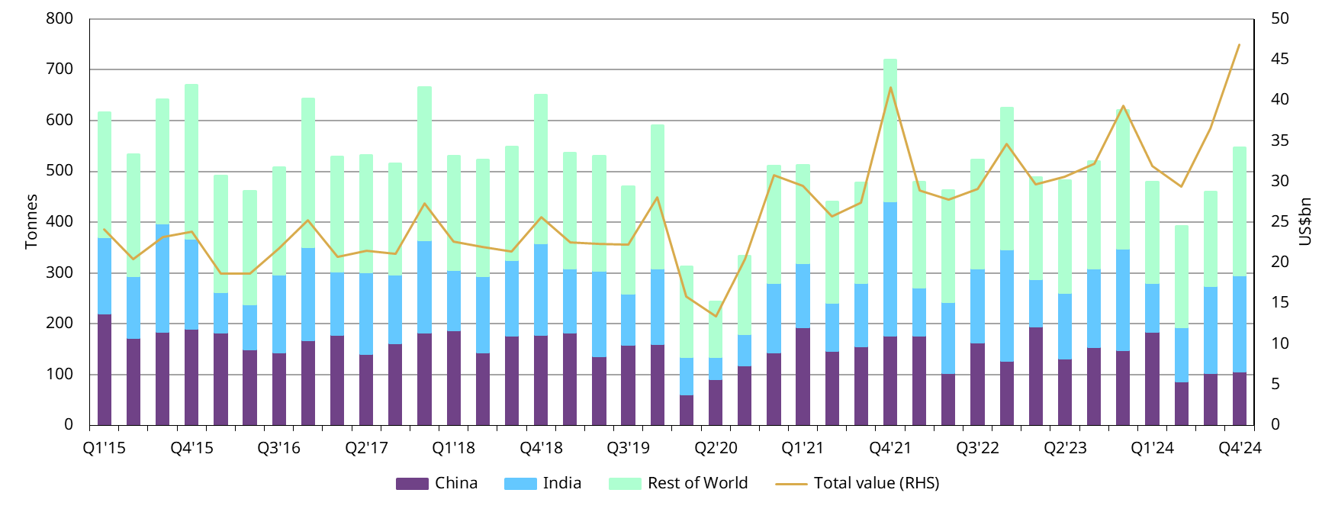
Gold jewellery demand thumped by gold’s price strength
Quarterly gold jewellery consumption, tonnes and value
Note: Data as of 31 December 2024. For an explanation of jewellery consumption, please see the Notes and definitions download: http://www.gold.org/goldhub/research/gold-demand-trends/gold-demand-trends-q3-2024/notes-and-definitions
Source: ICE Benchmark Administration, Metals Focus, Refinitiv GFMS, World Gold Council

Slide 9
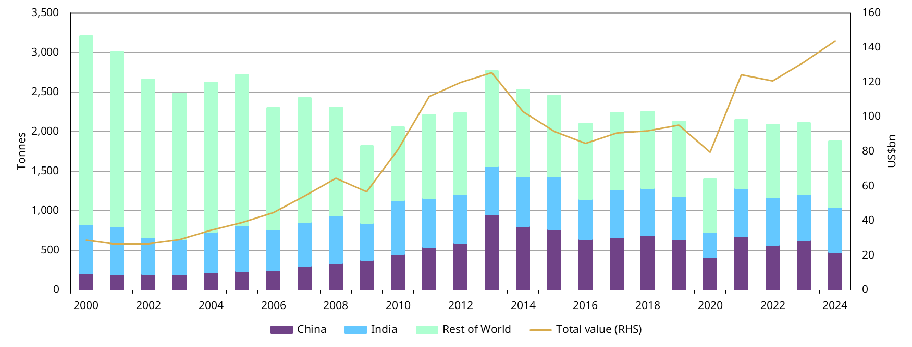
Gold jewellery demand thumped by gold’s price strength
Annual gold jewellery consumption, tonnes and value
Note: Data as of 31 December 2024. For an explanation of jewellery consumption, please see the Notes and definitions download: http://www.gold.org/goldhub/research/gold-demand-trends/gold-demand-trends-q3-2024/notes-and-definitions
Source: ICE Benchmark Administration, Metals Focus, Refinitiv GFMS, World Gold Council

Slide 10
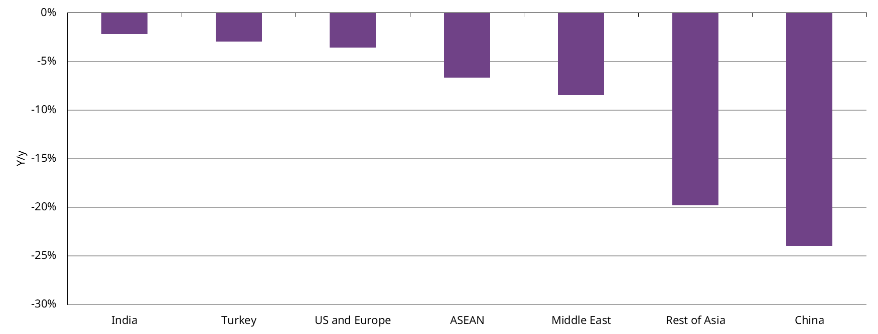
India’s resilience contrasted with China’s weakness
Y/y change in annual gold jewellery demand
Note: Data as of 31 December 2024. For an explanation of jewellery consumption, please see the Notes and definitions download: http://www.gold.org/goldhub/research/gold-demand-trends/gold-demand-trends-q3-2024/notes-and-definitions
Source: Metals Focus, World Gold Council

Slide 11
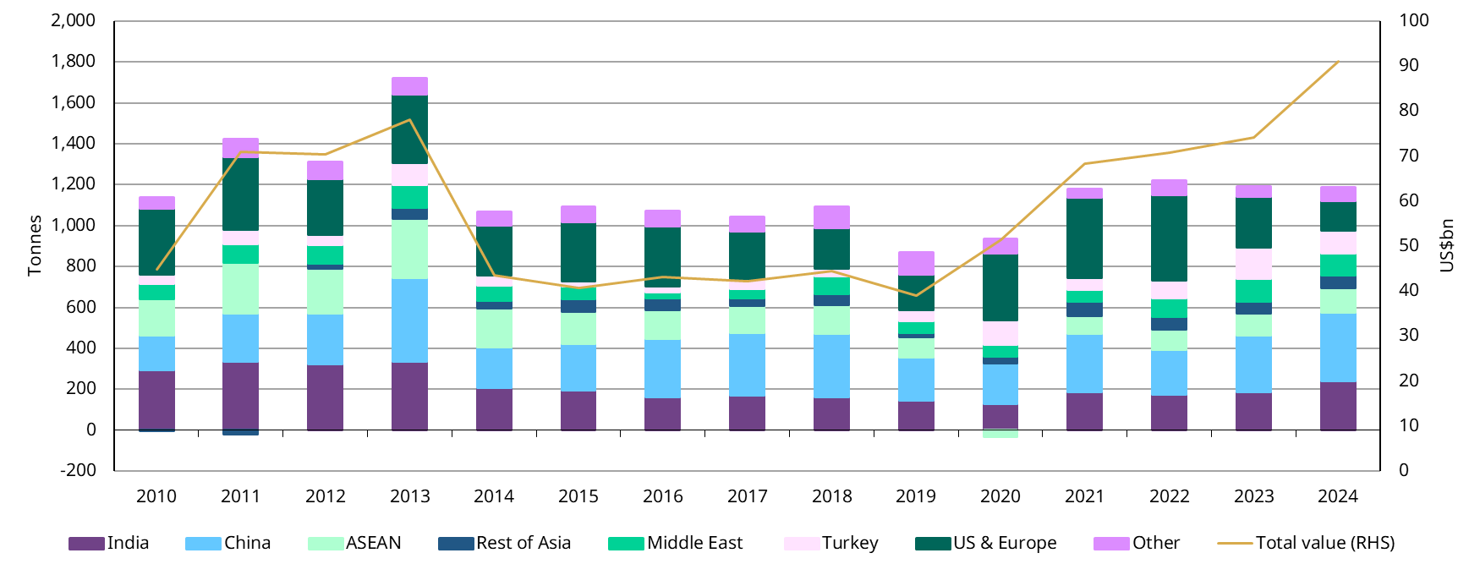
Global bar and coin demand supported by growth in Asia
Annual gold bar and coin demand by country/region, tonnes
Note: Data as of 31 December 2024. For an explanation of total bar and coin demand, please see the Notes and definitions download: https://www.gold.org/goldhub/research/gold-demand-trends/gold-demand-trends-full-year-2024/notes-and-definitions
Source: ICE Benchmark Administration, Metals Focus, World Gold Council

Slide 12
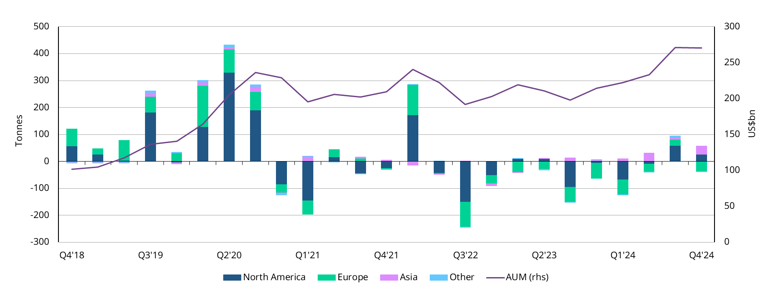
A surge of ETF inflows in H2 almost reversed H1’s outflows…
Quarterly change in global gold ETF holdings by region, tonnes
Note: Data as of 31 December 2024. For an explanation of ETF demand, please see the Notes and definitions download: https://www.gold.org/goldhub/research/gold-demand-trends/gold-demand-trends-full-year-2024/notes-and-definitions
Source: Bloomberg, company filings, ICE Benchmark Administration, World Gold Council

Slide 13
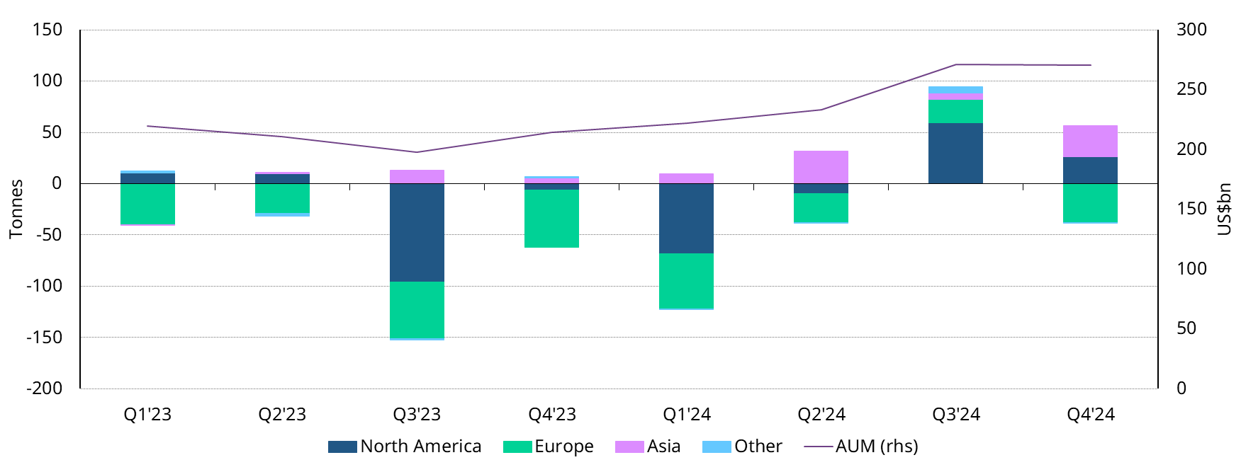
…driven by increased demand out of Asia and North America
Quarterly change in global gold ETF holdings by region, tonnes
Note: Data as of 31 December 2024. For an explanation of ETF demand, please see the Notes and definitions download: https://www.gold.org/goldhub/research/gold-demand-trends/gold-demand-trends-full-year-2024/notes-and-definitions
Source: Bloomberg, company filings, ICE Benchmark Administration, World Gold Council

Slide 14
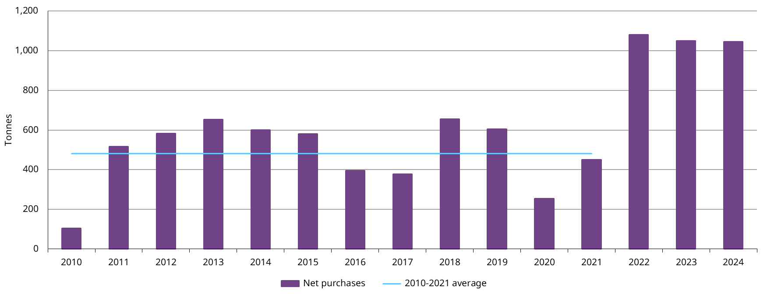
Central banks have been net buyers for 15 years…
Annual central bank net purchases, in tonnes
Note: Data as of 31 December 2024. Central bank demand presented here comprises aggregate reported changes as well as an estimate for unreported buying. For an explanation of central bank demand, please see the Notes and definitions download: https://www.gold.org/goldhub/research/gold-demand-trends/gold-demand-trends-full-year-2024/notes-and-definitions
Source: Metals Focus, World Gold Council

Slide 15
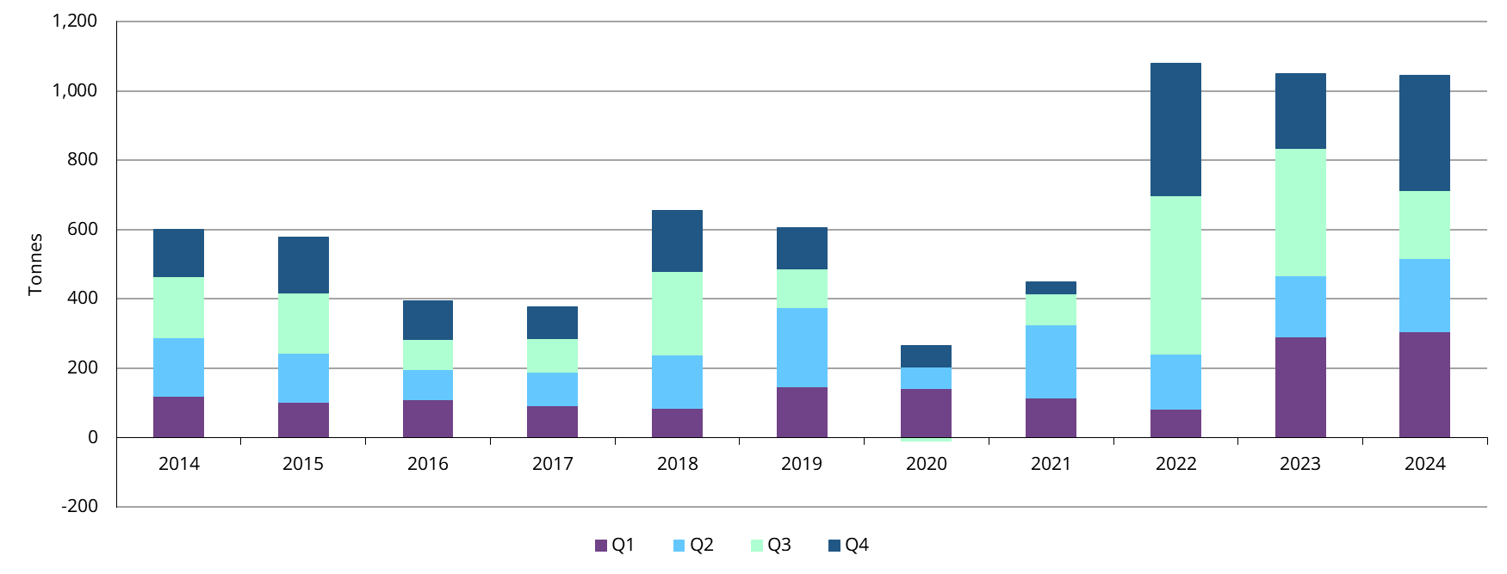
…exceeding 1,000t again thanks to a strong Q4…
Annual central bank net purchases by quarter, tonnes
Note: Data as of 31 December 2024. Central bank demand presented here comprises aggregate reported changes as well as an estimate for unreported buying. For an explanation of central bank demand, please see the Notes and definitions download: https://www.gold.org/goldhub/research/gold-demand-trends/gold-demand-trends-full-year-2024/notes-and-definitions
Source: Metals Focus, World Gold Council

Slide 16
…helped by a diverse set of central banks…
Major net annual purchases/sales reported by central banks and other official institutions, tonnes
Note: As of 31 December 2024, based on data published as of 30 January 2025. *Represents the gold reserves of the State Oil Fund of Azerbaijan (SOFAZ). For an explanation of central bank demand, please see the Notes and definitions download: https://www.gold.org/goldhub/research/gold-demand-trends/gold-demand-trends-full-year-2024/notes-and-definitions
Source: IMF IFS, respective central banks, World Gold Council

Slide 17
…even more visible when adding recent reports
Major net annual purchases/sales reported by central banks and other official institutions, tonnes
Note: As of 31 December 2024, based on data published as of 4 February 2025. *Represents the gold reserves of the State Oil Fund of Azerbaijan (SOFAZ). For an explanation of central bank demand, please see the Notes and definitions download: https://www.gold.org/goldhub/research/gold-demand-trends/gold-demand-trends-full-year-2024/notes-and-definitions
Source: IMF IFS, respective central banks, World Gold Council

Slide 18
Unreported buying remained elevated
Net official sector demand – reported vs. unreported, tonnes
Note: Data as of 31 December 2024. Central bank demand presented here comprises aggregate reported changes as well as an estimate for unreported buying. For an explanation of central bank demand, please see the Notes and definitions download: https://www.gold.org/goldhub/research/gold-demand-trends/gold-demand-trends-full-year-2024/notes-and-definitions
Source: IMF, Metals Focus, respective central banks, World Gold Council

Slide 19
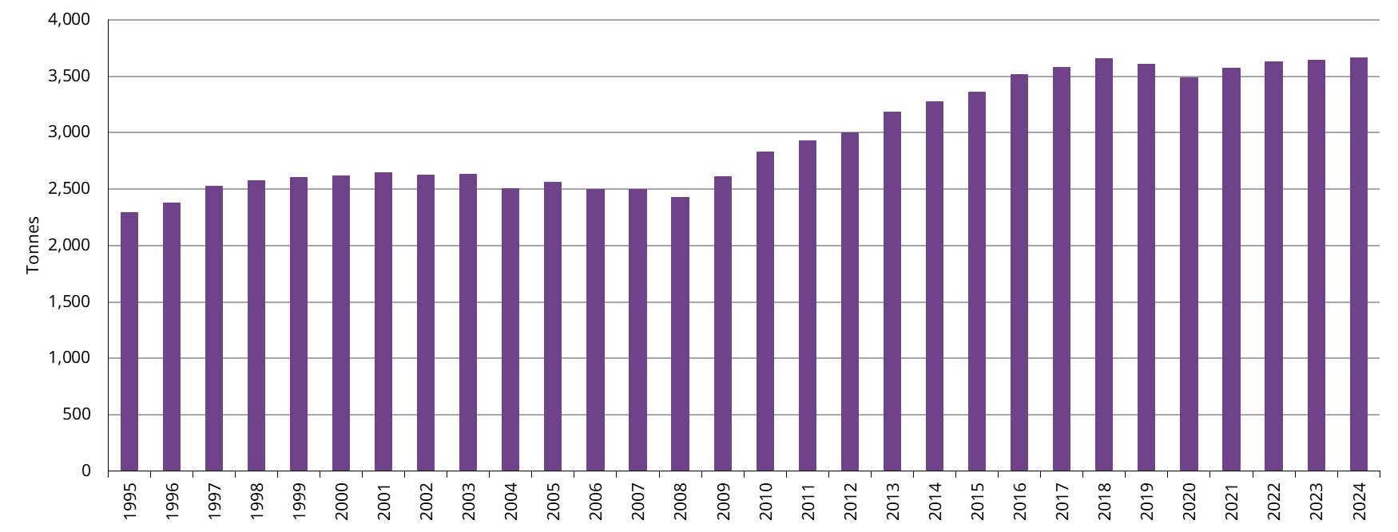
Mine production reached a new record high in 2024
Annual mine production in tonnes
Note: Data as of 31 December 2024. For an explanation of mine production, please see the Notes and definitions download: http://www.gold.org/goldhub/research/gold-demand-trends/gold-demand-trends-q3-2024/notes-and-definitions
Source: Metals Focus, Refinitiv GFMS, World Gold Council

Slide 20
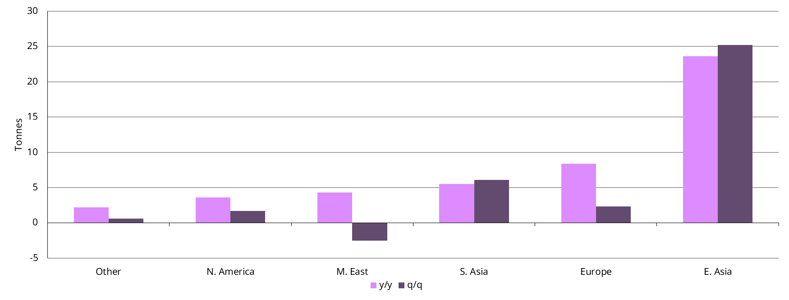
Higher gold prices = increased recycling quarterly and annually
Y/y and q/q change in recycled gold volumes, tonnes
Note: Data as of 31 December 2024. For an explanation of mine production, please see the Notes and definitions download: http://www.gold.org/goldhub/research/gold-demand-trends/gold-demand-trends-q3-2024/notes-and-definitions
Source: Metals Focus, Refinitiv GFMS, World Gold Council

Slide 21
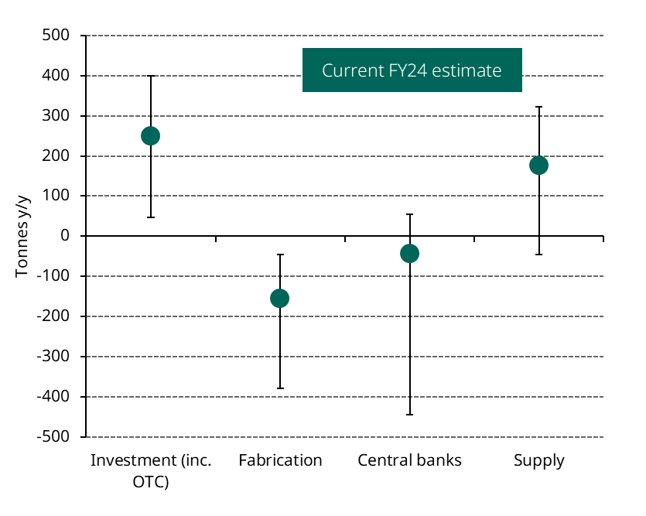
2025 full-year demand and supply outlook
Expected y/y tonnage change in demand and supply, 2025 vs. 2024*
We expect…
  Investment: Lower rates, richly valued equities, a weaker dollar and ongoing geopolitical risk should provide tailwinds for investment demand. Rate uncertainty in the US is likely to keep term premia intact and the bond-equity correlation elevated – a positive for gold
  Fabrication: Demand may be challenged by price level and a softer global economic outlook
  Central banks: 2024 proved to be a solid year, but we remain cautious of the potential downside risk
  Supply: Higher margins serve as an incentive for mine production strength to continue. Recycling is trending higher and tonnage is expected to increase again.
Chart note: *Data to 31 December 2024. Fabrication combines global jewellery and technology demand. Investment includes ETFs, bar and coin and OTC demand, Supply includes mine production and recycling. We have omitted hedging and assume it to be unchanged. Range estimates are generated by a combination of inputs including our independent analysis of the gold market, consensus market expectations for the global economy and Metals Focus forecasts, The width of the range reflects our confidence in the outlook, while the ratio of one tail to the other captures whether we see upside or downside risk to our view
Source: World Gold Council

Slide 22
Tactical Thinking

Slide 23
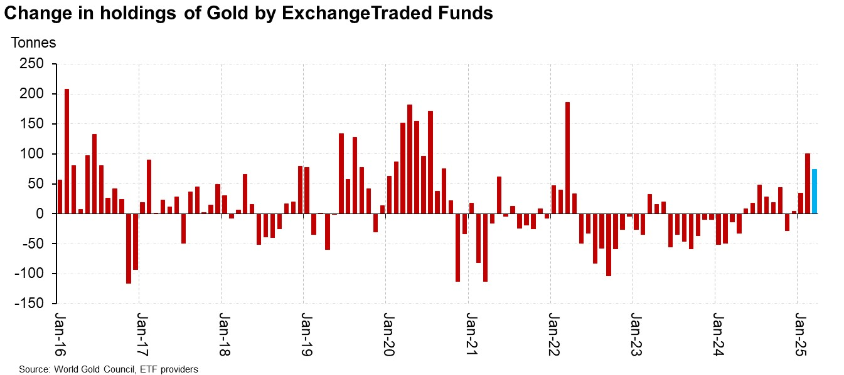
ETF investors are showing signs of returning (26/03/2025)

Slide 24
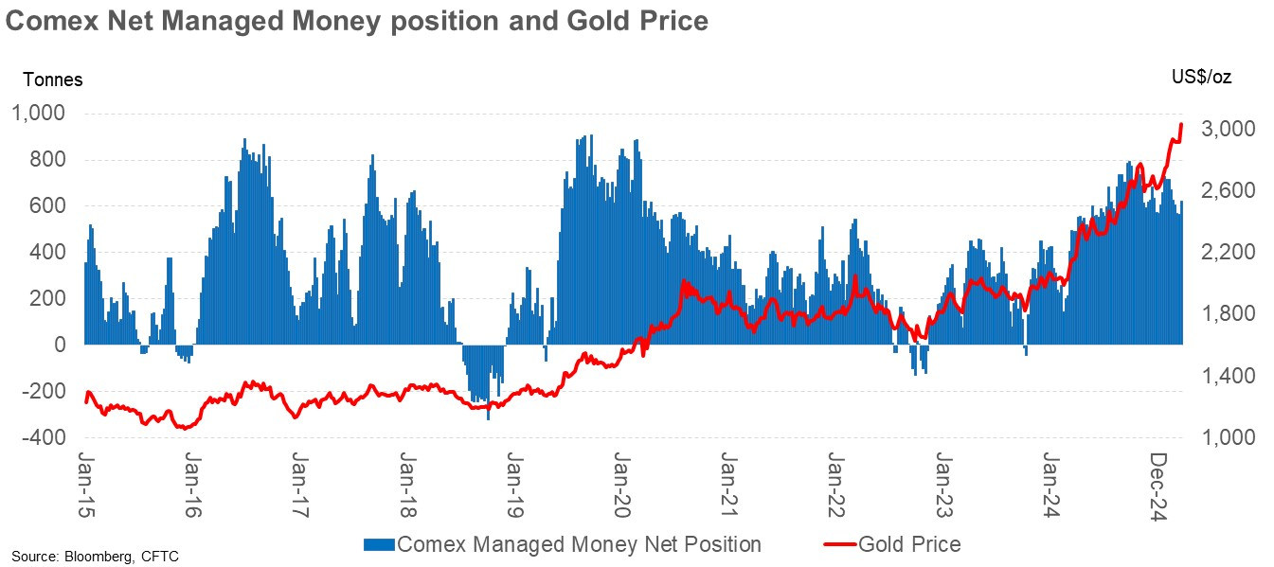
Comex NET Managed Money Positions (18/03/25)

Slide 25
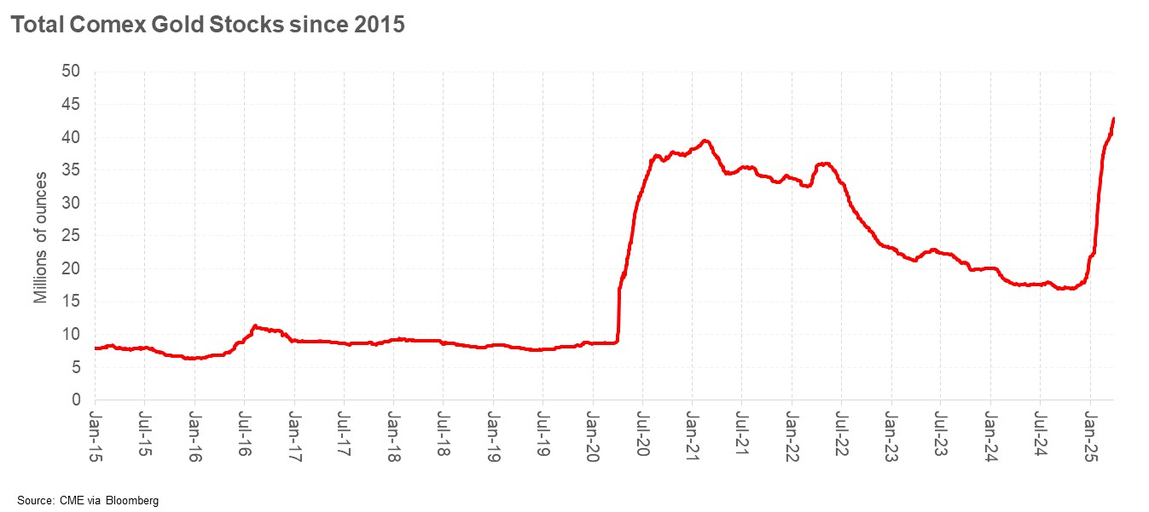
Comex gold stocks have surged over the past 3 months

Slide 26
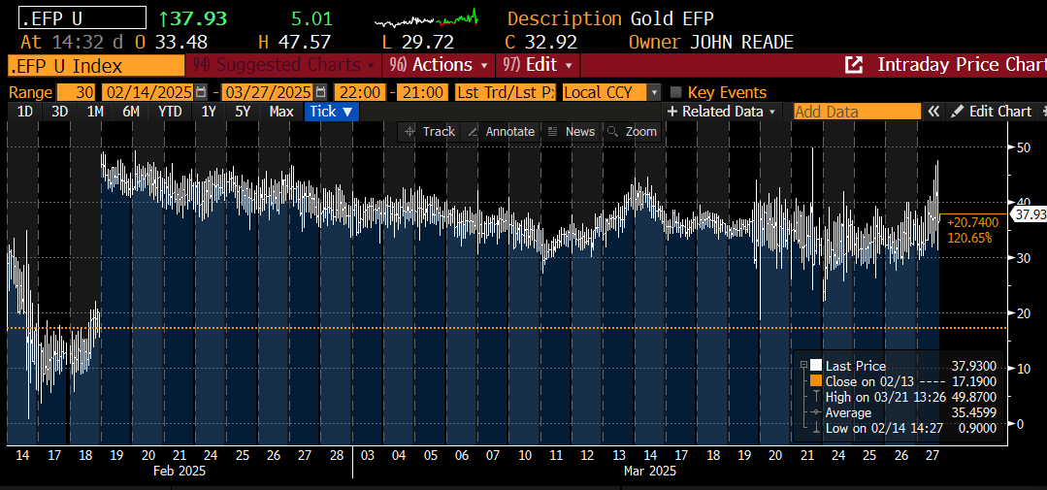
Comex / OTC EFP has been high and volatile, normalising

Slide 27
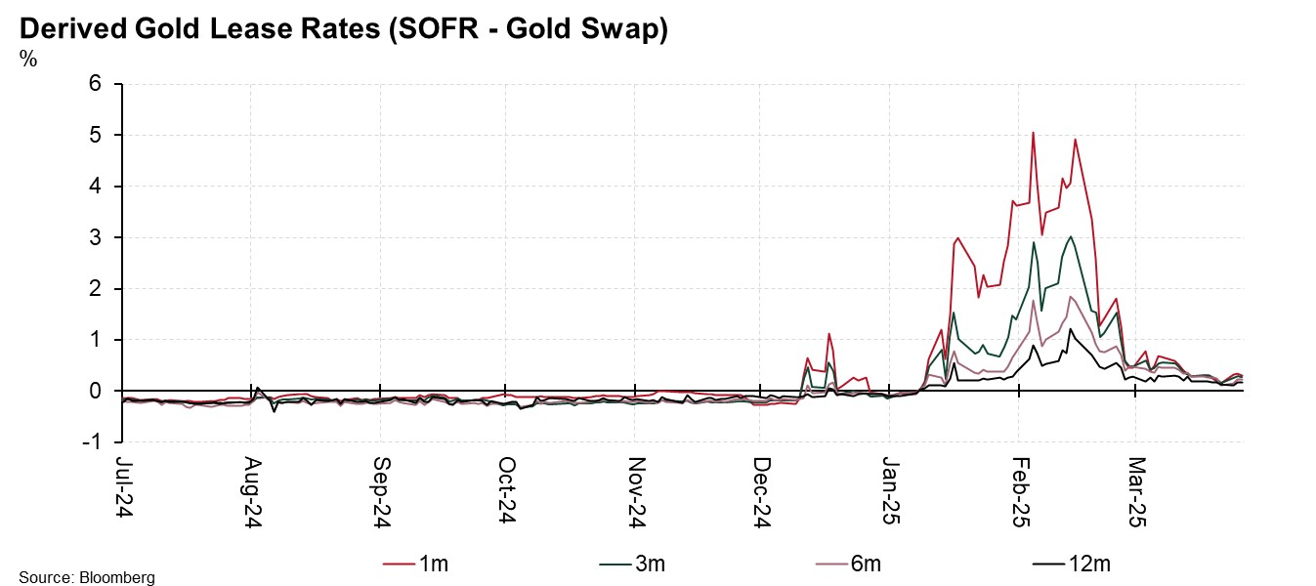
Gold borrowing costs now normalised

Slide 28
Where are we now?
Gold produced a stunning performance in 2024
Driven by speculators but underpinned by emerging market demand of all types
    EM central bank buying that doubled in 2022
    Retail investment demand in major EM markets
      Strong jewellery demand
      OTC investment demand
But EM buyers are showing signs of slowing…

Slide 29
Where to from here?
Western Investors are needed for gold to progress
DM rate cuts provide a positive tailwind for gold
We’ve already seen a turn in ETF flows, becoming significant
HNW / Family Office (OTC demand) reportedly strong from DM investors
Western physical investment demand remains weak(ish)
US Election result likely to be gold-positive in the medium term
Larger deficits; more USD weaponisation
US Deficit / Debt to become a more dominant theme for gold
Gold close to a fresh USD all-time high
Gold markets distorted by tariff fears
Gold’s strong start despite still-strong USD and high yields – Risk and Uncertainty

Slide 30
Gold Market Update
Q&A
Notes:
With that, let’s move on to Q&A section.
As you’ve noticed, I’ve stopped recording, so please ask your questions freely as we are among peers.

Slide 31
Important information and disclosures

