Slide 1
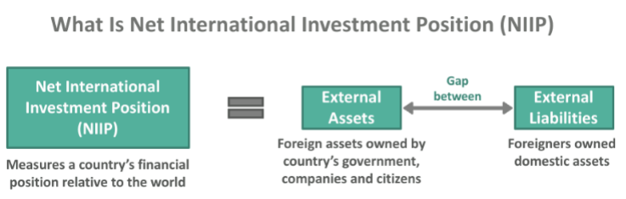
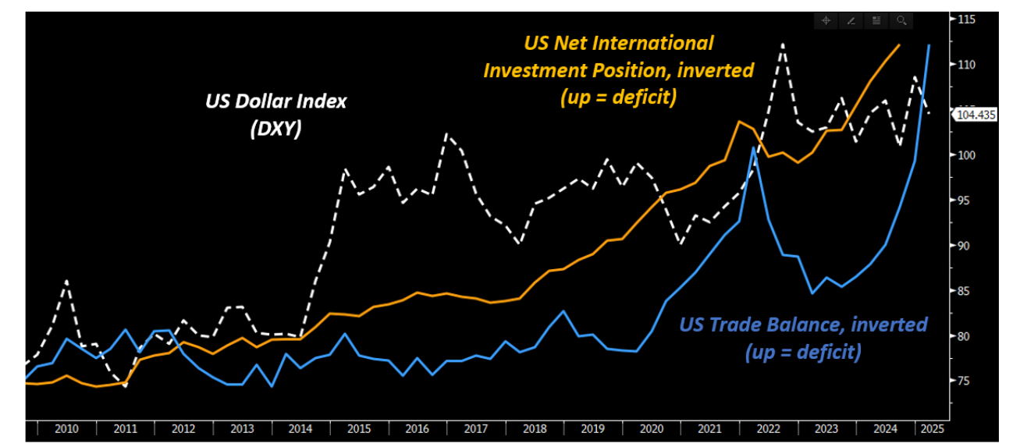
The Pre-Trump US Economic Model…

Slide 2
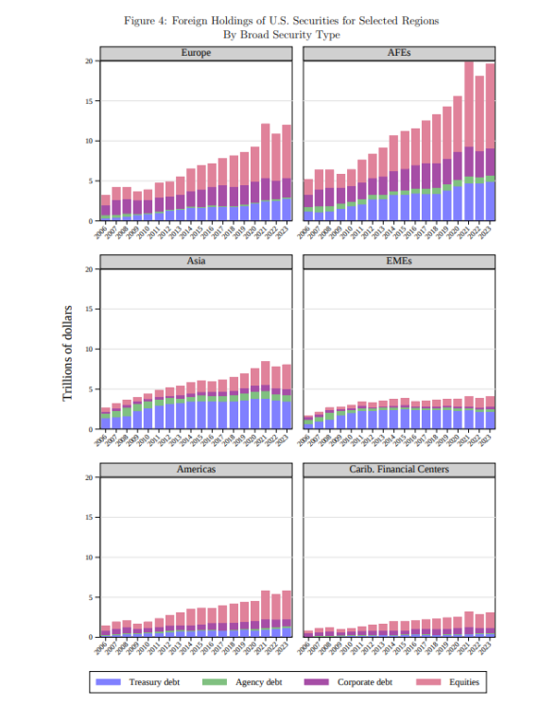
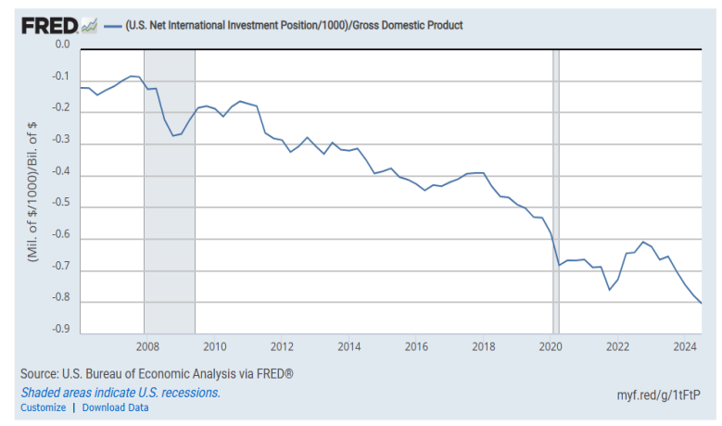
…Led To A Large Negative International Investment Position…

Slide 3
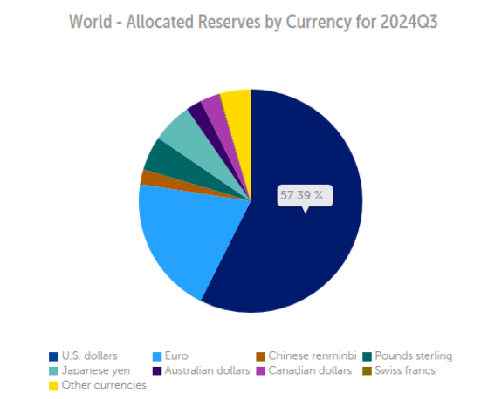
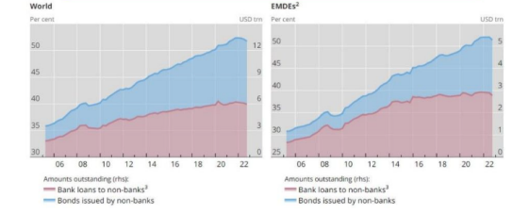
…Encouraged Foreign Investors To Accumulate USD Assets & EuroDollars…

Slide 4
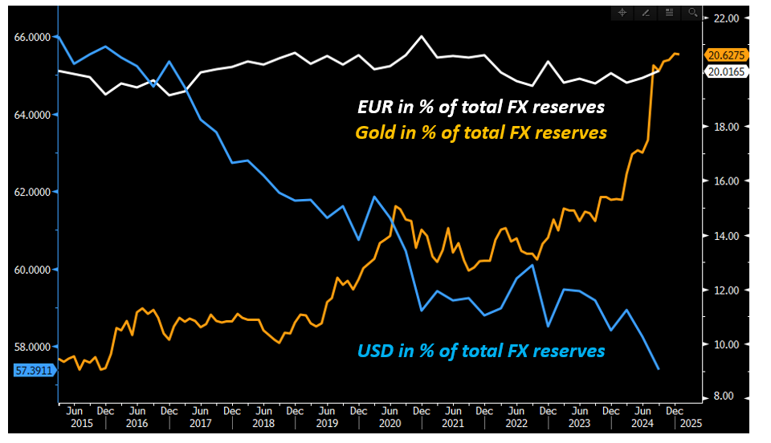
…But Under Trump, Incentives Are Changing…

Slide 5
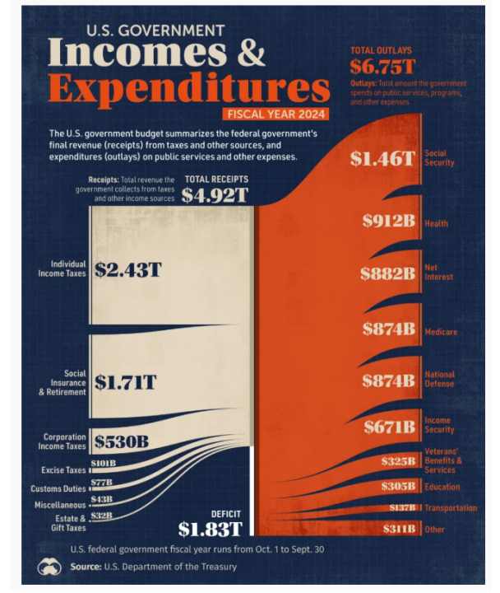
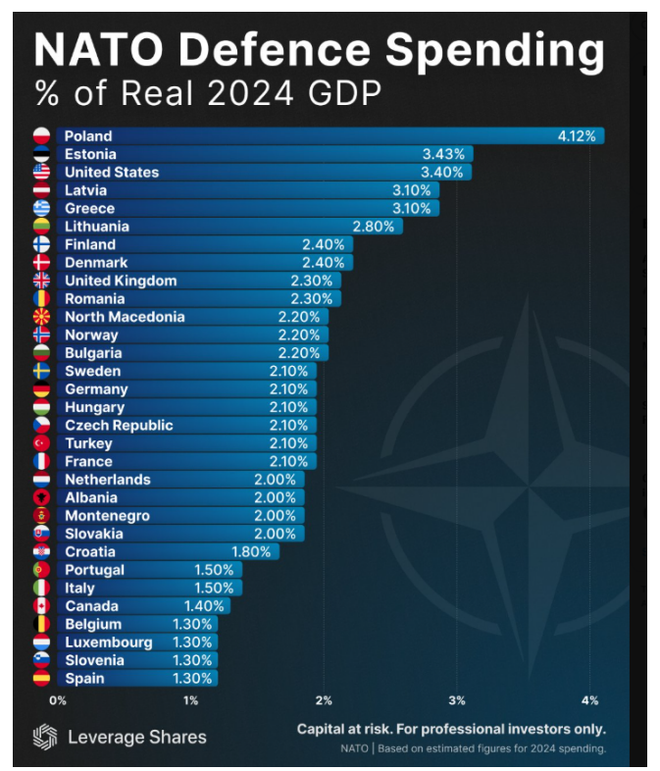
…Under The Threat Of Mar-A-Lago, Germany Went For The ‘’Berlin Accord’’…

Slide 6
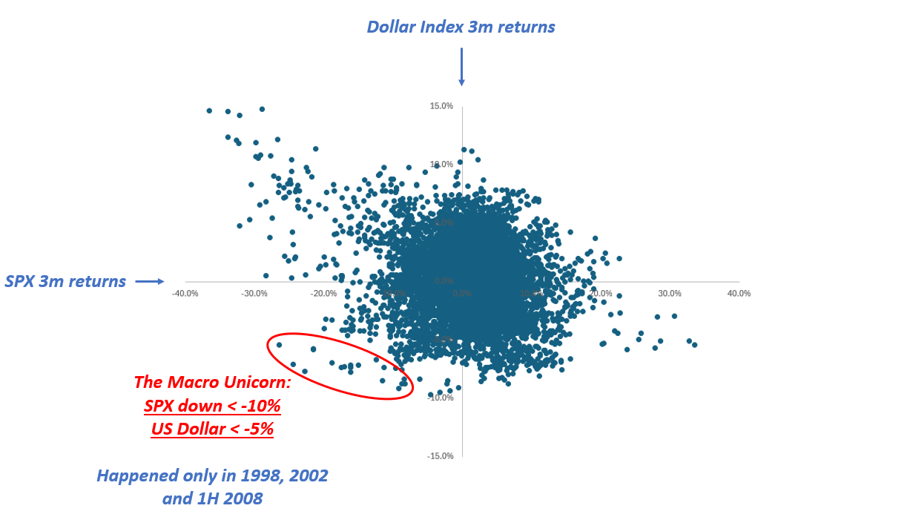
…Which Could Unleash The Macro Unicorn: S&P Down + USD Down

Slide 7

