Slide 1

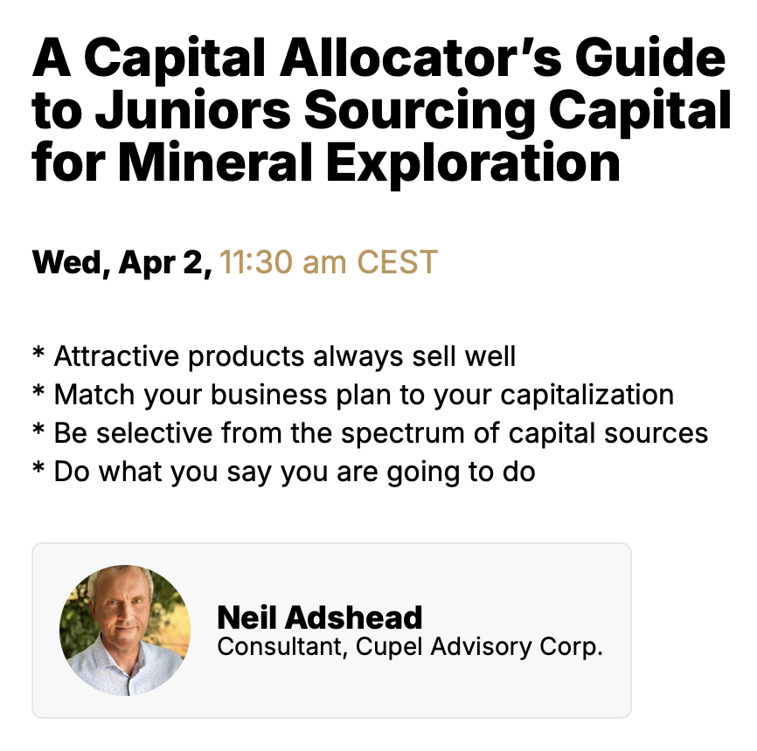
Notes:
Explain what the buy-side means
Explain how I designed the presentation
I’m presenting as a buy-side person without compliance constraints

Slide 2
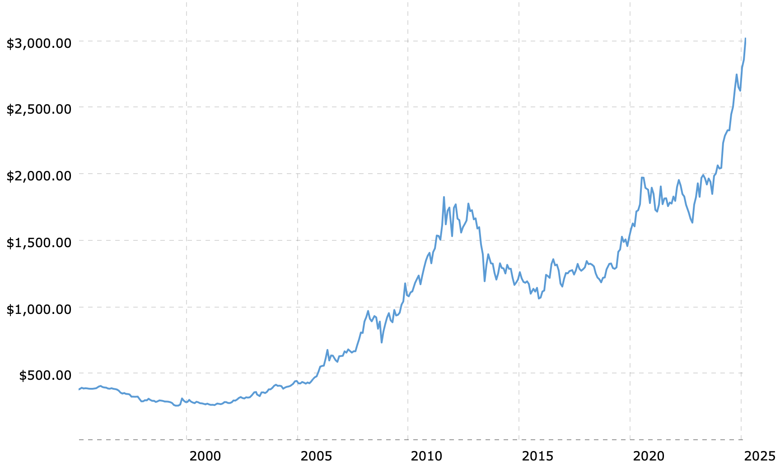










My Thirty-Year Career Relative to the Gold Price:
Gold Price in
USD/oz
1995
Notes:
I can speak to the topic as a mine geologist, exploration geologist, a corporate geologist, an equity analyst, a capital allocator, and someone who is involved with growth initiatives in a mining company and a junior explorer.
Issues:
Unattractive product for internal and external reasons
Investment Illiquidity should focus your capital sources (not traditional mutual funds, with liquidity rules)
Expanding Risk Profile, but you need to maximize your exposure to the correct type of risk. Explain “risk”. It’s an overused word. There is bad risk, and good risk.
Mineral exploration is selling a dream to gamblers, or greater fool theory, or praying for materially higher commodity prices.
Terrible Odds of Success, but often bad odds appeal to gamblers due to the buzz and the prize – compare it to the odds of red-and-black on a roulette table in a casino, plus the liquidity and taxation.
Increasing Regulation (cost) on Companies
Inflation for companies on many aspects of the business
High cost of capital for equity (finders’ fee, legal, discount to market, warrants)
Increasing Regulation (cost) on Capital Allocators
Increasing Exploration Maturity
Increasing short-termism/less patience, due to the need to report performance
Attracts Gamblers (speculators, rather than investors). Relies on greed and hubris.
Range of Business Plans
I’m investing in the business, not the project (“What Do You Like?”).
Natural Resources Canada reported that there are 1,234 mining-related juniors in Canada in 2023.
Need branding and marketing
Financing Technology start-ups in the VC World. KoBold is an example.
Use my existing capitalization slide (including ‘super junior’)
Warren Buffett Quote: “When a manager with a good reputation meets an industry with a bad reputation, it is normally the industry that leaves with its reputation intact”

Slide 3

My Experience as a Fund Manager in the Juniors:
Notes:
I can speak to the topic as an exploration geologist, a capital allocator, and someone who is involved with a mining company and a junior explorer
Issues:
Unattractive product for internal and external reasons
Investment Illiquidity should focus your capital sources (not traditional mutual funds, with liquidity rules)
Expanding Risk Profile, but you need to maximize your exposure to the correct type of risk. Explain “risk”. It’s an overused word. There is bad risk, and good risk.
Mineral exploration is selling a dream to gamblers, or greater fool theory, or praying for materially higher commodity prices.
Terrible Odds of Success, but often bad odds appeal to gamblers due to the buzz and the prize – compare it to the odds of red-and-black on a roulette table in a casino, plus the liquidity and taxation.
Increasing Regulation (cost) on Companies
Inflation for companies on many aspects of the business
High cost of capital for equity (finders’ fee, legal, discount to market, warrants)
Increasing Regulation (cost) on Capital Allocators
Increasing Exploration Maturity
Increasing short-termism/less patience, due to the need to report performance
Attracts Gamblers (speculators, rather than investors). Relies on greed and hubris.
Range of Business Plans
I’m investing in the business, not the project (“What Do You Like?”).
Natural Resources Canada reported that there are 1,234 mining-related juniors in Canada in 2023.
Need branding and marketing
Financing Technology start-ups in the VC World. KoBold is an example.
Use my existing capitalization slide (including ‘super junior’)
Warren Buffett Quote: “When a manager with a good reputation meets an industry with a bad reputation, it is normally the industry that leaves with its reputation intact”

Slide 4
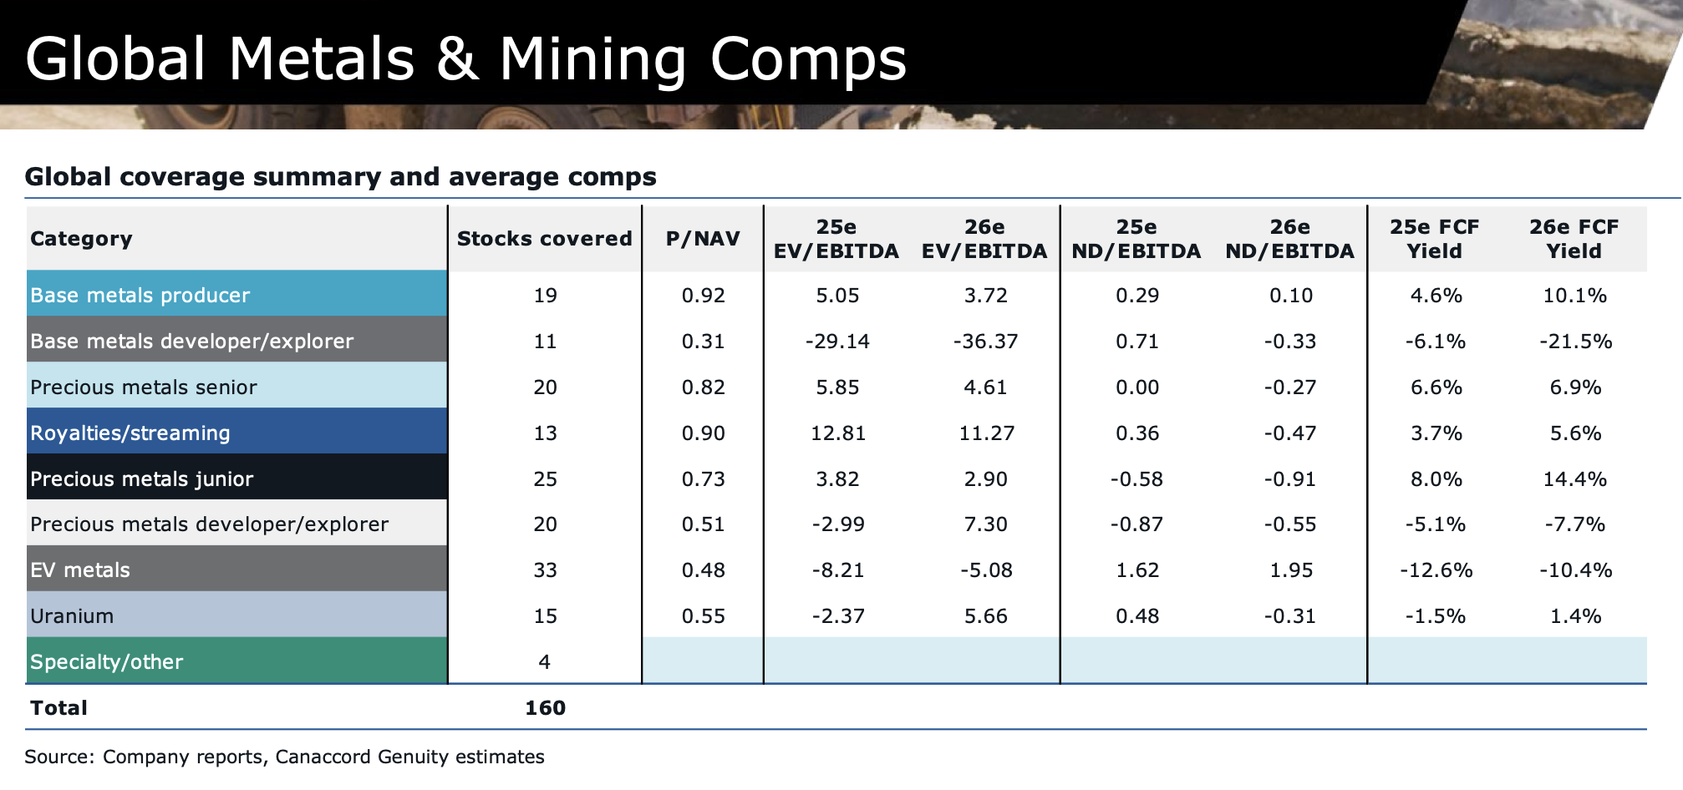
What is the Product? Is it Attractive?

Slide 5
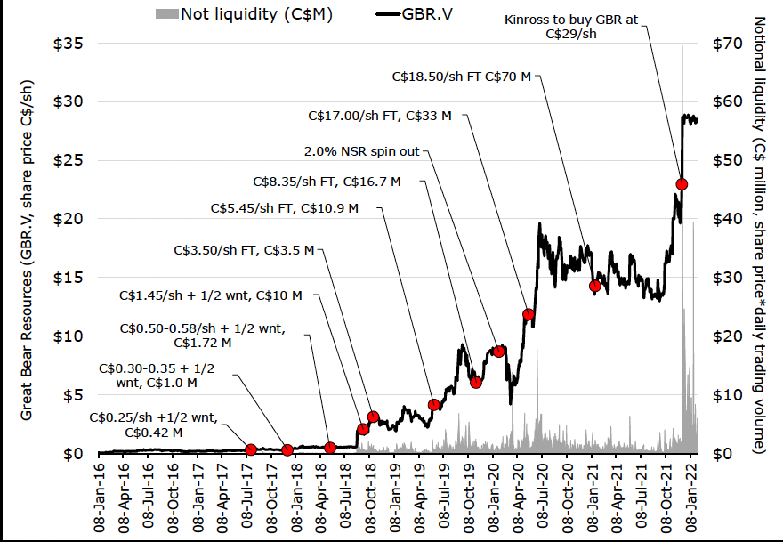
What is the Product? Is it Attractive?

Slide 6
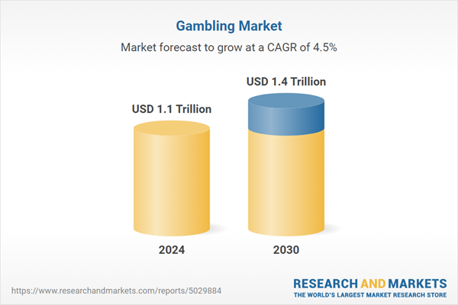
What is the Product? Is it Attractive?
Owning junior exploration company shares is a form of gambling
The key emotions for gamblers:
  The thrill of a possible win and the thrill of the hunt exceed ‘loss aversion’
  Greed and sloth (‘get-rich-quick’ and ‘making easy money’)
  An optimistic view of their ability
  Fear of Missing Out (FOMO), which is based on envy
The global gambling industry is competitive, but it is also huge, popular and growing
Embrace it, and react accordingly
Notes:
Issuers and Investors need to embrace that the Junior Mining Sector is a form of gambling. How else can you define it? Make it more attractive, but how?

Slide 7
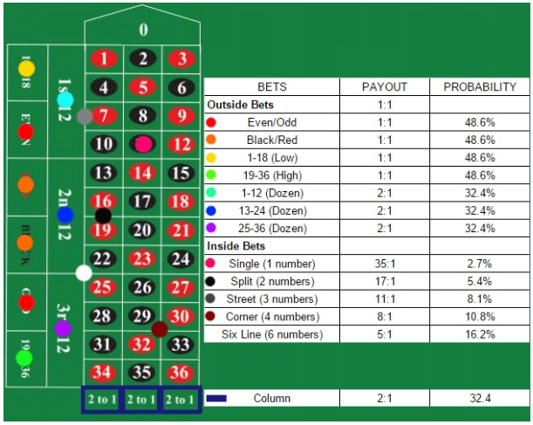
Juniors as a Gambling Product
Playing Roulette at a Canadian Casino:
Odds of success are known
Risks of loss are known
Taxation on winnings is nil
Liquidity is immediate
Zero cost to play
Zero dilution risk on your stake
Immediate result
No decisions to make on stock selection and market timing (simple: no research is required/zero skill)
Investing in Canadian Exploreco Juniors:
Odds of success are unknown (and not good)
Risks of loss are unknown (and numerous)
There is tax to pay on gains
Liquidity is often problematic
Fees are clipped on every trade
High dilution risk on your stake
It could take years for an outcome
Decisions to make on stock selection and market timing (complex; specialist research/knowledge is required)
Notes:
Main takeaway is that buying junior mining stocks is a poor form of gambling. But … the stock selection aspect, and The Thrill of the Hunt, is what drives investors/speculators to have a go. It’s not

Slide 8
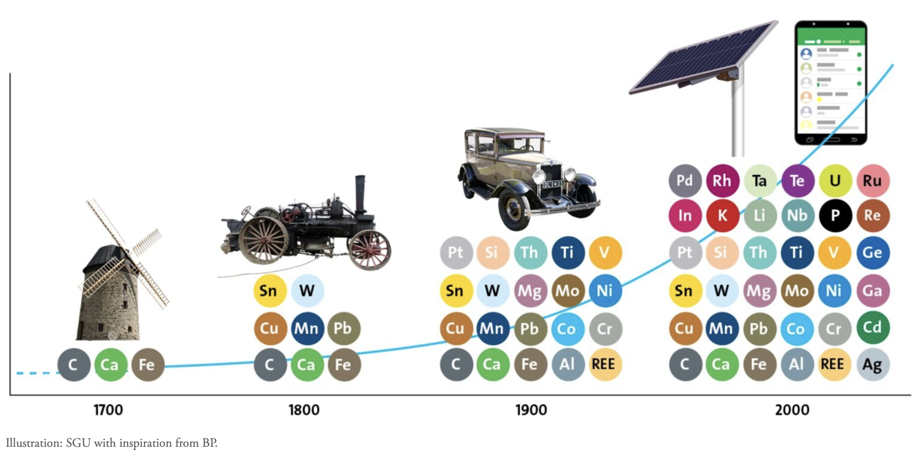
So why do ‘we’ invest in Junior Mining Equities?

Slide 9
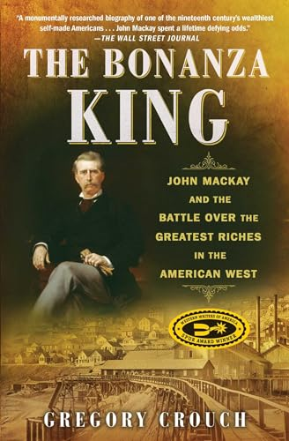


The Thrill of the Hunt/Desire to Discover/Back a Winner is Powerful

Slide 10

Juniors should Match the Capitalization to the Business Plan
Higher probability of failure
‘Super Junior’
Business Plan Scope
Ideal
‘Lifestyle’ company
Capitalization
Notes:
This a very important concept that juniors need to

Slide 11
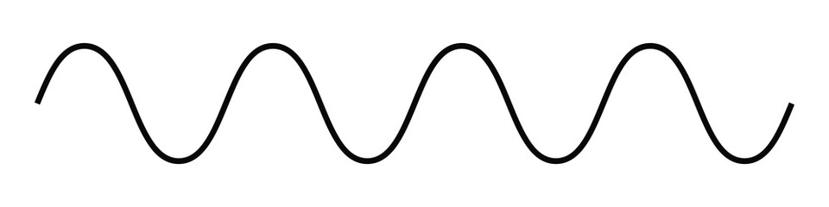




Cyclicity (‘Market Timing’) with respect to raising money
Zenith
‘Risk On’
Peak Capital
Misallocation
Peak Capital
Misallocation
Measured Capital
Allocation
Sentiment (Beta)
Peak Capital
Under Allocation
Peak Capital
Under Allocation
Zenith
‘Risk Off’
Time
Notes:
Cyclicity:
Why Commodity Prices rise and fall?
Why Fund Flows wax and wane?

Slide 12
Sources of Equity ‘Risk Capital’ and how they have changed:
Twenty Years Ago | Today | Suggested Reasons

Slide 13
Sources of Equity ‘Risk Capital’ and how they have changed:
Twenty Years Ago | Today | Suggested Reasons
LNW Retail | Decrease | Population growth, but there is a greater competition for available capital, plus higher cost of living/taxation …?

Slide 14
Sources of Equity ‘Risk Capital’ and how they have changed:
Twenty Years Ago | Today | Suggested Reasons
LNW Retail | Decrease | Population growth, but there is a greater competition for available capital, plus higher cost of living/taxation …?
HNW Retail (‘Sponsor’)/Family Office | Increase | Greater wealth concentration at the upper-end …? Greater influence potential due to media platforms

Slide 15
Sources of Equity ‘Risk Capital’ and how they have changed:
Twenty Years Ago | Today | Suggested Reasons
LNW Retail | Decrease | Population growth, but there is a greater competition for available capital, plus higher cost of living/taxation …?
HNW Retail (‘Sponsor’)/Family Office | Increase | Greater wealth concentration at the upper-end …? Greater influence potential due to media platforms
Influential Sell-Side Brokerages | Decrease | Sidestepped, increased regulation, reduced fees

Slide 16
Sources of Equity ‘Risk Capital’ and how they have changed:
Twenty Years Ago | Today | Suggested Reasons
LNW Retail | Decrease | Population growth, but there is a greater competition for available capital, plus higher cost of living/taxation …?
HNW Retail (‘Sponsor’)/Family Office | Increase | Greater wealth concentration at the upper-end …? Greater influence potential due to media platforms
Influential Sell-Side Brokerages | Decrease | Sidestepped, increased regulation, reduced fees
Mutual Funds | Decrease | Greater regulation, the rise of low cost online trading, and ‘free tips’ from self-appointed gurus on social media
Hedge Funds | Decrease | Greater regulation, poor multi-year performance

Slide 17
Sources of Equity ‘Risk Capital’ and how they have changed:
Twenty Years Ago | Today | Suggested Reasons
LNW Retail | Decrease | Population growth, but there is a greater competition for available capital, plus higher cost of living/taxation …?
HNW Retail (‘Sponsor’)/Family Office | Increase | Greater wealth concentration at the upper-end …? Greater influence potential due to media platforms
Influential Sell-Side Brokerages | Decrease | Sidestepped, increased regulation, reduced fees
Mutual Funds | Decrease | Greater regulation, the rise of low cost online trading, and ‘free tips’ from self-appointed gurus on social media
Hedge Funds | Decrease | Greater regulation, poor multi-year performance
Private Equity Funds | Decrease | Tough investment model in a small, illiquid, cyclical sector
Sovereign Wealth Funds | Decrease | Tough investment model in a small, illiquid, cyclical sector

Slide 18
Sources of Equity ‘Risk Capital’ and how they have changed:
Twenty Years Ago | Today | Suggested Reasons
LNW Retail | Decrease | Population growth, but there is a greater competition for available capital, plus higher cost of living/taxation …?
HNW Retail (‘Sponsor’)/Family Office | Increase | Greater wealth concentration at the upper-end …? Greater influence potential due to media platforms
Influential Sell-Side Brokerages | Decrease | Sidestepped, increased regulation, reduced fees
Mutual Funds | Decrease | Greater regulation, the rise of low cost online trading, and ‘free tips’ from self-appointed gurus on social media
Hedge Funds | Decrease | Greater regulation, poor multi-year performance
Private Equity Funds | Decrease | Tough investment model in a small, illiquid, cyclical sector
Sovereign Wealth Funds | Decrease | Tough investment model in a small, illiquid, cyclical sector
Corporates (Mining Companies) | Increase | Cashed-up, outsourcing exploration and seeking growth

Slide 19
Sources of Equity ‘Risk Capital’ and how they have changed:
Twenty Years Ago | Today | Suggested Reasons
LNW Retail | Decrease | Population growth, but there is a greater competition for available capital, plus higher cost of living/taxation …?
HNW Retail (‘Sponsor’)/Family Office | Increase | Greater wealth concentration at the upper-end …? Greater influence potential due to media platforms
Influential Sell-Side Brokerages | Decrease | Sidestepped, increased regulation, reduced fees
Mutual Funds | Decrease | Greater regulation, the rise of low cost online trading, and ‘free tips’ from self-appointed gurus on social media
Hedge Funds | Decrease | Greater regulation, poor multi-year performance
Private Equity Funds | Decrease | Tough investment model in a small, illiquid, cyclical sector
Sovereign Wealth Funds | Decrease | Tough investment model in a small, illiquid, cyclical sector
Corporates (Mining Companies) | Increase | Cashed-up, outsourcing exploration and seeking growth
Crowdfunding | Irrelevant | Several platforms but it never gained critical mass

Slide 20
Sources of Equity ‘Risk Capital’ and how they have changed:
Twenty Years Ago | Today | Suggested Reasons
LNW Retail | Decrease | Population growth, but there is a greater competition for available capital, plus higher cost of living/taxation …?
HNW Retail (‘Sponsor’)/Family Office | Increase | Greater wealth concentration at the upper-end …? Greater influence potential due to media platforms
Influential Sell-Side Brokerages | Decrease | Sidestepped, increased regulation, reduced fees
Mutual Funds | Decrease | Greater regulation, the rise of low cost online trading, and ‘free tips’ from self-appointed gurus on social media
Hedge Funds | Decrease | Greater regulation, poor multi-year performance
Private Equity Funds | Decrease | Tough investment model in a small, illiquid, cyclical sector
Sovereign Wealth Funds | Decrease | Tough investment model in a small, illiquid, cyclical sector
Corporates (Mining Companies) | Increase | Cashed-up, outsourcing exploration and seeking growth
Crowdfunding | Irrelevant | Several platforms but it never gained critical mass
Canadian Stock Exchanges | Decrease | Various impediments relative to Australia
Australian Stock Exchange | Increase | Various benefits relative to Canada

Slide 21
Sources of Equity ‘Risk Capital’ and how they have changed:
Twenty Years Ago | Today | Suggested Reasons
LNW Retail | Decrease | Population growth, but there is a greater competition for available capital, plus higher cost of living/taxation …?
HNW Retail (‘Sponsor’)/Family Office | Increase | Greater wealth concentration at the upper-end …? Greater influence potential due to media platforms
Influential Sell-Side Brokerages | Decrease | Sidestepped, increased regulation, reduced fees
Mutual Funds | Decrease | Greater regulation, the rise of low cost online trading, and ‘free tips’ from self-appointed gurus on social media
Hedge Funds | Decrease | Greater regulation, poor multi-year performance
Private Equity Funds | Decrease | Tough investment model in a small, illiquid, cyclical sector
Sovereign Wealth Funds | Decrease | Tough investment model in a small, illiquid, cyclical sector
Corporates (Mining Companies) | Increase | Cashed-up, outsourcing exploration and seeking growth
Crowdfunding | Irrelevant | Several platforms but it never gained critical mass
Canadian Stock Exchanges | Decrease | Various impediments relative to Australia (next slide)
Australian Stock Exchange | Increase | Various benefits relative to Canada (next slide)

Slide 22


ASX v TSX

Slide 23
ASX v TSX
Four-month hold | No four-month hold

Slide 24
ASX v TSX
Four-month hold | No four-month hold
Flow-through shares | No flow-through shares

Slide 25
ASX v TSX
Four-month hold | No four-month hold
Flow-through shares | No flow-through shares
Warrants are common | Warrants (“options”) are less common

Slide 26
ASX v TSX
Four-month hold | No four-month hold
Flow-through shares | No flow-through shares
Warrants are common | Warrants (“options”) are less common
Canadians gamble less | Australians have a deeper gambling culture

Slide 27
ASX v TSX
Four-month hold | No four-month hold
Flow-through shares | No flow-through shares
Warrants are common | Warrants (“options”) are less common
Canadians gamble less | Australians have a deeper gambling culture
No Superannuation (RRSP is not the same) | Superannuation

Slide 28
ASX v TSX
Four-month hold | No four-month hold
Flow-through shares | No flow-through shares
Warrants are common | Warrants (“options”) are less common
Canadians gamble less | Australians have a deeper gambling culture
No Superannuation (RRSP is not the same) | Superannuation
SEC resale restrictions on new placement shares | Fewer resale restrictions on new placement shares

Slide 29
ASX v TSX
Four-month hold | No four-month hold
Flow-through shares | No flow-through shares
Warrants are common | Warrants (“options”) are less common
Canadians gamble less | Australians have a deeper gambling culture
No Superannuation (RRSP is not the same) | Superannuation
SEC resale restrictions on new placement shares | Fewer resale restrictions on new placement shares
Larger Local Investor Pool | Smaller Local Investor Pool

Slide 30
Define a
‘Use of Proceeds’ to deliver
‘Value-per-Share’

Slide 31
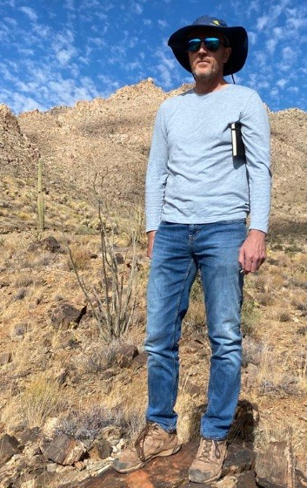
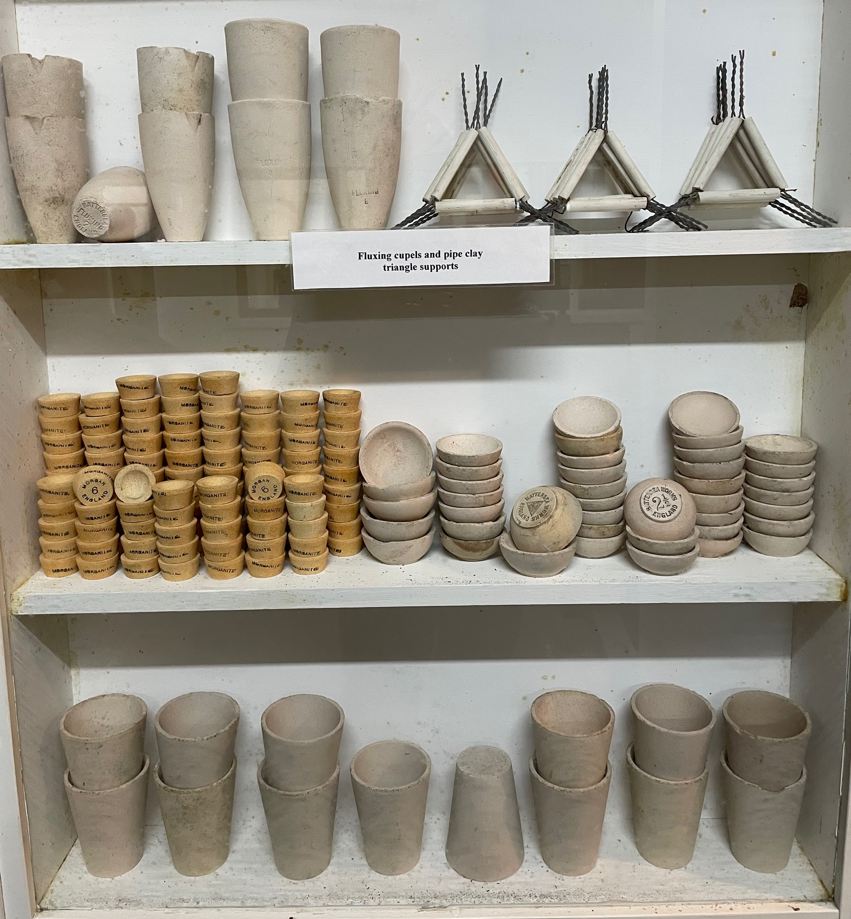
Notes:
Focus entirely on introducing myself in order to establish credibility with registrants. Introduce me:
Geologist with a PhD in Economic Geology, graduated thirty years ago.
Geology career for a decade, zero formal financial qualifications – we took a punt on one another in 2004.
Ten years with a major Canadian mining company working in exploration, mining and corporate roles.
Twenty years of buy-side experience – I was a capital allocator to dozens of juniors for two decades.
Currently I am a part-time “Fund Manager” for a cash-rich and growth-poor Canadian gold producer looking to partner with exploration companies in favoured jurisdictions by providing financial and technical assistance.
I also work as a part-time analyst with two sizeable equity investment funds.
I am Chairman of a private junior focused on Idaho that has raised US$20 million over the last two years.
I will connect with every registrant on LinkedIn, if you’re on LinkedIn. Alternatively, send me an email/give me a call. I will repeat my business card as the final slide of this presentation.

