Slide 1
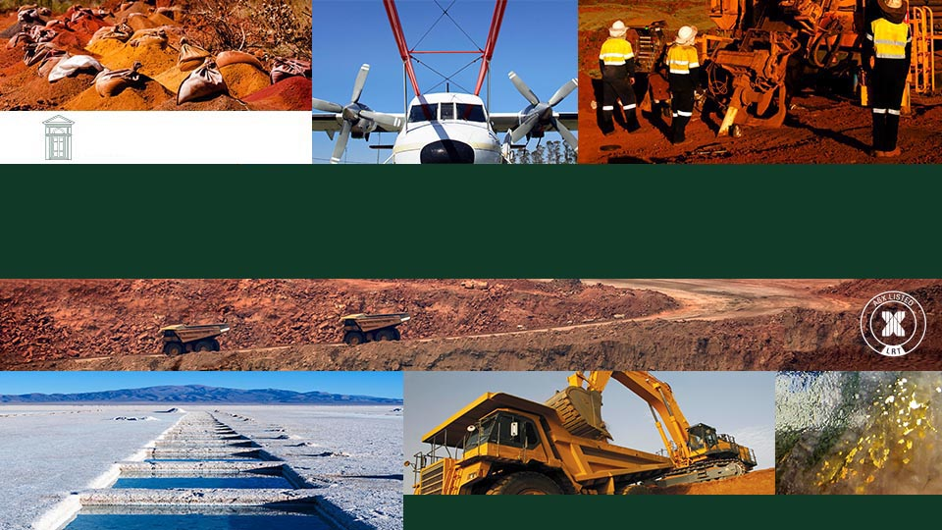
LOWELL RESOURCES FUND
LOWELL RESOURCES
FUNDS MANAGEMENT
PRESENTATION TO MINING FORUM EUROPE APRIL 2026
ABN 36 006 769 982 AFSL 345674

Slide 2
Disclaimer
Important Notice
This presentation does not constitute investment advice. Neither this presentation nor the information contained in it constitutes an offer, invitation, solicitation or recommendation in relation to the purchase or sale of units or shares in any jurisdiction.
A copy of the Product Disclosure Statements (“PDS”) lodged with the Australian Securities and Investments Commission (“ASIC”) on 19 August 2025 is available to be viewed on the Lowell Resources Fund’s website (http://www.cremornecapital.com/lrf-pds/) or can be requested from Cremorne Capital Limited, the Responsible Entity of the Lowell Resources Fund. Before deciding to acquire Units, you should read and consider the PDS in its entirety and, if in any doubt, consult with your professional advisor.
Investors should not rely on this presentation. This presentation does not take into account any person's particular investment objectives, financial resources or other relevant circumstances and the opinions and recommendations in this presentation are not intended to represent recommendations of particular investments to particular persons. All securities transactions involve risks, which include (among others) the risk of adverse or unanticipated market, financial or political developments.
The information set out in this presentation does not purport to be all inclusive or to contain all the information which its recipients may require in order to make an informed assessment of the Lowell Resources Fund. You should conduct your own investigations and perform your own analysis in order to satisfy yourself as to the accuracy and completeness of the information, statements and opinions contained in this presentation.
Readers should make their own independent assessment of the information and take their own independent professional advice in relation to the information and any proposed action to be taken on the basis of the information. To the fullest extent permitted by law, the Lowell Resources Fund and its professional advisors and their related bodies corporate, affiliates and each of their respective directors, officers, partners, employees, advisers and agents and any other person involved in the preparation of this presentation disclaim all liability and responsibility (including without limitation any liability arising from fault or negligence) for any direct or indirect loss or damage which may arise or be suffered through use of or reliance on anything contained in, or omitted from, this presentation and do not make any representation or warranty, express or implied, as to the accuracy or completeness of any information, statements, opinions, estimates, forecasts or other representations contained in this presentation.
Neither the Responsible Entity of the Lowell Resources Fund nor the Investment Manager, Lowell Resources Funds Management Ltd, is bound by any statement of intention contained in this presentation to then undertake the proposed activity, including any statement relating to the potential conduct an initial public offering for the Lowell Resources Fund.
This presentation may include various statements which constitute statements relating to intentions, future acts, and events (“Forward Looking Statements”). Forward Looking Statements are only predictions and are subject to risks, uncertainties and assumptions which are outside the control of the Responsible Entity and Investment Manager of Lowell Resources Fund. These risks, uncertainties and assumptions include commodity prices, currency fluctuations, economic and financial market conditions in various countries and regions, environmental risks and legislative, fiscal or regulatory developments, political risks, project delay or advancement, approvals and cost estimates. Actual values, results or events may be materially different to those expressed or implied in this presentation. Given these uncertainties, readers are cautioned not to place reliance on Forward Looking Statements.
Any Forward Looking Statements in this presentation speak only at the date of issue of this presentation. Subject to any continuing obligations under applicable law and the ASX Listing Rules, the Responsible Entity and Investment Manager of the Lowell Resources Fund do not undertake any obligation to update or revise any information or any of the Forward Looking Statements in this presentation or any changes in events, conditions or circumstances on which any such forward looking statement is based.
Neither the Responsible Entity or Investment Manager of the Lowell Resources Fund nor its advisors have any responsibility or obligation to inform the reader of any matter arising or coming to their notice after the date of this presentation document, which may affect any matter referred to in the presentation.

Slide 3
The Chart that Matters
Source Federal Reserve Bank of St Louis, S&P Global, FT.com

Slide 4
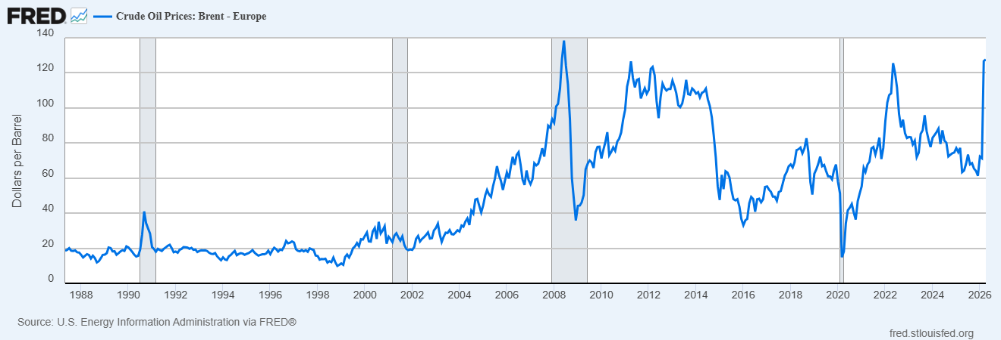
“Nightmare Scenario” for Central Banks

Slide 5
Major Junior Mining Stock Exchanges
Source Bloomberg, DealLogic, ASX
ABN 36 006 769 982 AFSL 345674
LOWELL RESOURCES FUNDS MANAGEMENT

Slide 6
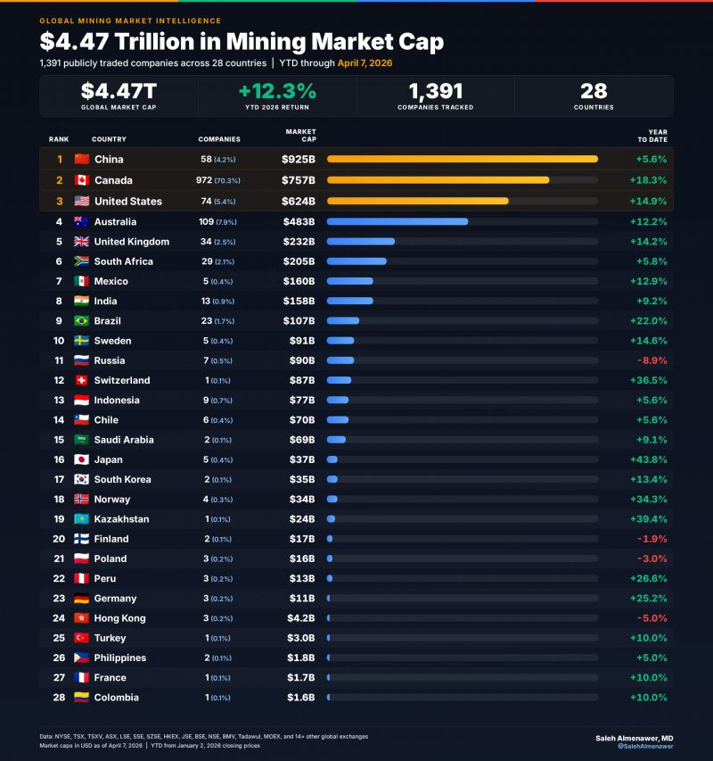


Mining Exchanges by Market Capitalisation
US$7578bn
US$4838bn
ABN 36 006 769 982 AFSL 345674
LOWELL RESOURCES FUNDS MANAGEMENT

Slide 7
ASX vs TSX
Source S&P Global, ASX

Slide 8
Lowell Resources Fund Existing Portfolio Snapshot
as at 31 March 2026
ABN 36 006 769 982 AFSL 345674
LOWELL RESOURCES FUNDS MANAGEMENT

Slide 9
Australia and Canada Pension Schemes

Slide 10
Pension System & Domestic Equities

Slide 11
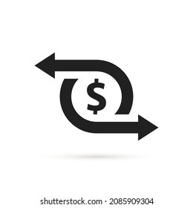

Tax Incentives
Canada’s Flow‑through
historically accounts for 65-75% of all exploration financing on Canadian exchanges
Australia
No “flow-through” in Australia (and JMEI scheme is finished).
BUT
Superannuation capital gains are taxed at a concessional rate of 10-15%
Or if superannuation is in “retirement phase” capital gains are tax-free!

Slide 12
Shares Outstanding – Misers vs Spendthrifts
ASX Co Average:
1,857m shares out
ASX 7x Canada
Canadian Co Average:
271m shares out
Source TD Cowen, Argonaut Securities

Slide 13

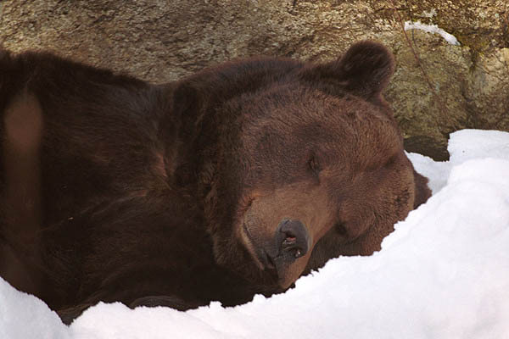
Mining NED Annual Fees (ASX vs TSXV vs AIM)
 | Exchange | Typical Annual Cash Fee | Typical Total Compensation (Cash + Equity) | Notes & Sources
 | ASX (Australia) | AUD $60k–$120k for most mining NEDs | AUD $80k–$200k+ depending on stage and size | ASX-listed miners face higher governance and risk loads; mid-tier and producers pay more.
 | TSXV (Canada) | CAD $15k–$40k (often lower for explorers) | CAD $25k–$80k with equity (eg options/warrants) | TSXV explorers frequently replace cash with equity.
 | AIM (UK) | £25k–£40k typical for NEDs | £30k–£60k+ depending on company size and sector | AIM NED median is £33k.
Less Visible share registers
Source Co-Pilot
ABN 36 006 769 982 AFSL 345674
LOWELL RESOURCES FUNDS MANAGEMENT

Slide 14
Project-level financing
Canadians Minimising Share Dilution
Market Cap CAD$mil
Market Cap AUD$mil
ABN 36 006 769 982 AFSL 345674
LOWELL RESOURCES FUNDS MANAGEMENT

Slide 15
TSXV Mining & Metals vs ASX Junior Resource
Source: S&P Global, FT.com
ABN 36 006 769 982 AFSL 345674
LOWELL RESOURCES FUNDS MANAGEMENT

Slide 16
Global Mining Equity Raisings
Source ASX, TMX

Slide 17
ASX Resource Raisings
Australia’s mineral and petroleum exploration companies held a record A$12 billion in cash reserves at 31 Dec 2025

Slide 18
April 2026
Intermediate Gold Producer Valuations
TSX Average US$22,291/oz
2.25x
ASX Average US$12,089/oz
April 2025 US$6,973/oz
1.73x
Companies with 2026 Forecast Production 175koz-725koz
Source Argonaut Securities, TD Cowen

Slide 19
April 2026
Intermediate Gold Producer Valuations
TSX Average US$768/oz
April 2025 US$395/oz
1.9x
ASX Average US$320/oz
1.3x
April 2025 US$252/oz
Companies with 2026 Forecast Production 175koz-725koz
Source Argonaut Securities, TD Cowen

Slide 20
Canadian Listings on the ASX
Source Investing.com

Slide 21

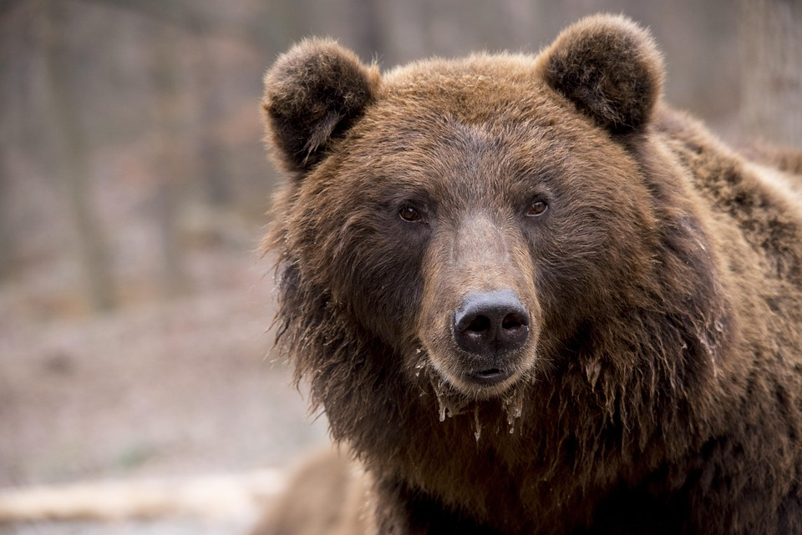
Conclusion

Slide 22
Contact
Investment Manager
Responsible Entity
LOWELL RESOURCES
FUNDS MANAGEMENT
ACN 006 769 982
AFSL 345674
Address
Level 6, 412 Collins Street,
Melbourne VIC 3000
Tel: (03) 9642 0655
Fax: (03) 9642 5177
Email: johnf@lowell.net.au
CREMORNE CAPITAL LIMITED
ACN 006 844 588
AFSL 241175
Address
8 Chapel Street,
Richmond VIC 3121
Tel: (03) 9665 2499

