Slide 1

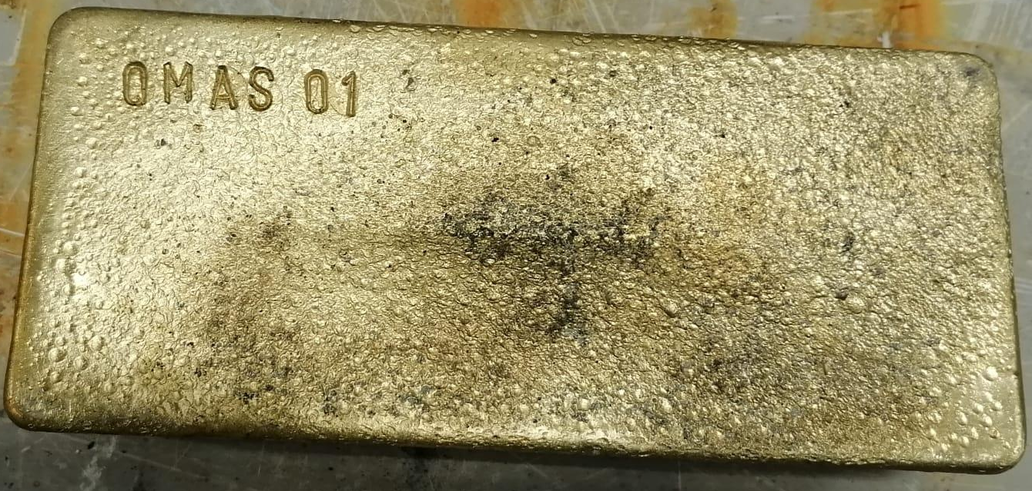
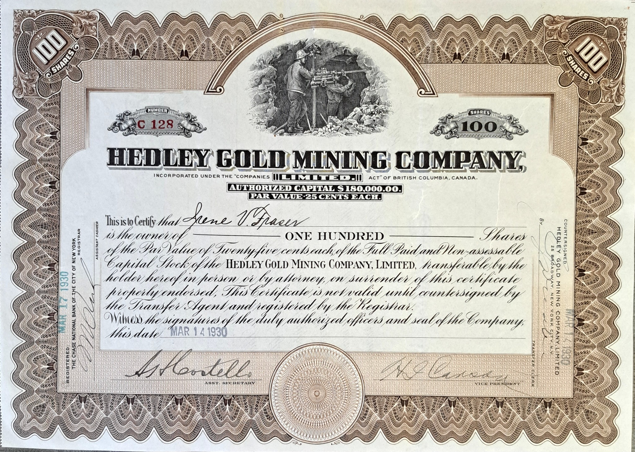
Gold Miners as Equity Portfolio Managers:
Value-Add or Capital Misallocation?
Neil Adshead, Cupel Advisory Corp., Mining Forum Americas, Zurich, 13-15 April 2026
Notes:
The reasoning behind this topic:

Slide 2
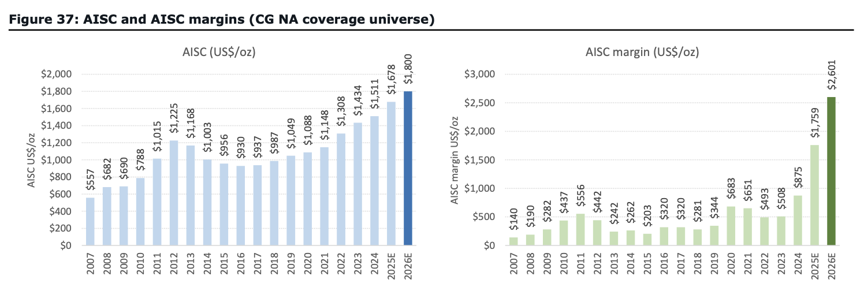
Producer Status Report: Record operating margins

Slide 3
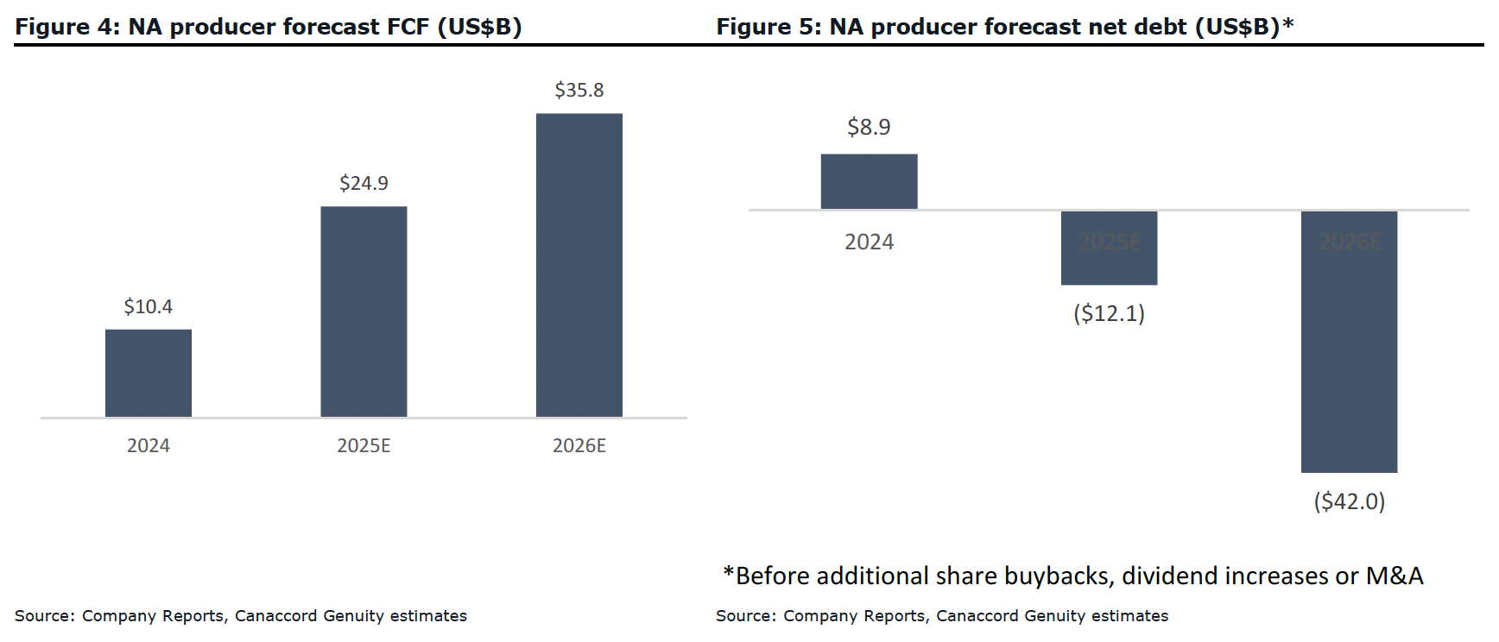
FCF Generation and Balance Sheet Improvement

Slide 4





Capital Allocation Cyclicity
Zenith
‘Risk On’
Peak Capital
Misallocation
Peak Capital
Misallocation
Measured Capital
Allocation
Sentiment (Beta)
Peak Capital
Under Allocation
Peak Capital
Under Allocation
Zenith
‘Risk Off’
Time
Notes:
Cyclicity:
Why Commodity Prices rise and fall?
Why Fund Flows wax and wane?

Slide 5
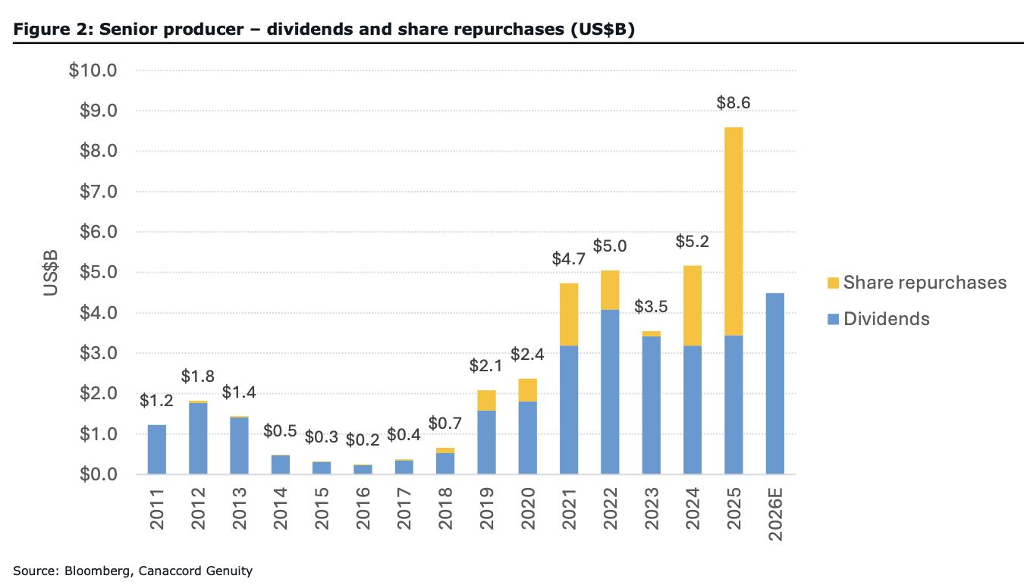
Excess Cash Allocation Options for Profitable Gold Producers
Save for Future Uses
Repay Debt
Distribute
  Dividends
  Share Repurchases
Acquire
Invest
  Mine Development/Expansion/Improvement
  Exploration Programs
  Junior Company Equity

Slide 6
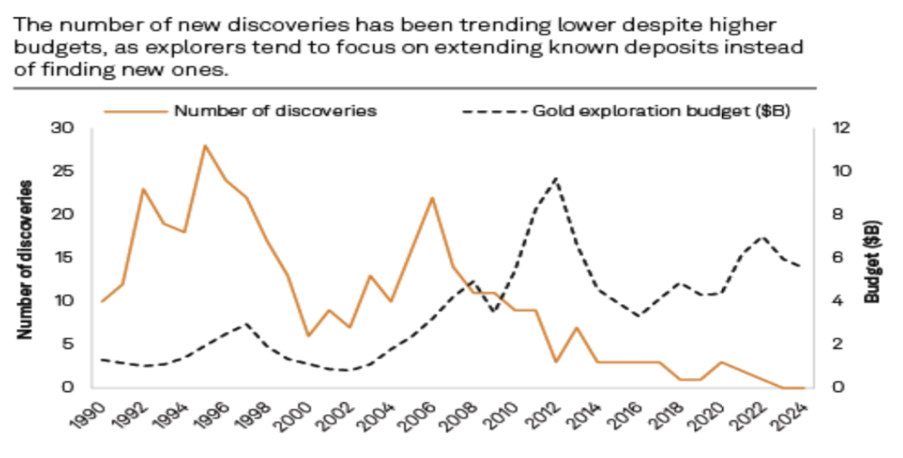
Gold Exploration Trends
https://www.capitaliq.spglobal.com/apisv3/spg-webplatform-core/news/article?id=91705513

Slide 7
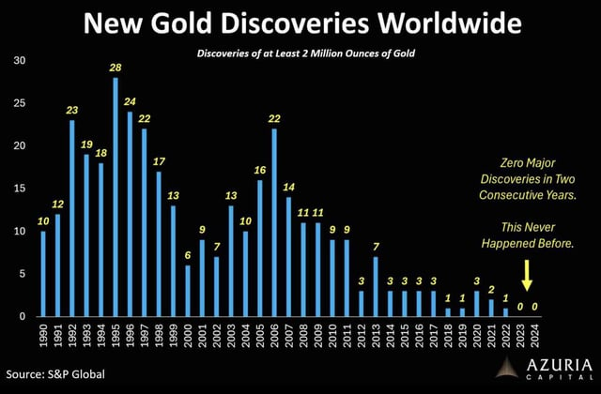
Gold Exploration Trends
https://www.capitaliq.spglobal.com/apisv3/spg-webplatform-core/news/article?id=91705513

Slide 8
Newsworthy Greenfields Gold Discoveries in the Last Decade
(ex-China and Russia)
Saddle, BC: GT Gold, 2017 (now owned by Newmont)
Silicon, Nevada: AngloGold Ashanti, Q1-2018 discovery drill hole
Great Bear (‘Dixie’), Ontario: Great Bear Resources, 2018 (now owned by Kinross)
Havieron, WA: Greatland Gold, 2018 (acquired 70% of Havieron and the nearby Telfer mine from Newmont in 2024)
Fourmile, Nevada: Barrick, first hole in late-2015 (but first Indicated & Inferred MRE not until 2025)
Hemi, WA: De Grey Mining, late-2019 (now owned by Northern Star)
Frotet, Quebec: Kenorland-Sumitomo, 2020 (now owned by Sumitomo Metals & Mining Canada)
Bankan, Guinea: Predictive Discovery, 2020 (currently merging with Robex)
Ikkari, Finland: Rupert Resources, 2020
Valley, Yukon: Snowline Resources, 2021
Rogozna, Serbia: Zlatna Reka Resources, 2021 (RTO into Strickland Metals in 2024)
Greater Oko, Guyana: Reunion Gold/G2 Goldfields, 2022 (both now owned by G Mining Ventures)
Assafou, Cote d’Ivoire: Endeavour Mining, 2022
Never Never (Dalgaranga), WA: Spartan Resources, 2022 (now owned by Ramelius)
Merlin, Nevada: Coeur Mining, 2020 (AngloGold made much larger in 2022-23, post-consolidation of pieces of the deposit owned by Corvus Gold and Coeur Mining)
Çoka Rakita, Serbia: DPM Metals, January 2023
AuRORA, Toodoggone District: Freeport-Amarc JV, January 2025

Slide 9
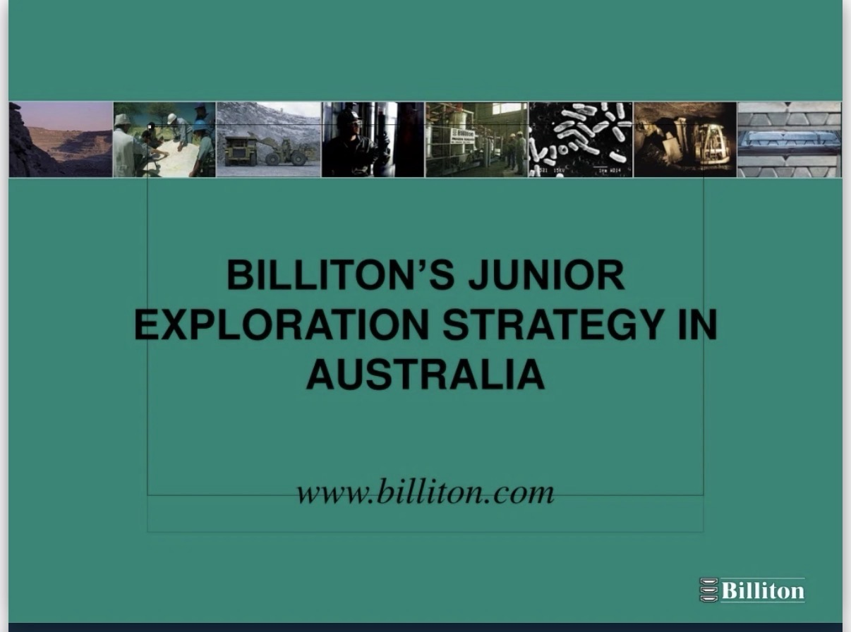
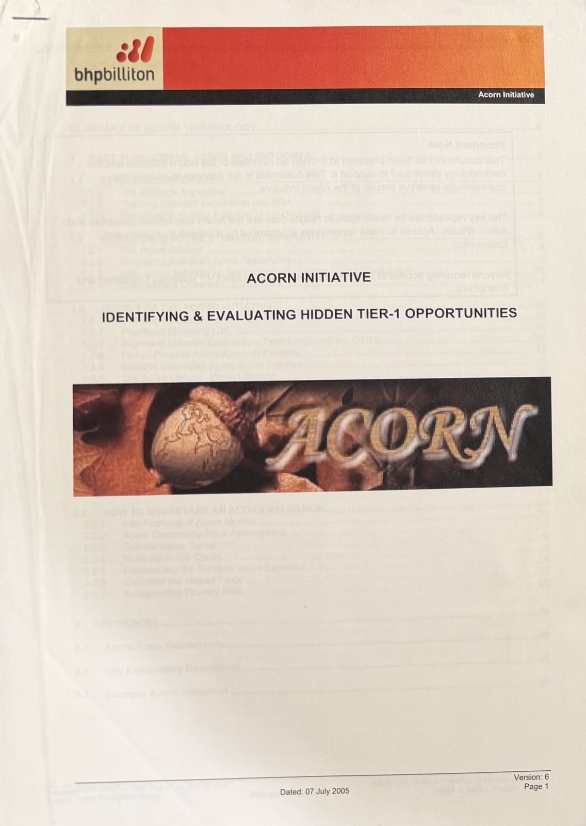
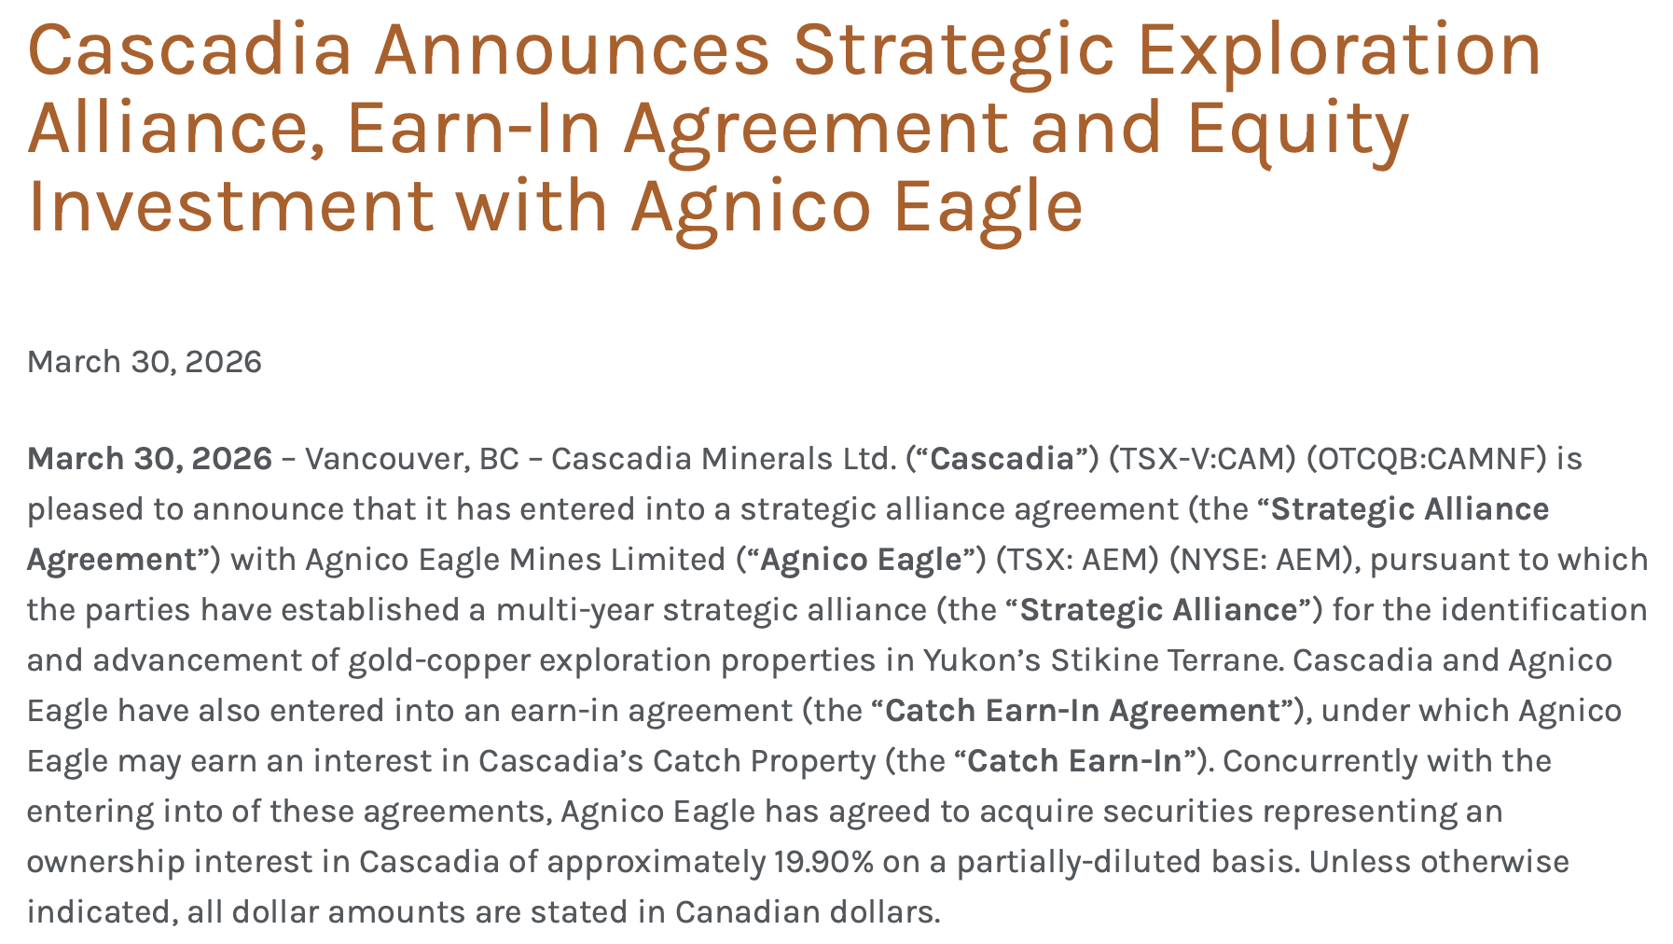
Xstrata Ventures

Slide 10

The Centerra Gold ‘EIF’ Experience
Corporate Objective: To expand exposure to high quality greenfields gold exploration risk in favoured jurisdictions
AUM: US$25 million initially (fully deployed this month)
Management: Part-time fund manager with gold exploration, gold mining and equity investment management experience
Status: Completed six 9.9% equity investments (plus top-ups) over 24 months, four gold projects optioned from investment companies, paper gain of 112% (>US$17 million) to the end of 2025, and an improved reputation as a favoured partner

Slide 11
Advantages for the Asset Manager (PM/Analysts)
Single capital source so reduced marketing and reporting requirements. It is analogous to a family office
Sticky money with close to zero redemption risk
Fewer securities regulations because there is no external (public/retail) money
Longer-term investment mandate focused on technical success, rather than share price performance
Less concern with mining sector cyclicity and quarterly or annual stock price performance
Access to broad internal technical and other relevant expertise.

Slide 12
Advantages for the Junior Exploration Company
Mining company investor capital is sticky, supportive and typically recurring
Mining companies typically make money, so the capital pool is large and sustainable
Higher likelihood of the corporate being a price agnostic and no-fee lead order that often does not require a warrant
Mining companies want to replace/grow their production through cost effective exploration/acquisition. Corporate investors focus on longer term technical success than short-term share price performance. There is a strong strategic alignment for discovery/project advancement
Mining company investors have greater and more varied technical expertise, which can be tapped
Marketing aspect of advertising that you have a larger company corporate investor. The relationship provides a public endorsement.

Slide 13
Advantages for the Cash-Generating Mining Company
Relationship building with nimble, passionate and motivated exploration teams
Broadening the exploration risk exposure, including into frontier jurisdictions if you do not want to advertise your presence
Exposure to a lower unit cost of exploration
Competitive edge to acquire a discovery through personal relationships and greater project knowledge
Paper or realized capital gains, improving the balance sheet, through equity investments with positive performance.

Slide 14
Conclusion
Gold Miners as Equity Portfolio Managers:
Value-Add or Capital Misallocation?

Slide 15
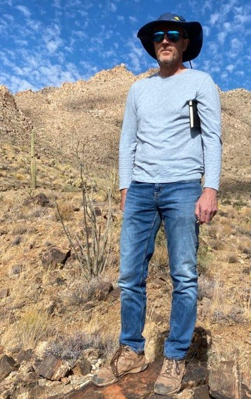
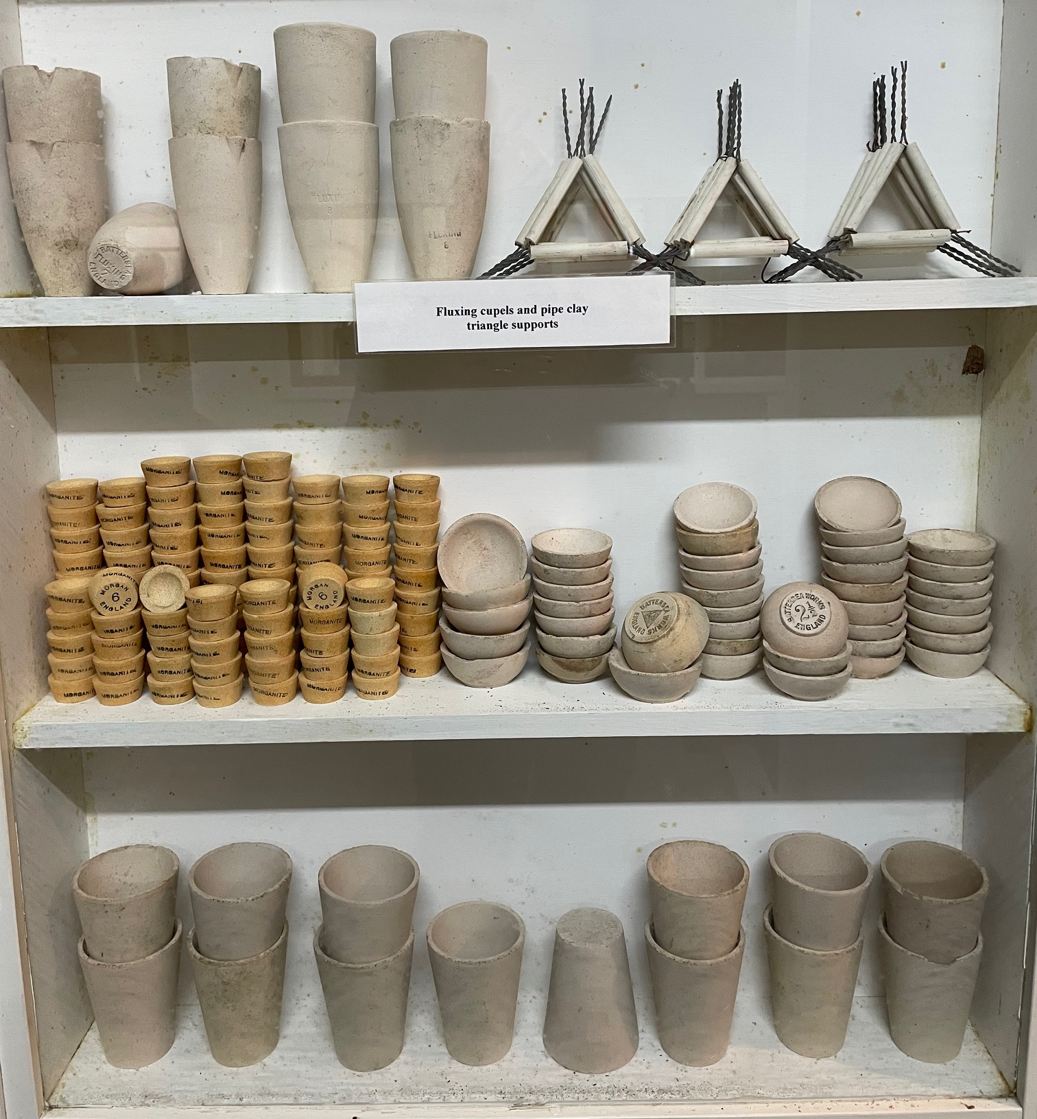
Notes:
Focus entirely on introducing myself in order to establish credibility with registrants. Introduce me:
Geologist with a PhD in Economic Geology, graduated thirty years ago.
Geology career for a decade, zero formal financial qualifications – we took a punt on one another in 2004.
Ten years with a major Canadian mining company working in exploration, mining and corporate roles.
Twenty years of buy-side experience – I was a capital allocator to dozens of juniors for two decades.
Currently I am a part-time “Fund Manager” for a cash-rich and growth-poor Canadian gold producer looking to partner with exploration companies in favoured jurisdictions by providing financial and technical assistance.
I also work as a part-time analyst with two sizeable equity investment funds.
I am Chairman of a private junior focused on Idaho that has raised US$20 million over the last two years.
I will connect with every registrant on LinkedIn, if you’re on LinkedIn. Alternatively, send me an email/give me a call. I will repeat my business card as the final slide of this presentation.

