Slide 1

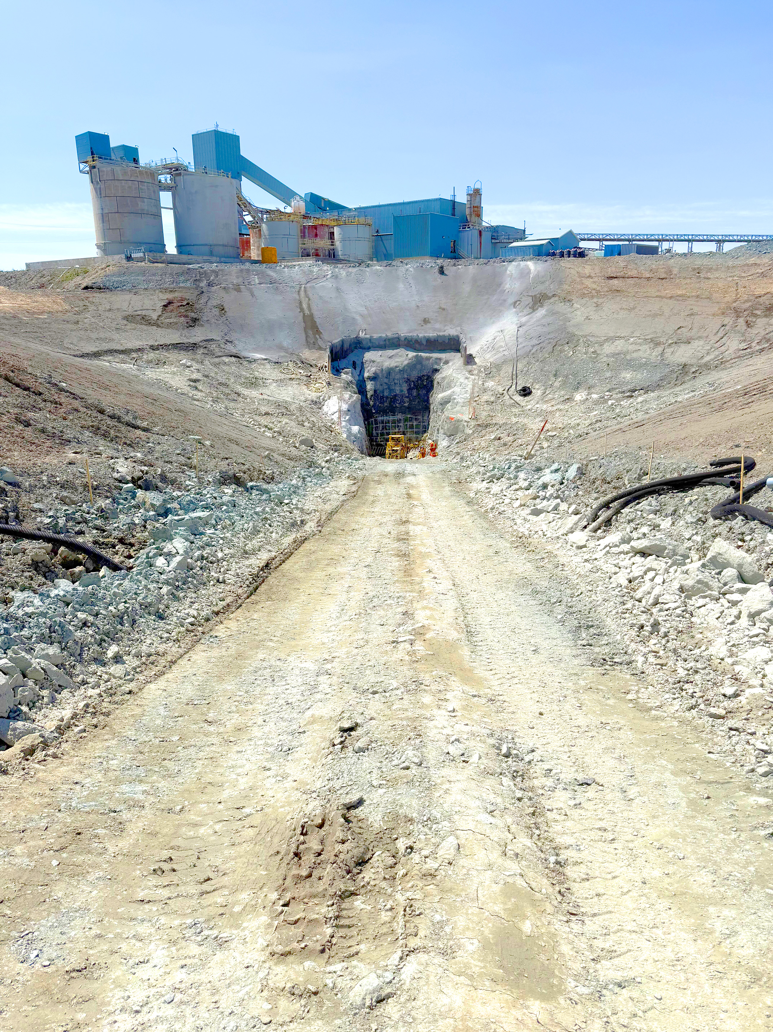
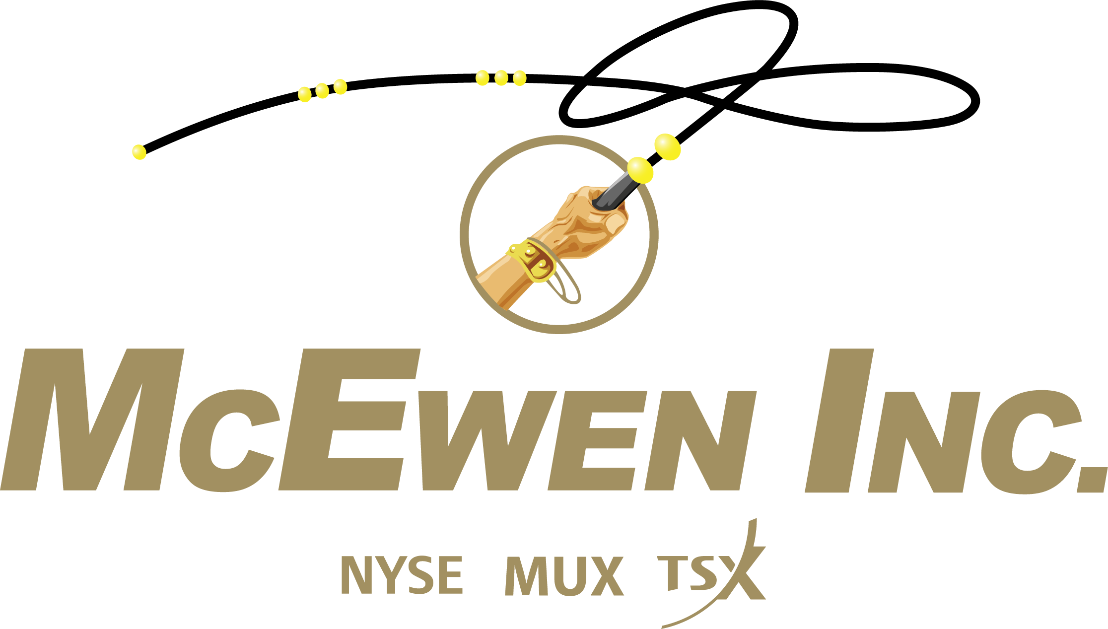
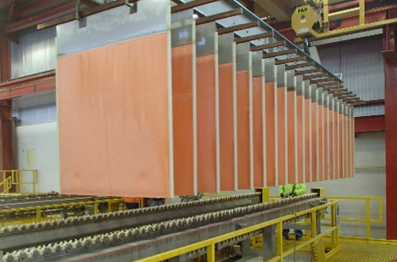
Areas of Future Production Growth
Fox Complex: Stock Mine Portal
Formerly McEwen Mining Inc.
How Are We Going to Make Money for You?
A Unique Combination of
Gold & Silver Production &
Massive Copper Deposit
Plus Exploration Upside
September 2025
Los Azules: Copper Cathode
Notes:
June 2, 10am

Slide 2
Cautionary Statement
This presentation and the information included herein do not constitute an offer to buy or the solicitation of an offer to subscribe for or to buy any of the securities described herein, nor shall there be any sale of these securities in any jurisdiction in which such offer, solicitation or sale would be unlawful prior to registration or qualification under the securities laws of any such jurisdiction.
This presentation contains certain forward-looking statements and information, including "forward-looking statements" within the meaning of the Private Securities Litigation Reform Act of 1995 ("Forward-looking Statements"). The Forward-looking Statements are intended to be subject to the safe harbor provided by Section 27a of the Securities Act of 1933, Section 21e of the Securities Exchange Act of 1934 and Private Securities Litigation Reform Act of 1995. The Forward-looking Statements express, as at the date of this presentation, McEwen Inc. (the "Company") estimates, forecasts, projections, expectations or beliefs as to future events and results. Forward-looking Statements are necessarily based upon a number of estimates and assumptions that, while considered reasonable by management, are inherently subject to significant business, economic and competitive uncertainties, risks and contingencies. There can be no assurance that such statements and information will prove to be accurate. Therefore, actual results and future events could differ materially from those anticipated in such statements and information. Risks and uncertainties that could cause results or future events to differ materially from current expectations expressed or implied by the Forward-looking Statements include, but are not limited to, factors associated with fluctuations in the market price of precious metals, mining industry risks, political, economic, social and security risks associated with foreign operations, the ability of the corporation to receive or receive in a timely manner permits or other approvals required in connection with operations, risks associated with the construction of mining operations and commencement of production and the projected costs thereof, risks related to litigation, the state of the capital markets, environmental risks and hazards, uncertainty as to calculation of mineral resources and reserves, risk of delisting from a public exchange, and other risks. Readers should not place undue reliance on Forward-looking Statements, which speak only as of the date hereof. The Company undertakes no obligation to reissue or update Forward-looking Statements as a result of new information or events after the date hereof, except as required by law. See McEwen Inc.'s Annual Report on Form 10-K/A for the fiscal year ended December 31, 2024, the Quarterly Report on Form 10-Q for the quarters ended March 31, 2025, June 30, 2025, and other filings with the Securities and Exchange Commission (the “SEC”), under the caption "Risk Factors", for additional information on risks, uncertainties and other factors relating to the Forward-looking Statements. All Forward-looking Statements made in this presentation are qualified by this cautionary statement. Unless otherwise stated, all currency information quoted in this presentation is in U.S. dollars.
The technical contents of this presentation, including reserves, have been reviewed and approved by William Shaver, P.Eng., COO; the exploration technical contents of this presentation including resources content have been reviewed and approved by Luke Willis, P. Geo., Director of Resource Modelling; all are Qualified Persons as defined by Canadian Securities Administrators National Instrument 43-101 "Standards of Disclosure for Mineral Projects".
We are subject to the reporting requirements of the Securities and Exchange Act of 1934, as amended (the “Exchange Act”) and applicable Canadian securities laws, and as a result, we have reported our mineral reserves and mineral resources according to two different standards. U.S. reporting requirements are governed by Item 1300 of Regulation S-K (“S-K 1300”), as issued by the SEC. Canadian reporting requirements for disclosure of mineral properties are governed by National Instrument 43-101 Standards of Disclosure for Mineral Projects (“NI 43-101”), as adopted from the definitions provided by the Canadian Institute of Mining, Metallurgy and Petroleum. Both sets of reporting standards have similar goals in terms of conveying an appropriate level of confidence in the disclosures being reported, but the standards embody slightly different approaches and definitions. All disclosure of mineral resources and mineral reserves in this report are reported in accordance with S-K 1300.
Investors should be aware that the estimation of measured resources and indicated resources involve greater uncertainty as to their existence and economic feasibility than the estimation of proven and probable reserves, and therefore investors are cautioned not to assume that all or any part of measured or indicated resources will ever be converted into S-K 1300 conforming reserves. The estimation of inferred resources involves far greater uncertainty as to their existence and economic viability than the estimation of other categories of resources. It is generally assumed that the majority of Inferred resources will be later upgraded to the Indicated or Measured categories with further exploration. Investors are cautioned not to assume that all or any part of inferred resources exist, or that they can be mined legally or economically.
2

Slide 3
Commodities Are Cheap @ 55 Year Low Relative to Equities S&P GS Commodity Index vs S&P 500 (1970-2025)
Market Timing
1990 Gulf War
2008 Financial Crisis
Oil Crisis
Commodities Expensive vs Equities
Commodities Cheap vs Equities
Tech Bubble
Current Period
3
Source: Bloomberg. January 1, 1970 - September 11, 2025.

Slide 4
Under Owned – A Neglected Market Sector Mining Industry as a Percentage of Global Equities Global Mining Industry Aggregate Market Cap Relative to Total Global Stocks Market Cap
Source: Statista, S&P Global Market Intelligence, Tavi Costa, Crescat Capital LLC. As of May 13, 2025.

Slide 5
Bullish Outlook for Copper
Copper Price
From Technical Perspective
The stage is set for the next leg higher
From Fundamental Perspective
Driving Demand
Growth of EVs
Renewable energy infrastructure
AI & data centers
Supply Constraints
Deep structural deficits by 2027-2028 RBC & JPM
New mines have long lead times & 8 yrs for permit & construction
Massive investment required to meet net zero goals
Source: Bloomberg, Copper futures price. As of September 11, 2025. ($4.55 / lb)

Slide 6
129 Years of History: Number of Ounces of Gold to Buy DJIA
Gold vs DJIA – Still Time to Buy Gold
44 oz
Jul 16, 1999
28 oz
Nov 26, 1966
# of Gold Ounces
to Buy the Dow
18 oz
Aug 30, 1929
Dow: $45,577
Gold: $3,633
Dow: $867
Gold: $850
Dow: $41
Gold: $21
Dow: $25
Gold: $21
13 oz
Sept 11, 2025
1 oz
Aug 7, 1896
2 oz
Jul 8, 1932
1 oz
Jan 18, 1980
1896
1920
1940
1960
1980
2000
2020
Note: Data presented for illustrative purposes only. Historical returns do not guarantee positive future returns. Source: Bloomberg. measuringworth.com. OnlyGold.com. As of September 11, 2025.

Slide 7
Gold: Outperforming DJIA Broken Out and Climbing Higher
%
Gold
601%
DJIA
321%
Source: Bloomberg. Monthly chart. January 1, 2006 - September 9, 2025.

Slide 8
Potential for Oversized Gains Gold Equities Lagging Behind Gold Divergence Performance: Gold (yellow) vs Gold Equities (GDX ETF blue & GDXJ ETF red)
Historically, Gold is the first mover, then capital flows in a cascading sequence into majors, mid-tiers, developers and finally the juniors, that are highly leveraged to gold!
%
Gold
236%
GDX
71%
GDXJ
1%
Source: Bloomberg. Monthly chart. January 1, 2010 - September 11, 2025.

Slide 9
Key Highlights of McEwen Inc. & McEwen Copper
Liquid Trader, NYSE & TSX
Significant Insider Ownership
Massive Copper Option
Exploration Increasing Gold Resources & Future Production
Attractive Leverage to Higher Gold, Silver & Copper Prices
9

Slide 10
McEwen Inc.
CEO’s Significant Financial Commitment
$205 M
15%
$1/ Yr
Large Investment ¹
High Ownership²
Low Salary
MUX Shares²
Ownership Distribution²
Top Holders^{2,4}
Outstanding | : | 54.1 M
Fully Diluted | : | 55.1 M
ADTV^{2,3} | : | 1,040,000
Price | : | US$13.81
Market Cap | : | US$746 M
Rob McEwen | 8.2 M
Van Eck Associates | 1.7 M
State Street | 1.5 M
UBS AG | 1.4 M
Mirae Asset Financial | 1.4 M
Dimensional Fund | 1.3 M
Blackrock | 0.9 M
Citadel | 0.9 M
Vanguard | 0.8 M
ETF Managers | 0.8 M
Other Institutions | 8.4 M
10
1. Rob McEwen’s investments (cost basis): $140 million in McEwen Inc.’s shares and $20 million in debt (Aug 13, 2018, Apr 5, 2022, Feb 11, 2025 press releases), plus $45 million in McEwen Copper shares
(Aug 3, 2021 & Jun 24, 2024 press releases) 2. As of September 11, 2025 3. Average Daily Trading Volume over 3 months, NYSE & TSX combined. Source: Bloomberg. 4. Insider Holdings, Bloomberg.

Slide 11
McEwen Inc. Compelling Value Management’s Estimate of Value. Sum of Its Parts.
MUX’s Assets |  | Range of Estimated $US Value per MUX Share¹​
MUX’s Assets |  | Low |  | High
McEwen Copper (46.4%)² | Los Azules | $8.44 | ³ | $28.95 | ⁴
Royalty Portfolio |  | $0.65 | ⁵ | $0.65 | ⁵ |  | MUX’s Closing Share Price on NYSE on September 11, 2025
Gold & Silver⁶ |  | $10.94 | ⁷ | $32.81 | ⁸
Total |  | $20.03 |  | $62.41 |  |  | $13.81
Based on NYSE closing share price on September 11, 2025.
Notes
McEwen Inc. has 54.1M shares, as of September 4, 2025, estimated by McEwen Inc. management.
McEwen Inc. owns 46.4% of McEwen Copper, as of June 13, 2025, which owns the Los Azules and the Elder Creek projects.
(US$984M x 46.4%) / 54.1M, = $8.44 using McEwen Copper’s implied market value of US$984 million on Oct 24, 2024.
($4.5B x 75% x 46.4%) / 54.1M = $28.95, using 75% of BHP / Lundin US$4.5 B deal for Josemaria’s and Filo del Sol’s copper deposits on July 29, 2024.
Estimated at $35M / 54.1M, based on 1.25% NSR on Los Azules and Elder Creek, plus three other royalties.
Peer group (Jaguar Mining, Silvercorp, Fortitude, Endeavour Silver) Peers Avg EV/GEO = US$9,575/ GEO, MUX EV/ GEO = $6,220/ GEO. As of September 4, 2025. Using (MUX Midpoint Guidance GEOs x Peers Avg EV/GEO + MUX Cash – MUX Debt)/ MUX Shares taken at:
50% discount to $20.45 market value; 8. 50% premium to $20.45 market value.

Slide 12
Financial Snapshot at June 30, 2025
Liquidity | Debt | Gross Profit | Adjusted EBITDA
Improving working capital Cash¹ $54 M Working Capital¹ $62 M | Positioning for project growth Convertible Debt US$110 M Closed in Feb 2025 Total Debt US$130 M | Strong gold price environment H1 2025 $22 M H1 2024 $17 M | Profitability in our operations H1 2025 $26.0 M $0.49/shr H1 2024 $13.6 M $0.27/shr
¹ Cash and working capital are preliminary estimates presented as at June 30, 2025. Cash includes cash, cash equivalents, and restricted cash. Working capital represents our current assets less current liabilities.

Slide 13
MUX Consolidated Annual Production – Future Potential Growth
Thousand
GEOs
225 –
255 E
²
E
²
E
²
E
²
E
¹
²
E
²
1 - 2024 Production 135,900. 2 - 2025 – 2030 Projection, internal estimates.

Slide 14
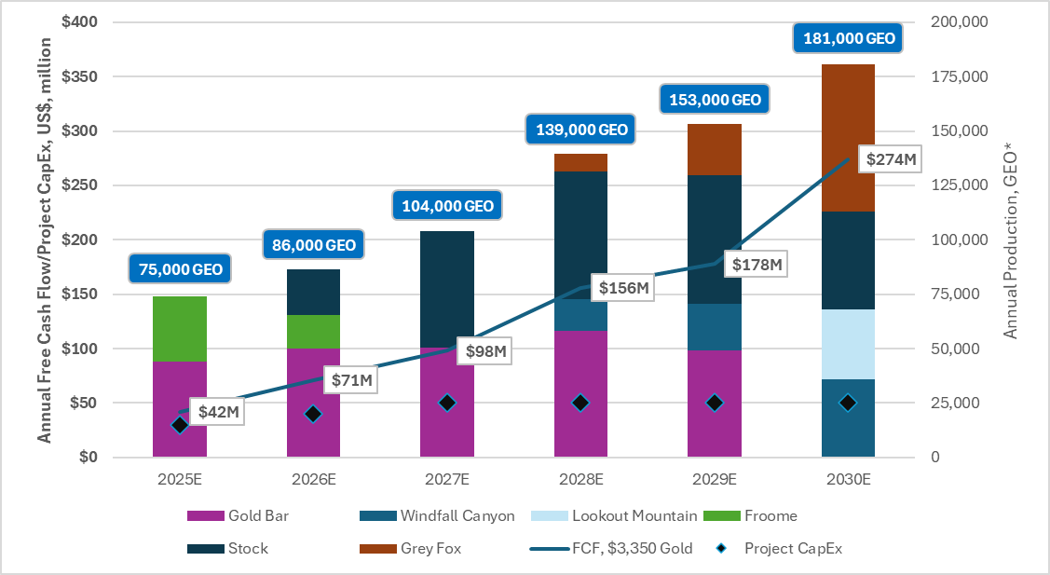
Organic Growth Self-Funded Through Free Cash Flow ($3,350/oz Gold)
*100% held operations, excludes San José
*Free Cashflow: After Tax Cashflow from Operations less Sustaining CapEx

Slide 15
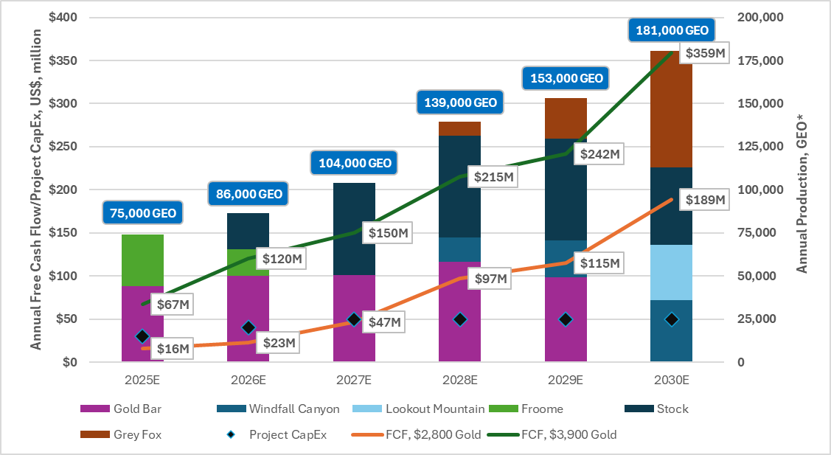
Free Cash Flow Sensitivity to Gold Price ($2,800 - $3,900 / oz)
*100% held operations, excludes San José
*Free Cashflow: After Tax Cashflow from Operations less Sustaining CapEx

Slide 16
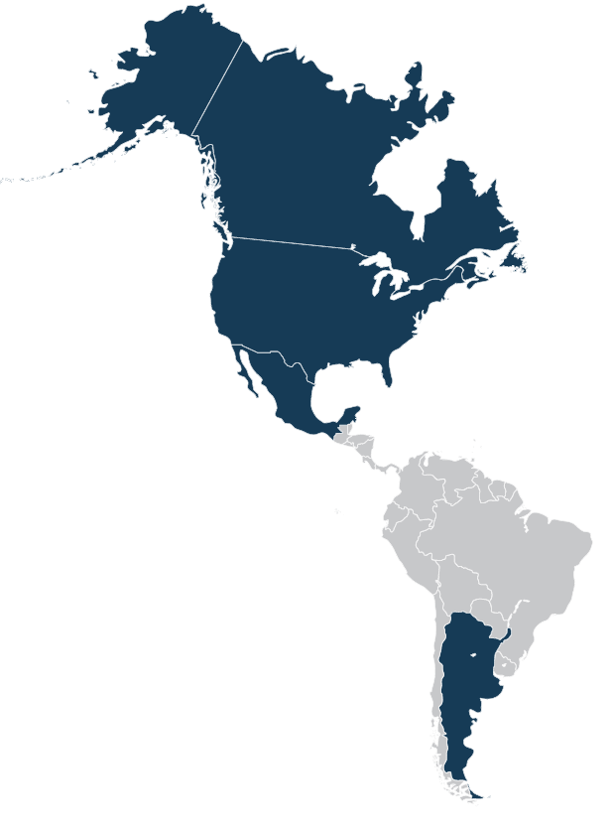

McEwen Inc.: Gold & Silver Production & Copper Development Project
Fox Mine Complex
Timmins, Canada (100%)
Elder Creek
Nevada
Gold Bar Mine Nevada (100%)
El Gallo – Fenix Project Mexico (100%)
Los Azules
Argentina
San José Mine Argentina (49%)
16

Slide 17
MUX's Relative Performance Over Past 36 Months
MUX's Relative Performance Sep 1, 2022 – Sept 11, 2025 | GDXJ +219% GDX +203% | ~2X
 | Silver +133% | ~3X
 | Gold +114%
 | Nasdaq +87% | ~4X
 | Dow +46% | ~8X
 | Copper +34% | ~11X
2023 EPS $1.15
Gold operations production met guidance
%
Investments in McEwen Copper
Stellantis ARS $30 B
Nuton - Rio Tinto $30 M
Los Azules 2023
PEA published
$12
$8
$4
Investments in
McEwen Copper
Stellantis ARS $42 B
Nuton - Rio Tinto $10 M
MUX convertible notes financing
MUX
+365%
McEwen Copper completes $81.85 M
financing incl. $25 M from Nuton - Rio Tinto
Reduced debt
by 39%
MUX
Share Price
US$
17
Note: Data presented for illustrative purposes only. Historical returns do not guarantee positive future returns. Source: Bloomberg. Chart from Sep 1, 2022 (MUX $2.97) to Sept 11, 2025 (MUX $13.81)

Slide 18
McEwen Inc. 2024 Production and 2025 Guidance
 | 2024 Guidance² | Q1 2024 | Q2 2024 | Full Year 2024^{1,2} | Q1 2025 | Q2 2025³ | 2025 Guidance²
Consolidated Production
GEOs⁽¹⁾ | 130,000 - 145,000 | 33,037 | 35,265 | 135,900 | 24,131 | 27,556 | 120,000 - 140,000
Cash Costs/GEO |  |  |  |  | $1,504 |  | $1,550 - $1,750
AISC/GEO |  |  |  |  | $2,318 |  | $1,800 - $2,000
Gold Bar Mine, Nevada
GEOs | 40,000 - 43,000 | 11,716 | 12,297 | 44,600 | 7,688 | 8,406 | 40,000 - 45,000
Cash Costs/GEO | $1,450 - $1,550 | $1,088 | $1,532 | $1,425 | $1,146 |  | $1,500 - $1,700
AISC/GEO | $1,650 - $1,750 | $1,201 | $1,634 | $1,677 | $2,197 |  | $1,700 - $1,900
Fox Complex, Canada
GEOs | 40,000 - 42,000 | 7,486 | 8,297 | 30,150 | 5,520 | 5,426 | 30,000 - 35,000
Cash Costs/GEO | $1,225 - $1,325 | $1,555 | $1,588 | $1,642 | $2,060 |  | $1,600 - $1,800
AISC/GEO | $1,450 - $1,550 | $1,928 | $1,874 | $1,980 | $2,504 |  | $1,700 - $1,900
San José Mine, Argentina (49%)²
GEOs | 50,000 - 60,000 | 12,934 | 14,672 | 60,100 | 10,924 | 13,724 | 50,000 - 60,000
Cash Costs/GEO | $1,300 - $1,500 | $1,607 | $1,624 | $1,742 | $2,275 |  | $1,600 - $1,800
AISC/GEO | $1,500 - $1,700 | $1,947 | $2,032 | $2,139 | $3,047 |  | $1,900 - $2,100
18
El Gallo Mine (on care and maintenance) sold 1,052 ounces in FY2024 from plant and pond cleanout.
Full Year 2024 results and 2025 guidance as per press release from March 18, 2025.
3. Preliminary production numbers.

Slide 19
McEwen Inc.: Gold, Silver & Copper Reserves & Resources (at Dec 31, 2024)
 | Proven & Probable |  |  | Measured & Indicated |  |  | Inferred
Gold | Tonnes (million) | Au Grade (g/t) | Contained Au (oz) | Tonnes (million) | Au Grade (g/t) | Contained Au (oz) | Tonnes (million) | Au Grade (g/t) | Contained Au (oz)
Fox Complex |  |  |  | 18.6 | 3.64 | 2,175,000 | 7.8 | 3.18 | 795,000
Gold Bar | 10.9 | 0.64 | 221,900 | 4.4 | 0.68 | 95,900 | 0.4 | 0.59 | 7,900
Timberline |  |  |  | 23.4 | 0.56 | 423,000 | 6.6 | 0.39 | 84,000
Fenix |  |  |  | 14.7 | 0.42 | 199,000 | 0.3 | 0.41 | 4,000
San José (49%) | 0.6 | 5.02 | 90,100 | 0.6 | 3.54 | 66,000 | 1.1 | 4.59 | 165,200
Total Gold |  |  | 312,000 |  |  | 2,958,900 |  |  | 1,056,100
Silver | Tonnes (million) | Ag Grade (g/t) | Contained Ag (oz) | Tonnes (million) | Ag Grade (g/t) | Contained Ag (oz) | Tonnes (million) | Ag Grade (g/t) | Contained Ag (oz)
Fenix |  |  |  | 14.7 | 42 | 20,100,000 | 0.3 | 33 | 300,000
San José (49%) | 0.6 | 286 | 5,100,000 | 0.6 | 150 | 2,800,000 | 1.1 | 252 | 9,100,000
Total Silver |  |  | 5,100,000 |  |  | 22,900,000 |  |  | 9,400,000
Copper | Tonnes (million) | Cu Grade (%) | Contained Cu (lbs) | Tonnes (million) | Cu Grade (%) | Contained Cu (lbs) | Tonnes (million) | Cu Grade (%) | Contained Cu (lbs)
Los Azules (46.4%) |  |  |  | 573.2 | 0.40 | 5,100,000,000 | 2,092.3 | 0.31 | 12,400,000,000
19
Measured & Indicated and Inferred Resources are presented exclusive of Reserves (Proven & Probable). Resources & Reserves from Dec 31, 2024, according to McEwen Inc.'s 2024 10-K Report. Numbers may not sum due to rounding.

Slide 20
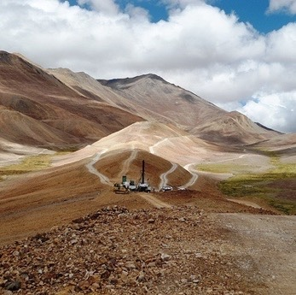



Positioning McEwen Copper as the New Vehicle for Copper Growth
Key Attributes of the McEwen Copper Story
World-class Resource
Not in the Hands of a Major
1
Experienced Board and Management Team
Argentina - Emerging Tier 1 Lithium & Copper Mining Jurisdiction
7
2
Backed by Key Strategic Partners
Robust Economics Throughout Price Cycles
6
3
5
4
Significant Upside Potential From Nuton Technologies & Exploration
Mining for the Modern World With Regenerative Principles + Low Carbon Intensity

Slide 21
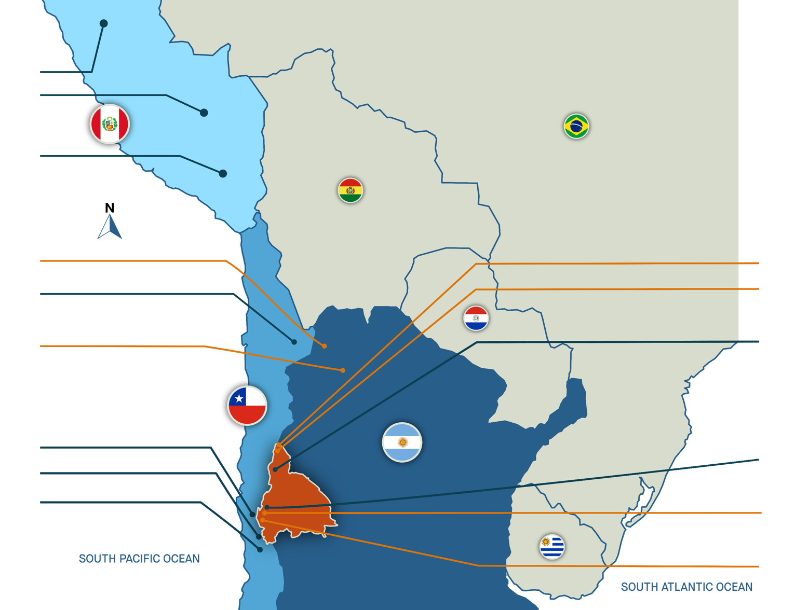















Argentina | Emerging Tier 1 Mining Jurisdiction | Strong Copper Potential
Chile & Perú produce 40% of the world's copper production
Multiple In-Country Key Industry Players
Antamina Teck
Las Bambas MMG
Cerro Verde
Freeport-McMoRan
MINE
DEVELOPMENT
Vicuña JV
Taca Taca
First Quantum
Escondida
BHP/Rio Tinto
MARA Glencore
Josemaria
Lundin - BHP
Filo del Sol
Lundin – BHP
Veladero Barrick/Shandong
Pelambres Antofagasta
Andina Codelco
Los Bronces Anglo American
Los Azules
McEwen Copper
(MUX, Rio Tinto, Stellantis)
Altar
Aldebaran Resources
El Pachón Glencore
*Ranking based on the 20 largest copper mines in the world in 2021 by production capacity. https://elements.visualcapitalist.com/the-largest-copper-mines-in-the-world-by-capacity/

Slide 22


McEwen Copper Is Planning the World’s 1st Regenerative Copper Mine in Argentina
Watch the video here:
https://t.ly/lAYts
22

Slide 23
Los Azules - It’s BIG!
World’s 9th Largest Undeveloped Copper Project (based on the 2023 resource)
# | Project | Country | Majority Owner | Development Status | Geology
1 | Vicuña | Argentina | BHP/ Lundin | Advanced Exploration / Feasibility | Porphyry
2 | Pebble | United States | Northern Dynasty Minerals | Preliminary Economic Assessment | Porphyry, Supergene Copper
3 | Resolution | United States | Rio Tinto | Feasibility Study | Porphyry
4 | Kerr-Sulphurets-Mitchell (KSM) | Canada | Seabridge Gold | Prefeasibility Study | Porphyry, Skarn
5 | El Pachon | Argentina | Glencore | Advanced Exploration | Porphyry
6 | La Granja | Peru | Rio Tinto | Advanced Exploration | Porphyry
7 | Reko Diq | Pakistan | Barrick | Feasibility Study | Porphyry
8 | Onto | Indonesia | Sunbawa Timur | Advanced Exploration | Porphyry
9 | Los Azules | Argentina | McEwen Copper | Preliminary Economic Assessment | Porphyry, Supergene Copper
10 | El Arco | Mexico | Southern Copper | Prefeasibility Study | Porphyry
Source: Company disclosure

Slide 24
McEwen Copper’s Growing Impact on MUX Share Value Private Financings: $453 M Completed 2 Large Shareholders – Rio Tinto (Nuton) & Stellantis
 | McEwen Copper |  |  |  |  |  | MUX
 | Amount |  | Share Price |  | Market Value |  | Ownership | Value |  |  | Value / Share
Aug 2022 | $82 M |  | $10 |  | $256 M |  | 68.1% | $175 M |  |  | $3.25
Feb 2023 | $30 M |  | $19 |  | $550 M |  | 51.9% | $285 M |  |  | $5.29
 | ARS $30 B¹
Oct 2023 | $10 M |  | $26 |  | $800 M |  | 47.7% | $382 M |  |  | $7.09
 | ARS $42 B²
Oct 2024 | $56 M |  | $30 |  | $984 M |  | 46.4% | $457 M |  |  | $8.44
M - millions, B - billions
Excludes 1.25% NSR on Los Azules & Elder Creek
Equivalent to US$155 M @ Official FX, 1 ARS = 0.005121 USD
Equivalent to US$120 M @ Official FX, 1 ARS = 0.002857 USD
Notes:
Appendix

Slide 25


McEwen Copper: 32.8 M Shares Outstanding Ownership: Private, Pre-IPO, Global Investors
World’s 6th Largest
Auto Manufacturer¹
Subsidiary of
World’s 2nd Largest
Mining Company²
46.4%
100%
Andes Corporacion Minera
100%
Founder of Goldcorp Inc.
Grew Market Cap
From $50 Million to $8 Billion
Source: 6th largest by units sold in 2024. https://www.focus2move.com/world-car-group-ranking/
Source: https://www.mining.com/top-50-biggest-mining-companies/

Slide 26




Comparative Value of McEwen Copper's Los Azules Project (Based on PEA)
Two Market Value Reference Points
Los Azules PEA: Same Province, Lower Altitude, Larger Resource, Higher Grade, Closer to Infrastructure, Lower C1 Cost
NB: Pending Feasibility Study - expect slightly smaller resource, higher cost / lb and higher capex
Comparison¹ of Los Azules with Josemaria & Filo del Sol (BHP/Lundin)
In the Same Province, San Juan, Argentina
Altitude
MASL
Copper Resources & Grades²
 | M&I |  |  | Inferred
Los Azules | 10.9 B lbs Cu | 0.40% |  | 26.7 B lbs Cu | 0.31%
Josemaria | 10.1 B lbs Cu | 0.28% |  | 3.5 B lbs Cu | 0.22%
Filo del Sol | 17.5 B lbs Cu | 0.50% |  | 51.8 B lbs Cu | 0.37%
Jose + Filo | 27.6 B lbs Cu |  |  | 55.3 B lbs Cu
Josemaria
Los Azules | 3,100 - 3,600 m
Josemaria | 4,000 - 4,900 m
Filo del Sol | 4,900 - 5,400 m
Filo del Sol
Los Azules
New
New
Distance From
Power Grid, Roads
Development Stage
$ C1 Cash Costs
US$ Market Value^{3,4}
$
Los Azules | - 70 km
Josemaria | - 244 km
Filo del Sol | - 77 km (Chile)
Los Azules | - PEA
Josemaria | - FS
Filo del Sol | - PFS
Los Azules | $1.07 / lb Cu
Josemaria | $1.55 / lb CuEq. (Co-prod.)
Filo del Sol | $1.54 / lb CuEq. (Co-prod.)
Los Azules | - $984 M
Josemaria | - $1.38 B
Filo del Sol | - $3.12 B
Los Azules - In the Lowest Quartile Of C1 Cash Cost
Sources: Filo del Sol PFS 2023, Josemaria FS Technical Report Nov 2020.
Source: Company websites. Los Azules cut-off grade variable by NSR. Filo del Sol cut-off grade 0.15% CuEq. Josemaria cut-off grade 0.10% CuEq.
Filo del Sol and Josemaria proposed purchase prices on July 29, 2024.
McEwen Copper's implied market cap US$984 M, based on the Oct 2024 financing
Notes:
365%
* Oxides and sulphides

Slide 27
McEwen Copper: Los Azules 2023 PEA (Feasibility Study Oct 2025)
Project Metrics | PEA Base Case 175 KTPA Cu June 2023
Mine Life | 27 Yrs
Strip Ratio | 1.16
Initial Capital Cost | $2,462 Million
Sustaining Capital Cost | $2,243 Million
Average Copper Recoveries | 72.8%
Copper Production – Cathode | 3,938 Ktonnes
C1 Costs (Life of Mine) | $1.07/ lb Cu
All-in Sustaining Costs (AISC) | $1.64/ lb Cu
After-tax Internal Rate of Return (IRR) | 21.2%
After-tax Net Present Value (NPV) @ 8% | $2,659 Million
After-tax Pay Back Period | 3.2 Yrs
Annual Copper Production - 1st 2 Yrs | 192,500 TPA
Annual Copper Production - Nominal | 175,000 TPA
Calculated by modifying PEA Base Case model with 3.2% higher Cu recovery and lower acid consumption – McEwen Copper Reports Improved Copper Recovery press release.
This disclosure should not be taken to modify or update the conclusions of the PEA published in June 2023.

Slide 28
Los Azules - Changes in Economics Since the PEA
Increased Copper Price
The PEA was estimated using a copper price of $3.75 / lb
Current copper price above $4.44 / lb
Increased Knowledge of Mineral Resources
Added 97,900 meters of resource drilling
Added structural interpretations to improve resource and geological model domaining
Converted the majority of the PEA Minable resource material into Measured & Indicated Mineral Resources
Increases in the Cost of the Project Expected in Feasibility Study (Oct 2025)
Initial Equipment Capital costs trending 20% higher due to cost escalation since the PEA
Argentina is deregulating and working to control inflation
The RIGI is incentivizing capital attraction.
From early Jan 2024 to Apr 2025, US dollar costs have risen due to 143% inflation outpacing 45% devaluation¹
1. INDEC - National Institute of Statistics and Census of Argentina, BCRA – Banco Central De La Republica Argentina

Slide 29
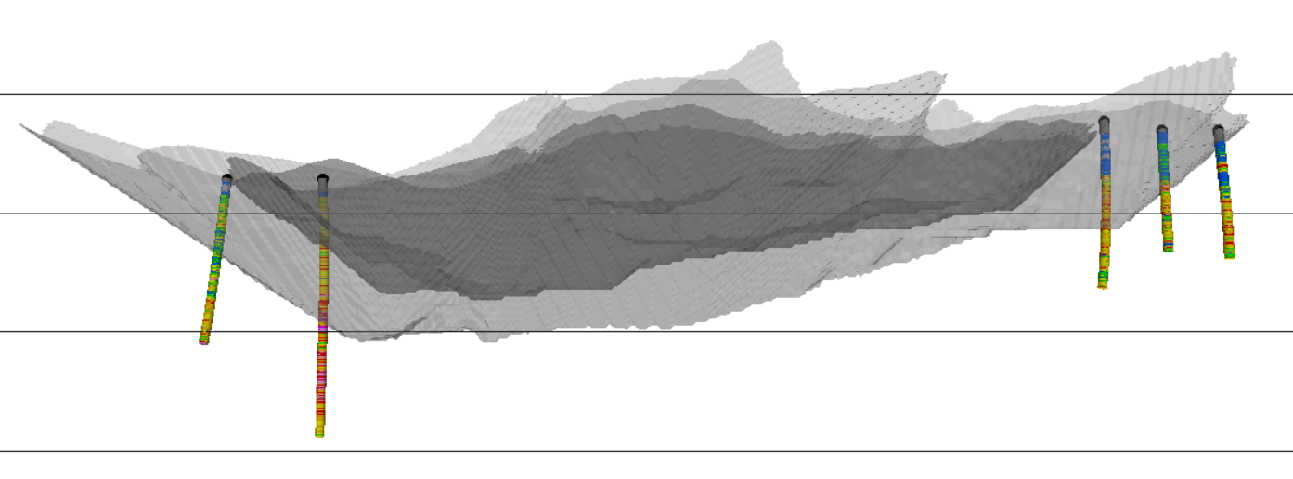
McEwen Copper
Los Azules, Mineralization Extending in 3 Directions: North, South & Deeper
To the North | AZ23241: over 400 m North of AZ22174 encountered 0.20% Cu over 202 m, with 0.44% Cu over the last 12 m
To the South | 0.20% to 0.30% Cu over long intercepts occur in the southern exploration holes AZ24338 intercepted 0.31% Cu over 70 m
At Depth | AZ22174: 0.29% Cu over 1,052 m incl. 0.42% Cu over 480 m coincides with a prominent deep geophysical anomaly
N
500 meters
S
4000
Elev
600 m
400 m
0.31% Cu / 70 m
3500
Elev
0.21% Cu / 276.3 m
0.29% Cu / 1052 m
Incl. 1.46% Cu / 26 m
0.23% Cu / 180 m
AZ24336CC
0.20% Cu / 202 m
AZ24338
AZ24339CC
3000
Elev
AZ23241
(740m)
0.42% Cu / 480 m
Legend:
2023 PEA base case mineable pit shell
Total resources unconstrained pit shell
AZ22174 (1,128m)
29
2500
Elev

Slide 30
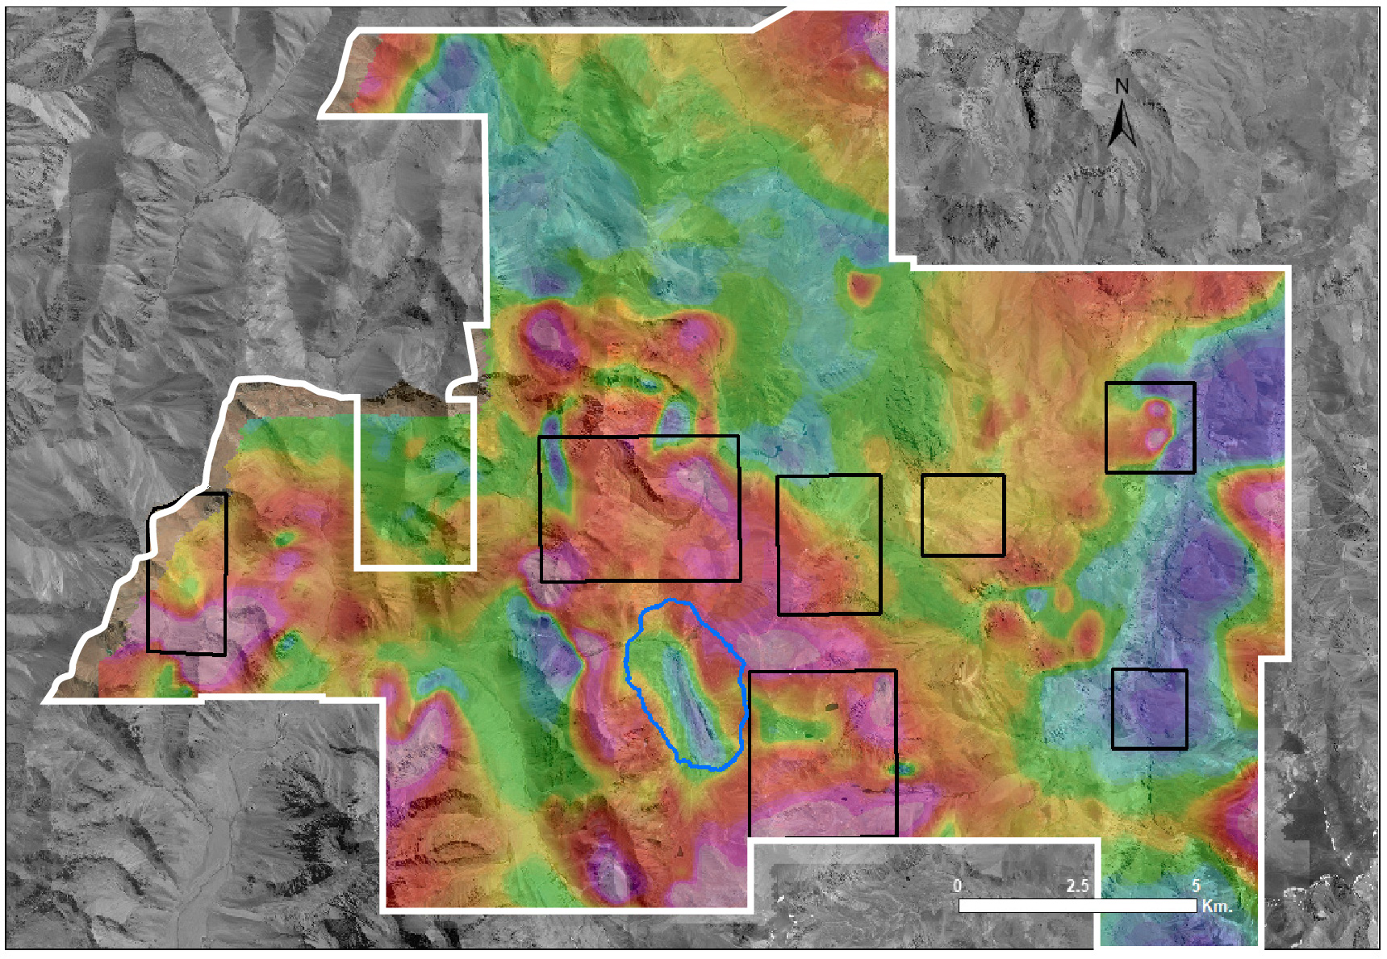

McEwen Copper
Potential for Additional Copper Resources Nearby – 7 New Exploration Targets
Helicopter MT
7 exploration targets with 5 key elements of large porphyry systems:
Multiple Intrusives
Porphyry Copper Alteration
Porphyry Copper Veining
Porphyry Geochemical Signatures
Geophysical Signature
Porfido Este
Porfido Norte
Las Leñas
Azufre Noreste
Mercedes
Los Azules
Pit Outline
Vetas Rio Cerrado
Tango
Total Magnetic Intensity (nT) Survey of Los Azules area ​
LOW
HIGH
30

Slide 31

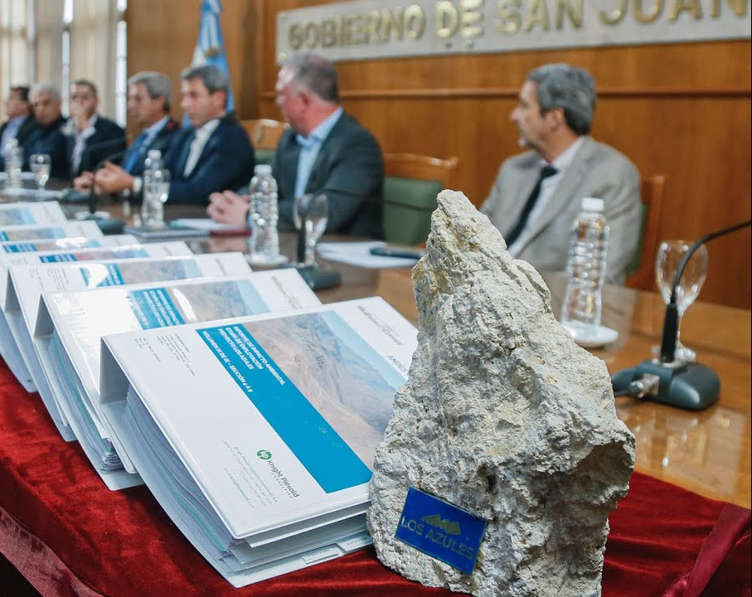
Los Azules:
Key Environmental Permit Approval – Received in December 2024
Los Azules received the approval of the Environmental Impact Statement (Environmental Permit) for construction and exploitation of the project.
This is the key permit granted by the province towards construction and future operation, a clear indicator of society's support of the future operation.
The environmental impact assessment (EIA) included a public consultation process and was evaluated by 14 organizations, public and private, provincial and national.
31
The EIA submitted in Apr 2023 was approved in Dec 2024

Slide 32
McEwen Copper: Significant Development Large Investment Incentive Regime (“RIGI”) Encouraging Foreign Investment in Argentina
Designed to attract foreign investment across multiple sectors in Argentina
RIGI includes mining, which is a key pillar to the country’s plans for economic growth
Key benefits:
Improved fiscal and financial benefits to mining companies developing large-scale projects in Argentina
Improved foreign exchange regime and ability to re-patriate capital¹
Stability on tax, customs and foreign exchange for a 30-year period
On February 11, 2025 McEwen Copper applied for admission of the Los Azules copper project to RIGI.
The RIGI fiscal and financial / tax benefits will result in a significant improvement to NPV & IRR for Los Azules.
Tax Benefits
Foreign Exchange
Other
Corporate tax rate of 25% (currently 35%)
Tax on dividends 3.5% after 7 years (currently 7%)
Accelerated depreciation on equipment and infrastructure
Unlimited loss carryforward
Unlimited interest deductions in first 5 years
Foreign technical services exempt from withholding tax
Export proceeds freely available abroad for big projects 100% 3 years after the start-up of the project¹ (currently 100% must be on-shored)
Financing proceeds freely available with no restriction to access AR foreign exchange when funds available abroad (currently with limitations)
Foreign exchange market freely accessible for repayment of loans, repatriation of investments, or payment of interest and dividends (currently in practice heavily restricted)
Exports: Freedom to export products, with exemption of duties after 3 years (currently 4.5%)
Construction VAT: Payable with tax credit certificate to be issued by the Government. Supplier can use or transfer (sell) the VAT credit to third parties
Imports: Freedom to import, with no quotas or restrictions, and exemption of duties on imports of capital goods (currently 0%-21%)
32
1. Prior to, 20% available after 1 year and 40% after 2 years.

Slide 33
Argentina Is Fast Becoming an Attractive Mining Investment Destination
1. | Dec 10, 2023 | - | Major Geopolitical Shift with the election of pro-business President Javier Milei
2. | July 8, 2024 | - | Large Foreign Investment Incentive Regime Approved – potential to significantly increase Los Azules NPV
3. | July 29, 2024 | - | BHP, World’s Largest Miner Completes US$4.5 Billion Copper Deal with Lundin Mining, consolidating the Filo del Sol & Josemaria Deposits in San Juan province, Argentina
4. | Aug 23, 2024 | - | United States Strengthens Relationship with Argentina by signing a Memorandum of Understanding to strengthen cooperation on critical minerals
5. | Oct 8, 2024 | - | Rio Tinto, World’s 2nd Largest Miner Buys Arcadium for US$6.7 billion for lithium mines in Argentina, Australia & Canada
6. | Nov 7, 2024 | - | Rio Tinto’s Nuton Technologies Options Aldebaran’s Altar Copper Deposit in San Juan province, Argentina. Nuton can acquire 20% by making staged payments totaling US$250 Million
7. | Dec 12, 2024 | - | Rio Tinto Announces $2.5 Billion Expansion of its Rincon Lithium Mine in Salta
8. | May 4, 2025 | - | Lundin Mining / BHP Announce New Cu, Au, Ag Resource for Vicuña JV, making it one of the largest copper resources on the planet
9. | Jun 10, 2025 | - | Argentina and France to Sign Deal on critical minerals and nuclear energy worth US$571 Million to strengthen industry resilience
33

Slide 34
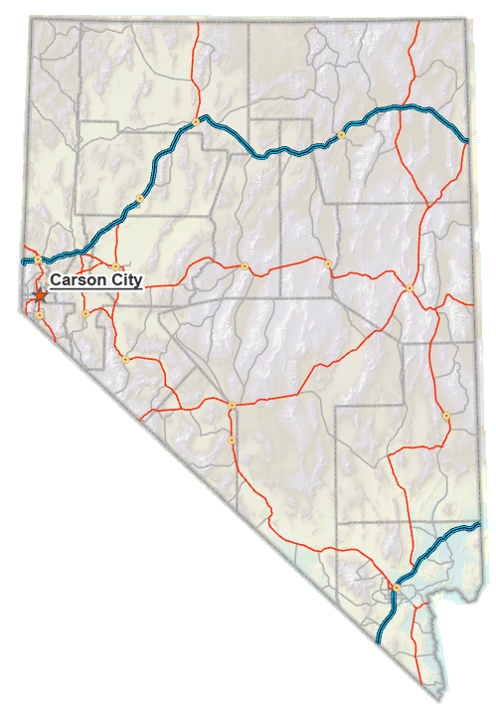
Nevada Exploration Projects | Location Map
Battle Mtn-Eureka Trend
Midas South
Projects in Northern Nevada
2025 Exploration Budget US$7 M
36,000 m drilling planned for 2025
Active Projects
Carlin-Type Deposits On Battle Mountain-Eureka Trend, South of Cortez:
Gold Bar Eureka
In High-Grade Epithermal Vein District, North of Lovelock:
Seven Troughs
Winnemucca
Seven Troughs
Elder Creek
Elko
Lovelock
Slaven
Cortez
Tonkin
Reno
New Pass
Gold Bar
Eureka
Eureka
N
Active Projects
Las Vegas
Inactive Projects
100 miles
34

Slide 35
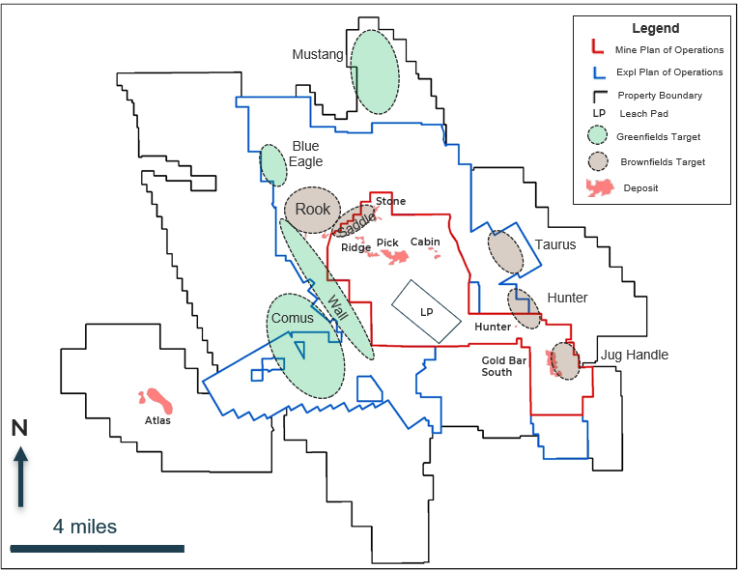
Gold Bar | Advancing Brownfields Targets in 2025
2024 Discovery Cost / oz $70
Dec 2024 Gold Bar Resources & Reserves¹:
221,900 oz Gold @ 0.64 g/t Proven & Probable
95,900 oz Gold @ 0.68 g/t Indicated
7,900 oz Gold @ 0.59 g/t Inferred
- 2024 Production 44,600 oz Gold
- Added 55,700 oz Gold in 2024 (net of production)
- Discovery cost per oz Gold: US$70
Near-Mine Targets
- Gold in Drill Intersections >1 g/t Gold at:
Taurus, Rook, Hunter, Saddle, Jug Handle
¹ Resources are presented exclusive of Reserves
35

Slide 36
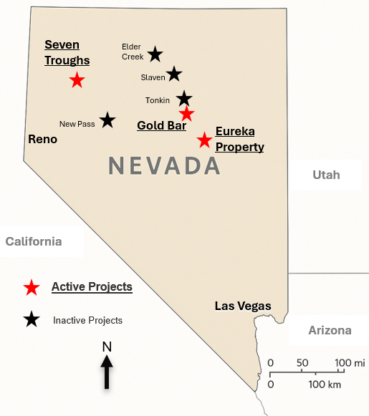
Eureka Property
Lookout and Windfall Projects
Ruby Hill Mine
i-80Gold Property
Located 30 miles from Gold Bar
2023 Lookout Resource (2024 acquisition from Timberline)
423 Koz Gold @ 0.017 oz/T (0.56g/t) Measured & Indicated
84 Koz Gold @ 0.011 oz/T (0.39g/t) Inferred
Windfall Potential
Open-Pit and underground oxide potential containing 100-200 Koz Gold @ 0.75-2 g/t
Past Production
154 Koz Gold @ 0.10-0.3 oz/T (3.4-20 g/t)
from Lookout and Windfall
2024 Drilling Program
Strong exploration results at Windfall
Eureka
(town)
Eureka Property
Map
McEwen Property
Mineralized Area
Windfall
Lookout
Mountain
N
4 km

Slide 37
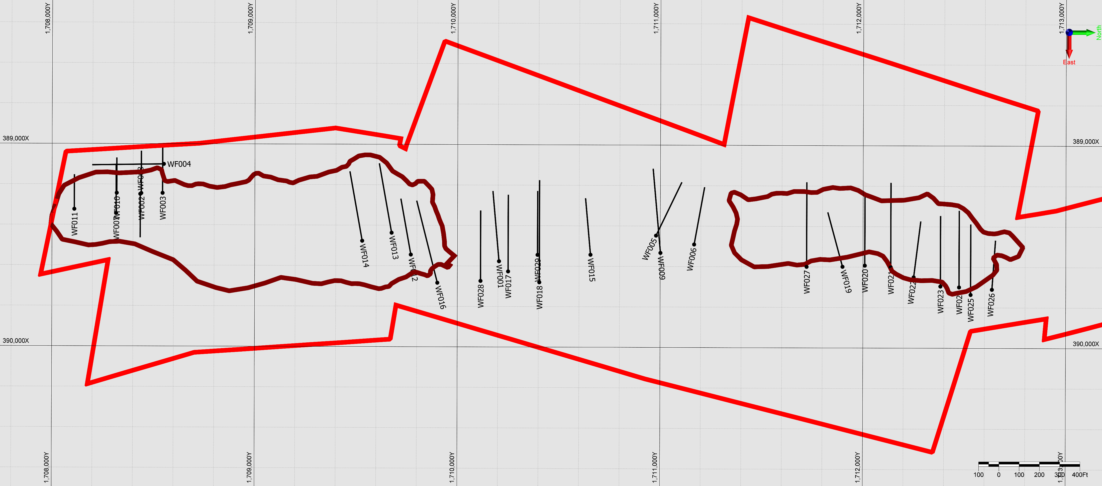
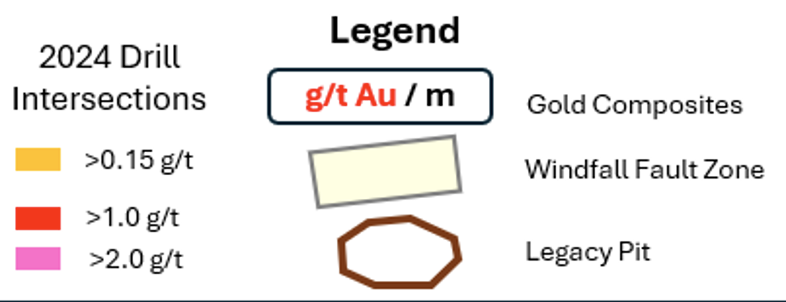
Eureka Property
Windfall Project
100-200 Koz Gold Open-Pit Oxide
Grading 0.75-2 g/t Au
Potential for:
Drill Results
Plan View
Patent Boundary
New Mineralized
Structure
WF030 1.19 / 10.1
and
3.24 / 6.6
Cross Section
Windfall Fault Zone
Rustler Pit
Windfall Pit
WF033 0.95 / 22.8
and
8.08 / 8.7
incl. 50.32 / 1.3
782 g/t Ag
15% Pb
2.5% Zn
WF031 1.2 / 17.1
incl. 3.45 / 2.9
WF032 2.00 / 38.3
incl. 6.05 / 5.4
200 Meters
~600 feet
N

Slide 38
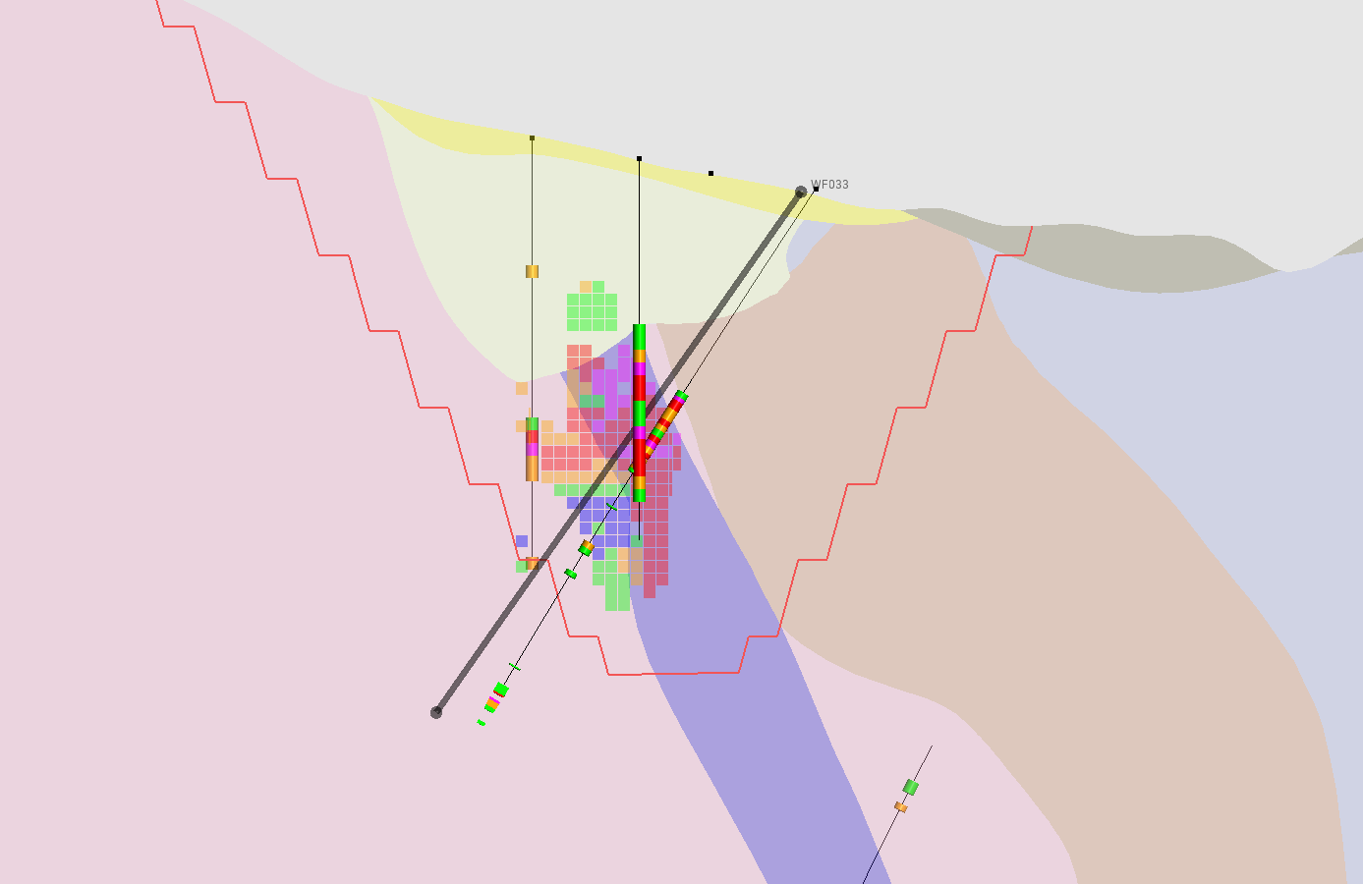
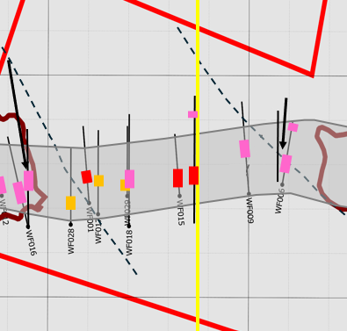
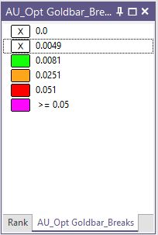
Eureka Property Cross-section of WF033 showing CRD + Carlin-style mineralization
Drill Section WF033
Looking Northt
WF033
Tertiary
Volcanics
Hamburg
Plan View
Dump
Dunderberg
Conceptual
Pit
Cross Section Line
Carlin-style
0.95 / 22.8
Windfall
Patent Boundary
Planned Hole
CRD-style
8.08 / 8.7
incl.
50.32 / 1.3
782 g/t Ag
15% Pb
2.5% Zn
Gold Composites
Windfall Fault Zone
100 Feet
g/t Au / m
Footwall Fault
30 Meters
CRD - Carbonate replacement deposit

Slide 39
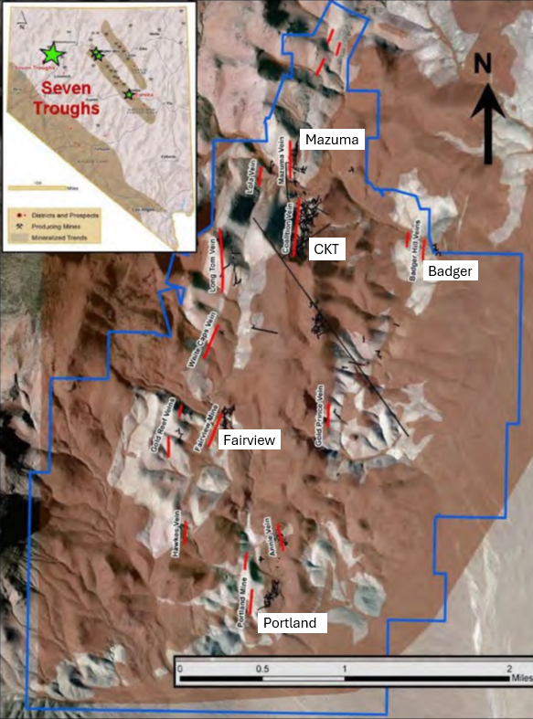
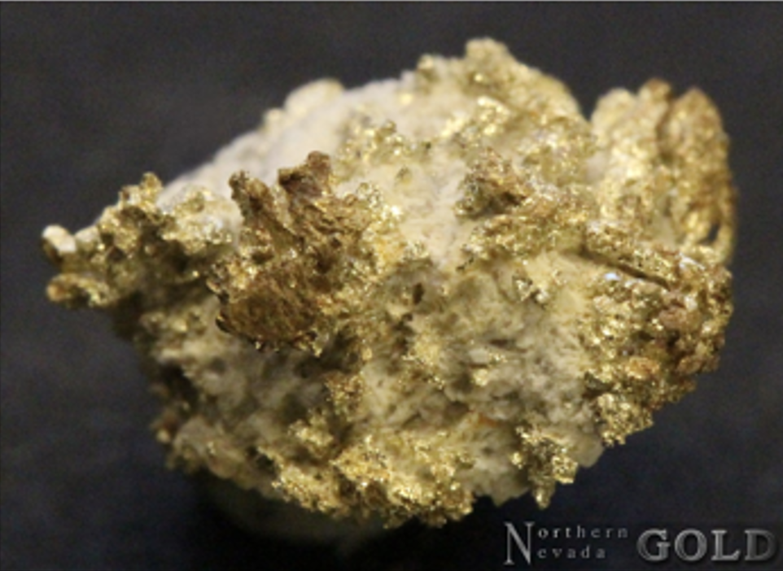
Seven Troughs Project
One of the highest-grade historical districts in Nevada: Early 1900's Gold Production @ avg. 1.2 oz/T (41 g/t)
High-Grade Epithermal Vein Mineralization:
>1 oz/T Gold left behind in flooded stopes @ 1,000 ft depth
>1 oz/T Gold in legacy drillholes
Near-Surface Mineralization
Exploration potential includes both underground and open-pit targets
Scale in Miles

Slide 40
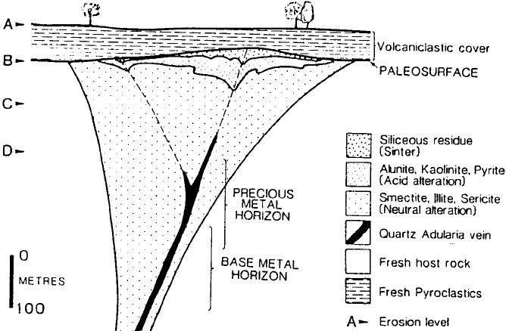





Seven Troughs Epithermal Deposit Model
CKT Target
Badger Hill Target
Hg
Hg
Depth of Historical Mining
As
Unaltered Cover
Silica/Opalite
ConceptualHigh-Grade Au Target
Advanced Clay Alt
Clay Alteration
Gold-Quartz Vein
~300 m
Unaltered

Slide 41
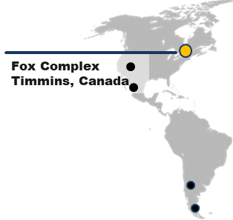
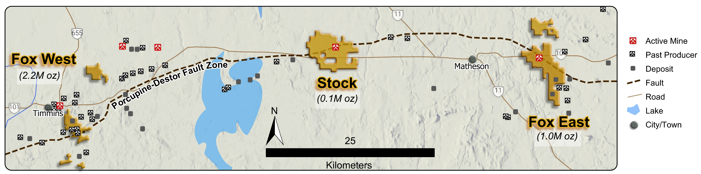
Growing Resource Base in the Timmins Camp
(Which has historically produced 70 M oz Gold)
Fox Complex
Production to Date: 3.3 M oz Gold
Resources: 2.2 M oz Gold M+I @ 3.64 g/t & 0.8 M oz Gold Inferred @ 3.18 g/t
Primary & Secondary Structural Controls: >30 km
2025 Exploration Budget: US$10 M (2024 Discovery Cost / oz $15)
2.2 M oz Au Production
0.1 M oz Au Production
>1 M oz Au Production

Slide 42
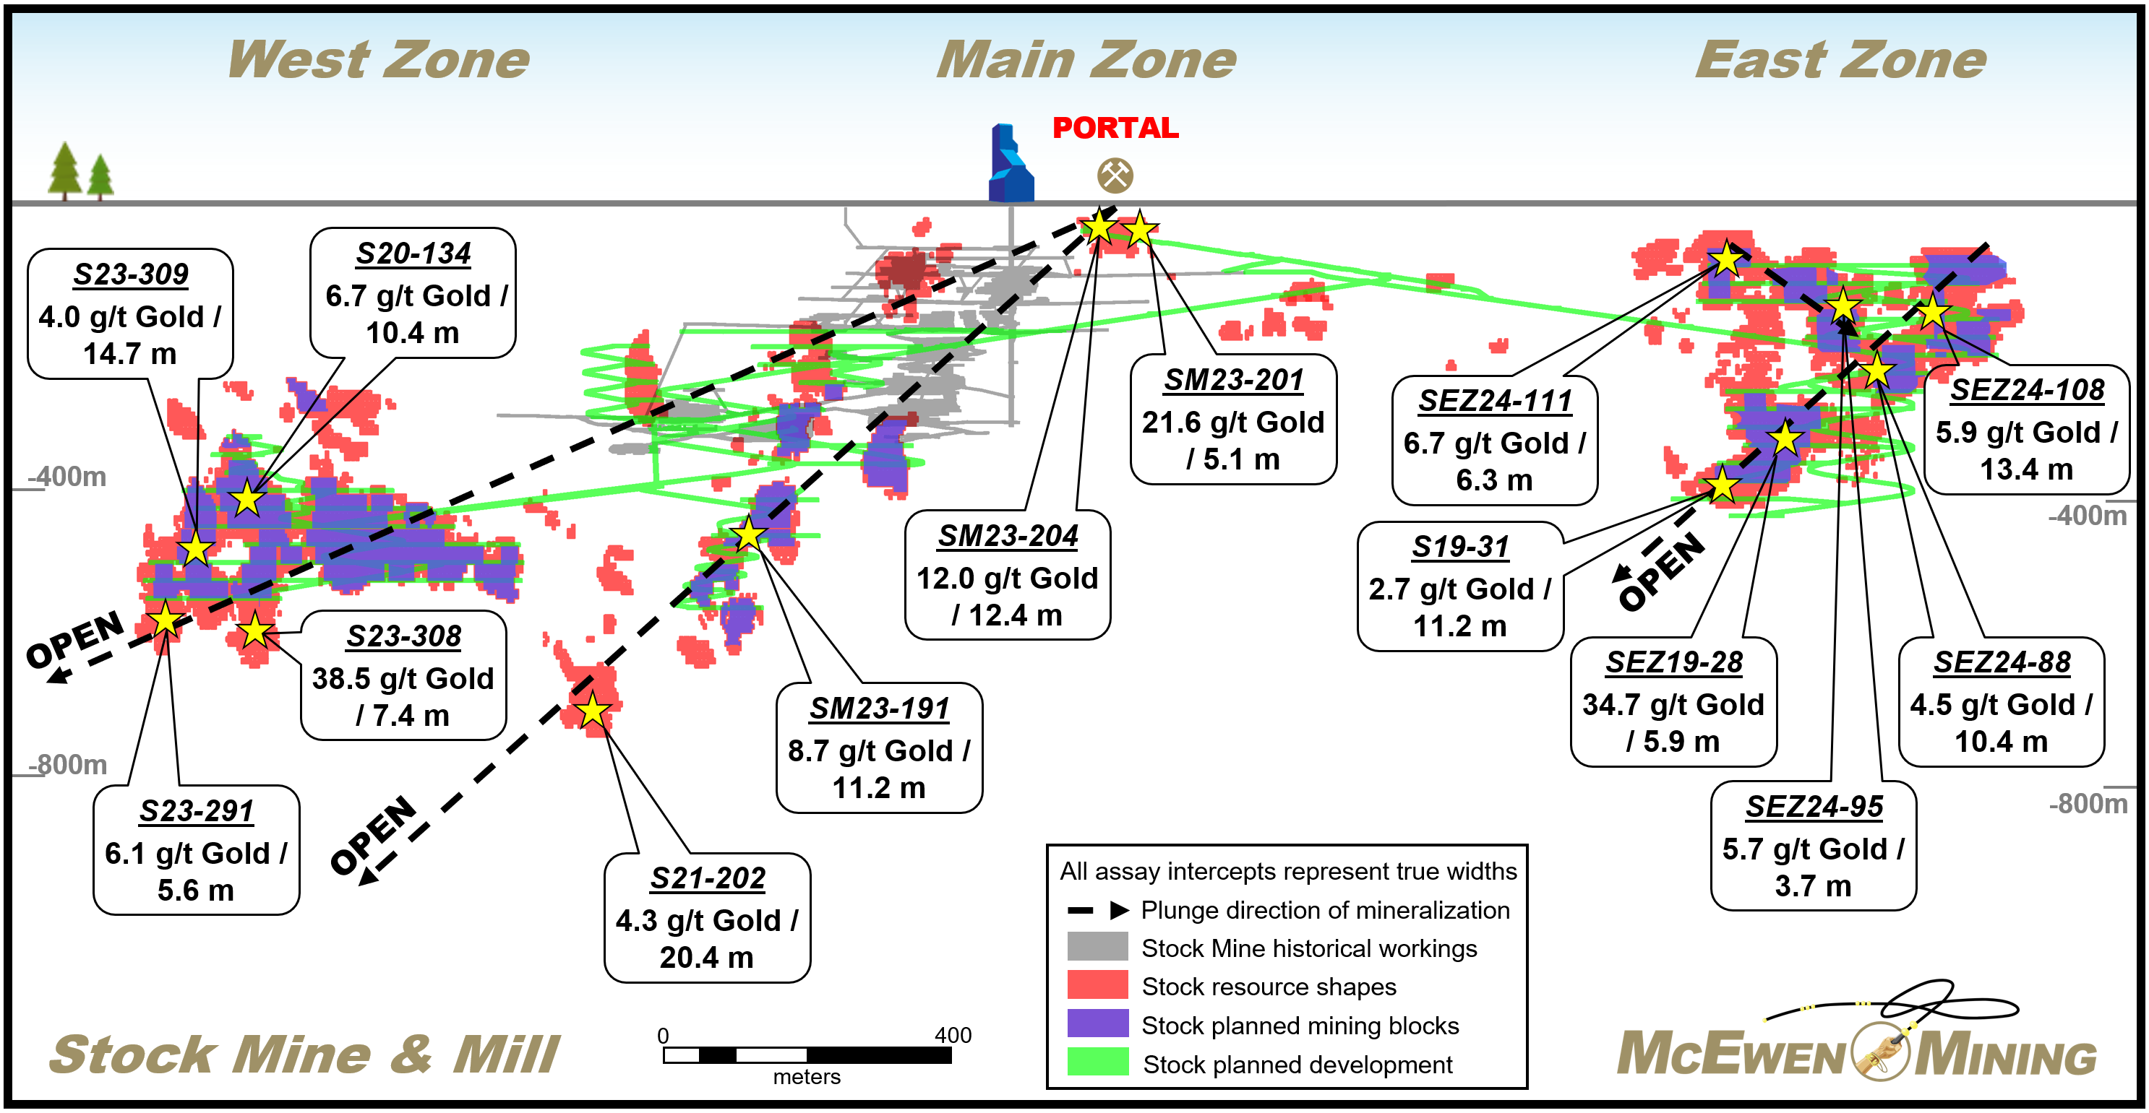
Stock Project | Estimated Resources and Exploration Potential
Stock Gold Resources¹
Indicated
West & Main 206,000 oz Au @ 3.31 g/t
East 75,000 oz Au @ 2.70 g/t
Total Indicated 281,000 oz Au @ 3.12 g/t
Inferred
West & Main 132,000 oz Au @ 2.96 g/t
East 50,000 oz Au @ 2.66 g/t
Total Inferred 181,000 oz Au @ 2.87 g/t
¹ Numbers may not sum due to rounding

Slide 43
Fox Complex: Stock Mine Portal

Slide 44
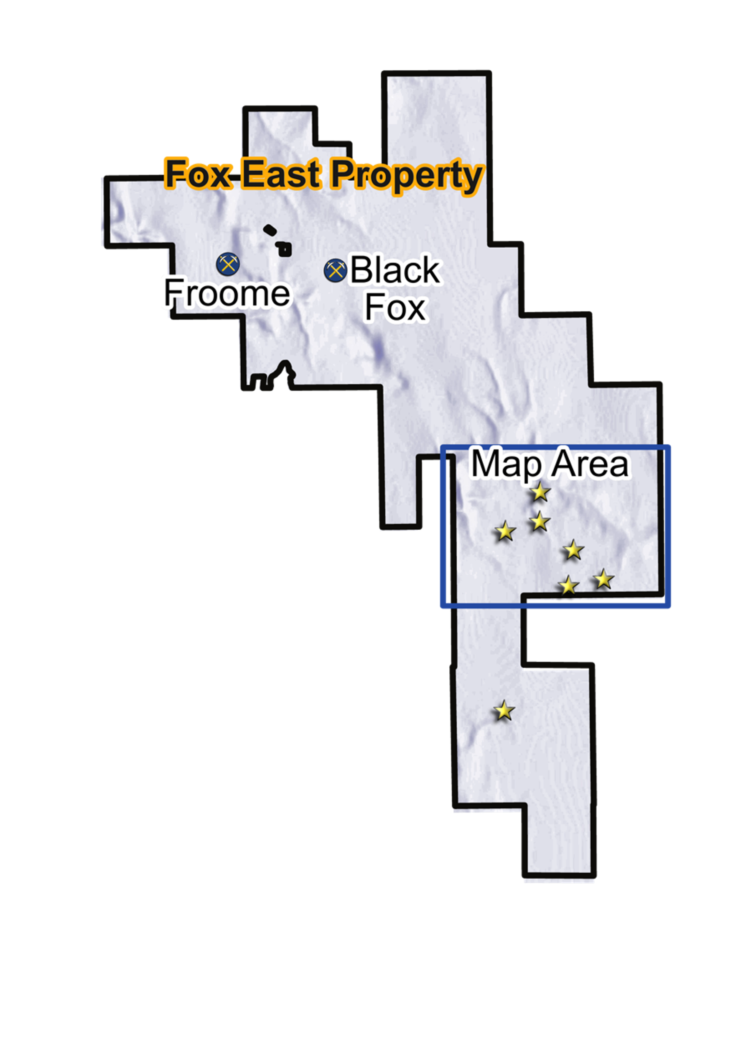
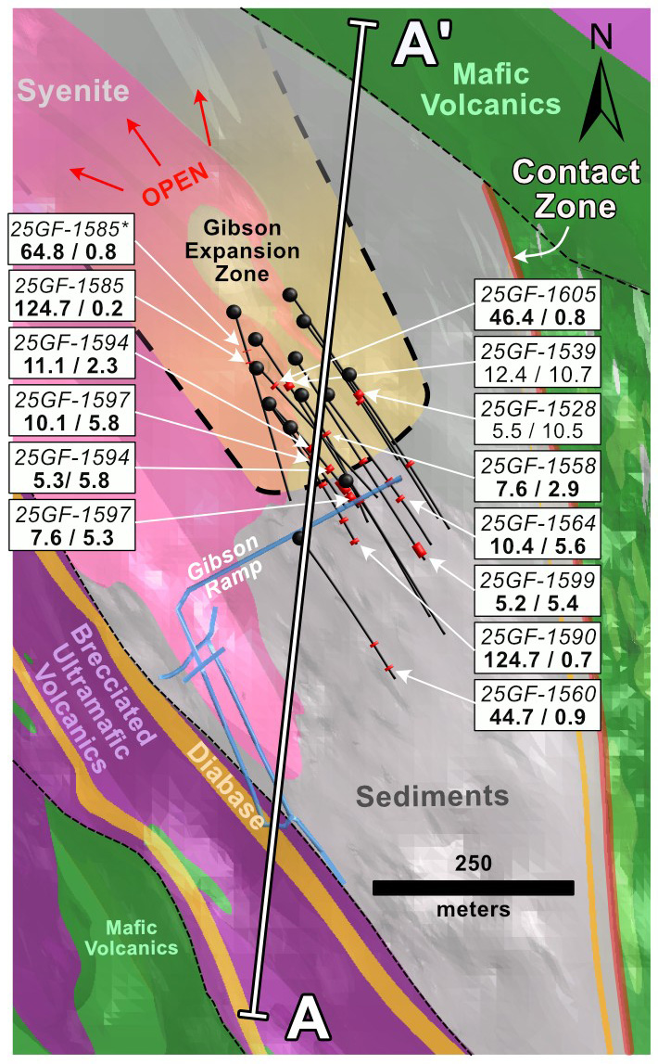
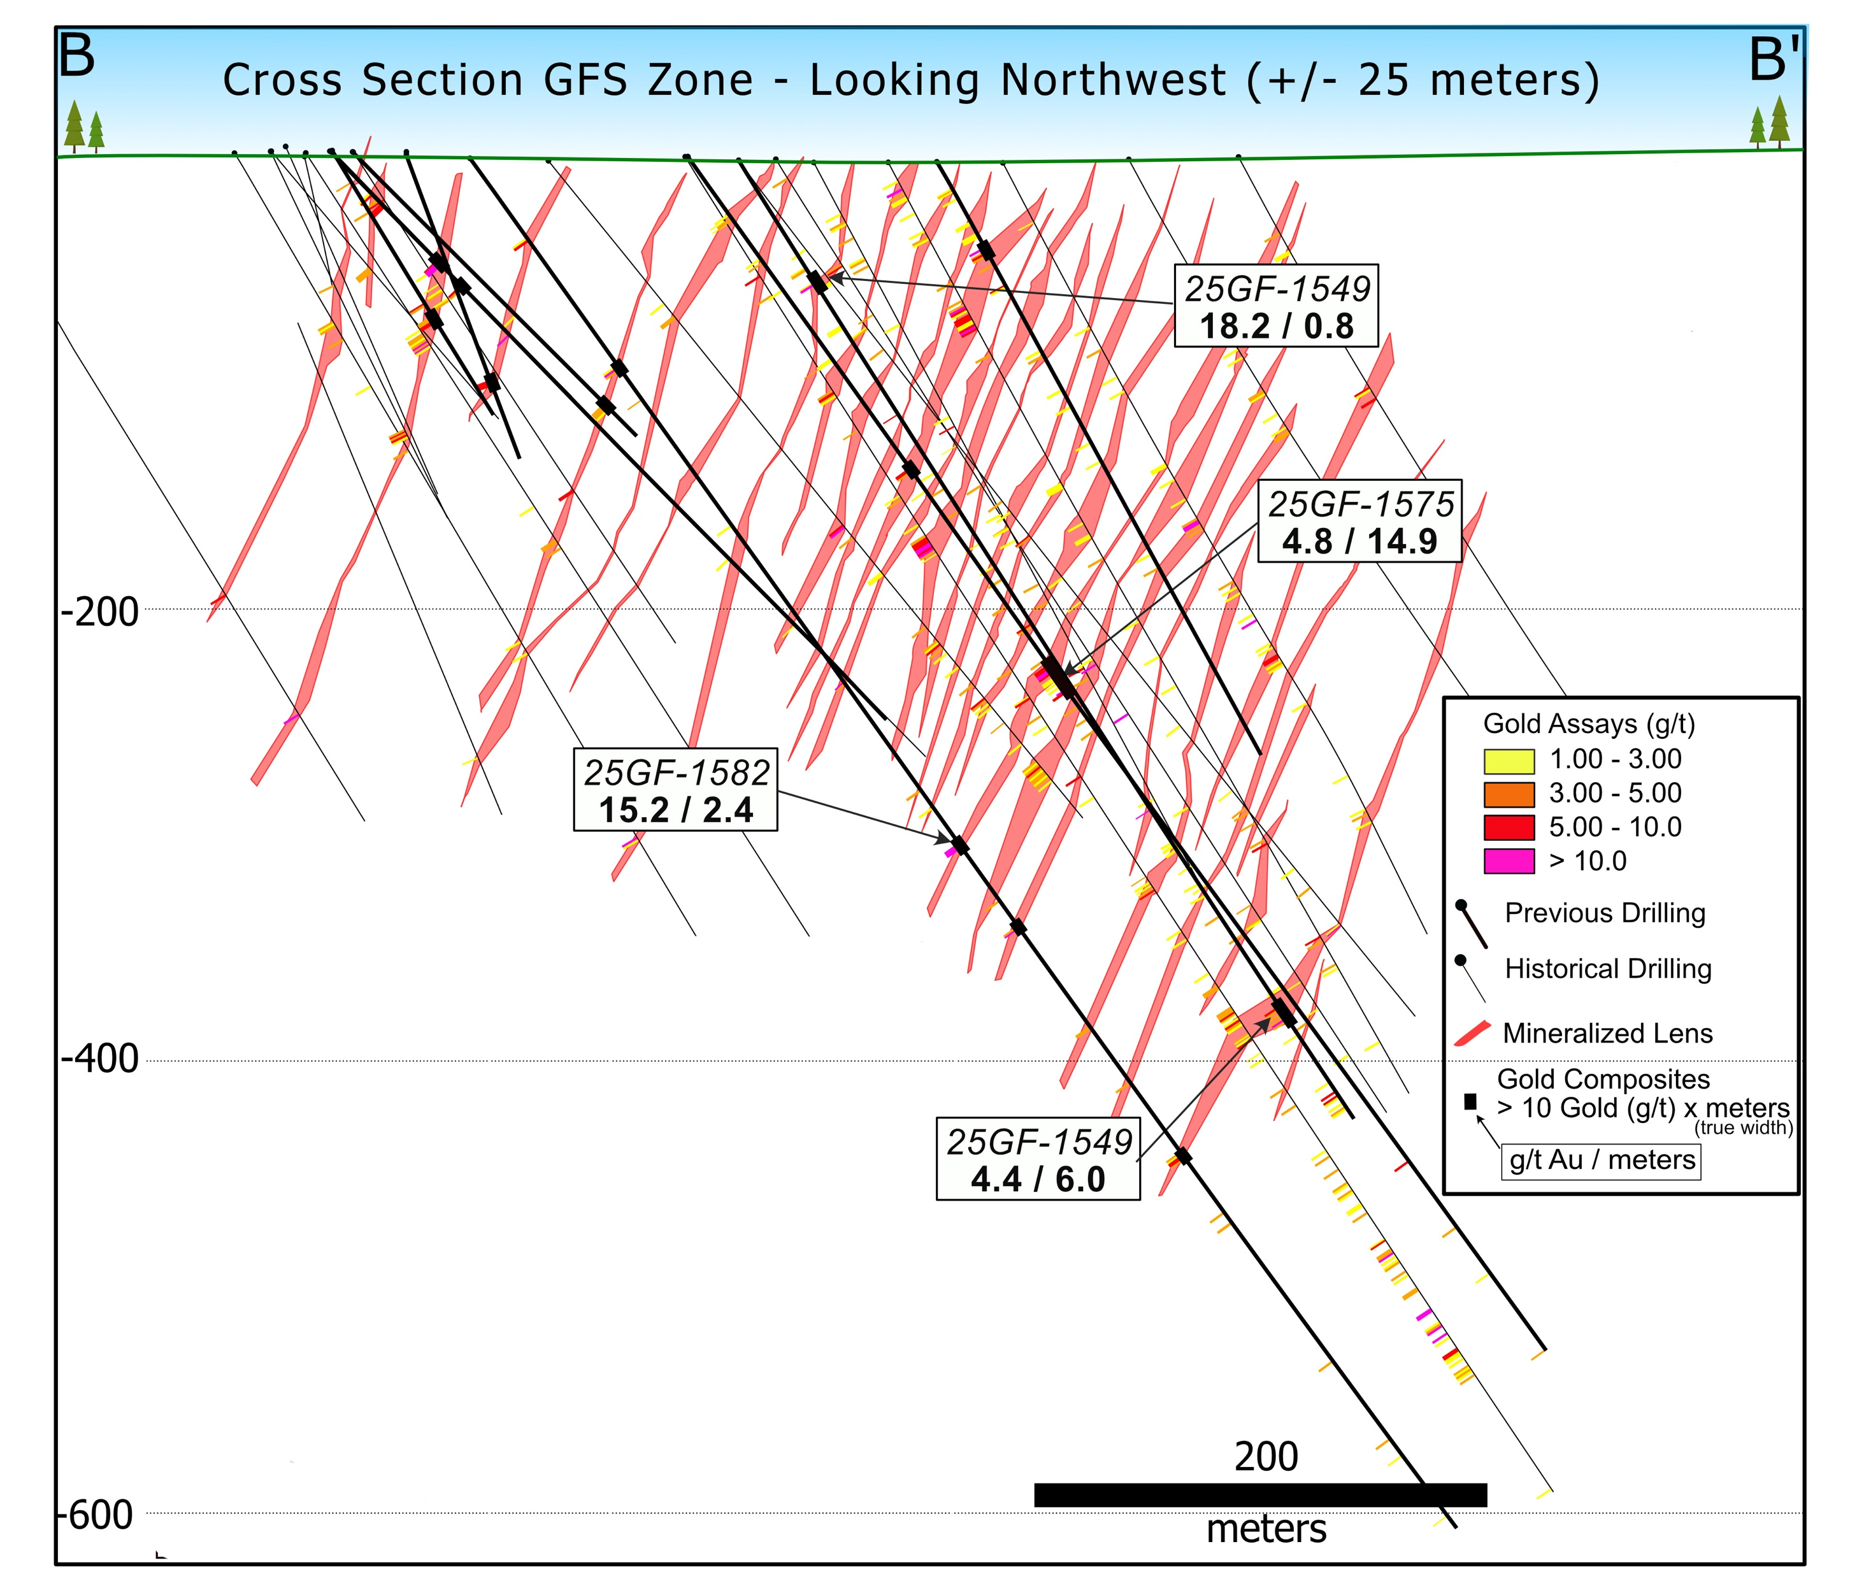
Grey Fox | A 2 Million oz Gold Deposit
Fox Complex
Hole ID | Gold Grade (g/t) | True Width (m) | Notes
25GF-1597 | 10.1 | 5.8 | High-grade vein, good continuity
25GF-1564 | 10.4 | 5.6 | Within the Gibson Expansion Zone
25GF-1575 | 4.8 | 14.9 | Broad mineralized zone
25GF-1549 | 4.4 | 6.0 | Confirming mineable grades and widths
25GF-1597
10.1 / 5.8
Stroud
25GF-1564
10.4 / 5.6
25GF-1575
4.8 / 14.9
25GF-1549
4.4 / 6.0
44
All assay intervals represent true widths.

Slide 45
Appendix
45

Slide 46












McEwen Inc.’s Management Team
Rob McEwen
CHIEF OWNER AND CHAIRMAN
William Shaver
CHIEF OPERATING OFFICER AND BOARD DIRECTOR
Perry Ing
CHIEF FINANCIAL OFFICER
Carmen Diges
GENERAL COUNSEL & SECRETARY
Michael Meding
VICE PRESIDENT AND GENERAL MANAGER - MCEWEN COPPER
Stefan Spears
VICE PRESIDENT - CORPORATE DEVELOPMENT
Jeff Chan
VICE PRESIDENT - FINANCE
Adrian Blanco S. DIRECTOR - AMERICA AND MEXICO OPERATIONS
Rory Greyvensteyn
DIRECTOR OF OPERATIONS CANADA
David Tyler
PROJECT DIRECTOR MCEWEN COPPER
Luke Willis
DIRECTOR
RESOURCE MODELLING
Kevin Bromfield
PROJECT DIRECTOR
GREY FOX
46
Notes:
Appendix

Slide 47
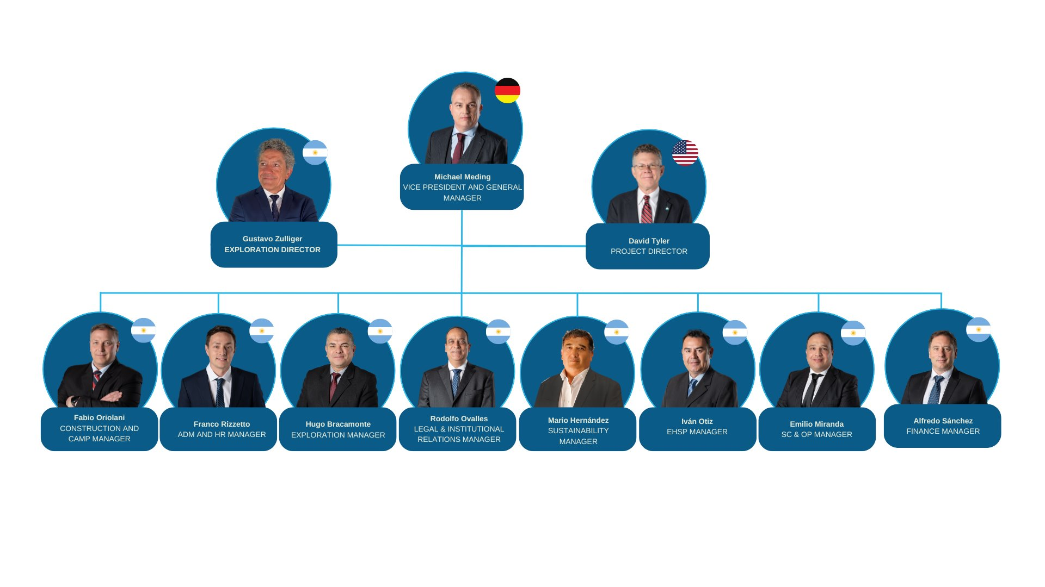







McEwen Copper’s Los Azules Management Team Deep Experience Plus a Track Record of Success in the San Juan Province
Over 250 years’ combined experience at top tier mining projects & operations in San Juan, Argentina, with major mining companies such as:
47
Notes:
Appendix

Slide 48
McEwen Copper’s Los Azules Project
Los Azules 2023 PEA Mineral Resources Estimate
 | Tonnes | Avg Cu Grade | Contained Metal
Indicated | 1.2 B | 0.40% | 10.9 B lbs Cu
Inferred | 4.5 B | 0.31% | 26.7 B lbs Cu
Since the 2023 PEA resource estimate was released, over 100,000 meters of additional drilling have been completed. Drilling was focused on upgrading the resource classification from Inferred to Indicated and from Indicated to Measured.
Updated resource estimate and Feasibility Study Q3 2025.
48
Notes:
Appendix

Slide 49

Los Azules vs. Comparably Sized Conventional Copper Mines
Low Cost / lb¹
Low Cost/ lb
Los Azules to be in the bottom quartile of the copper production C1 cash cost curve @ US$1.07/ lb Cu
Renewable Energy
Powered by 100% renewable energy sources
Reduced Water Consumption
Using less than ¼ of the water consumed by a comparable conventional copper mine
Processing
Heap leach producing green copper cathode.
No transport to smelter significantly reduces associated carbon emissions
No Tailings or Tailings Dam
Use of heap leach technology eliminates the need for tailings and tailings dams, addressing key environmental and safety concerns
Reduced to Zero Carbon
Ongoing efforts to reduce emissions, with a transition to carbon neutrality by 2038
25%
50%
75%
Los Azules
to be in the
bottom quartile
of the cost curve
@ US$1.07/ lb Cu
(2023 PEA Base Case)
Less Carbon²
Los Azules
2023 PEA Base Case
Los Azules
2017 PEA
Mara
El Pachon
Josemaria
49
Total Carbon Intensity per Asset (CO₂ kg/ t CuEq)
1. Wood Mackenzie 2023E Copper C1 Cash Cost Curve (Co-Product) 2. Wood Mackenzie. Source: Company disclosure.

Slide 50
Copper Heap Leach Mining Is Not New and Works at High Altitudes
Mine | Country | Operator | When | Max. Annual Production* (Cu tonnes) | MASL
Quebrada Blanca (QB1) | Chile | Teck | 1994-2023 | 87,000 | 4,400 m
Spence | Chile | BHP | 2006-present | 249,000 | 1,700 m
Lomas Bayas | Chile | Glencore | 1998-present | 72,700 | 1,200 m
El Abra | Chile | Freeport | 1996-present | 98,400 | 3,900 m
Radomiro Tomic | Chile | Codelco | 1998-present | 300,000 | 3,000 m
Cerro Verde | Peru | Freeport | 1976-present | 91,000 | 2,700 m
Morenci | USA | Freeport | 1937-present | 400,000 | 750 m
Bagdad | USA | Freeport | 1970-present | 77,000 | 800 m
Caserones | Chile | Lundin | 2014-present | 35,000 | 4,600 m
Los Bronces | Chile | Anglo | 2002-present | 43,000 | 3,500 m
50
*from Heap Leach + SX/EW only

Slide 51

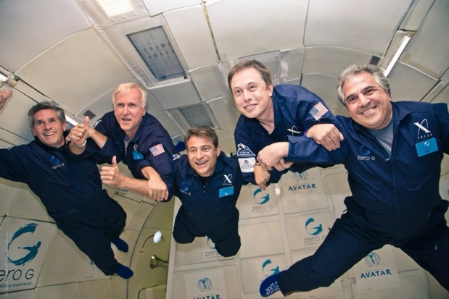
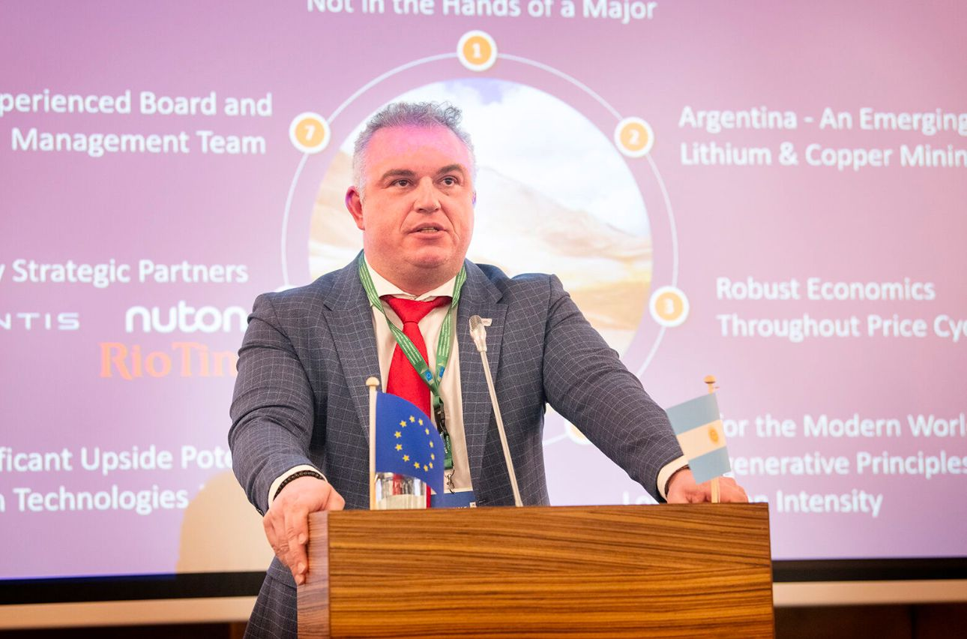
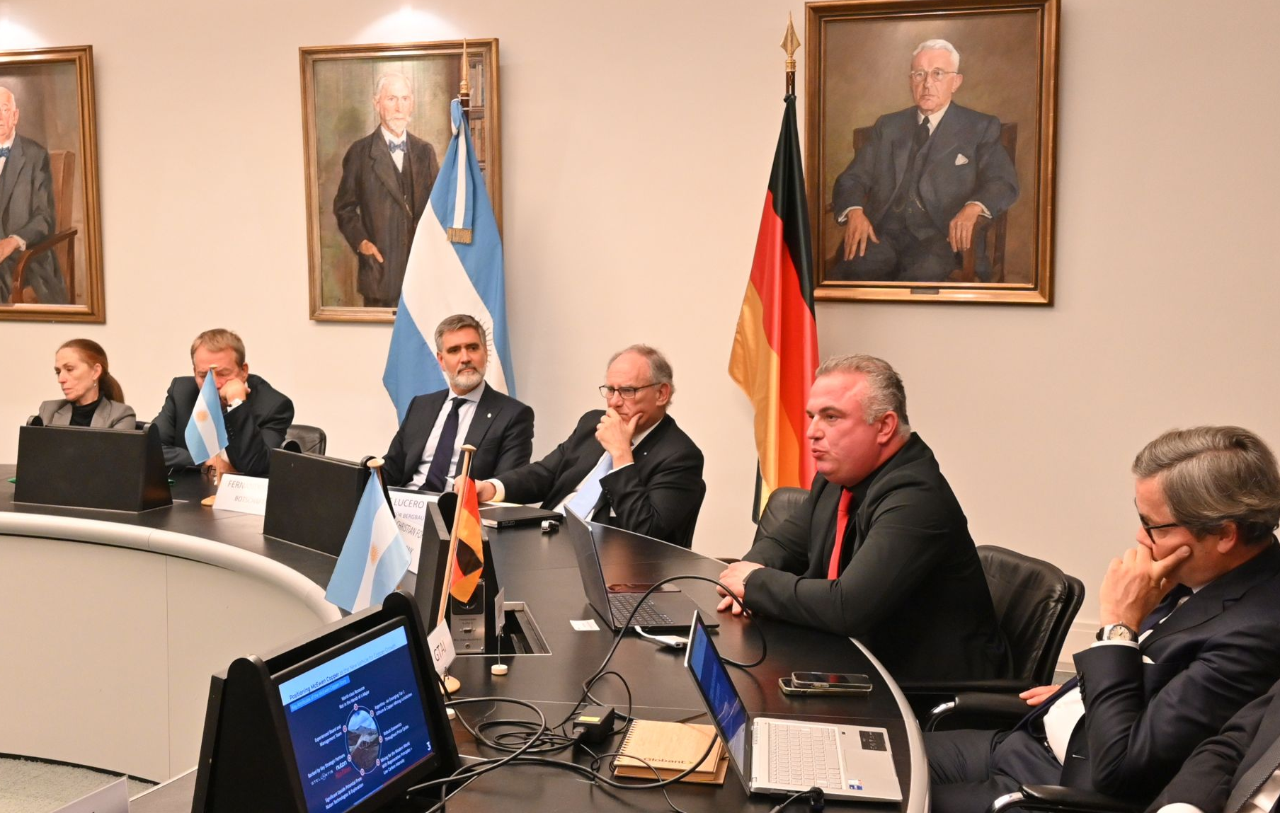
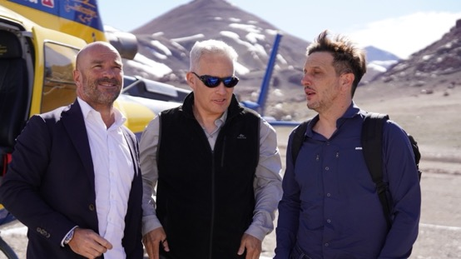



McEwen Inc. and McEwen Copper Global Leadership and Strategic Engagements
Michael Meding, President Milei, Rob McEwen
Rob McEwen with Elon Musk at the G Zero flight
Michael Meding, EU Raw Materials Week, Brussels
Michael Meding, Latin America Day, Hamburg
Visit of EU Ambassador Amador Sanchez Rico
Elon Musk, President Milei, President Trump
Rob McEwen, Paris Peace Forum Panel
Rob McEwen, Future Minerals Forum Saudi Arabia
Source: https://www.argentina.gob.ar/noticias/javier-milei-insto-unirse-para-hacer-frente-la-barbarie-y-formar-una-alianza-de-naciones
51
Notes:
Appendix

Slide 52
McEwen Inc.: Cautionary Note Regarding Non-GAAP Measures
In this presentation, we have provided information prepared or calculated according to U.S. GAAP, as well as provided some non-U.S. GAAP ("non-GAAP") performance measures. Because the non-GAAP performance measures do not have any standardized meaning prescribed by U.S. GAAP, they may not be comparable to similar measures presented by other companies.
Cash Costs per GEO, C1 costs per copper pound, and All-in Sustaining Costs (“AISC”) per GEO or copper pound
Cash costs consist of mining, processing, on-site general and administrative costs, community and permitting costs related to current explorations, royalty costs, refining and treatment charges, sales costs, export taxes and operational stripping costs, but exclude non-cash depreciation and amortization. C1 costs consist of mining, processing, on-site general and administrative costs, and sales costs. All-in sustaining cash costs consist of cash costs (as described above), plus accretion of retirement obligations, amortization of the asset retirement costs related to operating sites, sustaining exploration and development costs, sustaining capital expenditures and sustaining lease payments.
For both cash costs and all-in sustaining costs we include our attributable share of cash costs from operations where we hold less than a 100% economic share in the production, such as MSC, where we hold a 49% interest. Cash cost and all-in sustaining cash cost per GEO or copper pound sold are calculated on a co-product basis by dividing the respective proportionate share of the total cash costs and all-in sustaining cash costs for the period attributable to each metal by the units of each respective metal sold. We use and report these measures to provide additional information regarding operational efficiencies both on a consolidated and an individual mine basis, and believe that these measures provide investors and analysts with useful information about our underlying costs of operations.
52

Slide 53
Notes:
53

Slide 54
Thank you!
Stefan Spears
Vice President Corporate Development
McEwen Inc.
Direct: (647) 408-1849
Email: stefan@mcewenmining.com
Michael Meding
Vice President and General Manager
McEwen Copper
Direct: (775) 375-7125
Email: mmeding@mcewenmining.com

