Slide 1
MINING forum Americas
Beyers Nel, CEO
15 September 2025
Notes:
Slide 1:
Good day, ladies and gentlemen. I’m Beyers Nel, Chief Executive Officer of Harmony.
It is a privilege to be here, alongside industry leaders, investors, and partners who share our passion for creating sustainable value in mining.

Slide 2
Safe harbour statement
Disclaimer – Forward Looking Statements
This presentation contains forward-looking statements within the meaning of the safe harbour provided by Section 21E of the Exchange Act and Section 27A of the Securities Act of 1933, as amended (the “Securities Act”), with respect to our financial condition, results of operations, business strategies, operating efficiencies, competitive positions, growth opportunities for existing services, plans and objectives of management, markets for stock and other matters. These forward-looking statements, including, among others, those relating to our future business prospects, revenues, and the potential benefit of acquisitions (including statements regarding growth and cost savings) wherever they may occur in this presentation, are necessarily estimates reflecting the best judgment of our senior management and involve a number of risks and uncertainties that could cause actual results to differ materially from those suggested by the forward-looking statements. As a consequence, these forward-looking statements should be considered in light of various important factors, including those set forth in our integrated annual report. All statements other than statements of historical facts included in this presentation may be forward-looking statements. By their nature, forward-looking statements involve risk and uncertainty because they relate to future events and circumstances and should be considered in light of various important factors, including those set forth in this disclaimer. Readers are cautioned not to place undue reliance on such statements. Important factors that could cause actual results to differ materially from estimates or projections contained in the forward-looking statements include, without limitation: overall economic and business conditions in South Africa, Papua New Guinea, Australia and elsewhere; the impact from, and measures taken to address, Covid-19 and other contagious diseases, such as HIV and tuberculosis; high and rising inflation, supply chain issues, volatile commodity costs and other inflationary pressures exacerbated by the geopolitical risks; estimates of future earnings, and the sensitivity of earnings to gold and other metals prices; estimates of future gold and other metals production and sales; estimates of future cash costs; estimates of future cash flows, and the sensitivity of cash flows to gold and other metals prices; estimates of provision for silicosis settlement; increasing regulation of environmental and sustainability matters such as greenhouse gas emission and climate change, and the impact of climate change on our operations; estimates of future tax liabilities under the Carbon Tax Act (South Africa); statements regarding future debt repayments; estimates of future capital expenditures; the success of our business strategy, exploration and development activities and other initiatives; future financial position, plans, strategies, objectives, capital expenditures, projected costs and anticipated cost savings and financing plans; estimates of reserves statements regarding future exploration results and the replacement of reserves; the ability to achieve anticipated efficiencies and other cost savings in connection with, and the ability to successfully integrate, past and future acquisitions, as well as at existing operations; our ability to complete ongoing and future acquisitions; fluctuations in the market price of gold and other metals; the occurrence of hazards associated with underground and surface gold mining; the occurrence of labour disruptions related to industrial action or health and safety incidents; power cost increases as well as power stoppages, fluctuations and usage constraints; ageing infrastructure, unplanned breakdowns and stoppages that may delay production, increase costs and industrial accidents; supply chain shortages and increases in the prices of production imports and the availability, terms and deployment of capital; our ability to hire and retain senior management, sufficiently technically-skilled employees, as well as our ability to achieve sufficient representation of historically disadvantaged persons in management positions or sufficient gender diversity in management positions or at Board level; our ability to comply with requirements that we operate in a sustainable manner and provide benefits to affected communities; potential liabilities related to occupational health diseases; changes in government regulation and the political environment, particularly tax and royalties, mining rights, health, safety, environmental regulation and business ownership including any interpretation thereof; court decisions affecting the mining industry, including, without limitation, regarding the interpretation of mining rights; our ability to protect our information technology and communication systems and the personal data we retain; risks related to the failure of internal controls; the outcome of pending or future litigation or regulatory proceedings; fluctuations in exchange rates and currency devaluations and other macroeconomic monetary policies, as well as the impact of South African exchange control regulations; the adequacy of the Group’s insurance coverage; any further downgrade of South Africa’s credit rating and socio-economic or political instability in South Africa, Papua New Guinea, Australia and other countries in which we operate; changes in technical and economic assumptions underlying our mineral reserves estimates; geotechnical challenges due to the ageing of certain mines and a trend toward mining deeper pits and more complex, often deeper underground, deposits; and actual or alleged breach or breaches in governance processes, fraud, bribery or corruption at our operations that leads to censure, penalties or negative reputational impacts.
The foregoing factors and others described under “Risk Factors” in our Integrated Annual Report (www.har.co.za) and our Form 20-F should not be construed as exhaustive. We undertake no obligation to update publicly or release any revisions to these forward-looking statements to reflect events or circumstances after the date of this annual report or to reflect the occurrence of unanticipated events, except as required by law. All subsequent written or oral forward-looking statements attributable to Harmony or any person acting on its behalf are qualified by the cautionary statements herein. Any forward-looking statements contained in these financial results have not been reviewed or reported on by Harmony's external auditors.
Competent Person’s statement
The Mineral Resource and Ore Reserve figures published in this presentation are updated as at 30 June 2025. Harmony confirms that it is not aware of any new information or data that materially affects the information included in the statement, in the case of Mineral Resources or Mineral Reserves, that all material assumptions and technical parameters underpinning the estimates in the original release continue to apply and have not materially changed. Harmony confirms that the form and context in which the competent person’s findings are presented have not been materially modified from the original release.
Notes:
Slide 2:
Before we begin, please take note of our Safe Harbour Statement.

Slide 3
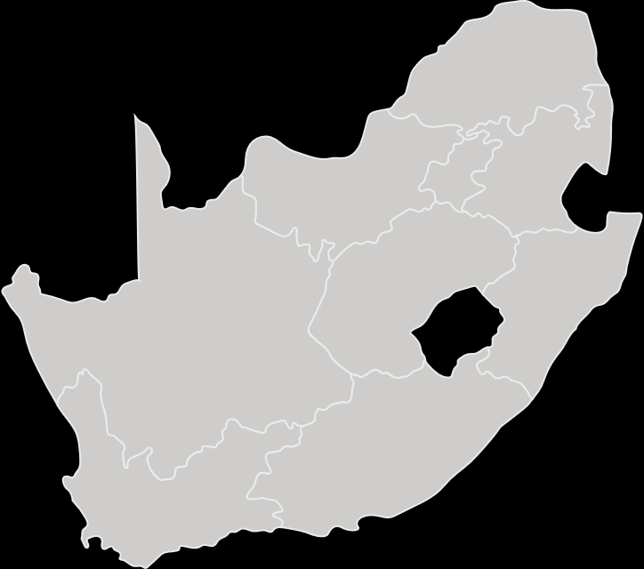
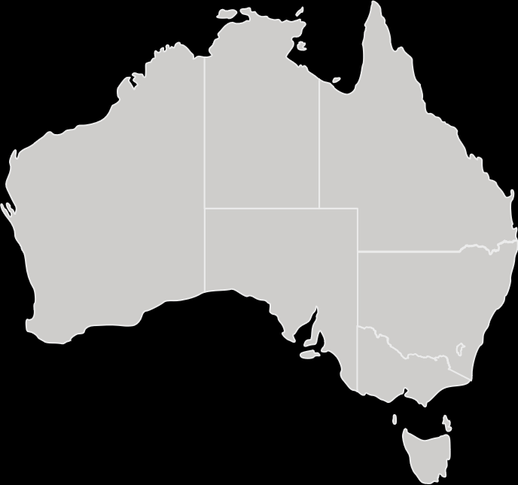
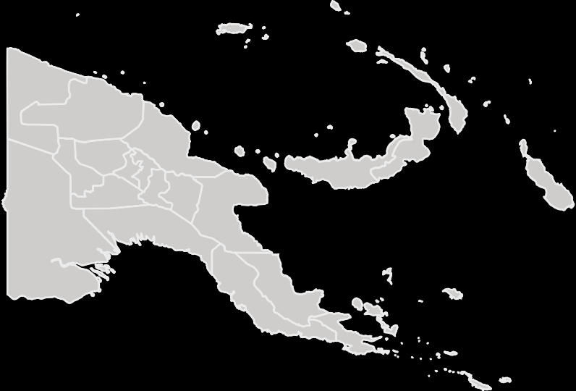










Discovering, developing and delivering metals that sustain the world
Our value proposition: Gold mining specialists with a growing international copper footprint
South Africa
Australia
Papua New Guinea
Pending MAC Copper transaction finalisation
SA underground
high-grade
operations
SA underground optimised
We mine with purpose
Surface
operations
International
copper-gold growth projects
Embedded sustainability | Disciplined, effective capital allocation | Higher-grade, long-life gold assets and adding copper | Operational excellence | Deliver cash flows through cycles | Value-accretive acquisition that enhance portfolio
Notes:
Slide 3:
Harmony is an industry leader and gold mining specialist with a growing copper footprint.
Our company is built on purpose and positioned for the future.
With operations in South Africa, Papua New Guinea and Australia, we are not just mining ounces.
We are discovering, developing and delivering critical metals that sustain the world.

Slide 4
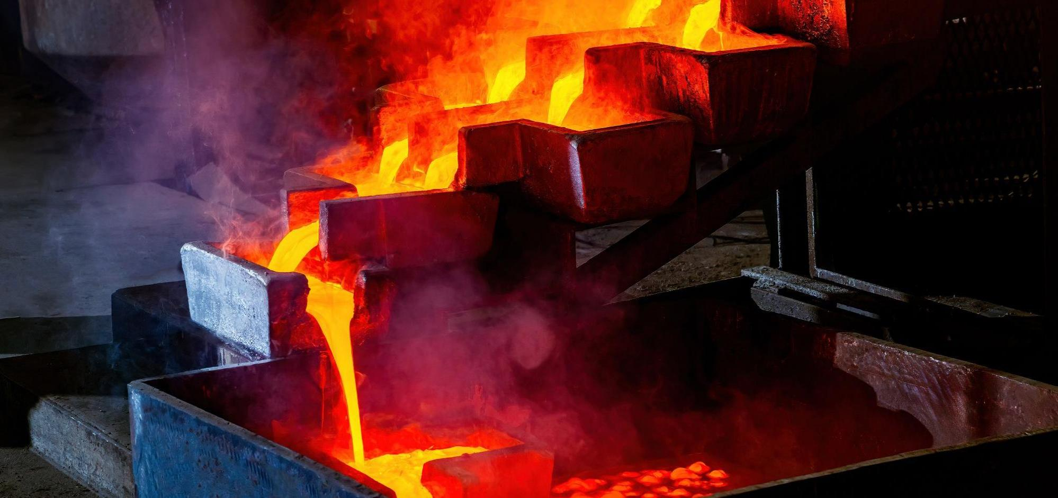

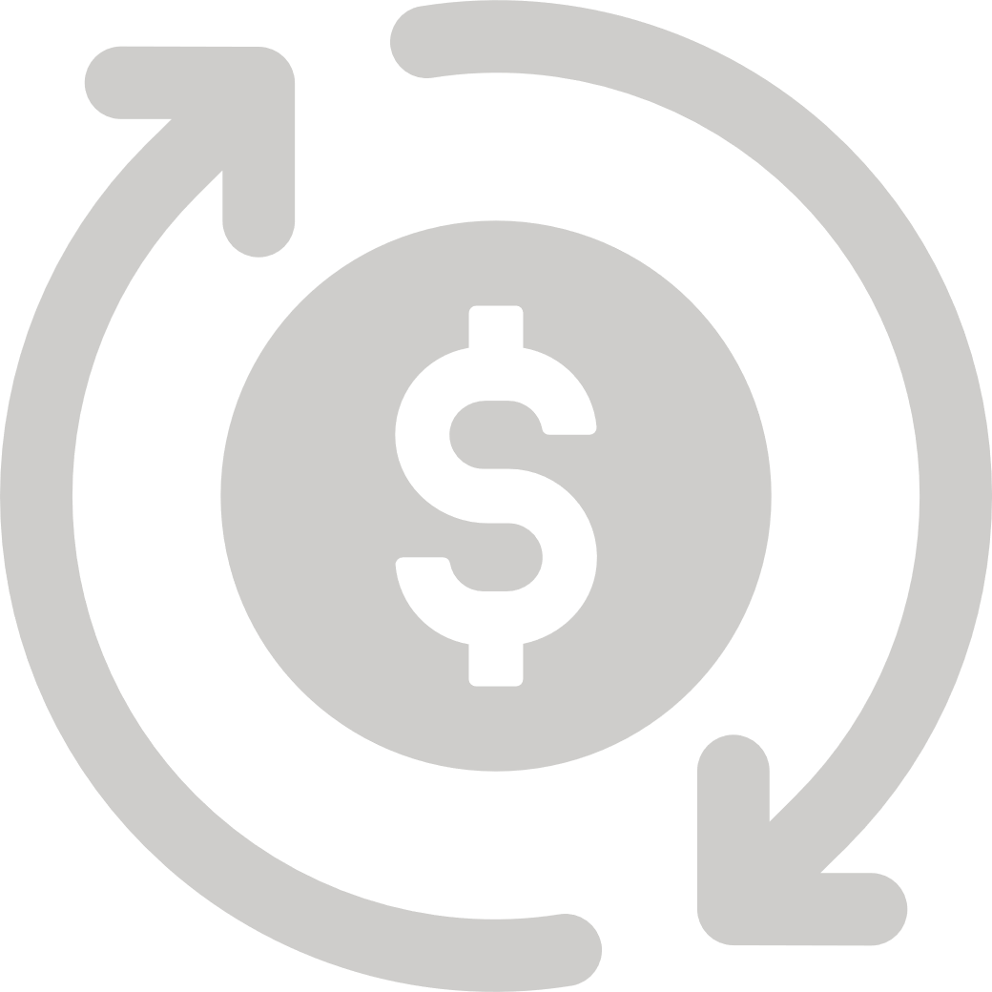


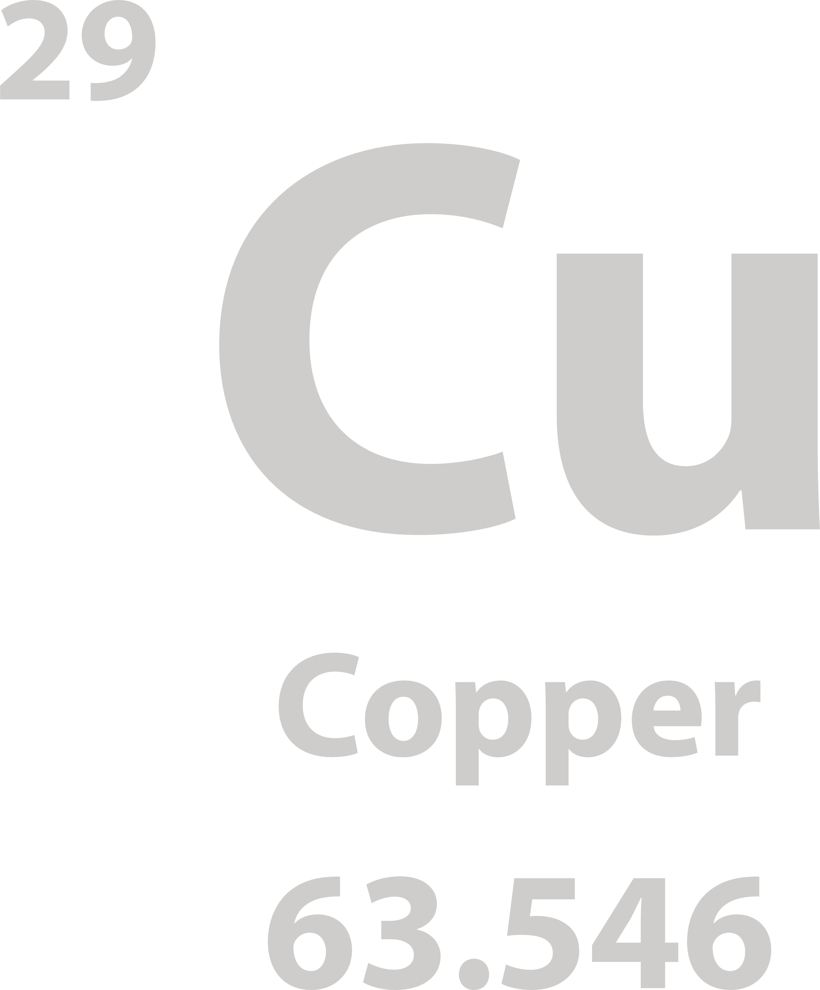

A decade of consistency
Record cash flows and a future powered by quality orebodies, copper and collaboration
Guidance met for 10th consecutive year
Record cash flows, strong balance sheet and record dividend pay-out
Higher-quality orebodies drive higher margins
Copper catalysts will enhance portfolio and protect cash flows
De-risking business through collaboration and partner of choice
Production: 1.48Moz
AISC: $1806/oz
Underground grade: 6.27g/t
Record cash flow: USD614 million
Net cash position: US$628million
Dividend payout: US$133million
Record adjusted free cash flow margin: 16%
MAC Copper
Eva Copper
Wafi-Golpu
Creating long-term value for all stakeholders
Notes:
Slide 4:
This year marks our 10th consecutive year of meeting guidance, contributing to investor confidence and long-term trust.
We delivered 1.48 million ounces at an All-in sustaining cost of around $1 800 per ounce.
Underground recovered grade increased to 6.27g/t, well above the upward-revised guidance figure.
This level of consistency is rare in our sector, and our investment case is underpinned by Responsible Stewardship, Operational Excellence, Effective Capital Allocation and Cash Certainty.
It also reflects the structurally improved quality of our portfolio and the durability of our operating model.
As a result, we are generating record cash flows and have built a robust balance sheet.
Our net cash position has surged to over US$620 million and we generated over $600 million in adjusted free cash flows at a record 16% margins.
We also announced a record dividend payout of US$133 million this financial year.
This sets the stage for a future powered by quality gold and meaningful copper.
Gold continues to anchor our business, and copper enhances portfolio resilience while amplifying our growth story.
MAC Copper, Eva Copper and Wafi‑Golpu are the key catalysts in this transformation as we aim to protect cash flows across commodity cycles.
Our success is built on trust and collaboration, and we remain focused on the needs and interests of ALL our stakeholders.
This commitment positions Harmony as the partner of choice wherever we operate.

Slide 5
Record-breaking cash flows
Restructured portfolio drives unmatched performance with 54% growth in adjusted free cash flow at a 16% margin
Impressive margin expansion
Adjusted free cash flows in US dollars: up 58%
Adjusted free cash flow margin: improved to 16%
FY25
vs FY24
Notes:
Slide 5:
Harmony has - for the second consecutive year - delivered record‑breaking cash flows.
While a record gold price has certainly assisted us, the main driver of our performance has been a combination of adding higher-grade assets and investing in life-of-mine extension projects.
We have delivered an unmatched performance, with a 54% growth in adjusted free cash flow – ALONGSIDE funding our approved major capital projects.
Cash is certainty but also provides us with strategic optionality.
It de‑risks our capital programme, supports a consistent dividend and positions us to fund our various projects and value-accretive acquisitions.

Slide 6
Solid, disciplined mining
Contributes to excellent grade control and consistent production in line with plans
Up 3% to 6.27g/t⁸
Exceeded upward revised guidance of 6g/t⁸
Driven by Mponeng
Down 5%, as planned
Impacted by safety related stoppages
Met upper end of FY25 guidance
FY25
vs FY24
FY25
vs FY24
Notes:
Slide 6:
Quality mining is imperative across our operations.
We are consistently getting this right which is evident in excellent grade control, and stable, predictable production of between 1.4 and 1.5 million ounces.
The higher underground recovered grades continue to be underpinned by the phenomenal performances at our high-grade mines namely Mponeng, and Moab Khotsong.
Quality over volume is yielding results, as we mine smarter ounces and deliver as promised year, after year.

Slide 7
Investing in quality significantly improves margins
High-grade and surface assets: globally competitive with AISC² below $1 500/oz
Below FY25 guidance
64% of production at AISC below $1500/oz
Affected by lower planned production, inflation and higher sustaining capital expenditure
Notes:
Slide 7:
The majority of our portfolio is highly competitive on the global cost curve.
64% of our total production is produced at an all-in sustaining cost below $1 500/oz. This is mainly from our high-grade underground, surface and international mines.
These assets are generating meaningful cash flows at substantial margins.
It is only our SA Optimised portfolio – reflected in the red bar - which sits on the higher end of the cost curve.
We are mining these mature assets for cash, and as these higher-cost ounces are mined out, and copper comes in, we naturally become more profitable.

Slide 8
A transformed company with higher margins
Effective capital allocation drives resilience and sustainability
* For definition of adjusted free cash flow (AFCF¹), see Glossary, slide 50
Notes:
Slide 8:
This slide perfectly illustrates how we have transformed Harmony into a company with SUSTAINED higher margins.
Through our various acquisitions and capital projects, the portfolio is now doing exactly what we designed it to do.
The South African High‑grade underground and surface operations generate significant free cash, with margins of 35% and 36% respectively.
Hidden Valley in Papua New Guinea continues to deliver with margins at an exceptional 48% margin.
Our optimised SA underground assets assist in funding our growth and enabling us to extend mine lives responsibly.
This portfolio balance is the engine behind record free cash flow generation.

Slide 9

Positioning Harmony for success
Significant margins ensure flexibility and optionality
Kobus – update UPDATED WHERE POSSIBLE, GUIDANCE NEEDS TO BE FINALISED
Cost comparison FY25
High operating margins boost balance sheet
Spot gold R2 000 000/kg (US$3 600/oz)#
FY26 total capital intensity of only
~R290 000/kg
or ~US$500/oz*
(US$1 991/oz)
(US$1 806/oz)
(US$1 499/oz)
How we protect margins:
Operational excellence
Investing in quality
Clear hedging programme
Margin: 24%
Margin: 31%
Margin: 43%
* Based on FY26 production guidance
** Converted at FY25 average exchange rate of R18.15/US$1
# As at 8 September 2025
Notes:
Slide 9:
Harmony, therefore, remains well-positioned for success.
Currently, 90% of our production comes from South Africa and we therefore benefit from the Rand per kilogram gold price.
At spot gold, our All-in cost margin is over 40%, which is significantly higher than what we achieved in FY25.
Our FY26 approved total capital intensity remains very affordable at only R290 000/kg or US$500 per ounce.
We continue to protect our balance sheet and lock in margins through our clear hedging programme.
Harmony is therefore in a strong position to execute on its project pipeline while delivering operational excellence.

Slide 10
Gold remains core. Copper provides growth
A long-life producer focused on value through investment in quality
Animated to build layer by layer, starting with the red
Positioned for long-term profitability
100kt¹¹ of copper = over 400koz¹¹ of gold equivalents**
* Potential projects, not yet approved
# Pending final approval
** Copper US$4.25/lb¹², gold US$1 841/oz¹⁶
Illustrative purposes only and subject to safe harbour statement. Assumes Papua New Guinea Government exercises 30% participation right in Wafi-Golpu, and theoretical start date post permitting, subject to granting of special mining lease. Other outcomes are dependent on feasibility studies, permitting and approvals for Eva Copper and SA surface projects
Notes:
Slide 10:
Our portfolio is evolving - not just in size, but in quality and mix.
We remain a gold-first company, and this continues to anchor our strategy.
The introduction of copper is a structural catalyst that enhances and diversifies our portfolio.
Our growth plan remains carefully sequenced and affordable, and is designed not to constrain the balance sheet or execution capacity.
It is focused on value and transforming Harmony into a higher-quality global gold and copper producer.
As the optimised ounces are mined out, we are transitioning to high-grade gold and copper production that enhances resilience and long-term value.
Copper, therefore, serves as an enhancement and strategic lever.
Within three years, we expect to produce around 100 000 tonnes of copper in Australia.
It is worth noting that - based on our current planning assumptions - every 100 000 tonnes of copper, equates to around 400 000 ounces in gold equivalents.

Slide 11
De-risking the portfolio
Investing in quality gold and copper assets
Hidden Valley currently only international asset in production
Copper expected to contribute approximately 40% of production by FY35
* This is for illustrative purposes based on FY25 planned gold equivalent ounces
Notes:
Slide 11:
We are not aiming for a fixed gold-copper ratio.
Rather, capital goes where we believe there is long-term value.
We base our decisions on solid fundamentals, return on invested capital, and the strength of our reserves.
As per our current plans, by FY35, we estimate that around 40% of production will be copper from Eva, MAC Copper, and Wafi Golpu.
These are high-quality assets that complement our South African gold base.

Slide 12
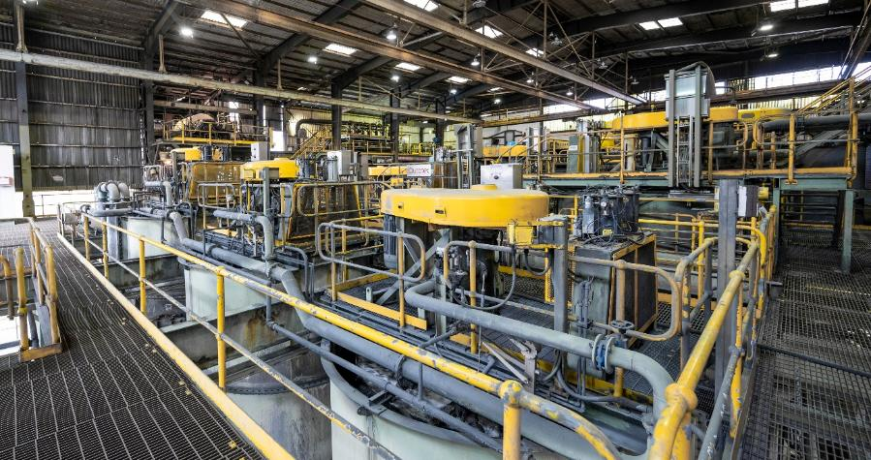
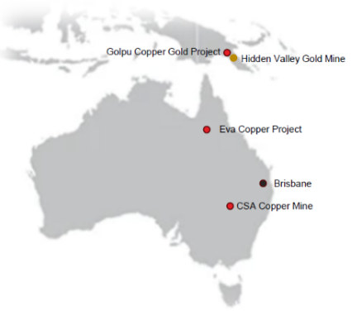
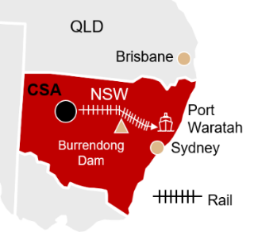
Investing in our future – CSA Copper mine
Immediate cash flows from high-grade operating copper asset in a Tier 1 jurisdiction
Acquisition of 100% of ASX and NYSE
Newcastle
Sydney
100% acquisition – announced in May 2025
Received South African Reserve Bank and Australian FIRB⁷ approval
Awaiting final court sanction, scheduled for 9 October 2025
Funded by a US$1.25bn bridge loan, with a robust balance sheet post-acquisition and leverage well-below target range
Immediate copper production at a low C1 cash cost
Mineral Reserves: adds ~2.8Moz¹⁴ in gold equivalents*
High Reserve grade
3.4% Cu³
Expected 2026 production of
>40kt¹¹ Cu³ p.a.
Low C1 cash costs**
US$1.67/lb¹²
Long-life asset⁴
12+ years
* Using assumptions of copper US$4.25/lb¹², gold US$1 841/oz¹⁶ ; per MAC’s 2024 Resource and Reserve Statement and Production Guidance
** MAC reported a H1 2025 C1 cash cost of US$1.67/lb¹² after by-product credits under their ownership
Notes:
Slide 12:
In May this year, we announced the acquisition of 100% of MAC Copper.
We have received all regulatory approvals and are now awaiting the final Jersey court sanction hearing scheduled for the 9th of October.
Provided all support and approvals are received, we will assume operational control towards the end of October.
This transaction will be funded with a bridge facility, and supported by our strong balance sheet.
At 3.4%, this is one of the highest-grade copper assets in Australia.
It offers over 12 years of reserve life, over 40 000 tonnes of copper per annum, with low C1 cash costs after by‑product credits.
Importantly, it adds around 2.8 million ounces of gold‑equivalents in reserves and is immediately EBITDA accretive.

Slide 13

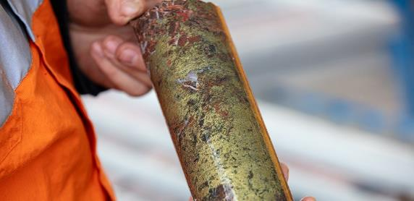






Investing in our future – Eva Copper growth project
Aligned with our strategic objectives
Embedded sustainability
Improving safety and lowering risk
✓
Geography
Australia, a Tier 1
mining jurisdiction
✓
✓
Near-term copper
Estimate first production in calendar year 2028**
✓
Commodity
mix
Copper, a green metal
Attractive price outlook
✓
De-risking project
Robust feasibility study update to be released before end of 2025
✓
Affordability
Competitive capital intensity
Forecast production:
55 000 to 60 000 tonnes of copper per annum
~14 000oz¹⁶ of gold annually
>300 000oz¹⁶ of gold equivalents*
8.6Moz¹⁴ *
in gold and gold equivalents
* Copper US$4.25/lb¹², gold US$1 841/oz¹⁶
** Subject to completion of the Feasibility Study Update and Financial Investment Decision
Notes:
Slide 13:
The Eva Copper Project is strategically aligned with our long-term objectives and checks all the right boxes.
We are advancing the feasibility update as planned and expect to release the results before the end of 2025.
The project is being de-risked to protect value and progress execution readiness.
Key features include:
A solid production mix of 55 to 60 thousand tonnes of copper and around 14 000 ounces of gold as a by-product per annum,
A 15-year life of mine, offering sustained value
Competitive cost positioning on the global copper curve, and
….a competitive capital intensity, enhancing project attractiveness.
Eva consolidates six deposits and ten open pits into a single, integrated operation feeding an 18 million tonne per annum concentrator.
This is supported by a strip ratio of 1.6 times.
The flowsheet is based on conventional crush, grind and flotation.
Mineral Resources continue to increase as we de-risk the project.
In FY25, Eva copper Resources grew by 31%, while gold Resources increased by 12%.
This means Eva now hosts approximately 8.6 million ounces in gold and gold equivalents!

Slide 14
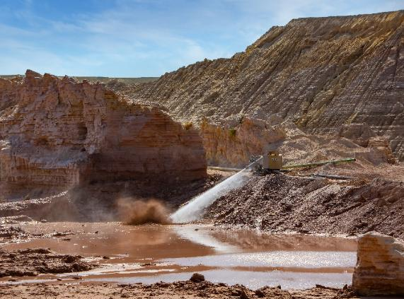
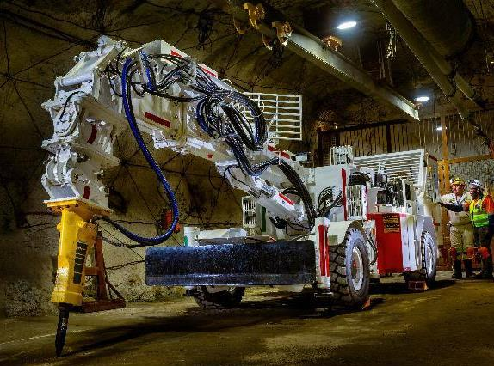
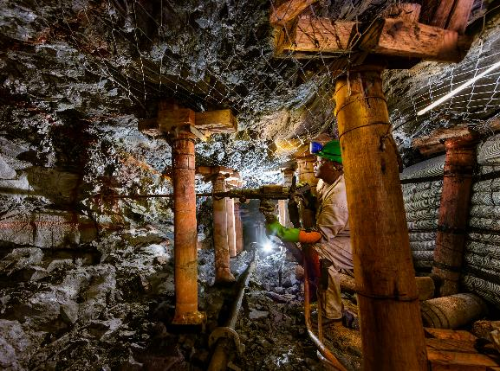
Investing in our assets
South African extension projects
Mine Waste Solutions
Moab Khotsong extension
Mponeng extension
Project largely complete with most major capital expenditure deployed
Total project capital expenditure spent to date: R2.5bn (US$144m)
Approved project capital expenditure: R3.1bn* (≈US$167m)
Life of mine extended to over 14 years
Annual production of ~110 000oz¹⁶ over life of mine
Life of mine extended to approximately 20 years
Will add 2.70Moz¹⁴ to Mineral Reserves
Total project capital expenditure to date: R1.8bn (US$95m)
Approved project capital expenditure: R7.2bn* (≈US$388m)
Project completion date: May 2033
Annual steady state production: >200 000oz¹⁶
Ground broken on 100MW¹⁹ solar plant
Project delays incorporated into plans and sequencing
Life of mine extended to approximately 20 years
Will add 2.34Moz¹⁴ to Mineral Reserves
Total project capital expenditure spent to date: R0.9bn (US$51m)
Approved project capital expenditure: R7.9bn* (≈US$426m)
Project completion date: December 2036
Grade sustained at ~9g/t⁸
Annual steady state production: ~250 000oz¹⁶
*Approved capital expenditure converted at the planned rate of R18.54/US$
Notes:
Slide 14
The acquisitions of Mponeng, Moab Khotsong and Mine Waste Solutions were transformational for Harmony.
We are investing in life-of-mine extensions at all three of these assets.
The Kareerand extension at Mine Waste Solutions, our mega tailings retreatment operation, is largely complete, with most of the major capital now deployed.
The extension projects at Moab Khotsong and Mponeng experienced some delays due to contractor issues but are now progressing well.
The project delays have been incorporated into plans and sequencing.
We have extended the lives of these high-grade mines to at least 20 years adding a combined 5 Million ounces of high-margin gold reserves.

Slide 15
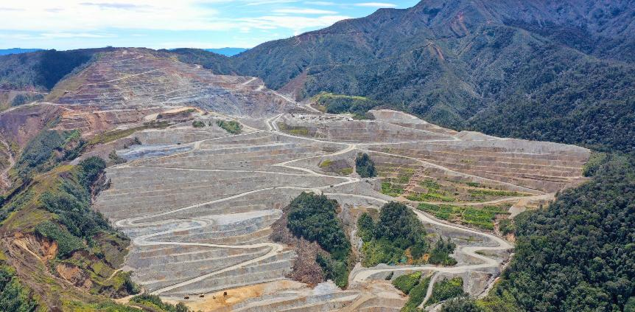
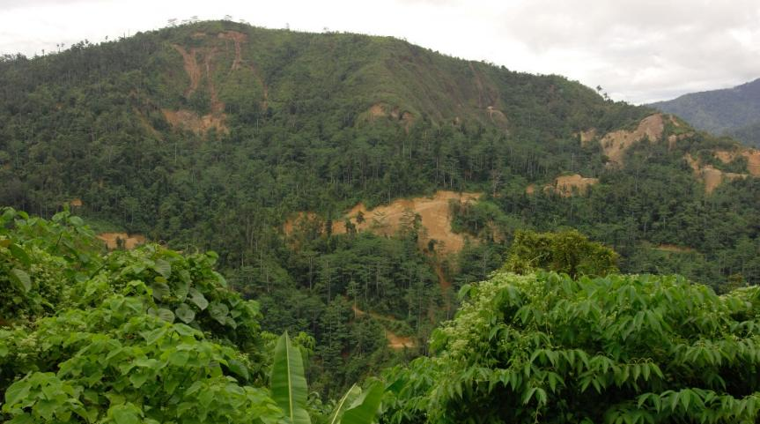
Investing in our assets
Papua New Guinea projects
Hidden Valley
Opportunity for further Mineral Reserve conversion and
life of mine extension
Hidden Valley life of mine extended by 18 months to March 2030
Dewatering cyclone project will optimise deposition into existing Tailings Storage Facilities
Stable reserves
Exploring opportunities to extend life beyond 2030
Wafi-Golpu
A Tier 1 copper-gold asset
Negotiating terms of Mining Development Contract, a prerequisite for Special Mining Lease (SML)
Feasibility study update to begin post SML award
Average annual production (100% attributable):
  Copper: 180kt¹¹ @ 1.2%
  Gold: 250koz¹¹ @ 0.86g/t⁸
Notes:
Slide 15
Papua New Guinea remains a core pillar of Harmony’s copper-gold growth strategy.
At Wafi‑Golpu, we’re negotiating the Mining Development Contract - a prerequisite for securing the Special Mining Lease.
Once finalised we will proceed with updating the feasibility study.
At 100% attributable, Wafi-Golpu is expected to deliver ~180 000 tonnes per annum of copper and ~250 000 ounces of gold annually — underscoring the world-class nature of this orebody.
At Hidden Valley, the dewatering cyclone project will optimise deposition into the existing Tailings Storage Facilities, enabling an 18-month life of mine extension to March 2030.
We are also exploring further extension opportunities beyond 2030.

Slide 16



Funding growth and delivering shareholder returns
Disciplined and balanced capital allocation focused on value
 |  | FY25 (Rand) | FY25 (US$)
Robust, flexible balance sheet | Cash | R13bn | US$738m
 | Debt | R2bn | US$110m
 | Headroom | R20.9bn | US$1 179m
Investing in our future | Sustaining capital | R6.3bn | US$347m
 | Major capital | R4.7bn | US$259m
 | M&A capital | R18.3bn | US$1bn
Total shareholder returns | Dividend yield* | 1.6% | 1.5%
 | 12 month share performance* | Up 50% | Up 48%
*Based on a closing share price on 30 June 2025 of R244.81 on the JSE and $13.97 on the NYSE
Notes:
Slide 16
We remain committed to rewarding our shareholders alongside our growth aspirations.
Our balance sheet remains strong with low gearing and ample headroom.
This gives us the agility to fund our capex cycle, and take advantage of any future opportunities.
We are also considering an optimal balance sheet structure to lower our cost of capital.
The FY25 dividend yield of 1.6% is supported by a 50% share price increase – delivering meaningful total shareholder returns and a market cap of approximately $9 billion.
This is effective capital allocation in action - funding growth, maintaining flexibility, and delivering consistent returns.

Slide 17
Conclusion
Notes:
Slide 17:
In conclusion...

Slide 18
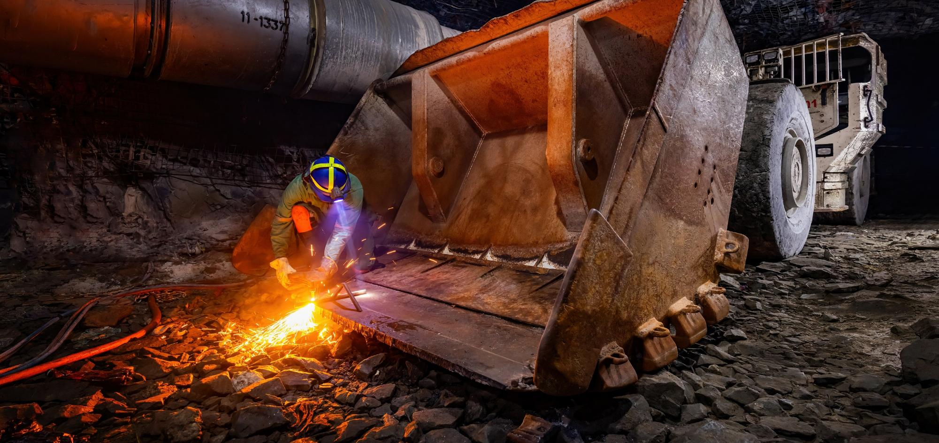


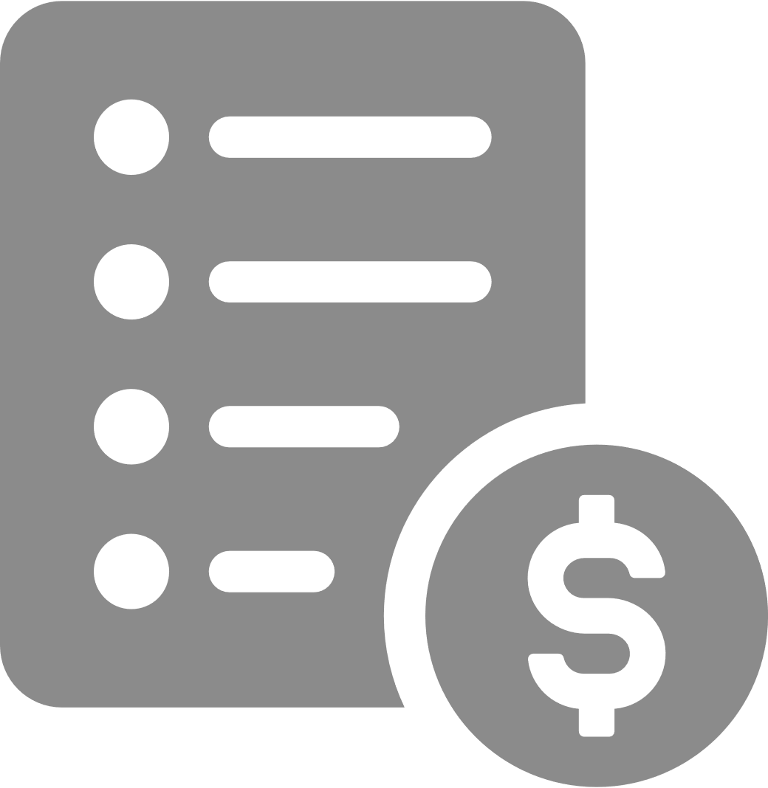

FY26 guidance*
Demonstrates consistency and confidence in our planning
Production
1.4Moz¹⁴
to 1.5Moz¹⁴
Underground grade
Above 5.8g/t⁸
All-in sustaining cost*
R1 150 000/kg¹⁰
to R1 220 000/kg¹⁰
Capital expenditure
US$699 million
*Guidance excludes MAC Copper and Eva Copper. To be updated in H2FY26 pending conclusion of acquisition and feasibility update
*predominantly rand-cost producer, therefore cost guidance in South African rand
Notes:
Slide 18:
Our FY26 guidance reflects consistency and confidence in our planning and cash flows.
This is aimed at ensuring sustainable operations - where safety and long-term viability are non-negotiable.
Production guidance remains steady at 1.4 to 1.5 million ounces - a level at which we have shown that our orebodies can deliver on safely.
Underground recovered grade stays strong at above 5.8 grams per tonne.
All-in sustaining costs are planned to rise to between R1.15 and R1.22 million per kilogram, driven mainly by mining inflation and higher sustaining capex.
Total capital expenditure rises to $700 million, driven by fleet replacement at Hidden Valley, and advancing the projects at Moab Khotsong, Mponeng, and Mine Waste Solutions.
We expect to close the MAC Copper transaction in October, with a final investment decision expected on the Eva Copper project later this year.
The positive impact of these catalysts will further transform our equity story, and we’ll update the market at our half-year results in late February 2026.
A breakdown of our production, grade, capex and life-of-mine for each of our current operations is available on our website.

Slide 19

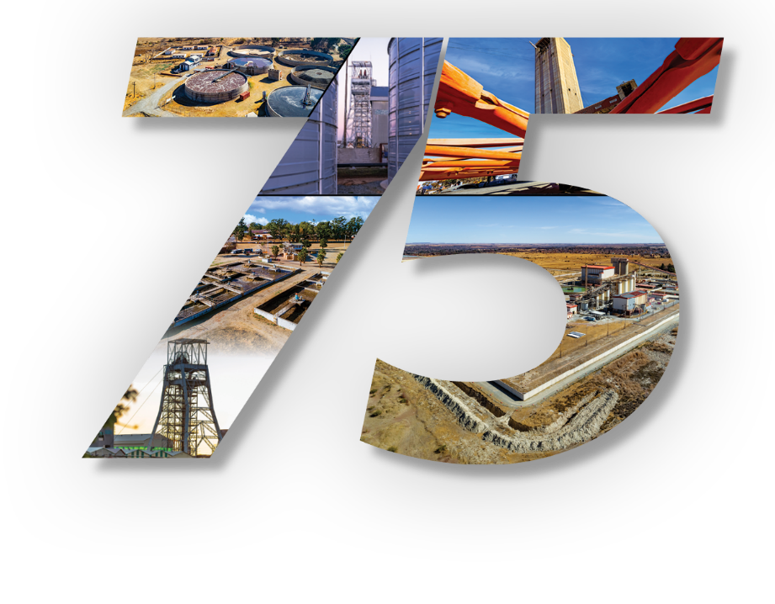
Unearthing tomorrow
Global leaders in gold mining and adding meaningful copper
Harmony, a gold mining specialist
with a growing international
copper footprint
Celebrating 75 years of operational excellence
Globally significant Mineral Resource base of 135.5Moz¹⁴ and Mineral Reserves of 36.8Moz¹⁴ in gold and gold equivalents
Enhancing portfolio quality through
  focus on value over volume
  ongoing investment in high-grade gold and copper assets
  strategic geographical diversification
Positioned for robust cash flow generation as improved asset quality supports resilience through commodity cycles
Notes:
Slide 19:
As we mark 75 years of Harmony, we do so with pride in our legacy, and confidence in our future.
We have a globally significant resource base of 136 million ounces in resources, and 37 million ounces in reserves in gold and gold equivalents.
Our strategy of producing safe, profitable ounces, is clear.
Sustainability is not an add-on; it’s embedded into our planning, how we mine, and how we grow.
The external recognition of our sustainable development framework illustrates our commitment to responsible mining and long-term value creation.
We prioritise value over volume, investing in high-grade gold and copper assets, while diversifying geographically.
This is aimed at benefiting ALL stakeholders while protecting and growing shareholder value through responsible and effective capital allocation.
Thank you

Slide 20


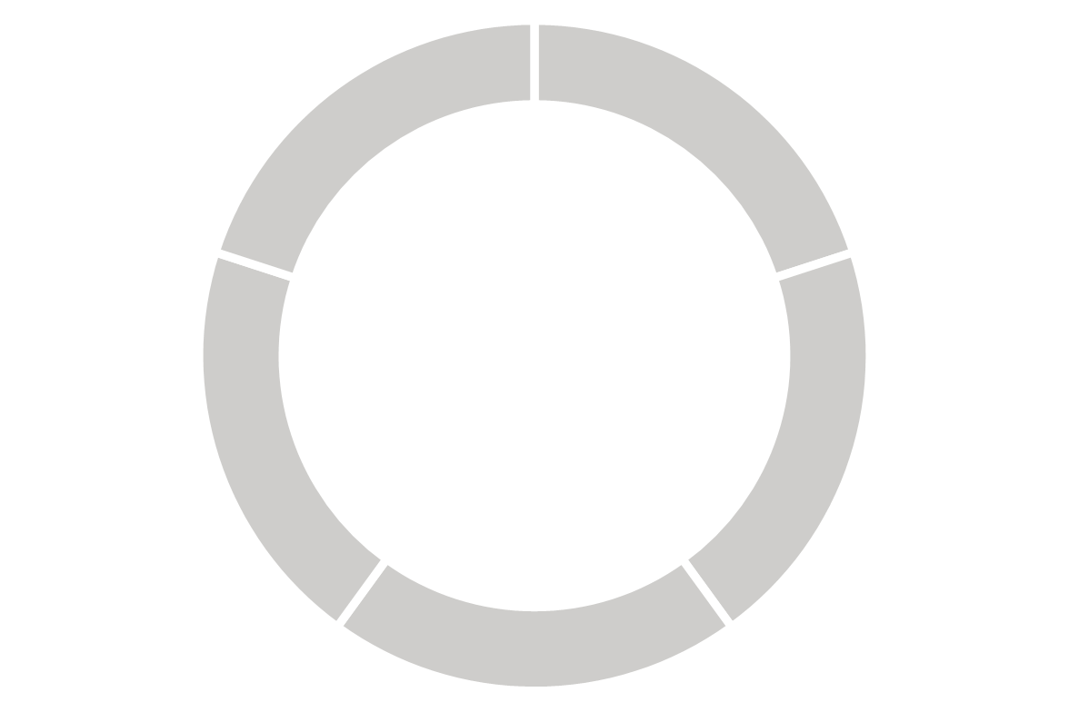
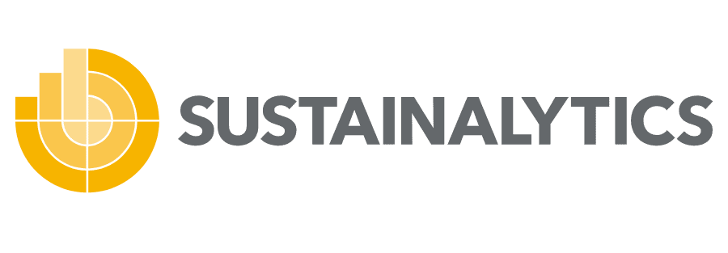


2. OPERATIONAL
EXCELLENCE
3. CASH CERTAINTY
4. CAPITAL ALLOCATION
1. RESPONSIBLE
STEWARDSHIP
Upgraded to 4.2
out of 5.0, placing Harmony in 93rd percentile in ICB⁹ Supersector
Upgraded to BB
Overall performance
better than industry average
LONG-TERM VALUE
1.4 - 1.5Moz
Harmony ranked in
Top 50 in
gold sub-industry category
SA
underground
high-grade
SA
underground
optimised
Scored ‘A-’ for our water management strategy
Harmony conforms
with the SBTi criteria
International
copper-gold growth
SA
surface
high-margin
Thank you
Contact us at harmonyir@harmony.co.za

Slide 21
Glossary of acronyms and definitions
Acronym and related footnote references
¹ AFCF | Adjusted free cash flow = cash generated from operating activities less additions to property, plant and equipment plus CAWMS post retirement obligation settlement
² AISC | All-in sustaining cost
³ Cu | Copper
⁴ EBITDA | Earnings before interest, tax, depreciation and amortisation as defined, also excludes unusual items such as impairment and restructuring cost: rolling 12-month historical
⁵ ESG | Environmental, social and governance
⁶ FID | Final Investment Decision
⁷ FIRB | Foreign Investment Review Board
⁸ g/t | Grams per tonne
⁹ ICB | Industry Classification Benchmark – a definitive system categorising 70 000 companies and 75 000 securities worldwide, enabling a meaningful comparison of companies across four levels of classification and national boundaries.
¹⁰ kg | Kilogram
¹¹ koz/kt | Thousands of ounces/tonnes
¹² lb | Pounds (weight)
¹³ LTIFR | Lost-time injury frequency rate per million hours worked
¹⁴ Moz | Million ounces
¹⁵ Mt/Mtpa | Million tonnes / million tonnes per annum
¹⁶ oz | Ounce
¹⁷ Rm/Rbn | South African rand millions/billions
¹⁸ US$m | United States dollar millions
¹⁹ MW | Megawatt
²⁰ GWh | Gigawatt hours
²¹ CO₂e | Carbon dioxide equivalent

