Slide 1
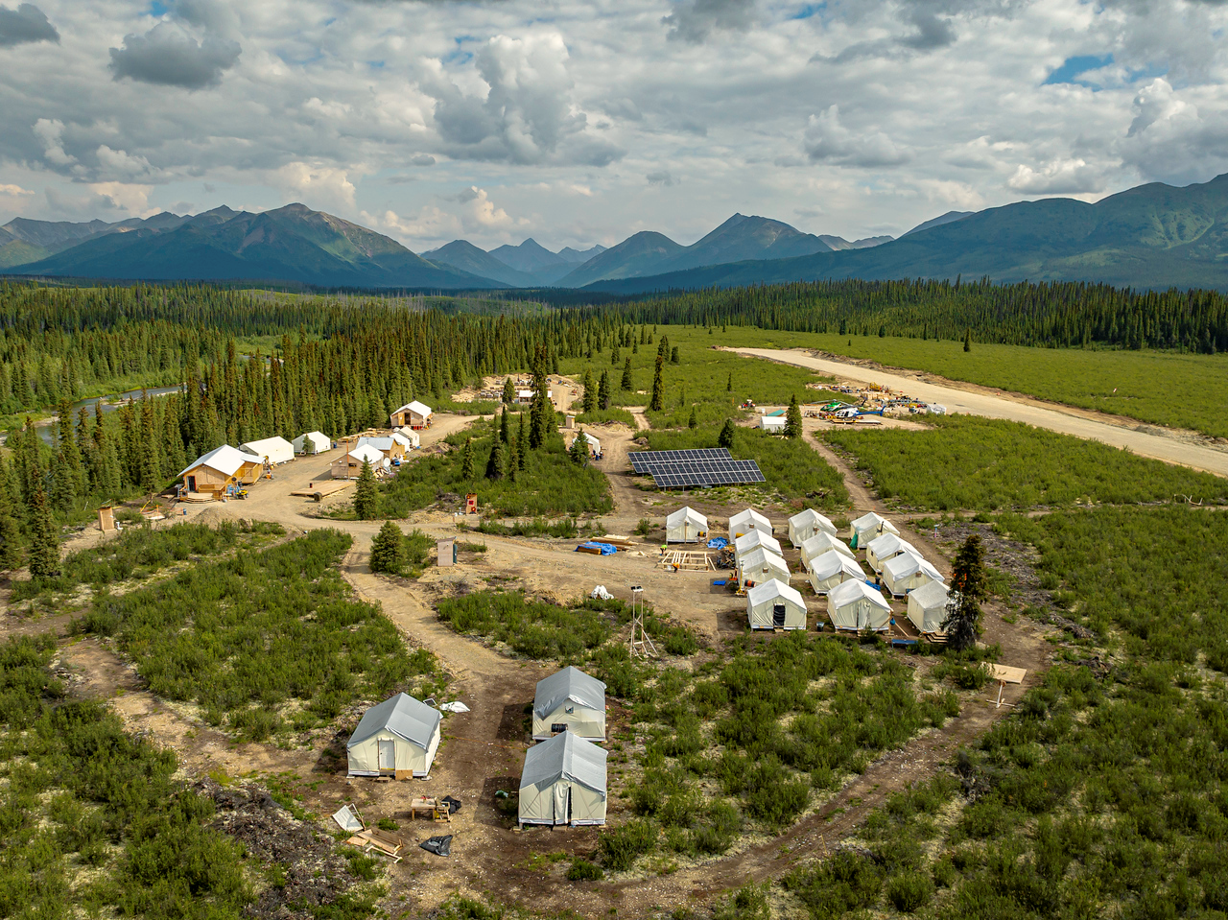


A NEW GOLD STANDARD
MINING FORUM AMERICAS
Denver Gold Group
September 15, 2025
TSX-V: SGD | OTCQB: SNWGF
SNOWLINEGOLD.COM

Slide 2
CAUTIONARY DISCLAIMERS
The information in this presentation is in a summary form and does not purport to be complete. It is not intended to be relied upon as advice to investors or potential investors and does not take into account the investment objectives, financial situation or needs of any particular investor.
Cautionary Note Regarding Forward-Looking Statements
This presentation includes certain statements that may be deemed "forward-looking statements" within the meaning of applicable Canadian securities legislation. All statements in this presentation, other than statements of historical facts, that address events or developments that Snowline expects to occur, are forward-looking statements, including statements relating to Snowline’s expectations and estimates with respect to: the economic parameters of the preliminary economic assessment (the “PEA”) for the Valley deposit (“Valley”); mineral resource estimates; the cost and timing of any development of Valley; the proposed mine plan and mining methods; dilution and mining recoveries; processing method and rates; anticipated production rates; projected metallurgical recovery rates; infrastructure requirements; energy sources; capital, operating and sustaining cost estimates; the projected life of mine and other expected attributes of Valley; the net present value (“NPV”), internal rate of return (“IRR”) and payback period of capital; future metal prices; the timing of any engineering, environmental assessment or Indigenous consultation processes; changes to Valley configuration that may be requested as a result of stakeholder or government input; government regulations and permitting timelines; tailings storage facility; access to Valley; water management; estimates of reclamation obligations; requirements for additional capital; environmental risks; current and future drill programs; general business and economic conditions; and general property exploration plans. Forward-looking statements are statements that are not historical facts and are generally, but not always, identified by the words "expects", "plans", "anticipates", "believes", "prospective", "envisions", "continues", "intends", "estimates", "budgets", "targets", "forecasts", "projects", "schedules", "potential" and similar expressions, or that events or conditions "will", "would", "may", "could" or "should" occur. Such statements reflect Snowline’s current views and intentions with respect to future events, and current information available to Snowline, and are subject to certain risks, uncertainties and assumptions. Many factors could cause the actual results, performance or achievements that may be expressed or implied by such forward-looking statements to vary from those described herein, should one or more of these risks or uncertainties materialize.
Certain of the "risk factors" that could cause actual results to differ materially from the Company's forward-looking statements include, without limitation risks relating to the following: risks to operations in the Yukon; political instability; nationalization of the mining industry; opposition from local residents and non-governmental organizations; changes to governmental regulations or regulatory requirements in the Yukon; environmental risks; licensing and permitting risks; substantial capital requirements; no mineral resources or reserves on Snowline’s properties; development and operating risks; inherent risks regarding cost estimates; the use of non-GAAP and non-IFRS (as defined below) measures in financial performance accounting; reliance on management and dependence on key personnel; health and safety risks; fluctuating mineral prices; currency fluctuation; financing; unanticipated resource grades and recoveries; infrastructure; results of future exploration activities; cost overruns; availability of materials and equipment; supply chain interruptions; and other factors beyond the control of the Snowline. Should any factor affect Snowline in an unexpected manner, or should assumptions underlying the forward-looking statements prove incorrect, the actual results or events may differ materially from the results or events predicted. Any such forward-looking statements are expressly qualified in its entirety by this cautionary statement. Moreover, Snowline does not assume responsibility for the accuracy or completeness of such forward-looking statements. The forward-looking statements included in this presentation are made as of the date of this presentation and Snowline undertakes no obligation to publicly update or revise any forward-looking statement, other than as required by applicable law.
This presentation has been prepared by Snowline using its best efforts to realistically and factually present the information contained herein. However, subjective opinion, dependence upon factors outside Snowline’s control and outside information sources unavoidably dictate that Snowline cannot warrant the information contained to be exhaustive, complete or sufficient. In addition, many factors can affect the presentation which could significantly alter the results intended by Snowline, rendering the presentation unattainable or substantially altered. Therefore, readers should conduct their own assessment and consult with their own professional advisors prior to making any investment decisions.
This presentation does not constitute a prospectus or public offering for financing, and no guarantees are made or implied with regard to Snowline’s proposed ventures. There is no guarantee that valuable minerals can be produced profitably from our projects, or at all. The presentation is being disclosed to the reader for the reader’s discussion, review, and/or evaluation only. The reader agrees to hold the presentation, and all related information and discussions, in strict confidence, except that the reader may disclose the presentation to a limited number of advisors and employees of the reader to the extent necessary for the reader to adequately evaluate the presentation. The reader warrants that any such persons shall be advised of the confidential nature of the presentation before gaining access to the same and that no such advisor or employee shall use or disclose the presentation except as permitted by this presentation.

Slide 3
CAUTIONARY DISCLAIMERS
Estimates of Mineral Resources
Disclosure regarding mineral properties included in this presentation, was prepared in accordance with NI 43-101. NI 43-101 is a rule developed by the Canadian Securities Administrators that establishes standards for all public disclosure an issuer makes of scientific and technical information concerning mineral projects. NI 43-101 differs significantly from the disclosure requirements of other jurisdictions, including of the Securities and Exchange Commission generally applicable to U.S. companies. Accordingly, information contained in this presentation is not comparable to similar information made public by U.S. companies reporting pursuant to SEC disclosure requirements or by companies reporting pursuant to other international jurisdictions.
Historical Geological Information
Any geological information and results presented which were not conducted by Snowline are believed to be accurate but have not been verified.
Qualified Persons
J. Scott Berdahl, P.Geo., Snowline’s Chief Executive Officer and a director, is a qualified person under NI 43-101 for the Company. He has reviewed, approved and verified the technical content of this presentation aside from the Valley Deposit Mineral Resource Estimate (“MRE”) and the Rogue Project Preliminary Economic Assessment (“PEA”). MRE parameters are taken from the Company’s updated MRE disclosed in its news release dated May 15, 2025, for which technical work was completed by Daniel J. Redmond, PGeo., an independent qualified person under NI 43-101 who has reviewed, approved and verified the technical information related to the MRE in this presentation. PEA parameters are taken from the Company’s PEA disclosed in its news release dated June 23, 2025. Full details of the PEA are available the recent technical report for Rogue, prepared in accordance with NI 43-101 standards, entitled “Independent Preliminary Economic Assessment for the Rogue Project Yukon, Canada,” dated July 30, 2025, with an effective date of March 1, 2025, available on SEDAR+ and the Company’s website.
Use of Non-GAAP Measures
Certain financial measures referred to in this presentation are not measures recognized under IFRS Accounting Standards (“IFRS”) and are referred to as non-GAAP financial measures or ratios. These measures have no standardized meaning under IFRS and may not be comparable to similar measures presented by other companies. The definitions established and calculations performed by the Company are based on management’s reasonable judgement and are consistently applied. These measures are intended to provide additional information and should not be considered in isolation or as a substitute for measures prepared in accordance with IFRS.
The non-GAAP financial measures used in this presentation and common to the gold mining industry are all-in sustaining cost per ounce of gold sold, and free cash flow.
All-in sustaining cost per ounce of gold sold and free cash flow are non-GAAP financial measures or ratios and have no standardized meaning under IFRS and may not be comparable to similar measures used by other issuers. As Valley is not in production, the Company does not have historical non-GAAP financial measures nor historical comparable measures under IFRS, and therefore the foregoing prospective non-GAAP financial measures or ratios may not be reconciled to the nearest comparable measures under IFRS.
U.S. Cautionary Note
This presentation does not constitute an offer to sell or the solicitation of an offer to buy, nor shall there be any sale of the securities of Snowline in any jurisdiction in which such offer, solicitation or sale would be unlawful prior to registration or qualification under the securities laws of such jurisdiction. The securities of Snowline have not been and will not be registered under the United States Securities Act of 1933, as amended, or any state securities laws and may not be offered or sold within the United States, unless an exemption from such registration is available, information concerning the assets and operations of Snowline included in this presentation has been prepared in accordance with Canadian standards and is not comparable in all respects to similar information for United States companies.

Slide 4
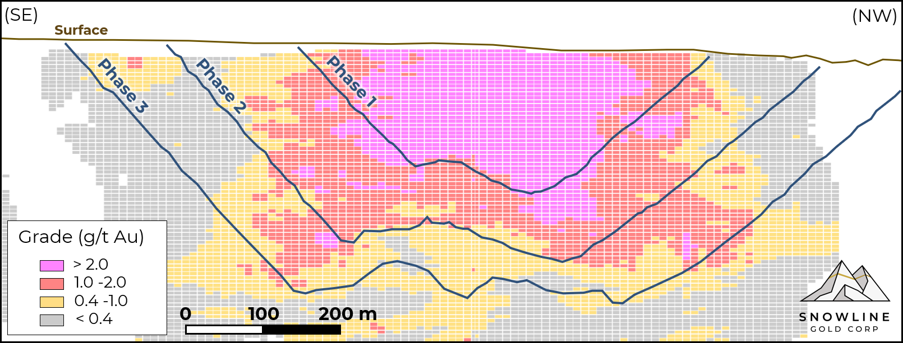
VALLEY – A “UNICORN” GOLD DEPOSIT
B
B’
LARGE SCALE
  7.4 Moz Au PEA averaging 1.34 g/t Au
  Deposit still open in multiple directions
VERY LOW STRIP RATIO
  LOM strip ratio of 1.09 : 1 (0.14 : 1 Phase 1)
  Compact footprint with minimal dilution
ATTRACTIVE STARTER PIT
  39% of gold is contained in the first 15% of total material (pre-stripping & Phase 1)
HIGH GOLD GRADES FROM SURFACE
  Phase 1 pit averages >2.3 g/t Au with low strip
  Initial capital de-risked by rapid payback
SOLID METALLURGY
  Non-refractory mineralization
  LOM recoveries estimated at 92.2%
STRONG LEVERAGE TO GOLD
  Gold-only resource creates strong NPV response to higher gold prices
  Low-cost production offers downside resilience
EXPORATION UPSIDE
  Promising near-deposit results
  Target-rich surrounding district
ACCESSIBLE LOCATION
  30 km from existing mining trails
  75 km from public road network
ATTRACTIVE JURISDICTION
  Safe, stable, rule-of-law jurisdiction in Yukon, Canada
  Long mining history & established permitting processes
The PEA is detailed in the recent technical report for Rogue, prepared in accordance with NI 43-101 standards, entitled “Independent Preliminary Economic Assessment for the Rogue Project Yukon, Canada,” dated July 30, 2025, with an effective date of March 1, 2025, available on SEDAR+ and the Company’s website.

Slide 5
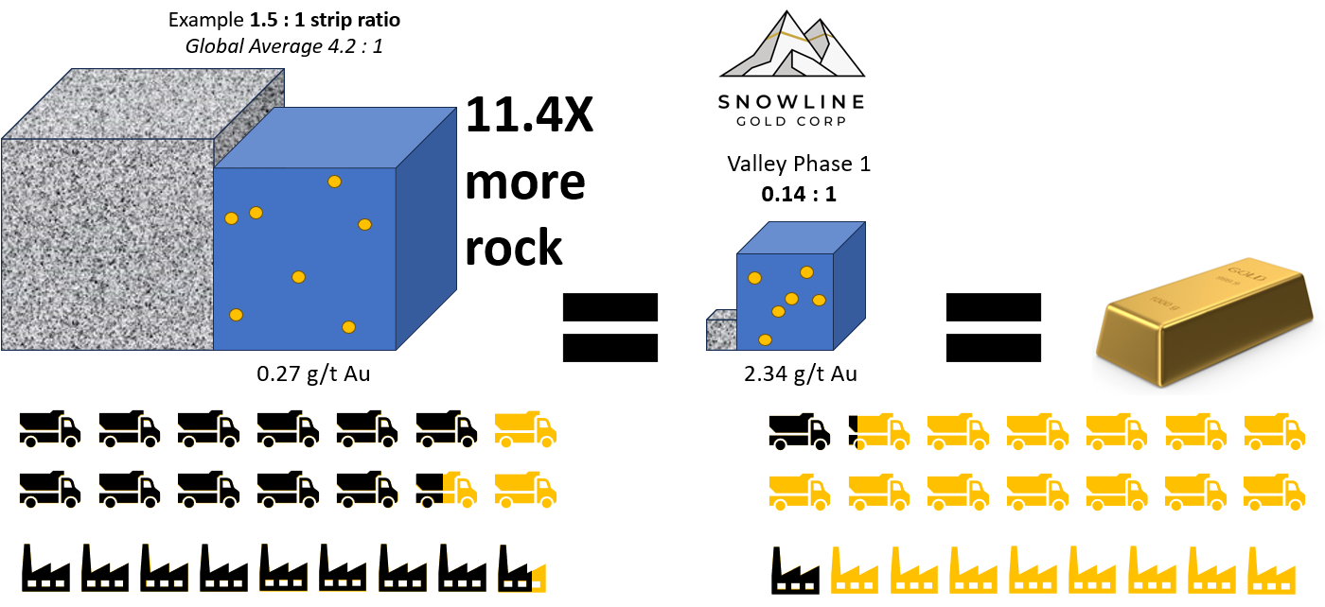
MORE GOLD PER UNIT OF ROCK MOVED
UNIQUE ON A GLOBAL SCALE
Ideal geometry with high gold grades at surface makes Valley the richest open pit globally for its scale in terms of gold content²
Combined effects of higher grade and lower waste:
(Conceptual, qualitative example)
Costs
Margin
Costs
Margin
Substantially less rock moved and processed for a given unit of output can have disproportionately large positive effects on margins
Strip Adjusted Grade = Grade / (1 + Strip Ratio)
Source: National Bank Financial Equity Research
¹Values for Valley from July 2025 PEA, available on SEDAR+
²Amongst projects in operation or development

Slide 6
VALLEY PEA – BY THE NUMBERS
PRODUCTION
544 koz/year
first 5 full years (payable gold)
341 koz/year life-of-mine
ALL-IN SUSTAINING COSTS¹
US $569/oz
first 5 full years
US $844/oz life-of-mine
PAYABLE GOLD
6.8 Moz Au
95% Measured & Indicated
from 7.4 Moz @ 1.34 g/t Au
MINE LIFE
20 years
open deposit with regional potential
INITIAL CAPEX
CDN $1.7 B
3.5-year build
STRIP RATIO
1.09 : 1
life of mine
STRONG AFTER-TAX ECONOMICS:
NPV_{5%}²
CDN $3.37 B
CDN $8.34 B
IRR²
25 %
41 %
Payback³
2.7 years
1.9 years
Free Cash Flow⁴ (life of mine)
CDN $426 M / year
CDN $864 M / year
Gold Price
US $2,150/oz
(study price⁵)
US $3,600/oz
(spot case⁶)
1 All-in Sustaining Costs (AISC) are a non-GAAP measure; the sum of site operating costs, product transportation and selling costs, royalty payments, sustaining capital and progressive reclamation costs, divided by payable gold ounces produced. AISC excludes closure costs and any post-closure costs. 2 After-tax NPV and IRR are calculated as of the assumed start of construction (Period -4), use a CAD/USD exchange rate of 1.40, and the gold price (US$/oz) indicated 3 Payback period shown is the time from first production that it takes to payback invested capital 4 Free cash flow, a non-GAAP measure, is equal to operating cash flow less all of the following: sustaining capital, progressive reclamation costs, closure costs and applicable taxes 5 PEA economics based on a study price of US $2,150/oz, with engineering designs based on a $1,950/oz gold price 6 At gold prices outside +/- 30% of the engineering price of US $1,950/oz Au, pit redesign appropriate to the gold price could improve project economics versus the current model

Slide 7
TOP TIER PRODUCTION & COST PROFILES
Annual Gold Production (koz)
All-in Sustaining Costs² (US$/oz)
Ramp-up
Average Payable Gold Production¹
First 5 Full Years | 544,139 oz/year
Life of Mine | 340,549 oz/year
Average Processed Gold Grade
First 5 Full Years | 2.01 g/t Au
Life of Mine | 1.34 g/t Au
All-in Sustaining Costs²
First 5 Full Years | US $569/oz
Life of Mine (incl. ramp-up) | US $844/oz
1 As a gold doré producer with onsite refinery, payable terms are assumed to be 100%
2 All-in Sustaining Costs (AISC) are a non-GAAP measure. They represent the sum of site operating costs, product transportation and selling costs, royalty payments (calculated at study price of US$2,150/oz Au), sustaining capital and progressive reclamation costs, divided by payable gold ounces produced. AISC excludes closure costs and any post-closure costs.

Slide 8
HIGH MARGINS & RAPID PAYBACK
$15.59 B
Cumulative post-tax FCF (LOM)
$6.63 B
Cumulative post-tax FCF (LOM)
Ramp-up
Initial Capital
C $1,685 M
Average FCF² | Years 2-6 | Years 7-20 | LOM (Years 1-20)
At US$2,150/oz | C $841 M/year | C $305 M/year | C $426 M/year
At US$3,600/oz | C $1,540 M/year | C $663 M/year | C $864 M/year
Payback
2.7 years
1.9 years
The PEA is detailed in the recent technical report for Rogue, prepared in accordance with NI 43-101 standards, entitled “Independent Preliminary Economic Assessment for the Rogue Project Yukon, Canada,” dated July 30, 2025, with an effective date of March 1, 2025, available on SEDAR+ and the Company’s website.
1 After-tax NPV and IRR are calculated as of the assumed start of construction (Period -4), use a CAD/USD exchange rate of 1.40, and the gold price (US$/oz) indicated. Payback period shown is the time from first production that it takes to payback invested capital.
2 Non-GAAP free cash flow is equal to operating cash flow less all of the following: sustaining capital, progressive reclamation costs, closure costs and applicable taxes

Slide 9
LEVERAGE TO GOLD PRICES
100% gold exposure offers substantial upside to higher gold prices
After-Tax Economics:
PEA Price
Spot Prices
“ALL WEATHER” DEPOSIT
High grades at surface drive compelling economics across a wide range of gold prices
HIGH LEVERAGE TO GOLD PRICES
Every +$100/oz increase in gold price increases NPV by roughly +$343 million
GOLD ACCOUNTS FOR 100% OF VALLEY’S PRODUCTION & REVENUE
NPV_{5%}¹
IRR¹
39.3%
36.9%
C $7.7 B
31.4%
C $6.8 B
28.3%
25.0%
C $5.1 B
16.9%
C $4.2 B
C $3.4 B
Sensitivities are based on a single mine plan and production schedule for the PEA, optimized for US $1950/oz Au.
C $1.6 B
The PEA is detailed in the recent technical report for Rogue, prepared in accordance with NI 43-101 standards, entitled “Independent Preliminary Economic Assessment for the Rogue Project Yukon, Canada,” dated July 30, 2025, with an effective date of March 1, 2025, available on SEDAR+ and the Company’s website.
¹After-tax NPV and IRR are calculated as of the assumed start of construction (Period -4), use a CAD/USD exchange rate of 1.40, and the gold price (US$/oz) indicated.

Slide 10






AMONG CANADA’S MOST PRODUCTIVE GOLD PROJECTS
132 Mt
2025 Estimates:
Gold Production (koz)
66 Mt
Open Pit Material Moved (incl. waste)
50 Mt
544
42 Mt
42 Mt
37 Mt¹
17 Mt
1
2
3
4
5
6
7
8
9
10
Valley would be the third largest asset in Canada by gold output
and a top 13 asset globally², with efficient open pit production
Source: S&P Capital IQ Pro
Note: Based on top 10 Canadian assets by 2025E Au production.
1 Total gold production at Canadian Malartic includes underground production not accounted for in open pit tonnes moved.
2 Based on top assets globally by 2025E Au production; excludes Russian assets or assets held by SOEs.

Slide 11




ONE OF THE LOWEST COST GOLD ASSETS GLOBALLY
First Quartile
Second Quartile
Third Quartile
Fourth Quartile
PEA Study Price: US$2,150/oz
Valley
(First five full years)
Valley
(LOM)
Pueblo
Viejo
Kibali
Detour
Lake
Lihir
Nevada
Operations
Valley’s cost profile years 2-6 would rank in the lowest 6% of projects globally by cost and life-of-mine in the lowest 12%
Source: S&P Capital IQ Pro
Note: Top 5 assets globally by 2025E Au production shown; excludes Russian assets or assets held by SOEs.
All-in sustaining costs are a non-GAAP measure.

Slide 12





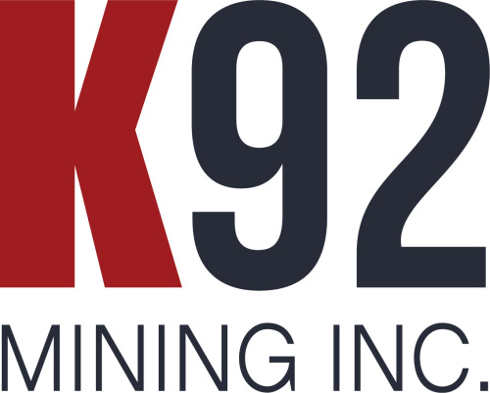








SINGULAR AMONGST SINGLE ASSET PRODUCTION
Valley (yr 2-6)
Valley (LOM)
Senior Producer Average (2020)
LOWER COSTS
Senior Producer Average (2024)
INCREASED PRODUCTION
Annual Gold Production (koz)
Valley’s low cost, high output production profile compares favorably to single-asset gold producers globally, particularly during the first five full years
Source: Company disclosure; Agentis Capital research.
Note: Production and AISC on co-product (AuEq) basis, 2025 estimates; excludes Russian assets or assets held by SOEs.
All-in sustaining costs are a non-GAAP measure.

Slide 13
UNIQUE IN THE GLOBAL DEVELOPMENT PIPELINE
Valley (yr 2-6)
Valley (LOM)
LOWER COSTS
Windfall
(2024)
Great Bear
(2021)
Back River
(2023)
Hemi
(2024)
Oko West
(2024)
INCREASED PRODUCTION
Valley sits at the head of the pack amongst development-stage gold assets globally, with an unparalleled 5-year starter pit
Source: Company disclosure; Agentis Capital research.
Note: Production and AISC on co-product (AuEq) basis, AISC inflated from study year to 2025 at 4%/yr.
All-in sustaining costs are a non-GAAP measure.

Slide 14


CANADIAN DEPOSIT - AUSTRALIAN CONTEXT
 | Hemi | Valley
Mineable Deposit¹ | 6.0 Moz Au | 7.4 Moz Au²
Number of Pits | 5 pits | 1 pit
Grade | 1.5 g/t Au | 1.34 g/t Au
Stripping Ratio | 6.6 to 1 | 1.1 to 1
Starter Pit | 1.8 Moz @ 1.6 g/t Au | 2.8 Moz @ 2.34 g/t Au
Mineralization | Refractory | Non-refractory
Discovery | 2019 | 2022
Initial Economics | 2022 (PFS) | 2025 (PEA)
Spot Gold | $2,646 (2024 buy out) | $3,646
Price | $5.0 B AUD (2024 buy out) | $2.0 B AUD (2025 mkt cap)
¹Hemi shows reserves as per 2023 DFS published by De Grey Mining; Valley shows resources mined in 2025 PEA. ²Figure includes 95% measured & indicated resources, 5% inferred.
14

Slide 15
DEVELOPMENT-STAGE PRECEDENT TRANSACTIONS¹
Greater than US $1B, last 15 years
With a strong go-forward team and treasury, Snowline has a clear path to unlocking shareholder value through development—while comparable M&A transactions highlight significant upside potential
Date | Target | Acquiror | Stage | Transaction Value (US$M) | P/NAV (x)
Mar-25 | Spartan | Ramelius | Resource Estimate | $1,331 | 1.2x
Dec-24 | De Grey | Northern Star | FS | $2,729 | 1.0x
Aug-24 | Osisko | Gold Fields | FS | $1,198 | 1.0x
Dec-21 | Great Bear | Kinross | Exploration | $1,338 | 0.9x
Dec-19 | Continental | Zijin | Construction | $1,187 | 0.8x
Dec-11 | Euro. Goldfields | Eldorado | FS | $2,339 | 0.8x
Feb-11 | Fronteer | Newmont | PFS | $1,840 | 1.4x
Nov-10 | Ventana | EBX | PEA | $1,159 | 1.1x
Sep-10 | Andean | Goldcorp | FS | $3,113 | 1.8x
 |  |  | Average |  | 1.11x
MAMMOTH M&A
Large, high-quality gold assets like Valley are increasingly rare globally and command relative premiums, particularly during bull markets
Gold Bull
¹Sources: BMO Capital Markets, company disclosure, street research
15

Slide 16
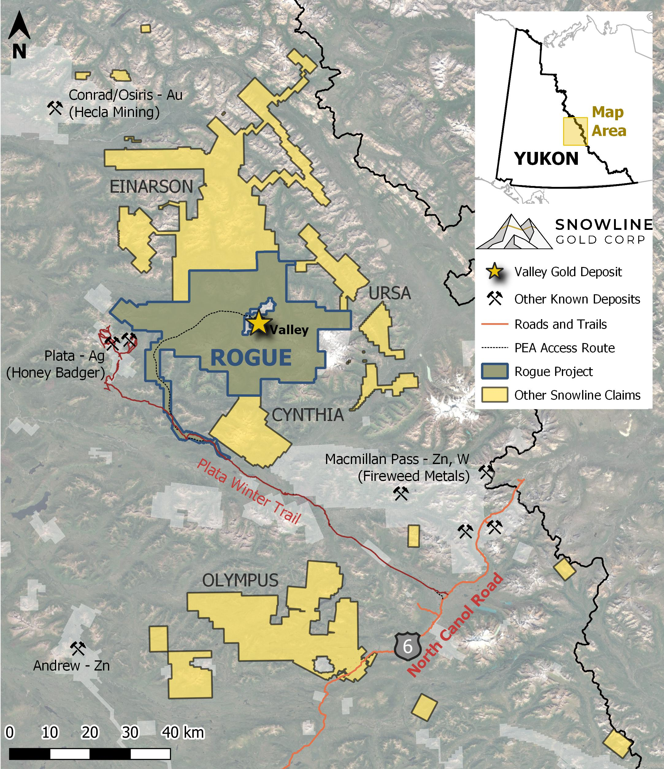
LOCATION & INFRASTRUCTURE
CANADA’S YUKON: A SAFE AND STABLE JURISDICTION
  Long mining history and established permitting processes
REMOTE BUT ACCESSIBLE
  75 km from government-maintained North Canol Road
  30 km from existing winter heavy equipment trail used for historical mining in the area
  Low-elevation corridor with no major barriers
PEA CONSIDERS ALL-SEASON ROAD ACCESS
  Includes bridge and upgrades along North Canol Road
  New ~130 km road primarily along existing Plata Trail
ON-SITE POWER GENERATION
  Baseline assumption is on-site diesel power
REGIONAL INFRASTRUCTURE SYNERGIES AND SUPPORT
  Funding from Canadian and US governments to advance road & power infrastructure along North Canol corridor for adjacent Macmillan Pass critical metals projects (not considered in PEA)
Alaska
NWT
British Columbia

Slide 17
SIGNIFICANT LOCAL IMPACT
Yukon GDP¹
6%
46%
GDP: US $260.7 B
Population: 3.3 M
GDP: C $4.1 B
Population: 41 k
+ Valley
25%
GDP: C $3.3 B
Population: 47 k
18%
GDP: C $353.3 B
Population: 4.8 M
GDP: C $4.2 B
Population: 45 k
Valley’s average annual gold sales across first five full years at spot equates to roughly 59%³ of the Yukon’s current GDP
¹ Statistics Canada: Gross domestic product by industry: Provinces and territories, 2024
²US Bureau of Economic Analysis: Gross Domestic Product by State
³Using average gross gold sales for 544koz Au Years 2-6 at US $3,600/oz Au

Slide 18
CONCEPTUAL ADVANCEMENT TIMELINE
Priorities for H2 2025 include detailed project scheduling, environmental baseline and continuing early engagement with First Nations on forward-looking plans
Construction Ready Project
2025
2026
2027
2028
2029
2030
PEA
Project Studies & Design Advancement
Engineering
Detailed Design
Environmental Baseline Studies
Baseline Studies to Inform Permitting
Environmental
Ongoing Monitoring
Pre-Submission Engagement
YESAB Screening & Assessment
Assessment & Permitting
Water License
YG Mining License
Pre-Submission Engagement
Assessment & Permitting Engagement
Agreement
Implementation
Indigenous Participation
First Nations Engagement, Participation & Agreement Negotiations

Slide 19
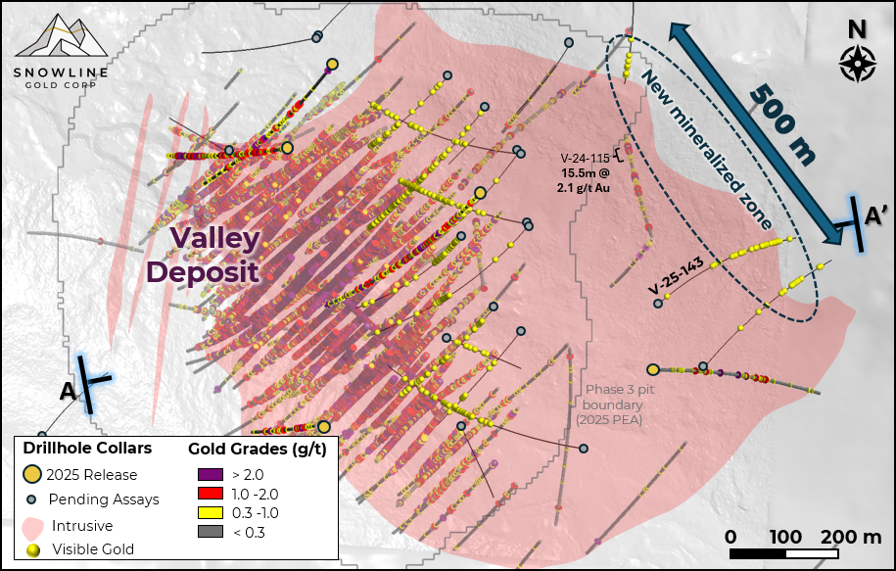
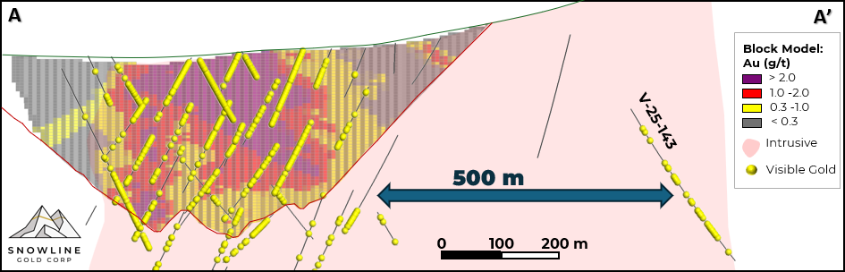
VALLEY OPPORTUNITIES
Additional opportunities to evaluate during subsequent study phases
PRODUCTION RATE OPTIMIZATION
  PEA a “base case” starting point – production rates and schedules to be studied in upcoming studies
  Increasing mill throughput for Year 6 could potentially sustain higher production levels LOM
INFRASTRUCTURE & POWER
  PEA conservatively includes public infrastructure, ignores potential synergies with Fireweed’s adjacent projects and allocated government funding
  Power sources to be examined in detail during PFS alongside grind size optimization
VALLEY RESOURCE EXPANSION
  Deposit remains open in several directions, with encouraging results outside of MRE (e.g. V-24-115)
  District potential: Additional targets on Rogue Project with similar characteristics to Valley
OPEN
OPEN
V-24-115
15.5m @
2.1 g/t Au
OPEN
OPEN
UNTESTED
The PEA is detailed in the recent technical report for Rogue, prepared in accordance with NI 43-101 standards, entitled “Independent Preliminary Economic Assessment for the Rogue Project Yukon, Canada,” dated July 30, 2025, with an effective date of March 1, 2025, available on SEDAR+ and the Company’s website.

Slide 20
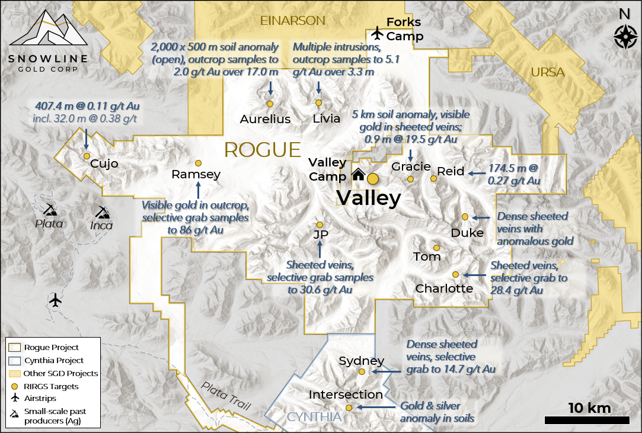
DISTRICT UPSIDE
100% owned, 360,000-hectare first-mover land package with 30+ primary targets
CLUSTERED SYSTEMS
  Reduced-intrusion related gold systems often occur in clusters
  Actively drilling multiple targets on broader Rogue project with similar gold and pathfinder mineralization
DISTRICT SCALE POTENTIAL
  Valley offers strong proof-of concept for regional fertility
  Valley lowers the bar for additional economic discoveries
  Early innings for district scale exploration:
Moz Au
Note that Valley represents a different style of gold mineralization than deposits of the Carlin Trend, and there is no guarantee that additional mineral resources will be located on or around the Rogue Project.
1 Coope, Alan J. “Carlin Trend Exploration History: Discovery of the Carlin Deposit.” Nevada BMG Special Publication 13
Year

Slide 21



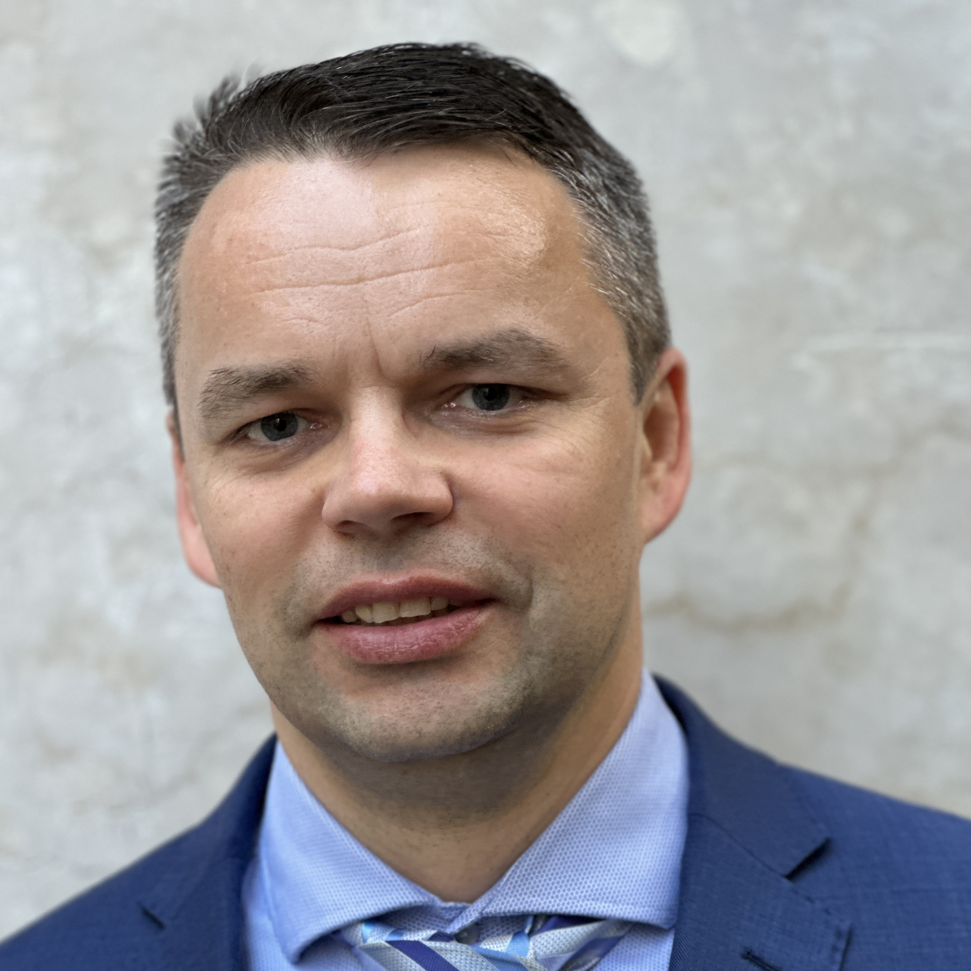








LEADERSHIP – DRIVING FORWARD
MANAGEMENT
= New Hire 2025
Scott Berdahl
CEO & Director
Calum Morrison
President & Director
Lauren McDougall
CFO & Corp. Sec.
Victor Vdovin
VP Engineering
Thomas Branson
VP Exploration
Sergio Gamonal
Chief Geologist
BOARD OF DIRECTORS (Includes CEO & President)
Brian Hegarty
VP Sustainability &
External Relations
Oliver Curran
VP Environment &
Permitting
Craig Hart
Independent Chair
Geology
Sarah Weber
Independent Director
Indigenous Engagement
Gil Lawson
Independent Director
Mine Development
Rob Doyle
Independent Director
Capital Markets

Slide 22
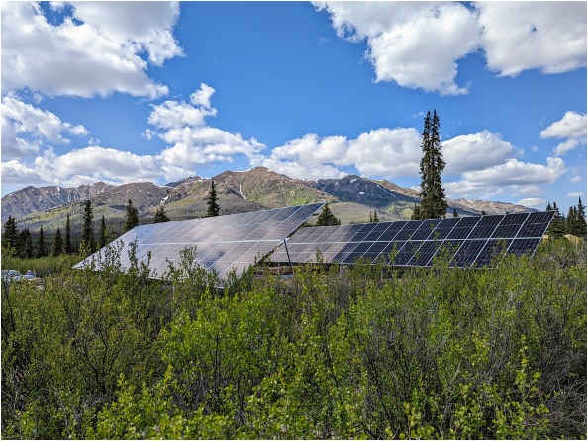
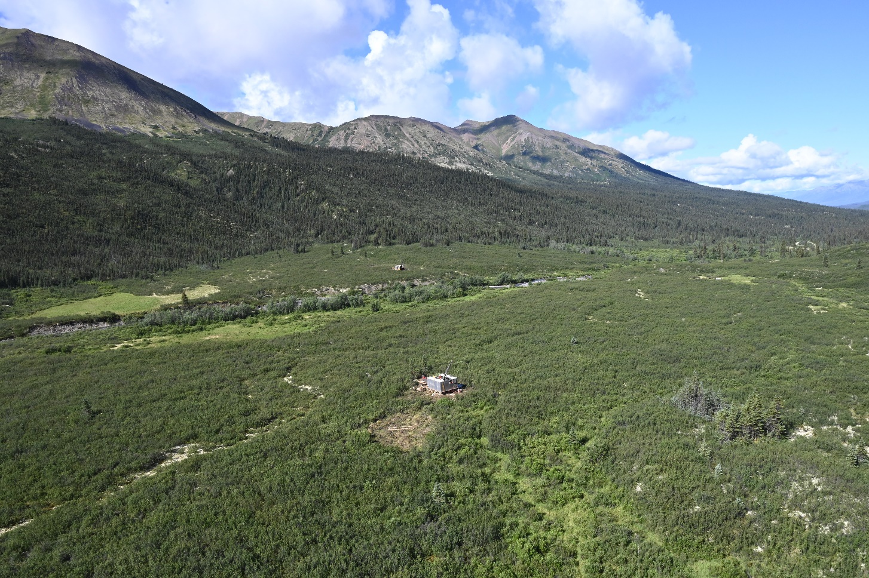
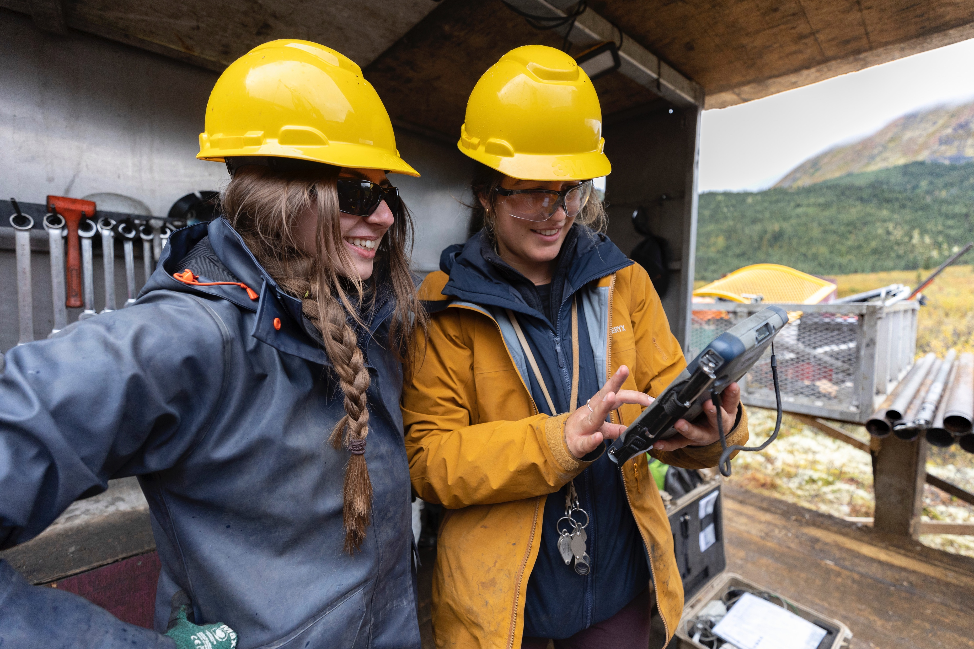

A NEXT-GENERATION RESOURCE COMPANY
2023 & 2024 ROBERT E. LECKIE AWARDS for Excellence in Environmental Stewardship
2025 YUKON SUSTAINABILITY AWARD
Snowline’s “Forks” Camp
Valley deposit, surface view
Snowline staff at Valley
SNOWLINE GOLD IS DRIVEN BY FOUR GUIDING PRINCIPLES:
ENVIRONMENTAL RESPECT
  Recognition that the Yukon’s wilderness is an invaluable asset with a commitment to responsible exploration
BUILDING COMMUNITY
  Working to benefit local communities, First Nations and the Yukon Territory with skills training, economic opportunities and local partnerships
GOING BIG
  Exploring blue-sky concepts in prospective rocks to find big deposits and sustainable mines
DOING THINGS RIGHT
  Commitments to safety, integrity and exceeding best practices; to scientific rigour and stewardship of shareholder’s funds

Slide 23



















STRONG CAPITAL & COVERAGE
CAPITAL STRUCTURE
OWNERSHIP
Basic Shares Outstanding | 172.3 M
Options ($0.30 – $8.64 strike price; $29.0 M total redemption*) | 10.7 M
Restricted Share Units & Deferred Share Units | 1.0 M
Fully Diluted Shares Outstanding | 184.0 M
Basic Market Capitalization (Sep 3, 2025 - $9.86 share price) | $1.70 B
Cash (Sep 4, 2025) | $130.4 M
Debt | $0
All figures in Canadian dollars
*A large proportion of stock options have not yet vested
ANALYST COVERAGE
INCREASING INSTITUTIONAL OWNERSHIP
Owners include, but not limited to:
Michael Gray
NAVPS: $31.43
Peter Bell
Target: $24.50
Brandon Gaspar
Target: $17.50
Rabi Nizami
Target: $15.00
Brian Quast
Target: $15.50
Scotia Global
Asset Management
Stefan Iannou
Target: $16.50
Luke Bertozzi
Target: $11.50
Allison Carson
Target: $14.00
Eric Winmill
Target: $14.50
Michael Curran
Target: $11.75
Institutional inclusion on this slide based on participation in previous private placements, direct communication and/or public disclosure of open market buying. Information last updated September 2025.

Slide 24
DELIVERING SHAREHOLDER VALUE
+2,091% in 4.5 years since launch
SGD
GDXJ¹
BTC/USD¹
¹Normalized to SGD opening price, March 1, 2021
To date, Snowline has outperformed the GDXJ by over 1,000%
(and Bitcoin by over 800%)
Mar 1, 2021
Jan 1, 2022
Jan 1, 2023
Jan 1, 2024
Jan 1, 2025
Sep 3, 2025
RECENT MILESTONES
UPCOMING CATALYSTS
Initial Valley PEA, highlighting high gold production, competitive margins and robust economics (Jun ’25)
Updated Valley MRE, expanding measured & indicated resources by 96% (May ’25)
Raised C$102M in combined bought-deal and private placement to finance multiple years of exploration and development (Sep ’25)
Second consecutive Robert Leckie Award for Excellence in Environmental Stewardship along with 2025 Yukon Sustainability Award (Feb ’25)
Valley expansion and near-deposit discovery potential via active 20,000 m drill program
District-scale discovery potential via active 10,000 m regional exploration drill campaign and extensive surface exploration
Rapid progress towards Pre-Feasibility Study and associated project de-risking
Ongoing engagement with Yukon First Nations

Slide 25
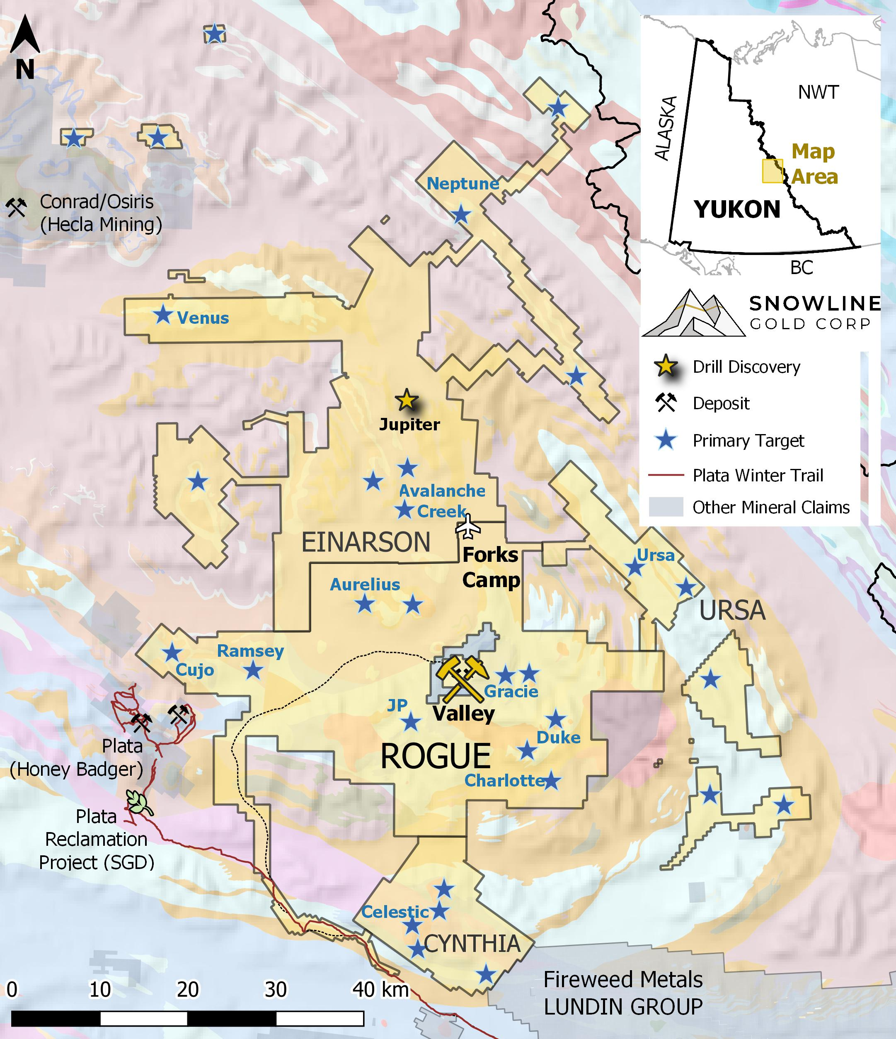
INVESTMENT HIGHLIGHTS
A WORLD CLASS FLAGSHIP ASSET
Robust economics in recent PEA for Snowline’s 100%-owned Valley deposit (C$6.8B NPV_{5%} @ US$3,150/oz Au¹), a best-in-class reduced-intrusion gold system with 7.94 million ounces gold M&I at 1.21 g/t Au¹ and favourable characteristics for efficient mining
FIRST MOVER, DISTRICT SCALE UPSIDE
Aggressive 30,000+ m exploration program underway on prospective >360,000 ha land package with 30+ gold targets in underexplored Yukon Territory
STRONG TREASURY & TEAM
>C$130M treasury with highly experienced, Yukon-focused team leading active exploration and development programs
COMMITTED TO RESPONSIBLE PROGRESS
Recipient of the 2023 & 2024 Robert E. Leckie Awards selected by Yukon Government and First Nations for Snowline’s environmental stewardship efforts, and the 2025 Yukon Sustainability Award from ECO Canada
1 The MRE and PEA are detailed in the recent technical report for Rogue, prepared in accordance with NI 43-101 standards, entitled “Independent Preliminary Economic Assessment for the Rogue Project Yukon, Canada,” dated July 30, 2025, with an effective date of March 1, 2025, available on SEDAR+ and the Company’s website.

Slide 26
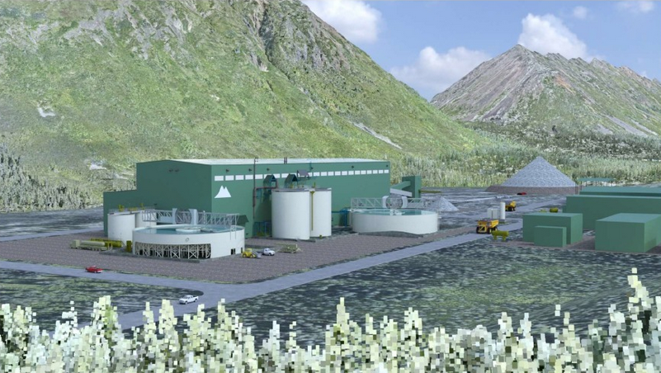





THANK YOU!
SNOWLINE GOLD
Whitehorse Office
3151 3rd Avenue
Whitehorse, YT Y1A 1G1
Vancouver Office
300-900 W Hastings Street
Vancouver, BC V6C 1E5
Connect With Us!
info@snowlinegold.com
snowlinegold.com
MINING FORUM AMERICAS | SEPTEMBER 2025 TSX-V: SGD | OTC: SNWGF

