Slide 1
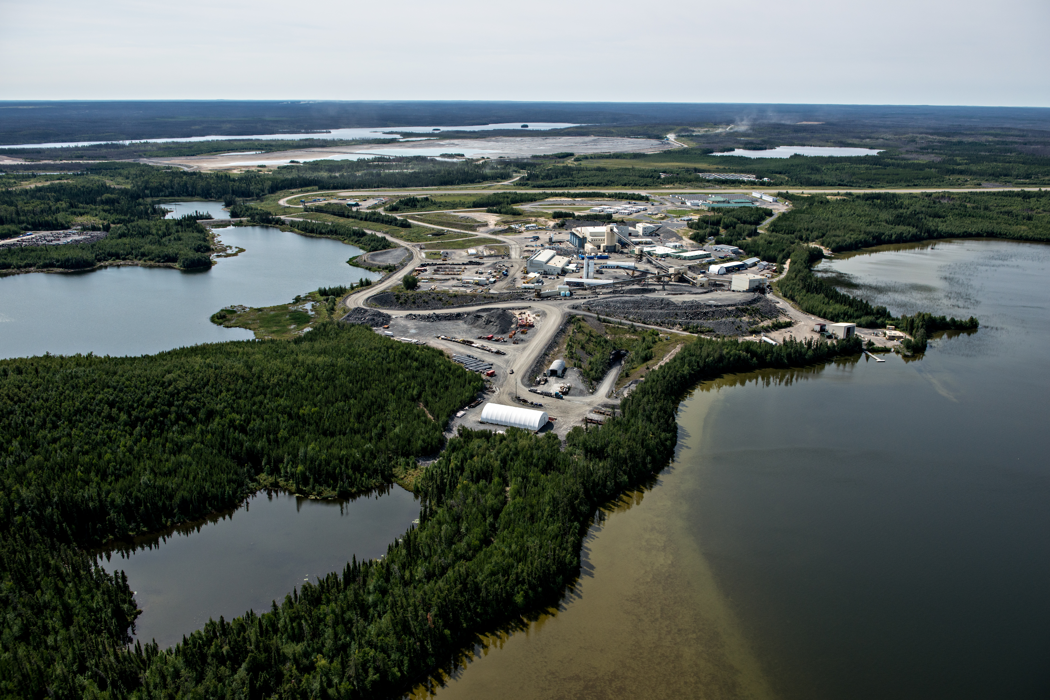

Even better tomorrow
The emerging producer of choice
TSX:OLA NYSE:ORLA | SEPTEMBER 2025

