Slide 1
September 2025
CHARTING A NEW PATH FOR VALUE REALIZATION AT MT TODD
VGZ
NYSE American & TSX

Slide 2
CAUTIONARY STATEMENT
Summary: If you are risk-averse you should not buy shares in Vista Gold Corp. Unexpected events happen and may change forecasts and targets. This presentation should be read in conjunction with Vista’s most current Forms 10-K and 10-Q available on EDGAR at www.sec.gov and SEDAR+ at www.sedarplus.ca. All dollar amounts are in U.S. dollars.
This presentation contains forward-looking statements within the meaning of the U.S. Securities Act of 1933, as amended, and U.S. Securities Exchange Act of 1934, as amended, and forward-looking information within the meaning of Canadian securities laws. All statements, other than statements of historical facts, are forward looking statements. These include statements relating to activities, events or developments that Vista expects or anticipates will or may occur in the future, including such things as, the Company’s continuing work and development on the Mt Todd gold project; estimates of mineral reserves and mineral resources; projected project economics, including anticipated production, average cash costs, all-in sustaining costs, after-tax NPV, IRR, capital requirements and expenditures, operating costs, average tonne per day milling, mining methods, Mineral Reserves and Mineral Resources estimates; project design, and life of mine; performance of and results of feasibility studies; the Company’s business strategy, including charting a new path for value realization at Mt Todd; the Company’s belief that the 2025 feasibility study demonstrates strong project economics and an achievable path for near-term production; the Company’s belief that the Mt Todd fit for purpose design supports conventional Australian mine and plant operations; the Company’s next steps to increase broad awareness of the value of the Mt Todd gold project, pursue and advance interest in a strategic transaction, and advance pre-development activities that benefit Mt Todd, including updating permits to align with the 15 ktpd project; the Company is pursuing development options to achieve near term production and a producer re-rating, including a potential corporate or asset transaction, joint venture, other forms of strategic transactions or to advance development of Mt Todd on a standalone basis; the Company’s belief that the feasibility study designed a project that is fit for purpose and right sized, with excellent opportunity for expansion; the Company’s belief that the feasibility study opens doors to various development opportunities; the Company’s belief that Mt Todd is a leading near-term development opportunity; the Company’s belief that Northern Territory, Australia is a Tier 1 jurisdiction; the Company’s belief that Mt Todd is the second largest undeveloped gold project in Australia; the Company’s belief that there is district-scale exploration potential within the largely unexplored 1,337 km2 of contiguous exploration licenses which hosts known occurrences of precious and base metals and are highly prospective for new discoveries; the Company’s belief that prior drilling within the boundaries of the mining licenses identified promising targets on the 24-km Batman-Driffield Trend with potential to add 1.8 – 3.5 million gold ounces to the resource base; the Company’s belief that the South Cross Lode is open at depth and along strike to the northeast, potentially connecting to other identified exploration targets; statements related to permits, authorizations and licenses, and taxation and royalties; the Company belief that modifications to align current permits and approvals with the 15 ktpd project will take approximately 12-18 months to compete; completion of future studies and exploration on the mining licenses including our understanding of the Quigleys deposit; risks relating to the future effectiveness of the water treatment program and risks related to the discharge of water into the Edith River; future business goals, strategy and plans, competitive strengths and project development; success of future joint ventures, partnerships or other arrangements on our properties; the potential monetization of our non-core assets including the mill equipment; and other such matters are forward-looking statements and forward-looking information. The material factors and assumptions used to develop the forward-looking statements and forward-looking information contained herein include the following: no changes to laws or regulations impacting mine development or mining activities, our approved business plans, mineral resource and reserve estimates and results of preliminary economic assessments, preliminary feasibility studies and feasibility studies on our projects, if any, our experience with regulators, assumed timing for regulatory approvals and studies anticipated and estimated costs and budget expenditures to continue to optimize and advance Vista’s core asset, our experience and knowledge of the Australian mining industry and positive changes to current economic conditions and the price of gold and other such matters. When used in this presentation, the words “estimate,” “plan,” “anticipate,” “expect,” “intend,” “believe,” “will,” “if,” “would,” “could,” and similar expressions are intended to identify forward-looking statements which may cause the actual results, performance or achievements of Vista to be materially different from any future results, performance or achievements expressed or implied by such statements. Such factors include, among others, uncertainty of resource and reserve estimates, uncertainty as to the Company’s future operating costs and ability to raise capital; risks relating to cost increases for capital and operating costs; risks of shortages and fluctuating costs of equipment or supplies; risks relating to fluctuations in the price of gold and fluctuations in currency values; the inherently hazardous nature of mining-related activities; potential effects on our operations of environmental regulations in the countries in which we operate; risks due to legal proceedings; risks relating to political and economic instability in certain countries in which we operate; uncertainty as to the results of bulk metallurgical test work; and uncertainty as to completion of critical milestones for Mt Todd; as well as those factors discussed under the headings “Note Regarding Forward-Looking Statements” and “Risk Factors” in the Company’s latest Annual Report on Form 10-K as filed in February 2025 and other documents filed with the U.S. Securities and Exchange Commission and Canadian securities regulatory authorities. Although we have attempted to identify important factors that could cause actual results to differ materially from those described in forward-looking statements and forward-looking information, there may be other factors that cause results not to be as anticipated, estimated or intended. Except as required by law, we assume no obligation to publicly update any forward-looking statements or forward-looking information, whether as a result of new information, future events or otherwise.
Vista Gold Corp. Qualified Person
All scientific and technical information related to the 2025 Updated Feasibility Study contained herein has been prepared by, or under the supervision of, Maria Vallejo, P.Eng., FAusIMM, Vista’s Director of Projects and Technical Services, a Qualified Person as defined by National Instrument 43-101 – Standards of Disclosure for Mineral Projects (“NI 43-101”) and subsection 1300 of Regulation S-K (“S-K 1300”) under the U.S. Securities Exchange Act of 1934, as amended (“Exchange Act”).
Cautionary Note to Investors Regarding Estimates of Measured, Indicated and Inferred Resources and Proven and Probable Mineral Reserves
We are subject to the reporting requirements of the U.S. Exchange Act and applicable Canadian securities laws, and as a result we report our mineral reserves and mineral resources according to two different standards. U.S. reporting requirements are governed by S-K 1300. Canadian reporting requirements for disclosure of mineral properties are governed by NI 43-101. Both sets of reporting standards have similar goals in terms of conveying an appropriate level of confidence in the disclosures being reported, but the standards embody slightly different approaches and definitions.
In our public filings in the U.S. and Canada and in certain other announcements not filed with the SEC, we disclose proven and probable reserves and measured, indicated and inferred resources, each as defined in S-K 1300 and NI 43-101. As currently reported, there are no material differences in our disclosed proven and probable reserves and measured, indicated and inferred resource under each of S-K 1300 and NI 43-101. The estimation of measured resources and indicated resources involve greater uncertainty as to their existence and economic feasibility than the estimation of proven and probable reserves, and therefore investors are cautioned not to assume that all or any part of measured or indicated resources will ever be converted into S-K 1300-compliant or NI 43-101-compliant reserves. The estimation of inferred resources involves far greater uncertainty as to their existence and economic viability than the estimation of other categories of resources, and therefore it cannot be assumed that all or any part of inferred resources will ever be upgraded to a higher category. Therefore, investors are cautioned not to assume that all or any part of inferred resources exist, or that they can be mined legally or economically.

Slide 3

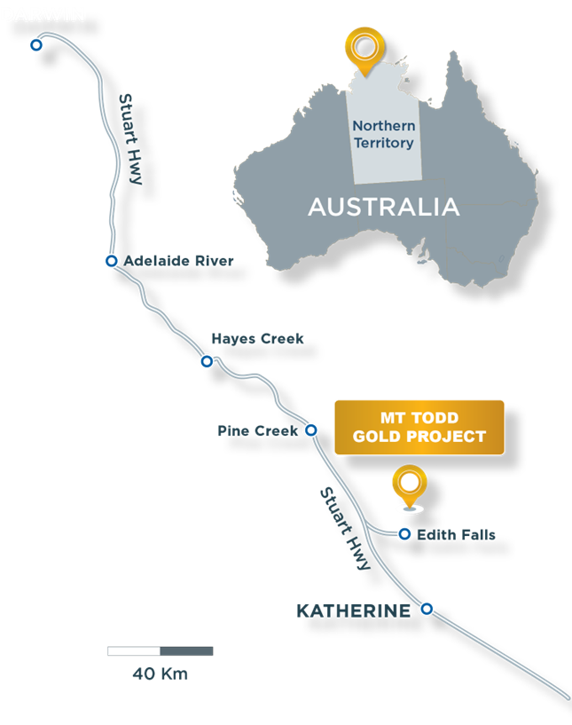

VISTA GOLD CORP.
New Feasibility Study Demonstrates Achievable Path to Near-Term Production
Australia’s Second Largest Undeveloped Gold Project
15 ktpd Feasibility Study Incorporates Fit for Purpose Design and Preserves Expansion Optionality
Prioritizes Grade over Tonnes and Significantly Lowers Initial Capex
Strong Project Economics Support Near-Term Production

Slide 4
VISTA GOLD CORP.
INSTITUTIONAL HOLDERS AND INSIDERS
Tight Capital Structure with No Debt
CAPITAL STRUCTURE
INSTITUTIONAL HOLDERS
AND INSIDERS
Symbol (NYSE American & TSX) | VGZ
Share Price (September 12, 2025) | $1.83
Shares Outstanding ¹ | 125.1M
Market Capitalization | $228.9M
Cash ² | $13.2M
Debt | Nil
Sun Valley Gold Fund | 13.2%
Vista Board & Management | 4.3%
Kopernik Global Investors | 3.2%
Cetera Investment Advisors | 1.6%
Loews Corporation | 1.5%
Redmond Asset Management | 0.8%
1 Outstanding shares as of June 30, 2025. Fully diluted 129.9 million.
2 As of June 30, 2025.
All currency values in this presentation are reported in U.S. dollars, unless otherwise noted.

Slide 5


CHARTING A NEW PATH FOR VALUE REALIZATION
MT TODD GOLD PROJECT
2024 FS
15 ktpd (5.3 MTPA) Feasibility Study
50 ktpd (17.8 Mtpa)
$1.03 B initial capex
0.35 g Au/t cut-off grade
479 koz/yr years 1-7 395 koz/yr LoM
Conservative equipment selection with owner-operated mining fleet
3rd party power generation
Community-based project
59% REDUCTION IN INITIAL CAPEX
PRIORITIZES GRADE OVER TONNES
CONTRACT MINING & POWER GENERATION
CONSISTENT ANNUAL GOLD PRODUCTION OVER EXTENDED MINE LIFE
FIT FOR PURPOSE DESIGN
BALANCES WORKFORCE SOURCING – 80-90% FIFO

Slide 6
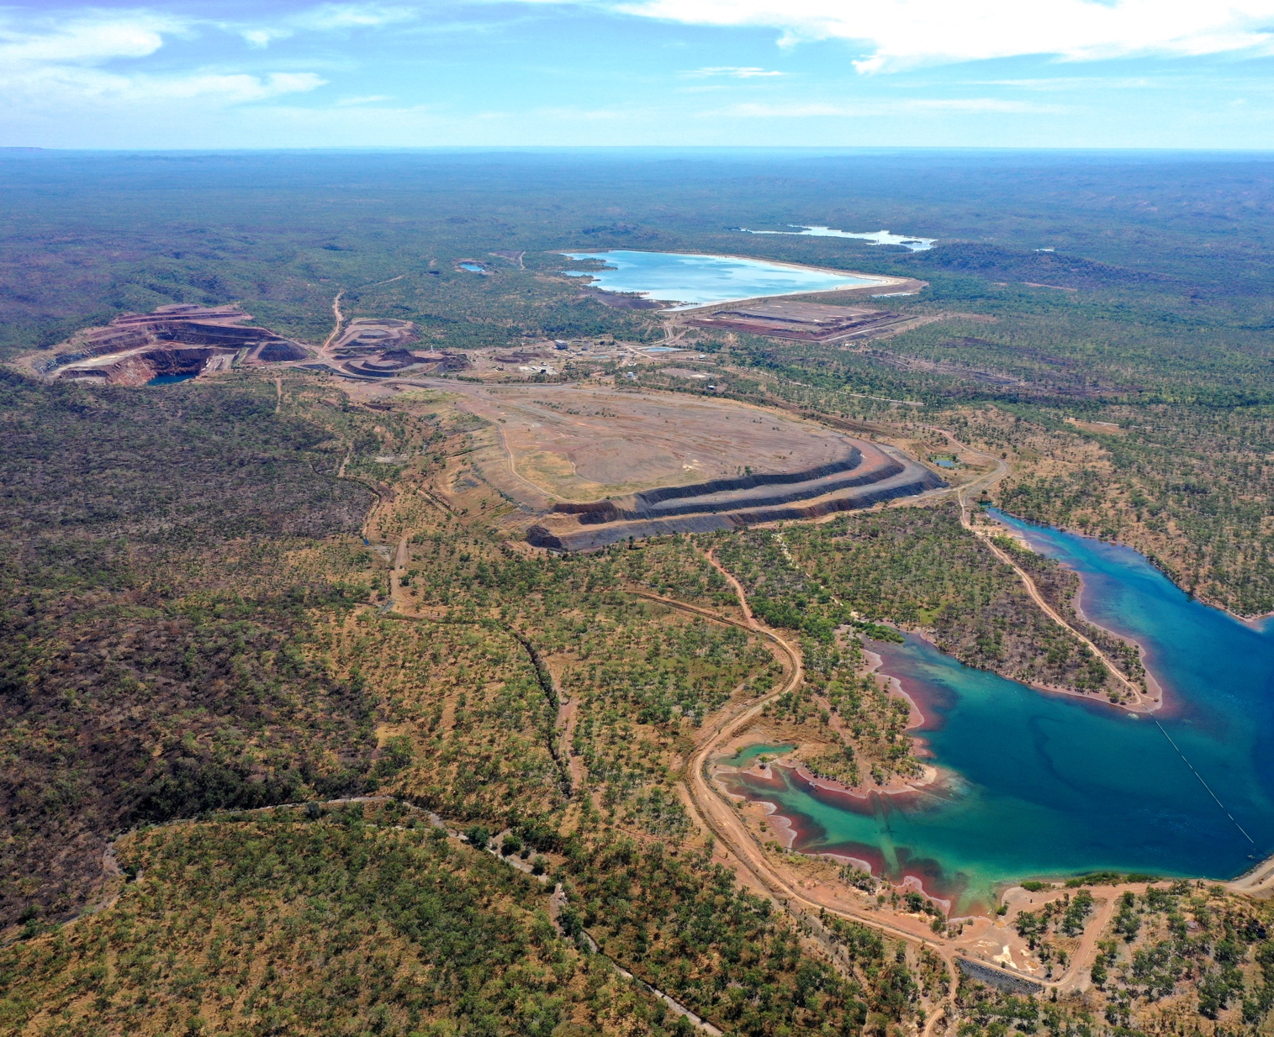
15 ktpd FEASIBILITY STUDY HIGHLIGHTS
MT TODD GOLD PROJECT
1.04 g Au/t
AVERAGE ORE GRADE
YEARS 1-15
153,000 oz
AVERAGE GOLD PRODUCTION
YEARS 1-15
$425 Million
INITIAL
CAPEX
5.2 Million oz Au
MINERAL RESERVES¹
10.6 Million oz Au
MINERAL RESOURCES²
$1.1 Billion
AFTER-TAX NPV_{5%}³
27.8%
AFTER-TAX IRR³
$2.2 Billion
AFTER-TAX NPV_{5%} AT SPOT GOLD⁴
44.7%
AFTER-TAX IRR AT SPOT GOLD⁴
$1,449/OZ
AISC YEARS 1-15
30 YEAR
MINE LIFE ⁵
At $1,800 gold price and 0.50 g Au/t cutoff - see slide 14 for details.
At $1,950 gold price and 0.40 g Au/t cutoff - see slide 13 for details.
Feasibility Study gold price of $2,500.
Spot gold price of $3,300.
Excludes years 31-33 of self-funding reclamation when heap leach ore from previous operations is re-processed.

Slide 7
MINERAL RESOURCES AND MINERAL RESERVES
MT TODD GOLD PROJECT
Increased Reserve Grade by 23% – 1.04 g Au/t Years 1-15 and 0.97 g Au/t LoM
Mineral Resources Estimate¹
Total gold resources now exceed 10.5 Moz
Mineral Reserves Estimate²
Proven and probable – 5.2 Moz at raised cutoff grade of 0.50 g Au/t
Total Mineral Resources
 | Tonnes (000) | Grade (g Au/t) | Gold Oz (000)
Measured & Indicated | 340,428 | 0.83 | 9,122
Inferred | 57,099 | 0.78 | 1,433
 |  |  | 10,555
Proven and Probable Mineral Reserves
 | Tonnes (000) | Grade (g Au/t) | Gold Oz (000)
Batman Deposit | 158,263 | 0.97 | 4,959
Heap Leach Pad | 13,352 | 0.54 | 232
 |  |  | 5,191
See Appendix – Mineral Resources slide 13 for details.
See Appendix – Mineral Reserves slide 14.

Slide 8

MINING AND PROCESSING
MT TODD GOLD PROJECT
Fit for Purpose Design Supports Conventional Australian Mine and Plant Operations
Mining Overview
Conventional truck and excavator open pit operation
Drill and blast on 12-meter benches (ore and waste)
Pit slope parameters re-evaluated
71 M tonnes of below cut-off material with economic potential to be segregated in waste rock dump for possible future processing
0.35-0.5 g Au/t (average grade of 0.43 g Au/t)
982 Koz contained gold
Batman pit stripping ratio (W:O) 4:1
Processing¹
Stockpiling used to deliver higher and consistent grades
Life of mine average gold recovery of 88.5%
3-stage crush (gyratory, cone and HPGR)
Single-stage sorting (XRT)
2-stage grind (P₈₀ 40 microns)
Carbon-in-leach recovery circuit
See Appendix – Conventional Gold Recovery Circuit slide 15 for process flowsheet details.

Slide 9
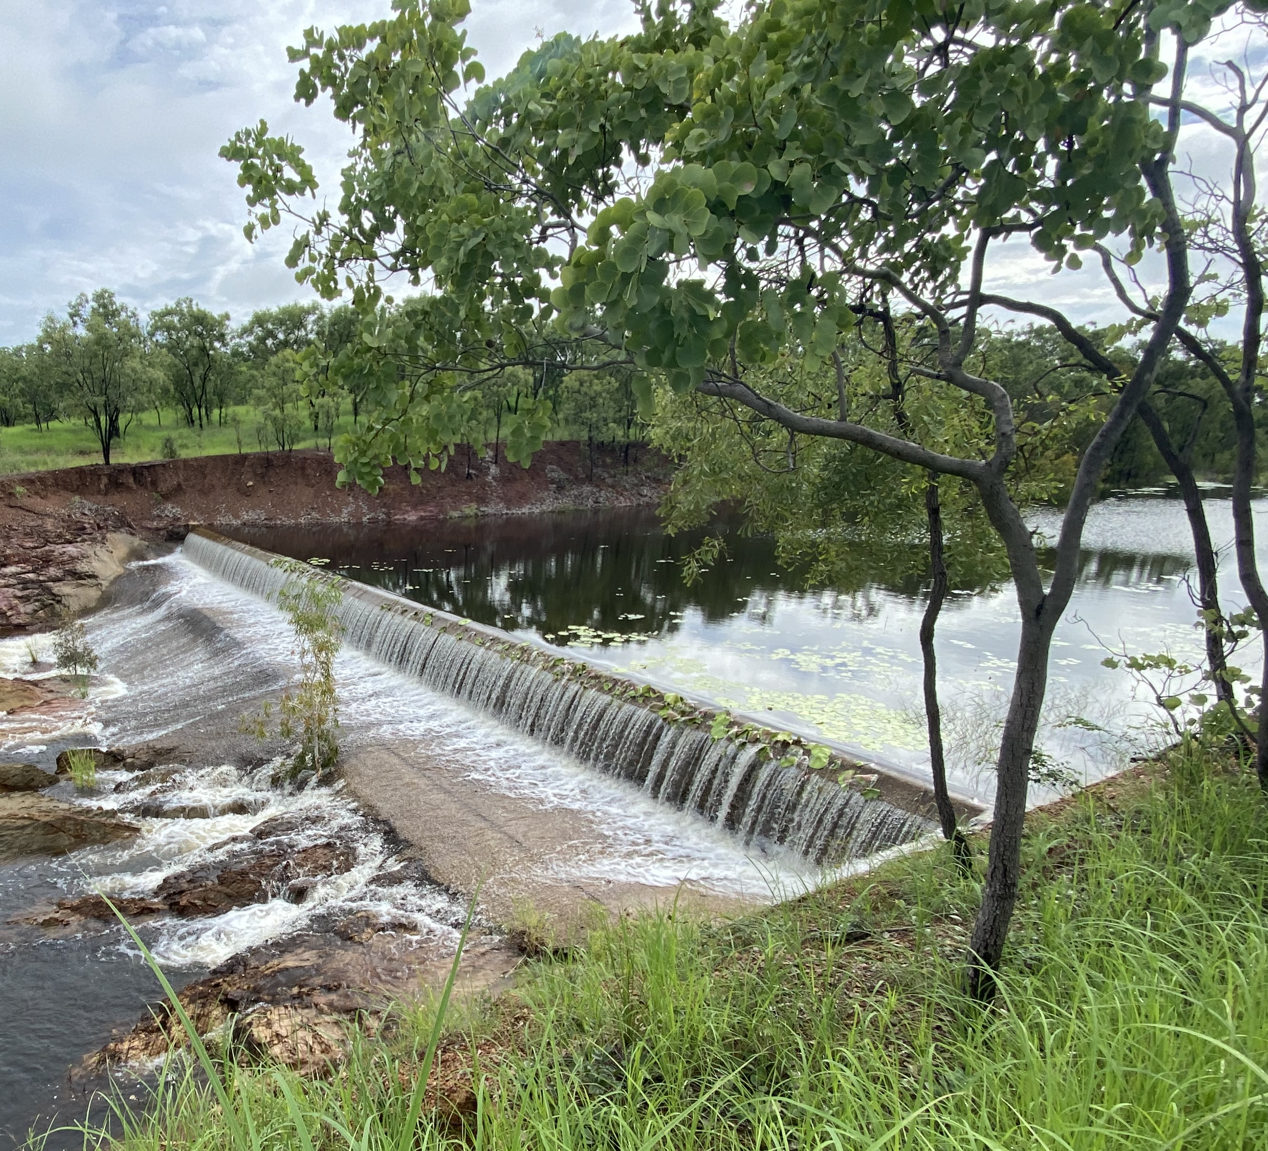
VISTA GOLD CORP.
Next Steps
Broadly Increase Awareness of the Value of Mt Todd Gold Project
Feasibility Study demonstrates strong economics and 30-year mine life with excellent opportunity for expansion
Technical and economic parameters are comparable to several highly valued Australian gold producers
Pursue and Advance Interest in a Strategic Transaction
Advance Pre-Development Activities that Benefit Mt Todd
Update permits to align with new 15 ktpd feasibility study
Testing and evaluations leading to the start of detailed engineering

Slide 10
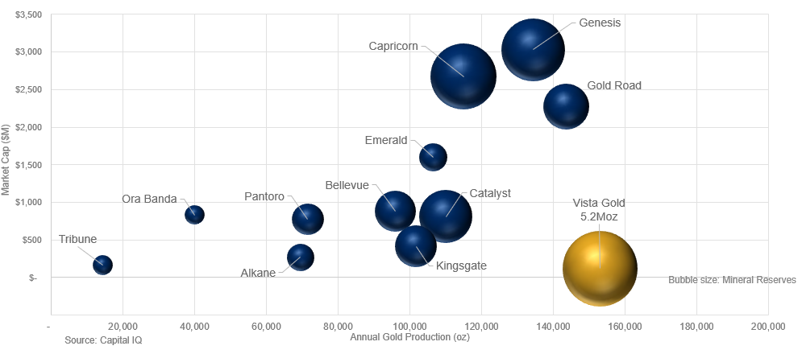
VISTA GOLD CORP. – Value proposition
Pursuing Development Options to Achieve Producer Re-Rating
Premier Asset in Tier 1 Mining Jurisdiction
Demonstrated Economic Feasibility
Achievable Near-Term Production
Expansion Opportunities
Strategic Path
Corporate or asset transaction
Joint venture
Advance on a standalone basis
Other form of strategic transaction
Comparison to Australian Gold Producers

Slide 11
VISTA GOLD CORP.
Charting a New Path for Value Realization at Mt Todd
Designed as an Australian Project for Near-Term Production
Fit for purpose and right sized
Attractive Development Option
1.04 g Au/t average ore grade over first 15 years; 0.97 g Au/t LoM
Reduced capex by 59% to $425 million
Steady gold production of approximately 153,000 oz/yr years 1-15; 146,000 LoM
Sustained Leverage to Gold Price
After-Tax NPV_{5%} of $1.1 billion and IRR of 27.8% at $2,500 gold price
After-Tax NPV_{5%} of $2.2 billion and IRR of 44.7% at spot gold price of $3,300
Expansion Opportunities
Reducing Development and Operating Risk
Renowned engineering firms with proven track records
Contract mining and 3rd party power generation
Predominantly FIFO workforce
Study Has Opened Doors to Various Development Alternatives

Slide 12

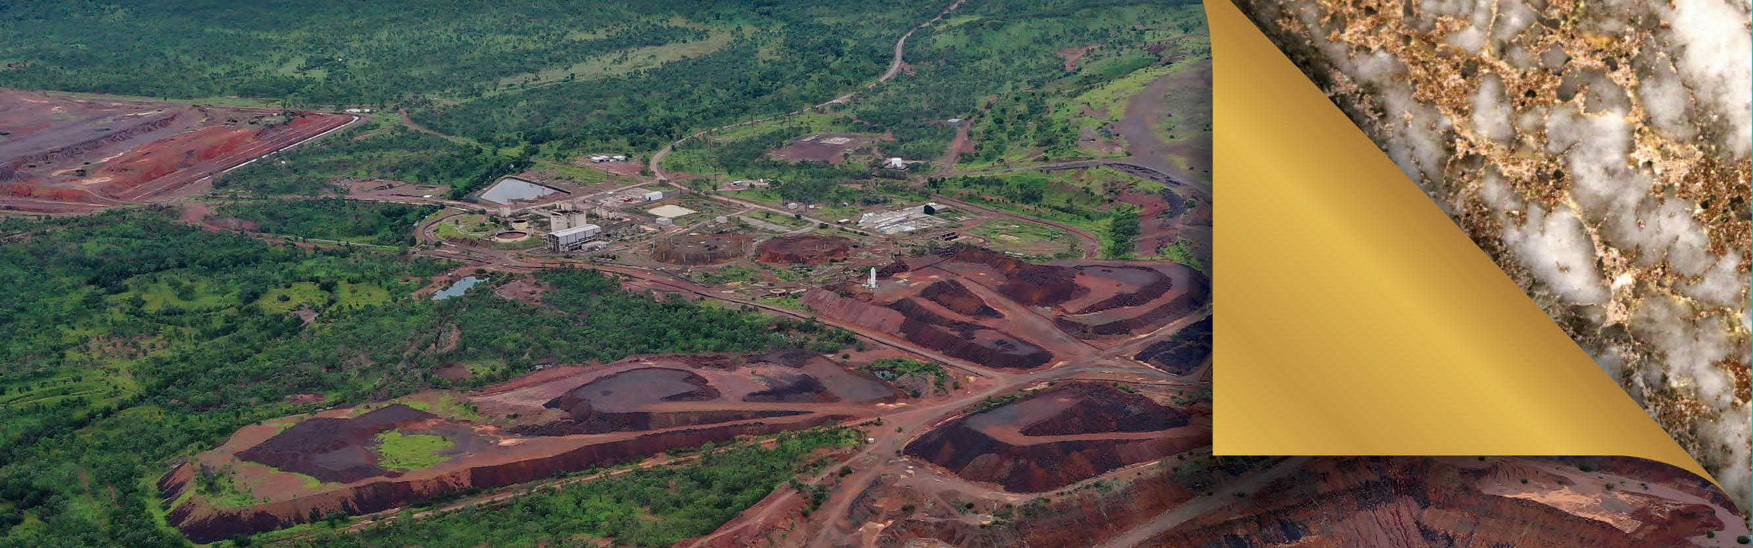


Contact
Pamela A. Solly
VP of Investor Relations
Phone: (720) 877-0132
Email: psolly@vistagold.com
NYSE AMERICAN & TSX: VGZ
www.vistagold.com

Slide 13
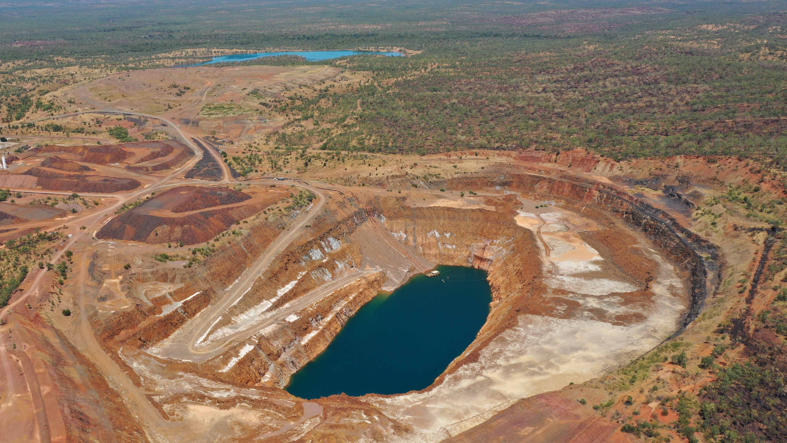
APPENDIX

Slide 14
MINERAL RESOURCES ESTIMATE
MT TODD GOLD PROJECT
Notes:
Measured & Indicated resources include Proven and Probable Reserves.
Batman and Quigley Resources are quoted at a 0.40g-Au/t cut-off grade. Heap Leach resources are the average grade of the heap, no cut-off applied.
Batman: Resources constrained within a $1,950/oz gold pit shell. Pit parameters: Mining Cost $3.00/tonne, Milling Cost $17.50/tonne processed, G&A Cost $1.50/tonne processed, Au Recovery metallurgical equation averaging 89.7%.
Quigleys: Resources constrained within a $1,950/oz gold pit shell. Pit parameters: Mining Cost $3.00/tonne, Milling Cost $17.50/tonne processed, G&A Cost $1.50/tonne processed, Au Recovery metallurgical equation averaging 89.7%.
Differences in the table due to rounding are not considered material. Differences between Batman and Quigleys mining and metallurgical parameters are due to their individual geologic and engineering characteristics.
Kira Johnson, MMSA, of Tetra Tech is the QP responsible for the Statement of Mineral Resources for the Batman, Quigleys deposits and Heap Leach pad.
The effective date of the Heap Leach, Batman and Quigleys resource estimate is July 25, 2025.
Mineral resources that are not mineral reserves have no demonstrated economic viability and do not meet all relevant modifying factors.
The Mineral Resources were estimated using the Canadian Institute of Mining, Metallurgy and Petroleum (CIM) Definition Standards for Mineral Resources and Reserves.

Slide 15
MINERAL RESERVES ESTIMATE
MT TODD GOLD PROJECT
Notes:
1) The Mineral Reserves point of reference is the point where material is fed into the processing plant.
2) Batman deposit Mineral Reserves are reported using a 0.50 g Au/t cutoff grade and $1,800/oz gold price.
3) Colin McVie, FAusIMMand Peter Lock , FAusIMM of Mining Plus are the QP's responsible for the Statement of Mineral Reserves for Batman Deposit Proven and Probable mineral reserves.
4) Because all the heap-leach pad reserves are to be fed through the mill, these Mineral Reserves are reported without a cutoff grade applied.
5) Deepak Malhotra SME registered member, is the QP responsible for reporting the heap-leach pad Mineral Reserves.
6) The effective date of the Batman and Heap Leach Mineral Reserves estimate is July 25, 2025.
7) Differences in the table due to rounding are not considered material
8) The Mineral Reserves were estimated using the CIM Definition Standards for Mineral Resources and Mineral Reserves.

Slide 16
15 KTPD FEASIBILITY STUDY RESULTS SUMMARY
MT TODD GOLD PROJECT
 |  | YEARS 1-15 | LIFE OF MINE ¹
Average Annual Gold Production | koz | 153 | 146
Gold Grade (ROM feed) ² | g Au/t | 1.04 | 0.97
Gold Recovery (ROM) ² | % | 88.6% | 88.5%
Total Gold Production | koz | 2,298 | 4,368
Cash Costs | $/oz | $1,399 | $1,413
All-in Sustaining Costs | $/oz | $1,449 | $1,499
Stripping Ratio | W:O | 4.15 | 3.98
Initial Capital | $ millions | - | $425
Capital Efficiency (initial capital : total oz Au produced) | $/oz | $93 | $97
Benefit Cost Ratio (NPV_{5%} : initial capital) |  | - | 2.5
Sustaining Capital | $ millions | $85 | $256
Reclamation and Closure, Net | $ millions | $29 | $176
After-tax NPV_{5%}³ | $ millions | - | $1,060
After-tax IRR ³ | % | - | 27.8%
After-tax Payback ³ | Years | - | 2.7
Life of Mine comprises years 1-30.
“ROM” means run of mine.
Feasibility Study gold price of $2,500.

Slide 17
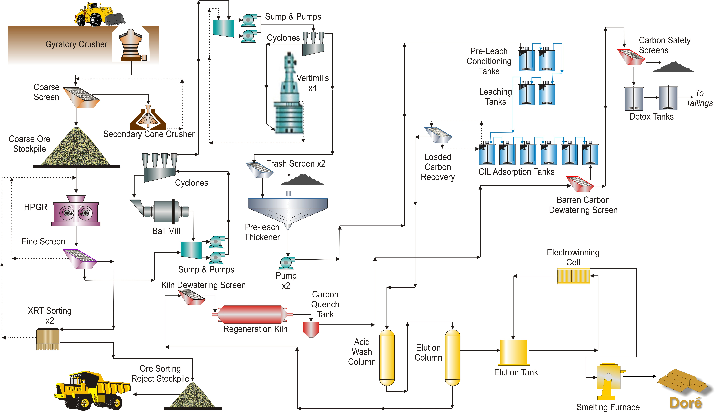
Conventional Gold Recovery Circuit

Slide 18
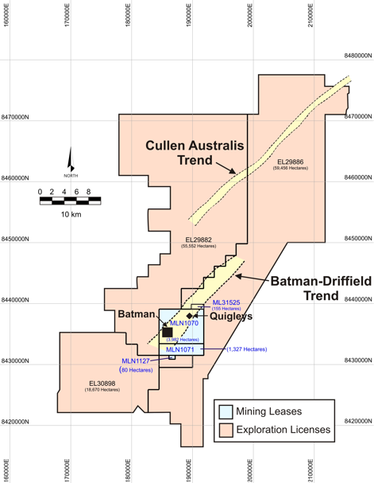
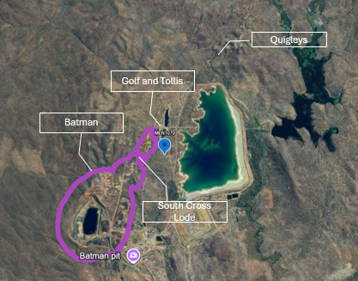
EXPLORATION
MT TODD GOLD PROJECT
Mining Leases and Exploration Licenses
Four mining leases (MLs)
55 km²
Four exploration licenses (ELs)
1,337 km²
Batman deposit and other previously mined open pits. Section is not representative of location and scale.

Slide 19
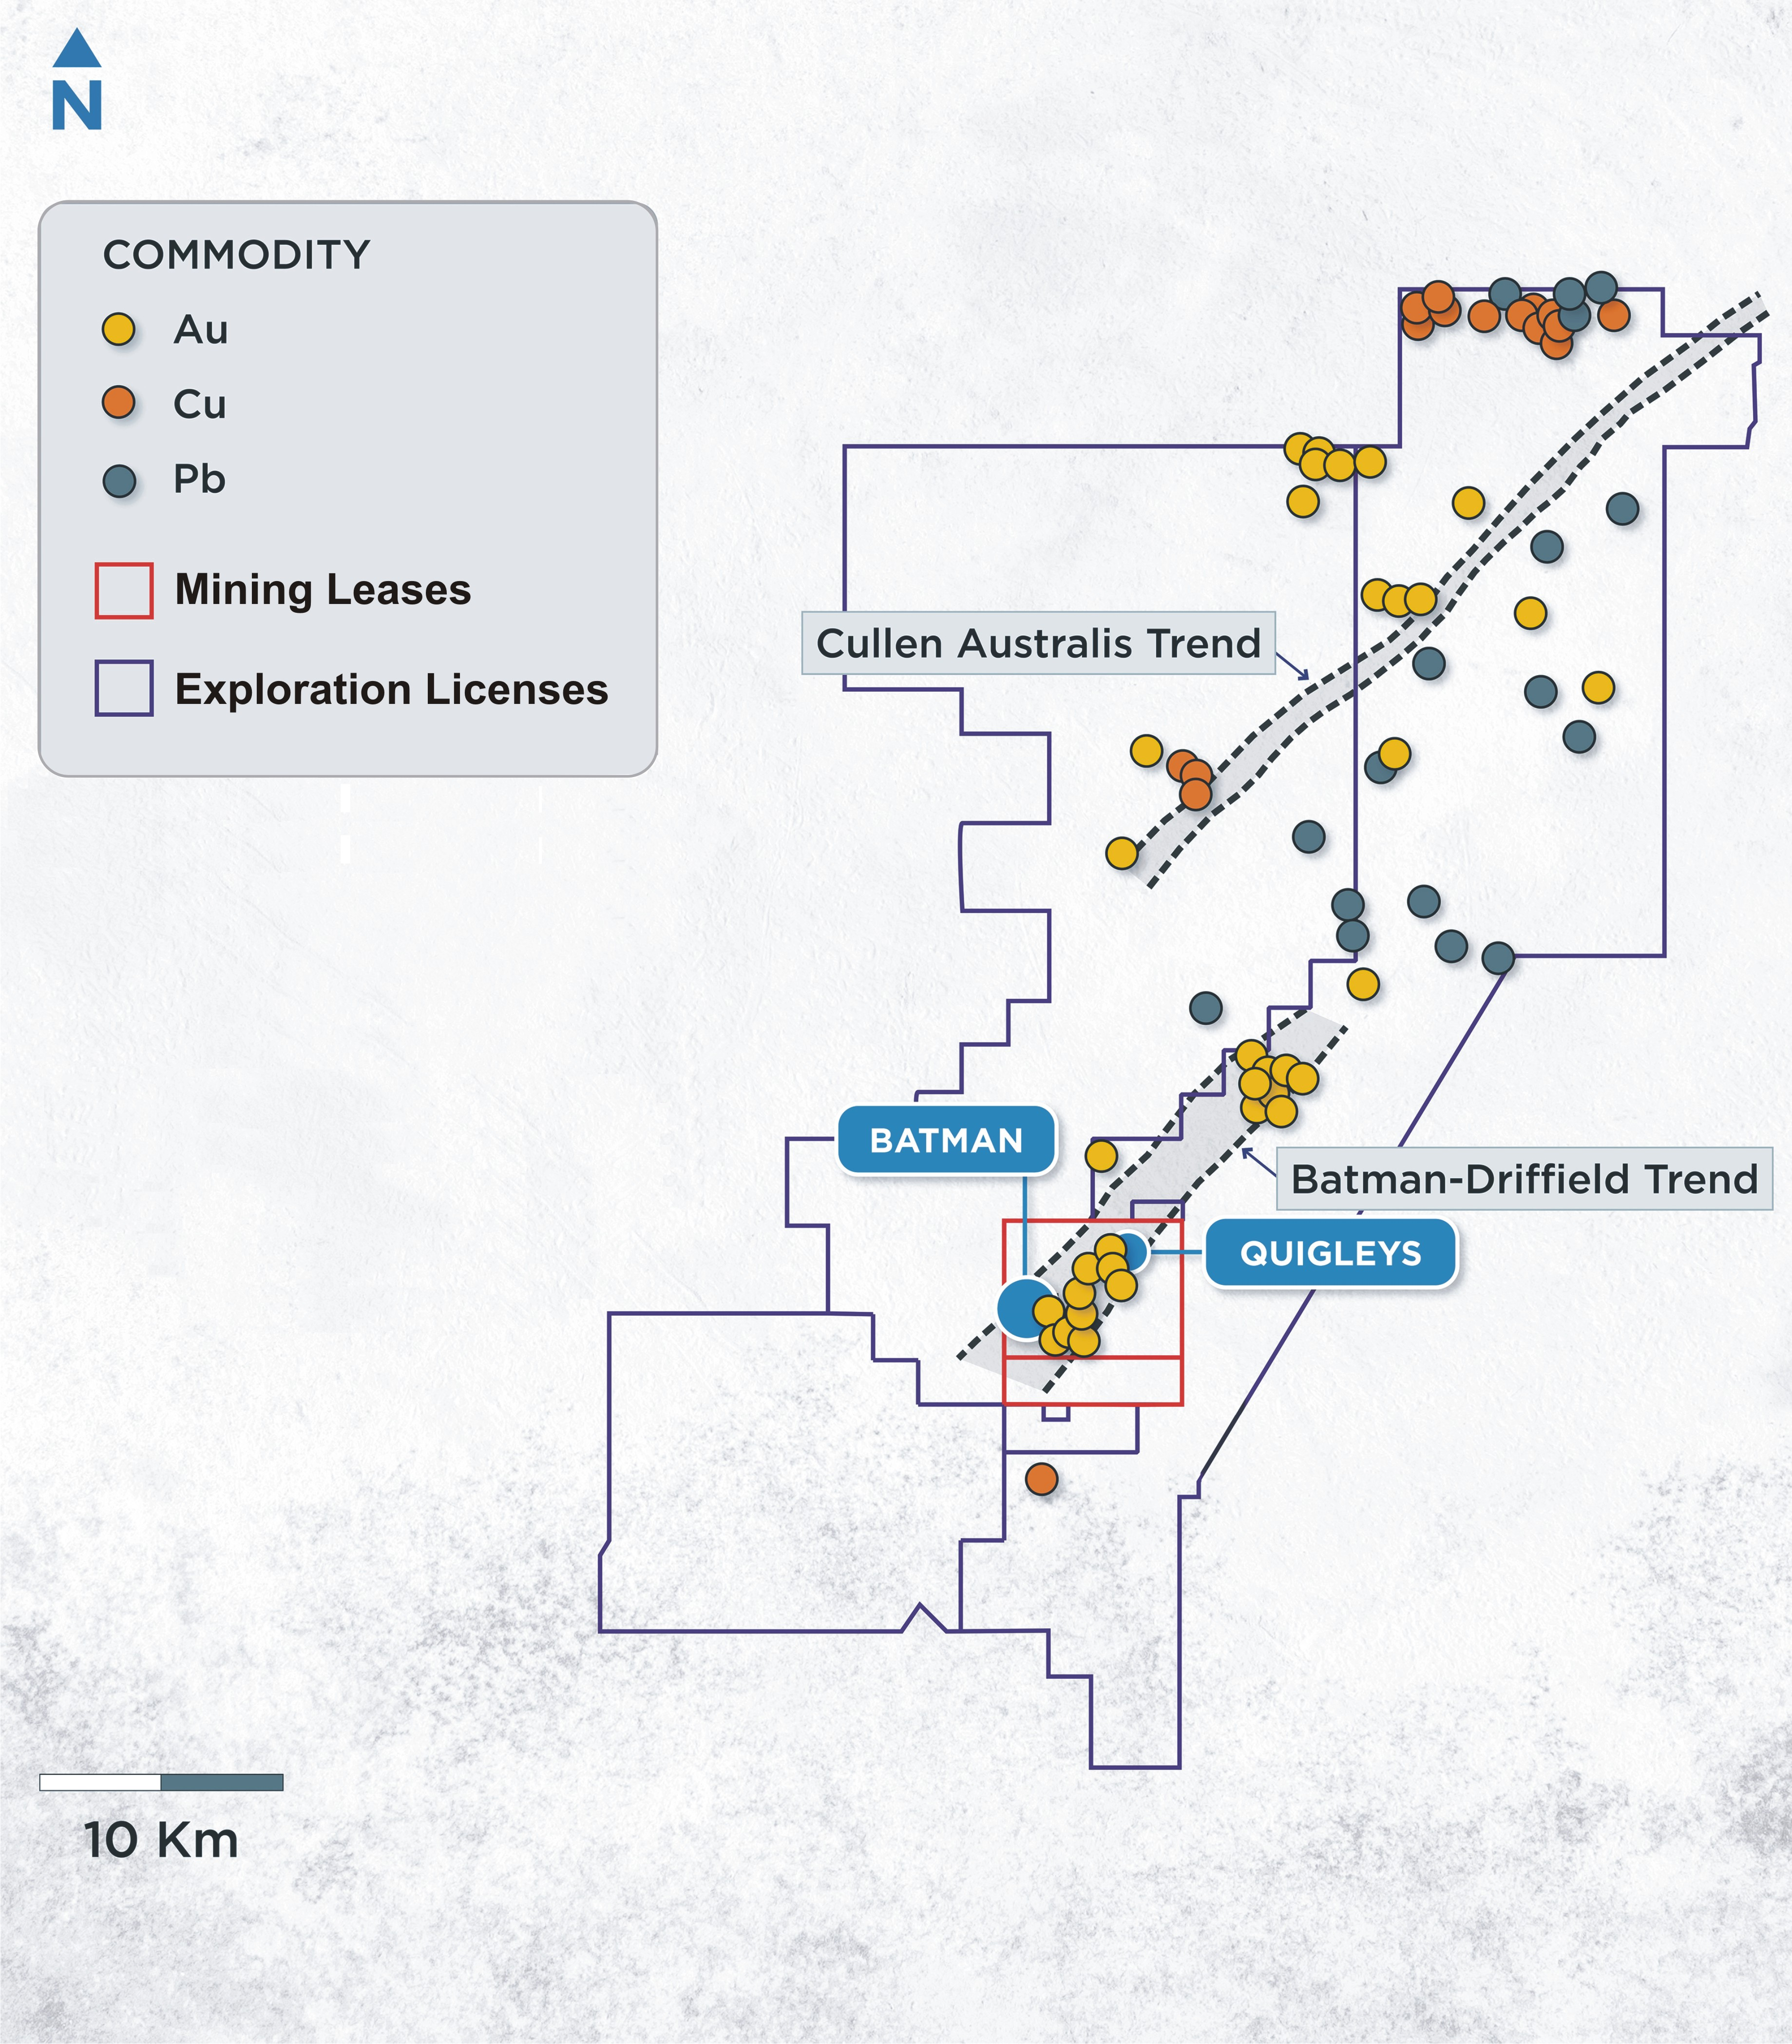
EXPLORATION
MT TODD GOLD PROJECT
District-Scale Exploration Potential
1,337 km² Contiguous Exploration Licenses
Largely unexplored, host to known occurrences of precious and base metals, and highly prospective for new discoveries
Prior Drilling within Boundaries of Mining Leases
Identified four promising targets to date on the 24 km Batman-Driffield Trend with potential to add 1.8 – 3.5 million gold ounces to resource base
Quigleys
Newly updated Mineral Resources estimate
MI&I Mineral Resources estimate of 496 koz gold at 1.15 g Au/t
South Cross Lode
South Cross Lode located adjacent to the Batman deposit and extends with a defined strike length of 400 meters northeast
Open at depth and along strike to the northeast, potentially connecting to other identified exploration targets

Slide 20
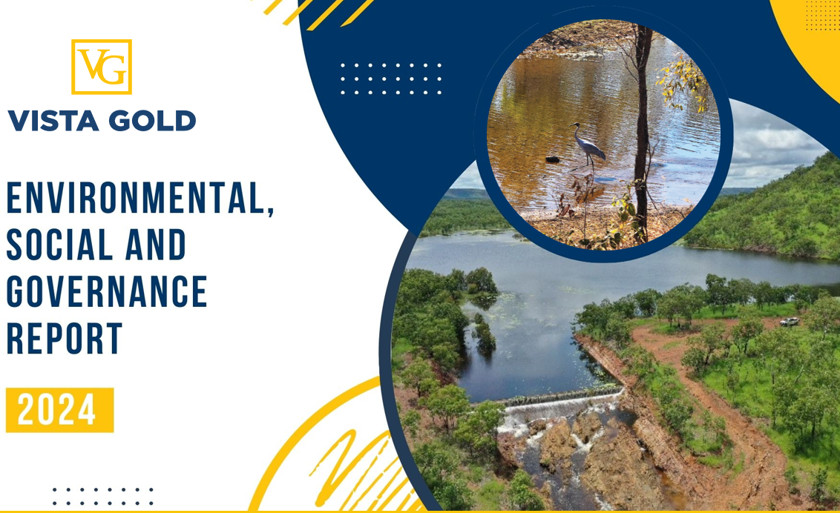
COMMITTED TO SUSTAINABLE AND SOCIALLY RESPONSIBLE DEVELOPMENT
MT TODD GOLD PROJECT
Environmental
Transparent environmental management programs with online site water management data
Successful treatment and discharge of over 11M cubic meters of water through our award-winning water management program
Key Environmental and Operational Permits Approved for 50 ktpd Project
Social
Committed to health, well being, and safety of our employees and contractors
Strong relationship with the Jawoyn Association Aboriginal Corporation underpinned by continual engagement
Strong project support across broad stakeholder base
Commitment to sponsorship programs that support education, community events, healthcare, and economic development
Governance
Increased diversity among the board and management
Published Vista’s 2024 ESG report
April 2021 (0.5 GL)

Slide 21
KEY PERMITS, AUTHORIZATIONS AND LICENSES
MT TODD GOLD PROJECT
All Major Environmental and Operating Permits Approved for a 50 ktpd Project
Permitting Milestones Achieved
Environmental Impact Statement
Mine Management Plan (now Deemed Mining License)
Authorizations Received
Environmental Protection and Biodiversity Conservation Act Authorization
Aboriginal Areas Protection Authority Certificates
Waterway Diversion Authorization
Water Extraction License
Required Amendments
Modifications underway to align with 2024 50 ktpd FS
Modifications to align approvals with 15 ktpd project expected to take 12-18 months to complete

Slide 22





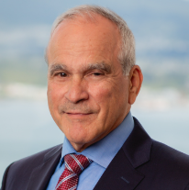
VISTA GOLD CORP.
Experienced Board of Directors
Tracy Stevenson
Chair
John Clark
Compensation Committee Chair
Frederick Earnest
President, CEO & Director
Deborah J. Friedman
Governance Committee Chair
Patrick Keenan
Audit Committee Chair
Mike Sylvestre
HSE&SR Committee Chair
Former director of Uranium Resources Inc., former director and non-executive chairman of Quaterra Resources and former director of Ivanhoe Mines Ltd.
Founding member of Bedrock Resources, a private resources financial advisory firm and SOS Investors LLC, a private resources investment firm
Former Global Head of Information Systems at Rio Tinto PLC
President of Investment and Technical Management Corp. and former CFO Polaris Geothermal Inc.
Director of Russel Metals Inc. and Zephyr Minerals
CEO since January 2012 and senior officer of Vista since 2006
Former President of Pacific Rim El Salvador and General Manager of Compañia Minera Dayton (Chile). 30+ years industry experience
Director of Golden Minerals Company and former Partner (retired) at Davis Graham & Stubbs LLP from August 2000 to December 2016 and counsel from May 1999 to August 2000
VP and General Counsel and other senior management positions at Golden Minerals Company, Cyprus Amax Minerals Company, and AMAX Gold
Retired mining executive and accomplished CFO, with more than 30 years of executive mining industry experience
Former EVP and CFO of PolyMet Mining Corp.; former SVP Finance and Treasurer of Newmont Mining Corporation; and held various senior management positions at Rio Tinto
Director of Hochschild Mining PLC and Nickel Creek Platinum Corp.
Former senior executive of Kinross Gold Corp., including SVP Americas and Regional VP Africa
Former Interim President, CEO and Chair of Claude Resources and former President and CEO of Castle Resources

Slide 23

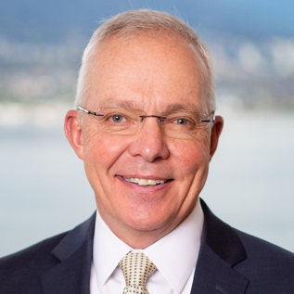


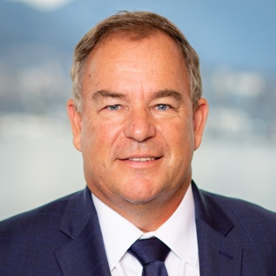

Proven Management Team
VISTA GOLD CORP.
Highly qualified
Proven track record
Management and Technical Team
of Exploration, Development and Operations Successes
Frederick H. Earnest
President, CEO and Director
Douglas L. Tobler
Chief Financial Officer
Pamela A. Solly
Vice President, Investor Relations
Brent Murdoch
General Manager of Mt Todd
Maria Vallejo
Director, Projects and Technical Services
CEO since January 2012 and senior officer of Vista since 2006
Over 35 years of industry experience (corporate management, mine operations and project turnarounds, new project engineering and construction)
Former President of Pacific Rim El Salvador, GM of Compania Minera Dayton in Chile and former director of Midas Gold Corp.
More than 40 years of corporate financial management experience gained as a chief financial officer, CPA, and corporate advisor
CFO of Vista since July 2019
Former CFO of Lydian International and Alacer Gold Corp.
Fellow with Coopers & Lybrand’s National Accounting and SEC Directorate
VP of Investor Relations at Vista since April 2019
More than 30 years of public company experience in investor relations and corporate communications
Former VP of Investor Relations of Lydian International
Director of the Denver Gold Group and a member of the National Investor Relations Institute and Women in Mining
General Manager since November 2012
25 years industry experience in mine start-ups and large project construction including Ore Processing Facility Manager at Solomon Mine in Western Australia for Leighton Contractors
Former GM of OM Manganese Pty Ltd and GM Construction for Harmony Gold at the Hidden Valley Mine
Serving since June 2024
Qualified Person with 15 years of experience in Mining Economics, Asset Valuation, and Technical Studies.
Registered Professional Engineer (P.Eng) and Fellow Australasian Institute of Mining and Metallurgy (FAusIMM).
Senior tenures with Barrick Gold, Mining Plus, Waterton Global Resource Management.

