Slide 1
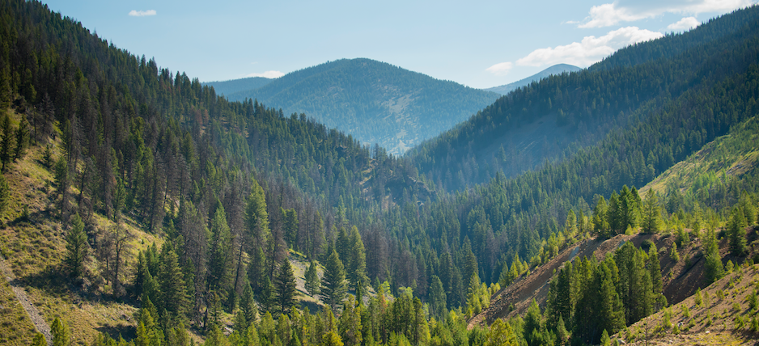
Perpetua Resources
Gold Forum Americas – September 2025
NASDAQ:PPTA
TSX:PPTA
Responsible Mining. Critical Resources.
Clean Future.

Slide 2
FORWARD-LOOKING STATEMENTS
Information and statements contained in this presentation that are not historical facts are “forward-looking information” or “forward-looking statements” (collectively, “Forward-Looking Information”) within the meaning of applicable Canadian securities legislation and the United States Private Securities Litigation Reform Act of 1995. We use words such as “may,” “would,” “could,” “should,” “will,” “likely,” “expect,” “anticipate,” “believe,” “intend,” “plan,” “forecast,” “outlook,” “project,” “estimate” and similar expressions suggesting future outcomes or events to identify forward-looking statements or forward-looking information. Forward-Looking Information includes, but is not limited to, information concerning the business of Perpetua Resources Corp. (the “Company”), the Stibnite Gold Project (the “Project”), including but not limited to statements with respect to results of the FS (as defined below) and the Financial Update (as defined below); the assumptions, qualifications and limitations of the results of the FS and the Financial Update, including the economic results and the sensitivity analysis of the variables included therein; other assumptions underlying the FS and the Financial Update, including regarding inflation, labor, regulatory and permitting outcomes and timing, construction timing, production capacity and expectations, LOM estimates, expected mining methods; the expected outcomes of the Project, including our reserves and resources; the financial projections and illustrative equity valuation presented herein (see "Financial Projections" at the end of this presentation) disclosure regarding possible events, conditions or financial performance that is based on assumptions about future economic conditions and courses of action; next steps and courses of action including the prospects and timing of successfully securing project financing on acceptable terms, or at all; disclosure regarding the EXIM review process and potential outcome of the Company’s EXIM financing application; the potential exercise of the underwriters’ over-allotment option with respect to the equity offering; disclosure regarding the review process, anticipated timing and potential outcome of the Company’s EXIM financing application; the status and anticipated terms and timing of the royalty, streaming and financial assurance negotiations; the estimate of the initial financial assurance obligations; the amount of potential debt financing available to the Company; the eligibility of the Project for funding under the MMIA and CTEP initiatives; the timing and potential outcome of any other discussions with governmental agencies; the amount and timing of any approval of reimbursement requests of the funding from the DOTC; the anticipated outcomes from the Executive Order for the Company or the mining industry; environmental clean up actions by us and our contractors; ongoing funding and anticipated liquidity; our ability to comply with, obtain and defend permits related to the Project; actions to be taken by the United States Forest Service (“USFS”), the Department of Defense, the State of Idaho and other government agencies and regulatory bodies; our ability to successfully implement and fund the Project and the occurrence of the expected benefits from the Project; timing of anticipated milestones related to the Project and financing; predictions regarding improvements to water quality, water temperature, and fish habitats and other environmental conditions at the site, including with respect to process and timing of such improvements; reduction of the Project footprint and the anticipated benefits and other effects thereof; our ability to successfully implement the Project and the occurrence of the expected benefits from the Project, including contributions to the workforce, national security and clean energy transition; the anticipated economic, environmental and other benefits of the Project; the viability of the Project; development and operating costs in the event that a production decision is made; success of exploration, development and environmental protection, closure and remediation activities; permitting time lines and requirements; requirements for additional capital; requirements for additional water rights and the potential effect of proposed notices of environmental conditions relating to mineral claims; risks and opportunities associated with the Project; planned exploration and development of properties and the results thereof; development of any additional resources and reserves and the permitting requirements with respect to any such additional resources and reserves; planned expenditures, production schedules and budgets and the execution thereof. Statements concerning mineral resource and mineral reserve estimates may also constitute Forward-Looking Information to the extent that they involve estimates of the mineralization that may be encountered if the Project is developed. In preparing the Forward-Looking Information herein, the Company has applied several material assumptions, including, but not limited to, assumptions that the conclusions and findings from the FS and basic engineering work, and the technical, geologic, engineering, production and reserve assumptions underlying such work, are reliable to form the basis for the Financial Update; that the EXIM application will be reviewed and approved within the expected timeframe at the amount equal to or higher than the amount indicated in the LOI; that the Company will be able to satisfy the conditions to obtain a funding commitment from EXIM and to receive committed funds when needed; the ongoing royalty or streaming and financial assurance negotiations will proceed in a timely manner and result in a binding agreement on the terms anticipated; that the Company will be able to satisfy financial assurance requirements applicable under applicable federal and state law; that the Company’s proposed financing package will be sufficient to finance permitting, pre-construction and construction of the Project or that the company will be able to secure alternate financing if necessary; that the initiatives outlined in the Executive Order, and the intended goals of the transparency projects list, will be implemented as proposed; assumptions that that the full amounts of the additional funding from the DOTC will be funded within a reasonable timeframe; that we will be able to obtain sufficient funding to finance permitting, pre-construction and construction of the Project and that all requisite information will be available in a timely manner; the exchange rates for the U.S. and Canadian currencies will be consistent with the Company’s expectations; that the current exploration, development, environmental and other objectives concerning the Project can be achieved and that its other corporate activities will proceed as expected; that the current price and demand for gold and antimony will be sustained or will improve; that general business and economic conditions will not change in a materially adverse manner and that all necessary governmental approvals for planned activities on the Project will be obtained in a timely manner and on acceptable terms; that permitting and operations costs will not materially increase; the continuity of the price of gold and other metals, economic and political conditions and operations; and the assumptions set out in the FS and Financial Update and in the Company’s public filings with the U.S. Securities and Exchange Commission (the "SEC") and its Canadian disclosure record. Forward-Looking Information involves known and unknown risks, uncertainties and other factors which may cause the actual results, performance or achievements of the Company to be materially different from any future results, performance or achievements expressed or implied by the Forward-Looking Information. Such risks and other factors include, among others, the industry-wide risks and project-specific risks identified in the Technical Reports (as defined below) and the Company’s public filings; operations and contractual obligations; changes in exploration programs based upon results of exploration; failure of mining methods or processes to operate as anticipated; changes in estimated mineral reserves or mineral resources or unexpected variations in quantity of mineralized material, grade, or recovery rates; changes in commodity prices, exchange rates, interest rates, tax rates, operating or production costs; availability of personnel and equipment; plant, equipment or process failure; accidents, effects of weather and other natural phenomena and other risks associated with the mineral exploration industry; delays in the EXIM application review process; any approved amount of EXIM financing may not be sufficient to commence construction of the Project; the terms of the proposed guarantee agreement and related surety agreements may not be sufficient to satisfy financial assurance requirements applicable under applicable federal and state law; environmental risks, including environmental matters under US federal and Idaho rules and regulations; impact of environmental remediation requirements and the terms of existing and potential consent decrees on the Company’s planned exploration and development activities on the Project; certainty of mineral title; community relations; delays in obtaining governmental approvals or financing; the Company’s dependence on one mineral project; the nature of mineral exploration and mining and the uncertain commercial viability; the Company’s lack of operating revenues; governmental regulations and the ability to obtain necessary licenses and permits; risks related to prior unregistered agreements, transfers or claims and other defects in title to mineral projects; currency fluctuations; changes in environmental laws and regulations and changes in the application of standards pursuant to existing laws and regulations; risks related to dependence on key personnel; risks to employee health and safety; estimates used in budgeting and financial statements proving to be incorrect; risks related to unforeseen delays in the permitting process; risks related to opposition to the Project; risks related to increased or unexpected costs in operations or the permitting process; risks that necessary financing will be unavailable when needed on acceptable terms, or at all; risks related to the outcome of litigation and potential for delay of the Project, as well as those factors discussed in the Company’s public disclosure record. Although the Company has attempted to identify important factors that could affect the Company and may cause actual actions, events or results to differ materially from those described in Forward-Looking Information, there may be other factors that cause actions, events or results not to be as anticipated, estimated or intended. There can be no assurance that Forward-Looking Information will prove to be accurate, as actual results and future events could differ materially from those anticipated in such statements. Because it is not possible to predict or identify all such factors, this list cannot be considered a complete set of all potential risks or uncertainties. Accordingly, readers should not place undue reliance on Forward-Looking Information. For further information on these and other risks and uncertainties that may affect the Company’s business and liquidity, see the “Risk Factors” and “Management’s Discussion and Analysis of Financial Condition and Results of Operations” sections of the Company’s filings with the SEC, are available at www.sec.gov and with the Canadian securities regulators, which are available at www.sedar.com. Except as required by law, the Company expressly disclaims any obligation to update the Forward-Looking Information herein.

Slide 3
CAUTIONARY NOTE & TECHNICAL DISCLOSURE
The presentation has been prepared by Perpetua Resources management and does not represent a recommendation to buy or sell these securities. Investors should always consult their investment advisors prior to making any investment decisions. All references to “dollars” or “$” shall mean United States dollars unless otherwise specified.
The material scientific and technical information in respect of the Stibnite Gold Project in this presentation, unless otherwise indicated, is based upon information contained in the technical report titled “Stibnite Gold Project, Feasibility Study Technical Report, Valley County, Idaho” dated effective December 22, 2020, and issued January 27, 2021 (the “FS” or “2020 Feasibility Study”). The 2020 Feasibility Study was prepared in accordance with National Instrument 43-101 – Standards of Disclosure for Mineral Projects (“NI 43-101”). NI 43-101 is a rule developed by the Canadian Securities Administrators that establishes standards for all public disclosure an issuer makes of scientific and technical information concerning mineral projects. These standards differ from the mining property disclosure rules specified in Subpart 1300 of Regulation S-K under the United States Securities Act of 1933 (“Subpart 1300”) promulgated by the SEC. Accordingly, information concerning mineral deposits from the 2020 Feasibility Study set forth herein may not be comparable with information made public by companies that report in accordance with U.S. standards.
The Company has issued a Technical Report Summary (the “TRS”), dated as of December 31, 2021, and amended as of June 6, 2022, developed for the Stibnite Gold Project in accordance with the mining property disclosure rules specified in Subpart 1300 promulgated by the SEC. The TRS summarizes, in accordance with the mining property disclosure rules specified in Subpart 1300, the FS, which was completed under NI 43-101, with the following notable differences between the FS and the TRS:
The TRS Mineral Resource estimates were developed based on a gold price of $1,500/oz versus the $1,250/oz gold price assumed for the FS. The change in gold price results from higher trailing average gold prices at the date of preparation for the respective reports.
The Measured Mineral Resources in the FS were reclassified to Indicated Mineral Resources in the TRS due to differences in Subpart 1300 versus NI 43-101 Mineral Resources classification guidelines.
The Proven Mineral Reserves from the FS were reclassified as Probable Mineral Reserves for the TRS resulting from the reclassification of the Measured Mineral Resources to Indicated Mineral Resources due to differences in Subpart 1300 versus NI 43-101 Mineral Resources classification guidelines.
The TRS is classified as a Preliminary Feasibility level study whereas the FS was classified as a Feasibility level study. This change was driven by the Subpart 1300 requirement that a compliant Feasibility level TRS include a capital cost contingency allowance no greater than 10%, whereas the initial capital cost estimate for the FS included a more conservative allowance at approximately 15%.
All other technical analyses, design information, capital and operating cost information, economic analyses, permitting and legal assumptions, conclusions and recommendations are consistent between the TRS and the FS.
Financial data in the FS and TRS are based on cost estimates as of December 31, 2020, as set forth in the FS . On February 13, 2025, the Company released an updated cash flow model for the Project (the “Financial Update”). The Financial Update was prepared by the Company and is based, in part, on the basic engineering work completed by Ausenco Engineering USA South Inc. (“Ausenco”) in January 2025, and with contributions from other mining engineers and consultants, utilities and financial advisors. It is intended to be read as a supplemental financial update to the cash flow forecast included in the FS with respect to economic information regarding the Project. Using the scientific and technical information presented in the FS, the Financial Update reflects the progression of the Project plan to a Basic Engineering level, including applying fourth quarter 2024 cost estimates for construction and operations and current and consensus commodity pricing for sales. Neither the Financial Update nor the studies or data underlying such update modifies the Mineral Resources and Mineral Reserves reported in the FS and the TRS or the material assumptions and information pertaining to such disclosure. The information contained in the Financial Update is subject to the assumptions, exclusions and qualifications set forth in the Company’s Current Report on Form 8-K filed with the SEC on February 13, 2025 and included in the Company’s Annual Report on Form 10-K filed with the SEC on March 19, 2025, as well as those contained in the FS and the TRS, except to the extent explicitly updated by the Financial Update.
Readers are encouraged to read the Financial Update and the Company’s Current Report on Form 8-K filed with the SEC on February 13, 2025, which is available under the Company’s profile on EDGAR. Readers are encouraged to read the TRS and the Company’s Current Report on Form 8-K filed with the SEC on January 3, 2021, as amended by the Company’s Current Report on Form 8-K/A filed with the SEC on June 8, 2022, which are available under the Company’s profile on EDGAR. Readers are also encouraged to read the FS, which is available on the Company’s website and under the Company’s profile on SEDAR, for detailed information concerning the Project. The FS, the TRS and the Financial Update are intended to be read as a whole, and sections should not be read or relied upon out of context. References to the “Technical Reports” in this presentation refer to the FS, the TRS and the Financial Update, as applicable. See also “Regulatory Information” at the end of this presentation.
This presentation contains certain mineral reserve, production, costs, valuation, capitalization, trading data and similar information regarding certain other mineral projects and peer companies. Such data was derived from publicly available reports by such companies and other trade and industry sources. While the company believes such sources to be reliable, the company has not independently verified such information. Furthermore, information regarding mineral reserves, production and similar mineral project information for each company is based on estimates, assumptions and reporting standards applied to available data by each company and their reserve engineers in their respective reports, which may differ materially from the estimates, assumptions and reporting standards applied by us, and therefore may not be comparable among the companies presented. As a result, comparisons of such data made in this presentation, while considered reasonable at the time they are made, are subject to a variety of risks and uncertainties which could cause actual events or results of each company to differ materially from those reflected and there can be no assurance that we will be able to achieve similar results at similar stages of development.
Investors should be aware that the Letter of Interest from US EXIM is non-binding and conditional, and does not represent a financing commitment. A funding commitment, if any, is conditional upon successfully completing the due diligence and underwriting process, which may not be completed on the expected timeline, or at all, and receiving all required Project approvals. If the Company’s application is approved, there can be no assurance that the EXIM financing will be for the full amount indicated in the LOI or the increased amount requested in the application, or that the approved EXIM financing will be sufficient for the Company to commence construction of the Project. Further, release of funding under any such commitment would be subject to the satisfaction of certain conditions and covenants by the Company.
Investors should be aware that the Company has not entered into any definitive agreement with respect to a royalty, streaming or guarantee and may not be able to enter into such agreement on the anticipated terms and timeline, or at all. In addition, the outcomes from such agreement, when entered into, may not be sufficient to satisfy the aggregate obligations of the Company to provide construction phase financial assurance under applicable federal and state law prior to commencing construction. Securing the financial assurance does not guarantee the Company will receive the USFS notice to proceed under the approved plan of operation and consummating the royalty or streaming financing may not satisfy the financial assurance conditions of various federal and state permits required to commence construction.
Investors should be aware that there can be no assurance that the that exploration activities will result in the discovery of additional resources or reserves. Exploration results are inherently uncertain and subject to numerous risks and uncertainties, including geological factors, market conditions, and regulatory changes. Furthermore, development of any additional resources and reserves discovered would be subject to any applicable NEPA and permitting requirements.
Investors should be aware that the Project’s inclusion as a Transparency Project on the Permitting Dashboard does not imply endorsement of or support for the project by the federal government, or create a presumption that the Project will be approved, favorably reviewed by any agency, or receive federal funding. The inclusion of a project on the Permitting Dashboard may be reconsidered based on updated information. Additionally, investors should be aware that the Executive Order does not indicate any commitments on part of the government or any government agency with regard to the applicability of any programs to the Project, or the timing or outcome of any such initiative that may be applicable to the Project.
.

Slide 4

  THE STIBNITE GOLD PROJECT
  Our goal is to transform an area abandoned after 100 years of mining activity into a national strategic asset for critical mineral and gold production through responsible mining and a sustainable approach to restore the environment for the benefit of all stakeholders.
4

Slide 5
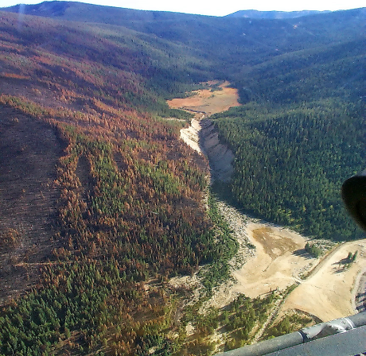
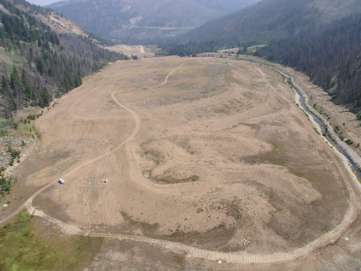
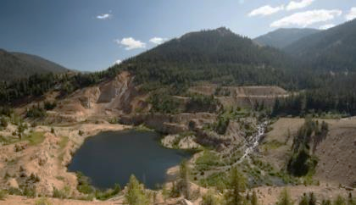
RESTORING AN ABANDONED BROWNFIELDS SITE
ENVIRONMENTAL SOLUTIONS FUNDED THROUGH MINE DEVELOPMENT
SEDIMENTATION
METAL LEACHING
BLOCKED FISH MIGRATION
Early repair of the largest source of sedimentation
Pick up, reprocess, reuse and safely store 10.5M tons of tailings and spent ore
Re-establish fish migration and provide temporary and permanent river restoration

Slide 6
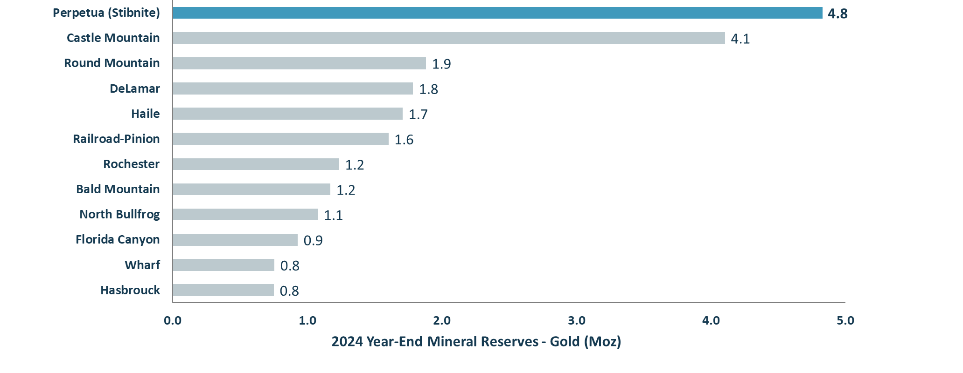
LARGEST INDEPENDENT U.S. GOLD RESERVE¹
Independent Gold Project Mineral Reserves¹
²
³
Source: Latest available company materials as of June 2025.
Independent refers to gold projects as not owned by Barrick or Newmont; Independent projects shown are from the lower 48 states in the U.S.
Based on the FS, which is intended to be read as a whole, and sections should not be read or relied upon out of context. The information in this presentation is subject to the assumptions, exclusions and qualifications contained in the Technical Reports. See “Cautionary Note and Technical Disclosure” at the beginning of this presentation.
Open Pit Reserves only.

Slide 7
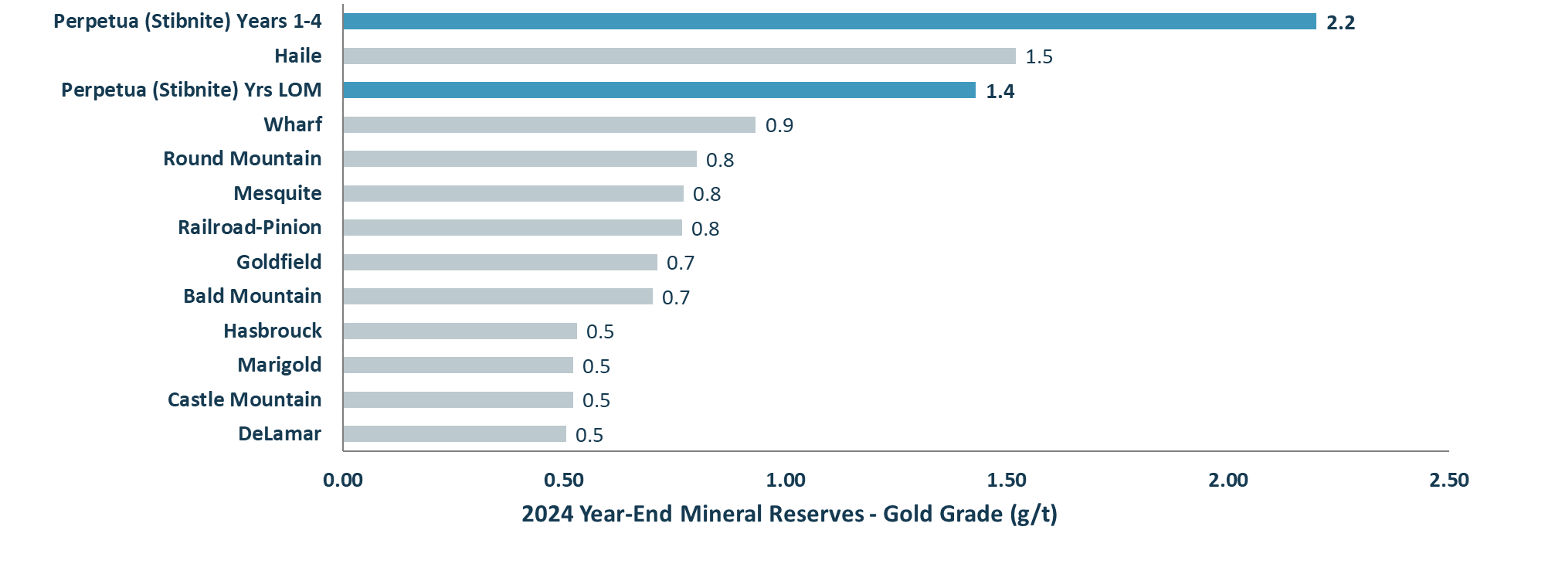
Highest grade open pit gold deposit*
Independent Open Pit Gold Deposits¹
²
³
²
Source: Latest available company materials as of June 2025.
*Based on Independent open pit gold project in lower 48 U.S.
Independent refers to gold projects as not owned by Barrick or Newmont; Independent projects shown are from the lower 48 states in the U.S.
Based on the FS, which is intended to be read as a whole, and sections should not be read or relied upon out of context. The information in this presentation is subject to the assumptions, exclusions and qualifications contained in the Technical Reports. See “Cautionary Note and Technical Disclosure” at the beginning of this presentation.
Open Pit Reserves only.

Slide 8
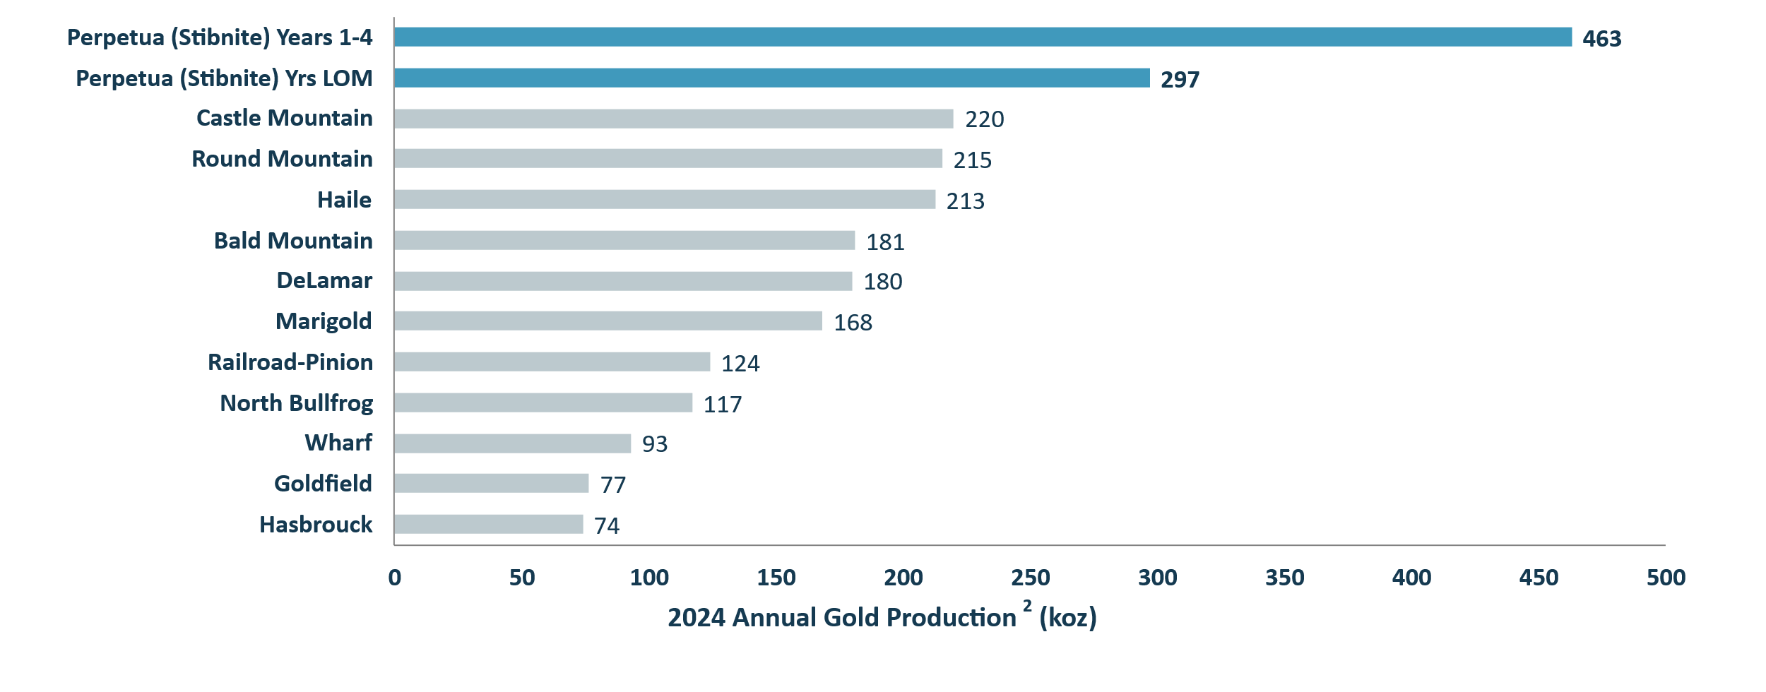
POISED TO BE LARGEST INDEPENDENT U.S. GOLD PRODUCER¹
Independent Projects and Producing Gold Mines¹
³
³
⁴
*
*
*
*
*Comparable projects not yet in production
Source: Latest available company materials as of June 2025.
Independent refers to gold projects as not owned by Barrick or Newmont; Independent projects shown are from the lower 48 states in the U.S.
2024 annual gold production for the peer group producing mines; future life-of-mine average annual production for the Railroad-Pinion, Goldfield, DeLamar, and Hasbrouck projects based on the most recent technical studies available; Perpetua (Stibnite) is based on estimated future production from the 2020 Feasibility Study.
Based on the FS, which is intended to be read as a whole, and sections should not be read or relied upon out of context. The information in this presentation is subject to the assumptions, exclusions and qualifications contained in the Technical Reports. See “Cautionary Note and Technical Disclosure” at the beginning of this presentation.
Open Pit part of the project only.

Slide 9
LOWEST ALL-IN SUSTAINING COSTS¹
Gold Projects with >250,000 production in Tier 1 Jurisdiction²
All-in Sustaining Costs ($/oz)^{1,2}
Valuable antimony by-product credit of $220/oz over life of mine³
All-in Sustaining Cost (“AISC”) is a non-GAAP measure. See “Non-GAAP measures” at the end of this presentation.
Based on a comprehensive list of gold projects in the United States, Canada and Australia with over 250,000 ounces of gold production expected in 2025 from Wood Mackenzie as of June 30 2025.
Based on the FS and Financial Update, which are intended to be read as a whole, and sections should not be read or relied upon out of context. Financial data as of Q4 2024 as set forth in the Financial Update. The information in this presentation is subject to the assumptions, exclusions and qualifications contained in the Technical Reports. See “Cautionary Note and Technical Disclosure” at the beginning of this presentation. Antimony by-product credit is calculated using antimony price of $10.00/lb.

Slide 10
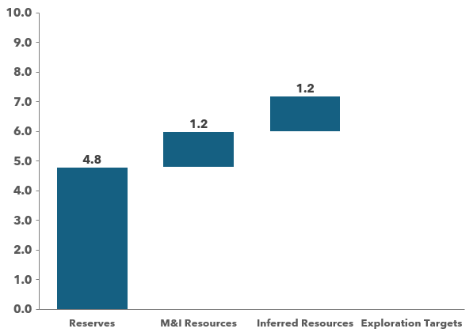
EXTENSIVE EXPLORATION UPSIDE
EXISTING DEPOSITS:
STIBNITE GOLD PROJECT MINERAL ENDOWMENT**
Million gold ounces
Northeast of Yellow Pine Deposit
Below Hangar Flats pit & Old Defense Minerals Exploration Act (DMEA) working area
West End along strike and at depth
PRIORITY EXPLORATION TARGETS:
High grade targets (Garnet, Scout, Upper Midnight)
Bulk tonnage targets (Cinnamid-Ridgetop, Saddle-Fern, Rabbit)
Undefined airborne targets (Mule, Salt & Pepper, Blow-out)
*Some of the prospects are conceptual in nature, there has been insufficient exploration to define a mineral resource and it is uncertain if further exploration will result in the target being delineated as a mineral resource. See the section titled "Forward-Looking Statements" at the beginning of this presentation.
**Based on the FS, which is intended to be read as a whole, and sections should not be read or relied upon out of context. The information in this presentation is subject to the assumptions, exclusions and qualifications contained in the Technical Reports. See “Cautionary Note and Technical Disclosure” and "Regulatory Information" at the beginning and end of this presentation, respectively. Mineral Reserves were calculated using an Au price of $1600/oz and Sb price of $3.50/lb and variable cut off grade of 0.39-0.49 g/t Au. Mineral Resources were calculated using a $1250/oz Au price and sulfide cut off grade of 0.45 g/t Au and oxide COG of 0.4 g/t Au based on the 2020 Feasibility Study. Based on a gold price of $1,500/oz in the TRS, Mineral Resources increased to 6.3Mozs @1.33 g/t using a sulfide cut off grade of 0.40 g/t Au and oxide cut off grade of 0.35 g/t Au. Inferred mineral resources are considered too speculative geologically to have economic considerations applied to them that would enable them to be categorized as mineral reserves.

Slide 11
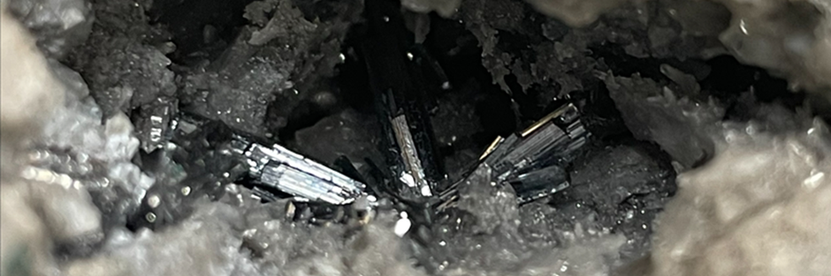
ONLY U.S. RESERVE OF ANTIMONY¹
ANTIMONY - IT’S CRITICAL
World Antimony 2024 Production (USGS)
Antimony is essential to industrial and national defense
The United States has no domestic mined production
China & Russia dominate the world supply (>70%)
China began antimony export controls in 2024
Perpetua received over $80 million in Department of Defense grants since 2022
Note: 2024 world production estimates by the USGS are rounded, and as such the percentages shown may not add to 100%.
¹Source: U.S. Geological Survey, Mineral Commodity Report Summaries, January 2024.

Slide 12
FUNDING PLAN FOR Stibnite Gold project DEVELOPMENT
Stibnite Gold Project Anticipated Capital Sources
Financing Component | Equity | Royalty / Stream | Financial Assurance Guarantee | U.S. EXIM Loan
Amount | $459M¹ (net proceeds) | $200-$250M² (net proceeds) | $155M² | Up to $2B³
Status | Secured | In progress | In progress | Application Submitted | Preliminary Project Letter & Indicative Term Sheet Received | Due Diligence In progress
Capital Availability Outlined | Up to $2.8 Billion⁴ + potential credit overrun facilities with other government agencies
1. Net proceeds calculated as the $312 million net proceeds of the equity offering (less underwriting discounts and commissions) and $100 million proceeds of the private placement. Includes net proceeds of $46.8 million from the full exercise of option by the underwriters.
2. There can be no assurance that ongoing royalty/stream financing and financial assurance guarantee negotiations will proceed in a timely manner and result in a binding agreement on the terms anticipated and with the proceeds and guarantees indicated herein. See “Cautionary Note & Technical Disclosure” at the beginning of this presentation.
3. Based on the Preliminary Project Letter and Indicative Term Sheet (see press release dated September 8, 2025). Also Bbased on formal application submitted for up to $2 billion, an increase from the $1.8 billion Letter of Interest, reflecting a higher estimated number of job-years (see Perpetua’s press release dated May 23, 2025). Any final commitment will be dependent on meeting EXIM's underwriting criteria, authorization process, finalization and satisfaction of terms and conditions. See “Cautionary Note & Technical Disclosure” at the beginning of this presentation.
4. The approximate capital available for project development assumes full exercise of the underwriters' option to purchase additional shares, royalty/stream financing proceeds of $250 million, the full amount of the financial assurance guarantee of $155 million and the full $2 billion debt funding of the EXIM loan. There can be no assurances that the over-allotment option will be exercised by the underwriters. Further, there can be no assurance that royalty/streaming financing an and financial assurance guarantee negotiations will proceed in a timely manner and result in a binding agreement on the terms anticipated and result in the anticipated proceeds and guarantees indicated herein. Additionally, there can be no assurance that the EXIM funding will be for the full amount of the application. Any final commitment will be dependent on meeting EXIM's underwriting criteria, authorization process, finalization and satisfaction of terms and conditions. See “Forward-Looking Statements” and “Cautionary Note & Technical Disclosure” at the beginning of this presentation.

Slide 13
ILLUSTRATIVE EQUITY VALUATION ONCE IN PRODUCTION
Illustrative Equity Valuation as of Year 1 of Operations*
+234%
+165%
+101%
*Illustrative Net Present Values (5%) as of year 1 of operations (assumes sunk initial capital costs) with a valuation date as of commencement of operations, less approximately $2 billion of debt, $200 million of interest, $250 million royalty/stream, and $150 million Corporate G&A. Commodity price assumptions include Antimony price of $10/lb and Silver of $27/oz and Gold price as presented. Other than commodity price assumptions, the Net Present Value calculation consistent with the information in the Financial Update starting in year 1 of operations.
Net Present Value (5%) based on the FS and Financial Update, which are intended to be read as a whole, and sections should not be read or relied upon out of context. Financial data as of Q4 2024 as set forth in the Financial Update. The information in this presentation is subject to the assumptions, exclusions and qualifications contained in the Technical Reports. See “Cautionary Note and Technical Disclosure” and "Forward Looking Statements" at the beginning of this presentation, and "Financial Projections" at the end of this presentation.
Perpetua Resources market cap based on fully diluted market cap using closing price as of September 11, 2025 (US$17.21 share price and fully diluted shares of 109.6 million as of June 30, 2025.

Slide 14
PATH FORWARD FOR THE STIBNITE GOLD PROJECT*
Spring 2026
Board approval of EXIM debt financing
2029
Commercial Operations
Fall 2025
Begin Early Works Construction
Summer 2025
Post Financial Assurance
Summer 2025
Close royalty/stream financing
Summer 2025
All key permits issued for construction
May 2025
Final Federals permits received
January 2025
Final Record of Decision
Early Works Construction anticipated to begin in Fall 2025
*See forward-looking statements at the beginning of this presentation. Based on the latest permitting agency schedules and management expectations.

Slide 15
UNLOCKING VALUE THROUGH DEVELOPMENT
ARTEMIS SHARE PRICE PERFORMANCE
G MINING SHARE PRICE PERFORMANCE
SKEENA SHARE PRICE PERFORMANCE
C$/share
C$/share
C$/share
+233%
+301%
+548%
+361% average value accretion across comparable single asset companies*
*Note: The information presented on this slide is derived from publicly available sources, including press releases and related public disclosures. Percent changes represent the stock price appreciation from financing announcement to current price. Share price performance may not be comparable due to various factors, including but not limited to, market conditions, project-specific factors and financing strategies.

Slide 16
NASDAQ:PPTA
TSX:PPTA
PERPETUA RESOURCES POISED FOR SUCCESS
World class gold-antimony project and national strategic asset
Superb Economics^{1,2}
Large reserve
High grade
High production
Low cost
Exploration Upside¹
4.8 Moz gold reserves
1.2 Moz gold M&I resources
1.2 Moz gold Inferred resources
Priority exploration targets
Critical Mineral
Only U.S. reserve of antimony³
Antimony is critical to national defense and clean energy future
Milestones & Catalysts
Jan ‘25 – Final Record of Decision
May ‘25 – Final Federal Permit
June ‘25 – Equity financing secured
Sept. ‘25 – EXIM Preliminary project letter received
Fall 2025 - Early works construction begins
Spring 2026 – Board approval of EXIM debt financing
Idaho
Premier U.S. mining jurisdiction
Stibnite Gold Project
100% owned by PPTA
Government Interest
+$80 million DoD Awards⁴
~$2.0 billion application for U.S EXIM financing⁵
Listed as priority project by White House
Restoring Brownfield Site
Environmental solutions integrated into plan of operations
Re-establish fish migration and improve habitat conditions
¹Based on the FS and Financial Update, which are intended to be read as a whole, and sections should not be read or relied upon out of context. Financial data as of Q4 2024 as set forth in the Financial Update. The information in this presentation is subject to the assumptions, exclusions and qualifications contained in the Technical Reports. See “Cautionary Note and Technical Disclosure” at the beginning of this presentation.
²Based on the latest global all-in sustaining cost information available on the World Gold Council website, www.worldgoldcouncil.org (Source: Metals Focus Gold Mine Cost Service).
³Source: U.S. Geological Survey, Mineral Commodity Report Summaries, January 2024.
⁴Includes Small Business Innovation Research Grants of $200K, Defense Ordnance Technology Consortium Agreement of up to $22.4 million and Defense Production Act Title III funding of $59.2 million. See Cautionary Note.
⁵Based on formal application submitted for up to $2 billion, an increase from the $1.8 billion Letter of Interest, reflecting a higher estimated number of job-years (see Perpetua’s press release dated May 23, 2025). The Letter of Interest from US EXIM indicated EXIM may be able to consider potential financing of up to $1.8 billion based on the preliminary information submitted regarding expected U.S. exports and U.S. jobs supported by the Project. Any final commitment will be dependent on meeting EXIM's underwriting criteria, authorization process, finalization and satisfaction of terms and conditions. All final commitments must comply with EXIM policies as well as program, legal and eligibility requirements. See Cautionary Note.

