Slide 1
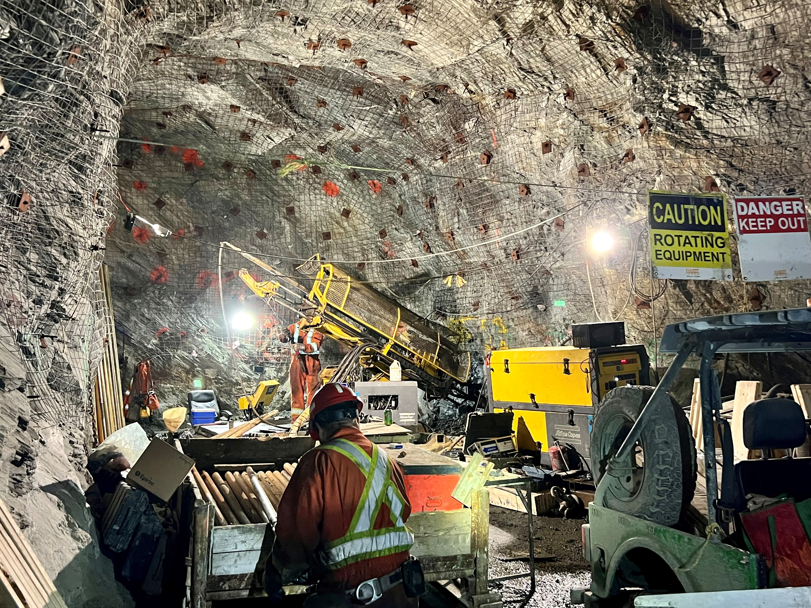






ASX | TSX
FFM
High Grade Copper and Gold
Significant and immediate growth through the drill bit
Building world-class scale - Already 1Mt of contained copper and 550koz of gold (24.4Mt for 460kt Cu and 200koz Au contained in M&I plus 34.5Mt for 690kt Cu and 350koz Au contained in Inferred)
Rapid Growth - 8 drill rigs turning
Dominant Position – A major copper and gold mineral district
Exceptional infrastructure - operational underground, shaft, processing plant, deep water port low-cost hydro power and skilled workforce
Environmentally Permitted in Tier One Mining Jurisdiction
Pickle Crow – an exceptional value creation opportunity for FireFly shareholders
September 14-17 2025

Slide 2
Not for release to US wire services or distribution in the United States
DISCLAIMER, COMPLIANCE & CAUTIONARY STATEMENTS
This presentation has been prepared by FireFly Metals Ltd (Company) based on information from its own and third party sources. No party other than the Company has authorised or caused the issue, lodgement, submission, dispatch or provision of this presentation, or takes any responsibility for, or makes or purports to make any statements, representations or undertakings in this presentation.
To the maximum extent permitted by law, the Company and its related bodies corporate, and their respective directors, officers, employees, agents and advisers:
(i) disclaim all responsibility and liability (including, without limitation, any liability arising from fault, negligence or negligent misstatement) for any expenses, losses, damages or costs incurred by you (including consequential or contingent loss or damage) arising from this presentation or reliance on anything contained in or omitted from it or otherwise arising in connection with this presentation, including any errors or omissions however caused, lack of accuracy, completeness, currency or reliability, or any reliance you or any other person may place on this presentation or its accuracy, completeness, currency or reliability;
(ii) disclaim any obligations or undertaking to release any updates or revision to the information in this presentation to reflect any change in expectations or assumptions; and
(iii) do not make any representation or warranty, express or implied, as to the accuracy, reliability, completeness of the information in this presentation or that this presentation contains all material information about the Company, or that a prospective investor or purchaser may require in evaluating a possible investment in the Company or acquisition of shares in the Company (Shares), or likelihood of fulfilment of any Forward-looking Statement (defined below) or any event or results expressed or implied in any Forward-looking Statement.
NO NEW INFORMATION OR DATA – GREEN BAY AND PICKLE CROW PROJECTS
This presentation contains references to the Mineral Resource Estimate at the Green Bay Project which have been extracted from the Company’s ASX announcement dated 29 October 2024, titled “Resource increases 42% to 1.2Mt of contained metal at 2% Copper Eq". Refer to Appendix 1 for a full break-down of the Green Bay Mineral Resource Estimate. Also refer to the Technical Reports for the Ming Copper Gold Mine and Little Deer Copper Project available on SEDAR+.
This presentation also contains references to the Inferred Mineral Resource Estimate at the Pickle Crow Project (currently 11.9Mt at 7.2g/t for 2.8Moz gold) which have been extracted from the Company’s ASX announcement dated 4 May 2023, titled "High-Grade Inferred Gold Resource Grows to 2.8Moz at 7.2g/t".
Metal equivalents for the Mineral Resource Estimate mineralisation at the Green Bay Project have been calculated at a copper price of US$8,750/t, gold price of US$2,500/oz and silver price of US$25/oz. Individual Resource grades for the metals are set out at Appendix 1 of this presentation. Copper equivalent was calculated based on the formula CuEq(%) = Cu(%) + (Au(g/t) x 0.82190) + (Ag(g/t) x 0.00822). Metallurgical factors have been applied to the metal equivalent calculation. Copper recovery used was 95%. Historical production at the Ming Mine has a documented copper recovery of ~96%. Precious metal metallurgical recovery was assumed at 85% on the basis of historical recoveries achieved at the Ming Mine in addition to historical metallurgical test work to increase precious metal recoveries.
Metal equivalents for drilling and exploration results have been calculated at a copper price of US$8,750/t, gold price of US$2,500/oz, silver price of US$25/oz and zinc price of US$2,500/t. Individual grades for the metals are set out at Appendix 1 of this presentation. Metallurgical factors have been applied to the metal equivalent calculation. Copper recovery used was 95%. Historical production at the Ming Mine has a documented copper recovery of ~96%. Precious metal metallurgical recovery was assumed at 85% based on historical recoveries achieved at the Ming Mine in addition to historical metallurgical test work to increase recoveries. Zinc recovery is applied at 50% based on historical processing and potential upgrades to the mineral processing facility. Copper equivalent was calculated based on the formula CuEq(%) = Cu(%) + (Au(g/t) x 0.82190) + (Ag(g/t) x 0.00822) + (Zn(%) x 0.15038).
In the opinion of the Company, all elements included in the metal equivalent calculations have a reasonable potential to be sold and recovered based on current market conditions, metallurgical test work, and the Company’s operational experience.
This presentation also contains references to certain Exploration Results that were first reported in accordance with ASX Listing Rule 5.7 in the Company's announcements of 28/01/2020, 26/03/2020, 01/09/2020, 11/11/2020, 19/01/2021, 7/04/2021, 16/06/2021, 15/07/2021, 2/08/2021, 5/10/2021, 2/12/2021, 18/1/2022, 3/5/2022, 23/6/2022, 22/11/2022, 24/1/2023, 31/8/2023, 11/12/2023, 16/1/2024, 4/3/2024, 21/3/2024, 29/4/2024, 19/06/2024, 22/08/2024, 3/09/2024, 16/09/2024, 3/10/2024, 29/10/2024, 10/12/2024, 12/02/2025, 25/3/2025, 7/05/2025, 15/05/2025, 17/07/2025 and 24/07/2025.
The Company confirms that it is not aware of any new information or data that materially affects the information included in the original announcements and that, in the case of Mineral Resources, all material assumptions and technical parameters underpinning the mineral resource estimates in the original announcements continue to apply and have not materially changed. The Company confirms that the form and context in which the Competent Persons’ findings are presented have not been materially modified from the original market announcements.
The Company has made reference to historic drilling and exploration results from a variety of exploration companies over the past 60 years that had previously explored its Projects. References to previous announcements should be read in conjunction with this presentation.

Slide 3
JORC CODE AND NI 43-101
Mineral Resource Estimates and Exploration Results are calculated in accordance with the 2012 Edition of the Australasian Code for Reporting of Exploration Results, Mineral Resources and Ore Reserves (JORC Code 2012) and Canadian National Instrument 43-101 - Standards of Disclosure for Mineral Projects (NI 43-101).
Investors outside of Australia and Canada should note that they may not comply with the relevant guidelines in other countries and, in particular, may not comply with Item 1300 of Regulation S-K, which governs disclosures in registration statements filed with the SEC. Information contained in this presentation describing mineral deposits may not be comparable to similar information made public by companies subject to the reporting and disclosure requirements of US securities laws.
DISCLOSURE OF TECHNICAL INFORMATION
All technical and scientific information in this presentation has been reviewed and approved by Group Chief Geologist, Mr Juan Gutierrez BSc, Geology (Masters), Geostatistics (Postgraduate Diploma), who is a Member and Chartered Professional of the Australasian Institute of Mining and Metallurgy and a Member of the Australian Institute of Geoscientists. Mr Gutierrez is a Competent Person as defined in the JORC Code 2012 and a Qualified Person as defined in NI 43-101. Mr Gutierrez consents to the inclusion in this presentation the matters based on his information in the form and context in which it appears.
NI 43-101 compliant technical reports for each of the Company’s Ming Copper Gold Mine, Little Deer Copper Project and Pickle Crow Gold Project are available under the Company’s SEDAR+ profile at www.sedarplus.ca.
FORWARD-LOOKING STATEMENTS
This presentation may contain certain forward-looking statements and forward-looking information concerning the Company, including but not limited to statements and information regarding the Company’s plans, forecasts and projections with respect to its mineral properties and programs, estimated Mineral Resources, cost projections, plans, strategies and objectives (Forward-looking Statements). Forward-looking Statements may be identified by the use of words such as “may”, “might”, “could”, “would”, “will”, “expect”, “intend”, “believe”, “forecast”, “milestone”, “objective”, “predict”, “plan”, “scheduled”, “estimate”, “anticipate”, “continue”, or other similar words and may include statements regarding plans, strategies and objectives.
Although the Forward-looking Statements contained in this presentation reflect management’s current beliefs based upon information currently available to management and based upon what management believes to be reasonable assumptions, such Forward-looking Statements are estimates for discussion purposes only and should not be relied upon. They are not guarantees of future performance and involve known and unknown risks, uncertainties and other factors many of which are beyond the control of the Company. Such factors may include changes in commodity prices, foreign exchange fluctuations, changes in economic, social and political conditions, and changes to applicable regulation.
Forward-looking Statements are inherently uncertain and involve known and unknown risks and uncertainties. Forward-looking Statements, and anticipated future results, performance or achievements expressed or implied by such Forward-looking Statements, may therefore differ materially from results and performance ultimately achieved by the Company. The performance of the Company may be influenced by a number of factors which are outside the control of the Company and its related bodies corporate and their respective directors, officers, employees, advisers and agents. Forward-looking Statements are inherently subject to business, economic, competitive, political and social uncertainties and contingencies. Many factors could cause the Company’s actual results to differ materially from those expressed or implied in any Forward-looking Statements provided by the Company, or on behalf of the Company.
Forward looking Statements in this presentation are based on the Company’s beliefs, opinions and estimates as of the dates the forward-looking Statements are made, and no obligation is assumed to update Forward-looking Statements if these beliefs, opinions and estimates should change or to reflect other future developments. Although management believes that the assumptions made by the Company and the expectations represented by such information are reasonable, there can be no assurance that the Forward-looking Statements will prove to be accurate and undue reliance should not be placed on Forward-looking Statements.
The Company does not undertake to update any Forward-looking Statements based on new information, future events or circumstances or otherwise, except in accordance with applicable securities laws. No representation, warranty or undertaking, express or implied, is given or made by the Company that any events expressed or implied in any Forward-looking Statements in this presentation will actually occur.

Slide 4
NOT A PROSPECTUS, DISCLOSURE OR OFFERING DOCUMENT
This presentation is not a prospectus, disclosure document or other offering document under Australian law or under any other law. It is provided for information purposes and is not an invitation nor offer of shares or recommendation for subscription, purchase, sale or any other transaction in any jurisdiction. This presentation does not purport to contain all the information that a prospective investor may require in connection with any potential investment in the Company. Each recipient must make its own independent assessment of the Company before acquiring any Shares.
NOT INVESTMENT ADVICE
Each recipient of the presentation should make its own enquiries and investigations regarding all information in this presentation including but not limited to the assumptions, uncertainties and contingencies which may affect future operations of the Company and the impact that different future outcomes might have on the Company. Information in this presentation is not intended to be relied upon as advice to investors or potential investors and has been prepared without taking account of any person’s individual investment objectives, financial situation or particular needs. Before making an investment decision, prospective investors should consider the appropriateness of the information having regard to their own investment objectives, financial situation and needs and seek legal, accounting and taxation advice appropriate to their jurisdiction. The Company is not licensed to provide financial product advice in respect of its securities.
INVESTMENT RISK
There are a number of risks specific to the Company and of a general nature which may affect the future operating and financial performance of the Company and the value of an investment in the Company, including and not limited to the Company's capital requirements, the potential for shareholders to be diluted, risks associated with the reporting of mineral resource estimates, budget risks, and operational risks. An investment in Shares is subject to known and unknown risks, some of which are beyond the control of the Company. The Company does not guarantee any particular rate of return or the performance of the Company. Investors should have regard to the risk factors outlined in the most recent prospectus published by the Company when making an investment decision.
NOT FOR UNITED STATES RELEASE AND DISTRIBUTION
This presentation may not be released to US wire services or distributed in the United States. Shares have not been, and will not be, registered under the US Securities Act of 1933 and may not be offered or sold in the United States except in transactions exempt from, or not subject to, the registration requirements of the US Securities Act and applicable US state securities laws. The distribution of this presentation in the United States and elsewhere outside Australia may be restricted by law. Persons who come into possession of this presentation should observe any such restrictions as any non-compliance could contravene applicable securities laws.
FINANCIAL DATA
All dollar values are in Australian dollars (A$ or AUD) unless otherwise stated. The information contained in this presentation may not necessarily be in statutory format. Amounts, totals and change percentages are calculated on whole numbers and not the rounded amounts presented.

Slide 5


Investment Highlights
Rapid low-cost growth through the drill bit = a proven strategy for value creation
GREEN BAY COPPER GOLD
PICKLE CROW GOLD
PROVEN TRACK RECORD
High grade copper and gold in Newfoundland Labrador, Canada
Large scale, high grade and open 1.2Mt contained metal at 2% copper equivalent¹ (M&I of 24.4Mt for 460kt contained metal at 1.9% and Inf of 34.5Mt for 690kt contained metal at 2% copper equivalent¹
A$250M of mine infrastructure
Significant and immediate growth drilling 130,000m in 2025
High grade gold in Ontario, Canada
2.8Moz @ 7.2g/t gold resource
Inferred resource remains open
Significant landholding with huge exploration upside
A major gold mining district
A value creation opportunity for FireFly shareholders
Management team with a proven track record of creating significant value for shareholders and stakeholders
Recent success with ASX200 Bellevue Gold from discovery to production in only 5 years
Well-funded with ~A$145M cash, receivables and liquid investments²
Prepared in accordance with JORC Code 2012 & NI 43-101. Metal equivalents for the Resource Estimate has been calculated at a copper price of US$8,750/t, gold price of US$2,500/oz and silver price of US$25/oz. Metallurgical recoveries have been set at 95% for copper and 85% for both gold and silver. CuEq(%) = Cu(%) + (Au(g/t) x 0.82190) + (Ag(g/t) X 0.00822). In the opinion of the Company, all elements included in the metal equivalent calculation have a reasonable potential to be sold and recovered based on current market conditions, metallurgical test work, and the Company’s operational experience.
Cash, receivables and liquid investment position at 30 June 2025, plus A$10 million proceeds received from the Share Purchase Plan completed on 14 July 2025 and net proceeds from the second tranche of the Institutional Placement of ~A$26.6 million completed on 3 September 2025 (T2 Placement)

Slide 6
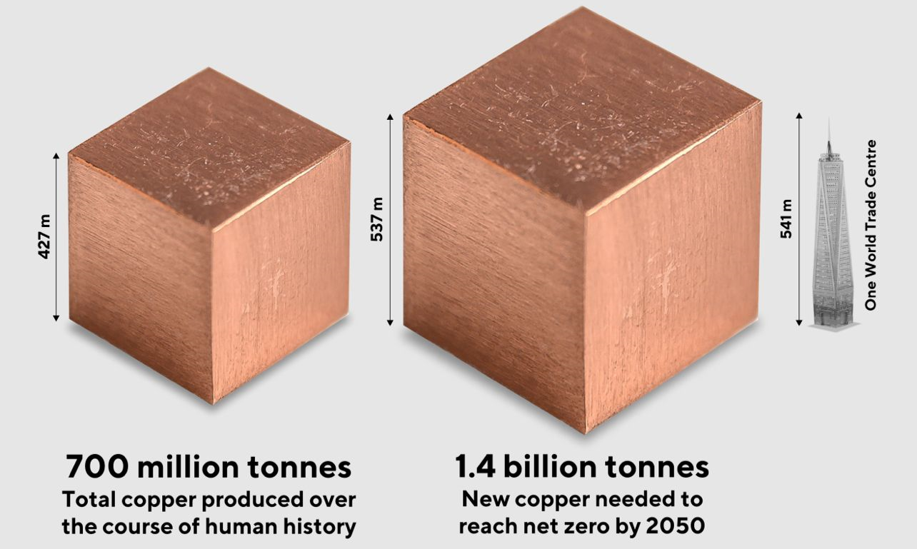
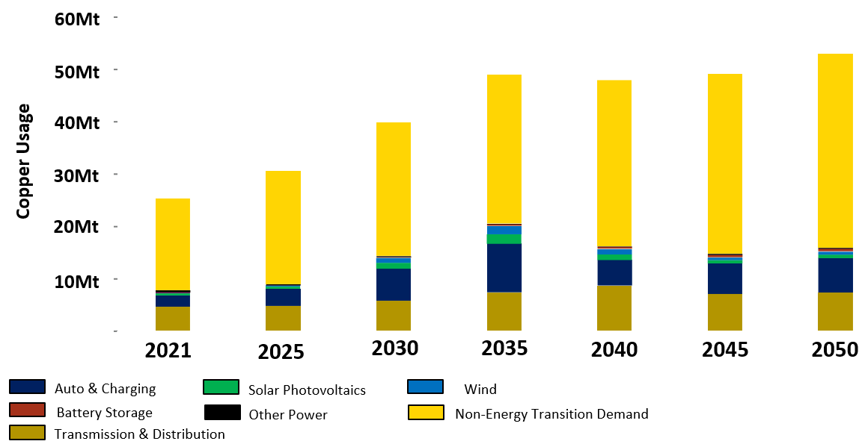
Copper – The Macro Landscape
Nearly twice the amount of copper mined in human history is required in the next 27 years to achieve net zero by 2050^{1,2}
Global Copper Mining Issues
Decreasing copper grades
Reduced discovery rates
Time and cost to production
Mining is getting deeper
Social License becoming more challenging
1. Source: https://energyminute.ca/infographics/the-volume-of-2050-net-zero-copper-demand/
2. Source: modified from ‘The Future of Copper’, S&P Global Report, July 2022

Slide 7





Outstanding transformation in less than two years
Rapid low-cost growth through the drill bit = a proven strategy for value creation
OCTOBER 2023
SEPTEMBER 2025
Market Cap
~A$70M¹
+ 1,070%
~A$819M²
Share Price
A$0.37³
+ 224%
A$1.20²
0 Drill Rigs
8 Drill Rigs
Drilling
+ 57%
202,740m (historic)
318,510m
39Mt @ 2% CuEq^{4,5}
59Mt @ 2% CuEq⁶
Resource
+ 51%
M&I: 24.4Mt @ 1.9% CuEq
Inferred: 34.6Mt @ 2.0% CuEq
M&I: 24.4Mt @ 1.9% CuEq
Inferred: 34.6Mt @ 2.0% CuEq
Land Holding
56km²
+ 518%
346km²
Exceptional Discovery Potential
1. As at 31 August 2023 2. As at 3 September 2025 3. Capital raise share price to acquire the Green Bay Project, after adjusting for a 15:1 consolidation in December 2023. Refer to ASX announcement dated 31 August 2023 4. Prepared in accordance with Canadian National Instrument 43-101. This is a foreign estimate and has not been reported in accordance with JORC 2012. A competent person has not done sufficient work to classify as a mineral resource in accordance with JORC 2012 and it is uncertain that following further evaluation and exploration work that the foreign estimate will be able to be reported as a mineral resource under the JORC Code 2012. See the Company’s ASX Announcement dated 31 August 2023 for further information regarding this foreign estimate. 5. Metal equivalents calculated using a copper price of US$8,295/t, gold price of US$1,912/oz and a silver price of US$22.59/oz. Individual grades for the metals are set out ASX announcement dated 31 August 2023. Copper equivalent was calculated based on the formula CuEq(%) = Cu(%) + (0.74112 x Au(g/t)) + (0.00876 x Ag(g/t)). No metallurgical recovery factors have been applied to the in-situ resource. It is the Company’s view that all elements in the copper equivalent calculation have a reasonable potential to be recovered and sold. 6. Refer to ASX announcement dated 29 October 2024 and Appendix 1 for details of the Mineral Resource Estimate and metal equivalents. 7. Percent increase calculated using the formula ((Final Value - Starting Value)/ Starting Value) x 100.
7

Slide 8










Exceptional Share Register & Strong Balance Sheet
Well-funded to deliver strong velocity of news flow through 2025/2026
CAPITAL STRUCTURE | CURRENT
Shares on issue | 682.7M¹
Management performance rights | 36.1M²
SHAREHOLDERS OVER 5% SUMMARY³
Australian & Global Institutions | 67%
BlackRock Group | 13%
Board & Management (fully diluted) | 8%
Regal Funds Management | 5%
GLOBAL BANKING & RESEARCH
A$1.20
~A$819M
Current Share Price¹
Market Capitalisation¹
2.4M
~A$145M
Average Daily Volume⁴
Cash Position⁵
ASX & TSX listings
No Offtake
No Streams
No Debt
ASX 300
1. As at 3 September 2025. 2. Management performance rights are unlisted. 3. As at 15 August 2025. 4. ASX Trading from 1 July 2024. 5. Cash, receivables and liquid investment position at 30 June 2025, plus A$10 million proceeds received from the Share Purchase Plan completed on 14 July 2025 and net proceeds from the second tranche of the Institutional Placement of ~A$26.6 million which was completed on 2 September 2025.

Slide 9
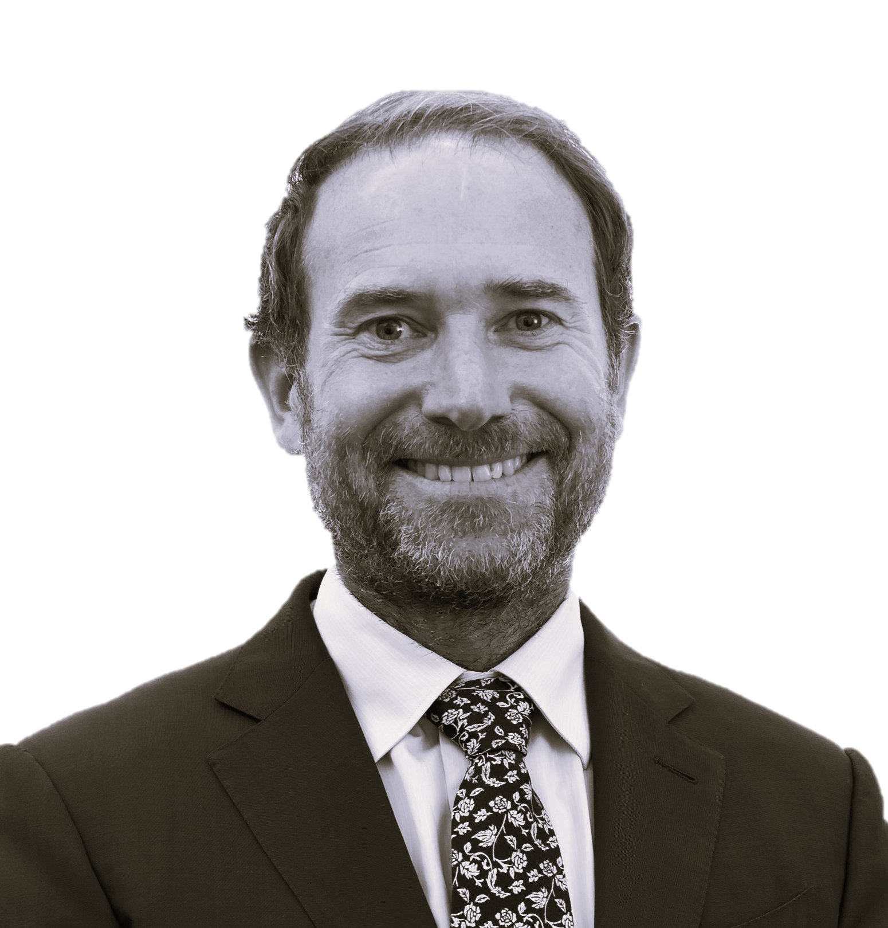
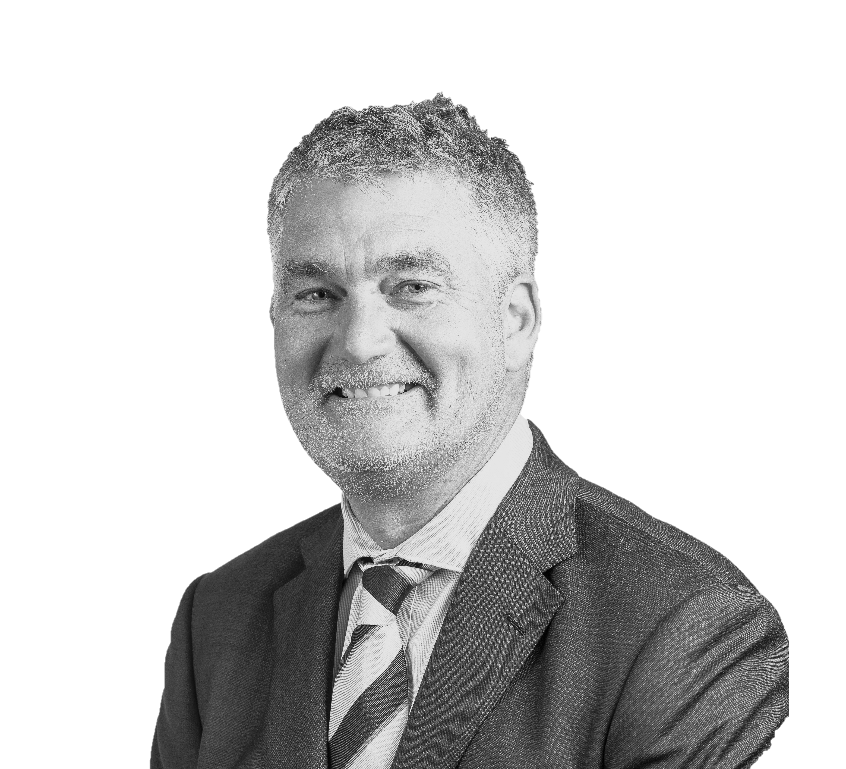
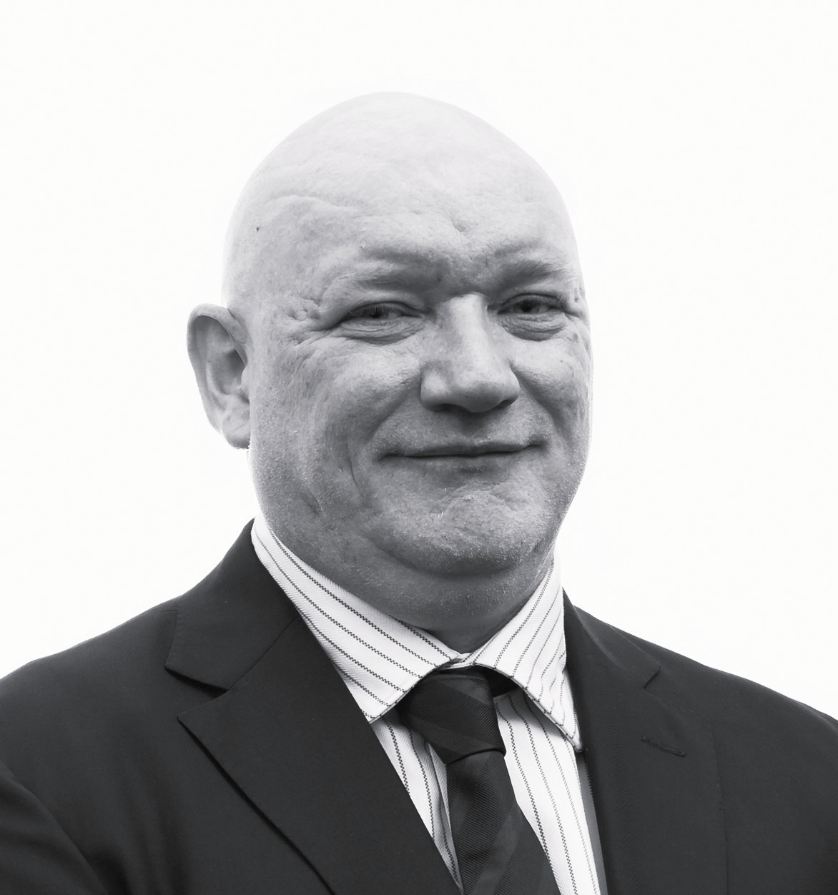
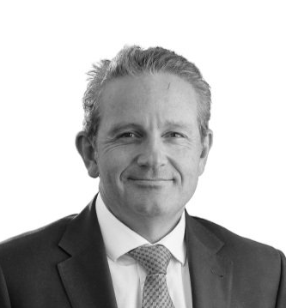
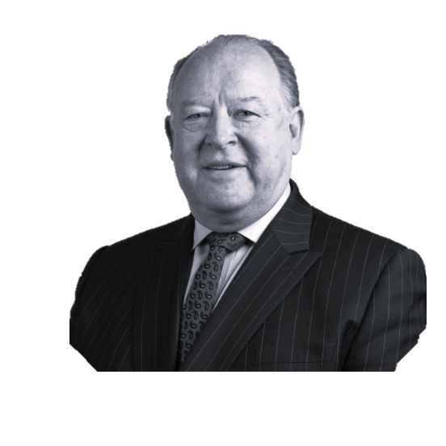

Board and Management
A Leadership team with proven success in the Resources Sector
Kevin Tomlinson
Steve Parsons
Michael Naylor
Renée Roberts
Darren Cooke
David Southam
Independent
Non-Executive Chair
Managing Director
Executive Director
Independent
Non-Executive Director
Chief Executive Officer
Advisor to the Board
Non-Executive Independent Chair of Bellevue Gold (ASX200), former Chair of Cardinal Resources and Non-Executive director of Centamin PLC.
Highly experienced mining executive with over 40 years’ experience across geology, investment banking and M&A in multiple jurisdictions including Canada, Australia, Africa and the UK.
Previous Managing Director of Investment Banking at Westwind Partners and Stifel Nicolaus.
Founder and Previous Managing Director and current Non-Executive Director of Bellevue Gold (ASX 200) and previous founder and Managing Director Gryphon Minerals (ASX 200).
Experienced geologist with a proven track record of mineral discoveries, corporate growth, international investor relations and creating shareholder wealth.
Non-Executive Director of Bellevue Gold (ASX200).
27 years' experience in corporate advisory and public company management since commencing his career and qualifying as a chartered accountant.
Involved in the financial management of mineral and resources focused public companies serving on the board and in the executive management teams.
Previously held C-Suite and director roles at large corporations including National Australia Bank, QBE and Bank of New Zealand as well as at the Australian Prudential Regulatory Authority (APRA).
Finance professional with considerable experience in risk management, financial services, governance, regulation, business transformation and growth, efficiency, strategic leadership, strategy development and execution.
Currently the Chief Risk Officer at Judo Bank and Director of Collingwood Football Club.
Previously held senior positions with Northern Star Resources, Newmont Mining and Barrick Gold.
Geologist with over 28 years’ experience. Extensive gold industry experience in Australia and North America spanning regional and near mine exploration, production geology, engineering planning, mine building and corporate development.
Previous positions include Kalgoorlie district geology manager for Barrick Gold and Principal Geologist – Business Development for Northern Star Resources.
Previously Managing Director of Mincor Resources NL (ASX: MCR) and Executive Director of ASX200 nickel company Western Areas (ASX: WSA). Held senior executive roles within Brambles Group, ANZ Investment Bank and WMC Resources.
David is a CPA with more than 30 years’ experience in accounting, operations, capital markets and finance across the resources and industrial sectors. Currently Executive Chairman of Cygnus Metals (ASX: CY5) and Non-Executive Director of Ramelius Resources (ASX: RMS).

Slide 10



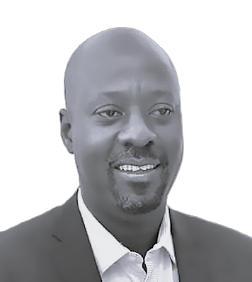

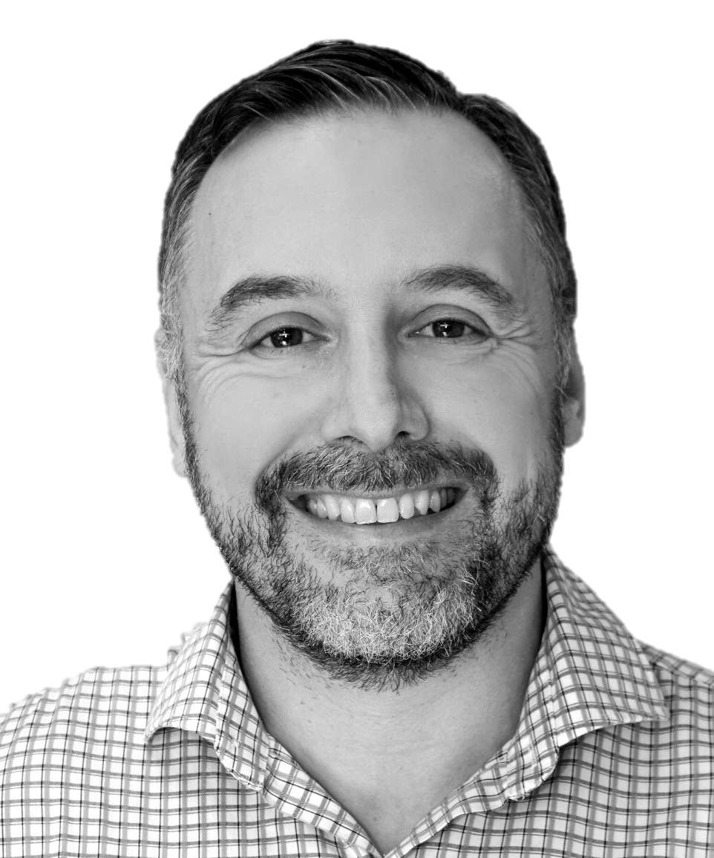


Exceptional Management and In-Country Team
Management team with in-depth Canadian mining expertise
Jessie Liu-Ernsting
Chen Sun
Laura Noonan-Crowe
Gus Simbanegavi
Chief Corporate Development Officer
Chief Financial Officer
General Counsel and Company Secretary
Vice President
Operations
Former VP investor relations at G Mining Ventures Corp (TSX:GMIN). Director of the Prospectors & Developers Association of Canada (PDAC).
Held senior technical, financial and strategic positions at Hudbay Minerals Inc (NYSE:HBM), global investment fund Resource Capital Funds and engineering groups Hatch and Golder Associates as well as investment banking at CIBC Capital Markets.
Ms Liu-Ernsting is also experienced in areas of corporate board audit, compensation, technical and special committees.
Ms Sun has over 15 years’ experience in stewarding business growth and overseeing accounting, corporate finance and financial management functions in the resources industry. Chen was previously CFO for nickel producer Mincor Resources NL, for 7 years until the company was taken over by Wyloo Consolidated Investments Pty Ltd in 2023.
Ms Sun holds a Bachelor of Commerce from Curtin University and is a member of the CPA Australia and the Australian Institute of Company Directors.
A lawyer with 18 years’ experience in the resources industry. Ms Noonan-Crowe was the General Counsel and Company Secretary, Australia for TSX-listed gold producer, Karora Resources Inc., before its merger with Westgold.
Ms Noonan-Crowe previously held senior legal roles at global gold mining majors, Northern Star Resources Limited, where she also served as Company Secretary to certain Committees of the Board of Directors, and Gold Fields Limited. Ms Noonan-Crowe commenced her career at Minter Ellison Lawyers.
Experienced Mining Engineer with > 25 years of mine operations management & project development.
Previously COO & Director of AIM listed Bluerock Diamonds where he was instrumental in the feasibility, development & construction of a 1.0Mtpa diamond mine & processing plant.
Experienced across a range of commodities including Gold, Platinum, Copper, Nickel, Zinc & Diamonds from his time in senior executive roles at companies such as Aquarius Platinum Mines, Vedanta Zinc International & Zimplats Platinum Mines.
Jared Dietrich
Juan Gutierrez
Tabatha LeBlanc
Bonnie Matthews
Vice President
Metallurgy
Group Chief Geologist
Vice President
Environment & Community
Vice President
Human Resources
Metallurgy expert with over 17 years’ experience in mining projects globally, across various engineering, construction, operational, & technical leadership roles.
Almost 15 years with Ausenco Engineering, in their Australian, Canadian & USA offices, across several engineering, study management & commissioning roles, most recently as VP of Technical Services, responsible for Cu-Au metallurgical technical governance & innovation across all process engineering in North America, and NI 43-101 delivery.
Over 17 years’ experience in a diverse range of mining projects globally.
Over 6 years with Northern Star Resources as Geology Superintendent where he was involved in discoveries at Jundee and Yandal totalling over 1Moz Gold.
Extensive experience from exploration and resource development to production and resource estimation in commodities including gold, nickel and copper.
25 years’ ESG experience in North America, with a proven track record of achieving social and government approvals for companies including TransCanada & Alliance Pipelines, Marathon PGM Corporation, Sibanye-Stillwater & Generation Mining.
Oversaw the management & delivery of critical environmental approvals & community agreements including successfully obtaining approval for an Environmental Assessment conducted by a Joint Federal-Provincial Review Panel in Ontario.
Over 20 years’ experience in Business Management and HR from previous positions with Tata Steel Minerals Canada and Grey Rock Mining as well as positions with the Governments of NL and of Nunavut.
Currently sits on the board of Canadian Manufactures and Exporters (CME) in NL, is the current Chairperson of the NL CME HR Committee, and is also on the board of Women in Resource Development for Newfoundland and Labrador.
10
10

Slide 11
An Exceptional High-Grade Asset
Two separate mineralised copper and gold zones at the mine
High Grade Upper Copper & Gold VMS Zones
Broad Footwall Copper Stringer Zone
10.7m @ 12.2% CuEq (9.0% Cu & 3.6g/t Au) MUG24_095
5.4m @ 12.2% CuEq (8.6% Cu & 4.0g/t Au) MUG24_023
3.2m @ 11.8% CuEq (2.9% Cu & 10.4g/t Au) MUG23_037
11.6m @ 9.3% CuEq (6.0% Cu & 3.9g/t Au) MUG24_128
26.0m @ 8.2% CuEq (6.1% Cu & 2.4g/t Au) MUG23_030
13.5m @ 7.6% CuEq (5.3% Cu & 2.6g/t Au) MUG23_029
14.7m @ 7.5% CuEq (2.6% Cu & 5.5g/t Au) MUG23_004
7.0m @ 7.4% CuEq (4.4% Cu & 1.5g/t Au) MUG24_038
5.5m @ 7.1% CuEq (5.4% Cu & 2.0g/t Au) MUG25_014
14.6m @ 6.7% CuEq (5.4% Cu & 1.5g/t Au) MUG25_032
17.8m @ 6.6% CuEq (4.4% Cu & 2.2g/t Au) MUG23_003
46.4m @ 5.6% CuEq (4.6% Cu & 1.2g/t Au) MUG23_006
26.2m @ 5.3% CuEq (4.9% Cu & 0.4g/t Au) MUG25_015
86.3m @ 3.7% CuEq (3.1% Cu & 0.6g/t Au) MUG24_079
24.1m @ 3.7% CuEq (3.5% Cu & 0.3g/t Au) MUG25_042
31.7m @ 3.5% CuEq (3.4% Cu & 0.1g/t Au)MUG24_063
58.2m @ 3.1% CuEq (2.4% Cu & 0.7g/t Au)MUG24_083
76.3m @ 2.9% CuEq (2.4% Cu & 0.5g/t Au)MUG24_073
56.8m @ 2.7% CuEq (2.5% Cu & 0.1g/t Au) MUG24_058
47.1m @ 2.4% CuEq (2.3% Cu & 0.2g/t Au) MUG23_014
63.1m @ 2.2% CuEq (2.0% Cu & 0.1g/t Au) MUG24_004
51.0m @ 2.2% CuEq (2.1% Cu & 0.1g/t Au) MUG24_009
BOTH THE HIGH-GRADE VMS & BROAD FOOTWALL ZONE REMAIN OPEN AT DEPTH

Slide 12
Scarcity of Quality Copper and Gold Projects
Attractive Commodity Mix
Global Primarily Gold & Copper Projects
with MRE, pre-production
2,194
Projects
Leading Jurisdiction
In Tier 1 Jurisdiction (USA, Canada, Chile, and Australia)
1,525
Projects
Owned by a Publicly Company
Held by Public Companies with a Market Cap. > US$150 m
261
Projects
Significant Capital Already Spent
Total capital already spent >US$100 m¹
57
Projects
High Grade
Resource Grade >1.5% Cu²
6
Projects
Owned by Developer
Not Owned by a Producer
1
Green Bay
Note: Market data as at 24 July 2025.
¹ Total capital investment is calculated as the sum of all disclosed capital cost figures. Capital costs are sourced by S&P Global Intelligence from company disclosure where available.
² Cu grades of assets based on S&P data where available.
³

Slide 13
A Lack Copper Opportunities on the ASX & TSX
Few junior companies with projects producing >30,000 tonnes of Cu 2024-2025
Green Bay Copper Gold Project has huge growth opportunity
Significant and immediate growth (130,000m drilling 2024-2025)
Targeting a larger scale mid-tier copper operation
District scale exploration potential
See Appendix 3 for original source data for production information.
This graph depicts actual copper production information and is not a representation of mineral resources or ore reserve estimates. All noted assets were therefore in production at the time.
The Ming Mine production data is from 2022. The Ming Mine is currently under care and maintenance.
Excludes assets with attributable production over 100kt of copper.

Slide 14

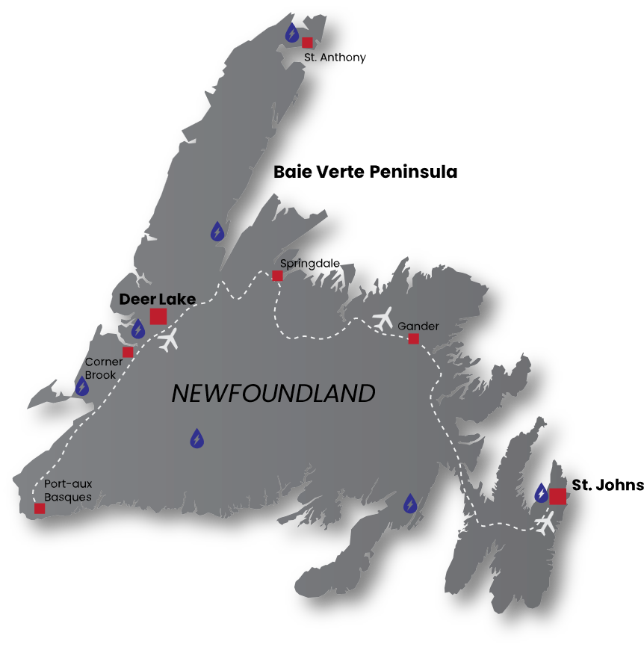
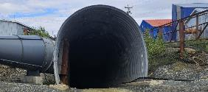
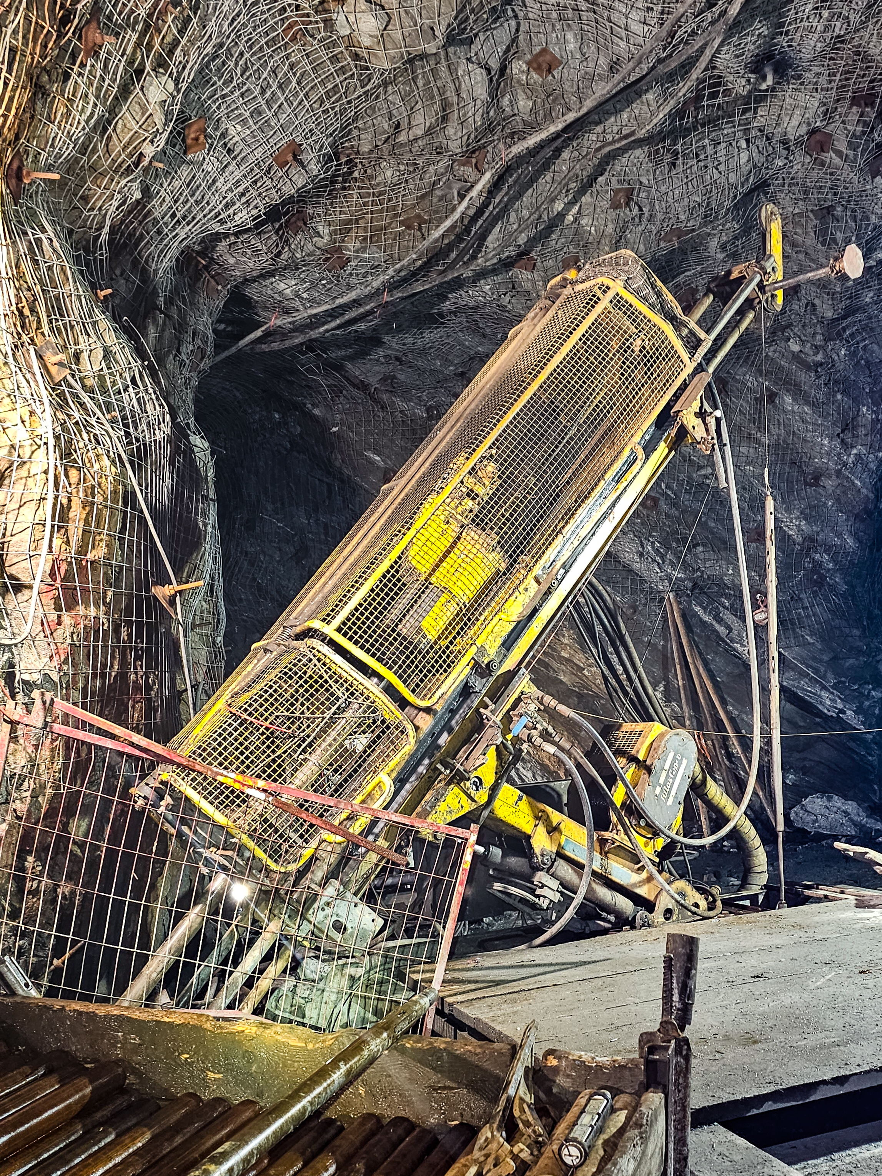
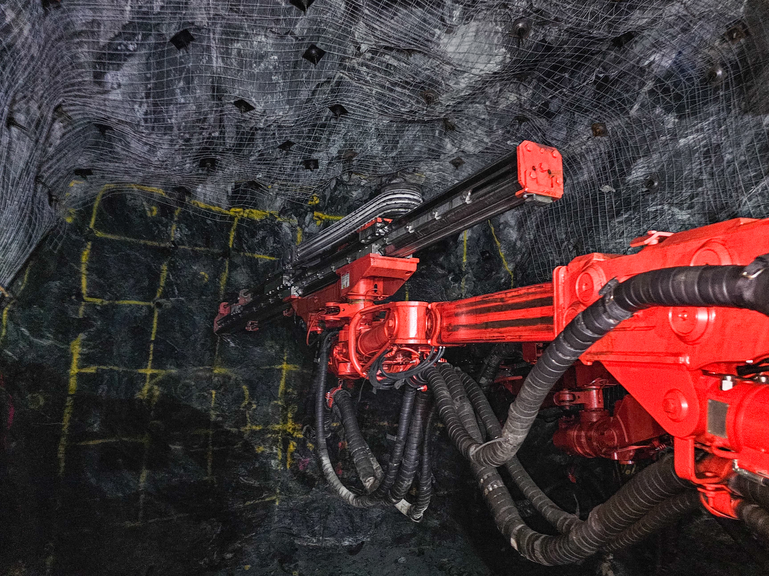

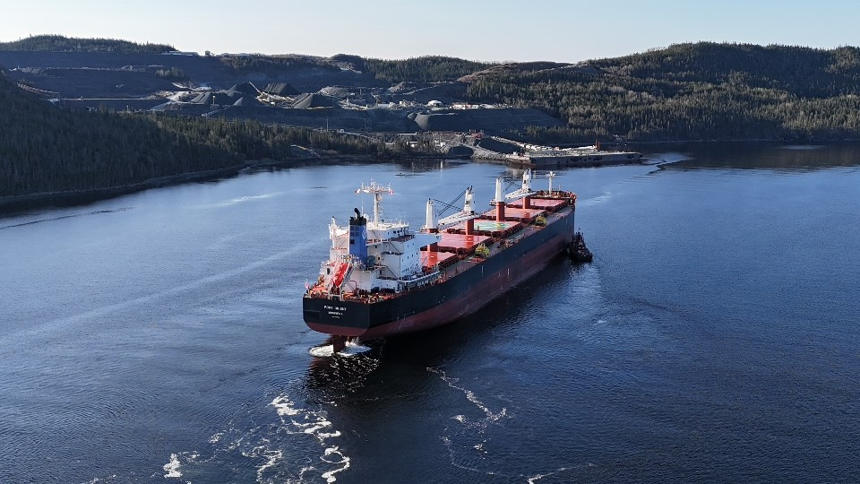
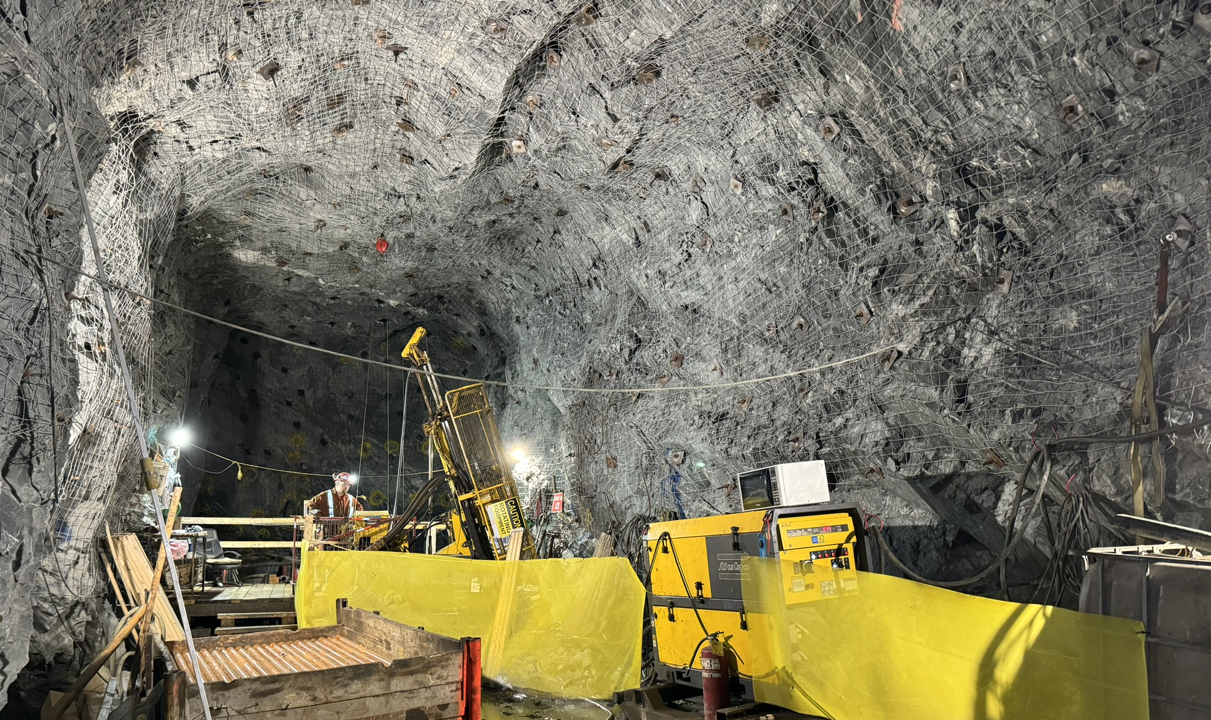
Newfoundland – A Maritime and Mining Province
Newfoundland & Labrador
Newfoundland & Labrador
Hydro
FireFly Metals Green Bay Operations
Ming Copper Mine
Fully Operational Mine
FireFly Metals
Pine Cove Deepwater Port
Hydro
Project is accessible 365 days a year by road, air & sea
Hydro
1.5 hour drive from Deer Lake to project site via Trans-Canada Hwy
Hydro
Tier 1 Mining Jurisdiction
Hydro
Strong government support
Mining sector contributes +32% to GDP¹
Skilled mining workforce readily available
Track record of expedited mine permitting
Rated Top 6 globally in 2024 by Fraser Institute
Hydro Power abundant throughout Newfoundland
Hydro
Hydro
1. Data Source: Statista Distribution of gross domestic product of Newfoundland and Labrador, Canada in 2021 by industry

Slide 15
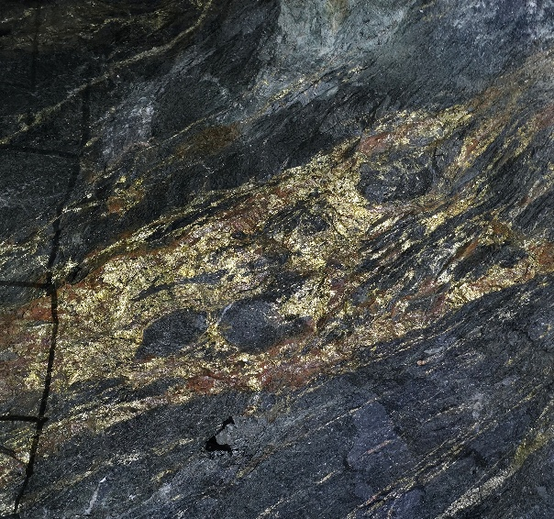

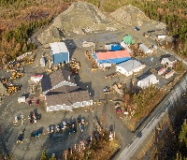
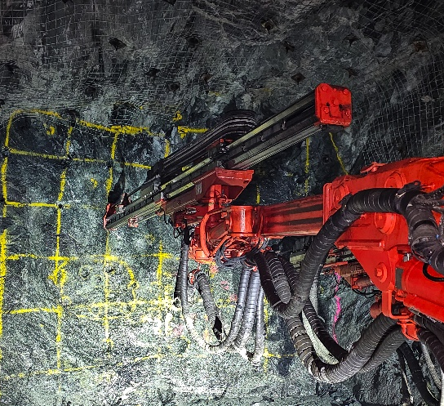
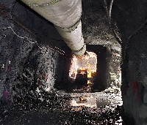
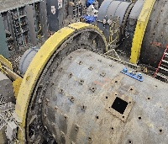
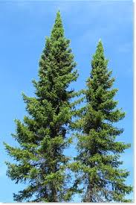
Why Green Bay is well positioned for the future
The ingredients are already in place for a substantial Copper Mine
A WORLD-CLASS VMS SYSTEM UNDERPINS THE MINE
Large scale (24.4Mt M&I + 34.6Mt Inf) and High-Grade (2% CuEq) Copper-Gold Deposit, rapidly growing through drilling & exploration with camp-scale potential for discovery
Mineral Deposit
EXISTING INFRASTRUCTURE SUPPORTS A LARGE OPERATION
Workshops, water treatment plant, offices etc., low-cost green Hydro Power runs through the property, 365-day access to site via sealed highways, well serviced local communities
Surface Infrastructure
OPERATIONAL UNDERGROUND MINE
Dewatered underground mine with access to 950m decline and shaft, +20km of historical development in place provides a low-cost foundation for drilling and mining, 6 rigs and a jumbo operating underground
Underground Access
PROVEN SIMPLE METALLURGY & HIGH-QUALITY CONCENTRATE
Long history of concentrate production. Excellent recoveries of >98% Copper, conventional processing flow (crush, grind, float). No deleterious elements. Historic concentrate grades consistently between 27% and 29% copper. Access to a deep-water port 6km from the mine.
Processing & Concentrate
ENVIRONMENTALLY APPROVED WITH A CLEAR GROWTH STREATEGY
Initial upscaled restart of production, with construction of TSF on site and new plant with throughput capacity of up to 1.8Mtpa,¹ has been conditionally released from further environmental and socio-economic assessment.
Approvals & Permitting
1. Green Bay has been conditionally released from further environmental assessment for an initial upscaled restart mining operation involving a plant with a throughput capacity of up to 1.8Mtpa. Investors are cautioned that the plant capacity is a technical specification forming part of the environmental submission and not a forecast of the estimated production of the mining operation. The mining operation’s forecast production will not be estimated until such time as the Company has prepared and announced its Scoping Study/Preliminary Economic Assessment. Should a larger scale case be adopted than contemplated by the environmental release, further assessment will be required by government agencies.

Slide 16
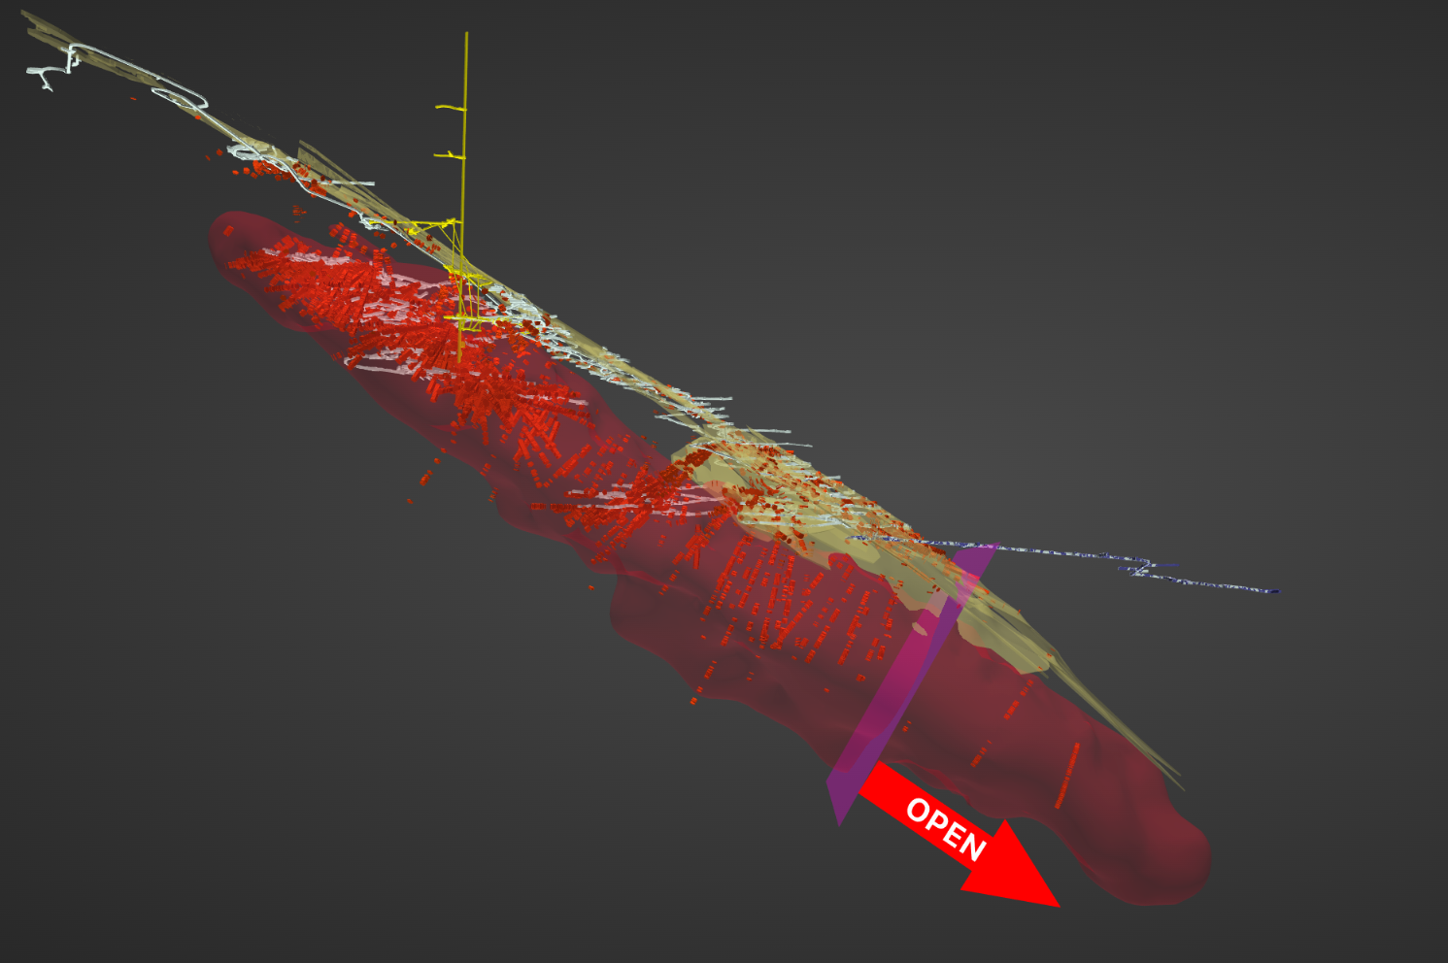
A Transformational Acquisition for FireFly
Shaft
Drilling at 20 October 2023
(On Acquisition by FireFly)
202,740m
No drill rigs
Poor drill spacing in upper part of the mine
Historical mining focused on high-grade VMS
Not focused on broad FWZ
Only 2 drill intersections beyond the mineral resource:
Demonstrated that both the VMS and FWZ styles of mineralisation continued +400m beyond mine workings
Portal
Mineralisation starts 250m below surface
High Grade Cu-Au VMS Zones
1.5km of Strike
Broad Cu Footwall Zone
102m @ 1.7%CuEq
Cu Assays
>0.5%
500m
Limit of Previous 30Mt Resource

Slide 17
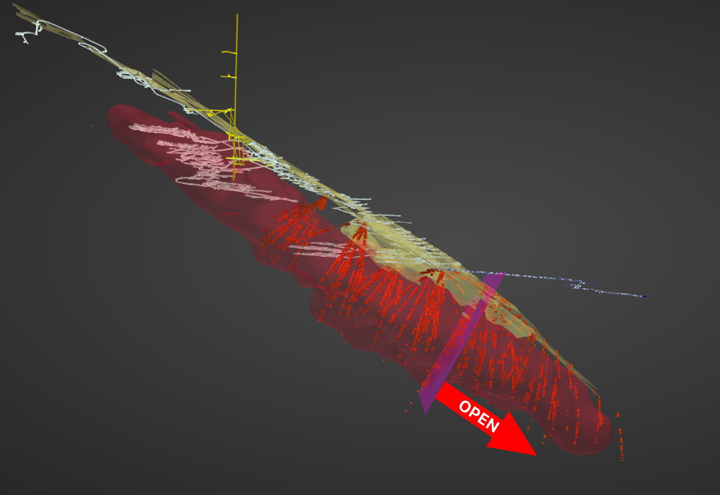
Rapid value creation by FireFly Metals
Underground development in place to position drill rigs to extend mineralisation
High-grade VMS Zone mineralisation continues beyond historical drilling:
10.7m @ 12.2% CuEq (VMS)
17.3m @ 7.4% CuEq (VMS)
Broad FWZ demonstrates both scale and grade:
86.3m @ 3.7% CuEq (FWZ)
58.2m @ 3.1% CuEq (FWZ)
Shaft
FireFly Drilling & Mining
(October 2023 – September 2025)
115,770m
57% Increase
Portal
Mineralisation starts 250m below surface
High Grade Cu-Au VMS Zones
805 Exp Drive
2,335m of Development Mined
1.5km of Strike
Broad Cu Footwall Zone
6 Rigs Underground (resource growth & infill)
Step-out extensional drilling is underway
Infill drilling vital to extract maximum value:
Higher-quality M&I Resource used in mining studies
High-Grade VMS Extended >600m to date
Cu Assays
>0.5%
500m
Limit of Previous 30Mt Resource

Slide 18
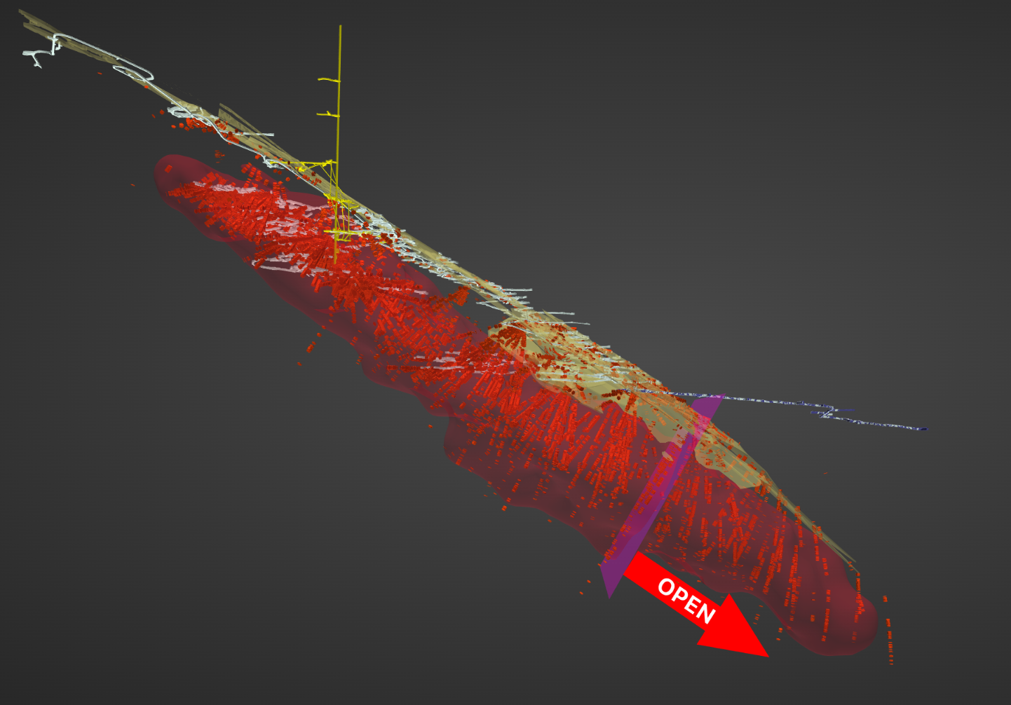
Drilling to Unlock Value by FireFly Metals
Shaft
Total Drilling & Mining
(2010 – September 2025)
318,510m
Portal
Mineralisation starts 250m below surface
Improved Definition to enable inclusion in Feasibility Studies
INTERSECTIONS OUTSIDE
OF 60Mt RESOURCE
High Grade Cu-Au VMS Zones
25.8m @ 5.1% CuEq
2.3km of strike, OPEN
Step-out drilling underway
Broad Cu Footwall Zone
12.4m @ 6.8% CuEq
High-Grade VMS Extended >600m to date
Cu Assays
+20Mt @ +2% CuEq Inferred Resource Added in 1st year
An additional 100,000m of underground drilling planned in 2025-2026
>0.5%
500m
Limit of Oct 2024 50Mt @ 2% CuEq Resource

Slide 19
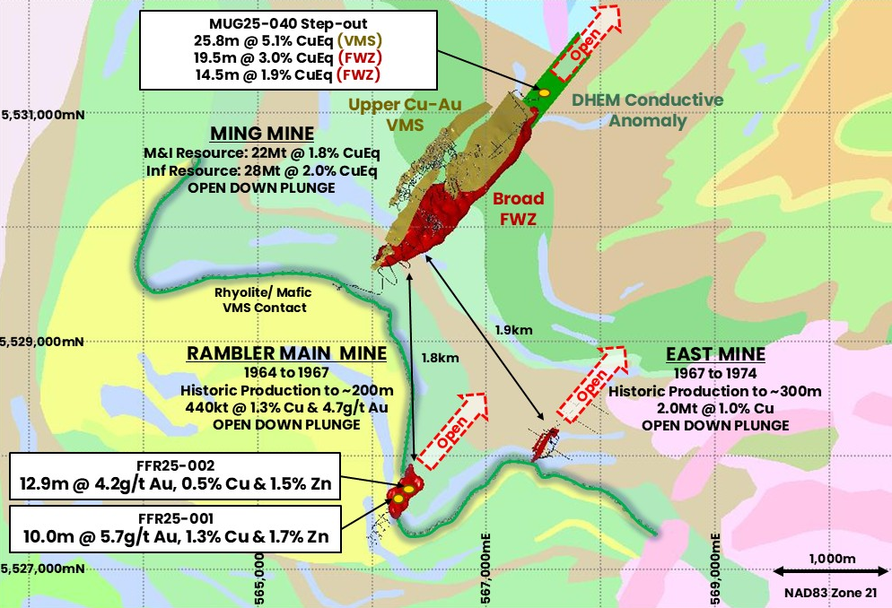
Multiple Targets Adjacent to Copper & Gold Ming Mine
Potential for another Ming………?
Multiple high priority regional targets to be drill tested over coming weeks through 2025
Rambler Main Mine drill results show similar style mineralisation to adjacent Ming Mine
All targets are shallow (~200m depth) and OPEN
Significant Gold as well as Copper and Zinc
Further drilling underway
Rambler and East Mines are only 2km from the Ming Mine; Easy trucking to future mine infrastructure

Slide 20
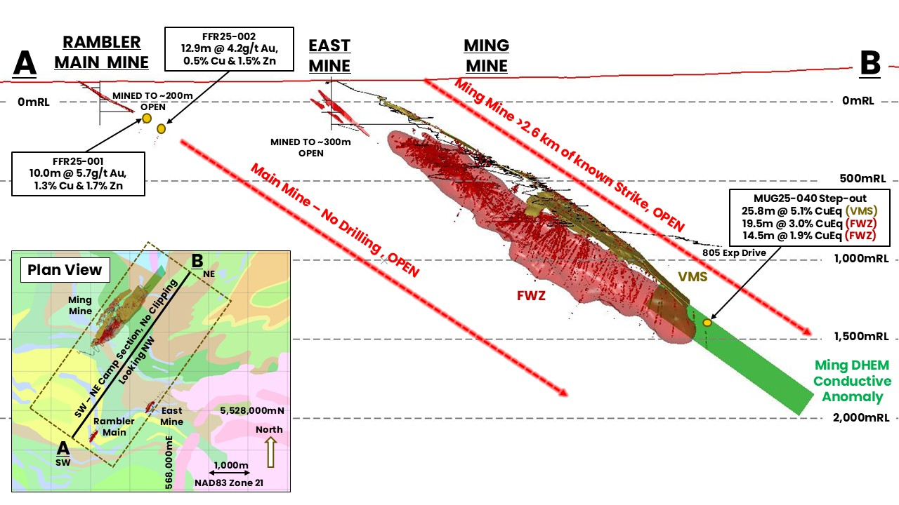
Initial Regional Drilling Intercepts High Grade Cu & Au
‘Look-alike’ to the adjacent Ming Mine
Maiden diamond drilling at Rambler Main - the first regional target
10.0m @ 6.4% CuEq (5.7g/t Au, 1.3% Cu, 1.7% Zn & 20.9g/t Ag) ~ true thickness
12.9m @ 4.3% CuEq (4.2g/t Au, 0.5% Cu, 1.5% Zn & 10.9g/t Ag) ~ true thickness
Shallow and OPEN
Step-out growth drilling underway
HOW BIG COULD THIS BE?

Slide 21
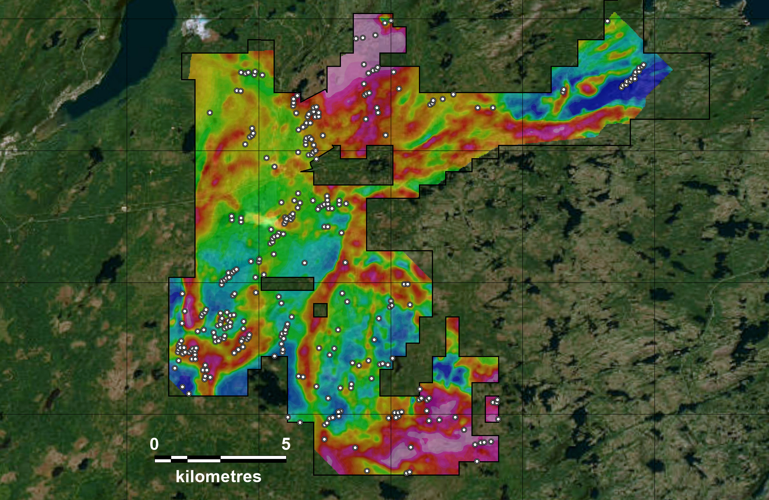
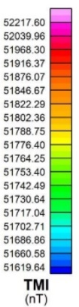
Unlocking the regional camp-scale potential
MING MINE
M&I Resource: 22Mt @ 1.8% CuEq
Inf Resource: 28Mt @ 2.0% CuEq
Open Down Plunge
UNTESTED
MING-ORIENTED CONDUCTIVE TRENDS
5,535,000mN
Recent FireFly geophysics identified 325 untested targets
2 x surface rigs turning, testing regional targets
Multiple Ming Mine look-alike targets
Exploration claims host 8 historically mined deposits - all remain OPEN
C$16M of flow-through funds to accelerate discovery during 2025-2026
UNTESTED
MING-ORIENTED CONDUCTIVE TREND
RAMBLER MAIN MINE
Historic Production (1964-1964)
440kt @ 1.3% Cu & 4.7g/t Au
Open Down Plunge
VTEM
5,530,000mN
Bedrock Conductive Anomaly
HILLBOG TREND
UNTESTED
EAST MINE
Historic Production (1967-1974)
2Mt @ 1.0%, Mined to 300m
Open Down Plunge
MAGNETICS
Total
Magnetic
Intensity (nT)
Marwan- Lewis Area
UNTESTED
MING-ORIENTED CONDUCTIVE TRENDS
5,525,000mN
UNTESTED
MING-ORIENTED CONDUCTIVE TRENDS
VTEM TRENDS
Known
Mineralisation
5,520,000mN
UTM NAD 83
Zone 21
Same Orientation
as Known
Mineralisation
Other Conductive Trend
560,000mE
565,000mE
570,000mE
575,000mE
580,000mE

Slide 22



















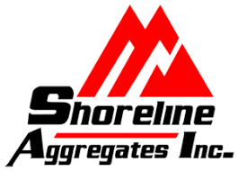

Economic studies targeting large-scale & long-life mine
Environmental approval secured for initial upscaled restart mining operation with construction of TSF on site and new plant with throughput capacity of 1.8Mtpa
Significant Progress to Date – Economic Studies scheduled for Q1 2026
Environment & Community
Mining
Mineral Processing
Released from Environmental Assessment in just 45 days
Application for early works permits in progress
Tailings site selected & designed
Ongoing sampling & monitoring
Strong community support
Mining method selected – bulk transverse long hole open stoping
Preliminary design and schedule shows potential for further upscaling
Geotechnical work in progress, including rock mass modelling and UCS testing
Paste fill studies underway
Preliminary met testwork completed, +98% Cu and +85% Au recovery
Site surface layout completed
Process flow and mill design in progress
Hydro studies underway – indicate ample power supply for upscaled plant
Port design and optimisation underway
Study Partners & Key Contractors
Mining
Processing
Environment, Permitting & Closure
Tailings
Geology
Paste Fill
Met Testwork
Power & Energy
Diamond Drilling
Assays
Port
1. the Company continues to explore opportunities that may support future increases in production capacity. These scenarios will be considered within broader economic evaluations as part of future alternative development pathways. Should any of these cases be pursued, they would be subject to further review and approval by the appropriate regulatory authorities

Slide 23
Rapid Resource and Mine Growth Over Next 12 Months
Well-funded for significant velocity of news flow through 2025
Milestone¹ | Q4 23 | Q1 24 | Q2 24 | Q3 24 | Q4 24 | Q1 25 | Q2 25 | Q3 25 | Q4 25 | Q1 26 | Q2 26
2024 – 2025 PROGRAM
Green Bay Project Acquisition 15 Oct 2023
UG Drill Drive Phase 1 750m (completed)
UG Drill Drive Phase 2 ~750m (commenced)
UG Resource Drilling x6 rigs 130,000m underway
Resource Updates
Geophysical targeting
Discovery near mine drilling x 1 rig New and geophysical targets
Regional targeting x 1 rig Geophysics, mapping, drilling
Upscaled Production & Engineering Studies
2025 Key Deliverables
Underground development drill drive completed
6 x underground drill rigs targeting resource growth and upgrades (100,000m completed of 130,000m)
2 x surface rigs targeting regional discovery; extensive geophysical surveys to continue
Upscaled mine production & engineering studies scheduled for Q1 2026
Environmental approval for start-up operation received
Studies
1. Please note that timeframes are indicative and may be subject to change
1. Timeframes are indicative and may be subject to change

Slide 24
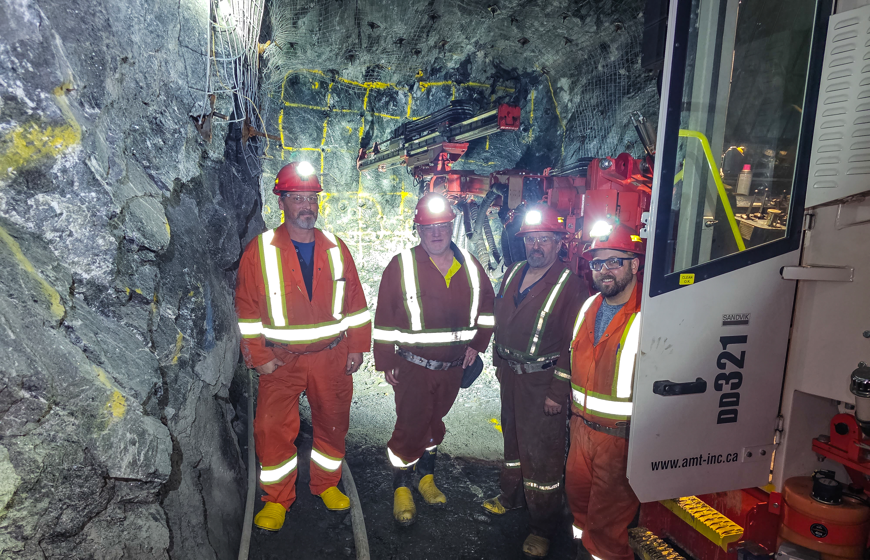
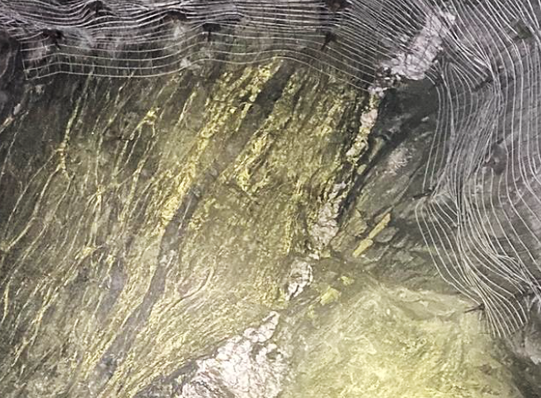
Game-Changing Catalyst-Rich High-Grade Opportunity
Board & Management Team with a Proven Track Record of Creating Shareholder Wealth
Strong Cash Position of A$145 Million¹ for Growth Throughout 2025
GREEN BAY COPPER & GOLD PROJECT
A fully operational underground mine in tier one mining jurisdiction
Large high-grade resource that is growing
Drilling for growth & further discovery (130,000m of drilling 2024-25)
Significant mine upscaling underway for a mid-tier copper operation
A$250M of Infrastructure a huge head start (UG mines, shaft, declines, processing plant, deep water port, camp and hydro power)
PICKLE CROW GOLD PROJECT
High-grade shallow 2.8Moz @ 7.2g/t gold inferred resource – OPEN
Significant regional scale land holding with huge growth opportunity
1. Cash, receivables and liquid investment position at 30 June 2025, plus A$10 million proceeds received from the Share Purchase Plan completed on 14 July 2025, and net proceeds from the second tranche of the Institutional Placement of ~A$26.6 million completed on 3 September 2025.

