Slide 1
Denver gold forum 2025
A 20+ year track record of growing ounces of gold in the ground faster than shares outstanding

Slide 2
Forward Looking Statements
All reserve and resource estimates reported by the Company were calculated in accordance with the Canadian National Instrument 43-101 and the Canadian Institute of Mining and Metallurgy Classification system. These standards differ significantly from the requirements of the U.S. Securities and Exchange Commission. Mineral resources which are not mineral reserves do not have demonstrated economic viability.
Statements relating to the estimated or expected future production and operating results and costs and financial condition of Seabridge, planned work at the Company’s projects and the expected results of such work are forward-looking statements within the meaning of the United States Private Securities Litigation Reform Act of 1995. Forward-looking statements are statements that are not historical facts and are generally, but not always, identified by words such as the following: expects, plans, anticipates, believes, intends, estimates, projects, assumes, potential and similar expressions. Forward-looking statements also include reference to events or conditions that will, would, may, could or should occur. Information concerning exploration results and mineral reserve and resource estimates may also be deemed to be forward-looking statements, as it constitutes a prediction of what might be found to be present when and if a project is actually developed. These forward-looking statements are necessarily based upon a number of estimates and assumptions that, while considered reasonable at the time they are made, are inherently subject to a variety of risks and uncertainties which could cause actual events or results to differ materially from those reflected in the forward-looking statements, including, without limitation: uncertainties related to raising sufficient financing to fund the planned work in a timely manner and on acceptable terms; changes in planned work resulting from logistical, technical or other factors; the possibility that results of work will not fulfill projections/expectations and realize the perceived potential of the Company’s projects; uncertainties involved in the interpretation of drilling results and other tests and the estimation of gold reserves and resources; risk of accidents, equipment breakdowns and labour disputes or other unanticipated difficulties or interruptions; the possibility of environmental issues at the Company’s projects; the possibility of cost overruns or unanticipated expenses in work programs; the need to obtain permits and comply with environmental laws and regulations and other government requirements; fluctuations in the price of gold and other risks and uncertainties, including those described in the Company’s Annual Information Form filed with SEDAR in Canada (available at www.sedar.com) for the year ended December 31, 2024 and in the Company’s Annual Report Form 40-F filed with the U.S. Securities and Exchange Commission on EDGAR (available at www.sec.gov/edgar.shtml).
Forward-looking statements are based on the beliefs, estimates and opinions of the Company’s management or its independent professional consultants on the date the statements are made.

Slide 3
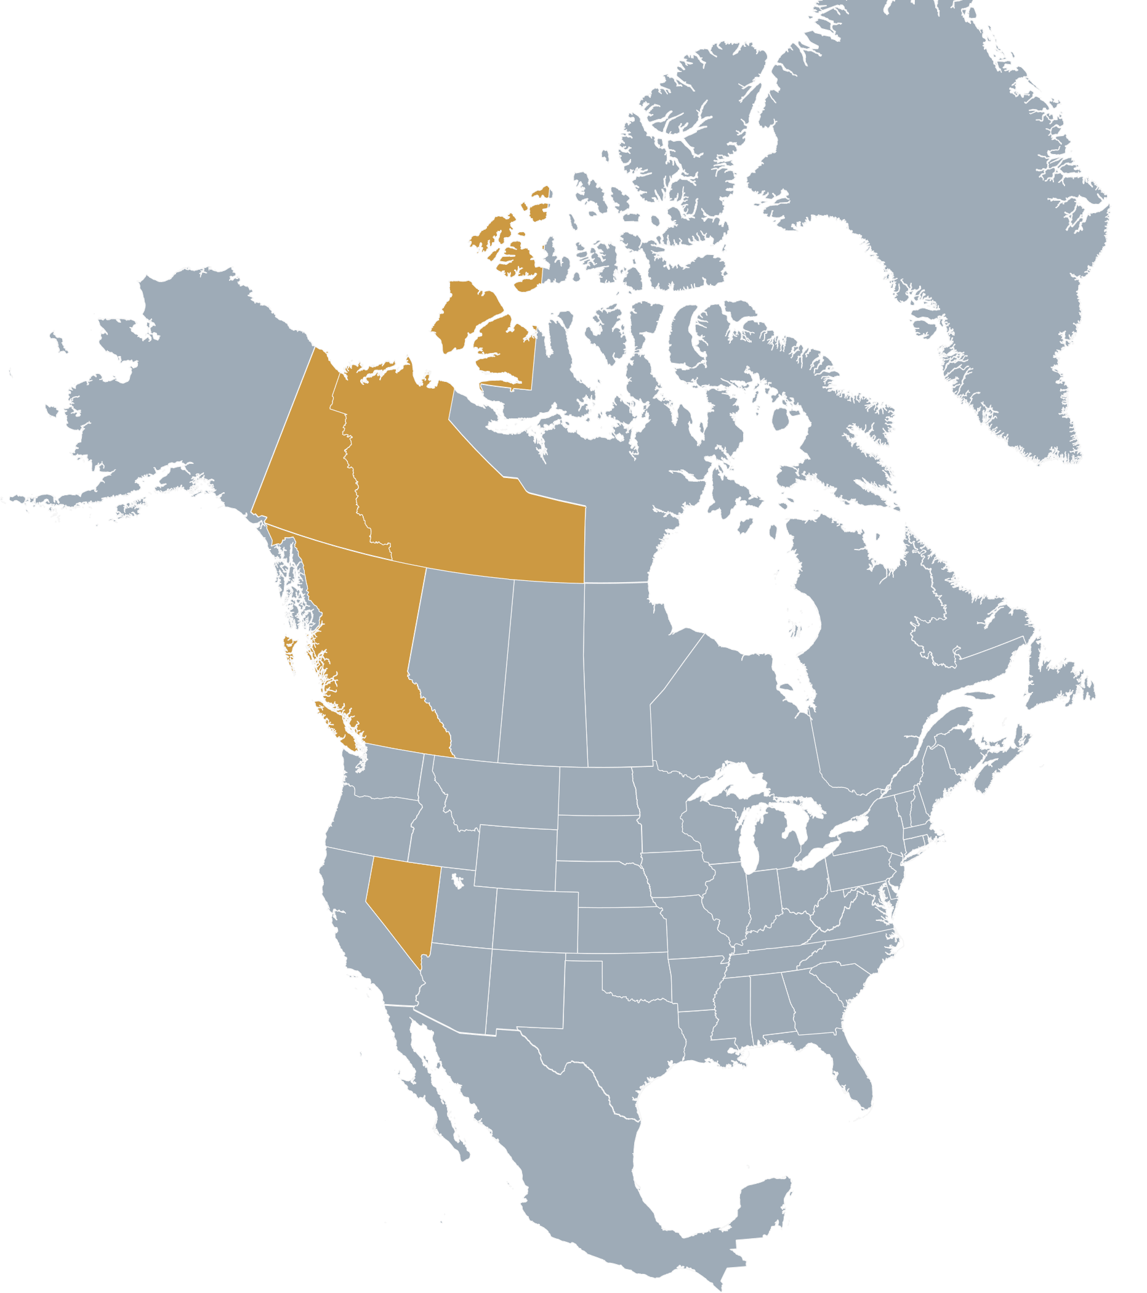
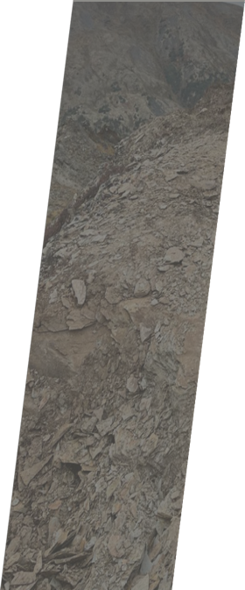
North American Portfolio of
Premier Gold and Copper Projects
ISKUT PROJECT (100%)
British Columbia, Canada
COURAGEOUS LAKE (100%)
Northwest Territories, Canada
294 km2 property located in northern British
Columbia, ~110 km northwest of Stewart, BC
Only 20 km by air from the KSM Project
Includes the former high-grade Johnny
Mountain gold mine and the Bronson Slope Cu-Au deposit
2024 drilling identifies new large gold-copper deposit at Snip North
2025 drill program underway to define Snip North maiden resource
Is this another KSM?
One of Canada largest undeveloped projects by gold resources (11.0M oz M&I Au at 2.36 g/t Au)
New 43-101 Technical Report demonstrates potential for 28-year mine life producing 200k ounces of gold per year
Potential spin out to shareholders
3 ACES (100%)
Yukon Territory, Canada
KSM (100%)
British Columbia, Canada
District-scale (> 300 km2), orogenic gold project with year-round access
300 holes with 37% intersecting +5 g/t Au
2024 drill program refines geologic model
$5 million 2025 program underway
One of the world’s largest undeveloped gold and copper projects
Received B.C. Environmental Assessment certificate and federal environmental approval
2022 PFS captures 47.3M ozs Au and 7.3B lbs Cu and 160M ozs Ag in proven and probable reserves
Recently completed 2022 PEA shows additional upside potential focused on copper rich deposits
US$444 million spent on early site construction activities to lock in permits for life of project
Substantially Started designation received July 2024 ⁽¹⁾
SNOWSTORM PROJECT (100%)
Nevada, USA
103 km2 property located at intersection of three major Nevada gold belts
Contiguous and on strike with several large gold mines (Turquoise Ridge, Twin Creeks)
10% NPI in Grassy Mountain (Oregon)
(1) See slide 16 for additional information

Slide 4
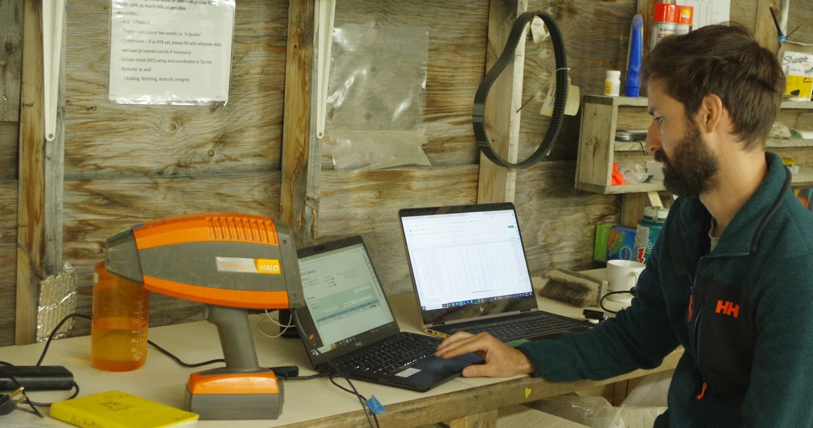
Share Dilution Matters
Our objective is to grow ounces in the ground faster than shares outstanding
From 2003 through December 2024, total gold resources have grown by 1075% during a period when shares outstanding increased by 233%
Source: Company data
Note: For a breakdown of Seabridge’s mineral reserves and resources by project, tonnes and grade, please visit http://seabridgegold.com

Slide 5
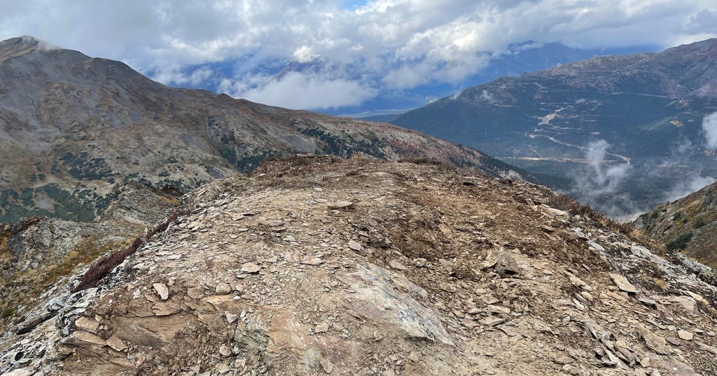
Superior Leverage to Gold
Seabridge ranks 1st in gold reserves/share among North American listed gold companies
Seabridge ranks 1st in gold resources/share among North American listed gold companies
Gold Reserves (ounces) per Common Share
Gold Resources (ounces) per Common Share
Source: Company data. Data as of August 31, 2025
Note: Companies shown include North America’s largest gold companies and selected gold project development companies

Slide 6
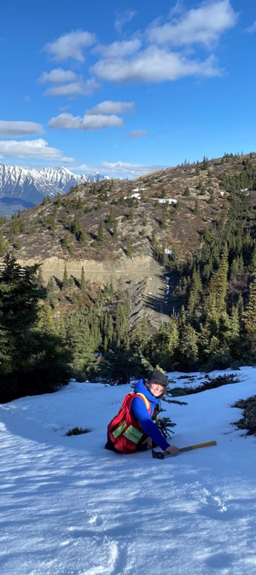
In A Rising Gold Market, Seabridge Is A Stock To Own
Source: Company data. As of August 31, 2025

Slide 7
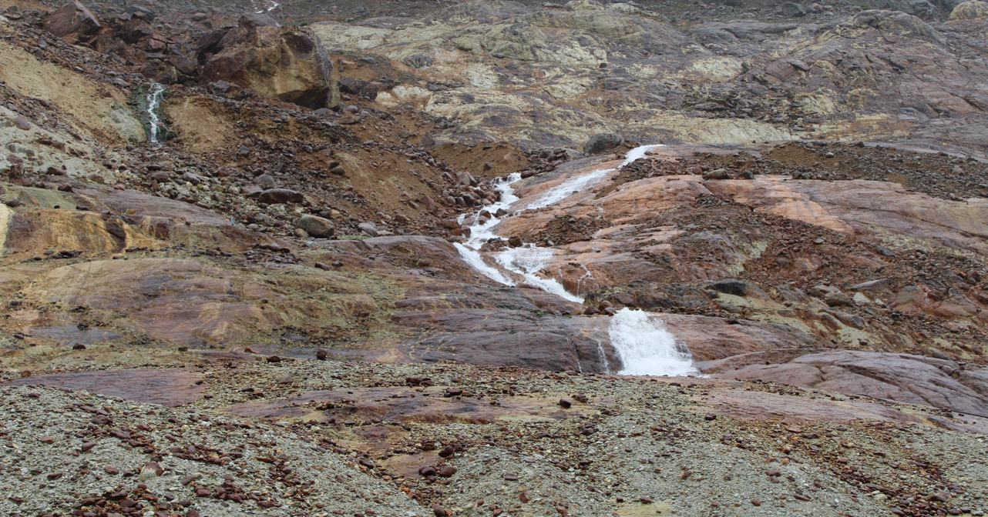
Superior Leverage To Copper
Seabridge ranks 1st in copper reserves/share among major listed copper/gold companies
Seabridge ranks 1st in copper resources/share among major listed copper/gold companies
Copper Reserves (pounds) per Common Share
Copper Resources (pounds) per Common Share
Source: Company data. Data as of August 31, 2025
Note: In addition to Seabridge, companies shown include North America’s largest copper and gold/copper producing companies

Slide 8
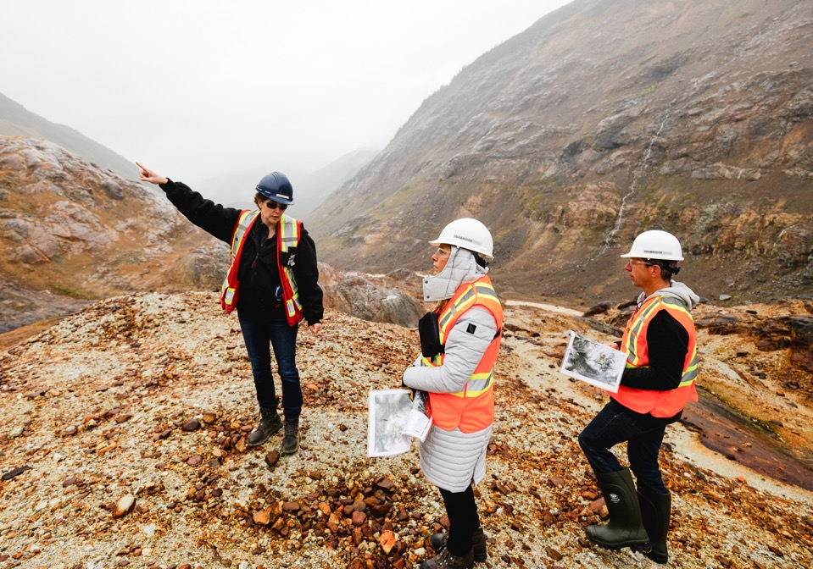
KSM Project
British Columbia, Canada

Slide 9
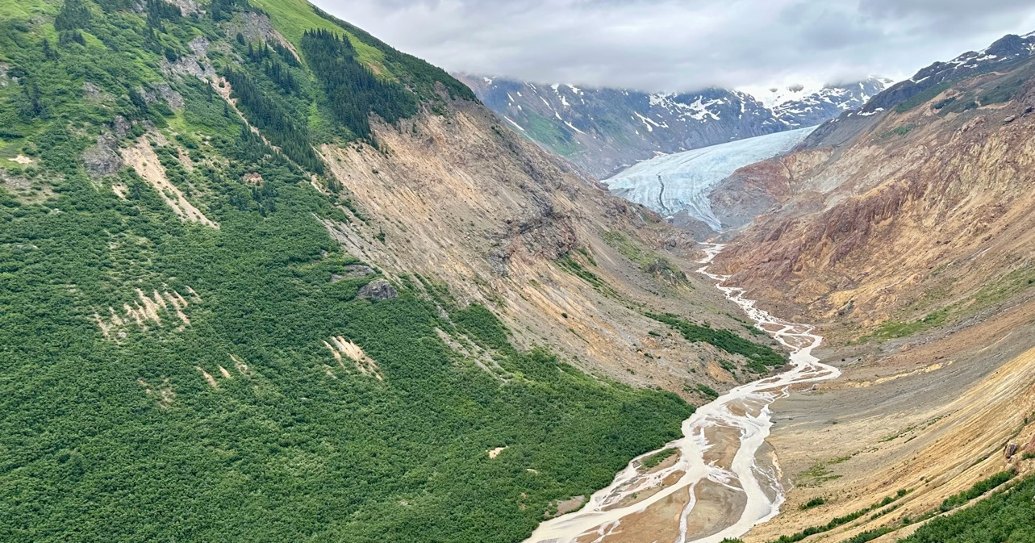
KSM is a World-Class Gold & Copper Project
Measured & Indicated Resources⁽¹⁾
Inferred Resources
✗ Owned by a Major
World-Class on Every Metric ⁽²⁾
KSM is the World’s Largest Gold Resource ⁽²⁾ (M oz Au)…
1st
✗
Largest gold resource in the world (89 M oz M&I + 71 M oz Inf.)
✗
✗
✗
3rd
✗
✗
✗
3rd largest copper development resource in the world (9 M tonnes M&I + 17 M tonnes Inf.)
1.4 Moz
Peer-leading annual production scale (1,027 k oz Au & 81 k tonnes Cu)
AuEq
1st
High margin lowest quartile AISC profile
…and the World’s 3rd Largest Copper Development Resource (M tonnes Cu)
Quartile
✗
+30
years
✗
Exceptional mine life with strong extension potential
✗
✗
✗
✗
✗
Permitted
Provincial & Federal EIA in hand and well-established social license
Source: S&P Market Intelligence, company disclosure, and WoodMac
Measured & Indicated Mineral Resources presented inclusive of Mineral Reserves
Statements made comparing KSM’s size to other mineral deposits globally are made against, and based on, mineral resource and mineral reserve estimates disclosed by all publicly traded mining and exploration companies in North America, the United Kingdom, Australia, New Zealand and Singapore

Slide 10
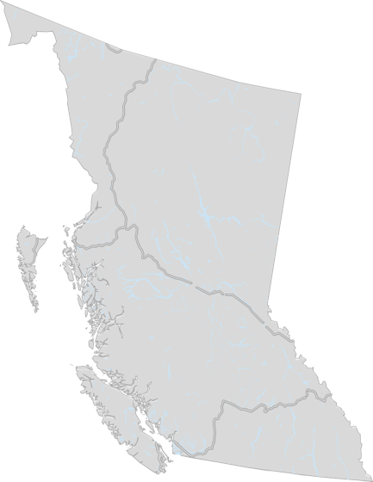
KSM:
Schaft Creek
Teck (75%) / Copper Fox (25%)
KSM Project Producing Mine Development Project Highway
Silvertip
Coeur Mining (100%)
(167 Employees)
A RARE, WORLD-CLASS PROJECT IN A TOP MINING JURISDICTION
(%) Primary Owner
37
One of the world’s largest undeveloped gold/copper projects by gold and copper resources
2022 PFS demonstrates a more sustainable and more profitable mining operation than its 2016 predecessor
Located in mining-friendly British Columbia near existing and past producers
    Adjacent to established infrastructure
    Access to regional workforce and supplies
    Established procedures for obtaining permits
Tatogga
Newmont (100%)
Galore Creek
Newmont (50%) / Teck (50%)
Red Chris
Newmont (70%) / Imperial (30%)
KSM
(380 Employees)
Mount Milligan
Centerra Gold (100%)
(485 Employees)
Willow Creek
Conuma (100%)
(190 Employees)
Brule
Conuma (100%)
(285 Employees)
Wolverine
Conuma (100%)
(325 Employees)
Mount Polley
Imperial Metals (100%)
Seabridge (100%)
BRITISH COLUMBIA
Brucejack
Newmont (100%)
(425 Employees)
Premier
Ascot (100%)
(425 Employees)
16
Endako
Centerra Gold (75%)
ENVIRONMENTAL AND SOCIAL APPROVALS
Huckleberry
Imperial Metals (100%)
Blackwater
Artemis (100%)
16
Yellowhead
Taseko (100%)
Fording River
Teck (100%)
(1,100 Employees)
Greenhills
B.C. Environmental Assessment certificate issued July 2014
Federal Environmental approval received December 2014
Substantially Started designation received July 2024⁽¹⁾
Established social license with local communities
    Signed Impact Benefit Agreements with Nisg̱a’a and Tahltan Nations
    Letters of support received from Terrace, Smithers and the Gitxsan Nation
    Non opposition agreement with Gitanyow Nation
Gibraltar
Taseko (75%)
(625 Employees)
New Prosperity
Taseko (100%)
New Afton
New Gold (100%)
(410 Employees)
Myra Falls
Nyrstar (100%)
(236 Employees)
Teck (80%)
(600 Employees)
Line Creek
Teck (100%)
(490 Employees)
1
Highland Valley
Teck (100%)
(1,300 Employees)
Elkview
Teck (95%)
(920 Employees)
Coal Mountain
Teck (100%)
Copper Mountain
Copper Mountain Mining (75%)
(445 Employees)
(1) See slide 18 for additional information

Slide 11
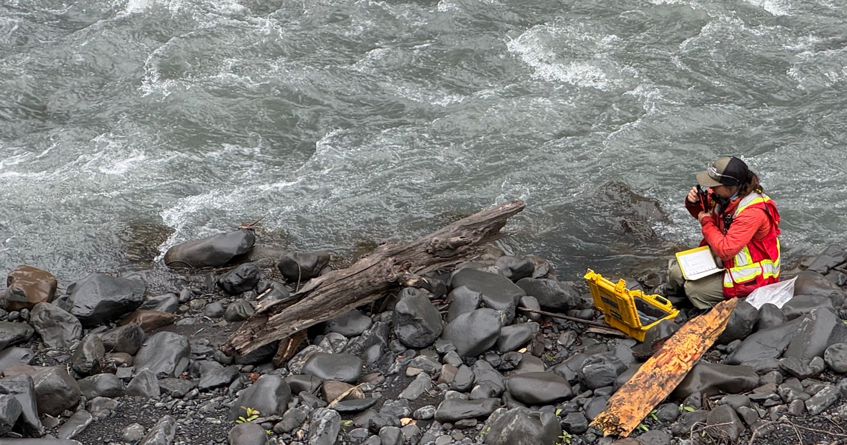
KSM has Been Radically Advanced In Recent Years
Milestone | Key Update
Acquired the East Mitchell / Snowfield Deposit | ☑ | Since renamed “East Mitchell”, the deposit enables an open-pit only mine plan with the addition of 31 Moz Au and 3.9 Blbs Cu M&I resource and 3 Moz Au and 0.4 Blbs Cu inferred resource
New PFS and PEA Incorporating East Mitchell | ☑ | Technical studies completed in mid 2022 update capex and reflect inflationary pressures; PFS simplifies operations with an open-pit only plan on Mitchell, East Mitchell, and Sulphurets only
Demonstrated Robust Returns | ☑ | Significant improvement to unlevered project returns after-tax IRR of 16.1% at US$1,742/oz Au and US$3.53/lb Cu; after-tax IRR of 29.4% at recent spot prices (US$3400/oz Au, US$4.50/lb Cu)
Substantial Start Achieved | ☑ | Key permits in-hand and locked into perpetuity having achieved Substantially Started designation in July 2024⁽²⁾
Spent >$500m on Early Works | ☑ | >$500M investment into early works, including power, camps,roads, bridges and fish habitat
Extensive First Nations Partnership | ☑ | IBAs in-place with key first nations groups; partnership signed between Tahltan and Nisga’a Nations to maximize contracting for KSM
Reduced Site Footprint | ☑ | Reduced environmental impact with smaller operating footprint; mining operations focused in one valley now (vs. two previously) with ~600 Mt less waste
Reduced Mine Contact Water | ☑ | Advancing designs that reduce mine contact water, improve construct-ability and increase life of structures
Secure JV Partner | ◻ | Seabridge continues to advance joint venture discussions on the KSM Project with a number of parties on terms advantageous to the company

Slide 12
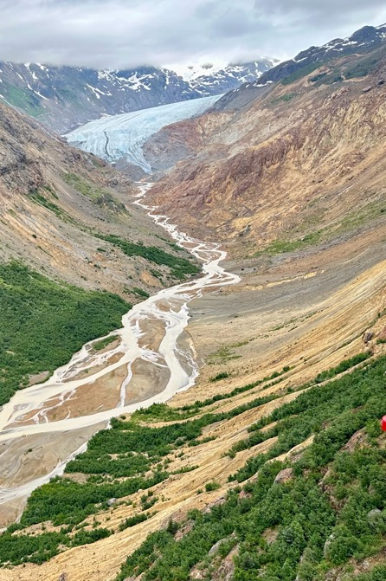
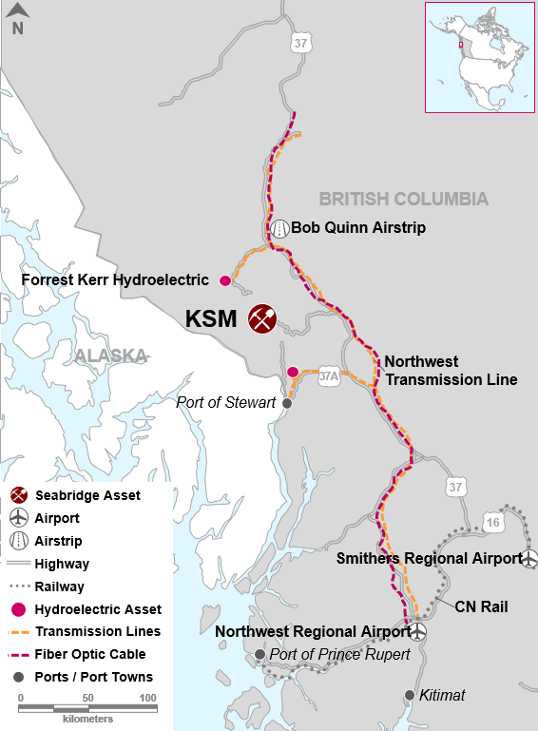
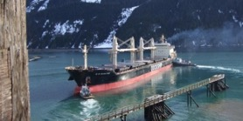
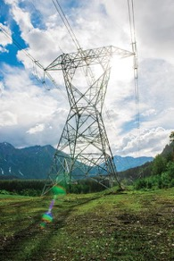
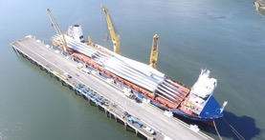
Significant Regional & Local Infrastructure
Northwest Transmission Line completed in 2014
Secured 245MW of cheap green hydro power from BC Hydro ($0.05/KWH)
Paved Highway 37 allows efficient transport to and from port and mine
Two nearby ports at Stewart B.C.
Two nearby regional airports and a local airstrip
Recent federal and provincial government additional funding to complete bringing fiber-optic communications to the Tahltan Territory

Slide 13
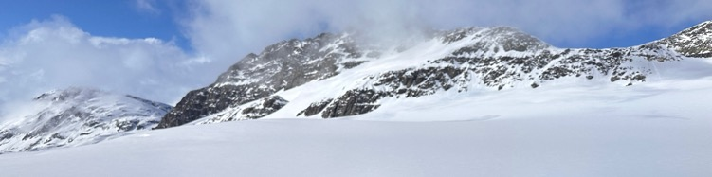
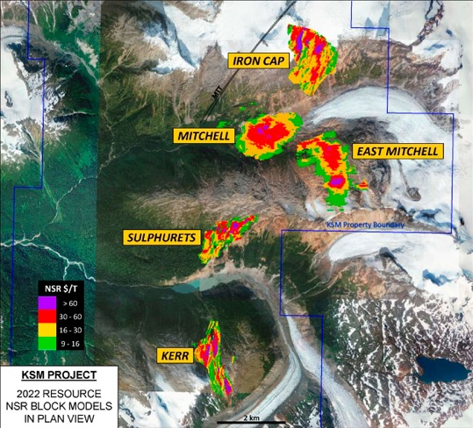
Multi-Generational District Potential
Five major deposits provide metal specific mining flexibility
All deposits daylight for open pit access
100+ year mine life
Significant exploration potential remains
Mineral Reserves & mineral Resources
 |  |  | M tonnes |  | g/t Au | % Cu | g/t Ag | ppm Mo |  | M oz Au | M lbs Cu | M oz Ag | M lbs Mo
Mitchell | P&P |  | 935 |  | 0.67 | 0.18 | 2.9 | 61 |  | 20.1 | 3,619 | 87 | 127
 | M&I |  | 2,359 |  | 0.54 | 0.15 | 2.9 | 62 |  | 41.1 | 7,996 | 222 | 320
 | Inferred |  | 1,283 |  | 0.29 | 0.14 | 2.5 | 47 |  | 11.8 | 3,832 | 102 | 133
 | Subtotal |  | 3,642 |  | 0.45 | 0.15 | 2.8 | 56 |  | 52.9 | 11,828 | 324 | 453
Iron Cap | M&I |  | 471 |  | 0.38 | 0.21 | 4.3 | 39 |  | 5.8 | 2,206 | 66 | 40
 | Inferred |  | 2,309 |  | 0.41 | 0.27 | 2.5 | 31 |  | 30.3 | 13,755 | 186 | 160
 | Subtotal |  | 2,780 |  | 0.40 | 0.26 | 2.8 | 32 |  | 36.1 | 15,961 | 252 | 200
Kerr | M&I |  | 384 |  | 0.22 | 0.41 | 1.2 | 5 |  | 2.7 | 3,456 | 14 | 4
 | Inferred |  | 2,589 |  | 0.27 | 0.35 | 1.7 | 21 |  | 22.8 | 19,852 | 142 | 120
 | Subtotal |  | 2,973 |  | 0.26 | 0.36 | 1.6 | 19 |  | 25.5 | 23,308 | 156 | 124
Sulphurets | P&P |  | 151 |  | 0.68 | 0.26 | 1.0 | 70 |  | 3.3 | 874 | 5 | 23
 | M&I |  | 446 |  | 0.55 | 0.21 | 1.0 | 53 |  | 7.9 | 2,064 | 14 | 52
 | Inferred |  | 223 |  | 0.44 | 0.13 | 1.3 | 30 |  | 3.2 | 639 | 9 | 15
 | Subtotal |  | 669 |  | 0.51 | 0.18 | 1.1 | 45 |  | 11.0 | 2,703 | 24 | 67
East Mitchell | P&P |  | 1,206 |  | 0.62 | 0.10 | 1.8 | 89 |  | 23.9 | 2,827 | 68 | 236
 | M&I |  | 1,759 |  | 0.55 | 0.10 | 1.8 | 85 |  | 31.2 | 3,904 | 101 | 328
 | Inferred |  | 281 |  | 0.37 | 0.07 | 2.3 | 61 |  | 3.4 | 403 | 21 | 38
 | Subtotal |  | 2,040 |  | 0.53 | 0.10 | 1.9 | 81 |  | 34.6 | 4,307 | 122 | 366
All | P&P |  | 2,292 |  | 0.64 | 0.14 | 2.2 | 76 |  | 47.3 | 7,320 | 160 | 385
 | M&I |  | 5,419 |  | 0.51 | 0.16 | 2.4 | 63 |  | 88.7 | 19,626 | 417 | 744
 | Inferred |  | 6,685 |  | 0.33 | 0.26 | 2.1 | 31 |  | 71.5 | 38,481 | 461 | 466
Note: blue lines indicate KSM property boundaries following announced transaction to acquire 100% of the Snowfield deposit now renamed East Mitchell property
Note: M&I resources are inclusive of reserves
12 Billion tonnes including East Mitchell (Snowfield)
Mineral Resources were estimated by Wood Plc under the direction of Henry Kim P.Geo.
Mineral Reserve were estimated by Moose Mountain Technical Services under the direction of Jim Gray P.Eng.

Slide 14
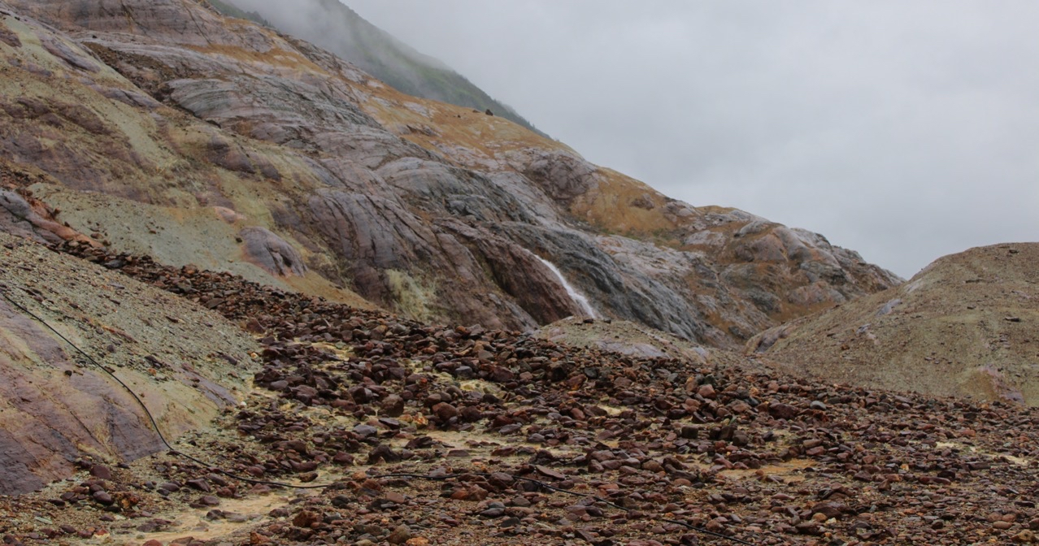
KSM 2022 Preliminary Feasibility Study (PFS)
 | Unit | Base Case | Recent Spot | Change
 |  | 2022 PFS | Case
Input Prices:
Gold | US$/oz | $1,742 | $3,400
Copper | US$/lb | $3.53 | $4.50
Silver | US$/oz | $18.00 | $34.00
US$/C$ Exchange Rate |  | 0.77 | 0.73
Proven and Probable Reserves:
Tonnes | M tonnes | 2,292 | 2,292
Gold | M oz | 47.3 | 47.3
Copper | B lbs | 7.3 | 7.3
Silver | M oz | 160 | 160
Designed Throughput | 000 TPD | 195 | 195
Mine Life | Years | 33 | 33
Average Annual Production (Years 1-7):
Gold | 000 oz | 1,413 | 1,413
Copper | M lbs | 250 | 250
Silver | M oz | 3.8 | 3.8
Average Annual Production (LOM):
Gold | 000 oz | 1,027 | 1,027
Copper | M lbs | 178 | 178
Silver | M oz | 3 | 3
Initial Capital Costs | US$B | $6.40 | $6.0
Sustaining Capital Costs | US$B | $3.20 | $3.0
Total LOM Capital Costs | US$B | $9.60 | $9.0
LOM Unit Operating Costs | US$/T to Mill | $11.36 | $10.62
Cash Op Costs (net of by-products) | US$/oz Au | $275 | $130 | -53%
All-In Total Costs (net of by-products) | US$/oz Au | $601 | $435 | -28%
After Tax Cash Flow | US$B | $23.9 | $63.0 | +163%
After-Tax NPV_{5%} | US$B | $7.9 | $23.5 | +198%
After-Tax NPV_{8%} | US$B | $4.0 | $14.0 | +250%
After-Tax IRR | % | 16.1 | 29.4 | +83%
Payback Period | years | 3.7 | 2.3 | -38%
33-year mine life uses less than 20% of current mineral resource
Mine plan limited to permitted tailings capacity (2.3 billion tonnes)
Open pit only at 1:1 life of mine strip ratio
Annual production averages over 1 million ounces of gold and 178M pounds of copper
Simple, conventional metallurgy produces clean, high-value concentrate
At $1742 gold and $3.53 copper, all in cost of production = US$601 per ounce, NPV at $7.9B, IRR at 16.1% and capital pay back in 3.7 years
At $3400 gold and $4.50 copper, all in cost of production = US$435 per ounce (-28%), NPV at $23.5B (+198%), IRR at 29.4% (+83%) and capital pay back in 2.3 years (-38%)
Metal prices are increasing much faster than capital and operating costs.
$6.4B capital cost estimate developed in 2022 when inflation was high
Able to withstand significant capital and operating cost increases
Base Case projected EBITDA totals US$12.6B in years 1-5
Recent Spot Case EBITDA totals $25.3B in years 1-5
Optionality to bring additional copper production forward in mine plan by adding Iron Cap and/or Kerr deposits

Slide 15
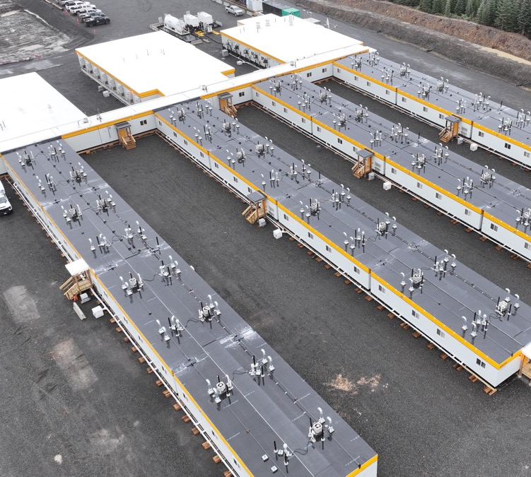
KSM Substantially Started funding and work
To extend KSM’s EA approvals for the life of the project, KSM had to be “substantially started” by July 2026
Since early site construction commenced in 2021, Seabridge has spent over $500 million on substantially started activities with a significant portion of the spend to First Nation related companies
Work focused on roads, bridges, camps, fish compensation and power infrastructure
In February 2022, Seabridge secured US$225 million in funding
for substantially started activities from Sprott Royalties and Ontario Teachers Pension Plan by issuing a note that converts
into a 60% silver royalty at KSM at commercial production
In June 2023, Seabridge secured an additional US$150 million
in funding for substantially started activities from Sprott
Royalties by issuing a note that converts into a 1.0% NSR
at KSM at commercial production
Camp 11 Work area

Slide 16
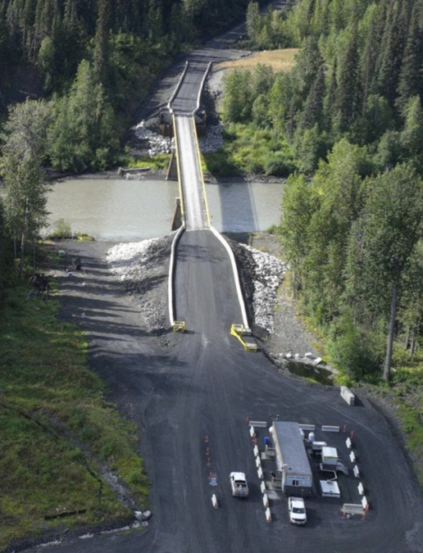
KSM Substantially Started designation
Bell-Irving Bridge
On January 16, 2024 Seabridge filed the formal application with the B.C. Regulators for a “Substantially Started” designation
The application was submitted with letters of support from the Tahltan Central Government, the Nisga’a Lisims Government, B.C. Hydro, District of Stewart, City of Terrace, District of New Hazelton, Town of Smithers, Office of the Gitxsan Hereditary Chiefs and the District of Kitimat-Stikine
On July 25, 2024 KSM was designated as “Substantially Started”
Two petitions have been filed seeking to quash the decision to designate the KSM Project “substantially started ”:
    One by Tsetsaut Skii km Lax Ha (TSKLH) claiming (1) a breach by the Province of its duties to consult and proceed fairly and (2) the decision was unreasonable
    One by two NGOs also claiming that the decision was unreasonable
  Seabridge will participate in defending the decision, is confident that consultation with TSKLH took place, and believes there is ample evidence the decision was reasonable
  Substantially Started remains in force. If a Petition is successful, a typical court order would require resumption of the “substantially started” determination process
  B.C Government and Seabridge have filed responses to petitions. Court date set for September 22 to October 1, 2025

Slide 17
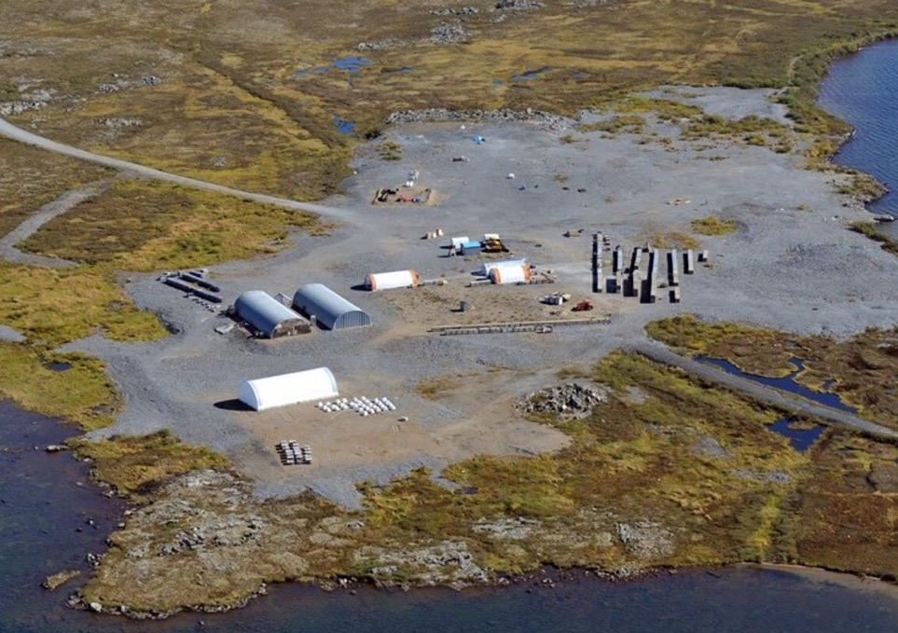
Courageous Lake
Northwest Territories, Canada

Slide 18
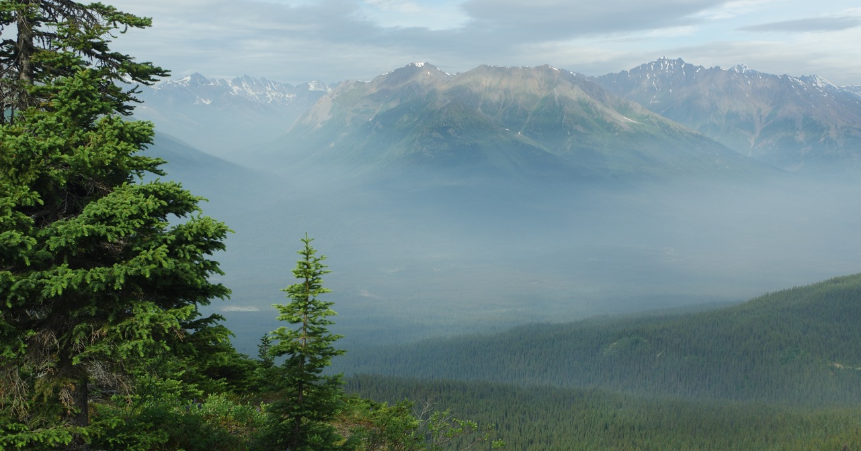
Courageous Lake Project (100% Interest)
503 km2 property located south of Courageous Lake approximately 240 km northeast of Yellowknife in the Northwest Territories
    Lies on a historic mining district that includes two past producing gold mines
Project located on winter ice road within 100 km of the Diavik and Ekati open pit diamond mines
    Demonstrates feasibility of year-round open pit bulk tonnage operations
54 km long Matthews Lake Greenstone Belt hosts 2 deposits: Courageous Lake and Walsh Lake
Courageous Lake deposit contains 11.0 million ounces of M&I gold resources at 2.36 gpt
2024 Updated PFS Confirms Significantly Improved Project Over 2012 PFS
12.6-year mine life averaging 201,000 ounces of gold production per year
2024 PEA demonstrates potential to extend mine life for another 15.9 years at 205k oz gold/year
NI 43-101 COMPLIANT RESERVE AND RESOURCE ESTIMATES as of Jan 2024
Deposit | Cut-off Grade | Category | Tonnage | Grade | Contained
 |  |  | M tonnes | g/T Au | M oz Au
Courageous Lake | C$43.66/T NSR | P&P reserves | 33.9 | 2.6 | 2.8
 | 0.80 g/T Au | M&I resources | 145.2 | 2.36 | 11.0
 | 0.80 g/T Au | Inferred resources | 40.6 | 2.52 | 3.3
Walsh Lake | 0.80 g/T Au | Inferred resources | 4.1 | 4.18 | 0.55
Note: M&I resources are inclusive of reserves
Resource and reserve estimates for the Courageous Lake deposit were presented in a news release dated January 16, 2024 and were prepared by Moose Mountain Technical Services using a gold price of $1,400/oz. The resource model incorporates a total of 616 holes totaling 127,168 m. M&I and inferred resource estimates are undiluted. P&P reserves for the Courageous Lake deposit were estimated using a series of Lerchs-Grossman pit shell optimizations using a NSR cut-off of C$49.66/tonne estimated from a gold price of US$1,400/oz, strip ratio of 7.58:1 and includes mining dilution within the ultimate pit limit.
Resource estimates for the Walsh Lake deposit was presented in a new release dated January 16, 2024 and were prepared by Moose Mountain
Technical Services using a gold price of $1,400/oz. Walsh Lake resource model is based on 92 diamond core holes (totaling 17,534 m). The
resource estimate is constrained within a conceptual pit limit based on a gold price of US$1,400/oz and a pit slope of 50 degree5

Slide 19
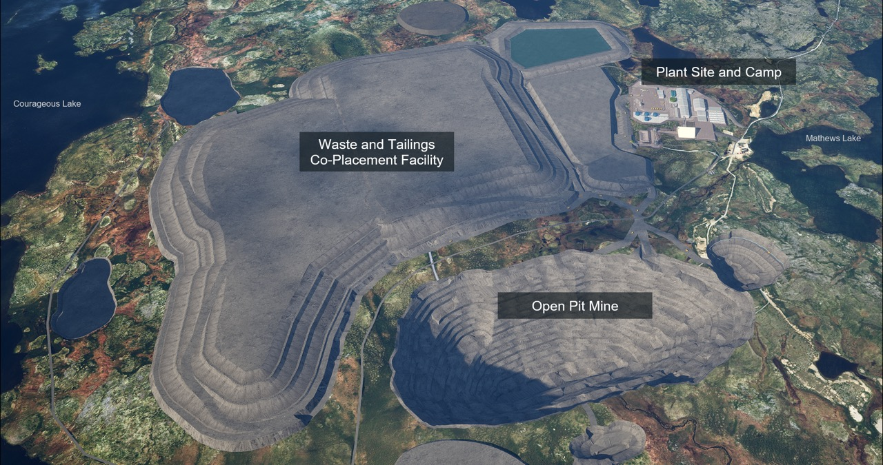
2024 courageous lake PFS site layout

Slide 20
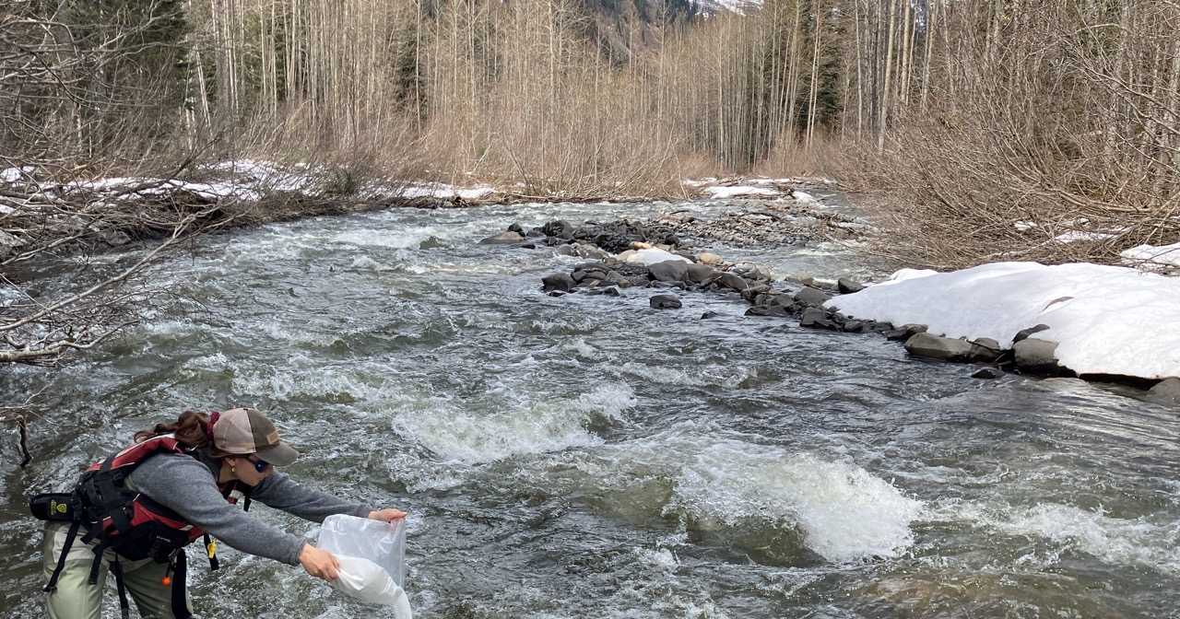
Courageous lake 2024 PFS demonstrates a Very profitable mine with exceptional leverage to gold
Highlights of the courageous Lake 2024 pfs
 | Unit | Base Case | Recent Spot | Change
Gold Price | US$/oz | $1,850 | $3,400
Exchange Rate | US$:C$ | 0.74 | 0.73
Mine Life | years | 12.6 | 12.6
LOM Ore | M tonnes | 33.9 | 33.9
LOM Average Grade | g/t Au | 2.6 | 2.6
Throughput Rate | tpd | 7,500 | 7,500
LOM Average Strip Ratio | waste: ore | 7.6:1 | 7.6:1
Avg Recovery Rate | % | 89.3 | 89.3
Avg Annual Production | 000 oz Au | 201 | 201
Cash Costs per ounce | US$/oz Au | $863 | $885
All-in sustaining costs | US$/oz Au | $999 | $1,020
Initial Capex | US$M | $747 | $737
After Tax Cash Flow | US$M | $929 | $3,702 | +298%
After Tax NPV_{5%} | US$M | $523 | $2,465 | +371%
After Tax NPV_{8%} | US$M | $360 | $1,957 | +443%
After Tax IRR | % | 20.6 | 62.6 | +204%
After Tax Payback Period | years | 2.8 | 1.1 | -61%
The 2024 PFS for the Courageous Lake deposit is based on a single open-pit mining operation with on-site processing
2024 PFS uses less than 30% of M&I gold resources
Average annual gold production of 201,000 ounces
All in sustaining costs estimated at US$999 per oz gold produced
Notable improvements over the 2012 PFS include:
    73% increase in after-tax NPV5% to US$523M from US$303M
    50% reduction in initial capital from US$1.522B to US$747M
    Increased after tax IRR from 7.3% to 20.6%
    Reduced capital payback from 11.2 years to 2.8 years
    19% increase in average gold reserve grade from 2.2gpT to 2.6gpT
    39% reduction in life of mine strip ratio from 12.5 to 7.6
    38% increase in M&I gold resources from 8.0M ozs to 11.0M ozs
Updated NI-43-101 technical report includes 2024 PEA demonstrating the potential to extend 2024 PFS mine life by an additional 15.9 years averaging over 200k ounces of gold production per year

Slide 21
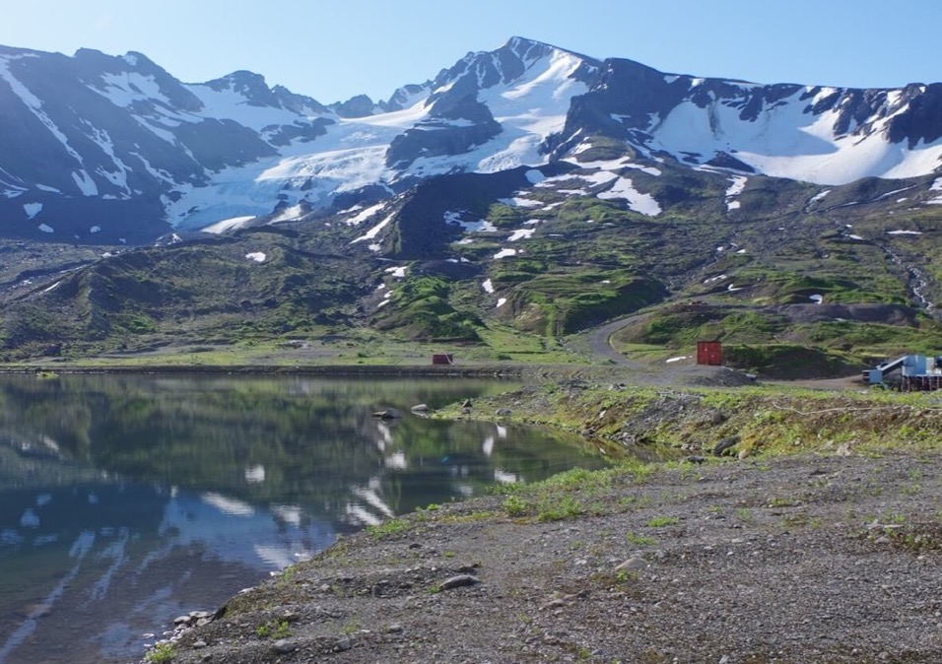
Iskut Project
British Columbia, Canada

Slide 22
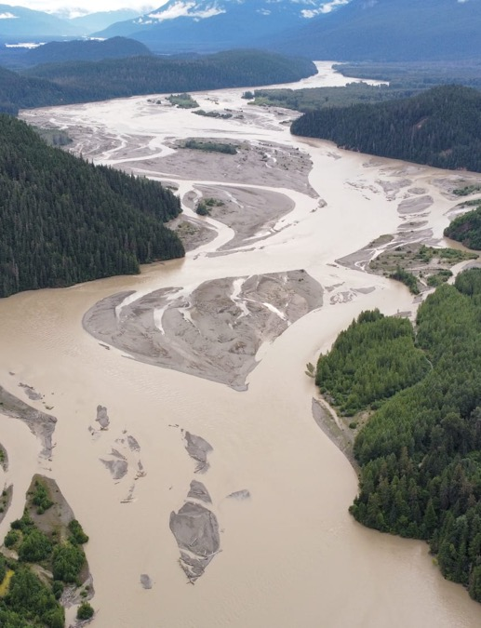
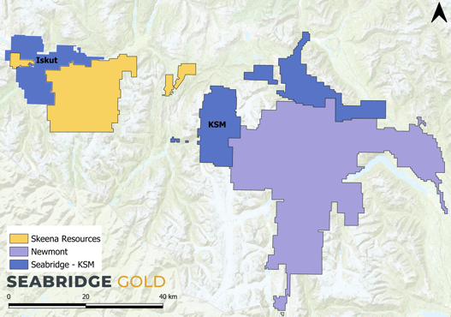
Iskut Project (100% Interest)
294 km2 property located in northern British Columbia, ~110 km northwest of Stewart, BC
Only 30 km by air from the KSM Project
Includes the former high-grade Johnny Mountain gold mine and the Bronson Slope Cu-Au deposit
Acquired in June 2016 for potential large gold-copper porphyry deposits similar to KSM
Highlights to date:
    Discovered massive N/S trending regional structure accounting for all known concentrations of copper and gold
    Discovered major mineralized breccia pipe below Bronson Slope likely caused by large porphyry intrusive
    Drilled 174 meters of core assaying 0.86 gpt gold and 0.34% copper in 2023
    2023 drilling expanded Bronson Slope deposit
    New NI-43-101 resource estimate announced on June 27, 2024 increased historic estimate by 3.2 million ounces of gold and 0.5 billion pounds of copper

Slide 23
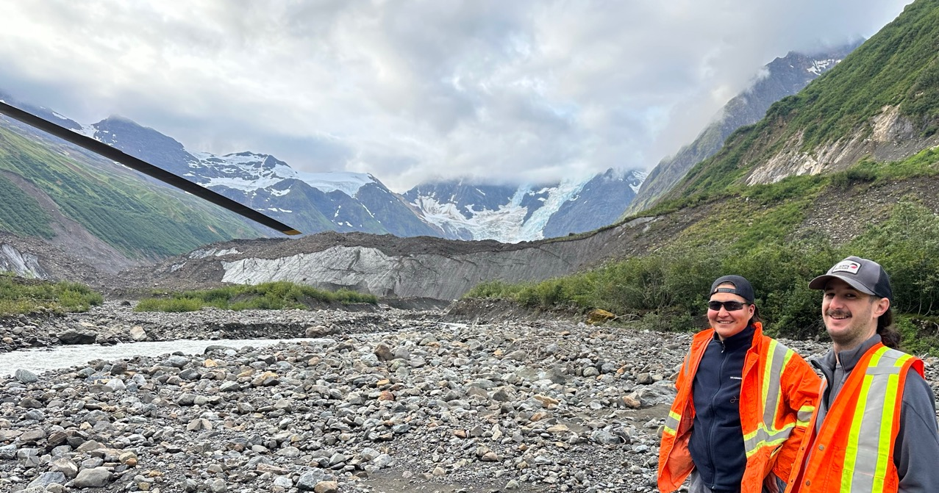
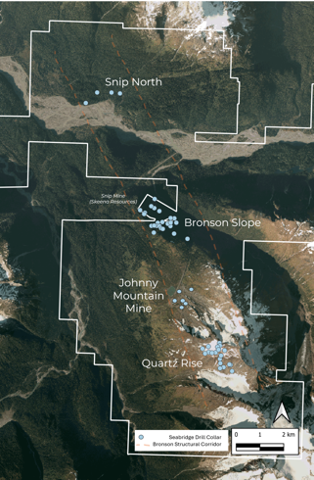
Iskut: Exploring for gold-copper porphyries similar to KSM’s Kerr deposit
Three district scale porphyry targets developed in similar geological setting to KSM below Quartz Rise, Bronson Slope and Snip North
All three targets validated by geology, geophysics and shallow drilling
2023 Program expanded Bronson Slope inferred resource: 5.4M ozs Au, 1.0B lbs Cu
2024 program confirmed new large gold-copper discovery at Snip North
Hole 17 intersects 303m of 0.75 gpt gold and 0.10% copper
Hole 18 intersects 478m of 0.49 gpt gold and 0.13% copper
Hole 20 intersects 532m of 0.48 gpt gold and 0.10% copper
2025 21k meter follow-up drill program underway to allow for maiden resource estimate for Snip North in Q1 2026 with mineralization extending 1,800x600x600 meters
Hole 25 intersects 729m of 0.48 gpt gold and 0.16% copper
Including 254 meters of 0.77 gpt gold and .31% copper
Hole 30 intersects 560m of 0.87 gpt gold and 0.16% copper
Including 57.6m of 2.62 gpt gold and 0.40% copper

Slide 24
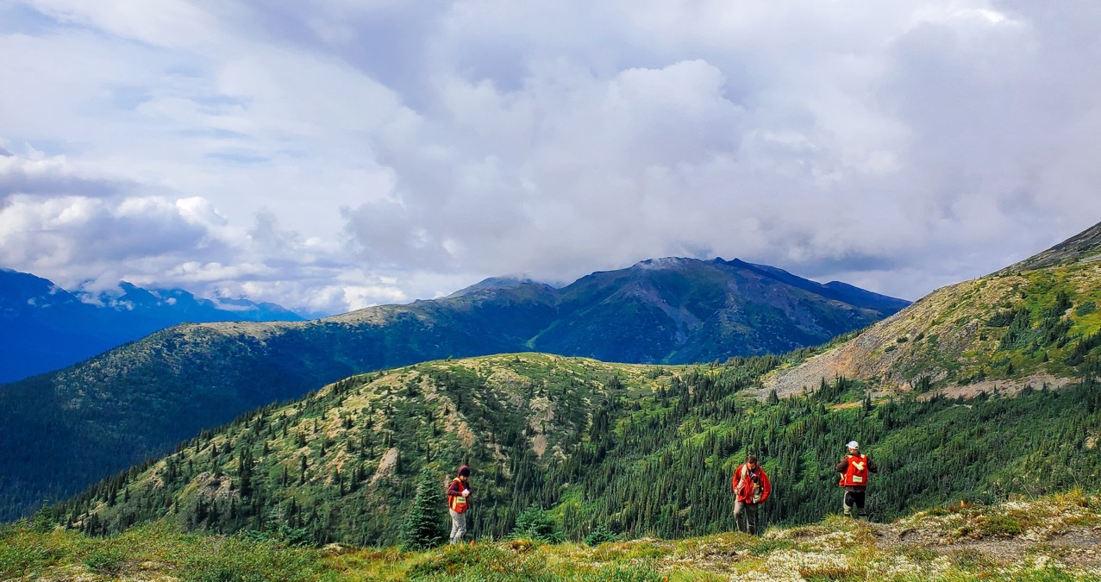
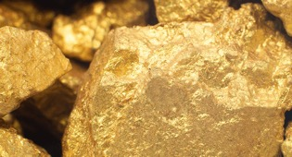
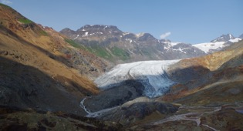
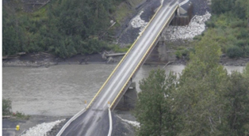
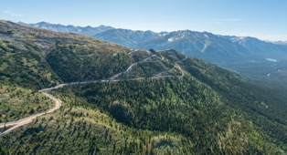
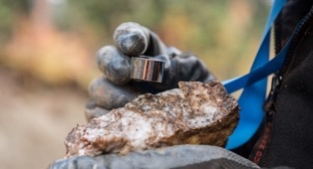
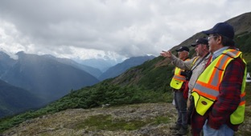
Why Invest in Seabridge
Unparalleled leverage
in emerging
gold and copper bull markets
100% Ownership of KSM –
One of the largest undeveloped gold/copper projects in the world
Significant progress at KSM,
including earning federal and provincial permits
Upside from large
North American exploration
project portfolio
A future KSM JV agreement with
major mining company
expected to unlock value
Excellent record of creating shareholder value

Slide 25
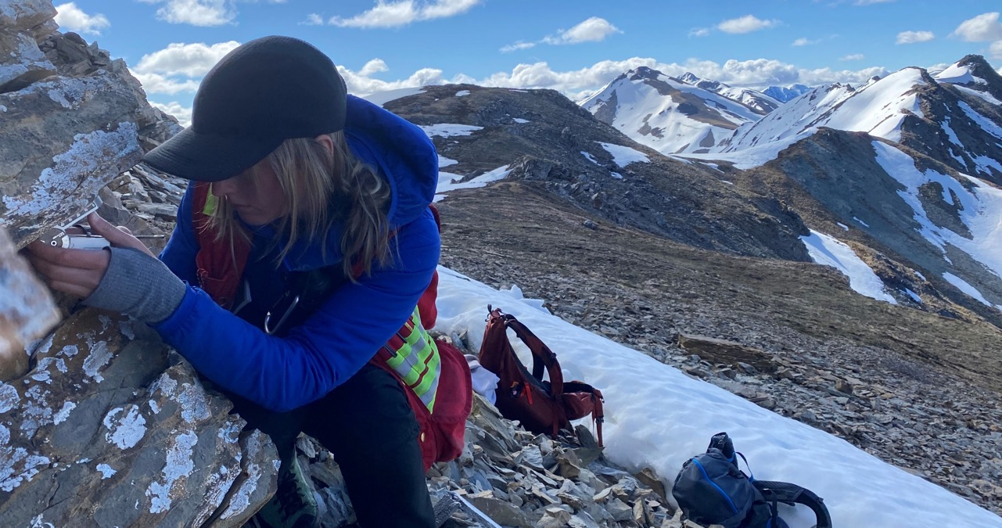
Finding a partner
A JV on a mega project like KSM requires an open window when many factors align
In 2012 KSM was unlike anything in BC and permits were in doubt
We got permits in December 2014, but the gold market collapsed in 2015
In 2018, gold had recovered, two proposals were received but copper collapsed
As copper revived, COVID closed projects, travel stopped, and DD was impossible
Prospective candidates signaled they were uncomfortable with block caving
Taking advantage of COVID, we acquired East Mitchell on great terms in 2020 (34M ozs Au for US$100M)
As COVID receded in 2022, we created a new PFS around Mitchell/East Mitchell, open pits only
New candidates emerged but permits were due to expire in mid 2024
Permits were extended to 2026 and then made permanent in 2024 via Substantially Started
Significant DD completed by 7+ majors finds no fatal technical, economic or social flaws
Discussions continue on multiple fronts including with a recent “strategic investor”
The window is now open!

Slide 26

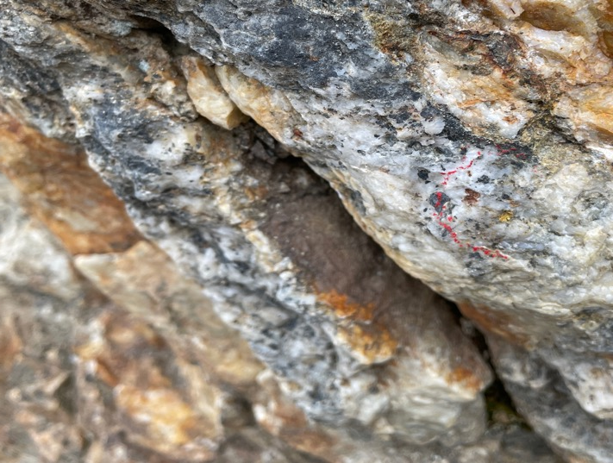
Capital Markets Profile
Share Price and Volume (Last 12 Months)
Capital Structure
Tickers | TSX:SEA | NYSE:SA
Indices | GDXJ, S&P/TSX Composite, Global Mining and Global Gold
Share Price (August 29, 2025) | C$23.98 (US$17.44)
52-Week Trading Range | C$13.44 – C$28.39
Basic Shares Outstanding | ~102.2M
FD Shares Outstanding | ~103.0M¹
Market Capitalization | C$1.8B
Cash and Short-Term Deposits | >C$120M²
Marketable Securities | C$5.4 M³
Top Shareholders (As of June 30, 2025)
Management, Board & Insiders (including Kopernik & FCMI) | >30%
Tidal Investments | 2.80%
Van Eck Associates | 2.70%
Paulson & Co. | 2.10%
Sprott Asset Management | 2.00%
CIBC World Markets, Inc. | 1.90%
Ontario Teachers’ Pension Plan Board | 1.50%
TD Asset Management | 1.30%
Research Coverage
Company | Research Analyst
B Riley | Nick Giles
Cantor Fitzgerald | Mike Kozak
Red Cloud | David Talbot
RBC Dominion Securities | Michael Siperco
Fave5Golds | John Doody
Includes 755.3K RSUs and DSUs
Balance of cash and short-term deposits as of June 30, 2025
Marketable securities include common shares of several mining companies that were received as consideration for optioned mineral properties, other short-term investments and ~7.84% of Paramount Gold Nevada Corp.

Slide 27



CONTACT US
HEADQUARTERS
Toronto, ON
Smithers, BC
Terrace, BC
Watson Lake, BC
+1 416 367 9292
+1 250 847 4704
+1 250 847 4704
+1 867 536 2727 or +1 867 536 2728
+1 416 367 2711
+1 416 367 2711
bpelletier@seabridgegold.com
susan@seabridgegold.com
info@seabridgegold.com
ksm_community@seabridgegold.com
101-4650 Lazelle Avenue
Terrace, BC, Canada, V8G 1S6
812A Adela Trail Unit#2, PO Box 655
Watson Lake, Yukon, Y0A 1C0
106 Front Street East, Suite 400 Toronto, ON, Canada, M5A 1E1
1330 Main Street
Smithers, BC, Canada, V0J 2N0

