Slide 1
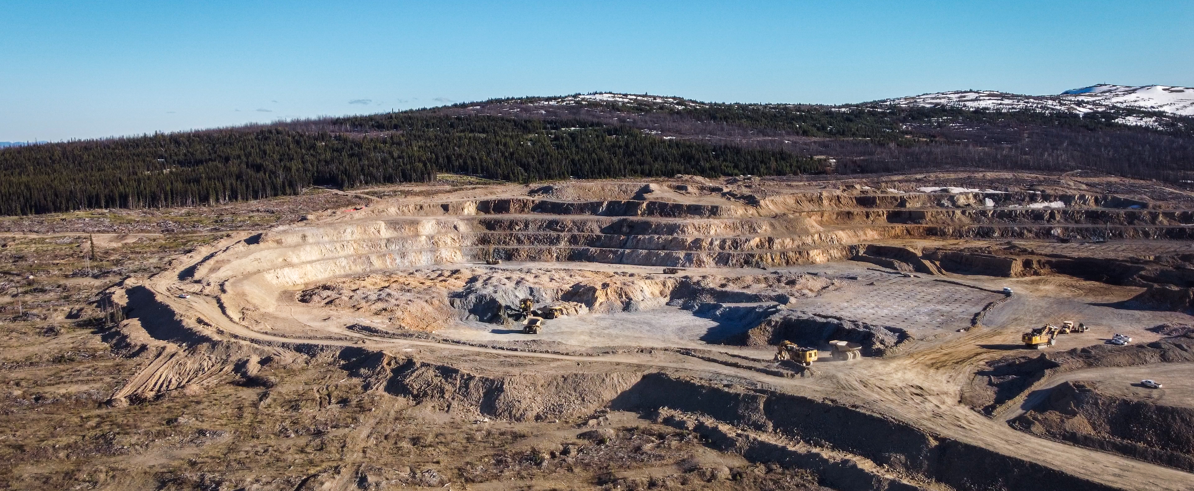
TSX-V: ARTG | artemisgoldinc.com
Disciplined Development of the Blackwater Mine in B.C.
SEPTEMBER 2025
Notes:
meg

Slide 2

Cautionary Note Regarding Forward-Looking Information
This presentation contains certain forward-looking statements and forward-looking information as defined under applicable Canadian and U.S. securities laws. Statements contained in this press release that are not historical facts are forward-looking statements that involve known and unknown risks and uncertainties. Any statements that refer to expectations, projections or other characterizations of future events or circumstances contain forward-looking statements. In certain cases, forward-looking statements and information can be identified using forward-looking terminology such as “may”, “will”, “expect”, “intend”, “estimate”, “anticipate”, “believe”, “continue”, “plans”, “potential” or similar terminology. Forward-looking statements and information are made as of the date of this press release and include, but are not limited to, statements regarding strategy, plans, future financial and operating performance of the Blackwater Mine, including the Company’s plans to refinance the PLF and Standby-Facility with the RCF; the expected timing to commissioning, completion and payback of Phase 1A, the expected cost and benefits of the work to be undertaken as part of Phase 1A, the timing of a decision related to Phase 2, the contribution of the mine to various stakeholders or the economy; opinions of the Province of British Columbia regarding the mine and the region; agreements and relationships with Indigenous partners; the future of mining in British Columbia; the plans of the Company with respect to optimizing and enhancing current Phase 1 operations and the next phase(s) of expansion, including construction, site preparation, procurement of plant and equipment, consultation with indigenous groups, and other plans and expectations of the Company with respect to the mine, future production and anticipated timing and cost of optimization, enhancement and expansion works.
These forward-looking statements represent management’s current beliefs, expectations, estimates and projections regarding future events and operating performance, which are based on information currently available to management, management’s historical experience, perception of trends and current business conditions, expected future developments and other factors which management considers appropriate. Such forward-looking statements involve numerous risks and uncertainties, and actual results may vary. Important risks and other factors that may cause actual results to vary include, without limitation: risks related to ability of the Company to accomplish its plans to refinance the PLF and Standby-Facility with the RCF on acceptable terms or at all; risks related to ability of the Company to accomplish its plans and objectives with respect to the operations, optimization, enhancement and expansion of the Blackwater Mine within the expected timing or at all, the timing and receipt of certain required approvals, changes in commodity prices, changes in interest and currency exchange rates, litigation risks (including the anticipated outcome or resolution of ongoing or potential claims and counterclaims, the timing and success of such claims and counterclaims),, risks inherent in mineral resource and mineral reserves estimates and results, risks inherent in exploration and development activities, changes in mining, optimization, enhancement or expansion plans due to changes in logistical, technical or other factors, unanticipated operational difficulties (including failure of plant, equipment or processes to operate in accordance with specifications, cost escalation, unavailability or unanticipated delays to the delivery of materials, plant and equipment or third party contractors, delays in the receipt of government approvals, industrial disturbances, job action, and unanticipated events related to heath, safety and environmental matters), changes in governmental regulation of mining operations, political risk, social unrest, changes in general economic conditions or conditions in the financial markets, and other risks related to the ability of the Company to proceed with its plans for the Mine and other risks set out in the Company’s most recent MD&A, which is available on the Company’s website at www.artemisgoldinc.com and on SEDAR+ at www.sedarplus.ca
In making the forward-looking statements in this press release, the Company has applied several material assumptions, including without limitation, the assumptions that: (1) market fundamentals will result in sustained mineral demand and prices; (2) any necessary approvals and consents in connection with the operations and expansion of the Mine will be obtained; (3) financing for the continued operation of the Blackwater Mine and future expansion activities will continue to be available on terms suitable to the Company; (4) sustained commodity prices will continue to make the Mine economically viable; and (5) there will not be any unfavourable changes to the economic, political, permitting and legal climate in which the Company operates. Although the Company has attempted to identify important factors that could affect the Company and may cause actual actions, events, or results to differ materially from those described in forward-looking statements, there may be other factors that cause the actual results or performance by the Company to differ materially from those expressed in or implied by any forward-looking statements. Accordingly, no assurances can be given that any of the events anticipated by the forward-looking statements will transpire or occur, or if any of them do so, what impact they will have on the results of operations or the financial condition of the Company. Investors should therefore not place undue reliance on forward-looking statements. The Company is under no obligation and expressly disclaims any obligation to update, alter or otherwise revise any forward-looking statement, whether written or oral, that may be made from time to time, whether because of new information, future events or otherwise, except as may be required under applicable securities laws.
Non-IFRS Measures – The Company has included certain non-IFRS measures in this presentation. The Company believes these measures, in addition to conventional measures prepared in accordance with IFRS, provide investors an improved ability to evaluate the underlying performance of the project. The non-IFRS measures are intended to provide additional information and should not be considered in isolation or as a substitute for measures of performance prepared in accordance with IFRS. These measures do not have any standardized meaning prescribed under IFRS and therefore may not be comparable with other issuers.
AISC – The Company believes AISC more fully defines the total costs associated with producing gold. The Company calculates AISC as the sum of production costs (such as mining, processing, refining and site administration, royalty payments and payments that are expected to be made to First Nations), general administration costs, sustaining capital and closure cost, less revenue generated from silver sales and adjustments to stockpile inventory, all divided by the gold ounces sold to arrive at a per-ounce figure. Other companies may calculate this measure differently because of differences in underlying principles and policies applied. Differences may also arise due to a different definition of sustaining capital versus growth capital.
Qualified Person – Artemis Gold President Jeremy Langford, FAUSIMM, a Qualified Person as defined by National Instrument 43-101, has reviewed and approved the scientific and technical information in this presentation.
Notes:
Alastair QP

Slide 3
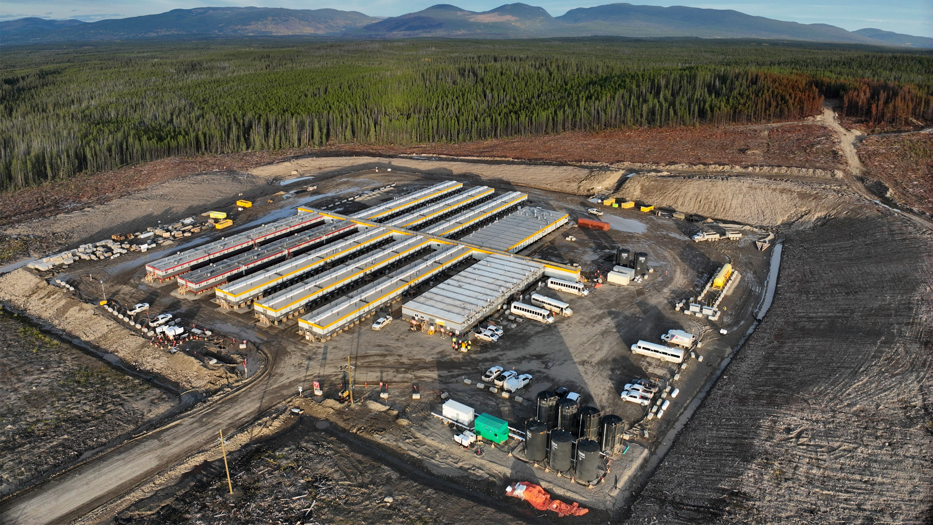




Why Artemis Gold?
One of the Largest Gold Mines in Canada
Board and Management Aligned with Shareholders
>$200m
BLACKWATER MINE
NEW
100%
TIER 1
BC
Board and
Management
Own
CANADA
Invested since 2020
GOLD MINE
39%
Now in Commercial Production
No equity dilution during construction through to commercial production
GOLD RESERVES¹
8
Million
ounces
Reported AISC of US$805/oz post-commercial production in Q2, in the lowest decile globally
F/D
Oz AuEq/YR
Proven Track Record of Execution and Value Creation
Expansion potential to >500K/year AuEq oz
Team successfully built and
operated multiple, large-scale gold mines; completed build of Phase 1 in 22 months
Phase 1A increases plant throughput by 33% to 8 Mtpa by Q4 2026; Phase 2 decision expected in Q4 2025
¹Refer to Appendix for details on Mineral Reserve and Resource estimates

Slide 4
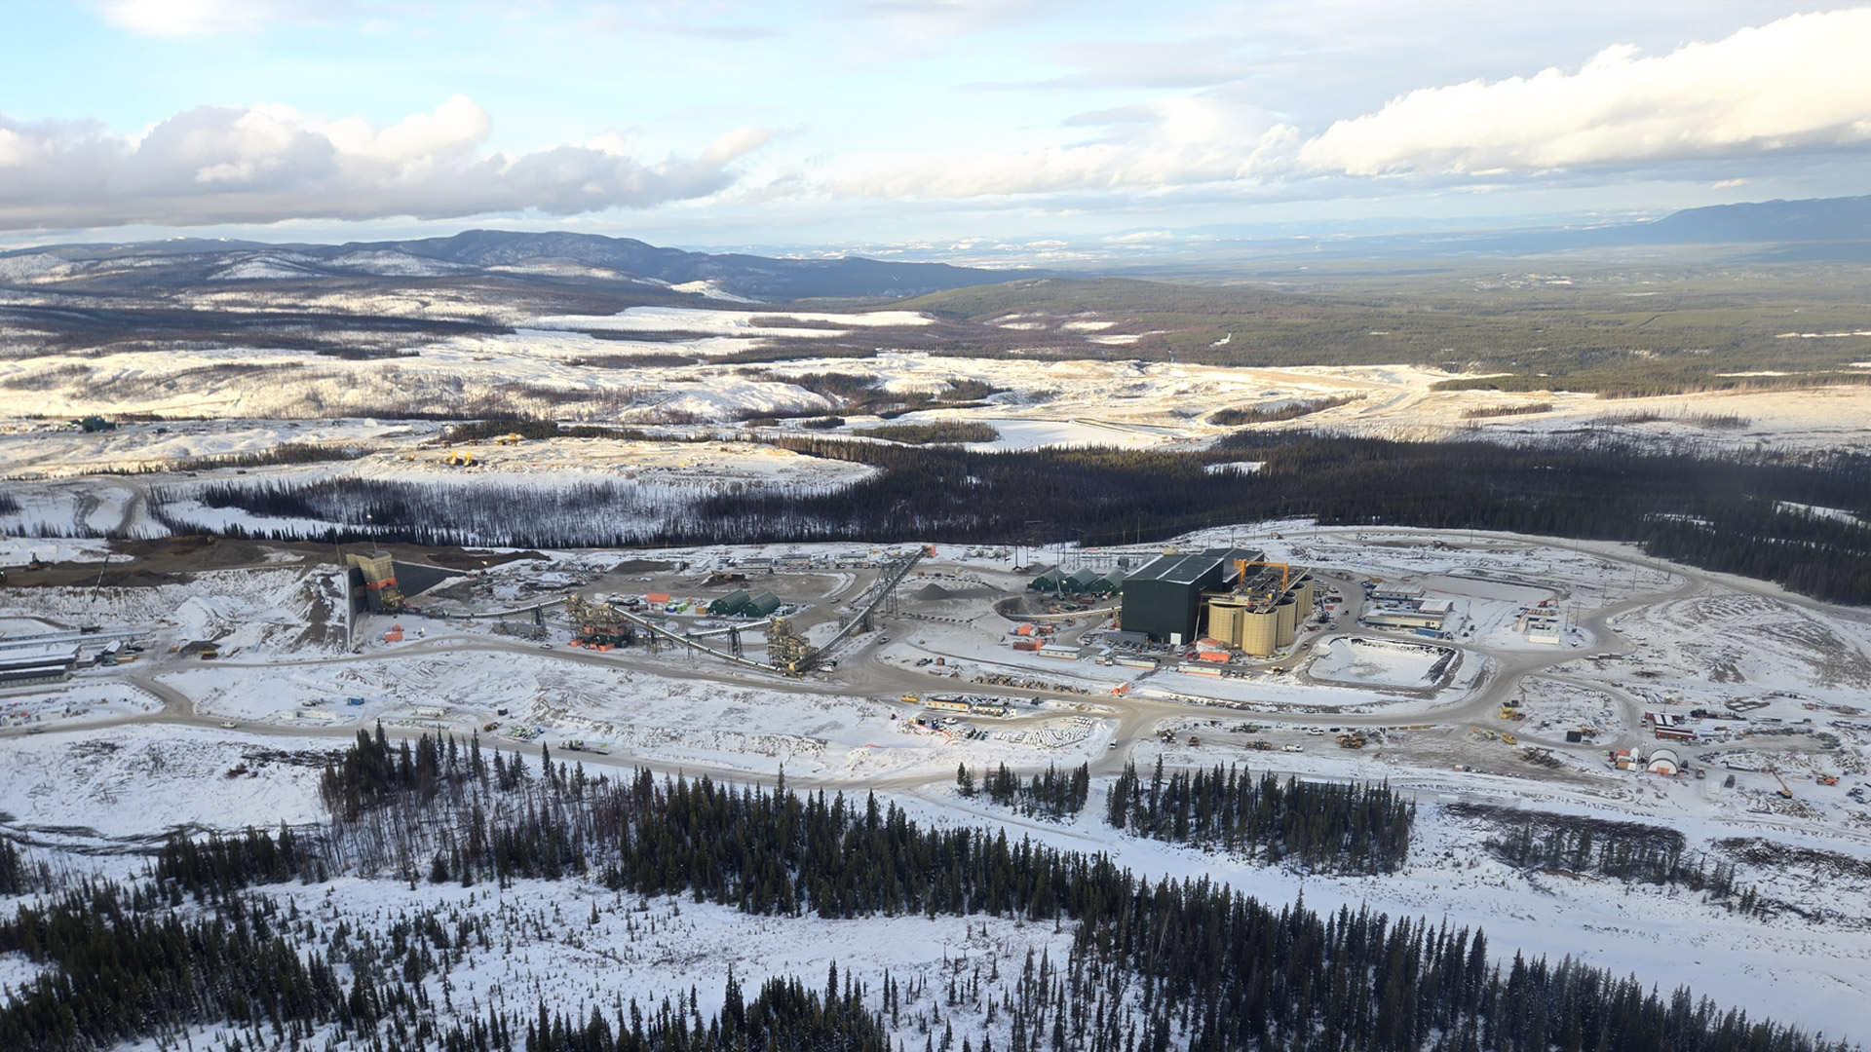

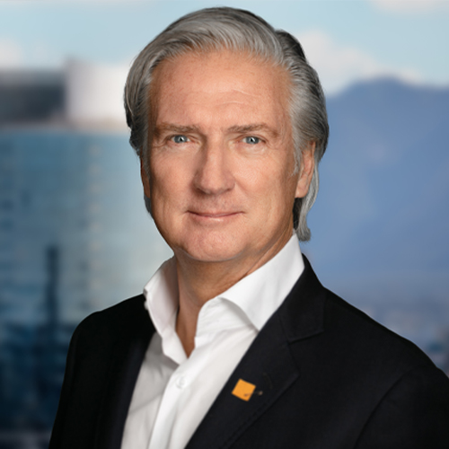
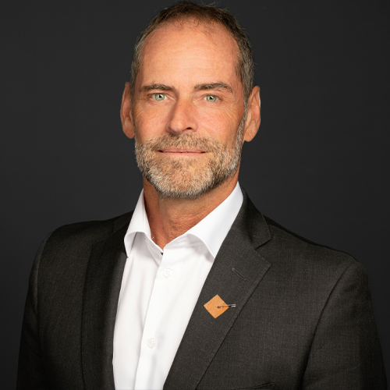
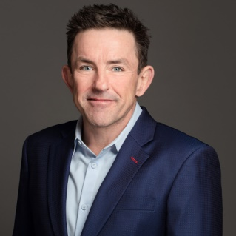
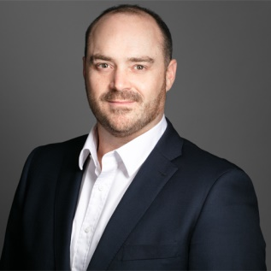

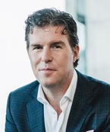
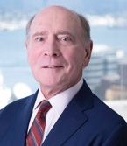



Board and Management
Steven Dean
Executive Chair
Steven Dean has extensive experience internationally in mining, including as President of Teck Cominco Limited (now Teck Resources Ltd.). More recently, Mr. Dean was Chairman, CEO and founder of Atlantic Gold Corporation, which was sold to St. Barbara Limited in 2019. He also serves as Chairman of Oceanic Iron Ore Corp. (TSX-V: FEO).
Dale Andres
Chief Executive Officer & Director
Dale Andres has more than 30 years' experience in the resource industry. Previously, he was Chief Executive Officer and Director of Gatos Silver, Inc. Prior to this, Mr. Andres also enjoyed a distinguished career of increasing seniority within Teck Resources Limited where he served as Senior Vice President, Base Metals, Senior Vice President, Copper, Vice President, Copper Strategy and North American Operations, Vice President, Gold and International Mining, as well as General Manager, Underground Mines.
Jeremy Langford
President
Jeremy Langford has multi-mine gold producer experience and an extensive proven track record in managing operations and the development of scale greenfield assets. Mr. Langford served most recently in the role of COO of Centamin Plc and prior to that COO & EVP Construction and Technical Services with Endeavour Mining Corporation. Over the past 20+ years, Mr. Langford has led the successful execution of six large-scale gold development projects.
Gerrie van der Westhuizen
Chief Financial Officer and Corporate Secretary
Gerrie van der Westhuizen has more than 20 years’ experience serving in progressively senior positions in the mining and natural resources industry. Mr. Van der Westhuizen joined Artemis in January 2021 as VP Finance, prior to which he served as VP Finance for Galiano Gold Inc. Gerrie is a Chartered Accountant and began his career with PricewaterhouseCoopers where he was a manager in their mining group. He also serves on the Board of Directors of Velocity Minerals Ltd.
Candice Alderson
Chief ESG Officer
Candice Alderson brings a legal and finance background with extensive major project management experience. Notably, Ms. Alderson most recently served as Senior Vice President, Infrastructure Investments for the Ledcor Group of Companies. She was also a member of Ledcor’s Inclusion and Diversity Committee.
Ryan Beedie
Director
David Black
Lead Director
Lisa Ethans
Director
Elise Rees
Director
Janis Shandro
Director

Slide 5

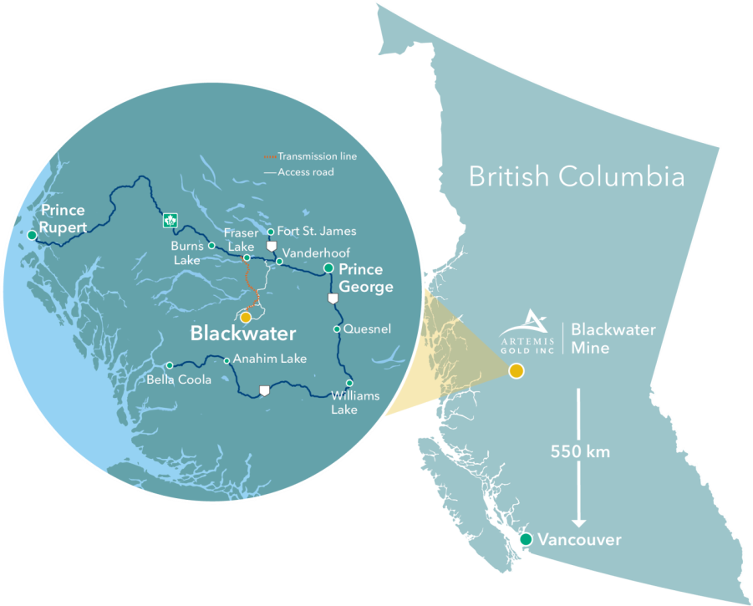
Blackwater Mine: Canada’s Newest Gold and Silver Mine
British Columbia hosts industry leading, best-in-class ESG
Acquired by Artemis Gold in August 2020
Major works construction commenced in Q1 2023
First gold poured in January 2025
Commercial production declared in May 2025
Located in British Columbia, a Tier 1 jurisdiction
Moderate climate; year-round access
Supportive government policy and effective regulations
Politically and socially stable
Recognized as a centre of excellence for geologic, financial, environmental and social expertise
Quality infrastructure: roads, power, water, communications
Ranked the world’s least risky mining jurisdiction in 2017 and 2018 (Mining Journal – World Risk Report)
Renewable, low-emission and low-cost hydroelectric power
First Nations and community support; workforce comprised of ~40% local and ~25% Indigenous
“The reason for the interest in investment in B.C. is the stable investment climate, when you get your regulatory approvals, you can be assured you're going to be able to continue to operate and your investment is secure …”
– DAVID EBY, PREMIER OF BRITISH COLUMBIA, BC NATURAL RESOURCES FORUM, JAN 2024

Slide 6




2025 – A Transformative Year for Artemis Gold
Transition from development to production – construction complete in 22 months; commercial production just three months after first gold pour; now advancing Phase 1A step change project
Low-cost production in a record gold price environment leading to strong cash flow and financial flexibility; delivered solid Q2 2025 results post-commercial production
Near-term plan to further expand Blackwater by accelerating Phase 2 expansion, solidifying Blackwater as one of Canada’s largest, lowest-cost, and environmentally responsible gold mines
Leadership transition – Dale Andres appointed CEO; Jeremy Langford President;
Steven Dean Executive Chair

Slide 7

Q2 2025 Highlights
Reached 102% of nameplate capacity in the month of June
Q2 production of 50,623 oz gold, including 34,824 oz in May and June
(YTD production of 63,343 oz gold)
Revenue of $231.1 million
Cash flow from operating activities $185.1 million
Q2 RESULTS
Cash costs² US$690/oz gold sold in post-commercial production period¹
AISC² US$805/oz gold sold in post-commercial production period¹
UNIT COSTS
To date, made $67 million in principal repayments against long-term debt, including a $40 million payment in July
Arranged a $700 million underwritten revolving credit facility to re-finance existing long-term debt and provide additional flexibility to support near-term expansion options³
BALANCE SHEET
¹ Post-commercial production period defined as the two months ending June 30, 2025
² Refer to Non-IFRS Measures on slide 2 of this presentation
³ Financial close of the revolving credit facility (RCF) remains subject to customary conditions precedent and is expected to mature four years following such financial close. See Appendix for details

Slide 8
2025 Guidance – On Track to Deliver
Production – a solid start; guidance maintained
Full-year 2025 guidance range is maintained at 190,000 to 230,000 ounces of gold, including 160,000 to 200,000 ounces during the post-commercial production period¹
Costs – guidance maintained
Post-commercial production AISC² of US$670 to US$770 per ounce of gold – in the lowest decile of gold producers globally³
Blackwater AISC¹ benefits from:
Low strip ratio – 2.0 over life of mine
Downhill hauling – mine sits above the mill
Low-cost, renewable hydroelectric power
¹ Post-commercial production period defined as the two months ending June 30, 2025
² Refer to Non-IFRS Measures on slide 2 of this presentation
³ Source: Canaccord; S&P
8

Slide 9
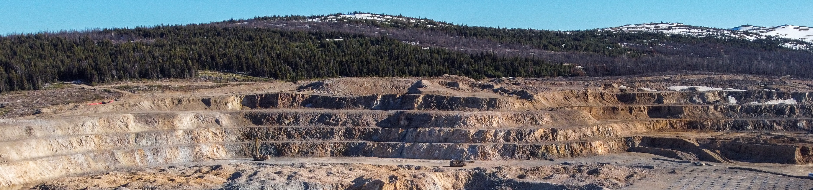
Meaningful and Near-term Organic Growth Opportunities
Phase 1 asset optimization – targeting 10% above design throughput by end of 2025
Phase 1A step change – increasing plant throughput by 33% for $100-$110M
Industry leading low capital intensity <$55 per tonne of annual throughput
Optimized and accelerated Phase 2 expansion advancing – decision expected in Q4 2025
Resource expansion and regional exploration – expect to commence drill program in Q4 2025
All supported by a strengthened balance sheet, delivering financial flexibility to fund growth

Slide 10
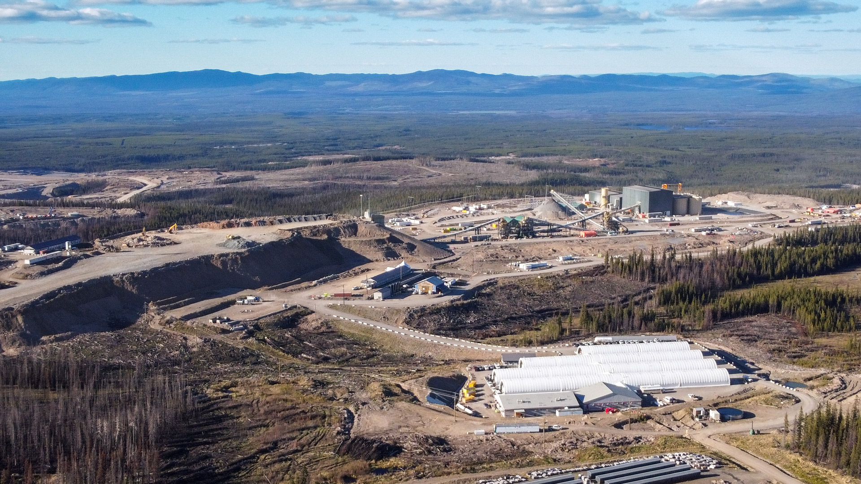

Optimizing Phase 1 – A Capital Efficient Step Change Opportunity
Nameplate plant capacity
33%
Capital cost
Industry low capital intensity
6Mtpa
8Mtpa
<$55
$100-$110M
per tonne of annual throughput
Q3 2025
Q4 2026
in nameplate capacity
Phase 1A will be funded through operating cash flows; payback period of <6 months
Work commenced in September 2025 and is expected to be fully commissioned in Q4 2026
Major mechanical equipment for Phase 1A has been ordered
Concurrently, continuing to optimize the current Phase 1 operation, targetting 10% over nameplate capacity by Q4 2025
On track to deliver an optimized and accelerated Phase 2 expansion; decision expected in Q4 2025
Phase 1A will drive higher revenue and cash flow in this record gold price cycle
  Opportunity to leverage best-in-class executive and project development team that successfully delivered Phase 1
  Provides greater operational flexibility to improve productivity and efficiency
  Supports and enhances our ESG standards by reducing manual handling of reagents and minimizing dust
  Derisks and enhances future free cash flows aimed at funding an optimized Phase 2 expansion
Notes:
.

Slide 11
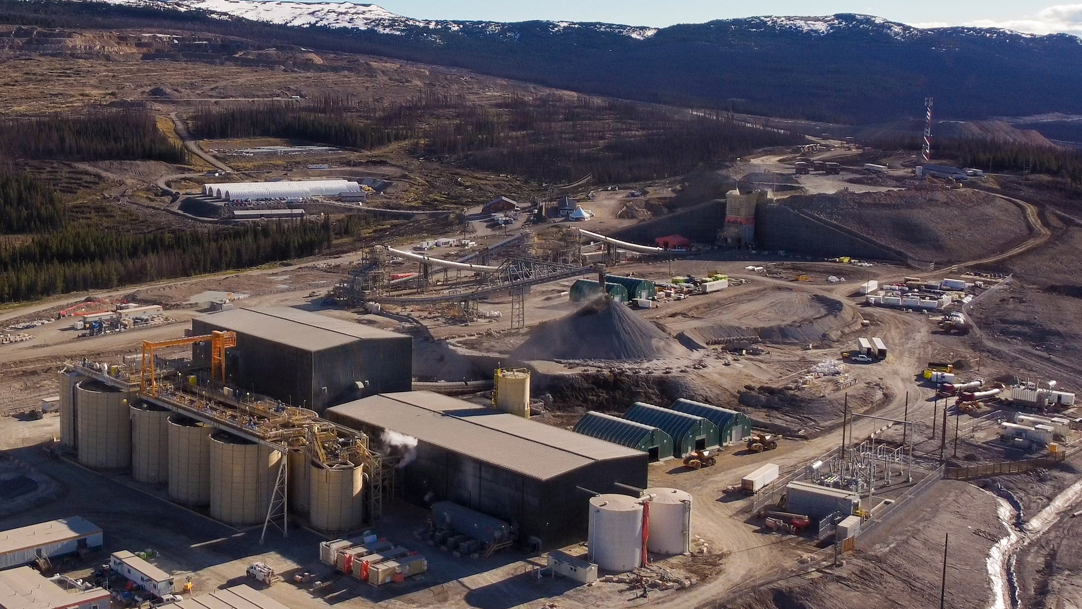
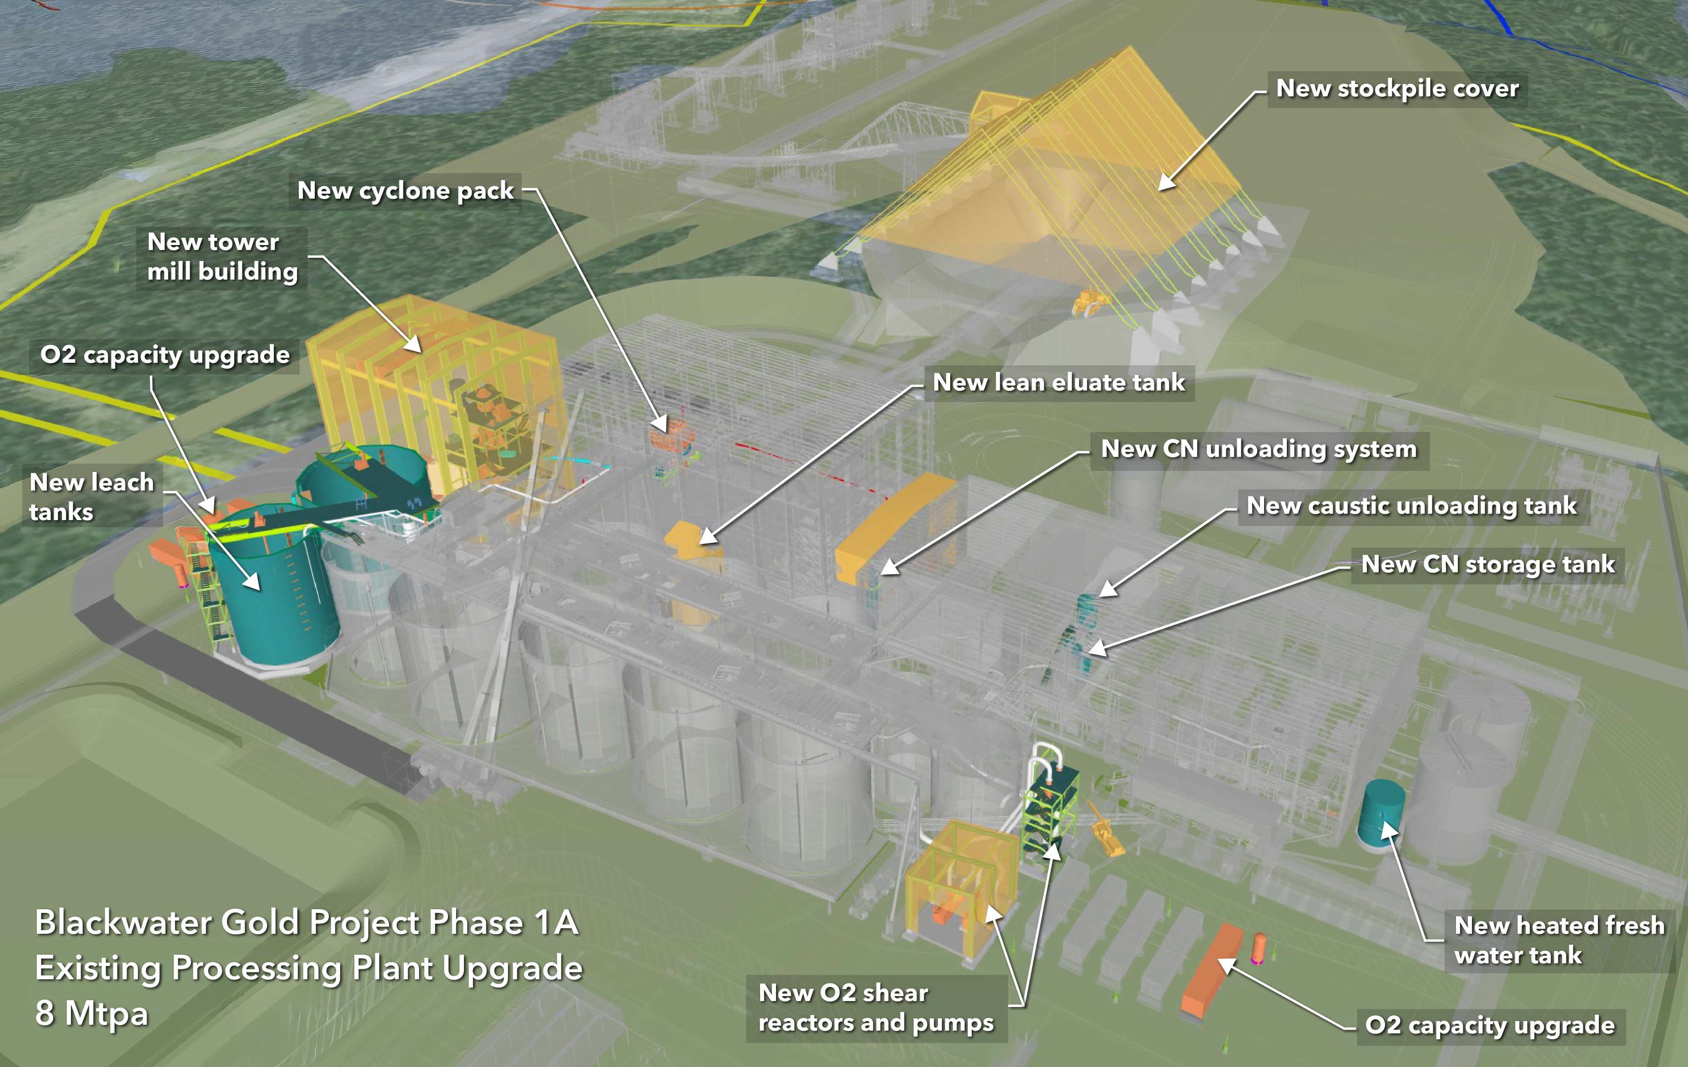
Phase 1A – Scope of Work
  Addition of a 3.5 MW vertical mill and modifications to the cyclone cluster
  Expanded leach circuit with the addition of one aeration tank and one pre-leach tank
  Expansion and upgrades to the oxygen supply system
  Upgrade of the existing elution circuit to increase carbon stripping capacity
  Optimization of the reagents mixing and delivery systems to increase efficiency and lower costs
  Addition of two storage ponds for fresh water and recycled process water near plant site for better operational flexibility
  Addition of a crushed ore stockpile cover, which will improve winter operation and further reduce fugitive dust
Notes:
.

Slide 12
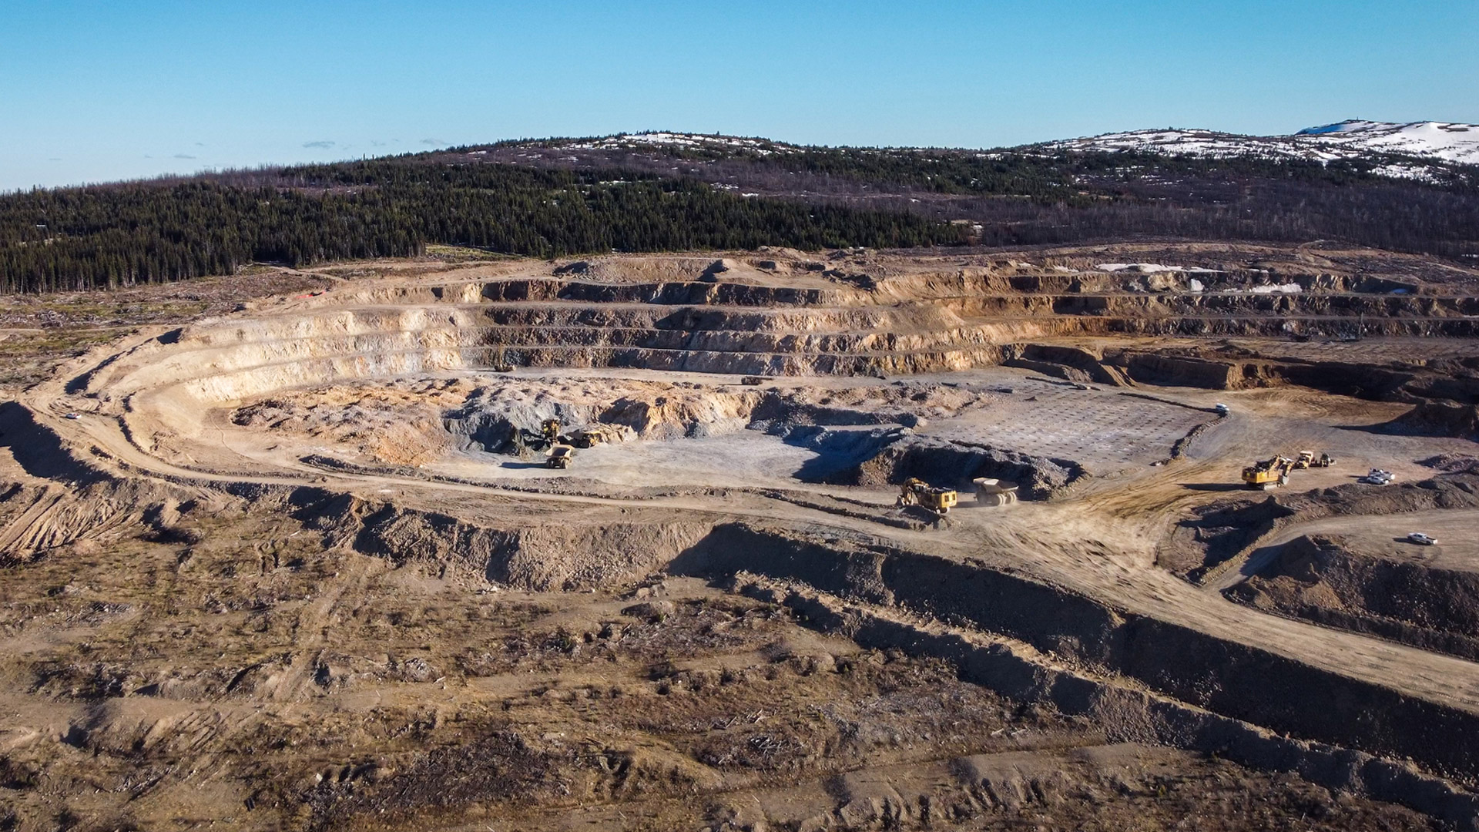
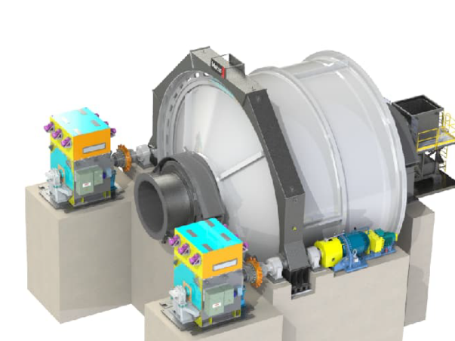
Phase 2 – Long Lead Time Equipment Opportunity
Design and engineering for an optimized Phase 2 are progressing
In anticipation of a Phase 2 investment decision in Q4 2025, orders have been placed for a ball mill and a SAG mill
The new ball mill is already fully fabricated, which significantly derisks the Phase 2 expansion schedule
Updated production and cost metrics for both Phase 1A and Phase 2 will be presented once the mine plan updates are completed and the Phase 2 expansion plan has been finalized; expected in Q4 2025
Notes:
.

Slide 13
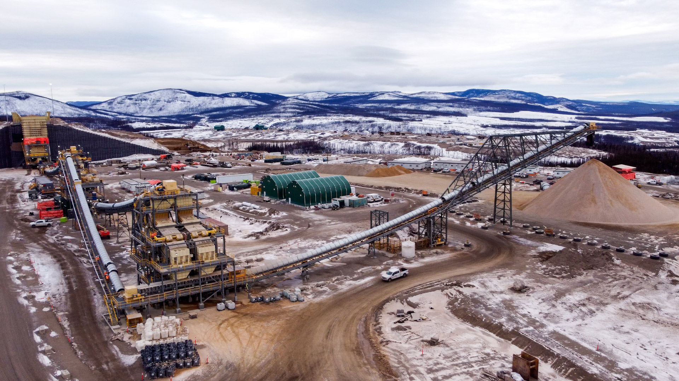
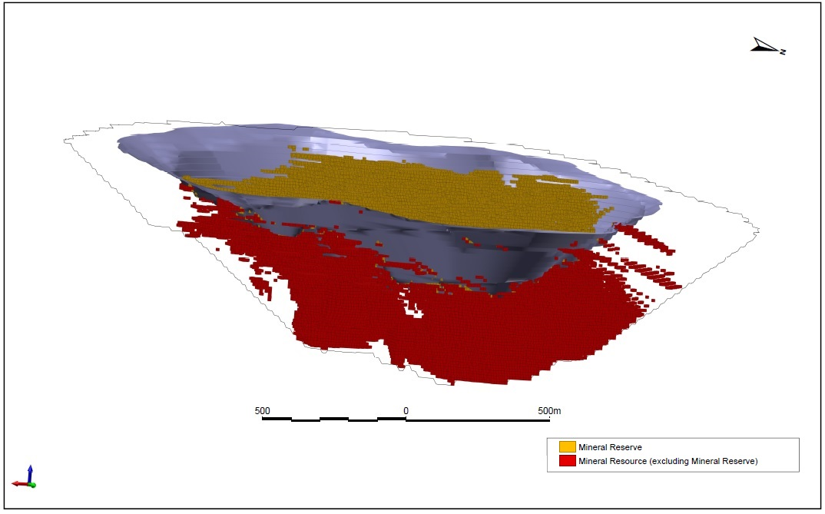
Gold Price Resource Upside
Current reserves based on a US$1,400/oz gold price pit shell
At US$2,000/oz gold price, the pit shell potentially expands
Purple Surface – Reserve pit shell (US$1,400/oz Au)
ADDITIONAL RESOURCE IN US$2,000/OZ GOLD PRICE
Category | Tonnes (Mt) | AuEq (g/t) | AuEq Moz
Measured | 40 | 0.60 | 0.76
Indicated | 116 | 0.66 | 2.45
Total M&I | 156 | 0.64 | 3.21
Resource Pit Shell (US$2,000/oz Au)
Resource Pit Shell (US$2,000/oz Au)

Slide 14
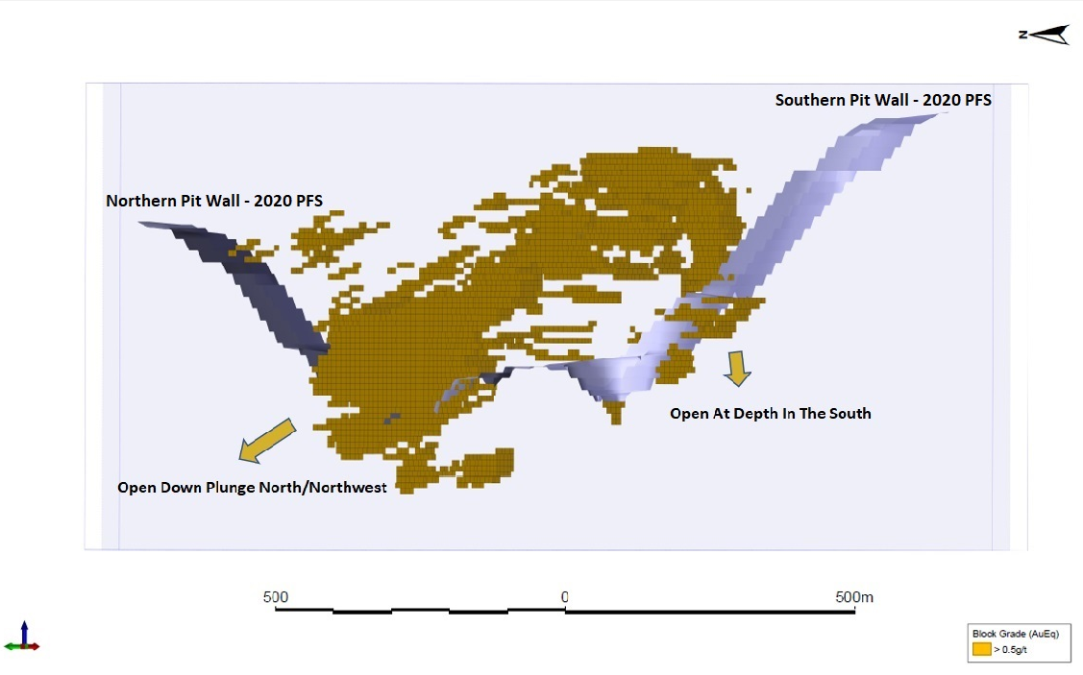
Exploration Potential: Open to the North, Northwest and at Depth
Long-term exploration
upside potential remains substantial
Open to the North
Open to the Northwest
Open at depth in the South
1,490 km² largely under-explored land package

Slide 15
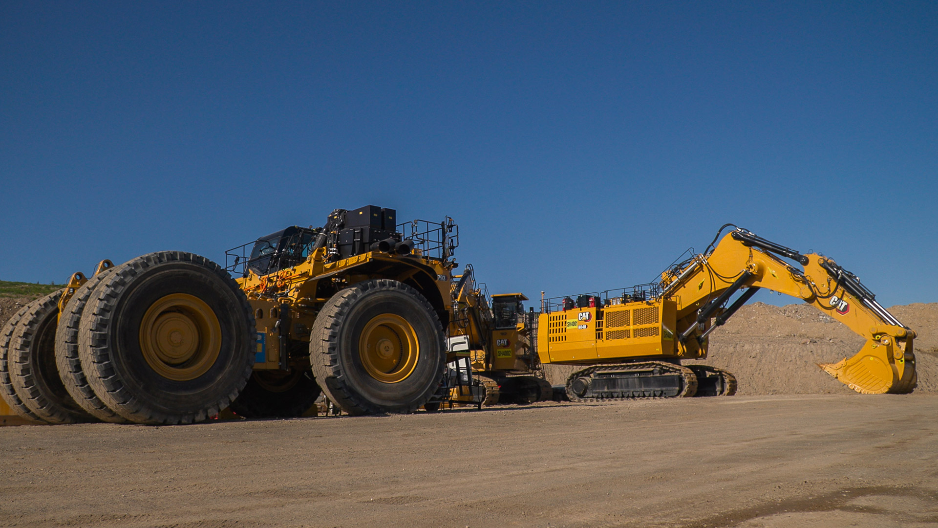
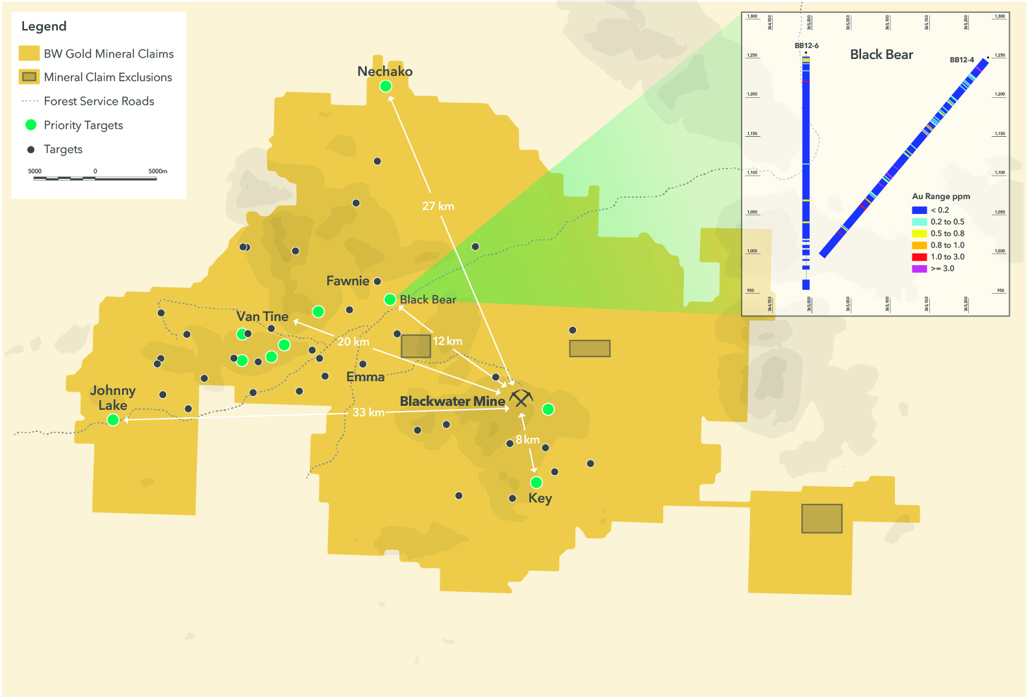
Priority Exploration Targets
Large land package of 1,490 sq km
Over 30 targets identified within trucking distance of the Blackwater mine; significant mineralization identified in numerous drill holes (e.g. Black Bear)
Previous exploration drilling completed 2009-2014
Historical dataset contains:
  > 40,000 rock, soil and till samples
  ground and airborne geophysics
  382 historical, mostly shallow drillholes
    169 diamond drill holes
    213 RC drillhole
15

Slide 16
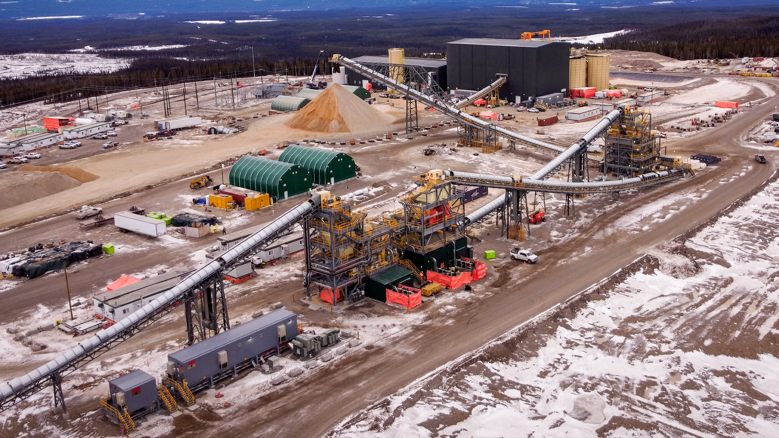
Capital Structure
CAPITAL STRUCTURE at September 12, 2025 | Phase 1
Issued and outstanding shares | 230M
Options, RSUs and DSUs | 11M
Fully diluted shares | 241M
Share price ($C) | $32.40
Market capitalization ($C) | $7.4B
90-day average daily value traded ($C) | $14M
LARGE SHAREHOLDERS
Ryan Beedie (Director) Steven Dean (Exec Chair) Lingotto Fourth Sail Helikon Blackrock Paulson | GDXJ T. Rowe Price Fidelity SILJ ETF CPR/Amundi Franklin David Black (Lead Director) | Baker Steel Allspring Gabelli Jeremy Langford (President) Stabilitas Van Eck Goehring & Rozencwajg | Credit Mutuel Schroder Amiral Gestion Kopernik XIB Sentry/CI Montrusco Bolton

Slide 17
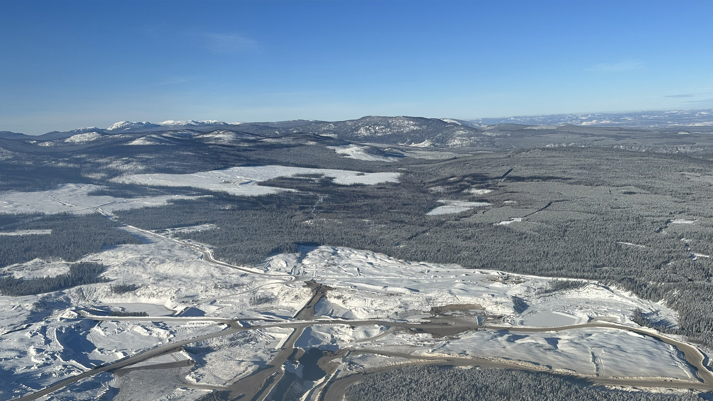
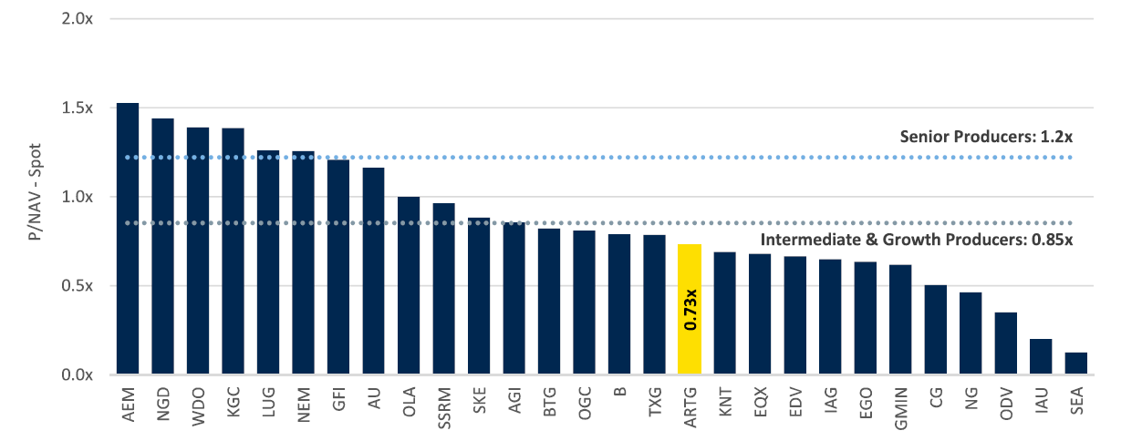
Relative Valuation
Blackwater is the ONLY ASSET in the peer group with potential to grow production organically >100% in the next five years; Artemis Gold continues to trade at a discount to peers
What’s next for Blackwater?
Upside valuation for a premium asset
source: RBC Capital markets; August 18, 2025

Slide 18
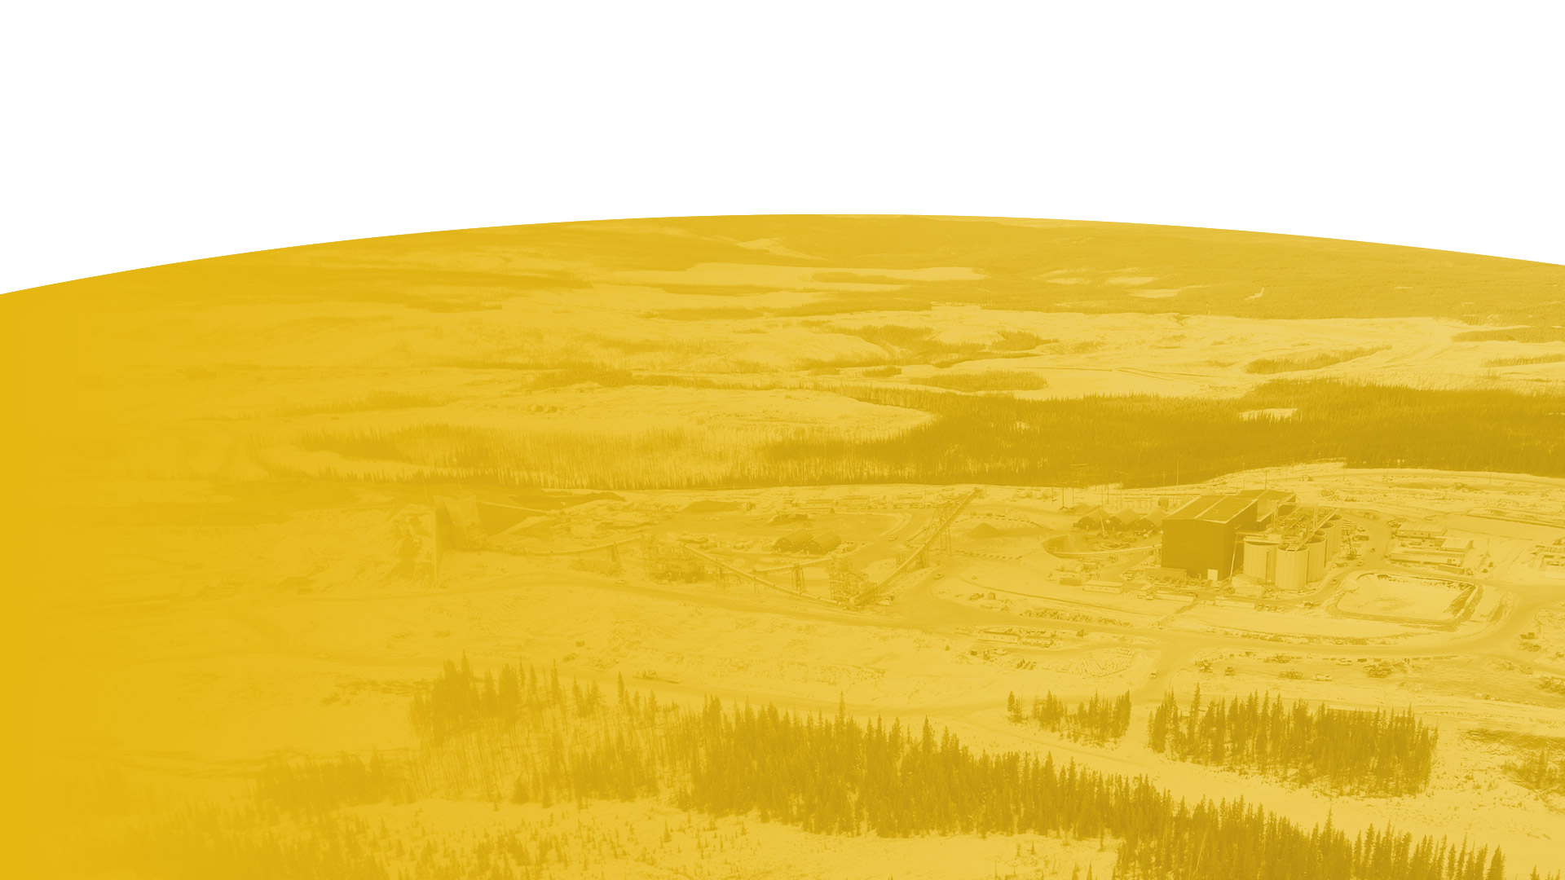




TSX-V: ARTG | artemisgoldinc.com
Want to know more about Artemis Gold?
Follow or Like our social
channels to stay up-to-date
LinkedIn
linkedin.com/company/artemis-gold
X
twitter.com/artemisgoldinc
Facebook
facebook.com/blackwatermine
CONTACT US
Artemis Gold Inc.
TEL: 604.588.1107
info@artemisgoldinc.com
3083-595 Burrard Street
Vancouver, BC V7X 1L3
artemisgoldinc.com

