Slide 1


SENIOR-QUALITY PORTFOLIO,
LEADING GROWTH POTENTIAL
MINING FORUM AMERICAS 2025
Colorado Springs, CO, USA
ORroyalties.com
TSX-NYSE | OR
Amounts presented are in United States Dollars, except where otherwise noted

Slide 2
CAUTIONARY STATEMENTS
FORWARD-LOOKING STATEMENTS
Certain statements contained in this presentation may be deemed “forward-looking statements” within the meaning of the United States Private Securities Litigation Reform Act of 1995 and “forward-looking information” within the meaning of applicable Canadian securities legislation. Forward-looking statements are statements other than statements of historical fact, that address, without limitation, future events, production estimates of OR Royalties’s assets (including increase of production), the 2025 guidance on GEOs and the 5-year outlook on GEOs included under “Guidance for 2025 and 5-Year Outlook” and other guidance based on disclosure from operators, timely developments of mining properties over which OR Royalties has royalties, streams, offtakes and investments, management’s expectations regarding OR Royalties’ growth, results of operations, estimated future revenues, production costs, carrying value of assets, ability to continue to pay dividend, requirements for additional capital, business prospects and opportunities, future demand for and fluctuation of prices of commodities (including outlook on gold, silver, diamonds, other commodities) currency, markets and general market conditions. In addition, statements and estimates (including data in tables) relating to mineral reserves and resources and statements and revised guidance as to gold equivalent ounces are forward-looking statements, as they involve implied assessment, based on certain estimates and assumptions, including the assumptions set out under “Guidance for 2025 and 5-Year Outlook”, and no assurance can be given that the estimates or related guidance will be realized. Forward-looking statements are generally, but not always, identified by the words “expects”, “plans”, “anticipates”, “believes”, “intends”, “estimates”, “projects”, “potential”, “scheduled” and similar expressions or variations (including negative variations), or by statements that events or conditions “will”, “would”, “may”, “could” or “should” occur. Forward-looking statements are subject to known and unknown risks, uncertainties and other factors, most of which are beyond the control of OR Royalties, and actual results may accordingly differ materially from those in forward-looking statements. Such risk factors include, without limitation, (i) with respect to properties in which OR Royalties holds a royalty, stream or other interest; risks related to: (a) the operators of the properties, (b) timely development, permitting, construction, commencement of production, ramp-up (including operating and technical challenges), (c) differences in rate and timing of production from resource estimates or production forecasts by operators, (d) differences in conversion rate from resources to reserves and ability to replace resources, (e) the unfavorable outcome of any challenges or litigation relating to title, permit or license, (f) hazards and uncertainty associated with the business of exploring, development and mining including, but not limited to unusual or unexpected geological and metallurgical conditions, slope failures or cave-ins, flooding and other natural disasters or civil unrest or other uninsured risks; (ii) with respect to other external factors: (a) fluctuations in the prices of the commodities that drive royalties, streams, offtakes and investments held by OR Royalties, (b) fluctuations in the value of the Canadian dollar relative to the U.S. dollar, (c) regulatory changes by national and local governments, including permitting and licensing regimes and taxation policies, regulations and political or economic developments in any of the countries where properties in which OR Royalties holds a royalty, stream or other interest are located or through which they are held, (d) continued availability of capital and financing to OR Royalties or the operators of properties, and general economic, market or business conditions, and (e) responses of relevant governments to infectious diseases outbreaks and the effectiveness of such response and the potential impact of such outbreaks on OR Royalties’ business, operations and financial condition; (iii) with respect to internal factors: (a) business opportunities that may or not become available to, or are pursued by OR Royalties, (b) the integration of acquired assets or (c) the determination of OR Royalties’ Passive Foreign Investment Company (“PFIC”) status. The forward-looking statements contained in this presentation are based upon assumptions management believes to be reasonable, including, without limitation: the absence of significant change in the Company’s ongoing income and assets relating to determination of its PFIC status; the absence of any other factors that could cause actions, events or results to differ from those anticipated, estimated or intended and, with respect to properties in which OR Royalties holds a royalty, stream or other interest, (i) the ongoing operation of the properties by the owners or operators of such properties in a manner consistent with past practice and with public disclosure (including forecast of production), (ii) the accuracy of public statements and disclosures made by the owners or operators of such underlying properties (including expectations for the development of underlying properties that are not yet in production), (iii) no adverse development in respect of any significant property, (iv) that statements and estimates relating to mineral reserves and resources by owners and operators are accurate and (v) the implementation of an adequate plan for integration of acquired assets.
For additional information on risks, uncertainties and assumptions, please refer to the most recent Annual Information Form of OR Royalties filed on SEDAR+ at www.sedarplus.ca and EDGAR at www.sec.gov which also provides additional general assumptions in connection with these statements. OR Royalties cautions that the foregoing list of risk and uncertainties is not exhaustive. Investors and others should carefully consider the above factors as well as the uncertainties they represent and the risk they entail. OR Royalties believes that the assumptions reflected in those forward-looking statements are reasonable, but no assurance can be given that these expectations will prove to be accurate as actual results and prospective events could materially differ from those anticipated such the forward-looking statements and such forward-looking statements included in this presentation are not guarantee of future performance and should not be unduly relied upon. In this presentation, OR Royalties relies on information publicly disclosed by other issuers and third-parties pertaining to its assets and, therefore, assumes no liability for such third-party public disclosure. These statements speak only as of the date of this presentation. OR Royalties undertakes no obligation to publicly update or revise any forward-looking statements, whether as a result of new information, future events or otherwise, other than as required by applicable law.
This presentation includes website addresses and references to additional materials found on third parties’ websites. These websites and information contained on or accessible through these websites are not incorporated by reference into, and do not form a part of, this presentation or any other report or document filed by OR Royalties with the Canadian securities regulators or the SEC, and any references to any websites are intended to be inactive textual references only.
SAFE HARBOUR STATEMENT
This presentation has been prepared for informational purposes only in order to assist prospective investors in evaluating an investment in OR Royalties Inc. The information related to mining operators provided in this presentation has been sourced from public disclosure. Inquiries regarding this presentation can be made to the senior management of OR Royalties.
CAUTIONARY NOTE TO U.S. INVESTORS REGARDING MINERAL RESERVE AND MINERAL RESOURCE ESTIMATES
OR Royalties is subject to the reporting requirements of the applicable Canadian securities laws, and as a result, reports its mineral resources and reserves according to Canadian standards. Canadian reporting requirements for disclosure of mineral properties are governed by National Instrument 43-101 (“NI 43-101”). The definitions of NI 43-101 are adopted from those described by the Canadian Institute of Mining, Metallurgy and Petroleum (“CIM”). In a number of cases OR Royalties has disclosed resource and reserve estimates covering properties related to the mining assets that are not based on CIM definitions, but instead have been prepared in reliance upon JORC and S-K 1300 (collectively, the “Acceptable Foreign Codes”). Estimates based on Acceptable Foreign Codes are recognized under NI 43-101 in certain circumstances. New mining disclosure rules under Subpart 1300 of Regulation S-K became mandatory for U.S. reporting companies beginning with the first fiscal year commencing on or after January 1, 2021. CIM definitions are not identical to those of the Acceptable Foreign Codes, the resource and reserve definitions and categories are substantively the same as the CIM definitions mandated in NI 43-101 and will typically result in reporting of substantially similar reserve and resource estimates. Nonetheless, readers are cautioned that there are differences between the terms and definitions of the CIM and the Acceptable Foreign Codes, and there is no assurance that mineral reserves or mineral resources would be identical had the owner or operator prepared the reserve or resource estimates under another code.
Mr. Guy Desharnais, PhD., P.Geo., is the qualified person for this presentation as defined by National Instrument 43-101 – Standards of Disclosure for Mineral Projects and has reviewed and verified the technical information contained herein. Mr. Desharnais is an employee of OR Royalties and is non-independent.

Slide 3


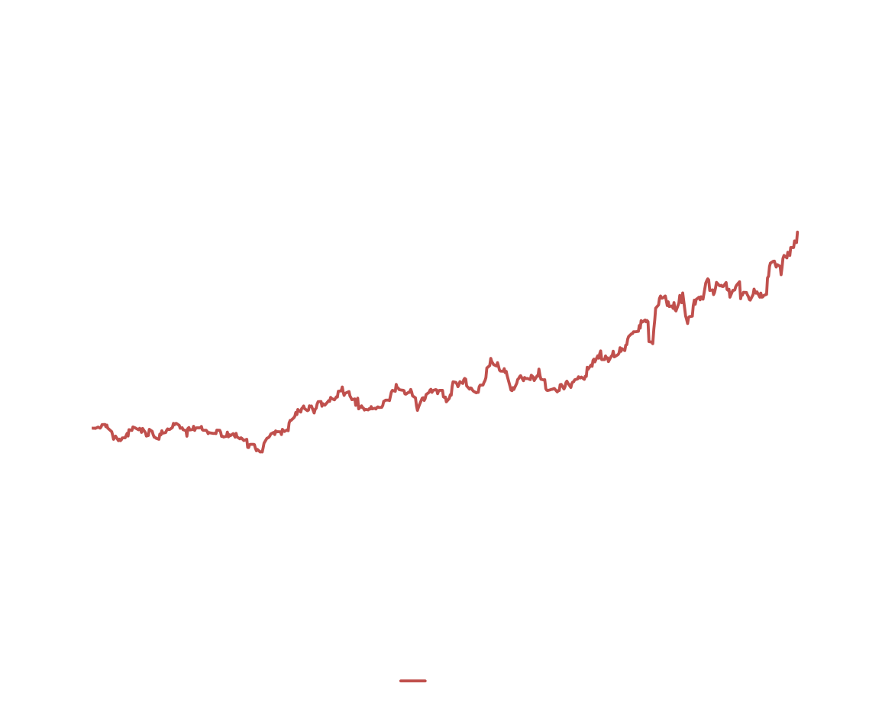
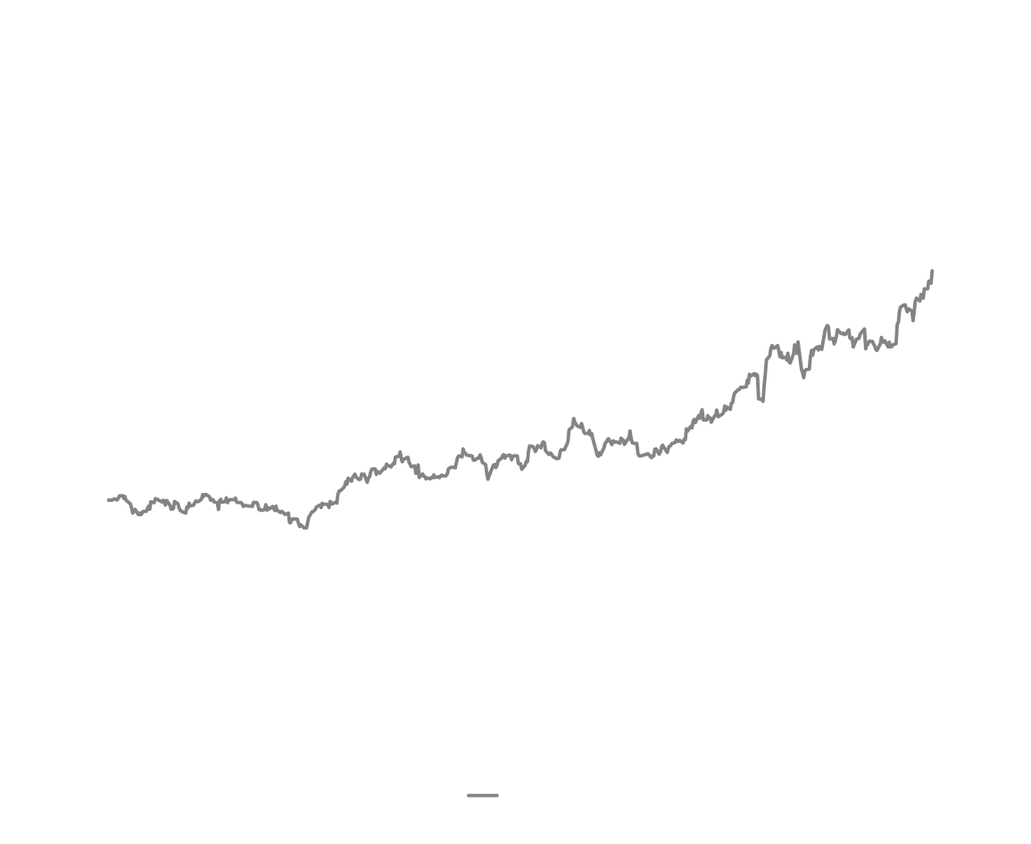
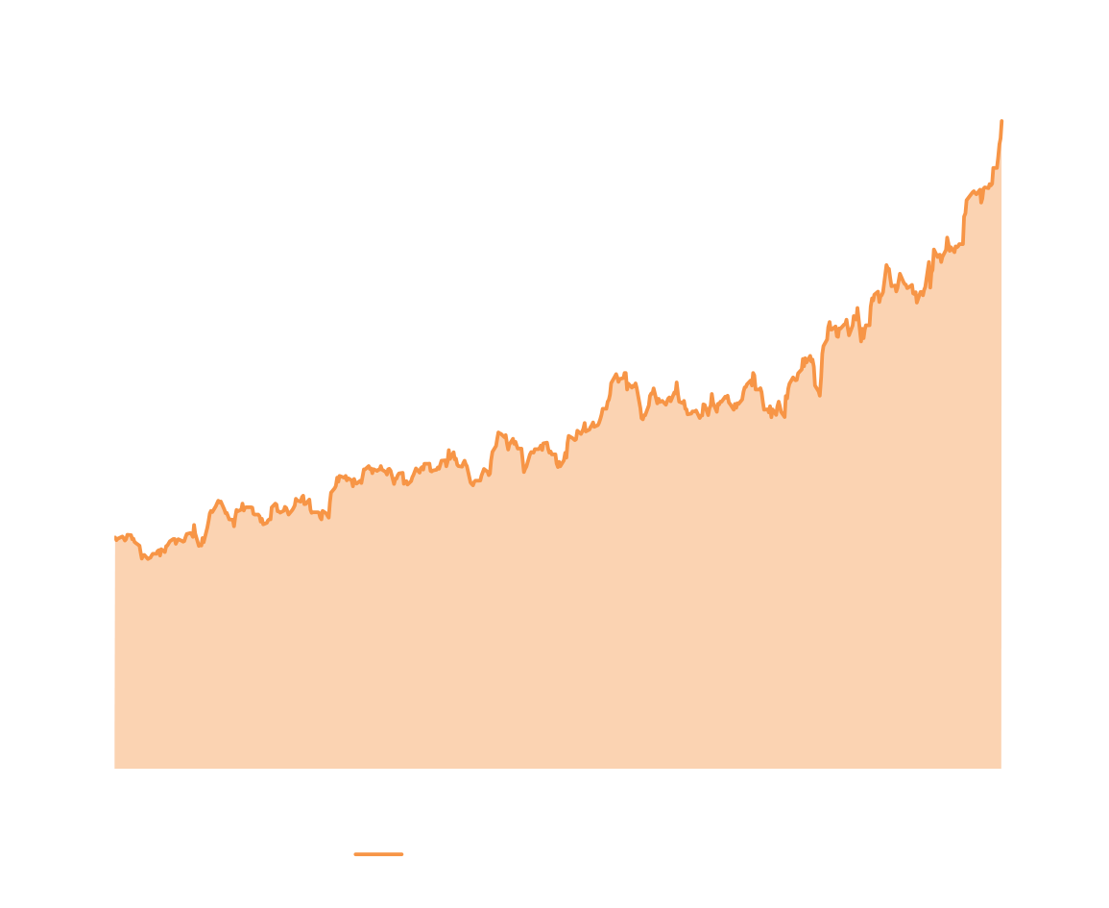
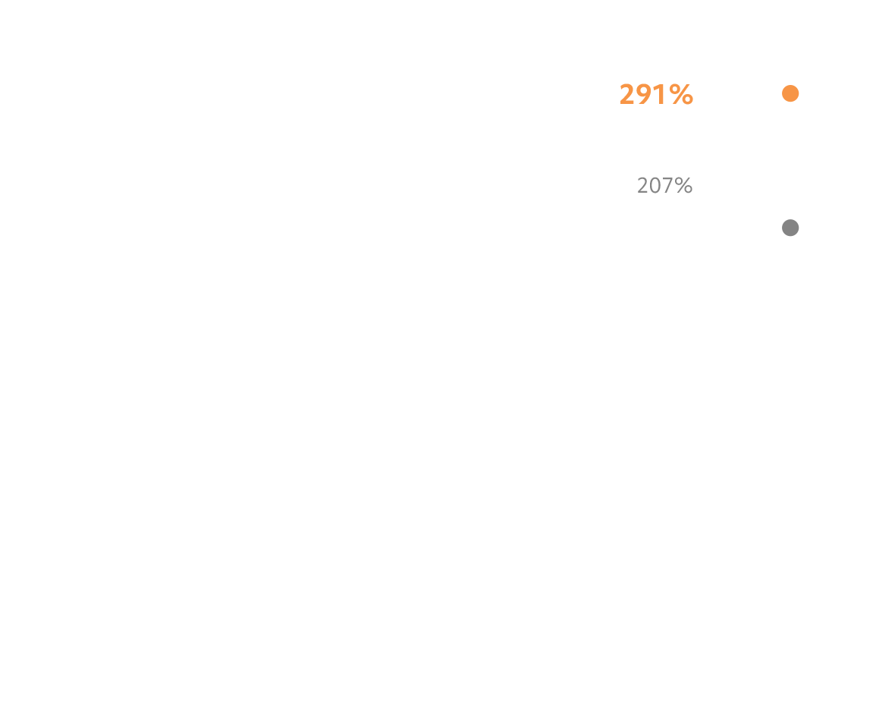
Total
Shareholder
Return
Sep. 2023 - Sep. 2025 (Indexed)
Commodity price perspective
Gold:
Copper:
+26.8%
+5.5%
Since the “copper vs gold” debate at PDAC in March^{(i)}
(i) Between March 2, 2025 and September 5, 2025
3

Slide 4



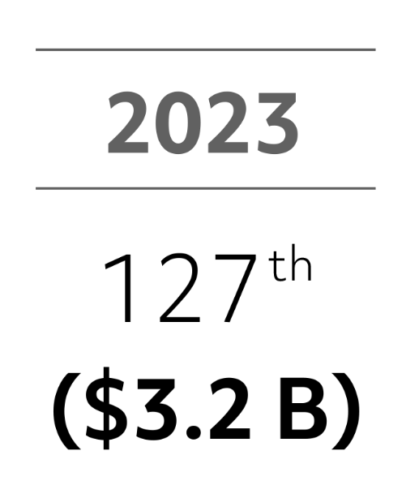
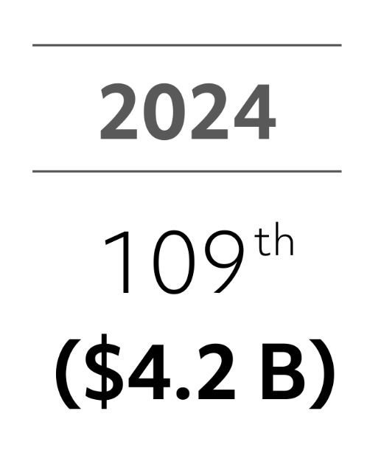
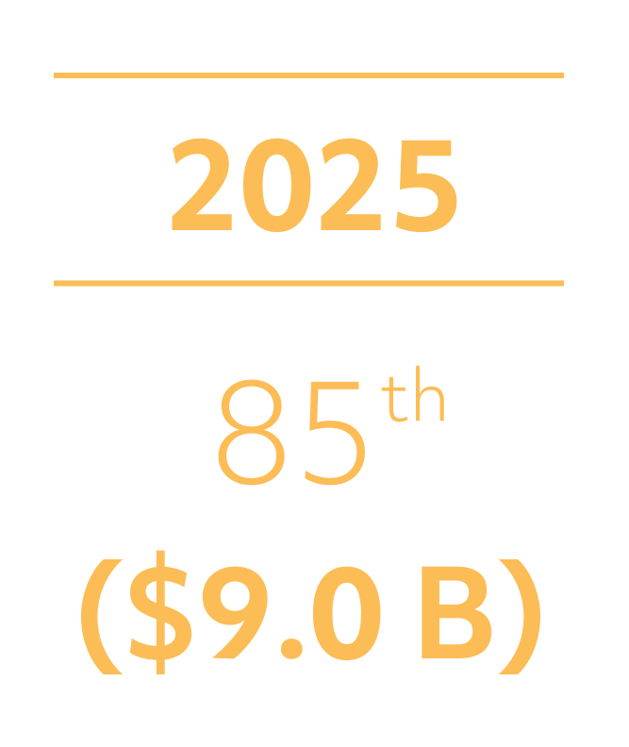
Growing Bigger
Sep. 5, 2023 - Sep. 5, 2025 (Market Capitalization, C$B - TSX)
4

Slide 5
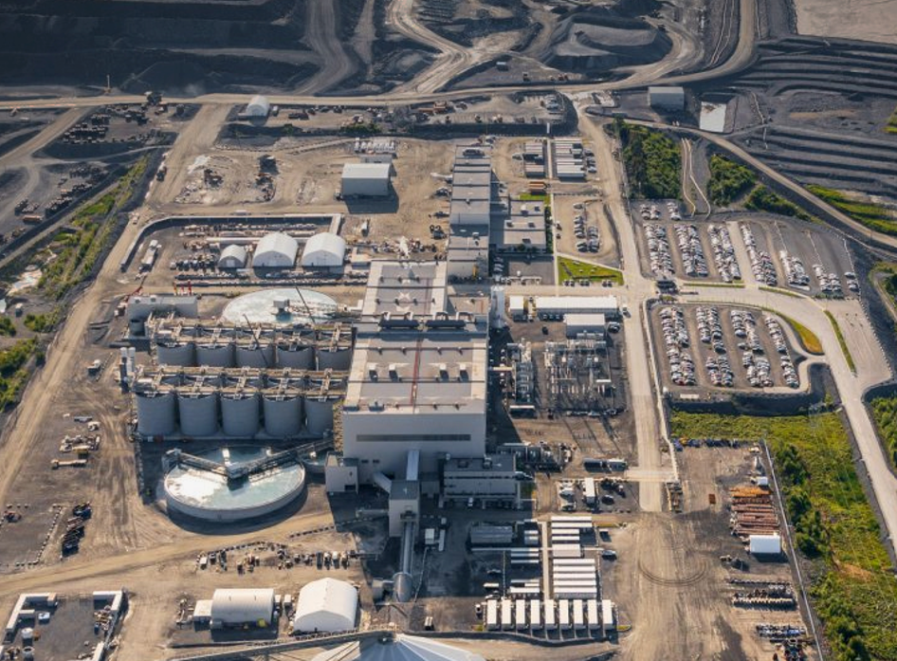
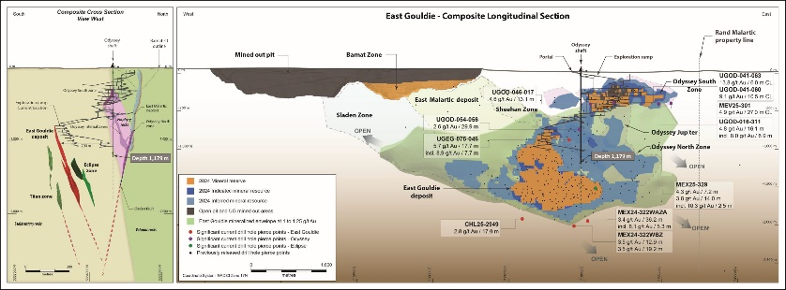

WHY OR ROYALTIES? 4 KEY POSITIVE DIFFERENTIATORS
1) NET ASSET VALUE BREAKDOWN BY JURISDICTION¹ (%)
3) ROBUST ORGANIC GEO GROWTH PROFILE³
XXX,000 – XXX,000?
Expansions
Odyssey Shaft #2
Mantos Blancos Phase II
Island Gold District Expansion
CSA Expansion Project(s)
+
Development
Amulsar
Costa Fuego
Cariboo
Casino
Cascabel
Copperwood
Hammond Reef
Marban
Shaakichiuwaanaan
Spring Valley
Upper Beaver
West Kenya
WKP
Others
+
Exploration
Altar
AntaKori
Whistler
Others
2029E outlook represents ~40% GEO growth^{(i)} over 2025E with no contingent capital required
Existing Assets
+
Expansions
Island Gold Phase 3+
Others
+
Development
Dalgaranga
Windfall
Hermosa (Taylor)
Marimaca MOD
Others
80,000 - 88,000
Existing Assets
+
Bralorne
Namdini
OR
2025E
Guidance
2029E
Outlook
Nearer-Term & Longer-Term Optionality
Tier-1 Jurisdictions²
2) 2024 CASH MARGIN (%)^{4,5}
4) CANADIAN MALARTIC COMPLEX
The world’s MOST VALUABLE precious metals royalty on mine operated by Canada’s #1 gold mining company!
3.0-5.0% NSR Royalty
2nd Biggest Gold Mine in Canada
7th Biggest Gold Mine in the World
OR
5
Source: Agnico Eagle Mines Ltd. (September 2025)
5

Slide 6
ENDNOTES
Data provided by Canaccord Genuity Capital Markets Precious Metals Research, September 2025
‘Tier-1’ mining jurisdictions defined as: Canada, USA, Australia
The 2025 outlook (published on February 19, 2025) is based on publicly available forecasts from our operating partners. When publicly available forecasts on properties are not available, OR Royalties obtains internal forecasts from the producers or uses management’s best estimate. The 2025 guidance uses current 2025 consensus commodity prices and a gold/silver price ratio of 83:1. The 5-year outlook uses current long-term consensus commodity prices and a gold/silver price ratio of 80:1. Optionality bar is illustrative only.
Cash margin is a non-IFRS financial performance measure which has no standard definition under IFRS. It is calculated by deducting the cost of sales (excluding depletion) from the revenues. Please refer to the non-IFRS measures provided under the Non-IFRS Measures section of OR Royalties’ MD&A for the three and six months ended June 30th, 2025, and published on August 5th, 2025. A cash margin of 96.5% was reported for 2024 and a cash margin of 97% was estimated for 2025; https://osiskogr.com/app/uploads/2025/02/OR-Q4-2024-MDA_En_Final_for-filing.pdf
For peer cash margin data, refer to “Triple Flag Precious Metals Corp. Fourth Quarter Report for the Three and Twelve Months ended December 31, 2024” (released 2025-02-19), “Sandstrom Gold Royalties 2024 Annual Report” (released 2025-02-18), “Franco-Nevada Corporation 2024 Annual Report” (released 2025-03-10), “Wheaton Precious Metals 2024 Financial Statements” (released 2025-03-13), and “Royal Gold, Inc. Form 10-K Report for the Fiscal Year Ended December 31, 2024” (released 2025-02-12)

