Slide 1
Mining Forum Americas

Slide 2
Forward Looking Information & Cautionary Statements
Certain statements and information contained in this presentation constitute “forward-looking statements” within the meaning of applicable U.S. securities laws and “forward-looking information” within the meaning of applicable Canadian securities laws, which we refer to collectively as “forward-looking statements”. Forward-looking statements are statements and information regarding possible events, conditions or results of operations that are based upon assumptions about future conditions and courses of action. All statements and information other than statements of historical fact may be forward-looking statements. In some cases, forward-looking statements can be identified correct, words such as “seek”, “expect”, “anticipate”, “budget”, “plan”, “estimate”, “continue”, “forecast”, “intend”, “believe”, “predict”, “potential”, “target”, “may”, “could”, “would”, “might”, “will” and similar words or phrases (including negative variations) suggesting future outcomes or statements regarding an outlook.
Forward-looking statements in this presentation include, but are not limited to: statements with respect to the five-year production and operational outlook for the AGM; production and cost guidance; the Company’s expectations regarding production, AISC, sustaining capital and development capital; estimated exploration expenditures for 2025 and the 2025 exploration program; the operating plans for the AGM and timing thereof; mine plan optimizations; operational improvements; pit wall pushback at Nkran and the timing thereof; sequencing of mining activities and the timing thereof; the merits of the AGM; commitment to health and safety; future exploration and exploration programs and the timing thereof; information regarding the plans and expectations of the Company; and related matters. Such forward-looking statements are based on a number of material factors and assumptions, including, but not limited to: the Company proceeding with operating plans as currently anticipated; the Company proceeding with further exploration and exploration programs as currently anticipated; development plans and capital expenditures; the price of gold will not decline significantly or for a protracted period of time; the accuracy of the estimates and assumptions underlying mineral reserve and mineral resource estimates; the Company's ability to raise sufficient funds from future equity financings to support its operations, and general business and economic conditions; the global financial markets and general economic conditions will be stable and prosperous in the future; the ability of the Company to comply with applicable governmental regulations and standards; the mining laws, tax laws and other laws in Ghana applicable to the AGM will not change, and there will be no imposition of additional exchange controls in Ghana; the success of the Company in implementing its development strategies and achieving its business objectives; the Company will continue to have sufficient working capital to fund its operations; and the key personnel of the Company will continue their employment.
The foregoing list of assumptions cannot be considered exhaustive.
Forward-looking statements involve known and unknown risks, uncertainties and other factors which may cause actual results, performance or achievements to differ materially from those anticipated in such forward-looking statements. The Company believes the expectations reflected in such forward-looking statements are reasonable, but no assurance can be given that these expectations will prove to be correct and you are cautioned not to place undue reliance on forward-looking statements contained herein. Some of the risks and other factors which could cause actual results to differ materially from those expressed in the forward-looking statements contained in this presentation, include, but are not limited to: the mineral reserve and mineral resource estimates may change and may prove to be inaccurate; metallurgical recoveries may not be economically viable; LOM estimates are based on a number of factors and assumptions and may prove to be incorrect; actual production, costs, returns and other economic and financial performance may vary from the Company's estimates in response to a variety of factors, many of which are not within the Company's control; inflationary pressures and the effects thereof sustained increases in costs, or decreases in the availability, of commodities consumed or otherwise used by the Company may adversely affect the Company; adverse geotechnical and geological conditions (including geotechnical failures) may result in operating delays and lower throughput or recovery, closures or damage to mine infrastructure; the ability of the Company to treat the number of tonnes planned, recover valuable materials, remove deleterious materials and process ore as planned is dependent on a number of factors and assumptions which may not be present or occur as expected; the Company's mineral properties may experience a loss of ore and the Company may experience lack of access to its mineral properties and other issues due to illegal mining activities; the Company's operations may encounter delays in or losses of production due to equipment delays or the availability of equipment; outbreaks of infectious diseases may have a negative impact on global financial conditions, demand for commodities and supply chains and could adversely affect the Company's business, financial condition and results of operations and the market price of the common shares of the Company; the Company's operations are subject to continuously evolving legislation, compliance with which may be difficult, uneconomic or require significant expenditures; the Company may be unsuccessful in attracting and retaining key personnel; labour disruptions could adversely affect the Company's operations; recoveries may be lower in the future and have a negative impact on the Company's financial results; the lower recoveries may persist and be detrimental to the AGM and the Company; the Company's business is subject to risks associated with operating in a foreign country; risks related to the Company's use of contractors; the hazards and risks normally encountered in the exploration, development and production of gold; the Company's operations are subject to environmental hazards and compliance with applicable environmental laws and regulations; the effects of climate change or extreme weather events may cause prolonged disruption to the delivery of essential commodities which could negatively affect production efficiency; the Company's operations and workforce are exposed to health and safety risks; unexpected costs and delays related to, or the failure of the Company to obtain, necessary permits could impede the Company's operations; the Company's title to exploration, development and mining interests can be uncertain and may be contested; geotechnical risks associated with the design and operation of a mine and related civil structures; the Company's properties may be subject to claims by various community stakeholders; risks related to limited access to infrastructure and water; risks associated with establishing new mining operations; the Company's revenues are dependent on the market prices for gold, which have experienced significant recent fluctuations; the Company may not be able to secure additional financing when needed or on acceptable terms; the Company's shareholders may be subject to future dilution; risks related to changes in interest rates and foreign currency exchange rates; risks relating to credit rating downgrades; changes to taxation laws applicable to the Company may affect the Company's profitability and ability to repatriate funds; risks related to the Company's internal controls over financial reporting and compliance with applicable accounting regulations and securities laws; risks related to information systems security threats; non-compliance with public disclosure obligations could have an adverse effect on the Company's stock price; the carrying value of the Company's assets may change and these assets may be subject to impairment charges; risks associated with changes in reporting standards; the Company may be liable for uninsured or partially insured losses; the Company may be subject to litigation; damage to the Company's reputation could result in decreased investor confidence and increased challenges in developing and maintaining community relations which may have adverse effects on the business, results of operations and financial conditions of the Company and the Company's share price; the Company may be unsuccessful in identifying targets for acquisition or completing suitable corporate transactions, and any such transactions may not be beneficial to the Company or its shareholders; the Company must compete with other mining companies and individuals for mining interests; the Company's growth, future profitability and ability to obtain financing may be impacted by global financial conditions; the Company's common shares may experience price and trading volume volatility; the Company has never paid dividends and does not expect to do so in the foreseeable future; the Company's shareholders may be unable to sell significant quantities of the Company's common shares into the public trading markets without a significant reduction in the price of its common shares, or at all; and the risk factors described under the heading "Risk Factors" in the Company's Annual Information Form.
Although the Company has attempted to identify important factors that could cause actual results or events to differ materially from those described in the forward-looking statements, you are cautioned that this list is not exhaustive and there may be other factors that the Company has not identified. Furthermore, the Company undertakes no obligation to update or revise any forward-looking statements included in, or incorporated by reference in, this news release if these beliefs, estimates and opinions or other circumstances should change, except as otherwise required by applicable law.
Neither the Toronto Stock Exchange nor the Investment Industry Regulatory Organization of Canada accepts responsibility for the adequacy or accuracy of this presentation.
Amri Sinuhaji, P. Eng., Vice President Technical Services with Galiano is a “qualified person” as defined by Canadian National Instrument 43-101 – Standards of Disclosure for Mineral Projects and Chris Pettman, P. Geo, has approved the scientific and technical information contained in this presentation.
All dollar amounts US$ unless otherwise stated.

Slide 3
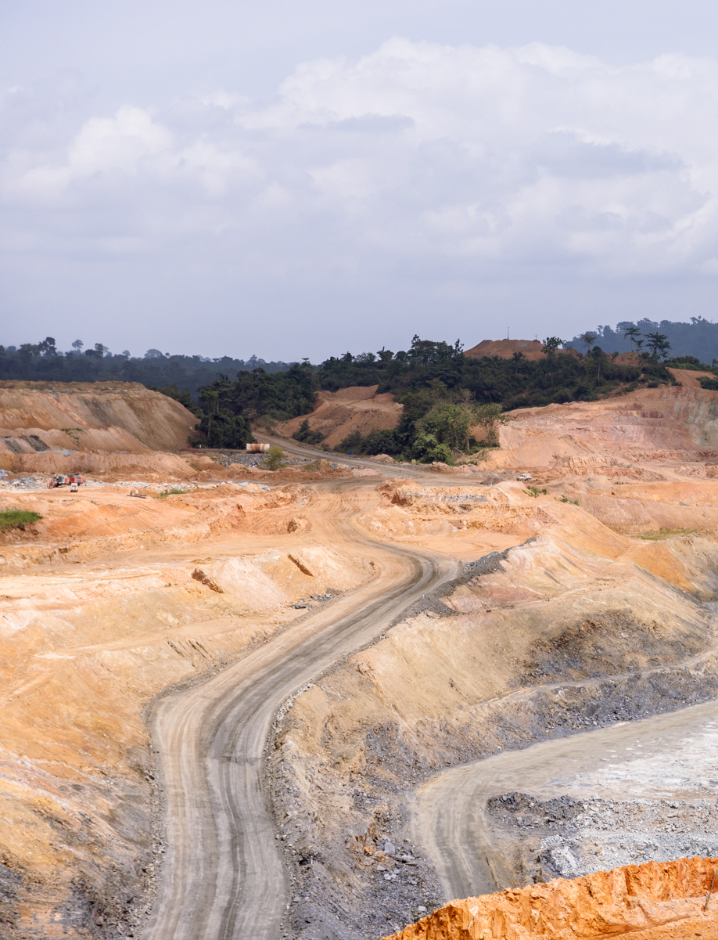

Non-IFRS Measures
Non-IFRS Performance Measures
The Company has included certain non-IFRS performance measures in this presentation. These non-IFRS performance measures do not have any standardized meaning and therefore may not be comparable to similar measures presented by other issuers. Accordingly, these performance measures are intended to provide additional information and should not be considered in isolation or as a substitute for measures of performance prepared in accordance with IFRS. Refer to the Non-IFRS Measures section of Galiano’s Management’s Discussion and Analysis for an explanation of these measures.
Total Cash Costs per Gold Ounce
Management of the Company uses total cash costs per gold ounce sold to monitor the operating performance of the AGM. Total cash costs include the cost of production, adjusted for share-based compensation expense, by-product revenue and production royalties per ounce of gold sold.
All-in Sustaining Costs Per Gold Ounce
The Company has adopted the reporting of “all-in sustaining costs per gold ounce” (“AISC”). AISC include total cash costs, mine site G&A expenses, sustaining capital expenditure, sustaining capitalized stripping costs, reclamation cost accretion and lease payments on the AGM’s mining and service contractor lease agreements per ounce of gold sold.
EBITDA and Adjusted EBITDA
EBITDA provides an indication of the Company’s continuing capacity to generate income from operations before taking into account the Company’s financing decisions and costs of amortizing capital assets. Accordingly, EBITDA comprises net income (loss) excluding finance expense, finance income, depreciation and depletion expense, and income taxes. Adjusted EBITDA adjusts EBITDA to exclude certain non-cash and/or non-recurring items. Other companies may calculate EBITDA and Adjusted EBITDA differently.

Slide 4
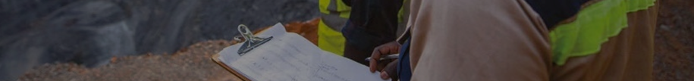
Corporate Snapshot
Analyst Price Targets¹
C$3.50
C$5.90
C$2.50
C$4.50
C$5.00
US$3.20
Scotia
Hannam Partners
BMO
Beacon Securities
Cormark
HC Wainwright
Operating Asset
Market Cap¹
Ownership³
Gold Fields Ltd | 19.58%
Equinox Partners LLP | 11.25%
Donald Smith | 9.96%
Ruffer LLP | 7.35%
Sun Valley | 4.77%
Konwave | 3.32%
Goldman Sachs | 3.21%
Zijin Mining | 3.07%
Franklin | 2.91%
Ownership Breakdown
90% interest in Asanko
Gold Mine, Ghana
$597M
Cash Balance²
Closing Price (NYSE: GAU)¹
$115 M (no debt)
$2.31
Ticker: GAU
Common Shares Outstanding²
NYSE American & TSX
258.4M
As of September 2, 2025
As of June 30, 2025 (unaudited)
As of June 30, 2025, as reported on Nasdaq
Retail
Gold Fields
Institutional
Equinox

Slide 5
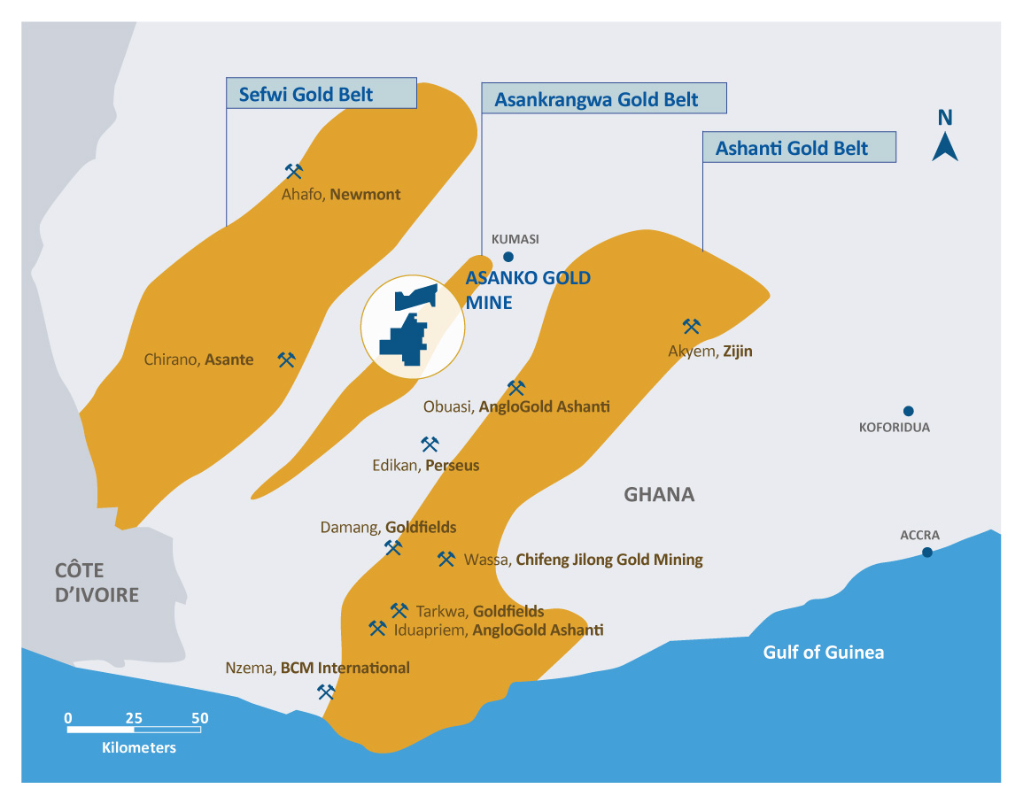
Building a Leading Gold Producer in Ghana
Stable democracy
No 1 gold producer
in Africa
Secure jurisdiction
Mature mining
regulations
Large presence of major mining companies
Access to skilled
employee base

Slide 6
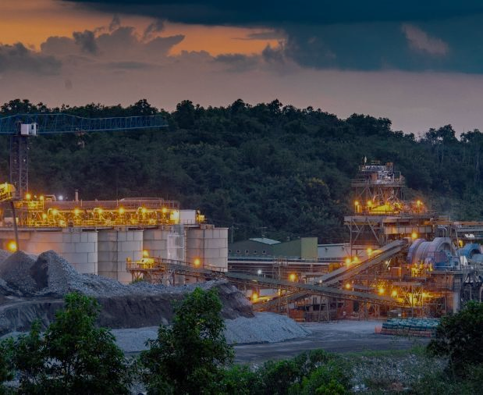
Asanko Gold Mine (“AGM”) at a Glance
2025 Expected Production
Expected 2025 AISC¹
130-150koz Au
$1,750 – $1,950/oz
Increasing Gold Production³
Decreasing AISC¹
+82% over LOM avg
<$1,300/oz over LOM avg
Mineral Reserves²
M&I Mineral Resources²
2.03 Moz Au
(47.1 Mt at 1.36 g/t Au)
M&I 3.7 Moz Au
(83.9 Mt at 1.36 g/t Au)
Exploration Potential
No Development Risk
Highly prospective
land package ~476 km²
Fully permitted & operating 5.8Mtpa processing plant
Nkran Stripping ahead of schedule
Non-IFRS measure.
As of December 31, 2024. Mineral resources are inclusive of mineral reserves.
Refer to “NI 43-101 Technical Report and Feasibility Study for the Asanko Gold Mine, Ashanti Region, Ghana" with an effective date of December 31, 2022.

Slide 7


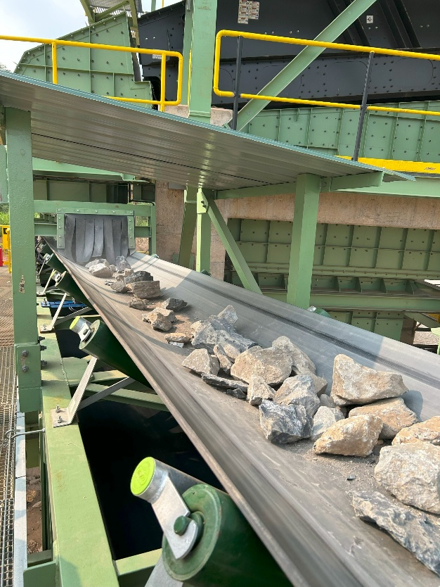
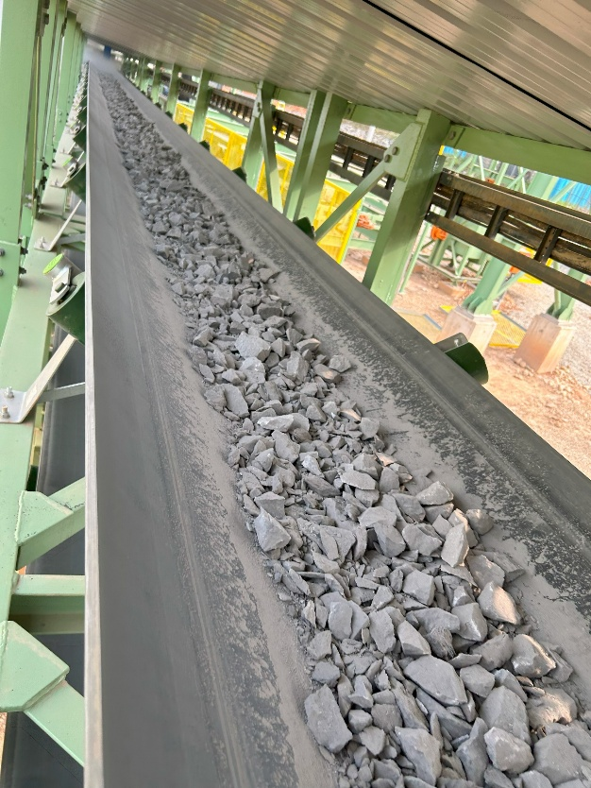
Q2 Summary: Positive Momentum
Metric | Q2 2025 | Q1 2025 | Change
Lost-time injuries | Nil | 2 | -100%
Total recordable injuries | Nil | 3 | -100%
Gold produced (oz) | 30,350 | 20,734 | +46%
Avg realized gold price ($/oz) | $3,317 | $2,833 | +17%
Revenue ($m) | $97.3 | $76.6 | +27%
Cash flow from operations ($m) | $35.8 | $25.9 | +38%
Cash and cash equivalents ($m)⁽²⁾ | $114.7 | $106.4 | +8%
AISC ($/oz sold)⁽¹⁾ | $2,251 | $2,501 | -10%
Free Cash Flow ($m)⁽¹⁾ | $5.6 | $0.7 | +700%
Secondary Crusher Commissioned
On time
Below budget
⁽¹⁾ Refer to Non-IFRS Performance Measures
⁽²⁾ As of June 30, 2025 and March 31, 2025, respectively (unaudited)

Slide 8
Maintaining Strong Cash Balance – No Debt
*cash unaudited @ Q3 24, Q1 25, Q2 25
**non-IFRS measure

Slide 9
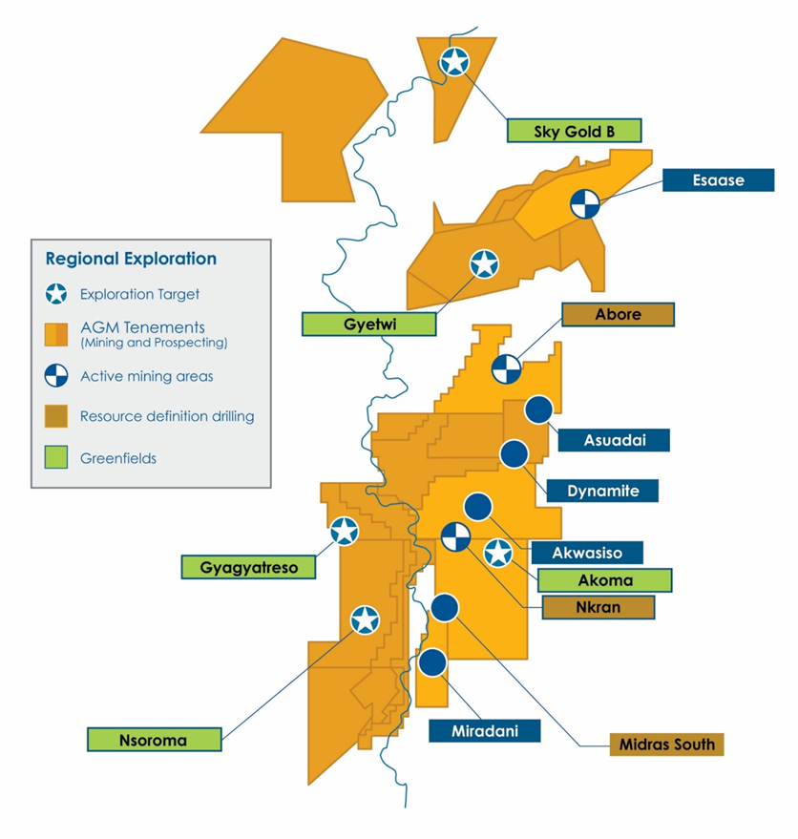
Q2 2025 Exploration Update
~$15M
2025 Exploration Budget
  AGM holds 476 km² of under explored tenements
  Robust pipeline of greenfields and brownfields targets
  Well funded program with ~$15M allocated in 2025
  Strong technical team in country and drill rigs in place to continue to execute work plans
  H1 2025 drilling results proved exploration targeting approach at Abore with wide, new high-grade mineralization zones confirmed below the Mineral Resource
  Aggressive drilling campaign to continue at Abore through H2 2025 with mineralization open in all directions
  Multiple Greenfields targets ready for drilling in H2
  Q2 Drilling Results Highlights Include:
23m@ 6.8 g/t
ABDD25-388
16.4m @ 5.3 g/t
ABDD25-384
44.8m @ 2.0 g/t
ABPC25-368
30.6m @ 2.9 g/t
ABPC25-380
17.5m @ 3.0 g/t
ABDD25-354
29.7m @ 2.9 g/t
ABPC25-371

Slide 10
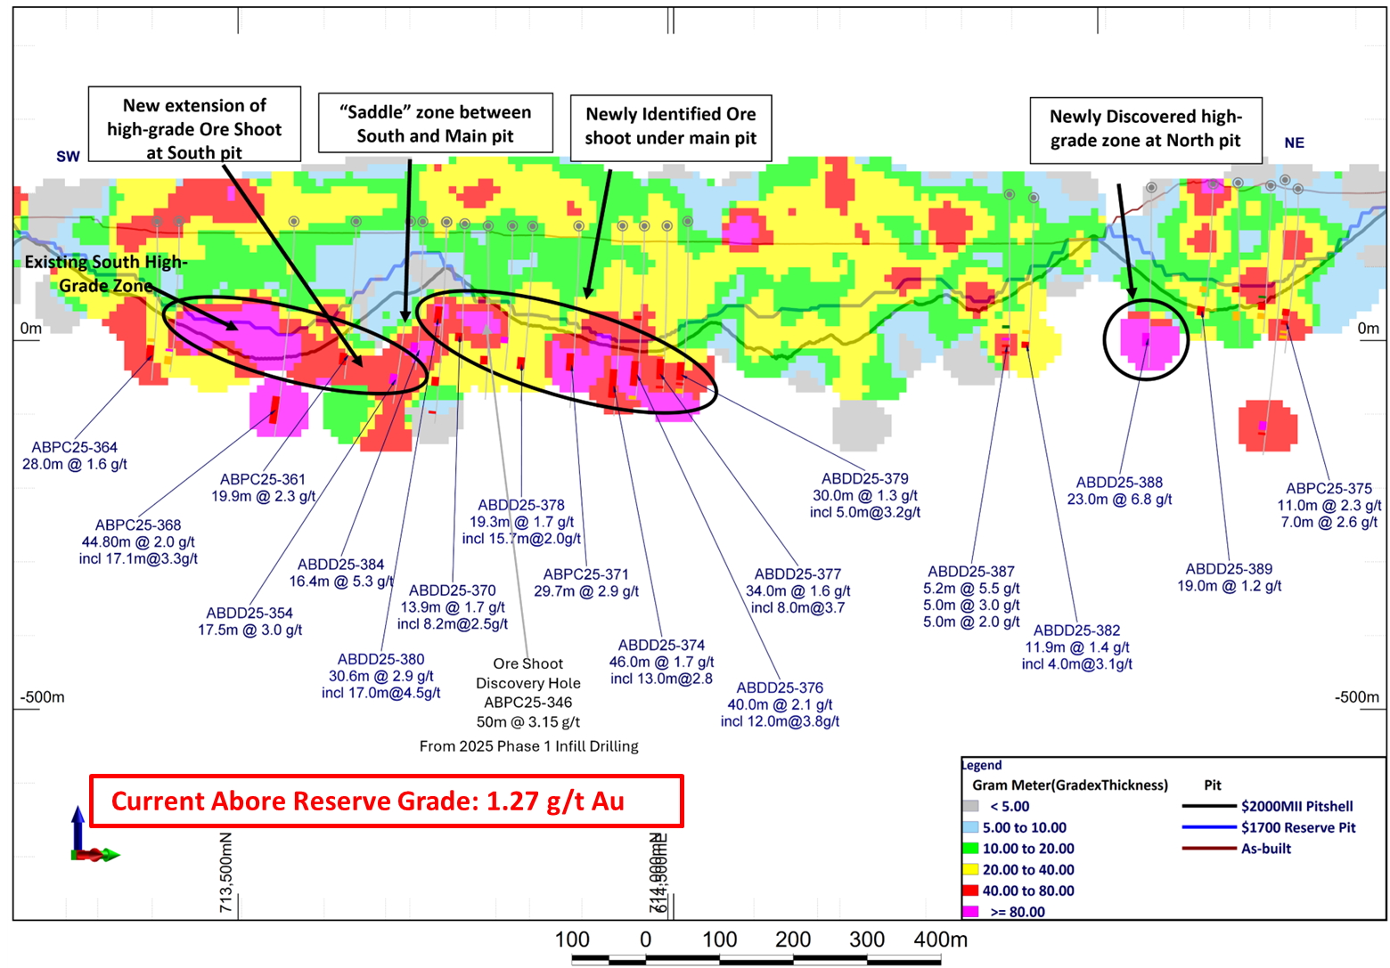
Abore Gram Meter Long Section of Q2 Drilling: Grades Increasing

Slide 11
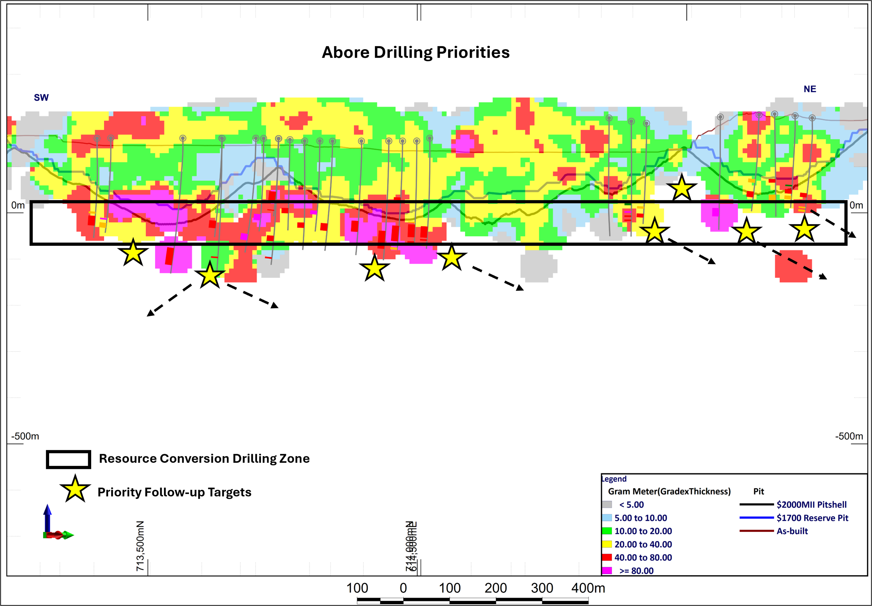
Abore: Targets for H2 2025
  Following excellent H1 2025 drilling results, an aggressive campaign of continued drilling will be ongoing throughout at least the remainder of 2025
  Drilling will focus on conversion of Resources and testing for further continuations of mineralization
150m

Slide 12
Guidance & 5 Year Outlook
AISC
Gold Production
 | Units | 2025 | 2026 | 2027 | 2028 | 2029
Gold Production | koz | 130-150 | 180-210 | 190-220 | 210-240 | 230-260
AISC¹ | $/oz | 1,750-1,950 | 1,400-1,700 | 1,300-1,600 | 1,200-1,500 | 1,100-1,400
Sustaining Capital^ | $M | 15 | 13-18 | 10-15 | 18-23 | 5-10
Development Capital* | $M | 60-65 | 120-130 | 115-125 | 70-80 | 20-30
Non-IFRS Measure
^ Excludes capitalized stripping costs
* Includes Nkran stripping costs.

Slide 13
Upcoming Value Drivers
82% increase in production
Organic Growth – 82% increase Au production over LOM
Advancing Nkran
Secondary Crusher
Commissioning
Exploration Upside
Decrease in AISC¹ to
<$1,300/oz over LOM
Cut 3 waste stripping
Commenced Feb 2025
Return to mill capacity
5.8Mtpa by H2 2025
Underground potential at Abore and Nkran
¹ Non-IFRS Measure.
² FactSet, Company estimates.

Slide 14
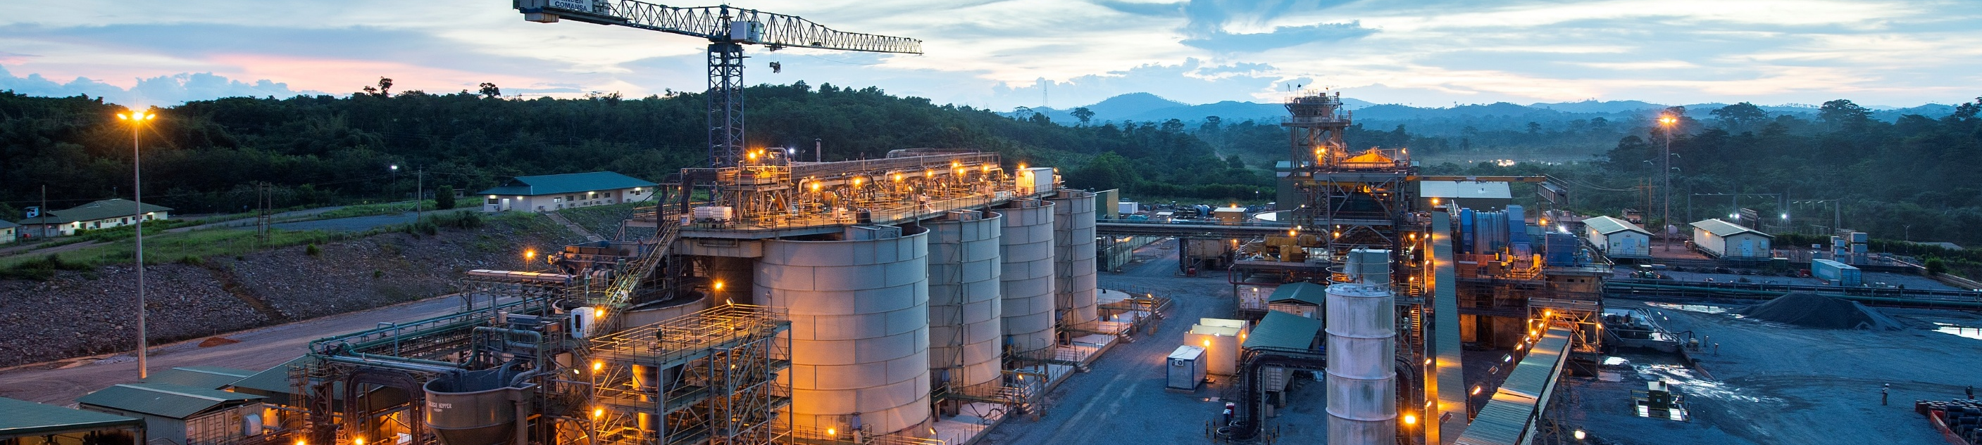
New Management Team, Building on Strong Fundamentals
Outlook
Financial
Exploration
Mining
Processing
Location
Valuation
Near term production increase & reduction in AISC
8 year Mine Life
Strong cash balance of $115M
Debt free
Self-funded mine plan
Underexplored 476 km² land package
Exploration grades proving significantly higher than reserve
Ahead of pre-strip schedule at Nkran
Accessing higher grade Abore ore
Secondary crusher project complete, circuit optimization underway
Ramping up throughput to 5.8 Mtpa
Largest single asset producer in Ghana – premier African mining jurisdiction
Mature and stable mining regulations
Turnaround story with Q2 25 the inflection point
Team in place
Currently trading at <0.45 P/NAV
Unique High-Growth Gold Producer
Largest single asset gold producer in Ghana
⁽¹⁾ As of June 30, 2025 (unaudited).

Slide 15

Contact
N. American Toll-Free: 1-855-246-7341
Email: info@galianogold.com

Slide 16
Updated Mineral Reserve Estimate, as of December 31, 2024
Deposit | Proven |  |  | Probable |  |  | Total Proven and Probable
 | Tonnes (Mt) | Au Grade (g/t) | Au Content (koz) | Tonnes (Mt) | Au Grade (g/t) | Au Content (koz) | Tonnes (Mt) | Au Grade (g/t) | Au Content (koz)
Nkran |  |  |  | 10.6 | 1.67 | 571 | 10.6 | 1.67 | 571
Esaase |  |  |  | 13.6 | 1.22 | 533 | 13.6 | 1.22 | 533
Miradani North |  |  |  | 6.8 | 1.41 | 310 | 6.8 | 1.41 | 310
Abore |  |  |  | 11.2 | 1.27 | 458 | 11.2 | 1.27 | 458
Dynamite Hill |  |  |  | 1.1 | 1.31 | 45 | 1.1 | 1.31 | 45
Adubiaso |  |  |  | 1.5 | 1.39 | 67 | 1.5 | 1.39 | 67
Midras South |  |  |  | 1.4 | 1.12 | 49 | 1.4 | 1.12 | 49
Stockpiles | 0.9 | 0.78 | 22 |  |  |  | 0.9 | 0.78 | 22
Total Reserve | 0.9 | 0.78 | 22 | 46.2 | 1.37 | 2,033 | 47.1 | 1.36 | 2,055
The Nkran, Abore, Adubiaso, Midras South and Stockpiles Mineral Reserves are stated as of December 31, 2024 and the Esaase, Miradani North and Dynamite Hill Mineral Reserves are stated with an effective date of December 31, 2022.
Mineral Reserves are reported assuming a gold price of US$1,700/oz for Nkran, Abore, Adubiaso, Midras South and Stockpiles, and US$1,500/oz for Esaase, Miradani North and Dynamite Hill.
Mineral Reserves are reported at the point of delivery to the process plant or to stockpile. All tonnages are reported as diluted dry metric tonnes. Mineral Reserves are reported using the 2014 CIM Definition Standards.
Mineral Reserves are defined within seven different pit designs guided by pit shells derived from the optimization software, HxGN MinePlan's Minesight Economic Planner, GEOVIA Whittle™ and Datamine Studio NPVS™.
Mining cost inputs are in US$/t mined. All other unit cost inputs are US$/t ore. Mining costs vary based on the pit, the rock type, and the depth of the pit. The base mining costs for Nkran, Esaase, Miradani North, Abore, Dynamite Hill, Adubiaso and Midras South are $2.63/t, $1.98/t, $1.94/t, $2.03/t, $2.29/t, $2.03/t, and $2.03/t respectively. There are additional expenditures for fixed contractor monthly fees, grade control, community fees, Owner's Mining G&A, and other small costs that vary with each deposit and are in addition to the $/t stated.
Processing cost assumptions for Nkran, Abore, Adubiaso, Midras South and Stockpiles is $10.39/t for oxide ore, $11.25/t for transition ore and $11.52/t for fresh ore, and for Esaase, Miradani North and Dynamite Hill processing cost assumptions are $8.81/t for oxide ore, $10.39/t for transition ore and $10.66/t for fresh ore.
General and administration cost assumptions varies by pit and timing with a range in unit costs from $5.17/t to $6.69/t ore.
Ore transportation cost varies for each pit based on the haul distance. It ranges between $0.61/t for Nkran and $6.15/t for Esaase.
Processing recovery is 94.0% for all ore types in all pits except for Abore and Esaase. Processing recovery for Abore is calculated using a fixed tail of 0.10 g/t but capped to a maximum of 94%. Processing recovery varies based on the ore type and head grade in Esaase, where the average recovery for oxide, Upper Sandstone, Cobra and Central Sandstone ore types are 90.1%, 73.8%, 71.3% and 76.4%, respectively. Processing recovery for existing stockpiles ore is calculated using a fixed tail of 0.10 g/t but capped to a maximum of 85%.
Mining dilution varies between pits. The average mining dilution is calculated to be 7.4%, 14.4%, 6.0%, 7.8%, 11.6%, 13.6% and 8.3%, for Nkran, Esaase, Miradani North, Abore, Dynamite Hill, Adubiaso and Midras South, respectively.
Mining ore loss varies between pits. The average mining ore loss is calculated to be 3.7%, 2.0%, 2.0%, 6.2%, 2.0%, 3.7% and 11.7%, for Nkran, Esaase, Miradani North, Abore, Dynamite Hill, Adubiaso and Midras South, respectively.
The overall strip ratio (the amount of waste tonnes mined for each tonne of ore) for AGM is 7.4 : 1. The strip ratio for Nkran, Esaase, Miradani North, Abore, Dynamite Hill, Adubiaso and Midras South is 13.5, 4.5, 5.6, 5.9, 9.8, 9.3, and 6.9, respectively.
Figures are rounded to the appropriate level of precision for the reporting of Mineral Reserves. Due to rounding, some columns or rows may not compute as shown.
Mr. Richard Miller, P.Eng., Vice President Technical Services for Galiano Gold Inc., is the Qualified Person responsible for the Nkran, Abore, Adubiaso, Midras South and Stockpiles Mineral Reserves. Dr. Anoush Ebrahimi, P.Eng., Principal Consultant (Mining) SRK (Canada) Inc., is the Qualified Person responsible for Esaase, Miradani North and Dynamite Hill Mineral Reserves.
The Qualified Persons are not aware of any mining, metallurgical, infrastructure, permitting, or other relevant factors that could materially affect the Mineral Reserve estimates.
Cut-off grades vary based on the deposit and oxidation. All cut-off grades are applied to the fully diluted Au grade. The Mineral Reserves are reported at the following cut-off grades: 0.35 g/t for all Nkran ore; 0.40 g/t for all ore types from Adubiaso and Midras South; 0.50 g/t for all ore types from Abore, Miradani North, and Dynamite Hill; 0.55 g/t for Esaase oxide ore, and 0.70 g/t for the remaining Esaase ore types;

Slide 17
Updated Mineral Resource Estimate, as of December 31, 2024
Deposit | Measured |  |  | Indicated |  |  | Measured + Indicated |  |  | Inferred
 | Tonnes (Mt) | Grade (g/t) | Au Contained (koz) | Tonnes (Mt) | Grade (g/t) | Au Contained (koz) | Tonnes (Mt) | Grade (g/t) | Au Contained (koz) | Tonnes (Mt) | Grade (g/t) | Au Contained (koz)
Nkran |  |  |  | 16.3 | 1.81 | 950 | 16.3 | 1.81 | 950 | 6.4 | 1.31 | 271
Esaase |  |  |  | 30.6 | 1.25 | 1,227 | 30.6 | 1.25 | 1,227 | 8.2 | 1.26 | 334
Abore |  |  |  | 16.0 | 1.24 | 638 | 16.0 | 1.24 | 638 | 2.1 | 1.17 | 78
Adubiaso |  |  |  | 2.0 | 1.46 | 95 | 2.0 | 1.46 | 95 | 0.2 | 0.81 | 5
Akwasiso |  |  |  | 1.4 | 1.16 | 52 | 1.4 | 1.16 | 52 | 0.2 | 1.28 | 9
Asuadai |  |  |  | 1.6 | 1.23 | 64 | 1.6 | 1.23 | 64 | 0.1 | 1.29 | 4
Dynamite |  |  |  | 2.2 | 1.34 | 95 | 2.2 | 1.34 | 95 | 1.0 | 1.24 | 40
Midras South |  |  |  | 4.9 | 1.09 | 173 | 4.9 | 1.09 | 173 | 1.1 | 1.17 | 40
Miradani North |  |  |  | 7.9 | 1.39 | 352 | 7.9 | 1.39 | 352 | 2.9 | 1.30 | 122
Stockpiles | 0.9 | 0.78 | 22 |  |  |  | 0.9 | 0.78 | 22
Total | 0.9 | 0.78 | 22 | 83.0 | 1.37 | 3,646 | 83.9 | 1.36 | 3,668 | 22.2 | 1.26 | 903
Mr. Eric Chen, P.Geo., Vice President Mineral Resources for Galiano Gold Inc., is the Qualified Person responsible for the Mineral Resource statements of Nkran, Abore, and Adubiaso deposits. Resources are reported within an optimized pit shell assuming a price of USD2,000/oz gold and using various cut-off grades: 0.35 g/t gold in Nkran, 0.40 g/t Au for Abore, and Adubiaso. Metallurgical recovery for Abore assumes constant 0.10 g/t Au in tails. Metallurgical recovery of 94% was assumed for Nkran, Adubiaso, and Midras South deposits.
Mr. Ertan Uludag, P.Geo., Director Mineral Resources for Galiano Gold Inc., is the Qualified Person responsible for the Mineral Resource statement of the Midras South deposit. Resources are reported within an optimized pit shell assuming a price of USD2,000/oz gold and using a cut-off grade of 0.40 g/t Au. Metallurgical recovery of 94% was assumed.
Dr. Oy Leuangthong, PEng and Mr. Glen Cole, PGeo of SRK Consulting (Canada) Inc. are Qualified Persons responsible for the Mineral Resource statements of Esaase, Miradani North, Akwasiso, Asuadai and Dynamite Hill. Resources are reported within an optimized pit shell assuming a price of USD1,800/oz gold and using various cut-off grades: 0.50 g/t in Oxides and 0.60 g/t gold in Transition and Fresh for Esaase; and 0.45 g/t gold for all other deposits. Metallurgical recovery of 94% was assumed for Miradani North, Akwasiso, Asuadai and Dynamite Hill. Metallurgical recovery for Esaase vary based on lithology and grade.
Mineral Resources are not Mineral Reserves and have not demonstrated economic viability. All figures have been rounded to reflect the relative accuracy of the estimates. Due to rounding, some columns or rows may not compute exactly as shown.
All tonnages are reported as in situ dry tonnes.
Mineral Resources are inclusive of Mineral Reserves.
All quantities are reported on a 100% basis.
Mineral Resources for Nkran, Abore, Adubiaso Midras South, and Stockpiles are stated with an effective date of December 31, 2024. Mineral Resources for Esaase, Miradani North, Akwasiso, Asuadai, and Dynamite Hill are stated with an effective date of December 31, 2022.

