Slide 1



Strategic Approach to
Investing in
Gold & Silver
PURE GOLD & SILVER INVESTMENT PORTFOLIO
TSXV : EMPR
OTCQX : EMPYF
Corporate Presentation - September 2025

Slide 2
CAUTIONARY NOTE
Forward Looking Statements
This Presentation contains or incorporates by reference "forward-looking statements" or "forward-looking information" within the meaning of applicable Canadian securities legislation. Such statements involve known and unknown risks, uncertainties and other factors which may cause the actual results, performance or achievements of the Company, to be materially different from any future results, expectations, performance or achievements expressed or implied by such forward-looking statements or information. Such statements can be identified by the use of words such as "may", "would", "could", "will", "intend", "expect", "believe", "plan", "anticipate", "estimate", "scheduled", "forecast", "predict" and other similar terminology, or state that certain actions, events or results "may", "could", "would", "might" or "will" be taken, occur or be achieved although not all forward-looking statements contain such identifying words. These statements reflect the Company's current expectations regarding future events, performance and results based on information currently available and speak only as of the date of this presentation. Specific statements contained in or incorporated by reference in this Presentation that constitute forward-looking statements or information include but are not limited to information concerning the Company’s investments, statements or information concerning the Company’s growth strategy and the Company’s future performance and business prospects and opportunities. These statements reflect management’s current assumptions and expectations and by their nature are subject to certain underlying assumptions, known and unknown risks and uncertainties and other factors which may cause actual results, performance or events to be materially different from those expressed or implied by such forward-looking statements. These forward-looking statements are based on the beliefs of Empress' management, as well as on assumptions, which such management believes to be reasonable based on information currently available at the time such statements were made. However, there can be no assurance that the forward-looking statements will prove to be accurate. By their nature, forward-looking statements are based on assumptions and involve known and unknown risks, uncertainties and other factors that may cause the actual results, performance, or achievements of Empress to be materially different from any future results, performance or achievements expressed or implied by the forward-looking statements. Forward-looking statements are subject to a variety of risks, uncertainties and other factors which could cause actual events
or results to differ from those expressed or implied by the forward-looking statements. Forward-looking statements involve significant risks and uncertainties, should not be read as guarantees of future performance or results, and will not necessarily be accurate indicators of whether such results will be achieved. New risks may emerge from time to time and the importance of current factors may change from time to time and it is not possible for the Company to predict all such factors, changes in such factors and to assess in advance the impact of such factor on its business or the extent to which any factor, or combination of factors, may cause actual results to differ materially from those contained in any forward-looking statements. Although the forward-looking statements contained in this presentation are based upon what management of the Company believes are reasonable assumptions, the Company cannot assure readers that actual results will be consistent with these forward-looking statements. The Company's actual results could differ materially from those anticipated in these forward-looking statements and those listed in the heading “Risk Factors” in the Company’s Annual Information Form for the year ended December 31, 2024, which is available under the Company’s SEDAR profile at www.sedarplus.ca. Accordingly, readers should not place undue reliance on forward-looking information. These forward-looking statements are made as of the date of this Presentation and are expressly qualified in their entirety by this cautionary statement. Subject to applicable Canadian securities laws, the Company assumes no obligation to update or revise the forward-looking statements contained herein to reflect events or circumstances occurring after the date of this Presentation. Richard Mazur, P.Geo, a Qualified Person as defined by National Instrument 43-101 Standards of Disclosure for Mineral Projects and consultant to the Company, has read and approved all technical and scientific information contained in this Presentation. Viewers should note that the Company is dependent on the operators of the properties and their qualified persons to provide information to the Company or on publicly available information to prepare disclosure pertaining to properties and operations on the properties on which the Company hold interests and generally will have limited or no ability to independently verify such information. Although the Company does not currently have any knowledge that such information may not be accurate, there can be no assurance that such third-party information is complete and accurate.

Slide 3










Option 6
Body text
100% Gold & Silver
Pure gold & silver revenue from royalties and streaming investments
100% Gold & Silver
Pure gold & silver revenue from royalties and streaming investments
100% Gold & Silver
Pure gold & silver revenue from royalties and streaming investments
Option 2
Body text
EMPRESS SNAPSHOT
High Growth Precious Metals Investment Company
Disciplined Model
Upfront capital for a share in future gold and silver production, generating scalable, steady returns
4 Key Assets
Globally diversified portfolio of revenue generating investments
Record Revenue
Achieved record revenue of US$8M and positive operational cash flow in 2024
Proven Expertise
Management & Board bring over 250 years experience with US$8B completed in mining finance transactions
Growth Plans
Growth strategy driven by expansion of portfolio will bring in additional high-yielding investments
100% Gold & Silver
Pure gold & silver revenue from royalties and streaming investments
Superscript to copy formatting
**

Slide 4




Option 6
Body text
100% Gold & Silver
Pure gold & silver revenue from royalties and streaming investments
100% Gold & Silver
Pure gold & silver revenue from royalties and streaming investments
100% Gold & Silver
Pure gold & silver revenue from royalties and streaming investments
Option 2
Body text
WEALTH PROTECTION STRATEGY
Why Gold & Silver Are Essential
Enduring Safe Haven
in Global Uncertainty
Gold and silver thrive in times of geopolitical and economic stress by offering investors lasting stability and security
Inflation Hedge
and Wealth Preservation
With a long history as inflation hedge, gold and silver help protect purchasing power
as currencies weaken
Portfolio Diversification
and Risk Reduction
Create balanced portfolios by reducing risk and providing downside protection through market cycles

Slide 5
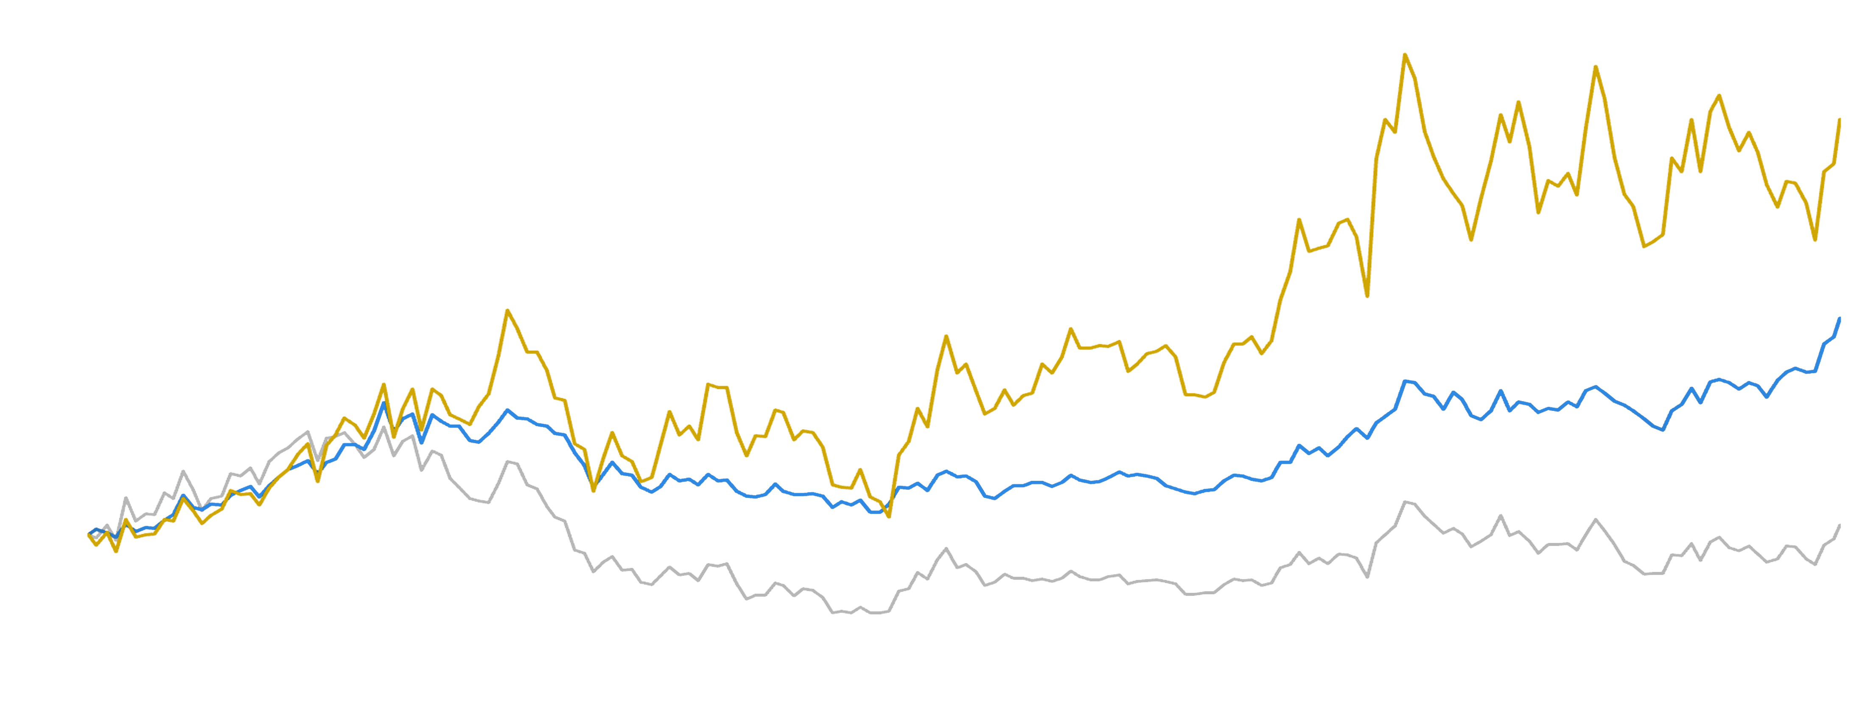
OUTPERFORMING GOLD
Power of Royalty & Stream Investments
VanEck Gold Miners ETC
Gold
Royalty Index*
500
450
400
350
300
250
200
150
100
50
0
+418%
SUPERIOR RETURNS TO BOTH GOLD & MINERS ETF
+266%
+107%
2009 2010 2011 2012 2013 2014 2015 2016 2017 2018 2019 2020 2021 2022 2023 2024
*Royalty Index: average of Wheaton Precious Metals, Royal Gold, Franco Nevada & Sandstorm Gold. Source: S&P Global Capital IQ

Slide 6
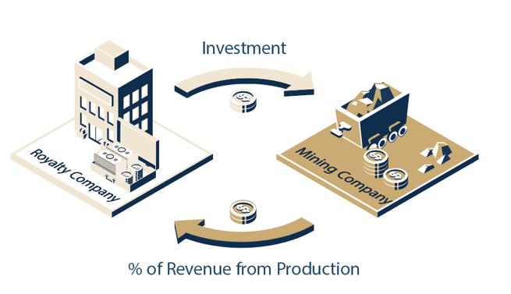
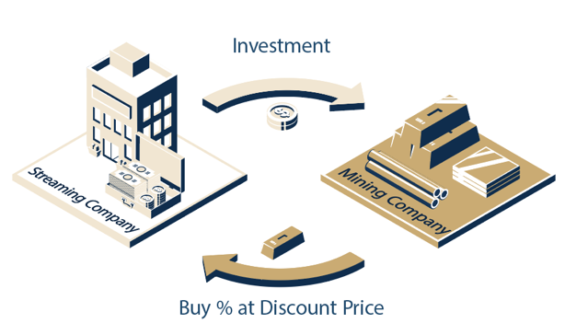

Option 6
Body text
100% Gold & Silver
Pure gold & silver revenue from royalties and streaming investments
100% Gold & Silver
Pure gold & silver revenue from royalties and streaming investments
100% Gold & Silver
Pure gold & silver revenue from royalties and streaming investments
Option 2
Body text
ROYALTIES & STREAMS
How Royalty & Streaming
Investments Deliver Value
Benefits to Shareholders of Empress Royalty
Royalty Agreements
A royalty agreement is where a company provides upfront capital to a mining company in exchange for a percentage of future revenue from the mine
1
Returns without high operational costs of
typical mining companies
2
Hedge against
inflationary costs
and cost of production
Stream Agreements
In a streaming agreement, a company provides upfront capital to a mining company in exchange for the right to purchase a portion of the mine's future metal production at a predetermined, discounted price
3
Globally diversified portfolio
4
Pure gold & silver
exposure

Slide 7

Option 6
Body text
100% Gold & Silver
Pure gold & silver revenue from royalties and streaming investments
100% Gold & Silver
Pure gold & silver revenue from royalties and streaming investments
100% Gold & Silver
Pure gold & silver revenue from royalties and streaming investments
Option 2
Body text
Types of Royalty & Streaming Models
Not All Royalty Models Are Created Equal
Exploration
Generation
Early stage and typically inexpensive to acquire
Exploration risk - no guarantee the project will turn into a mine
If successful, long lead time to revenue generation
Third Party
Acquisition
Royalty already exists which means simple acquisition process but no ability to negotiate /change terms
Crowded market space, paying a premium, and part of a competitive bidding process
Historically, provides low returns
Creation
The Empress Model
Active Investor
Relationship with mining partner to directly invest into the mine and money goes to advancing production
Transparent reporting
Flexible structures to fit
the goals of all parties

Slide 8



Option 6
Body text
100% Gold & Silver
Pure gold & silver revenue from royalties and streaming investments
100% Gold & Silver
Pure gold & silver revenue from royalties and streaming investments
100% Gold & Silver
Pure gold & silver revenue from royalties and streaming investments
Option 2
Body text
WHY EMPRESS ROYLATIES
WHY EMPRESS ROYALTY
Our Investment Thesis
Capitalize on
Market Opportunity
We identified a significant gap in the market with a lack of competitors creating streaming solutions for mining companies needing capital
Financial Expertise
& Network
Driven by a team of mining finance experts, we employ sophisticated financial strategies backed by merchant banking principals to generate substantial returns
Tailored, Asset-Backed Investments
We design highly customized, asset-secured agreements that yield substantial income directly from gold and silver by building strong, direct relationships with mining companies
Long Term Perspective
We employ a disciplined, patient approach to capital allocation, focused on sustainable, long-term value creation

Slide 9

Option 6
Body text
100% Gold & Silver
Pure gold & silver revenue from royalties and streaming investments
100% Gold & Silver
Pure gold & silver revenue from royalties and streaming investments
100% Gold & Silver
Pure gold & silver revenue from royalties and streaming investments
Option 2
Body text
WHY EMPRESS ROYLATIES
INVESTMENT MANAGER
Harnessing Top-tier Resources & Expertise
Endeavour Financial Corporation
30+ Years
Established in 1988
US$900M
Royalty & Stream Finance
US$1.3B
JV & Strategic Investments
20+
International Awards
US$28B
Mergers & Acquisitions
US$8B
Debt Finance
Empress has formed a strategic partnership with Endeavour Financial, both as its Investment Manager and a significant shareholder. Leveraging Endeavour Financial’s global team of seasoned professionals—including investment bankers, geologists, mining engineers, cash flow analysts, and financial experts – Empress is equipped to effectively source, assess, and execute high-value investment opportunities in the precious metals sector.

Slide 10
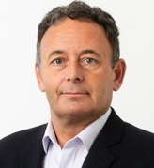


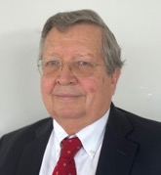


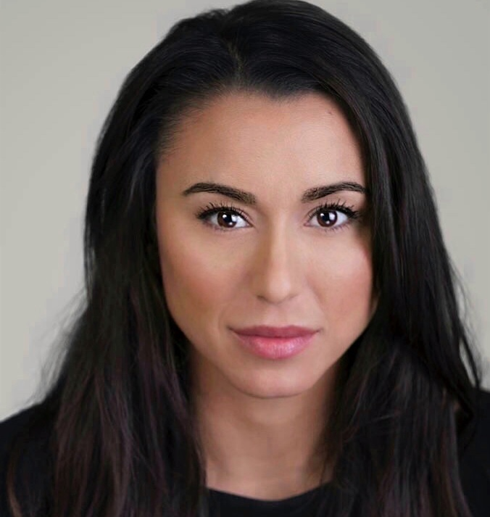

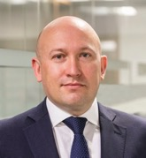

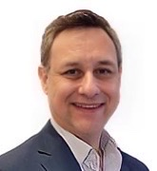


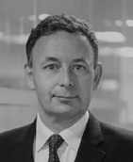


Option 6
Body text
100% Gold & Silver
Pure gold & silver revenue from royalties and streaming investments
100% Gold & Silver
Pure gold & silver revenue from royalties and streaming investments
100% Gold & Silver
Pure gold & silver revenue from royalties and streaming investments
Option 2
Body text
PROVEN EXPERTISE
Structured Mining Finance Experience
Board of Directors & Advisors
Management
David Rhodes
Executive Chair
Alexandra Woodyer Sherron
CEO & President
Jeremy Bond
Director
David Laing
Technical Advisor
Alexandra Woodyer Sherron
CEO & President
Michelle Borthwick
Vice President
Corporate Affairs
Michelle Borromeo
Strategic Communications Advisor
Natascha Kiernan
Lead Director
Paul Mainwaring
Director
Mark Ashcroft
Business Development Advisor, North America
Xavier Wenzel
CFO
Kris Gruber
Vice President
Corporate Operations

Slide 11




Option 6
Body text
100% Gold & Silver
Pure gold & silver revenue from royalties and streaming investments
100% Gold & Silver
Pure gold & silver revenue from royalties and streaming investments
100% Gold & Silver
Pure gold & silver revenue from royalties and streaming investments
Option 2
Body text
PORTFOLIO FOCUS
Investment Criteria
1
LOCATION
Global Focus
2
COMMODITIES
Gold & Silver Only
3
INVESTMENT SIZE
Up to US$25M
=
ASSET STAGE
Production or Near-Term Producing Mine
PEOPLE
Strong Management
& Operational Teams
ESG
Focus on Strong Community Programs
4
5
6

Slide 12


Option 6
Body text
100% Gold & Silver
Pure gold & silver revenue from royalties and streaming investments
100% Gold & Silver
Pure gold & silver revenue from royalties and streaming investments
100% Gold & Silver
Pure gold & silver revenue from royalties and streaming investments
Option 2
Body text
Cornerstone Investments
Global Portfolio
of Producing Mines
Tahuehueto
MEXICO
Sierra Antapite
Peru
Manica
MOZAMBIQUE
Galaxy
SOUTH AFRICA

Slide 13
Option 6
Body text
100% Gold & Silver
Pure gold & silver revenue from royalties and streaming investments
100% Gold & Silver
Pure gold & silver revenue from royalties and streaming investments
100% Gold & Silver
Pure gold & silver revenue from royalties and streaming investments
Option 2
Body text
Silver Stream
Tahuehueto Mine
Underground Gold & Silver Mine in Mexico
Owned by Luca Mining (TSXV: LUCA)
Investment Overview
Investment Size | US$5M
Type | 100% silver stream
Terms | 1.25M oz. then 20% for 10 years
Annual Cash Flow | US$6.9M
Annual GEOs | 2,289
NAV | US$23.9M
Highlights
Empress' investment was instrumental in completing
the construction of the mine, now fully operational.
On March 31, 2025, Luca announced commercial production at Tahuehueto mine. Luca launched
an exploration program earlier this year, aimed
at expanding the underground deposit, further
enhancing the value of Empress’ investment.
Note: Management case assumption of US$30/oz silver. *The above forecasts are based upon information provided by the Operator projected at full production capacity, using a 5-year average. **NAV calculated with a 5% discount rate.

Slide 14
Gold Stream
Antapite Mine
Underground Gold Mine in Peru
Owned By Sierra Sun Group (Private)
Investment Overview
Investment Size | US$10M
Type | 4.5% gold stream
Terms | 11k oz. then 1% LOM
Annual Cash Flow | US$5.6M
Annual GEOs | 1,853
NAV | US$23.7M
Highlights
Empress's investment has enabled Sierra Antapite
to expand its production capacity at this high-grade underground mine, with ongoing development aimed
at boosting near-term output. Sustainability initiatives at the site are backed by the Swiss Better Gold Initiative, enhancing responsible mining practices.
Note: Management case assumption of US$3,000/oz gold. *The above forecasts are based upon information provided by the Operator projected at full production capacity. Annual Cashflow & GEO 5-year average. **NAV calculated with a 5% discount rate.

Slide 15
Gold Stream
Galaxy Mine
Underground Gold Mine in South Africa
Owned by Golconda Gold (TSXV: GG)
Investment Overview
Investment Size | US$5M
Type | 3.5% gold stream
Terms | 8k oz. with stepdown
Annual Cash Flow | US$2.9M
Annual GEOs | 999
NAV | US$17.1M
Highlights
Empress's investment provided Galaxy with the capital
to acquire underground mining equipment, accelerating mine development which enables Galaxy to maximize mill throughput, increase production volumes, and reduce the AISC. The development plan focuses on scaling mining operations by leveraging available capacity in an expanded milling circuit. This approach boosts production volumes and optimizes efficiency.
As a result, Galaxy expects to increase its gold production and thereby increasing the value of Empress’ investment.
Note: Management case assumption of US$3,000/oz gold. *The above forecasts are based upon information provided by the Operator projected at full production capacity, using a 5-year average. **NAV calculated with a 5% discount rate.

Slide 16
Gold Royalty
Manica Mine
Open Pit Gold Mine in Mozambique
Owned by MMP (Private)
Investment Overview
Investment Size | US$3M
Type | 3.375% gold stream
Terms | 95k oz. then 1.125% LOM
Annual Cash Flow | US$1.7M
Annual GEOs | 581
NAV | US$4.3M
Highlights
Empress' investment was instrumental in completing the construction of the oxide plant, enabling the commencement of gold production. The plant is now actively processing oxide gold from multiple open-pit sources, generating consistent output and revenue. In parallel, exploration activities are underway to identify additional resources, enhancing the long-term growth potential and value of the investment to Empress.
Note: Management case assumption of US$3,000/oz gold. *The above forecasts are based upon information provided by the Operator projected at full production capacity, using a 5-year average. **NAV calculated with a 5% discount rate.

Slide 17


THE pipeline
Fueling Growth &
Increasing Diversification
Strategic Deal Flow
Advancing a strong pipeline of near-term opportunities sourced through our global network and Endeavour partnership – focused on cash-generating assets
with high return potential
Disciplined Evaluation
With over US$50M in deals
under review, we apply rigorous due diligence to ensure alignment with our return thresholds, counterparties, and portfolio strategy
Growth with Control
Each transaction must
strengthen our portfolio through cash flow, diversification, and strategic exposure – supporting
long-term value while
minimizing dilution

Slide 18
Enduring Safe Haven
in Global Uncertainty
Gold and silver thrive in times of geopolitical and economic stress – offering investors lasting stability
and security
+418%
Boosted By Surging Gold & Silver Prices
Revenue on the Rise
POTENTIAL REVENUE INCREASE
WITH HIGHER COMMODITY PRICES
US$ Millions
US $8M
US $3.5M
US $6.6M
AT JUNE 30, 2025
US $1.8M
Reported Revenue
COMMODITY PRICE
$2,500/oz Gold
$25/oz Silver
$3,000/oz Gold
$30/oz Silver
$3,500/oz Gold
$40/oz Silver
Projected revenue calculated using management estimates on the five key assets; Manica, Tahuehueto, Sierra Antapite, Galaxy and Pinos
US$8M
Reported Revenue
GOLD PRICE
$2,500/oz
$3,000/oz
$3,500/oz
SILVER PRICE
$25/oz
$30/oz
$40/oz
Projected revenue calculated using management estimates on the five key assets; Manica, Tahuehueto, Sierra Antapite, Galaxy and Pinos

Slide 19

CAPITAL STRUCTURE
Strong Shareholder Base
TICKER
TSXV:EMPR | OTCQX:EMPYF
25%
35%
Share Price* | CAD$0.81
52 Week Low / High* | CAD$0.32 - $1.01
Market Cap* | CAD$98M | US$69M
Shares O/S ¹ | 121M
Warrants & Options ¹ | 29M
Fully Diluted ¹ | 150M
Cash ² | US$4.2M
Debt ³ | US$4M US$20M Debt Facility Available
BOARD
& MANAGEMENT
Endeavour
Financial
Terra Capital
INSTITUTIONAL / STRATEGIC INVESTORS
Rick Rule
Stefan Gleason, Money Metals Exchange
Sprott Asset Management
US Global
40%
* As of September 12, 2025. Note 1: Effective June 30, 2025. Note 2: As per financial statements as at June 30, 2025. Note 3: Executed Nebari Accordion Credit Facility on December 11, 2023, for US$28.5M, with one drawdown of US$3.5M in December 2023, and a second drawdown of US$5M in March 2024. Balance as per June 30, 2025 financial statements reflects outstanding amount less unamortized financing costs.
PUBLIC FLOAT

Slide 20





Enduring Safe Haven
in Global Uncertainty
Gold and silver thrive in times of geopolitical and economic stress – offering investors lasting stability
and security
+418%
Poised to Accelerate Gold & Silver Revenue Growth
Near-Term Catalysts
1
2
3
Growing Cash Flow
from Core Assets
Producing assets are delivering rising cash flow as portfolio yield scales
Operational leverage supports stable, recurring revenue and long-term value
Strategic Deployment into New Transactions
Actively advancing a pipeline of advanced-stage, cash-generating deals
Capital allocation remains disciplined – focused on returns, and efficiency
Cashflow Optimization for Strategic Allocation
As recurring revenue grows, anticipate market recognition
and valuation uplift
Rising gold and silver prices
further enhance upside across
the portfolio

Slide 21











EMPRESS ROYALTY
Trading at a
44% Discount
Why Invest Now?
Growing Revenue & Expanding Portfolio
Substantially Undervalued
Track Record of Doubling Revenue
Pure Precious Metals Royalty Company
Expertise in Mining Finance

Slide 22








CONTACT US
Vancouver, Canada
+1-604-331-2080
TSXV : EMPR
OTCQX : EMPYF
info@EmpressRoyalty.com
EmpressRoyalty.com

Slide 23
Notes

