Slide 1
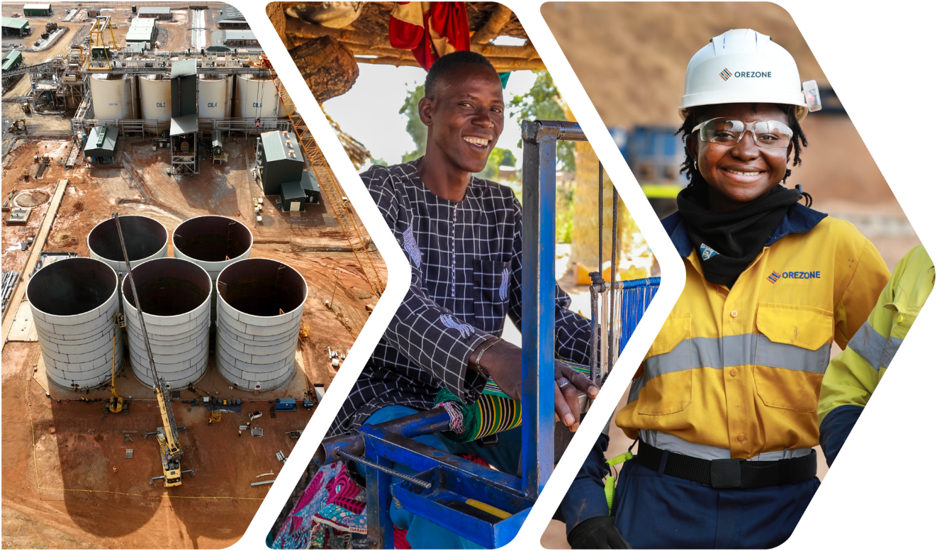

TSX ORE I ASX ORE I OTCQX ORZCF
BUILD.
OPERATE. EXPAND.
Corporate Presentation | September 2025
BOMBORÉ GOLD MINE BURKINA FASO

Slide 2
DISCLAIMER
This presentation contains certain “forward-looking information” within the meaning of applicable Canadian securities laws. Forward-looking information and forward-looking statements (together, “forward-looking statements”) are frequently characterized by words such as “plan”, “expect”, “project”, “intend”, “believe”, “anticipate”, “estimate”, “potential”, “possible” and other similar words, or statements that certain events or conditions “may”, “will”, “could”, or “should” occur.
Certain statements in this presentation with respect to Orezone and the Bomboré Mine are forward-looking statements. These include statements regarding, among others, target 7-10Moz, 3-year production forecast, 2025 being a significant transition year (including statements with respect to stage 1 construction (including the estimated CAPEX, the expansion being fully financed and on schedule and budget, estimated first gold and increased production of 50%) and the accelerate stage 2 hard rock), exploration upside and tier 1 potential (including Burkina Faso being a supportive mining jurisdiction), Orezone being significantly undervalued (including supporting a re-rate and the value gap between Orezone and the ASX), financial position outlook (including statements with respect to the future amount of debt outstanding), and Analyst Target Price and Recommendations. Furthermore, statements regarding mine plan and production; mineral processing; project infrastructure; project economics; initial project capital costs; development and timeline timetables; and enhancement opportunities are forward-looking statements.
All such forward-looking statements are based on certain assumptions and analysis made by management and qualified persons considering their experience and perception of historical trends, current conditions and expected future developments, as well as other factors management and the qualified persons believe are appropriate in the circumstances. The forward- looking statements are also based on metal price assumptions, exchange rate assumptions, cash flow forecasts, and other assumptions used in the NI 43-101 technical report entitled “Bomboré Phase II Expansion, Definitive Feasibility Study” (the “2023 FS”). Readers are cautioned that actual results may vary from those presented.
In addition, all forward-looking information and statements are subject to a variety of risks and uncertainties and other factors that could cause actual events or results to differ materially from those projected in the forward-looking statements including, but not limited to, use of assumptions that may not prove to be correct, unexpected changes in laws, rules or regulations, or their enforcement by applicable authorities; the failure of parties to contracts to perform as agreed; social or labour unrest; changes in commodity prices; unexpected failure or inadequacy of infrastructure, the possibility of project cost overruns or unanticipated costs and expenses, accidents and equipment breakdowns, political risk (including but not limited the possibility of one or more coup d’état), unanticipated changes in key management personnel and general economic, market or business conditions, the failure of exploration programs, including drilling programs, to deliver anticipated results and the failure of ongoing and uncertainties relating to the availability and costs of financing needed in the future, and other factors described in the Company’s most recent annual information form and management discussion and analysis filed on SEDAR+. Readers are cautioned not to place undue reliance on forward-looking information or statements.
The Company provides analyst target price and recommendations for informational purposes only. These recommendations are not intended as investment advice and should not be relied upon by investors to make financial decisions. Investors are encouraged to conduct their own research and consult with a qualified financial advisor before making any investment choices. The Company disclaims any responsibility for decisions made based on this information.
This presentation also contains references to estimates of mineral resources and mineral reserves. The estimation of mineral resources is inherently uncertain and involves subjective judgments about many relevant factors. Mineral resources that are not mineral reserves do not have demonstrated economic viability. The accuracy of any such estimates is a function of the quantity and quality of available data, and of the assumptions made and judgments used in engineering and geological interpretation, which may prove to be unreliable and depend, to a certain extent, upon the analysis of drilling results and statistical inferences that may ultimately prove to be inaccurate. Mineral resource estimates may require re-estimation based on, among other things: fluctuations in the price of gold; results of drilling; results of metallurgical testing, process and other studies; changes to proposed mine plans; the evaluation of mine plans subsequent to the date of any estimates; and the possible failure to receive required permits, approvals and licenses.
Although the forward-looking statements contained in this presentation are based upon what management of the Company believes are reasonable assumptions, the Company cannot assure investors that actual results will be consistent with these forward-looking statements. These forward-looking statements are made as of the date of this presentation and are expressly qualified in their entirety by this cautionary statement. Subject to applicable securities laws, the Company does not assume any obligation to update or revise the forward-looking statements contained herein to reflect events or circumstances occurring after the date of this news release.
Independent reference should be made to the full text of the 2023 FS and the news release dated October 11, 2023 for the assumptions, qualifications and limitations relating thereto. The 2023 FS is available on the Company’s website and SEDAR+.
AISC includes cash costs (mine-level operating costs covering mining, processing, administration, royalties, and selling charges) and adds sustaining capital, sustaining exploration, sustaining lease payments, and corporate general and administration costs. Excluded from the Company’s AISC definition are depreciation and depletion, accretion and amortization of reclamation costs, growth capital, growth exploration, financing costs, and share-based compensation.
Qualified Persons
Dale Tweed, P. Eng., VP Engineering; and Rob Henderson, P. Eng., VP Technical Services of Orezone, are Qualified Persons under NI 43-101 and have reviewed and approved the scientific and technical information contained in this presentation. Messrs. Tweed, and Henderson are not independent within the meaning of NI 43-101.

Slide 3

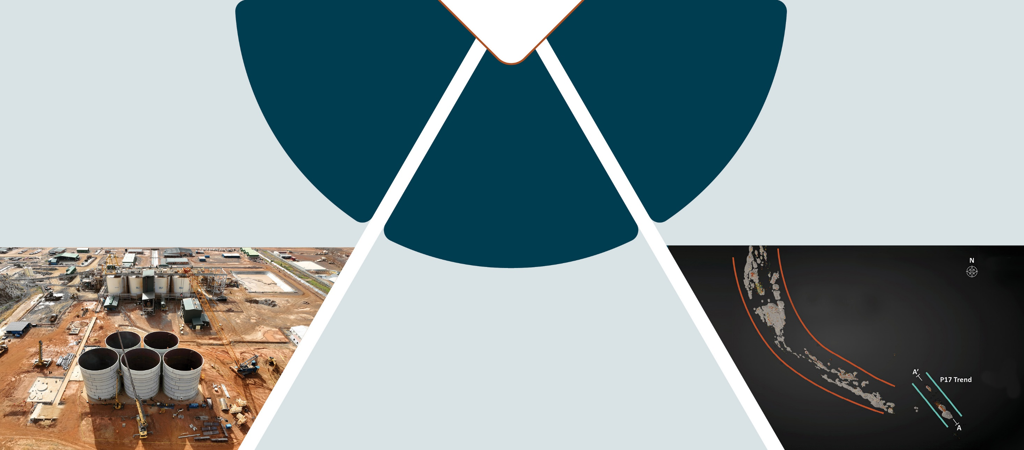







BUILD | OPERATE | EXPAND
Oxide plant built
on-time and under-budget
>100,000 oz/yr
Tier 1 potential
Exploration
14km reserve defined
system, average
reserve depth of <40m
Operations
Stage 1
>170,000 oz/yr
Expansion
Commercial Production
Dec 2022
Production Guidance Achieved 2023 & 2024
Drilling Underway
Multi-year Drill Program
Throughput optimized to 6.0Mtpa
5.0Moz global resource, targeting 7-10Moz
Construction of an independent parallel 2.5Mtpa hard rock plant
On Budget
Nearing Completion
First Gold Q4-2025
Targeted Stage 2 completion Q4-2026: 220,000-250,000oz/yr

Slide 4

2025 A Significant Transition Year
BUILD | OPERATE | EXPAND
Stage 1 Hard Rock – 2.5Mtpa
  Construction nearing completion
  Commissioning Q4-2025
  Production: >170,000oz/yr
Stage 2 Hard Rock – 5.5Mtpa
  Detailed engineering commenced
  Long-lead items ordered
  Targeted completion Q4-2026
  Production: 220,000 - 250,000oz/yr
Bomboré will be one of the largest mines in
West Africa following Stage 2 completion
Bomboré Three-Year Production
(100% Basis)
220-250koz
170-185koz
 | Oxide |  | Oxide & Hard Rock

Slide 5
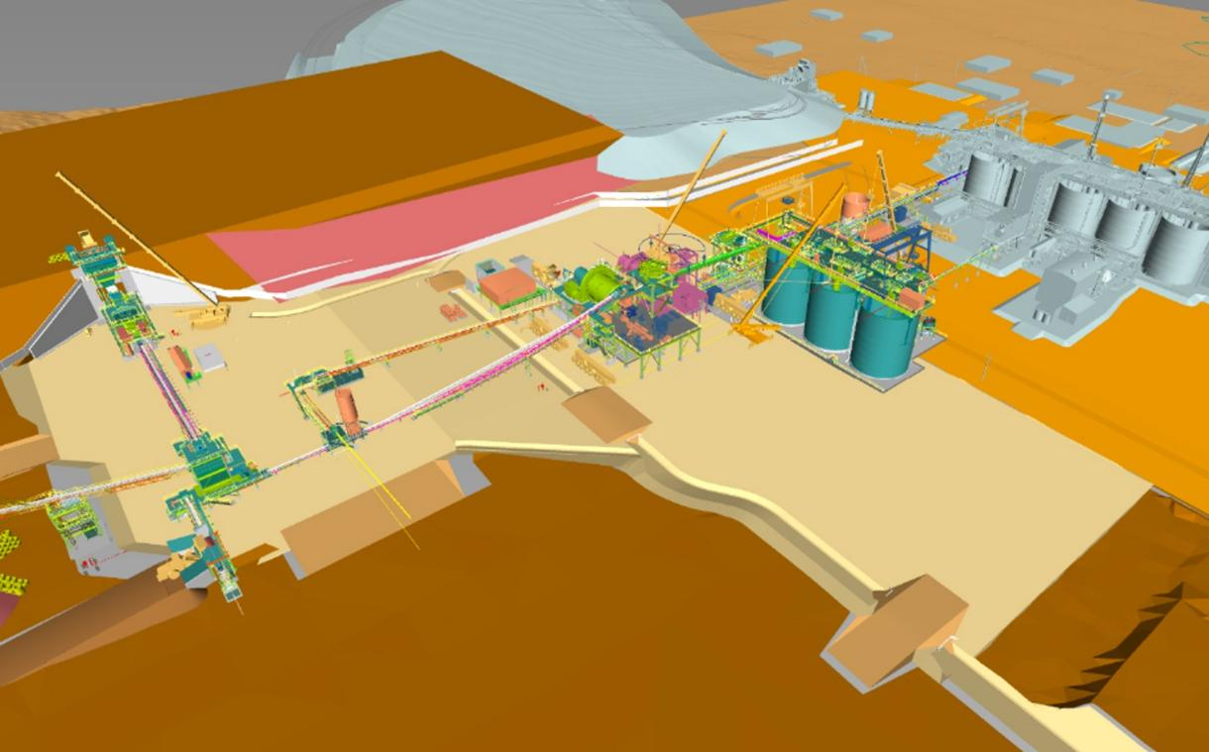

STAGE 1 Hard Rock Expansion – 2.5Mtpa
BUILD | OPERATE | EXPAND
Budgeted CAPEX of $90-95M
  On Schedule and Budget
Current Progress
  Engineering and procurement complete
  Jaw crusher installation advanced
  Ore bin structural steel advanced
  SAG mill installation nearing completion
  CIL tank & structural steel installation complete.
  E&I well advanced
  TSF expansion in progress
  Commissioning: Q4-2025
Existing Oxide Plant
5.5Mtpa Jaw Crusher
SAG Mill
CIL Tanks
Ore Bin
Notes:
Commenced?

Slide 6
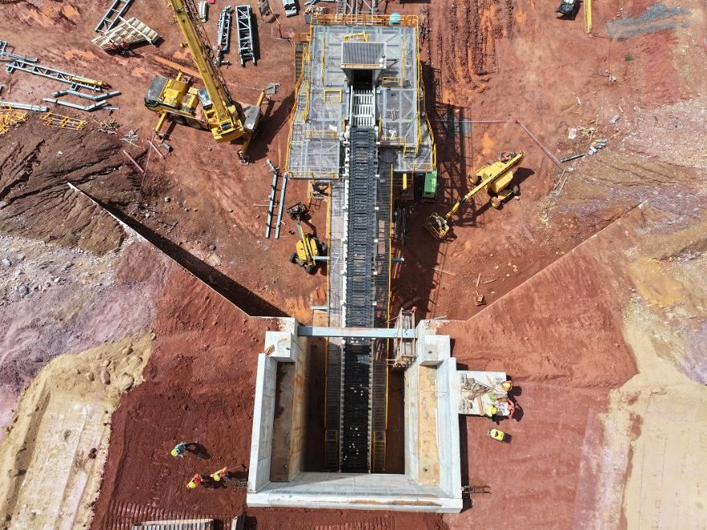
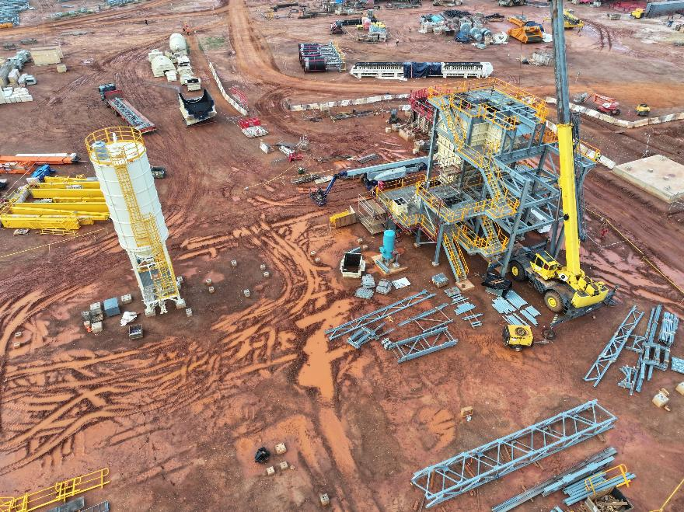
STAGE 1 Hard Rock Major Mill Components
BUILD | OPERATE | EXPAND
Jaw Crusher & Dump Pocket
Lime Silo & Ore Bin

Slide 7
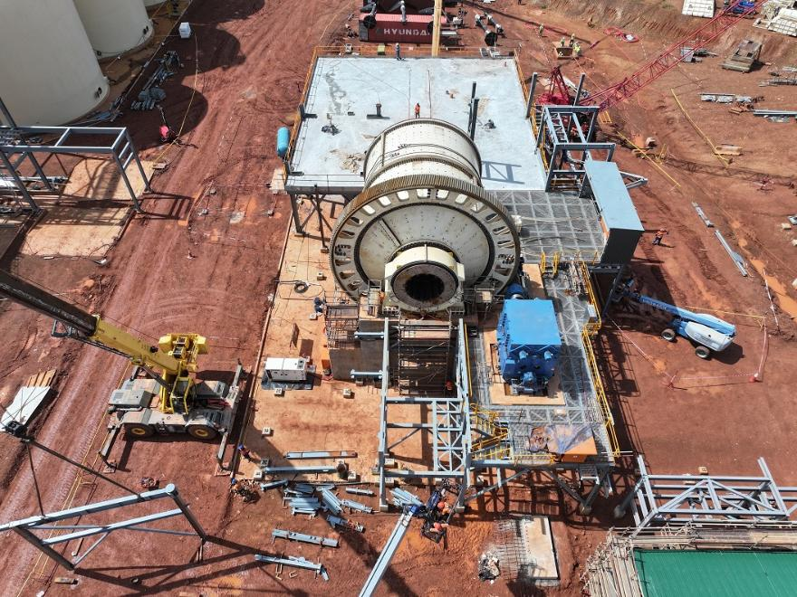
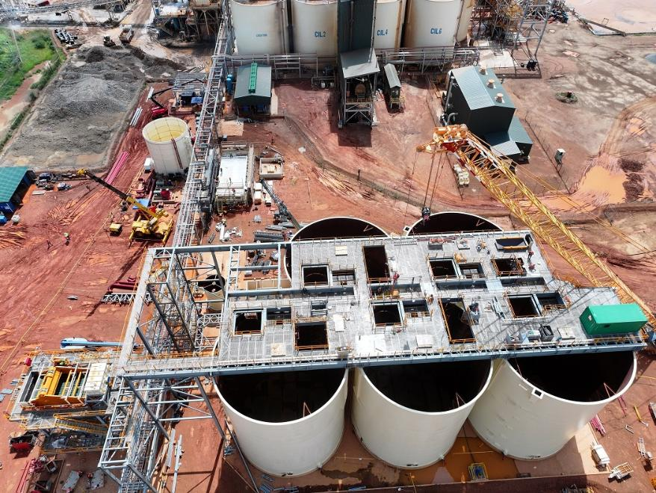
STAGE 1 Hard Rock Major Mill Components
BUILD | OPERATE | EXPAND
9.0MW SAG Mill
Trash Screen & CIL Tanks

Slide 8
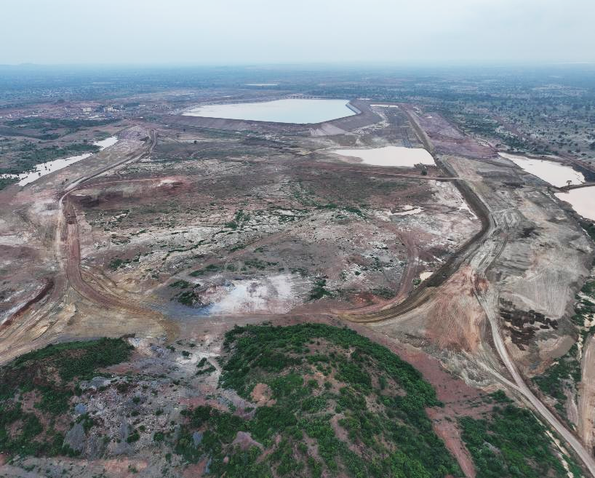
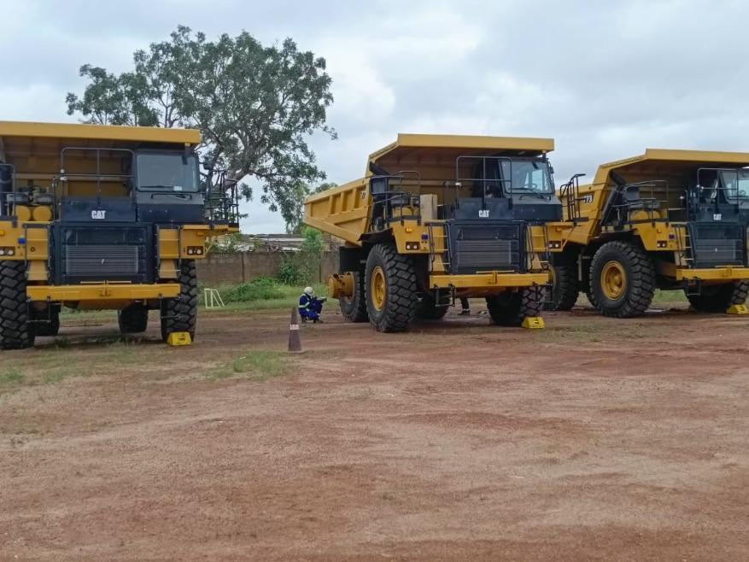
STAGE 1 Hard Rock Expansion
BUILD | OPERATE | EXPAND
TSF Cell 1
TSF Cell 2
TSF Expansion
Hard Rock Mining Fleet

Slide 9
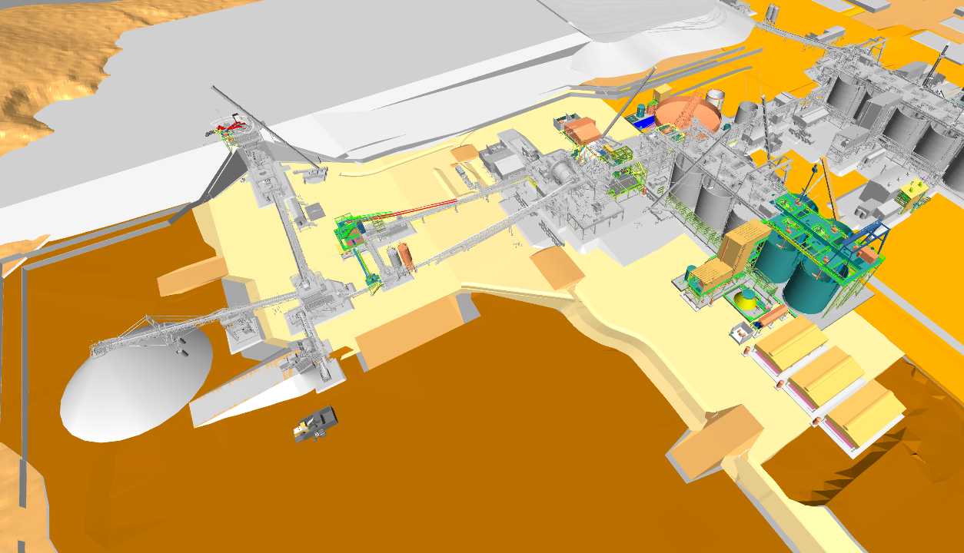
STAGE 2 Hard Rock Expansion – 5.5Mtpa
BUILD | OPERATE | EXPAND
Mill throughput to increase
from 2.5Mtpa to 5.5Mtpa
Overall Production
220,000 – 250,000oz/yr
Additions to hard rock plant
4 additional CIL tanks
Ball mill & pebble crusher
Thickener & water tank
Oxygen plant
Gold room expansion
Engineering well advanced with procurement underway
  Commissioning: Q4-2026
Thickener
Existing Oxide Plant
Rock Breaker
Ball Mill
Pebble Crusher
Elution Circuit
4 CIL Tanks
Oxygen Plant

Slide 10
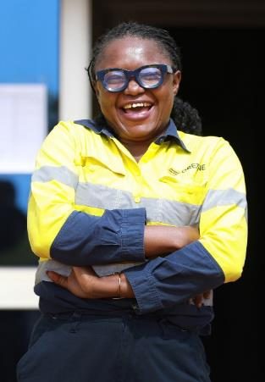
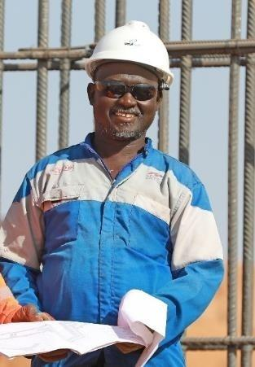
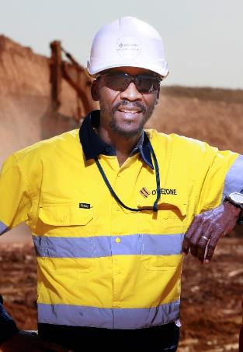
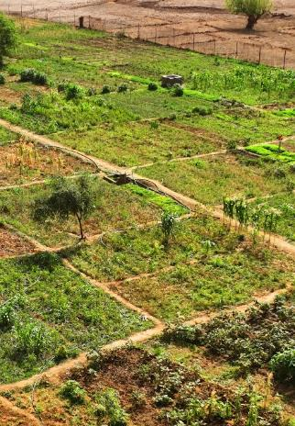
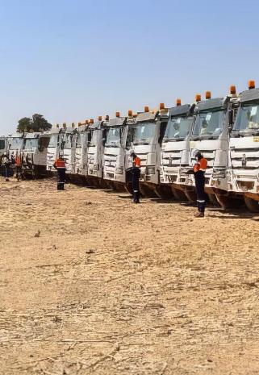
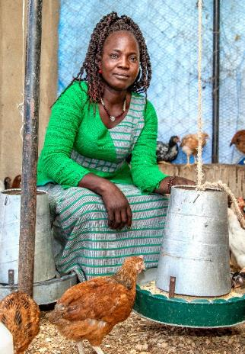
KEY TO OUR SUCCESS Commitment to Local Content
Local Workforce
97% Burkinabe workforce
Well established workforce in country with 16 mines developed
Only four expats
First to use an in-country mining contractor
Very successful ramp-up and performance since commissioning
Now performing similar services for two major mining companies in country
Local Financial Partners
Nioko Resources
West African based investment group, currently holds 17.3% ownership in Orezone
Coris Bank – senior lender Based out of Burkina Faso, one of the largest banks in West Africa

Slide 11
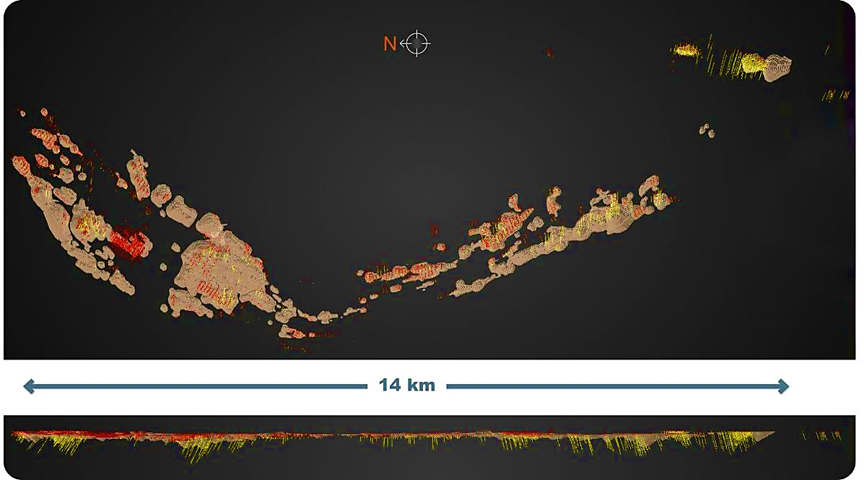
EVOLVING EXPLORATION OUTLOOK
BUILD | OPERATE | EXPAND
Prior to 2017: heap leach focus
2017 to 2022: hard rock integration
  New management team
  2.4Moz Mineral Reserve¹
  Average reserve pit depth <40m
  Full ramp-up: 220,000-250,000oz/yr
  Only 38 holes deeper than 250m
2024 onward: expanding scope
  Strike extensions and new discoveries at surface
  Extending pits to depth
  Underground potential of
  higher-grade sub-zones
P17
P17
North
Zone
P16
P16
Siga
Siga
P11
P8P9
P11
P8P9
See the NI 43-101 technical report entitled “Bomboré Phase II Expansion, Definitive Feasibility Study” which is available on SEDAR+ for full resource and reserve disclosure.

Slide 12
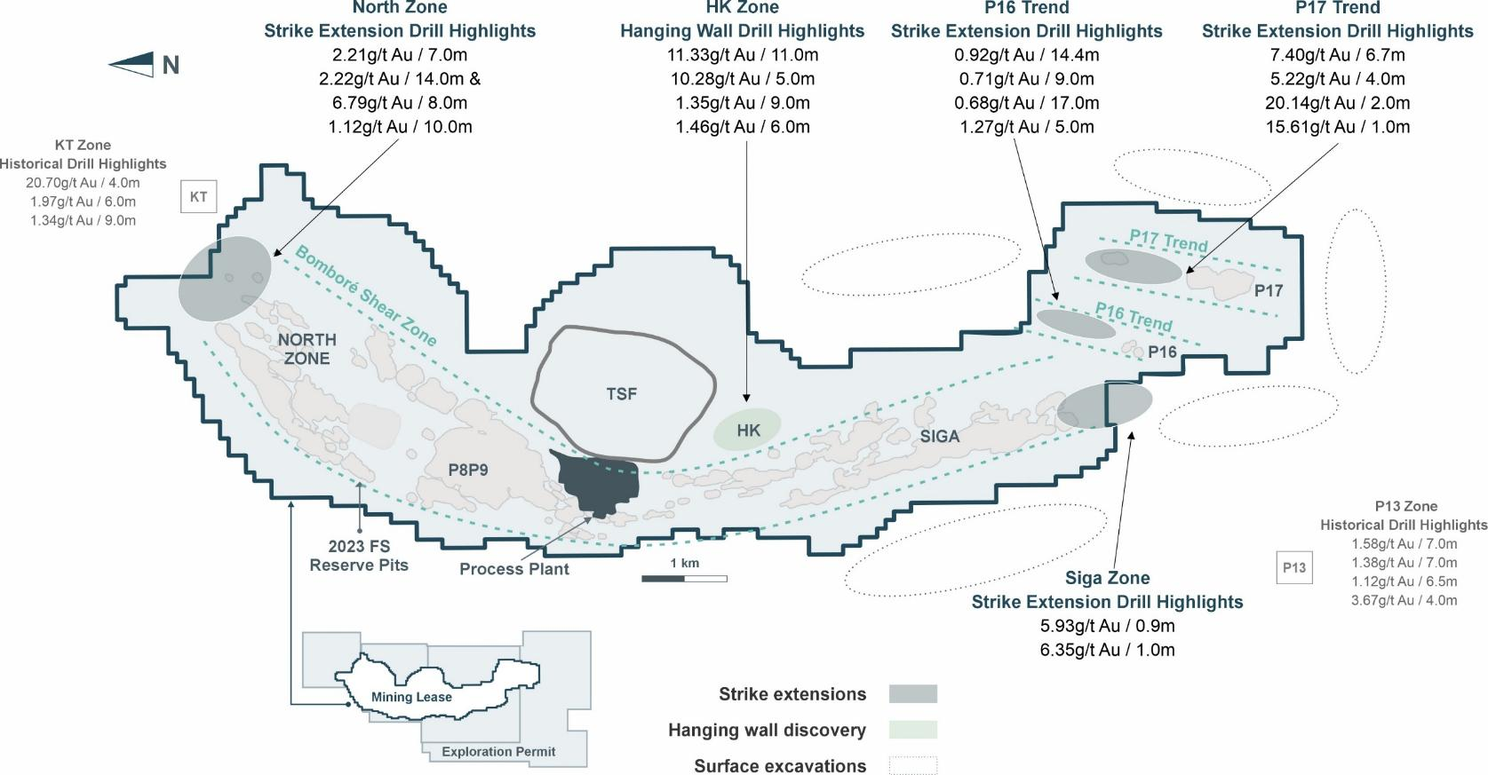
BOMBORÉ Recent Drilling & Discoveries

Slide 13
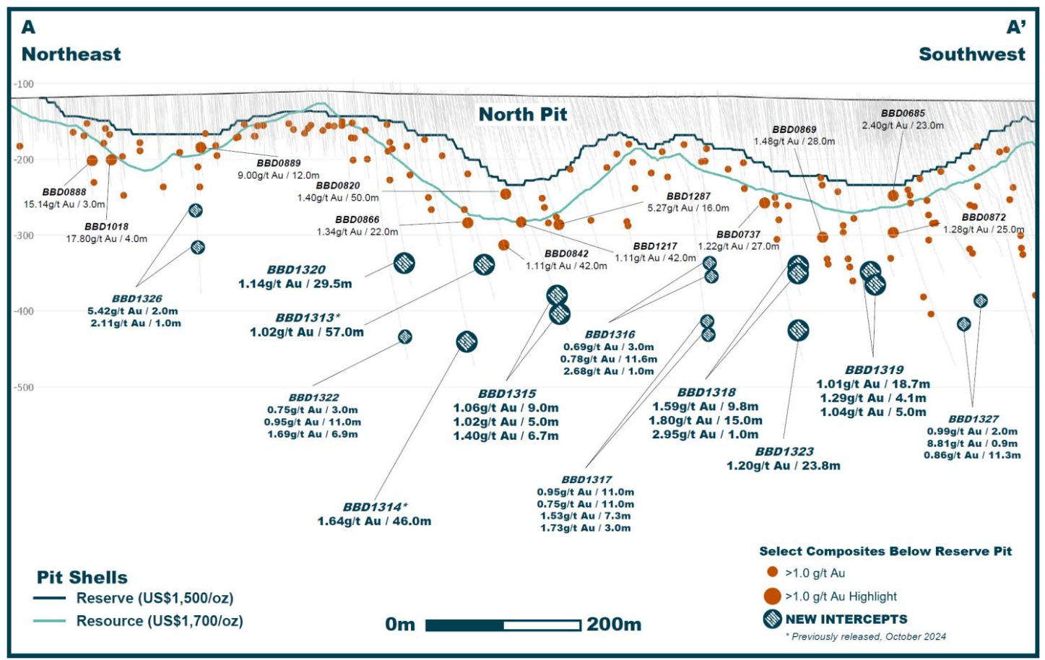
NORTH ZONE FW LONG SECTION Looking Northeast

Slide 14
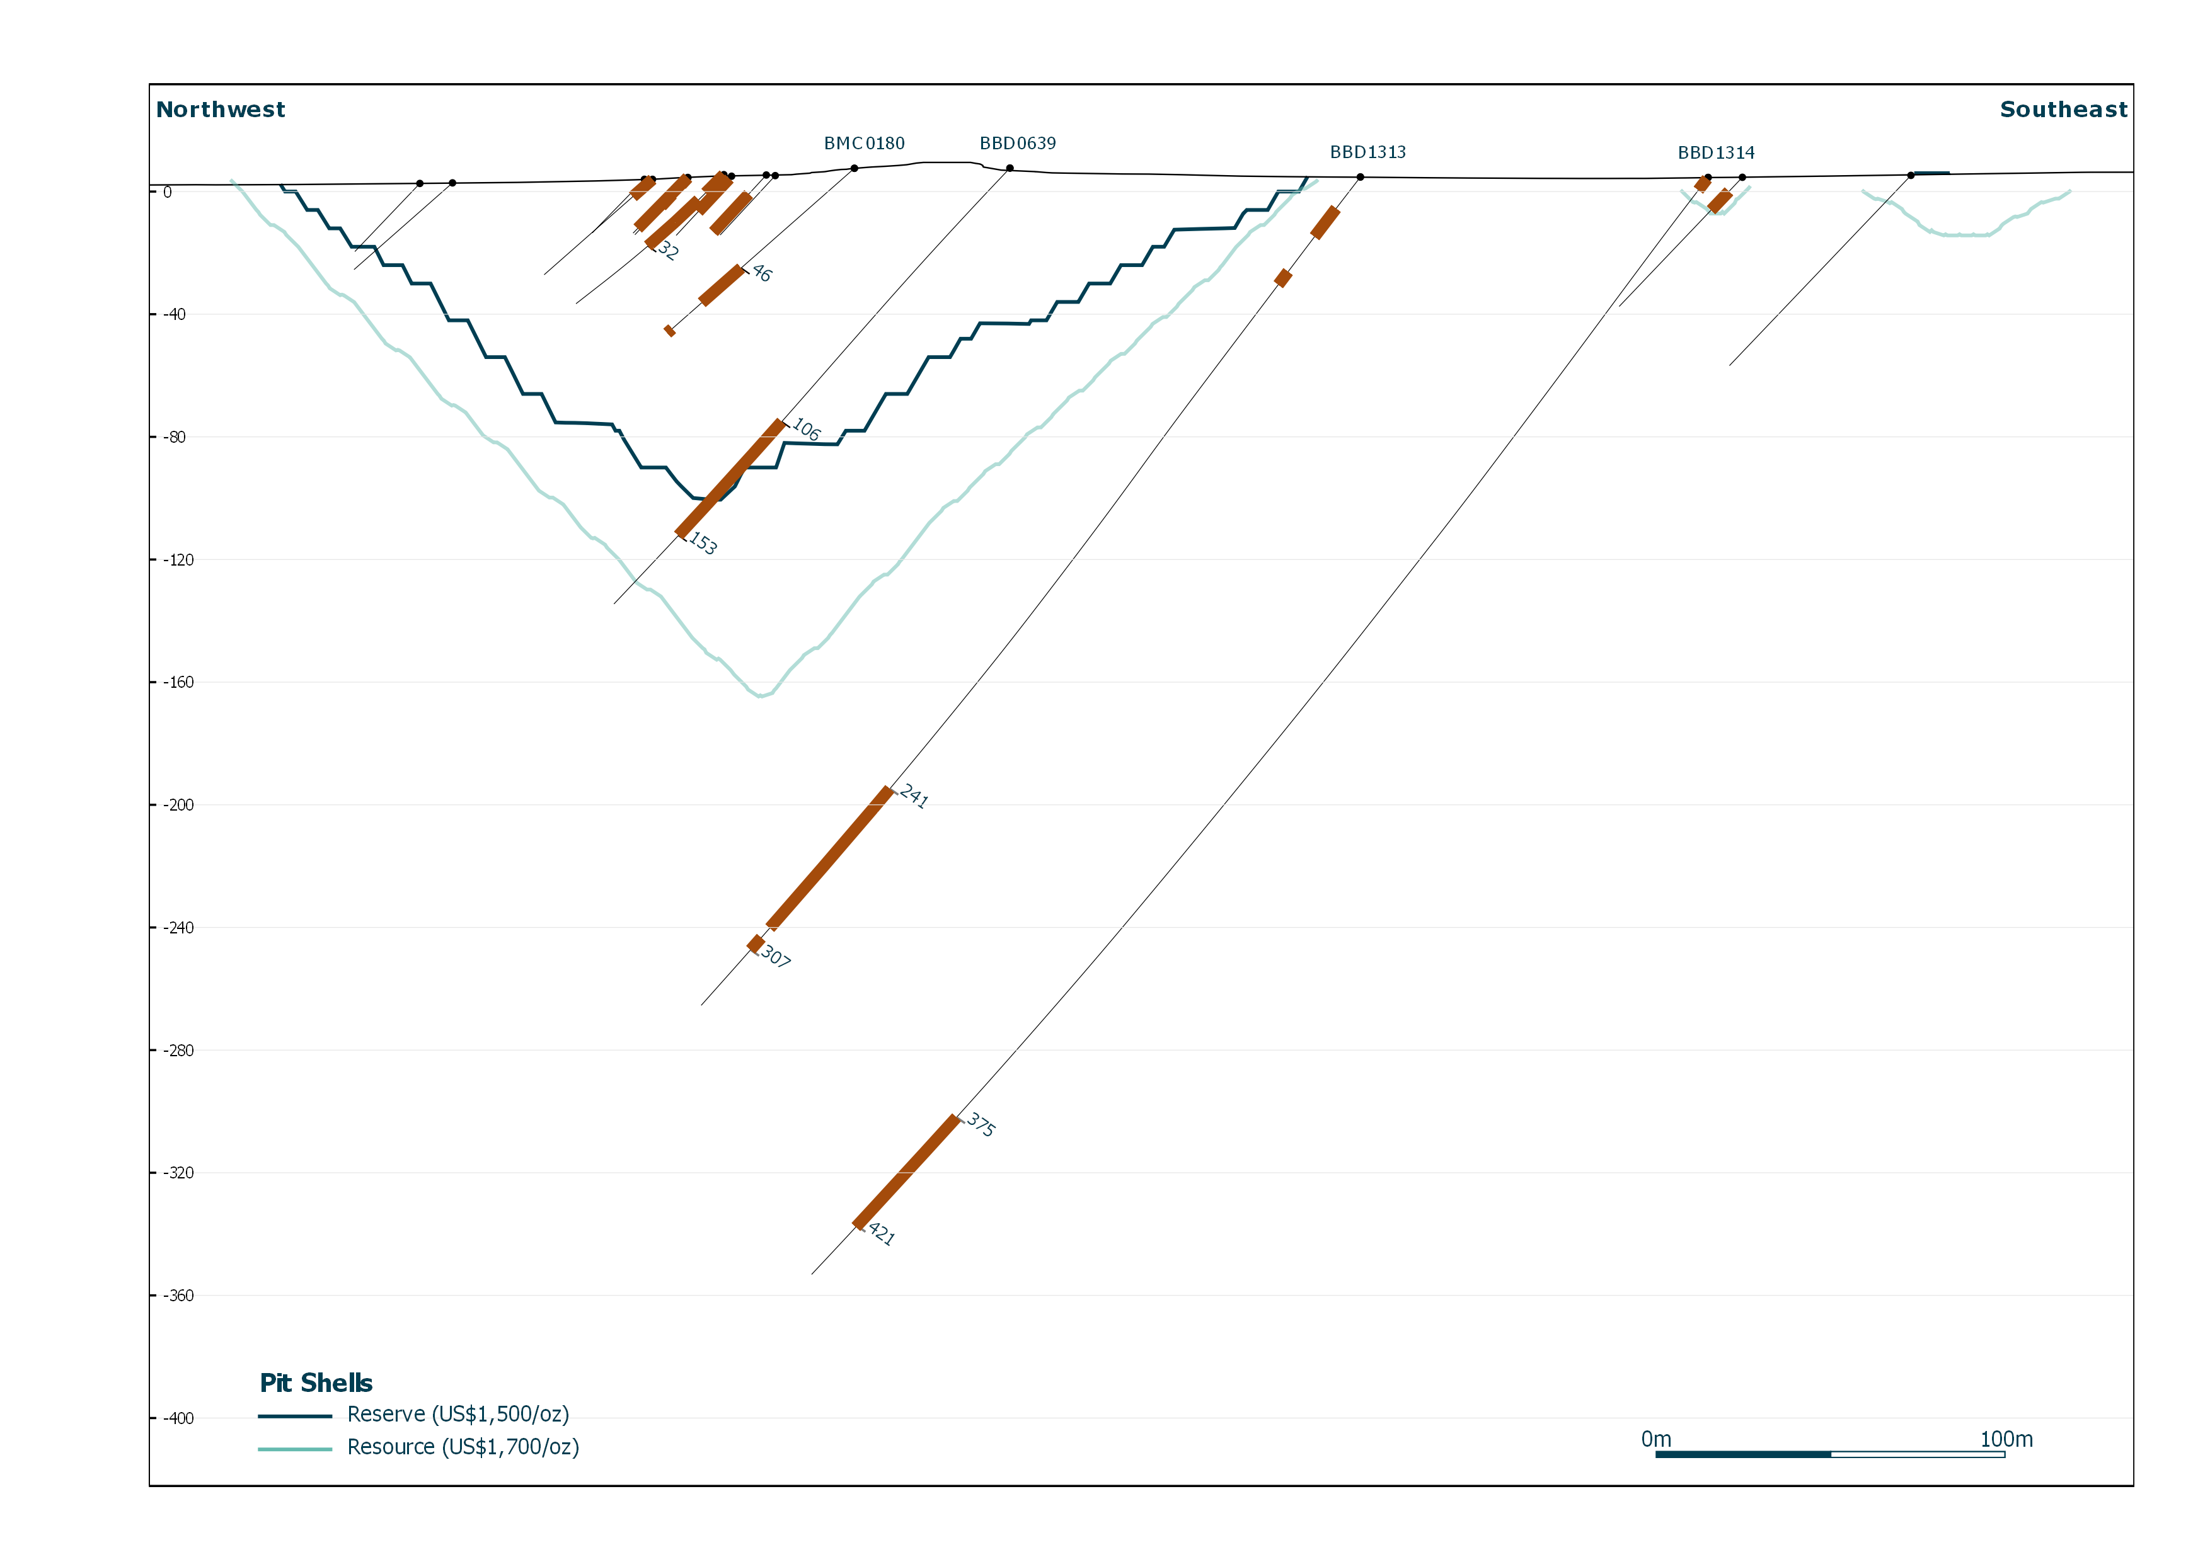
NORTH ZONE CROSS SECTION Looking Northeast
B
Northwest
Historic Drilling
BBD1313
BBD1314
B’
Southeast
BBD1313
0.75g/t Au / 11.1m
BMC0180
0.90g/t Au / 16m
BBD0639
1.25g/t Au / 47.5m
BBD1313
1.02g/t Au / 57m
over 200 meters below reserve pits (US$1,500/oz)
BBD1314
1.64g/t Au / 46m
Incl. 2.03g/t Au / 22m & 5.56g/t Au / 3m
0m
100m

Slide 15
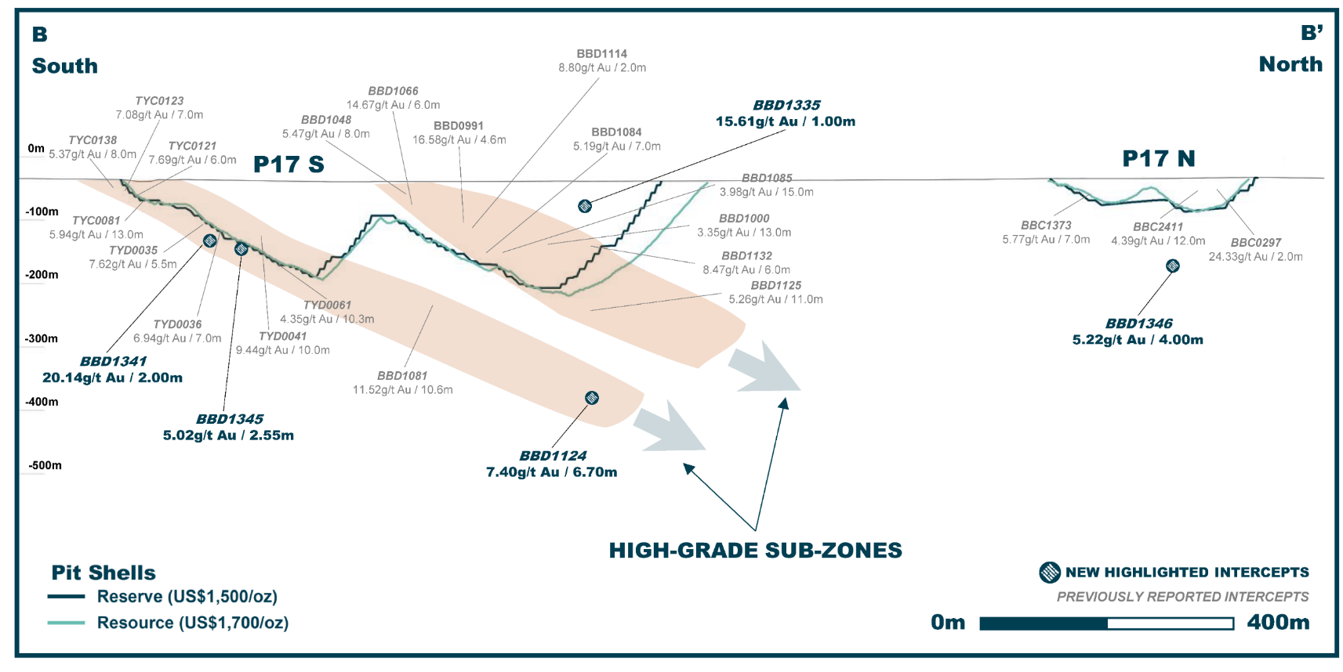
P17 LONG SECTION Looking West

Slide 16
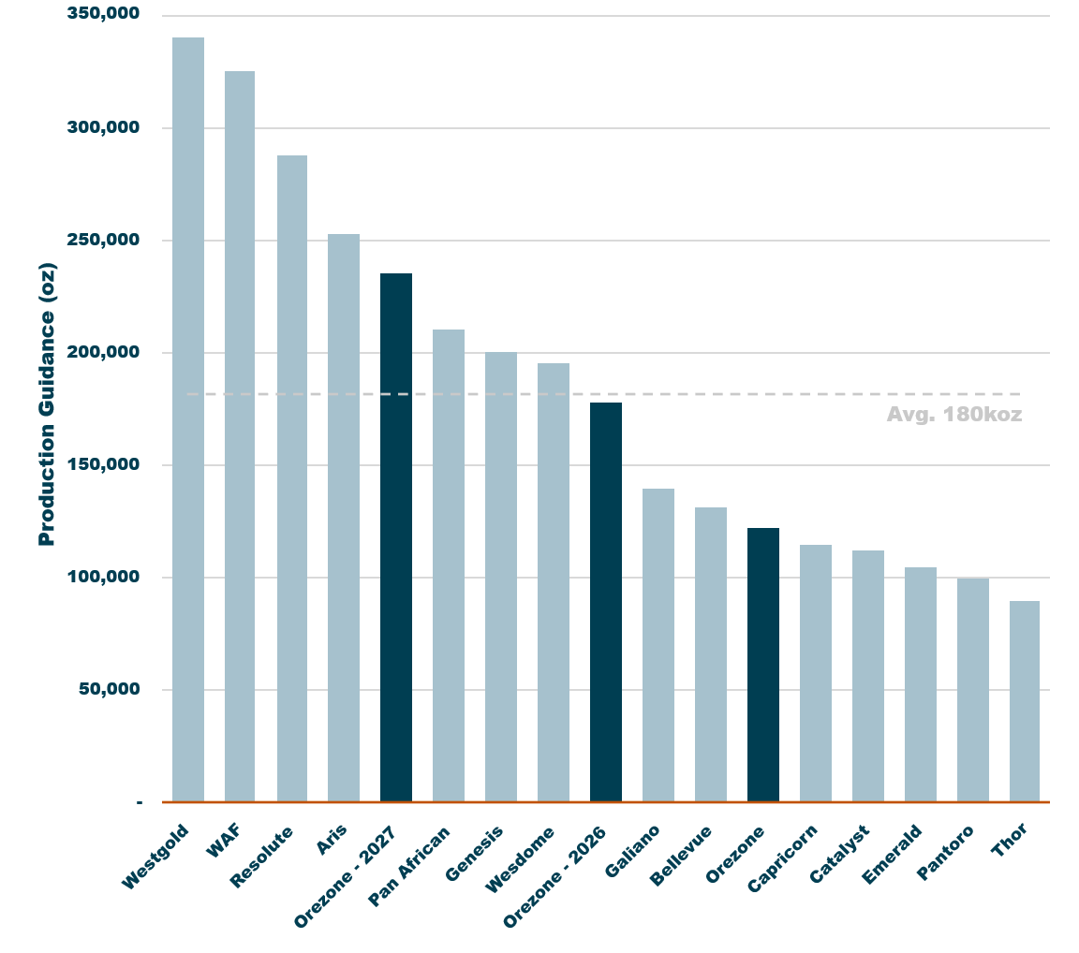
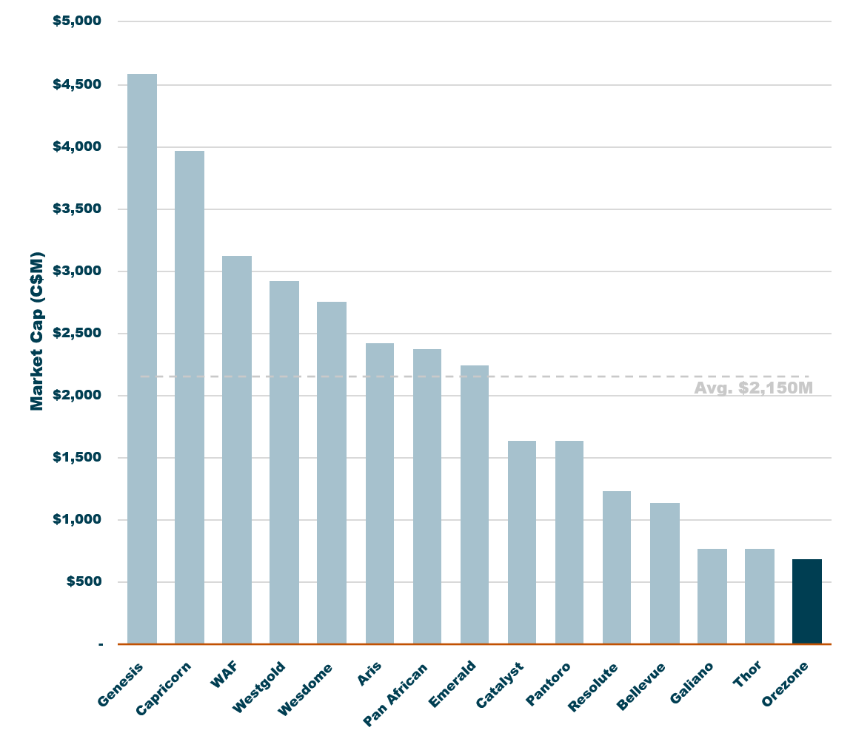
OREZONE Significantly Undervalued
Mid-point 2025 Production Guidance
Market Capitalization
Stage 2
HR
Stage 1
HR
2025
Guidance
OREZONE
OREZONE
OREZONE – 2027
OREZONE – 2026

Slide 17

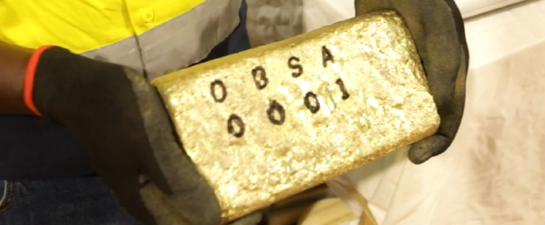
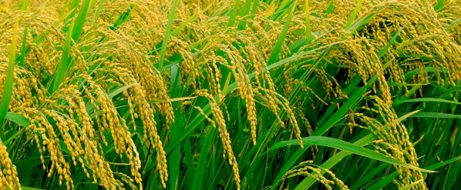
2025 A Transformational Year
BUILD | OPERATE | EXPAND
Completion of
Stage 1 Hard Rock Expansion
  To increase overall production by 45% to 170,000-185,000oz in 2026
  Hard rock plant to provide increased operational flexibility vs current standalone oxide plant
ASX
Secondary Listing
(began trading Aug. 8)
  Increased trading liquidity and access to new investors, including specialist mining focused funds
  Recent financing to accelerate stage 2 hard rock expansion
    Included participation of several large Australian funds
Renewed Focus:
Multi-year Exploration Program Planned
  Current drilling focused on extending mineral system to depth and delineating higher grade centres of mineralization
  Approximately 30,000m of drilling completed in H1-2025. Successful on multiple fronts, including:
    North Zone footwall extended 200m below reserve pit and 800m along strike
    P17 high-grade sub-zone extended 300m down plunge

Slide 18

CAPITAL STRUCTURE & Research Coverage
Capital Structure
Major Shareholders³
TSX: ORE, ASX: ORE, OTCQX: ORZCF
Shares Issued¹ | 597,799,455
Shares Fully Diluted¹ | 625,004,355
Market Capitalization² | C$681M
17%
Nioko
37%
Other
20%
North America
Analyst Coverage
Broker | Analyst
Argonaut | Patrick Streater
Canaccord | Jeremy Hoy
CIBC | Cosmos Chiu
Hannam | Jonathan Guy
Raymond James | Craig Stanley
4%
Europe
18%
Australia
2%
Management
2%
Asia
As at August 13, 2025. Shares fully diluted assumes US$35M Convertible conversion and exercise of options, RSU’s and DSU’s
As at August 31, 2025.
Most recent data available from Irwin and www.sedi.ca. Numbers may not add due to rounding

Slide 19
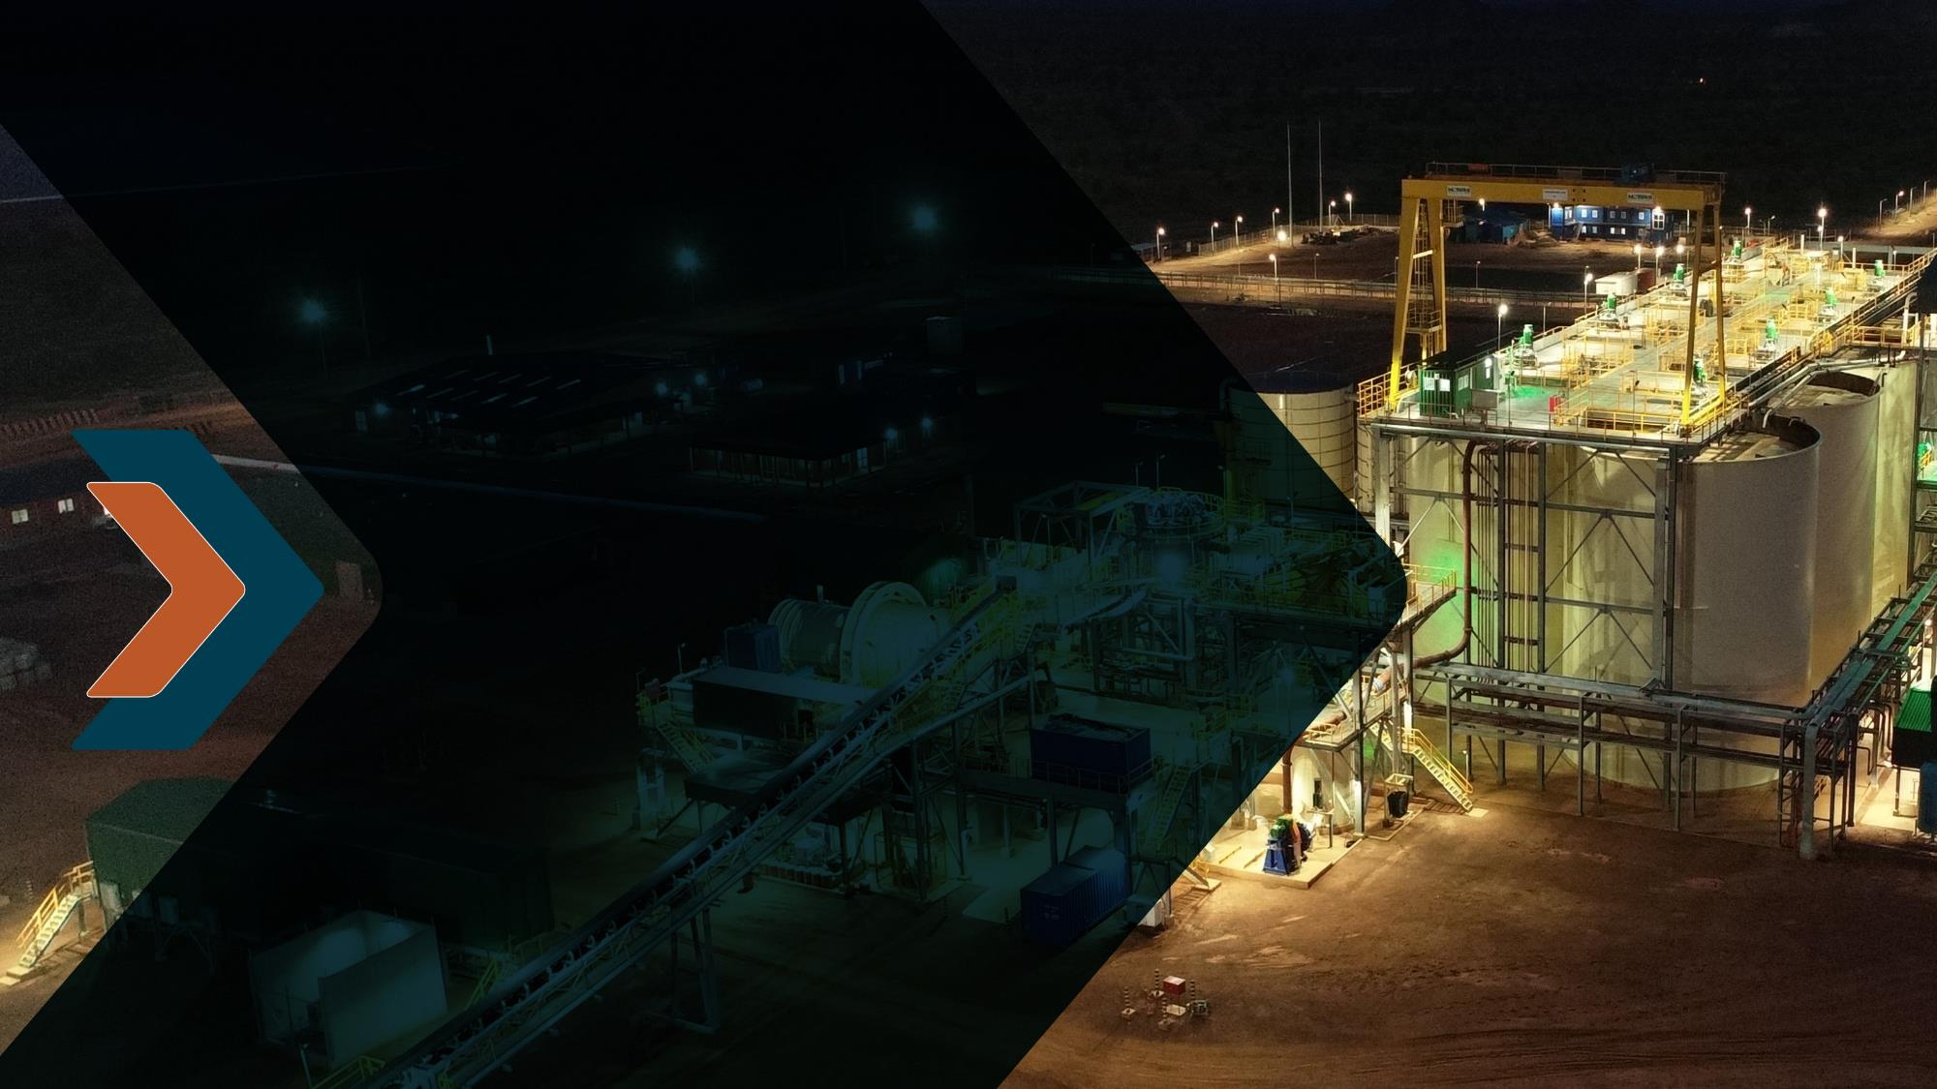
CONTACT
Kevin MacKenzie
VP, Corporate Development & IR
kmackenzie@orezone.com
www.orezone.com

Slide 20
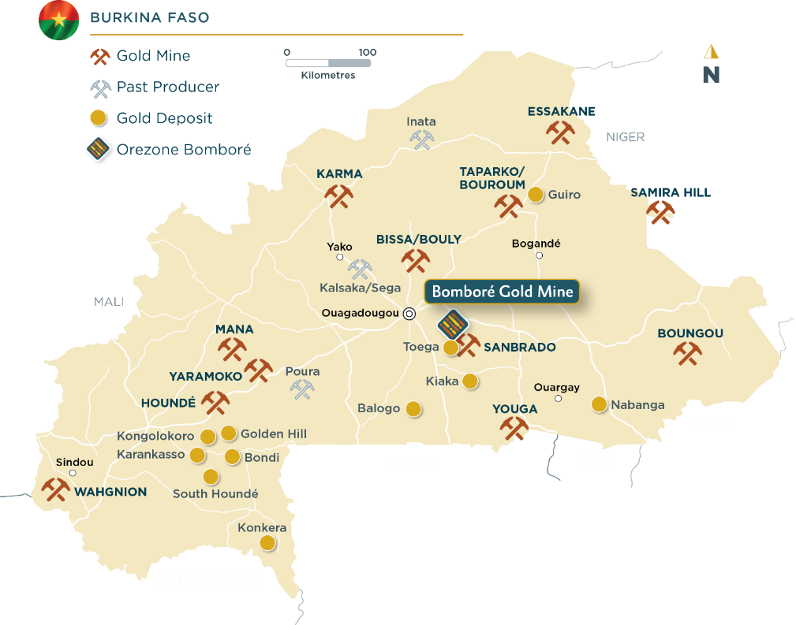
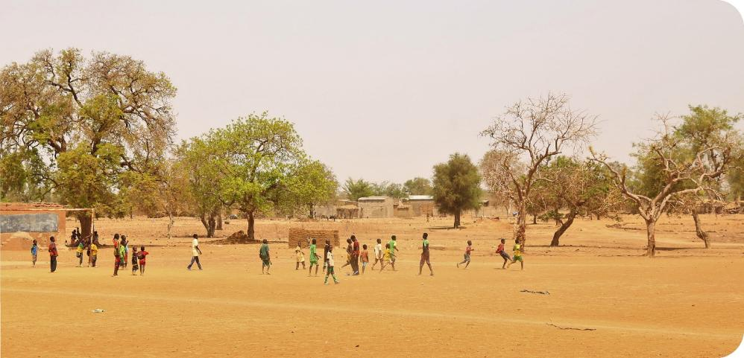

BURKINA FASO An Established Gold Mining Jurisdiction
Ideal Location
90-minute drive from the capital city
Ease of logistics and security
Skilled local labour force
> 18Moz Gold within 50km¹
West African Resources: Sanbrado, Toega and Kiaka
New high-grade gold discoveries
Supportive Mining Jurisdiction
16 mines brought into production
Majority of mines built on/ahead of schedule
and on/under budget
Strong support from local communities and
in-country partners

