Slide 1

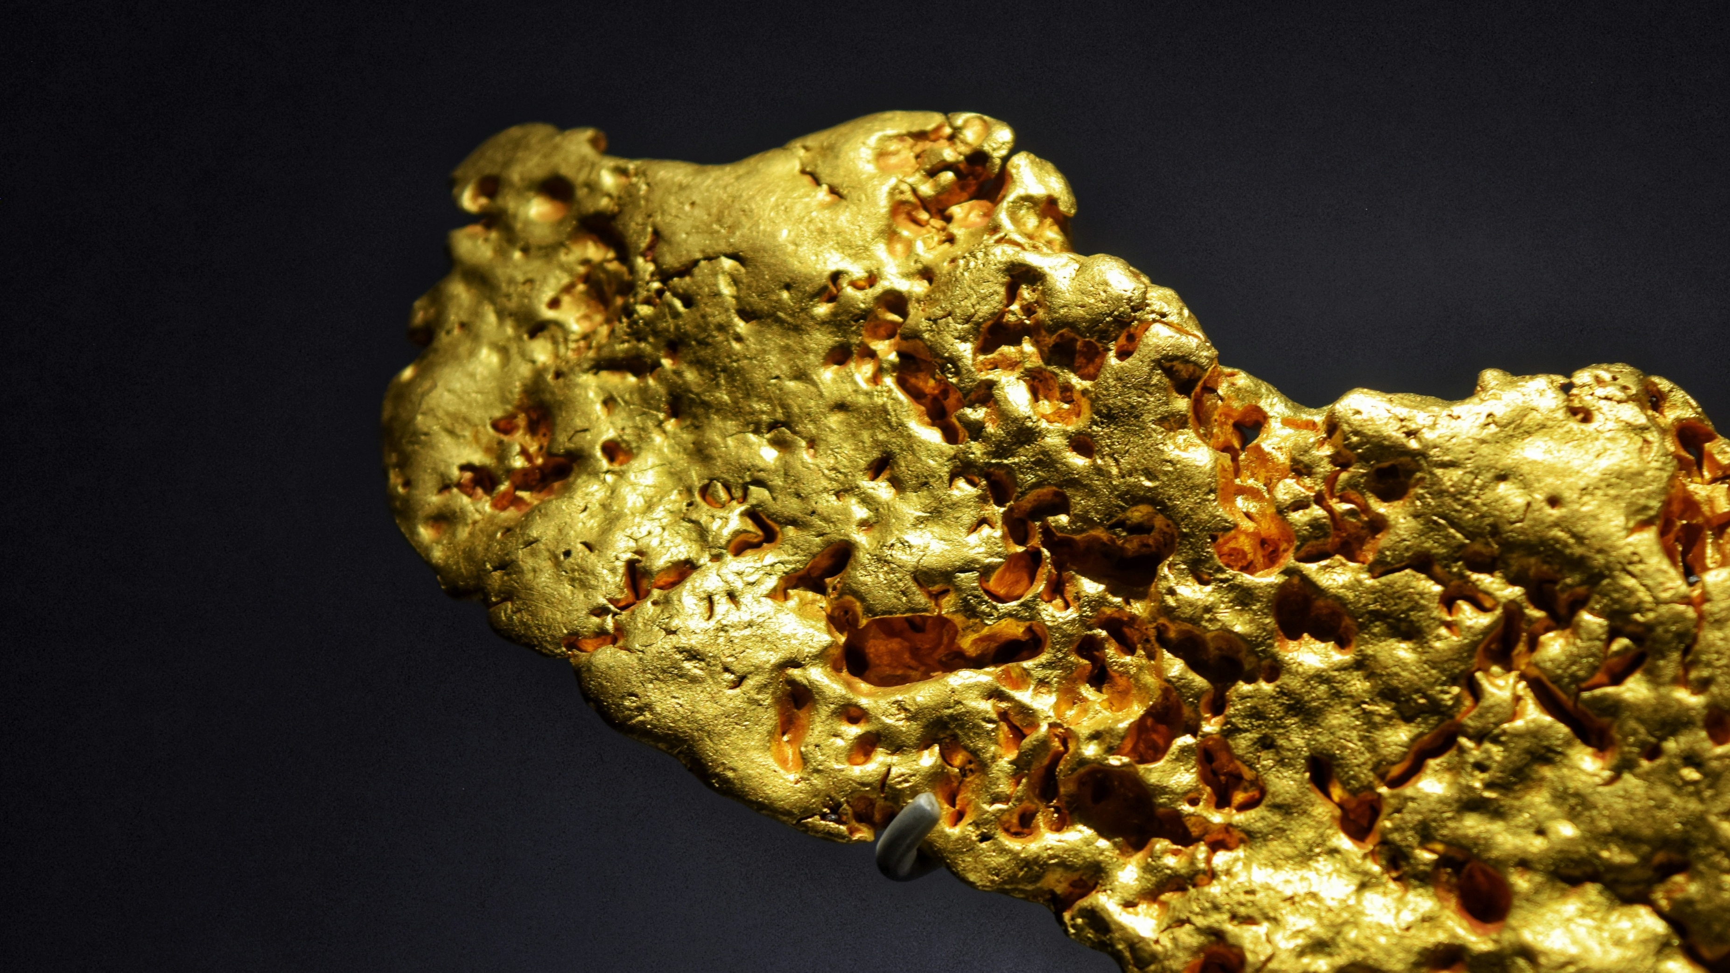

Reward Gold Mine
Australian High-Grade Gold Developer & Producer
ASX: VTX | OTCMKTS: VTXXF
Corporate Presentation | Mining Forum Americas

Slide 2

Disclaimer
The information contained in this presentation has been provided by VertexMinerals Ltd (Company) and other sources identified herein. The information contained in this presentation is for informational purposes only and is not a recommendation as to whether to invest in the Company’s shares. The information contained in this presentation is not investment or financial product advice and is not intended to be used as the basis for making an investment decision. The presentation has been prepared without taking into account the investment objectives, financial situation or particular needs of any particular person. Unless otherwise specified, data and tables set out in this presentation are based on the Company’s management estimates. No representation or warranty, express or implied, is made as to the fairness, accuracy, completeness or correctness of the information, opinions and conclusions contained in this presentation. To the maximum extent permitted by law, none of the Company or, its directors, or any of their employees or agents, nor any other person accepts any liability, including, without limitation, any liability arising out of fault of negligence, for any loss arising from the use of the information contained in this presentation. In particular, no representation or warranty, express or implied is given as to the accuracy, completeness or correctness, likelihood of achievement or reasonableness or any forecasts, projections, prospects or returns contained in this presentation nor is any obligation assumed to update such information. Such forecasts, prospects or returns are by their nature subject to significant uncertainties and contingencies. Past performance is no guarantee of future performance. This presentation includes “forward-looking statements” within the meaning of securities laws of applicable jurisdictions. Forward-looking statements can generally be identified by the use of forward-looking words such as “may”, “will”, “expect”, “intend”, “plan”, “estimate”, “anticipate”, “believe”, “continue”, “objectives”, “outlook”, “guidance” or other similar words, and include statements regarding certain plans, strategies and objectives of management and expected financial performance. These forward-looking statements involve known and unknown risks, uncertainties and other factors, many of which are outside the control of VertexMinerals Ltd, and any of their officers, employees, agents or associates. Actual results, performance or achievements may vary materially from any projections and forward-looking statements and the assumptions on which those statements are based. Readers are cautioned not to place undue reliance on forward-looking statements and the Company assumes no obligation to update such information.
Mineral Resource Statement
The Exploration Target is classified in accordance with the Australasian Code for Reporting of Identified Mineral Resources and Ore Reserves (JORC, 2012). The Exploration Target Estimate was completed by Andrew Hawker of HGS Australia. Mr Hawker has sufficient experience that is relevant to the style of mineralisation and type of deposit under consideration and to the activity being undertaken to qualify as a Competent Person as defined in the 2012 Edition of the ‘Australasian Code for Reporting of Exploration Results, Mineral Resources and Ore Reserves’. Mr Hawker consents to the inclusion in the report of the matters based on his information in the form and context in which it appears.
JORC Compliance Statements
Information in this announcement is extracted from reports lodged as market announcements referred to in this presentation and available on the Company’s website http://www.vertexminerals.com.au/. The Company confirms that it is not aware of any new information that materially affects the information included in the original market announcements and that all material assumptions and technical parameters underpinning the estimates in the relevant market announcements continue to apply and have not materially changed. The Company confirms that the form and context in which the Competent Persons’ findings are presented have not been materially modified from the original market announcements.
ASX: VTX | OTCMKTS: VTXXF

Slide 3
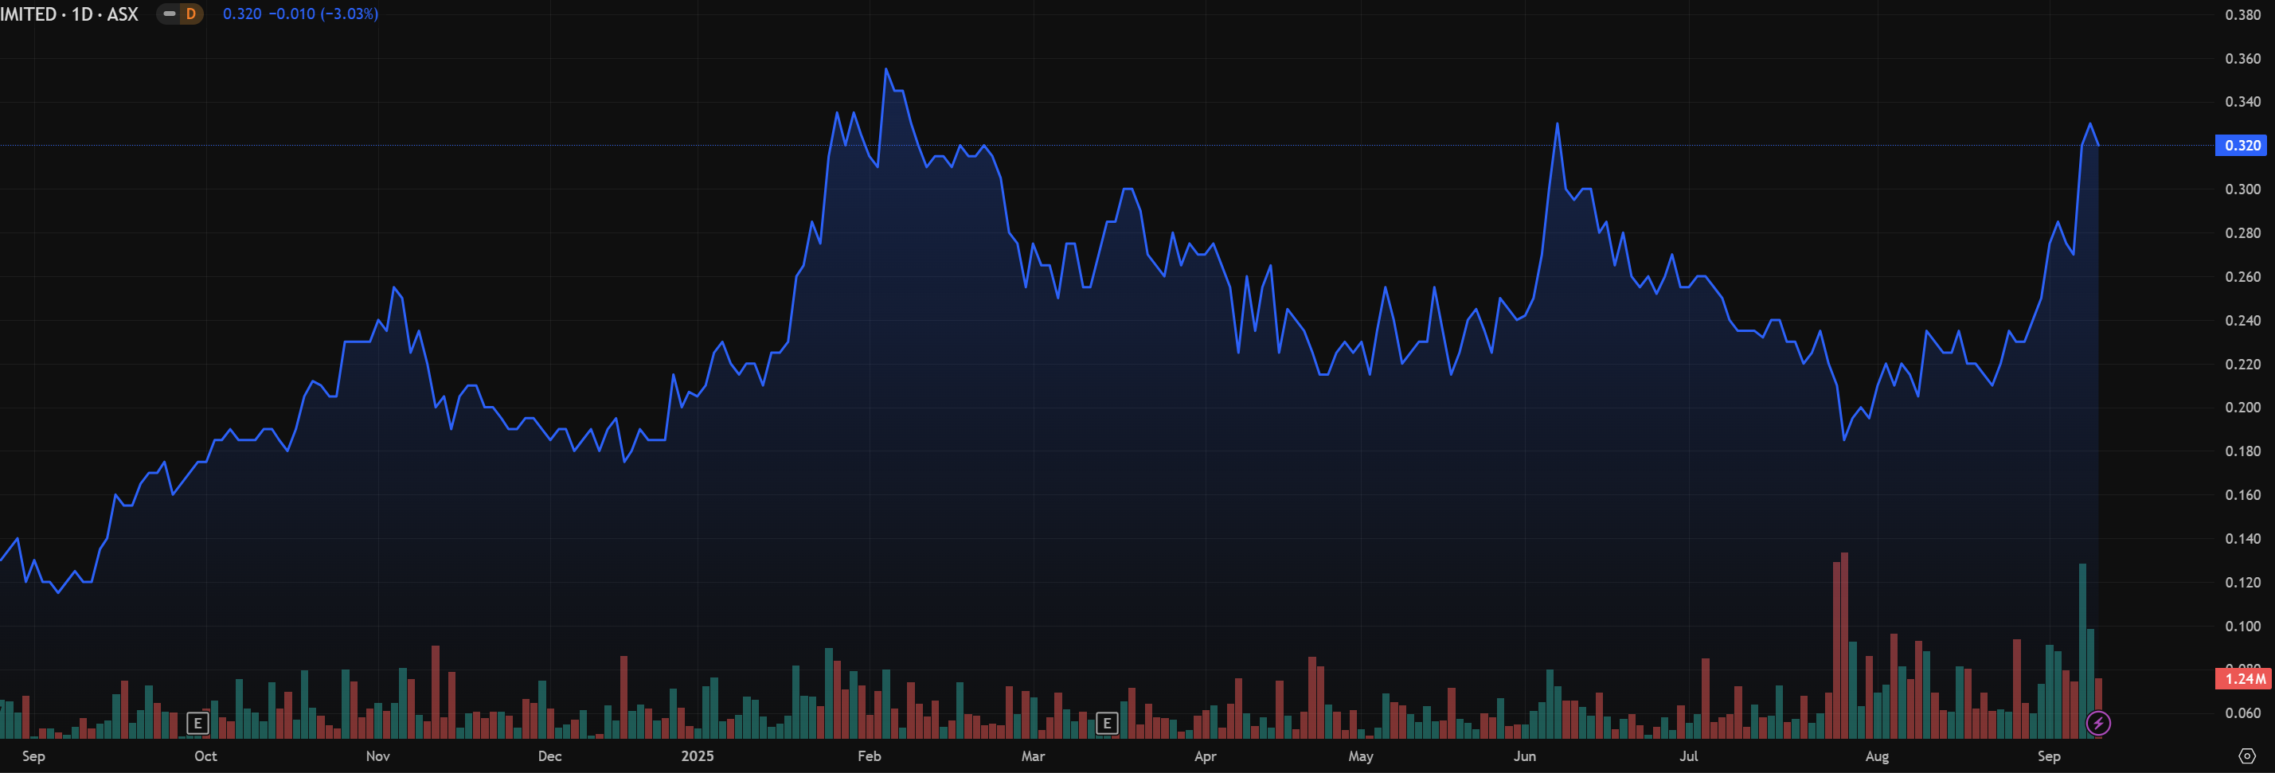
Corporate Structure
242M
~$0.32
Shares on Issue
Share Price
119M
~ $77M
Options and
rights on Issue
Market Capitalization
undiluted (2025/09/25)
$14.0M
Cash
*Share Purchase Plan
** Recent Convertible loan Raise
*** Recent Placement
ASX: VTX | OTCMKTS: VTXXF
Notes:
Update graph to 12months

Slide 4
Directors and Management
Directors
Management
Roger Jackson
Ian Morgan
Chris Hamilton
Alan Mills
Executive Chairman
Company Secretary
General Manager Operations
Manager Commercial
30+ years as a mine operator, services contractor and explorer. He is a geologist with strong knowledge of gold exploration and mining
40+ years experience in company secretarial and accounting.
Jeff Williams
Tom Cowan
Manager Maintenance
Mining Engineer
Tully Richards
Vince Fayad & Kurt Lane
Executive Director
Joint CFO’s
Experienced gold geologist based in Orange, NSW. Mr. Richards is an experienced minerals industry executive with 30 years operational consultancy and managerial experience.
Mick Irwin
Casey Robinson
Safety Training
Environment
Carl Clark
Julian Geldard
Declan Franzmann
Mine Geology
Mine Geology
Non-Executive Director
Management Mining engineer with over 30 years of experience from discovery, through construction, operations and mine closure.
Rick Liang
Mick Premus
Human Resources
Drilling
ASX: VTX | OTCMKTS: VTXXF

Slide 5
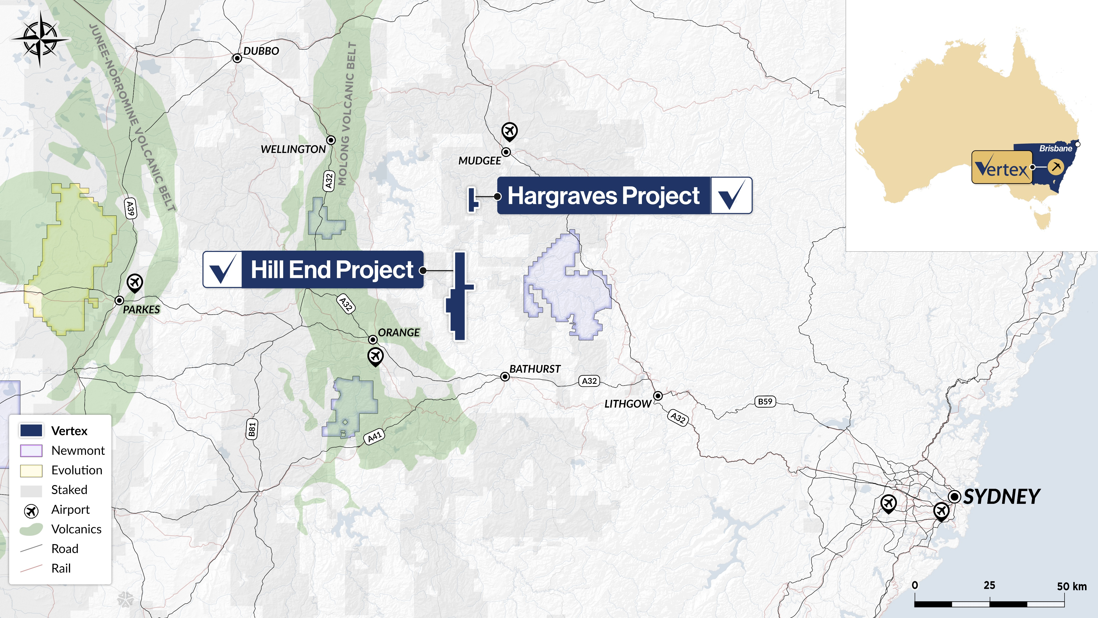
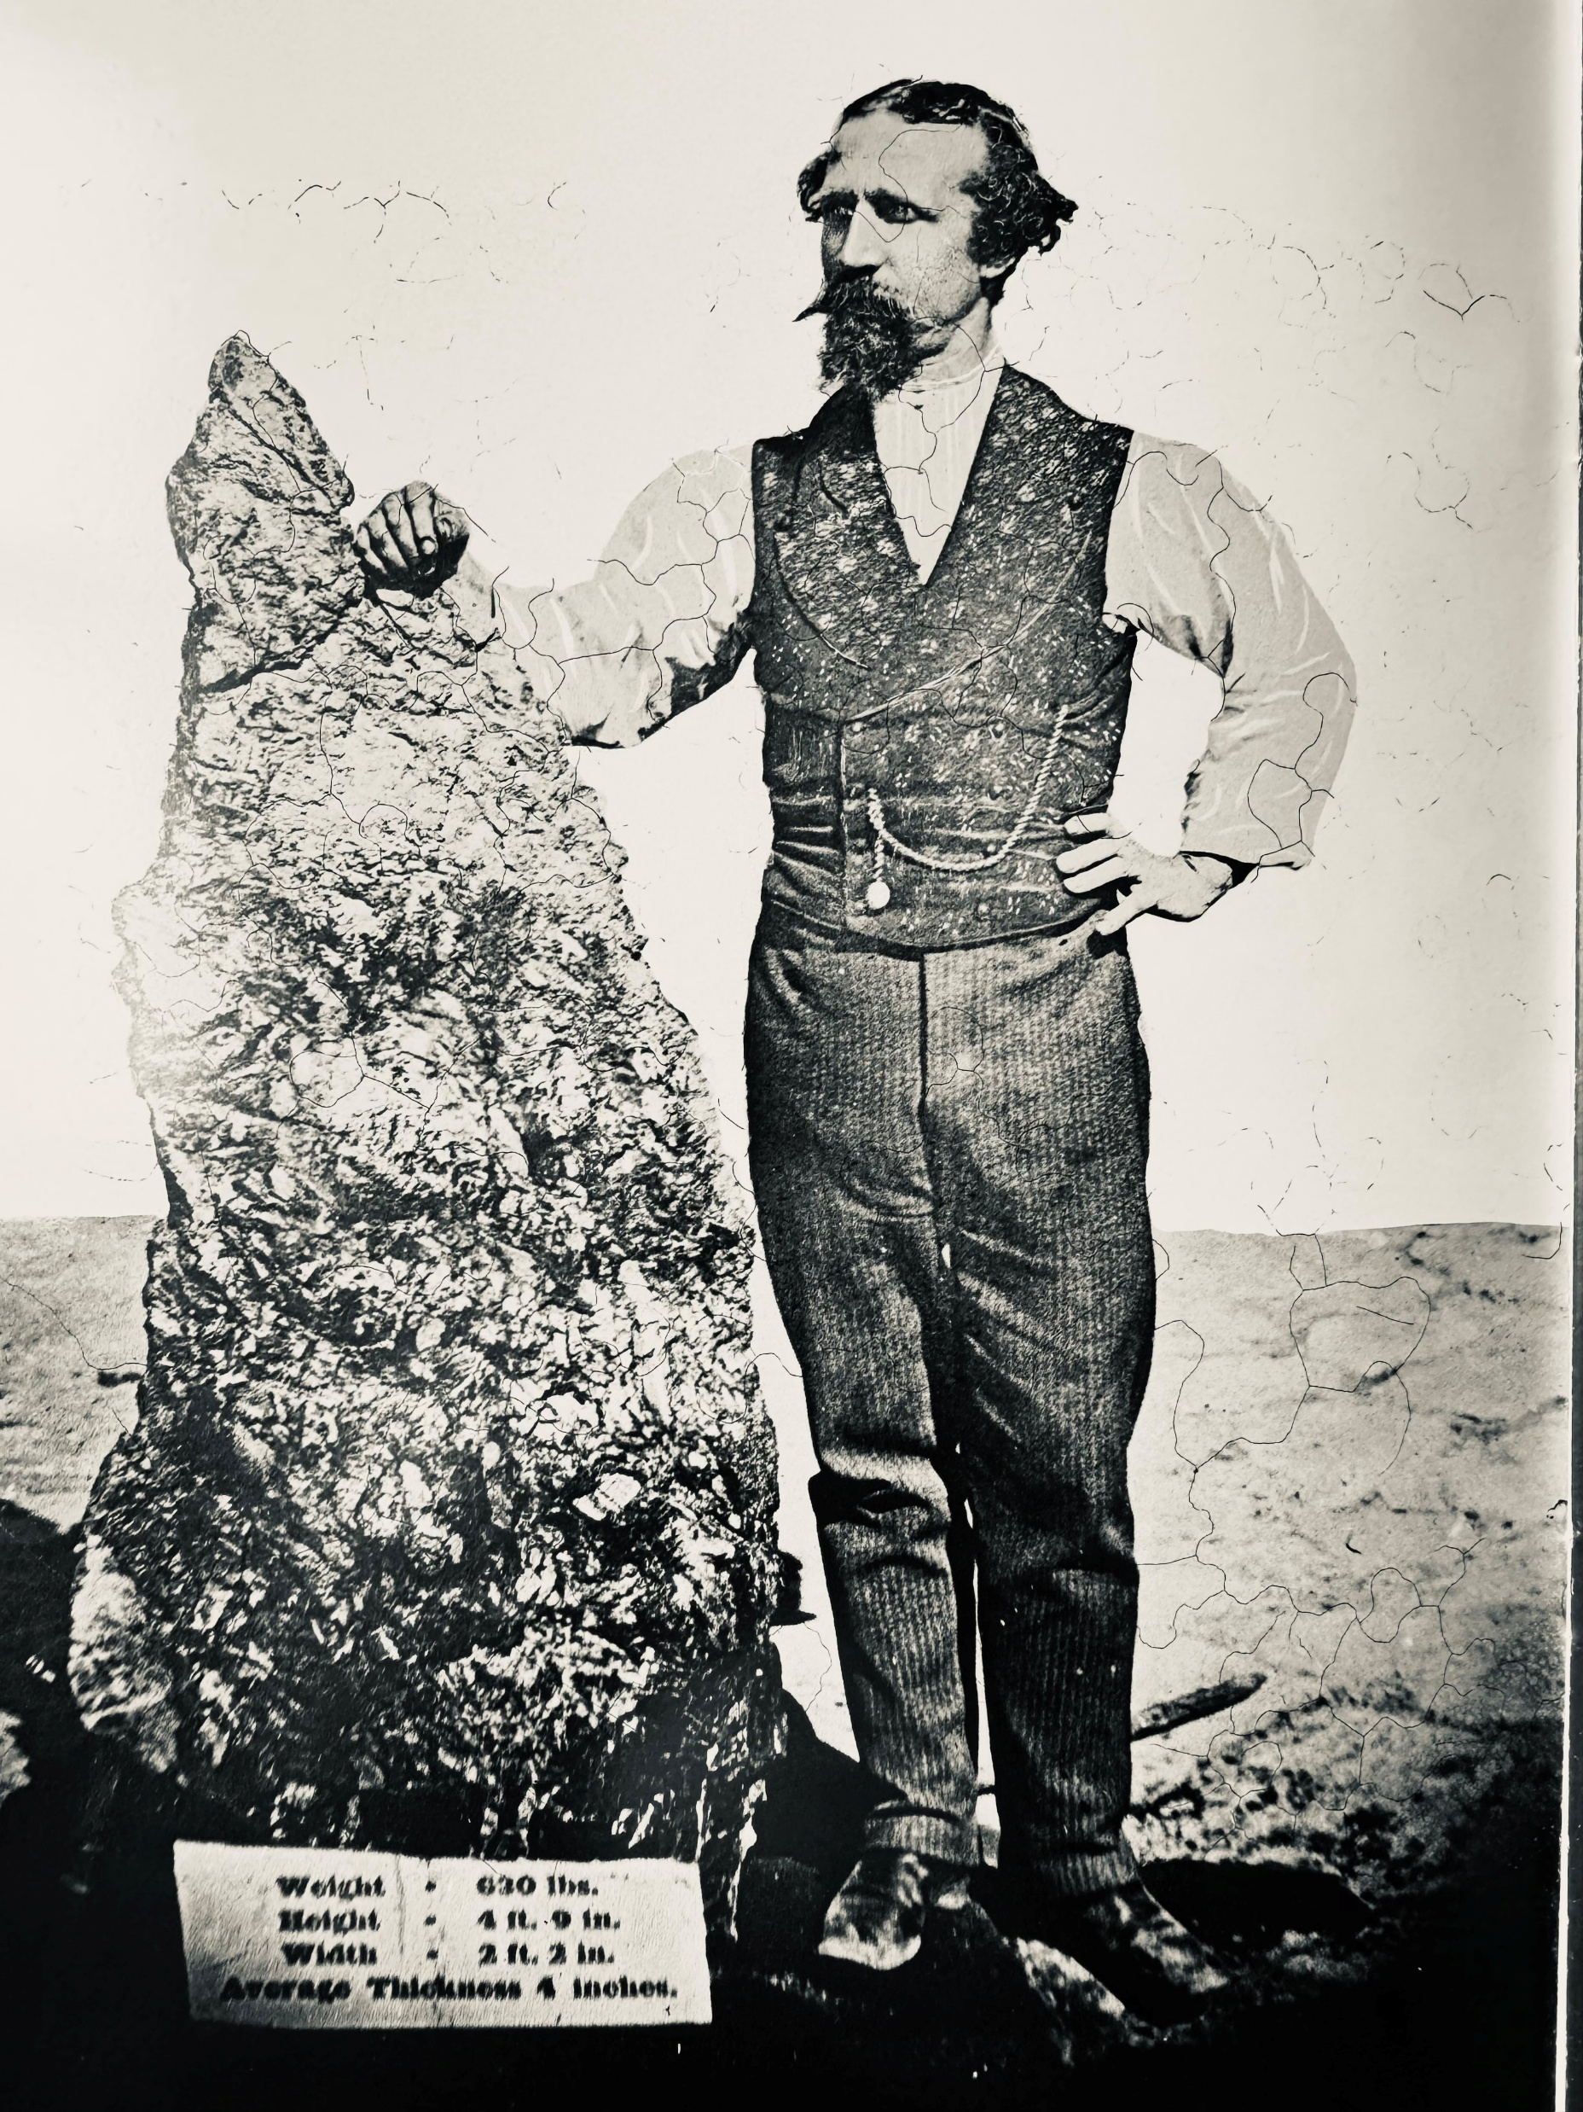
Home to The Holtermann Nugget,
the World’s Largest Gold Specimen (286kg)
4 Hours Drive from Sydney

Slide 6
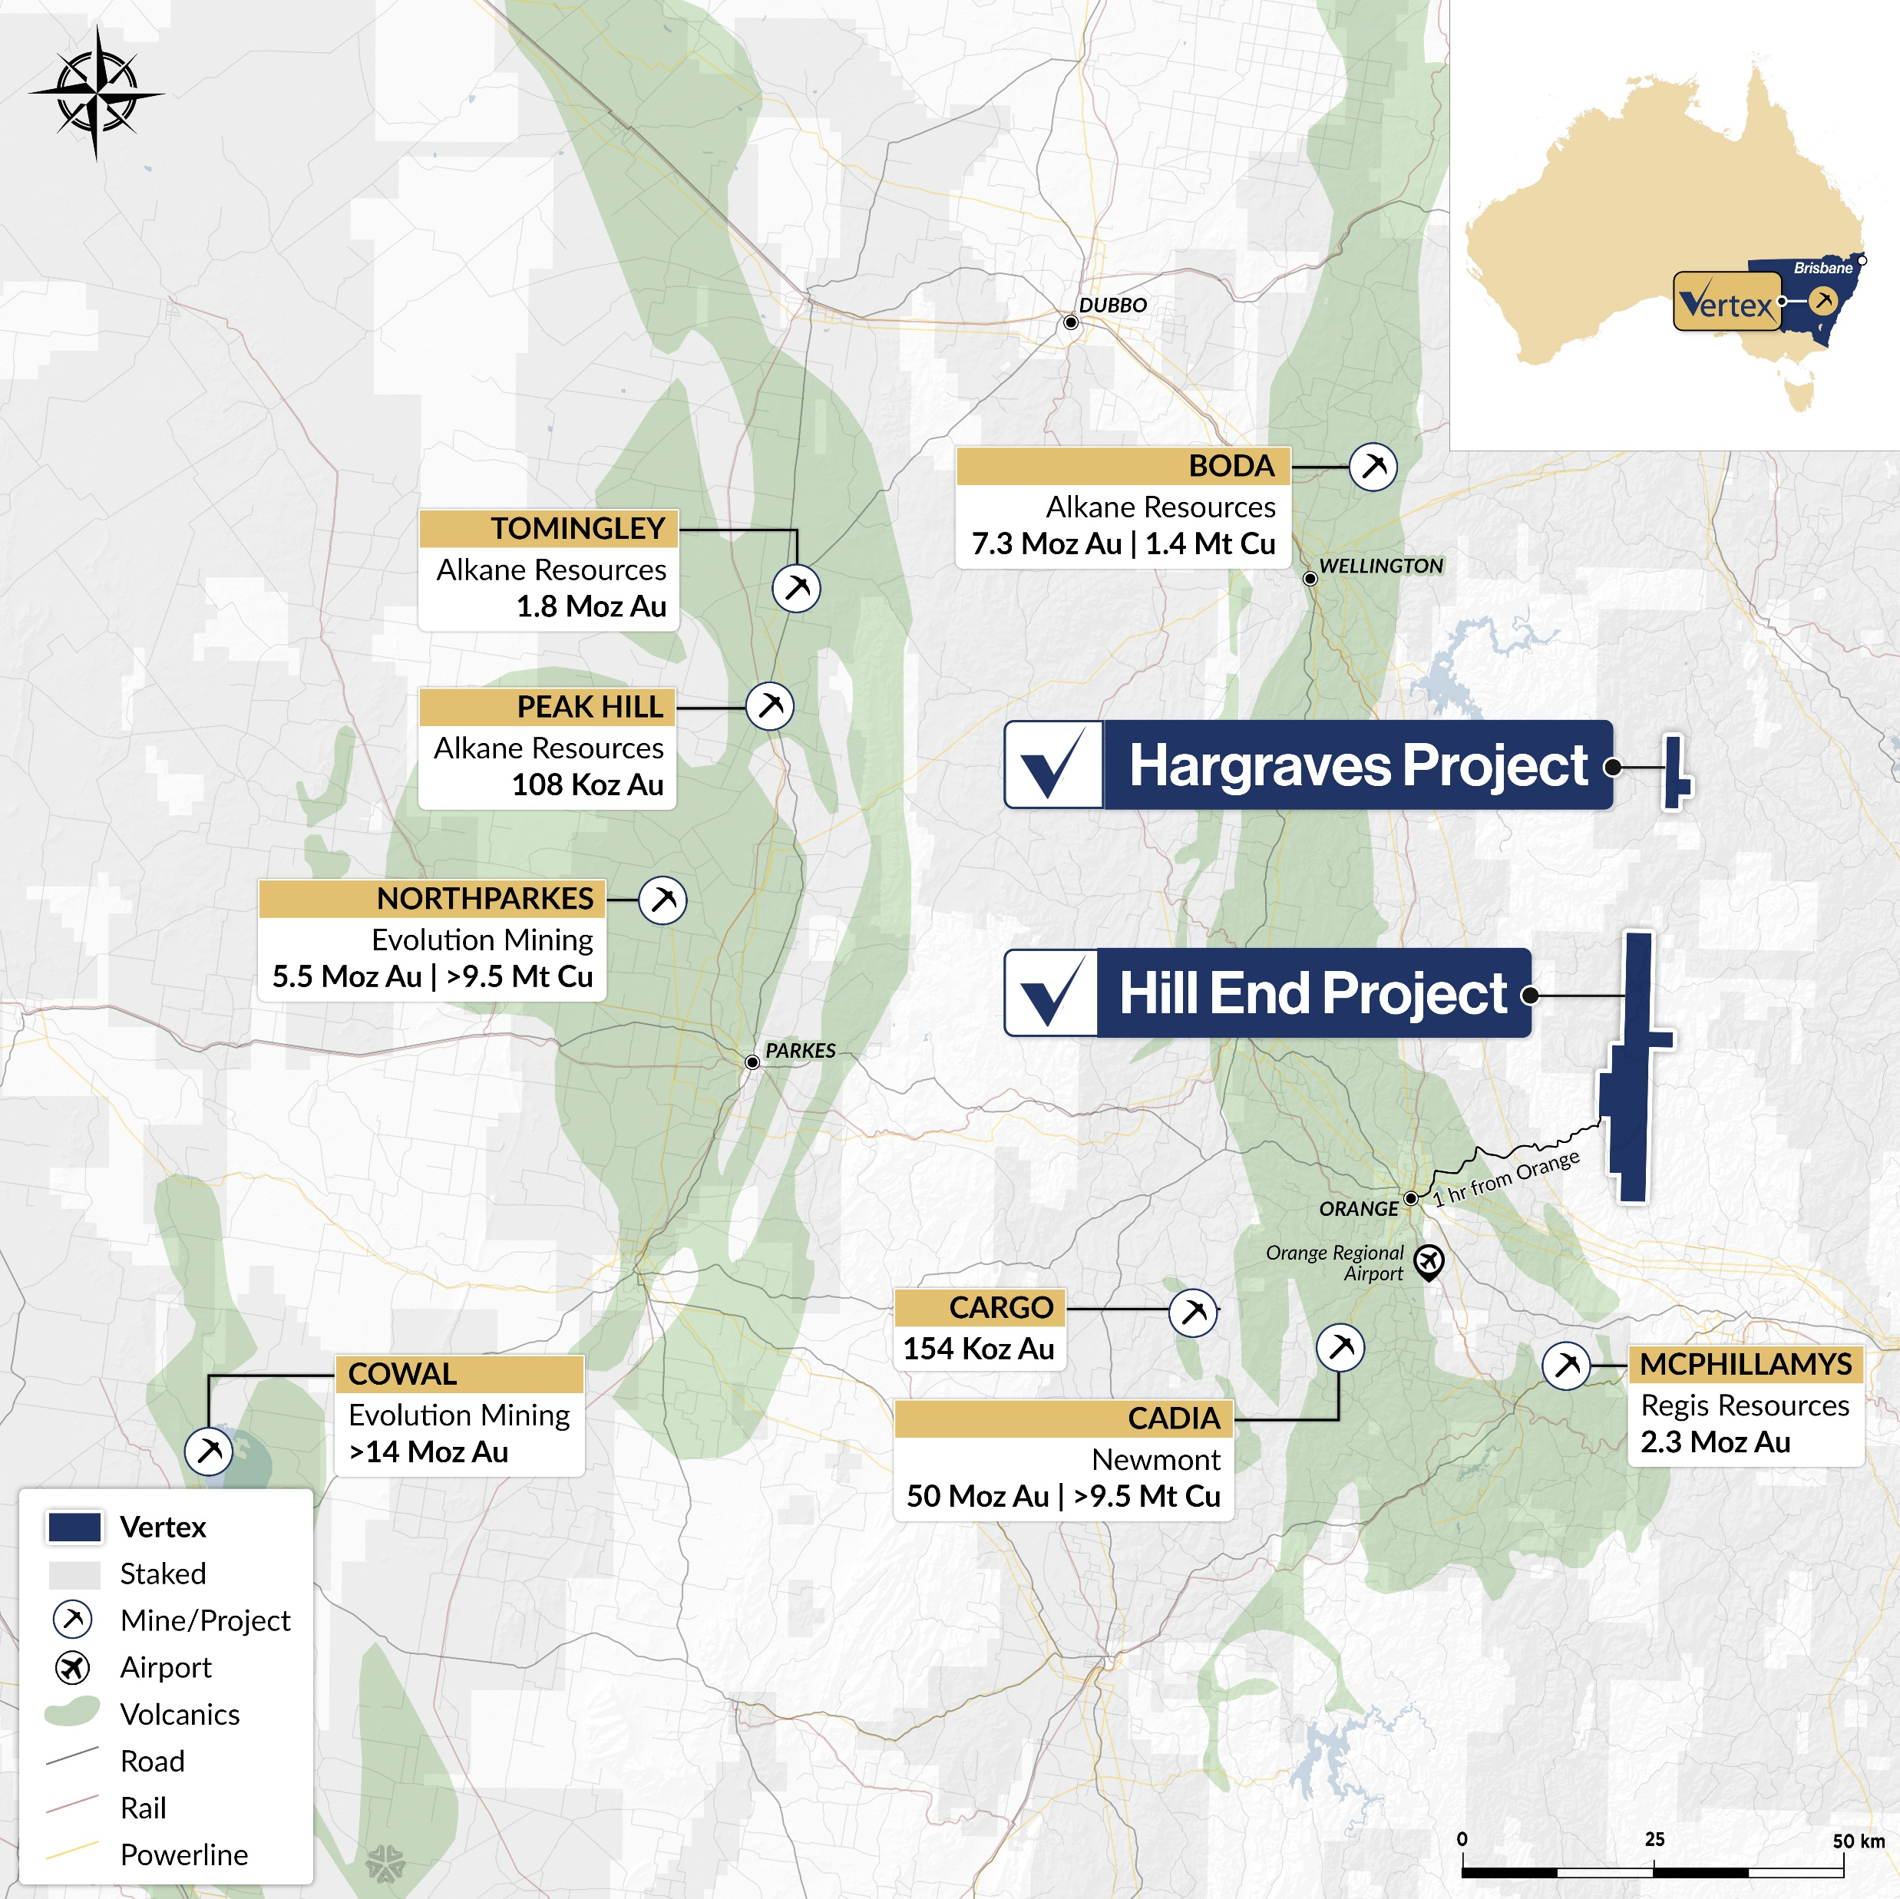
Lachlan Fold- Reward Gold mine sits
amongst the Giants
Hill End Project Mineral Resource Estimate
Deposit | Classification | Tonnes (kt) | Grade Au (g/t) | Contained Au (koz)
Reward Gold Mine | Indicated Inferred | 141 278 | 15.5 17.3 | 71 155
Sub Total |  | 419 | 16.7 | 225
Hargraves Project | Indicated Inferred | 1,109 1,210 | 2.7 2.1 | 97 80
Sub Total |  | 2,319 | 2.4 | 178
Red Hill Project | Indicated Inferred | 413 1,063 | 1.4 1.8 | 19 61
Sub Total |  | 1,476 | 1.7 | 80
Project Total | Indicated Inferred | 1,663 2,551 | 3.5 3.6 | 187 296
Grand Total |  | 4,214 | 3.6 | 483

Slide 7
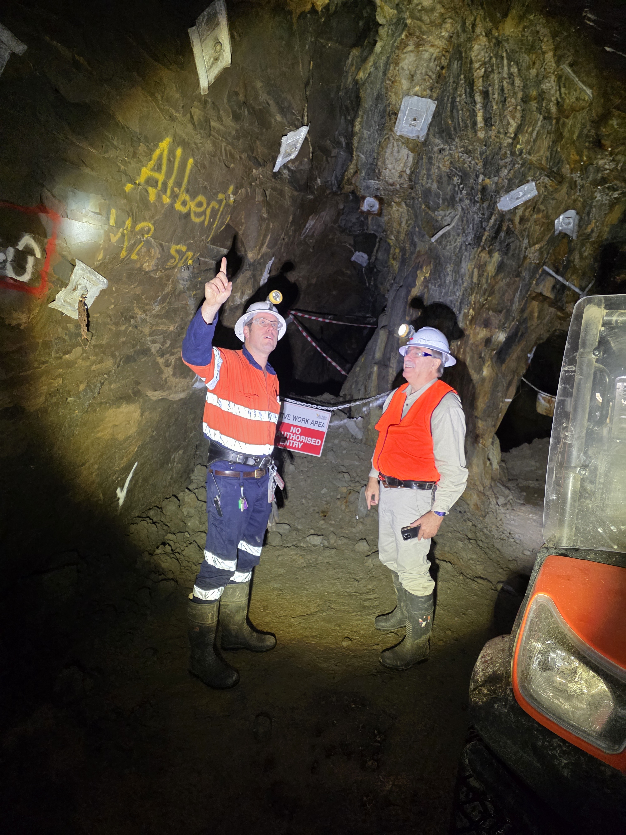
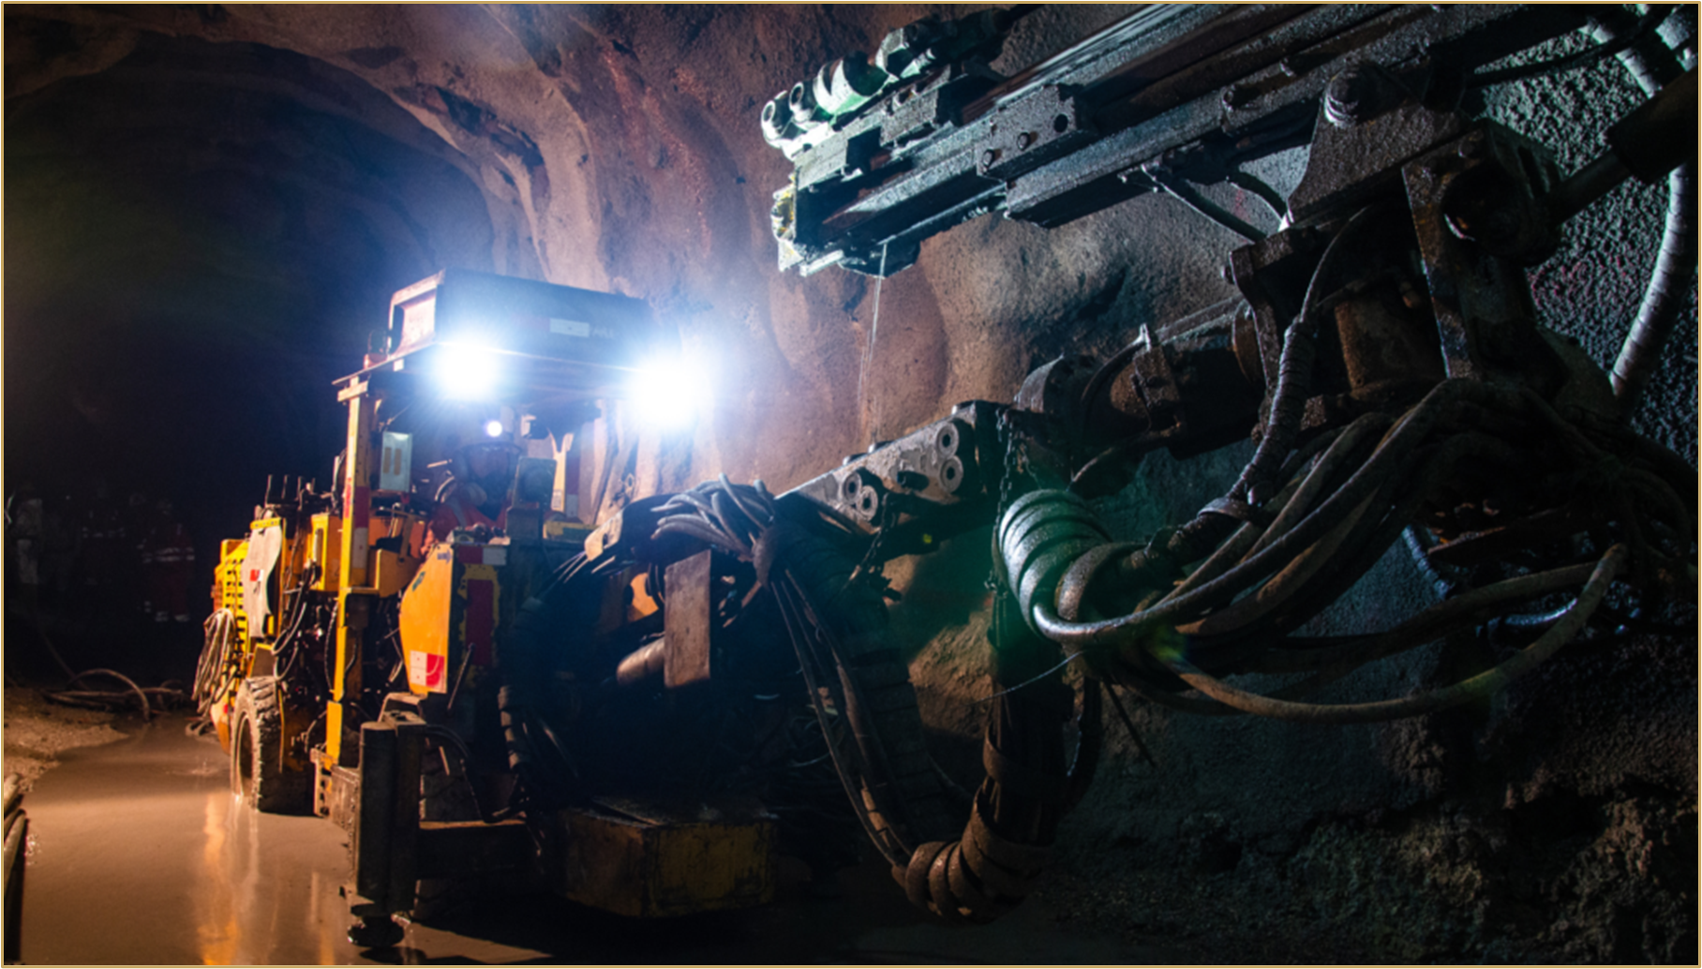
Flagship Project for Vertex - Reward High Grade Gold Mine, Hill End
Commenced Gold processing in new Gekko Gravity Gold plant
100% owned Mining operation
No hedge - No Secured debt – fully funded
Low operating Cost
High Grade Gold Resource and Reserve 225 ozs at 16.7g/t + more
Inherited AUD $25m of Underground development at Reward
1.8m Au ozs historic mining
Reward sits just under the Hawkins Hill Mine 435kozs at 309 g/t
Up to 95% recovery by gravity processes only
Big Gold System – 25km + strike

Slide 8
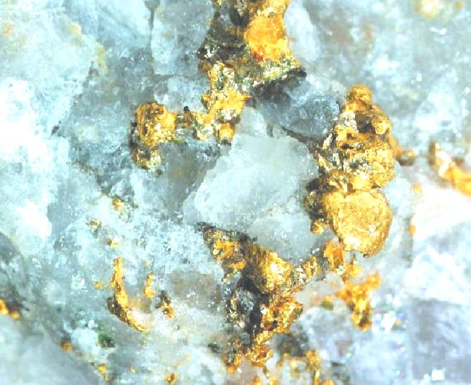
UNIQUE GOLD MINE
No associated sulphide metals to speak of
Gold recovers up to 95% - by gravity only
No Cyanide No chemicals
23 fine gold
No gold in country rock
Textbook ore sorts
Recovers gold at 650 micron – no ball mill
Produced the world record gold specimen
ASX: VTX | OTCMKTS: VTXXF
Notes:
Update the claims – shown on next slide
This might be a better place show 1 hr drive from Orange
Use this map that
Identify Reward on the map, Red Hill and Hargraves
Make the table fit

Slide 9
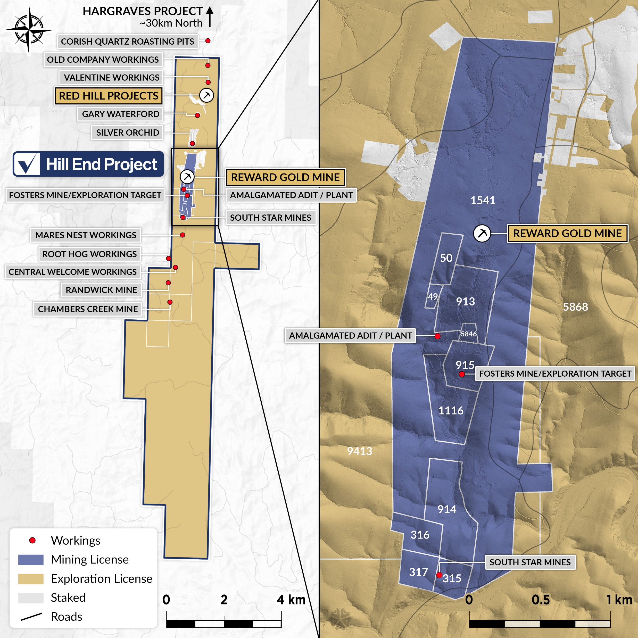




Scratching the
Surface
21miles (34km) of prospective strike that was the source of the largest Gold specimen ever to be found globally - discovered at Hill End
Lidar survey completed with 3500+ surficial gold workings identified over the line of lode
Most lodes only mined to
the water table 60ft (<20m)
Only 0.5miles (800m) of strike has been drilled and only down a few hundred meters
ASX: VTX | OTCMKTS: VTXXF

Slide 10
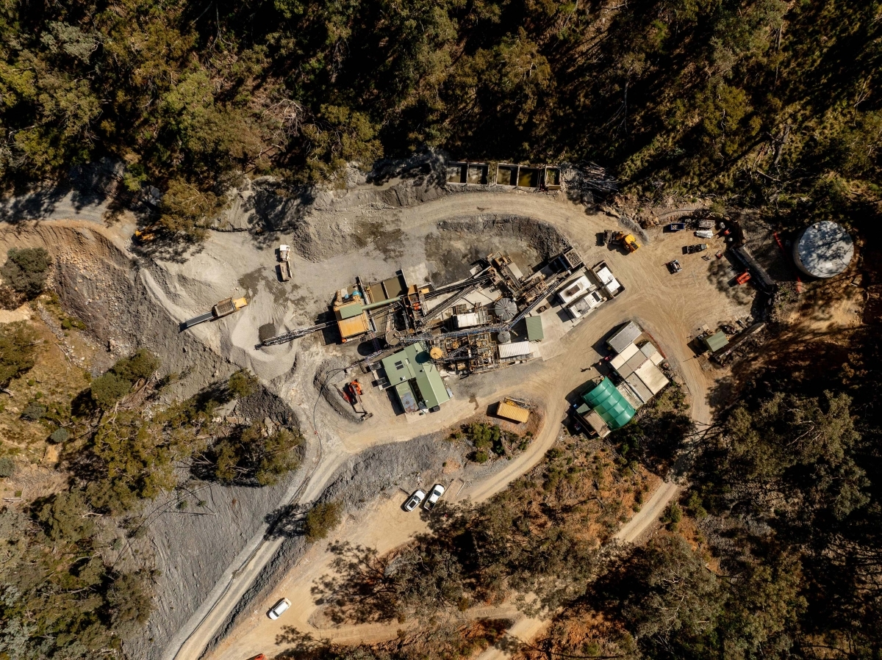
Vertex Strategy
Growth & Leadership
(2025 →)
Aggressive drilling to expand Hill End inventory
Build robust ESG reputation
Deliver shareholder value
Establish as Australia’s most prominent high-grade gold miner
Production Kick-off
(Early 2025)
Gold production
from stockpiles
Commence mining at Reward Gold Mine
Start at reduced throughput, ramp up with ore sorting
Foundations
(Late 2024)
Re-install refurbished Gekko Gravity Plant
PHASE 1
PHASE 2
PHASE 3
ASX: VTX | OTCMKTS: VTXXF

Slide 11
Gekko Gravity Gold Plant installed at Reward Gold Mine with a TOMRA ore sorter
Under $9M AUD total build cost
TOMRA
Ore Sorter
The New plant is located at the old plant site
Utilising the existing:
Gold Room
Water systems
Power generation
Change Rooms
Workshop
Storeroom
Jaw Crusher
Access Roads
Security System
Offices
Crib Room
ASX: VTX | OTCMKTS: VTXXF

Slide 12
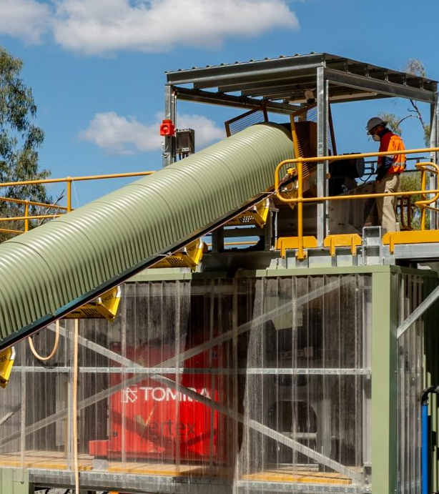
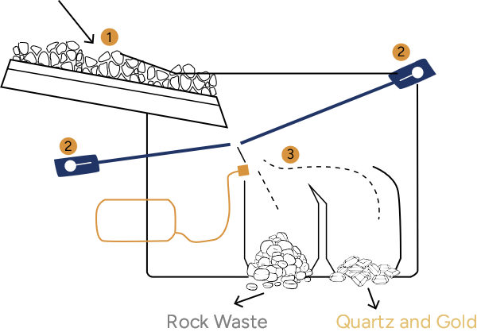
Feeding of unsorted material
Textbook Ore Sorting
Detection by LASER technology
Separation by compressed air
Plant And Ore Sorter Up And Running
Reward Gold Mine ore sorts perfectly, with 79% mass reduction & 337.20% increase in grade in the 8mm to 50mm range.
Refer to VTX ASX announcement 11 September 2024
ASX: VTX | OTCMKTS: VTXXF

Slide 13




Benefits of Gravity Plant with Sorter
Efficiency & Automation
Sustainability
Treats up to 110 ktpa
Fully automated – can be run from phone app
Only 2 operators required → lower costs
Processes same ounces in
1/3 of the time
No cyanide, no chemicals
50% less water use
Only 1/3 of tails (sand material) produced
Lower power consumption
Safety & Security
Full monitoring (density, flows, mass, sampling)
State-of-the-art safety systems
Ergonomic design
Rigid gold security
Sorter increases grade to gravity circuit
ASX: VTX | OTCMKTS: VTXXF

Slide 14
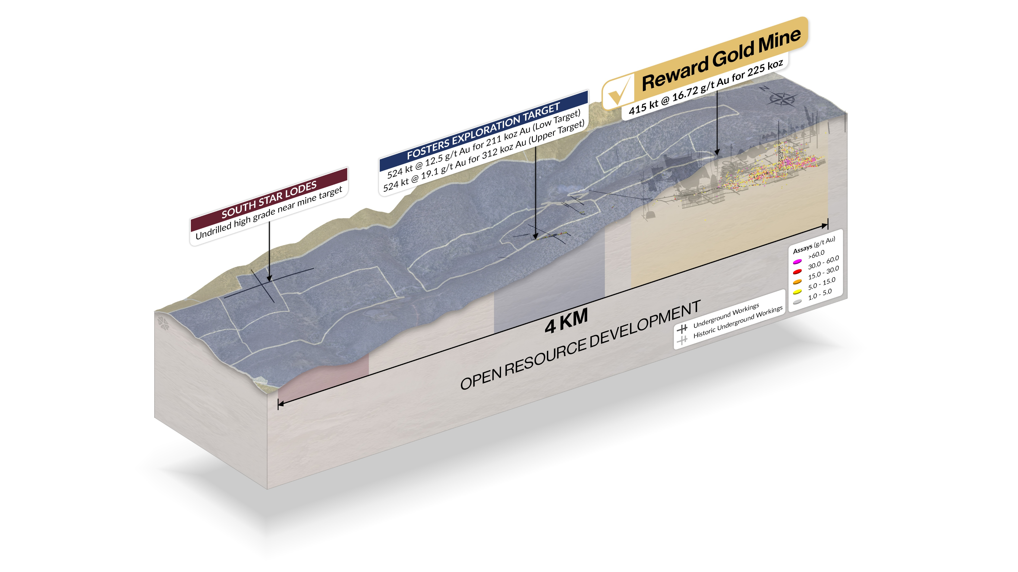
Reward
Gold Mine
Exploration Target at Fosters, approx. 400m south of Reward Gold Mine. Fosters sits within ground already covered by Vertex Mining Licenses and existing Development Consent. Fosters is accessed by an existing Adit and development drive.
ASX: VTX | OTCMKTS: VTXXF

Slide 15
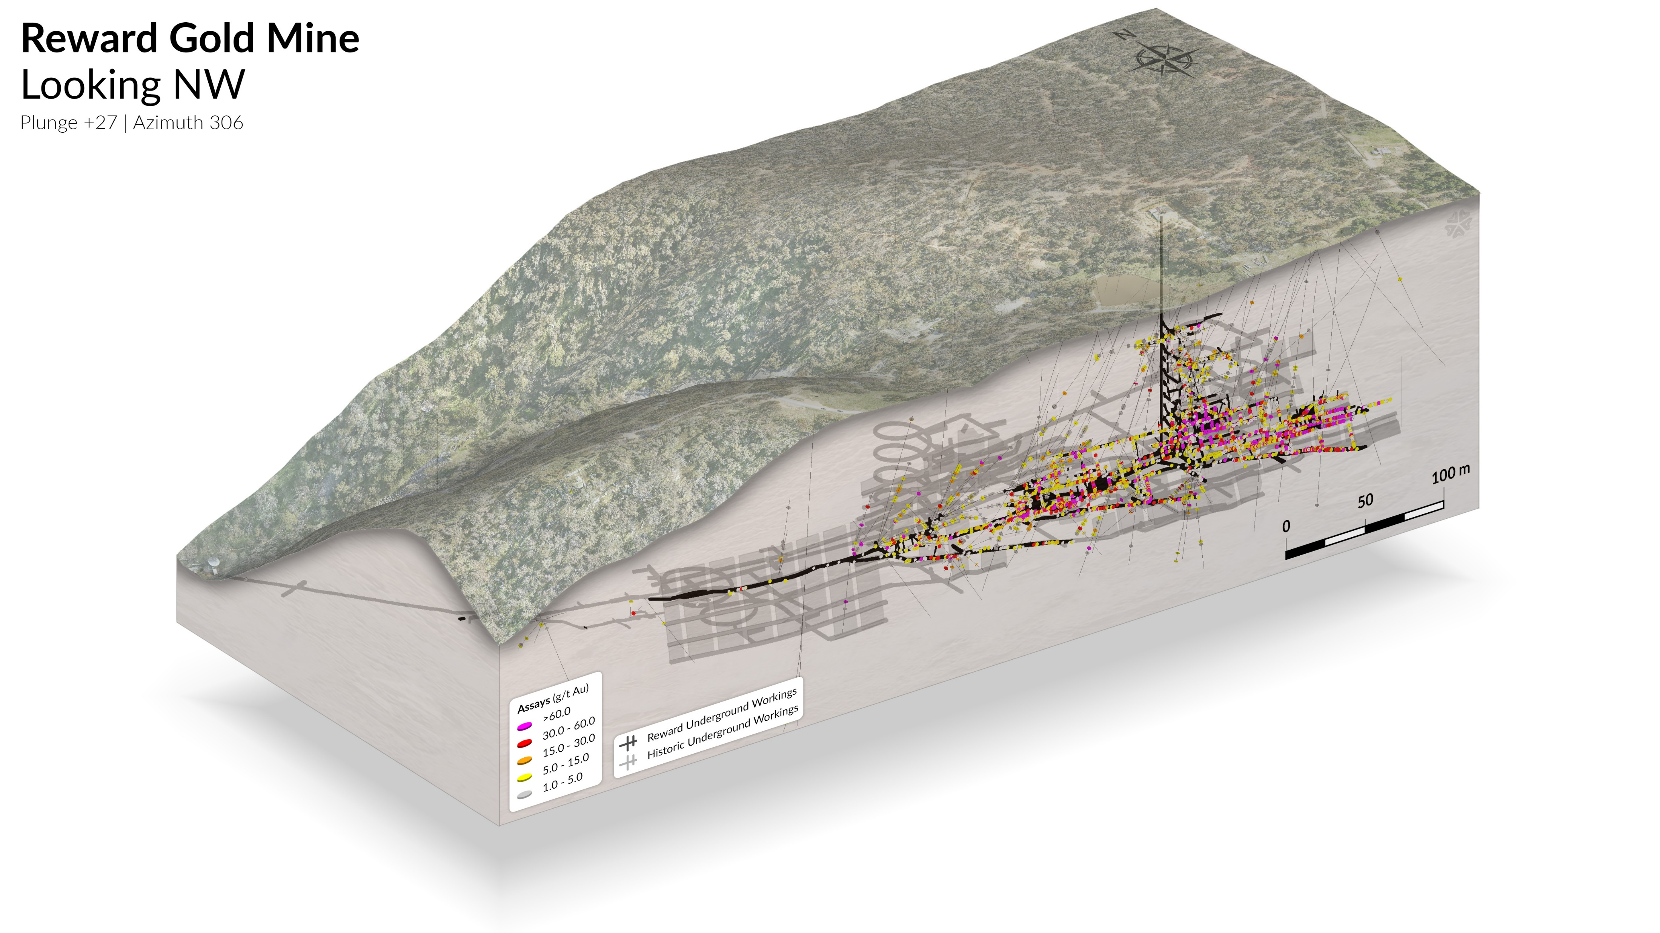
ASX: VTX | OTCMKTS: VTXXF

Slide 16
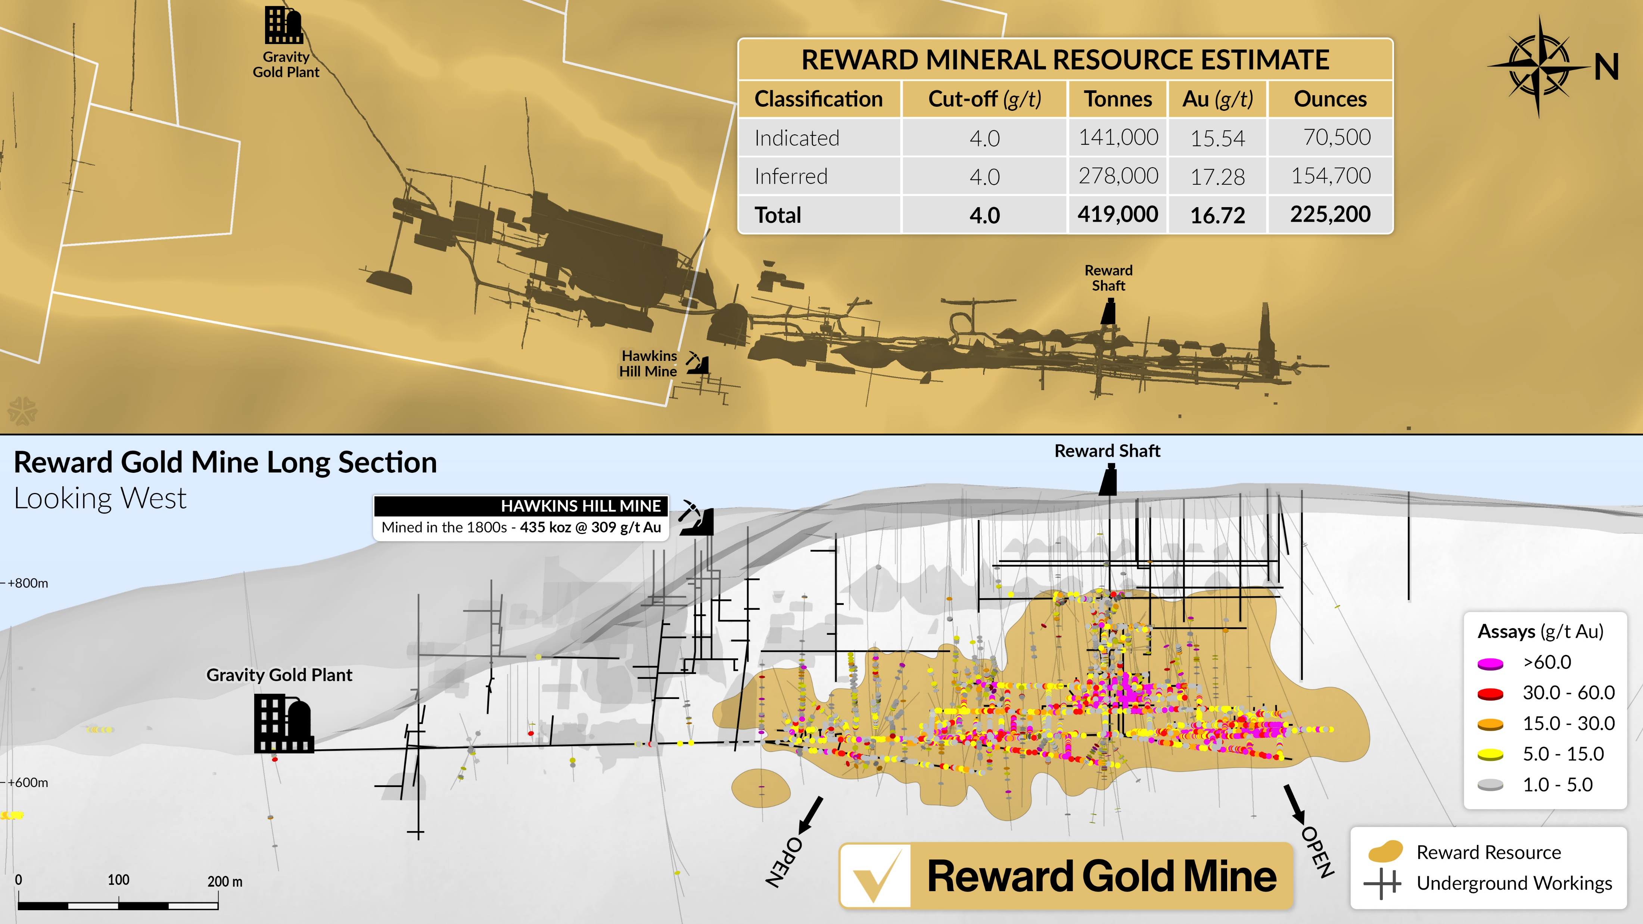

A Long Life Expected
Beyond the Mine Plan
Exploration Target at Fosters, approx. 400m south of Reward Gold Mine. Fosters sits within ground already covered by Vertex Mining Licenses and existing Development Consent. Fosters is accessed by an existing Adit and development drive.

Slide 17
Reward Gold Mine
Mine Ready for Production
Experienced Team & Equipment
High-Grade
Stopes
Gold ore is ready to mine at the Reward Gold Mine, with multiple headings available for advancement. Production of underground ore is scheduled to commence in September 2025.
Advanced underground mining equipment is already on site or nearby, supported by a highly skilled mining team operating under the Vertex owner-operator model — where Grade is KING.
The first stope block comprises 700 tonnes @ 42.5 g/t Au, with the total stope containing 2,075 tonnes @ 17.8 g/t Au, positioning the mine for strong early-grade production.
ASX: VTX | OTCMKTS: VTXXF

Slide 18

At only AUD $3,000 (Based on ASX: VTX announcement 26 February 2024)
Reward Gold Mine Financials
from PFS
Based on Reserve 2-year production – Management Mine Plan 6 years
Project Life
Gold Production
Gross Revenue
2 years of minerals
processing activities
49,890 ounces
$150 million
CAPEX
AISC
Total Employment
$17 million Pre Production
AUD $1,833 per ounce
70 Full Time Employees
Free Cashflow
NPV at 7%
IRR
$41 million pretax
$33.3 million pretax
110% pretax
Does not include stockpile processing
Note: based on Indicated Resource only –This is a JORC rule. (The model uses 50kozs of the 225kozs at 16.7 g/t)First 6 months day shift only at a reduced input.
ASX: VTX | OTCMKTS: VTXXF

Slide 19

Vertex will carry out its own resource development utilizing its own rig
The diamond rig will be utilised to target
The ultra high grade vein system that runs down plunge of Reward Gold Mine
To bring the Reward Resource into Indicated-225 kozs@16.7 grams
The exploration target
ASX: VTX | OTCMKTS: VTXXF

Slide 20
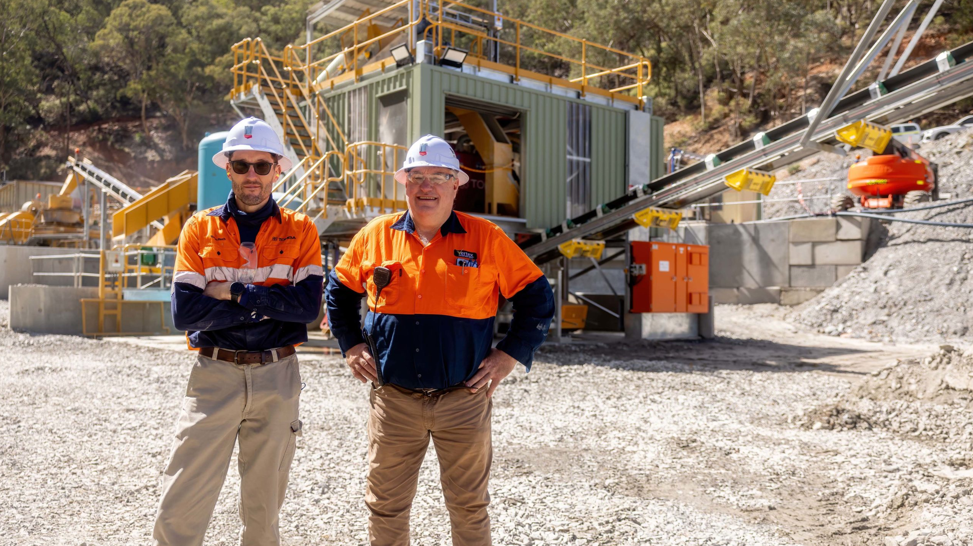



Environmental and Sustainable Mining Objectives
Efficient &
Responsible Processing
Cost &
Resource Efficiency
Environmentally
Friendly Tailings & Waste
Gravity Recoverable Gold
Minimal grind (200–650 micron
No chemicals – no cyanide
Recovery of fine gold (to 23 µm)
Low Capex and low operating cost
Low water usage
Re-usable water
Benign tails with potential for commercial sand
Benign waste
Minimal tailings compared to production
No tailings dam required – dry stack
ASX: VTX | OTCMKTS: VTXXF

Slide 21
Vertex Summary
Production & Assets
Team & Strategy
01
02
01
02
Australia’s next high-grade gold producer
Hill End (1.8 Moz historic production)
Blue chip exploration ground in Australia’s Lachlan Fold Belt
+3000 historic workings, BIG system, largely untapped
03
04
03
04
40 km from Cadia, one of the world’s largest
gold mines
Underground mining commenced
Talented, dedicated operations team
Proven Board
& Management
ASX: VTX | OTCMKTS: VTXXF

Slide 22
Contact
Roger Jackson
Head Office
roger@vertexminerals.com.au
Bowen Street Hill End
+61 2 7229 4849
Website
Email
www.vertexminerals.com.au
admin@vertexminerals.com.au
ASX: VTX | OTCMKTS: VTXXF
Vertex Minerals

Slide 23

TOMRA Video

Slide 24
Hill End Project Mineral Resource Estimate
Deposit | Classification | Tonnes (kt) | Grade Au (g/t) | Contained Au (koz)
Reward Gold Mine | Indicated Inferred | 141 278 | 15.5 17.3 | 71 155
Sub Total |  | 419 | 16.7 | 225
Hargraves Project | Indicated Inferred | 1,109 1,210 | 2.7 2.1 | 97 80
Sub Total |  | 2,319 | 2.4 | 178
Red Hill Project | Indicated Inferred | 413 1,063 | 1.4 1.8 | 19 61
Sub Total |  | 1,476 | 1.7 | 80
Project Total | Indicated Inferred | 1,663 2,551 | 3.5 3.6 | 187 296
Grand Total |  | 4,214 | 3.6 | 483
Robust and
Primed to Grow
Gold Inventory
Where statements in this announcement refer to exploration results which previously been reported, the Company confirms that it is not aware of any new information or data that materially affects the information included in the original announcements, and in the case of estimates of Mineral Resources, that all material assumptions and technical parameters underpinning the estimates in the relevant market announcements continue to apply and have not materially changed. The Company confirms that the form and context in which the Competent Persons’ findings are presented have not materially modified from the original
market announcements.
Reward Gold Mine: 2.0g/t reporting cutoff grade
Hargraves: 0.8 g/t reporting cutoff grade (ASX Announcement 29 May 2020).
Red Hill: 0.5 g/t per block, ordinary kriging grade interpolation, classified mineral Resources Limited to 160mRL below surface. (ASX Announcement November 2015)
ASX: VTX | OTCMKTS: VTXXF

