Slide 1

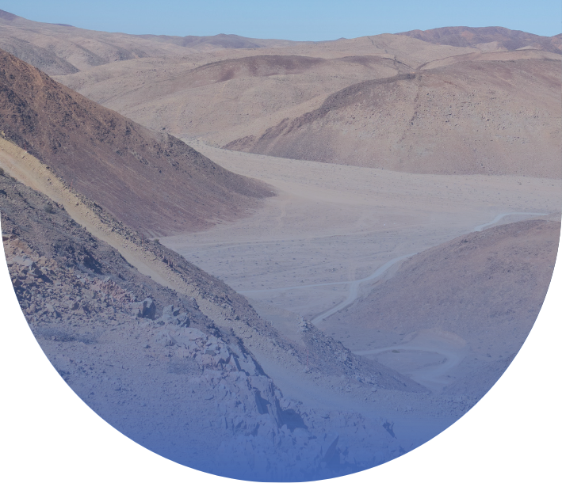


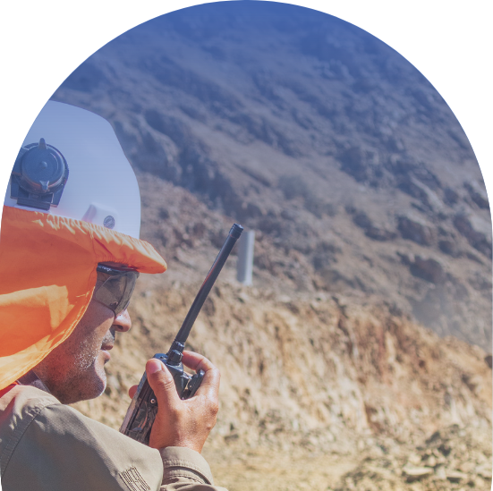
UNLOCKING A DISTRICT-SCALE GOLD SYSTEM IN ONE OF THE WORLD’S PREMIER MINING JURISDICTIONS
MINING FORUM AMERICIAS
September 2025
ASX:TSO | OTCQB:TSORF

Slide 2
DISCLAIMER
This presentation and any accompanying verbal presentation (together the Presentation) are confidential and have been prepared by Tesoro Gold Limited (Tesoro or the Company) and approved by the Board of the Company. The information contained in the Presentation (Information) is summary only and should be read in conjunction with any other documents provided to you by the Company. The Information is current as at 08 September 2025 and the Company does not undertake to provide any additional or update information, whether as a result of new information, future events or results or otherwise. By receiving the Presentation, you acknowledge and represent to the Company that you have read, understood and accepted the terms of this disclaimer.
The Company has prepared the Presentation based on information available to it at the time of preparation. No representation or warranty, express or implied, is made as to the currency, accuracy, reliability, completeness or fairness of the information, opinions and conclusions contained in this Presentation. Tesoro, or related bodies corporate, shareholders or affiliates, nor any of their respective officers, directors, employees, affiliates, agents or advisers (Agents) guarantee or make any representations or warranties, express or implied, as to or take responsibility for, the currency, accuracy, reliability, completeness or fairness of the information, opinions and conclusions contained in this Presentation. Tesoro does not represent or warrant that this Presentation is complete or that it contains all material information about Tesoro or which a prospective investor or purchaser may require in evaluating a possible investment in Tesoro or acquisition of shares. To the maximum extent permitted by law, Tesoro and its Agents expressly disclaim any and all liability, including, without limitation, any liability arising out of fault or negligence, for any loss arising from the use of information contained in this Presentation, or otherwise arising in connection with it.
Any forward-looking statements in this Presentation, including projections, forecasts and estimates, are provided as a general guide only and should not be relied on as an indication or guarantee of future performance and involve known and unknown risks, uncertainties, assumptions, contingencies and other important factors, many of which are outside the control of Tesoro and which are subject to change without notice and could cause the actual results, performance or achievements of Tesoro to be materially different from the future results, performance or achievements expressed or implied by such statements. Past performance is not necessarily a guide to future performance and recipients of this Presentation are cautioned not to place undue reliance on such forward-looking statements.
The information contained in this Presentation is for information purposes only, does not constitute investment or financial product advice (nor taxation, accounting or legal advice) and is not intended to be used as the basis for making an investment decision. In providing this Presentation, Tesoro has not considered the objectives, financial position or needs of any particular recipients. Before making an investment decision prospective investors should consider the appropriateness of the information in this Presentation having regard to their own objectives, financial situation and needs, and seek legal, taxation and financial advice appropriate to their jurisdiction and circumstances.
This Presentation is not a prospectus, product disclosure statement or other offer document under Australian law or any other law (and will not be lodged with the Australian Securities and Investments Commission or any other foreign regulator) and is not, and does not constitute, an invitation or offer of securities for subscription, purchase or sale in any jurisdiction. In particular, this Presentation does not constitute an invitation or offer of securities for subscription, purchase or sale in the United States or any other jurisdiction in which such an offer would be illegal. The securities referred to in this Presentation have not been, and will not be, registered under the U.S. Securities Act of 1933 as amended or the securities laws of any state or other jurisdiction of the United States and may not be offered or sold, directly or indirectly in the United States. The information in this Presentation is strictly confidential. It may not be disclosed, reproduced, disseminated, quoted or referred to, in whole or in part, without the express consent of Tesoro.
Competent Person’s Statements
The information in this report that relates to Exploration Results, Exploration Target and Metallurgical Results is based on information compiled by Mr Zeffron Reeves (B App Sc (Hons) Applied Geology) MBA, MAIG). Mr Reeves is a member of the Australian Institute of Geoscientists and a Director and shareholder of the Company. Mr Reeves has sufficient experience that is relevant to the style of mineralisation and type of deposit under consideration and to the activity which he is undertaking to qualify as a Competent Person as defined in the 2012 Edition of the Australasian Code for Reporting of Exploration Results, Mineral Resources and Ore Reserves. Mr Reeves consents to the inclusion in this report of the matters based on this information in the form and context in which it appears.
The information in this report that relates to Mineral Resources is based on information compiled by Mr Lynn Widenbar (B.Sc(Hons) Geology, M.Sc. FAusIMM, MAIG), a Competent Person who is a Fellow of The Australasian Institute of Mining and Metallurgy. Mr Widenbar is acting as an independent consultant to Tesoro Gold Limited. Mr Widenbar has sufficient experience that is relevant to the style of mineralisation and type of deposit under consideration, and to the activity being undertaken to qualify as a Competent Person as defined in the 2012 Edition of the ‘Australasian Code for Reporting of Exploration Results, Mineral Resources and Ore Reserves’. The Company confirms that it is not aware of any new information or data that materially affects the information contained the form and context in which the Competent Person’s findings are presented have not been materially modified from in the original announcement on 4 August 2025, and all material assumptions and technical parameters underpinning the estimates in that announcement continue to apply and have not materially changed.
The information in this report that relates to the Production Target, assumptions on Modifying Factors and evaluation of other relevant factors are based on and fairly represents information and supporting documentation that has been compiled for this announcement and have been compiled under the supervision of Mr Linton Putland BEng (Mining), MSc (Mineral Economics) & Member AusIMM. Mr Putland is a Director of the Company. Mr Putland has reviewed and approved the technical content of this announcement. Mr Putland is a Competent Person as defined in the 2012 Edition of the Australasian Code for Reporting of Exploration Results, Mineral Resources and Ore Reserves (JORC Code 2012). Mr Putland consents to the inclusion in this announcement of the matters based on his information in the form and context in which it appears.
The Company has released all material information that relates to Exploration Results for the El Zorro Gold Project, on a continuous basis to the ASX and in compliance with JORC 2012. The Company confirms that it is not aware of any new information that materially affects the content of this ASX release.
INVESTOR PRESENTATION |

Slide 3

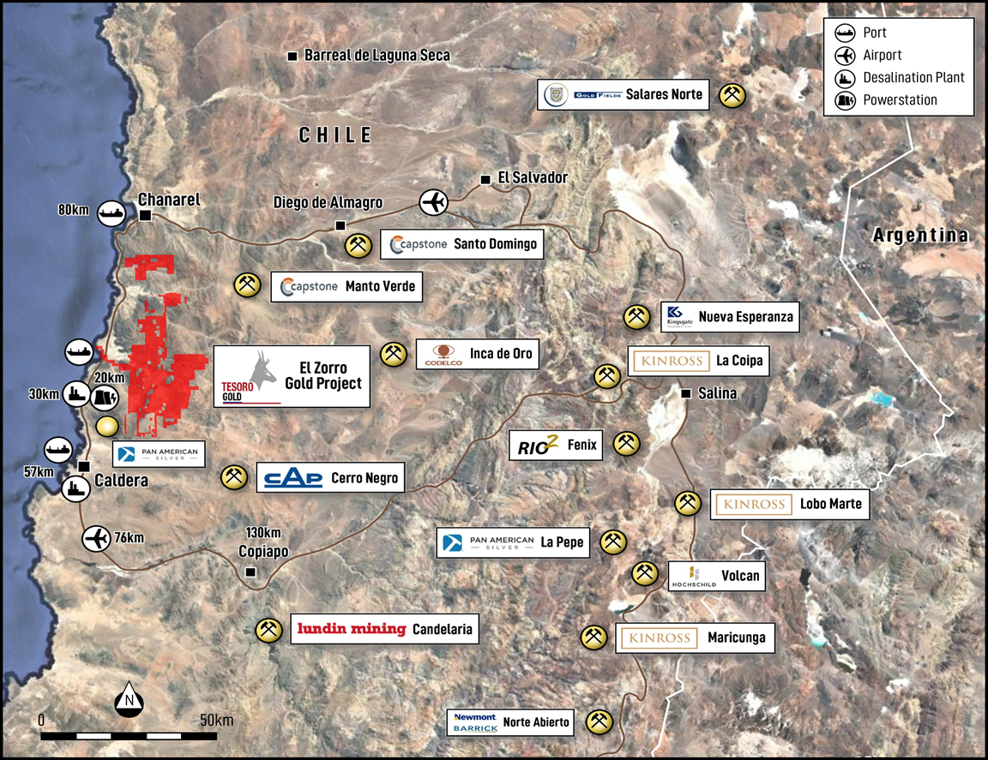
CHILEAN GOLD EXPLORATION AND DEVELOPMENT
PROXIMATE TO ESTABLISHED infrastructure AND EXISTING MINES
  Coastal location surrounded by mines.
  Four of the world's largest gold company’s operating in the region.
  Just 15km from the Pan American Highway and Pacific Ocean.
  Grid power within 20km.
  Water within 30km.
  Atacama Airport less than a 1-hour drive.
  Chile’s Capital, Santiago a 1 hour flight.
  Close to population centres of Caldera, Chañaral and Copiapó.
EL ZORRO GOLD PROJECT
INVESTOR PRESENTATION |

Slide 4
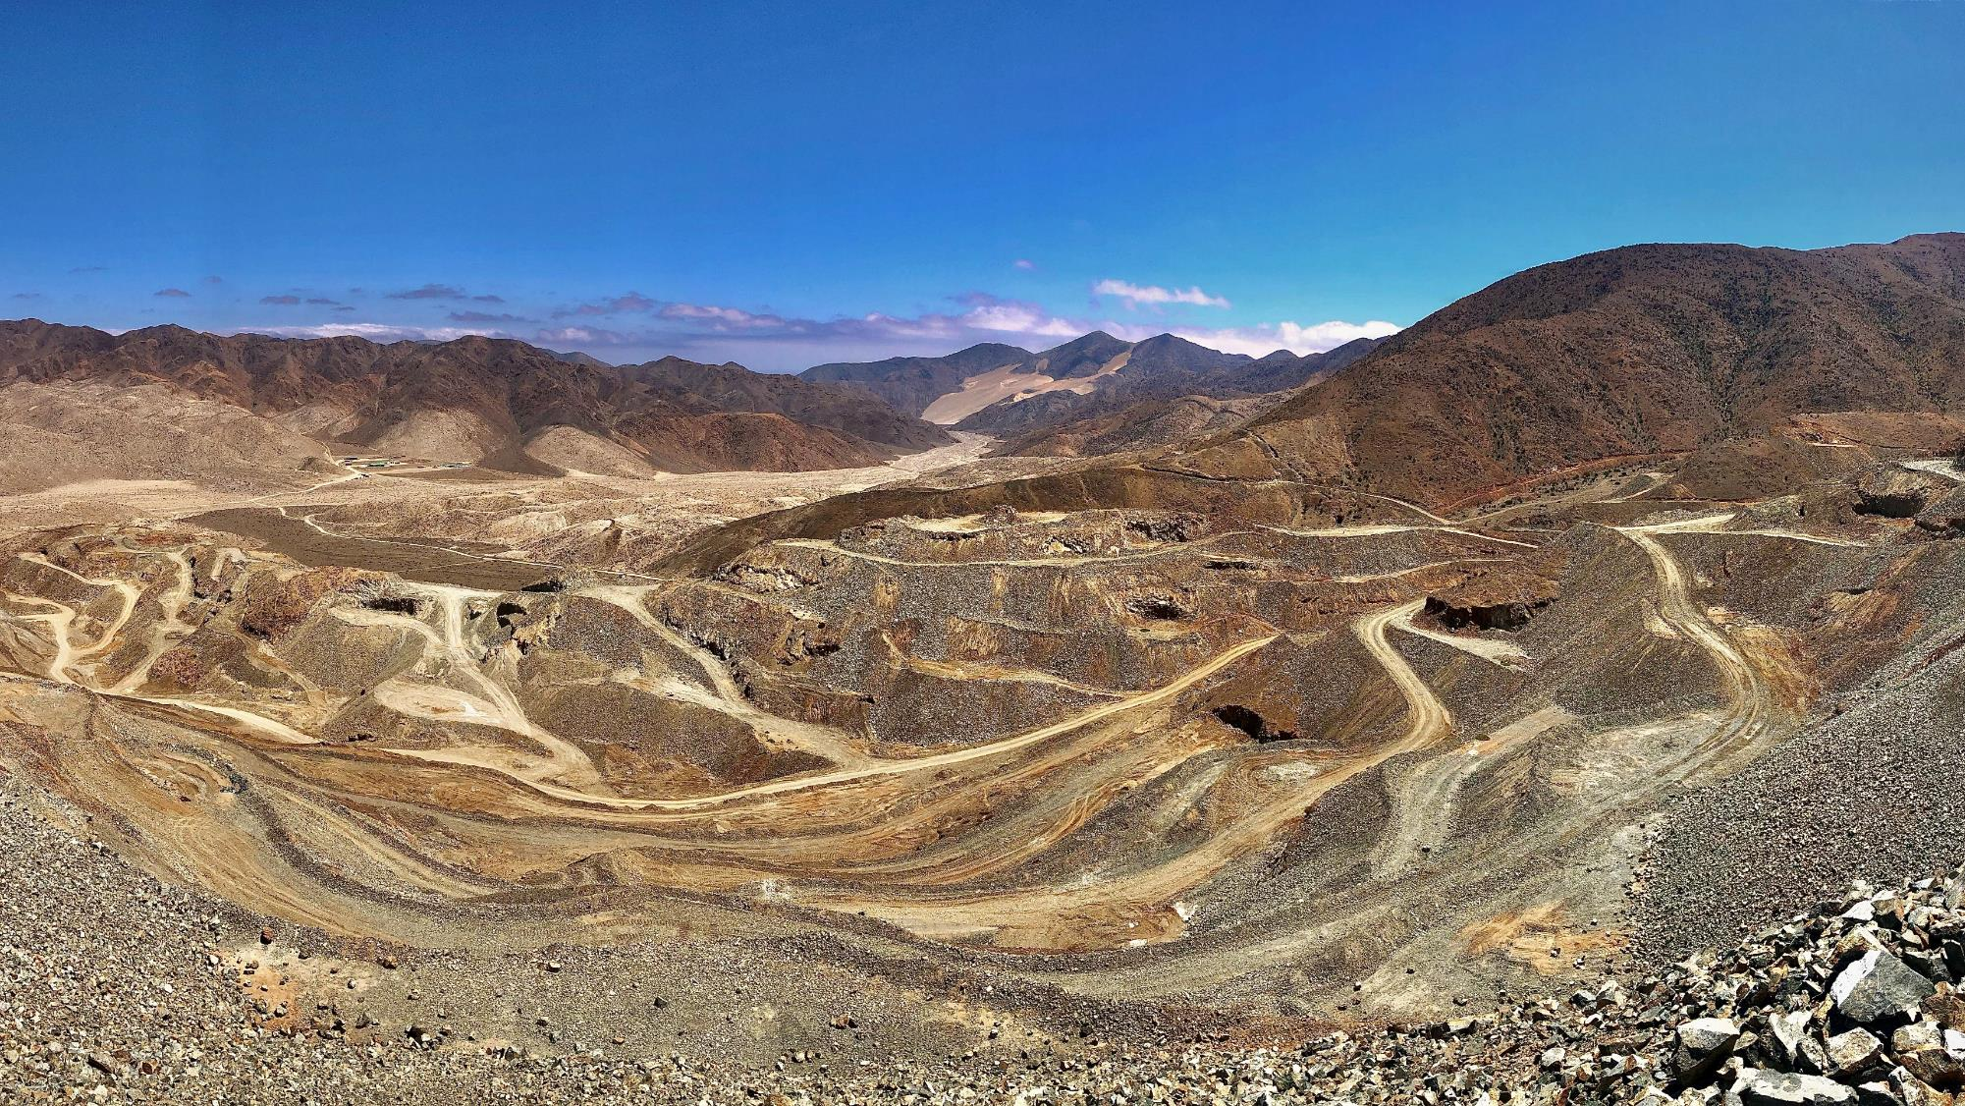
JULY 2025
ASX:TSO | OTCQB:TSORF | FSE:5D7

Slide 5
MULTIPLE >100 GRAM-METRE INTERCEPTS
UNLOCKING A NEW GOLD PROVINCE
ZDDH0297: 434.60m @ 1.22g/t Au; incl. 89.95m @ 3.07g/t Au, incl. 20.80m @ 9.19g/t Au;
ZDDH0394: 46.67m @ 11.86g/t Au; incl. 22.25m @ 23.66g/t Au, incl. 0.50m @ 924g/t Au;
ZDDH0025: 121.55m @ 1.32g/t Au; incl. 12.27m @ 4.98g/t Au, incl. 4.70m @ 10.69g/t Au;
ZDDH0356: 132.18m @ 1.28g/t Au, incl. 32.20m @ 3.28g/t Au, incl. 3.25m @ 12.64g/t Au;
ZDDH0378A: 63.97m @ 1.26g/t Au; incl. 9.34m @ 6.60g/t Au; incl. 4.00m @ 13.74g/t Au;
ZDDH0288: 63.93m @ 7.61g/t Au; incl. 7.00m @ 66.10g/t Au;
ZDDH0154: 67.00m @ 3.44g/t Au; incl. 13.50m @ 15.84g/t Au;
ZDDH0290: 63.60m @ 2.89g/t Au; incl. 10.60m @ 14.34g/t Au;
ZDDH0338: 1.80m @ 77.15g/t Au; incl. 0.8m @ 173.00g/t Au; and
ZDDH0351: 58.70m @ 2.10g/t Au; incl. 7.50m @ 12.42g/t Au.
Refer ASX announcements, 28 October 2024 (349A), 31 August 2022, (288 & 290) 30 March 2022, (011), 27 May 2020 (025), 4 September 2020 (031), 4 November 2020 (049), 22 December 2020 (069), 11 January 2021 (075), 5 August 2021 (154), 8 November 2022 (309), 16 January 2025 (351, 356), 30 June 2025 (378A), 13 June 2024 (338).
INVESTOR PRESENTATION |

Slide 6

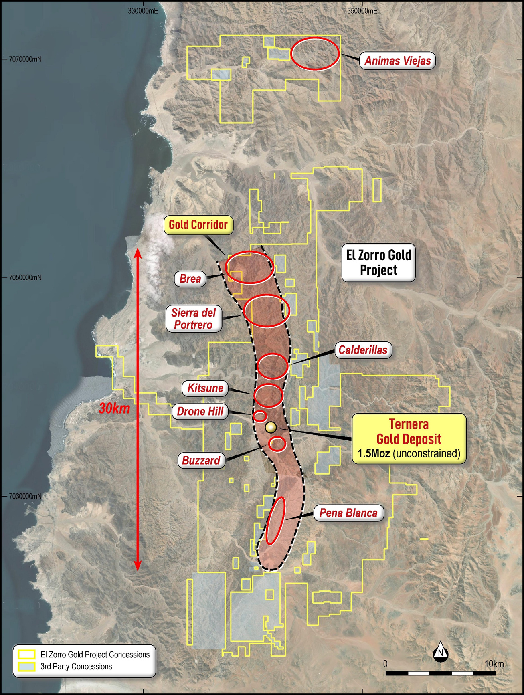





A GOLDEN OPPORTUNITY
DEVELOPING A MAJOR NEW GOLD DISTRICT
GOLD CORRIDOR
EL ZORRO GOLD PROJECT, CHILE
Large surface footprint spanning 570km² in Chile’s prolific Atacama mining region.
Constrained Ternera MRE now stands at 1.82Moz with 62% classified as Indicated ¹.
Metallurgical results delivered average gold recovery of approximately 95%².
Supports a conventional, simple, well-understood and low-cost CIP process.
Ternera updated open pit scoping study:
Base Case gold price US$2,750/oz;
NPV_{7.5%;} US$663M, 51% IRR (post-tax) ; and
AISC of US$1,216/oz.
TERNERA
GOLD DEPOSIT
2Moz RESOURCE
Refer to Mineral Resource Update 4 August 2025 and Appendix A. Tesoro Gold Limited confirms that it is not aware of any new information or data that materially affects the information included in that release. All material assumptions and technical parameters underpinning that release continue to apply and have not materially changed.
Refer to ASX announcement dated 29 August 2025

Slide 7

CORPORATE SNAPSHOT
GOLD FIELDS STRATEGIC INVESTMENT
TESORO GOLD (ASX: TSO, OTCQB:TSORF)
GOLD FIELDS STRATEGIC INVESTMENT
REGISTER DETAIL
GOLD FIELDS STRATEGIC INVESTMENT
Global gold producer - nine operating mines across Australia, Chile, Ghana, Peru and South Africa
Owns Salares Norte gold-silver mine in Northern Chile, near El Zorro Gold Project¹
Large-scale industry player - 3.9 Moz Resource and 3.5 Moz Reserve (gold only)²
Partnership with Tesoro continues to accelerate exploration at El Zorro Gold Project
REGISTER DETAIL
CAPITAL STRUCTURE
BOARD AND MANAGEMENT
Share price (3 September 2025) | A$0.053
Shares on issue | 2,015M
Performance rights | 76.3M
Share Rights | 1.9M
Unlisted options | 17.0M
Listed options¹ | 136.3M
Market capitalisation (undiluted) | A$100M
Cash (30 June 2025) | A$7.5M
Debt (30 June 2025) | Nil
Mark Connelly | Independent Non-Executive Chair
Zeff Reeves | Managing Director
Linton Putland | Executive Director – Mining and Development
Emma Curnow | Chief Financial Officer
Tim Williams | Chief Development Officer
Sergio Uribe | Country Manager Chile
Geoff Mcnamara | Non-Executive Director
Alan Gibson | Non-Executive Director
Sue Wong | Company Secretary
REGISTER DETAIL
Source: https://www.bnamericas.com/en/features/5-chilean-gold-projects-set-to-help-boost-national-output
Source: www.goldfields.com
7
INVESTOR PRESENTATION |
INVESTOR PRESENTATION |

Slide 8
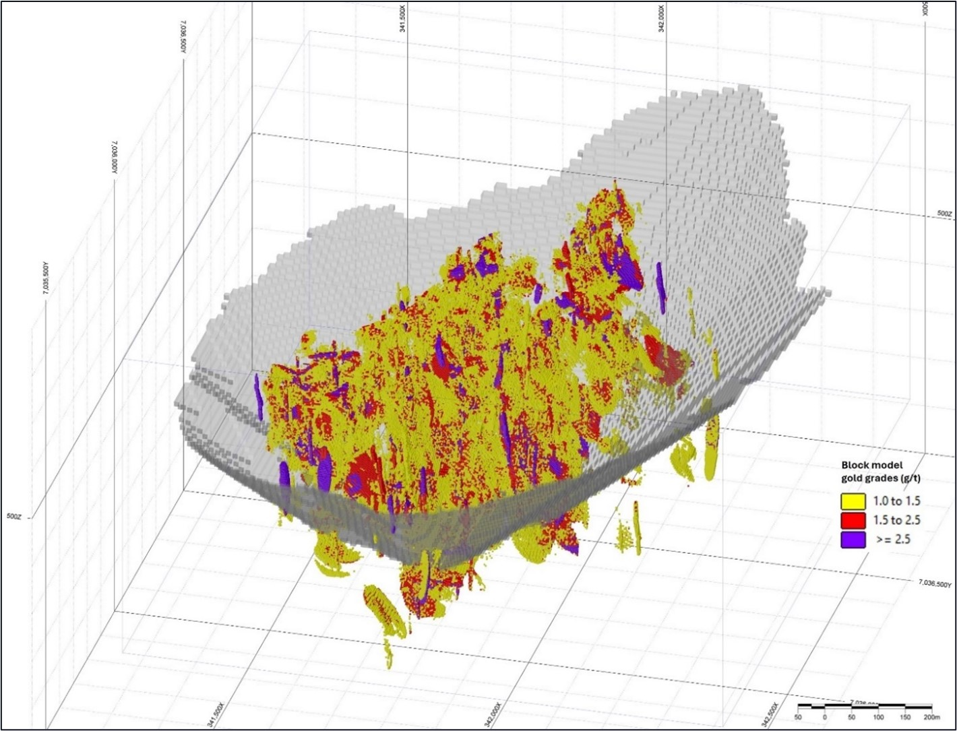
EXPANDED AND UPGRADED TERNERA MRE
CONTINUED GROWTH OF THE RESOURCE BASE
OPPORTUNITY FOR A SINGLE OPEN PIT
  Constrained MRE 1.82Moz with 62% Indicated.
  Deposit remains open in all directions.
  New zones to chase in the north and south.
  Represents a significant improvement in ounces per vertical metre.
NEXT STEPS
NEXT STEPS
  Ongoing exploration across the 30km gold corridor with multiple high-priority targets.
  Excellent potential for additional discoveries.
  Ternera infill and extensional drilling continues.
  Drilling of regional targets, Q4 2025.
Isometric view if the Ternera Gold Deposit block model looking north-west. Showing >1g/t blocks only and US$3000/oz pit shell. Datum PSAD56 19S
Refer to ASX Announcement dated 4 August 2025 and the Appendix. Tesoro Gold Limited confirms that it is not aware of any new information or data that materially affects the information included in that release. All material assumptions and technical parameters underpinning that release continue to apply and have not materially changed.
INVESTOR PRESENTATION |

Slide 9
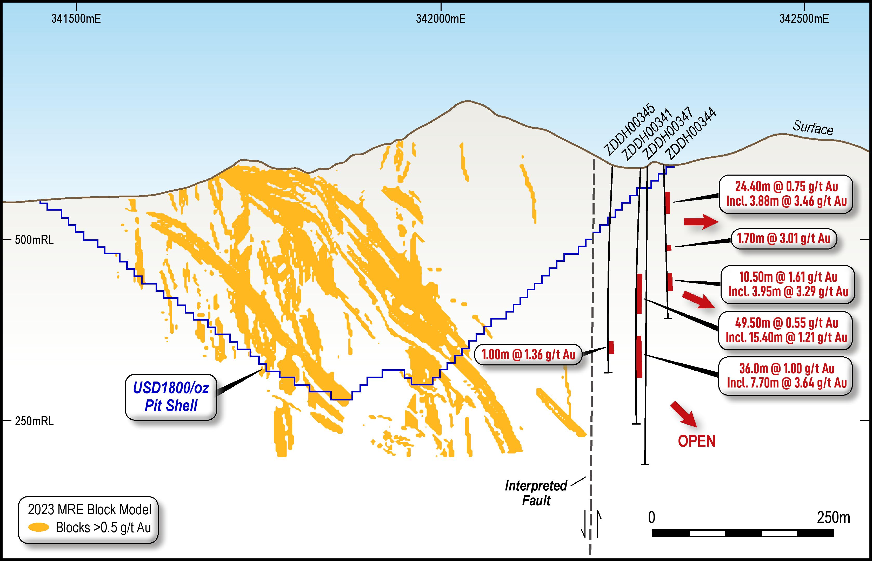
NEW DISCOVERIES ADJACENT TO TERNERA
NEW DISCOVERY AT TERNERA EAST AND DRONE HILL
potential major fault
offset or Ternera ‘repeat’
Ternera East
Two substantial, well-mineralised zones including;
    49.50m @ 0.55g/t Au from 179.00m, including;
        15.40m @ 1.21g/t Au from 182.00m; and
        5.40m @ 2.21g/t Au from 182.0m and;
    36.00m @ 1.00g/t Au from 281.50m including;
        17.50m @ 1.91g/t Au from 282.00m
        7.70m @ 3.64g/t Au from 283.30m
        2.30m @ 9.50g/t Au from 288.30m
Ternera Gold Deposit Cross Section looking north: Showing Ternera East drilling (holes projected onto section)
drilling program underway TARGETING DEFINITION OF
Ternera East –FOR ADDITIONAL PIT OUNCES
Refer Tesoro ASX releases 2 July 2024, 12 February 2024, 19 October 2023, 18 September 2023 and 28 October 2024
INVESTOR PRESENTATION |

Slide 10

FINANCIAL OUTCOMES
DEMONSTRATE ECONOMIC VIABILITY
Financials (± 35%) | UoM | Base | Spot
Gold price | US$/oz | 2,750 | 3,300
NPV_{7.5%} (pre-tax) | US$M | 917 | 1,331
IRR (pre-tax) | % | 60 | 79
Net cash flow (undiscounted, pre-tax) | US$M | 1,684 | 2,377
NPV_{7.5%} (post-tax) | US$M | 663 | 966
IRR (post-tax) | % | 51 | 68
Net cash flow (undiscounted, post-tax) | US$M | 1,230 | 1,983
Payback period (post-tax) | months | 20 | 16
HIGHLY ATTRACTIVE CHILEAN GOLD DEVELOPMENT OPPORTUNITY
WITH STRONG ECONOMICS AND SIMPLE DEVELOPMENT PATHWAY
Exceptional cash flow generation even in a conservative Base Case scenario
Rising to almost US$2 billion over the initial life of mine in a Spot Case scenario
Refer to ASX announcement dated 11 September 2025. Tesoro Gold Limited confirms that it is not aware of any new information or data that materially affects the information included in that release. All material assumptions and technical parameters underpinning that release continue to apply and have not materially changed.
INVESTOR PRESENTATION |

Slide 11
SENSITIVITY ANALYSIS
STRONG PROJECT VALUE ACROSS GOLD PRICE SCENARIOS
THE RIGHT COMMODITY
BASE CASE POST TAX NPV_{7.5%} SENSITIVITY
  Greatest economic leverage to changes in gold price and operating costs.
  Underlying macroeconomic environment supportive of spot price stability with further upside potential in the medium term.
US$663M
(post-tax)
DETAILED GOLD PRICE SENSITIVITY
 |  | 2,300 | 2,450 | 2,600 | 2,750 | 2,900 | 3,050 | 3,200 | 3,350 | 3,500 | 3,650 | 3,800 | 3,950
Pre-Tax
NPV_{(7.5%)} | US$M | 578 | 691 | 804 | 917 | 1,030 | 1,143 | 1,256 | 1,369 | 1,482 | 1,595 | 1,708 | 1,821
IRR | % | 43% | 49% | 54% | 60% | 65% | 70% | 75% | 80% | 85% | 90% | 95% | 100%
LOM FCF | US$M | 1,118 | 1,307 | 1,496 | 1,684 | 1,873 | 2,062 | 2,251 | 2,440 | 2,629 | 2,818 | 3,007 | 3,196
Post-Tax
NPV_{(7.5%)} | US$M | 414 | 497 | 580 | 663 | 745 | 828 | 911 | 993 | 1,076 | 1,159 | 1,241 | 1,324
IRR | % | 37% | 42% | 46% | 51% | 56% | 60% | 65% | 69% | 73% | 77% | 81% | 85%
LOM FCF | US$M | 816 | 954 | 1,092 | 1,230 | 1,368 | 1,505 | 1,643 | 1,781 | 1,919 | 2,057 | 2,195 | 2,333
INVESTOR PRESENTATION |

Slide 12
NEW METALLURGY ENHANCES PREVIOUS OUTCOMES
TERNERA SAMPLES HIGHLY AMENABLE TO CONVENTIONAL CIP PROCESSING
KEY OUTCOMES
  Overall average recoveries of 95%.
  Gravity recoveries of 41%.
  Tests show highly consistent performance across both composite and master samples.
  No deleterious elements or preg-robbing.
  Ore is siliceous, brittle and fractures easily at coarse crushing size of 125μm.
  Low variability across composites, providing confidence to support advanced levels of technical studies.
HIGH RECOVERIES DELIVERED WITH VERY LOW REAGENT CONSUMPTION AND COARSE GRIND SIZE
Excellent average gold recovery of 95% from Ternera composite samples at coarse 125μm grind size.
Low (<0.2 kg/t) cyanide consumption and highly-favourable comminution characteristics.
Refer to ASX announcement dated 29 August 2025
INVESTOR PRESENTATION |

Slide 13

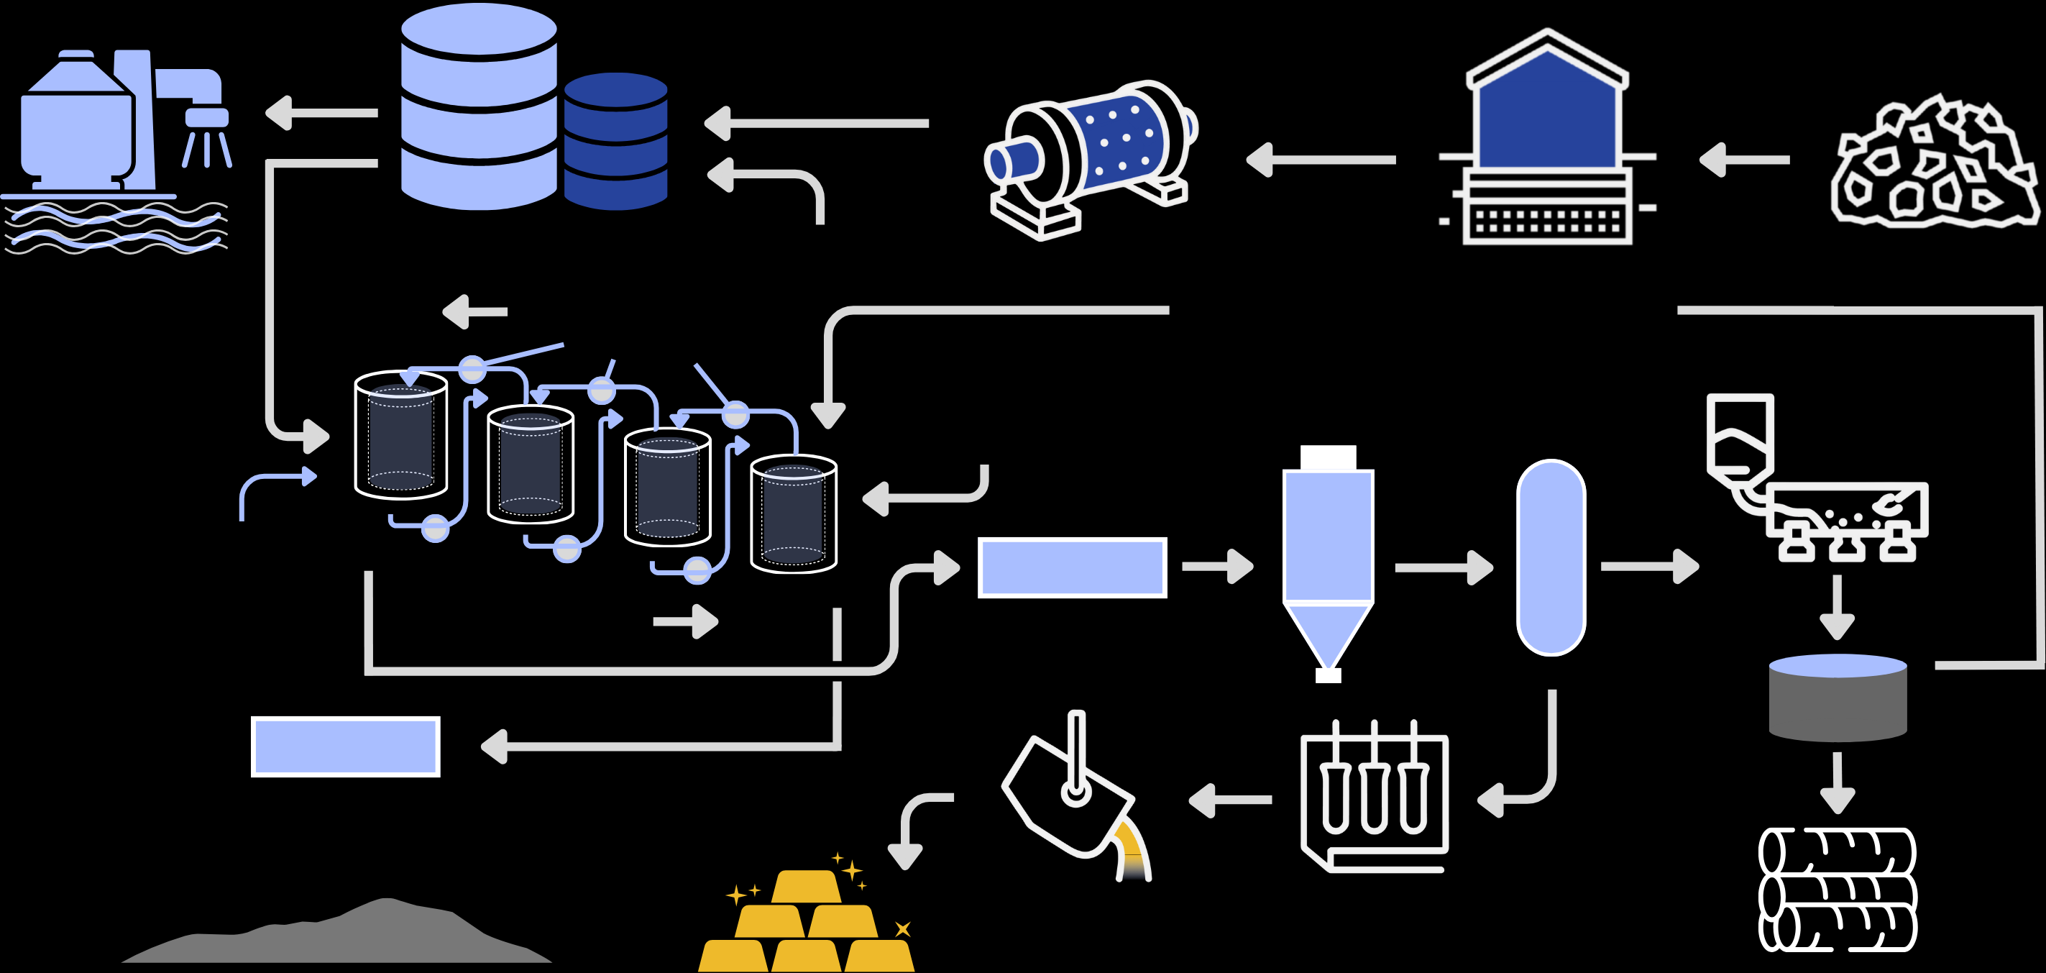
A SIMPLE, WELL UNDERSTOOD FLOWSHEET
TESTWORK CONFIRMS LOW-COST CIP PROCESSING ROUTE
LEACHING
TANKS
CRUSHING
PROCESS
WATER
BALL MINING
ORE STOCK PILES
Cyanide & other reagents
Desalination
plant
Carbon Advance
Regenerated Carbon
Transfer Pumps
Fresh Carbon after Pre-attritioning
Carbon
Acid Wash
Carbon
Elution
Carbon Regeneration
Interstage
Screens
SCREENS
Pulp Advance
SCREENS
TAILINGS
Carbon fines reused for other applications
SMELTING
ELECTROWINNING
Gold Dore
Schematic representation of expected CIP processing route.
INVESTOR PRESENTATION |

Slide 14
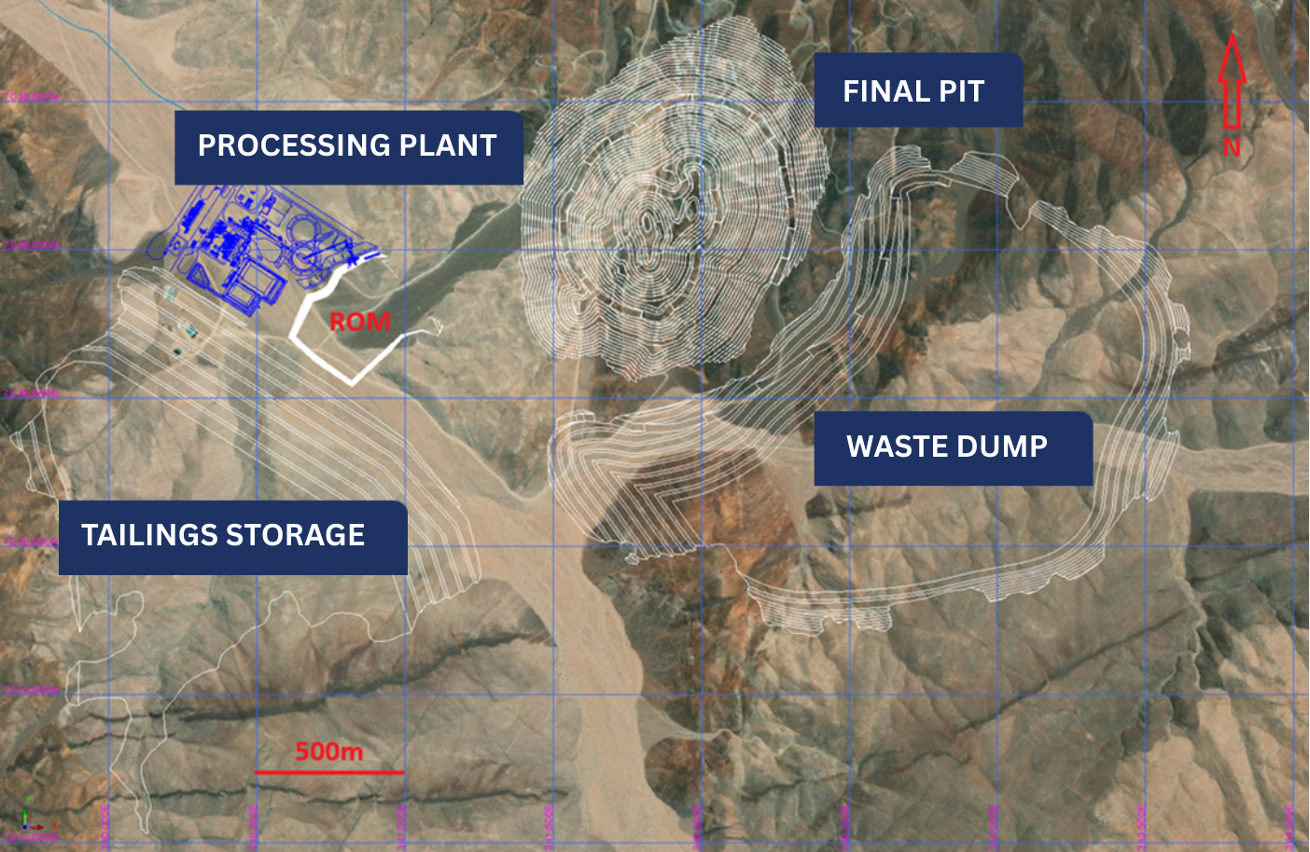
DETAILED COST ANALYSIS
LOW UPFRONT CAPITAL BURDEN
Costs (± 35%) | UoM | Outcome
Upfront capital (plant and process infrastructure) | US$M | 180.1
Upfront capital (open pit mining) | US$M | 26.4
Upfront capital (pre strip) | US$M | 41.4
Total upfront capital | US$M | 247.9
Sustaining capital | US$M | 39.7
Operating costs (mining) | US$/oz Au | 640
Operating costs (processing) | US$/oz Au | 444
Operating costs (general and administration) | US$/oz Au | 101
AISC (life of mine average) | US$/oz Au | 1,216
Development Plan At US$2,750 at 0.40g/t Au
Refer to ASX announcement dated 11 September 2025. Tesoro Gold Limited confirms that it is not aware of any new information or data that materially affects the information included in that release. All material assumptions and technical parameters underpinning that release continue to apply and have not materially changed.
INVESTOR PRESENTATION |

Slide 15
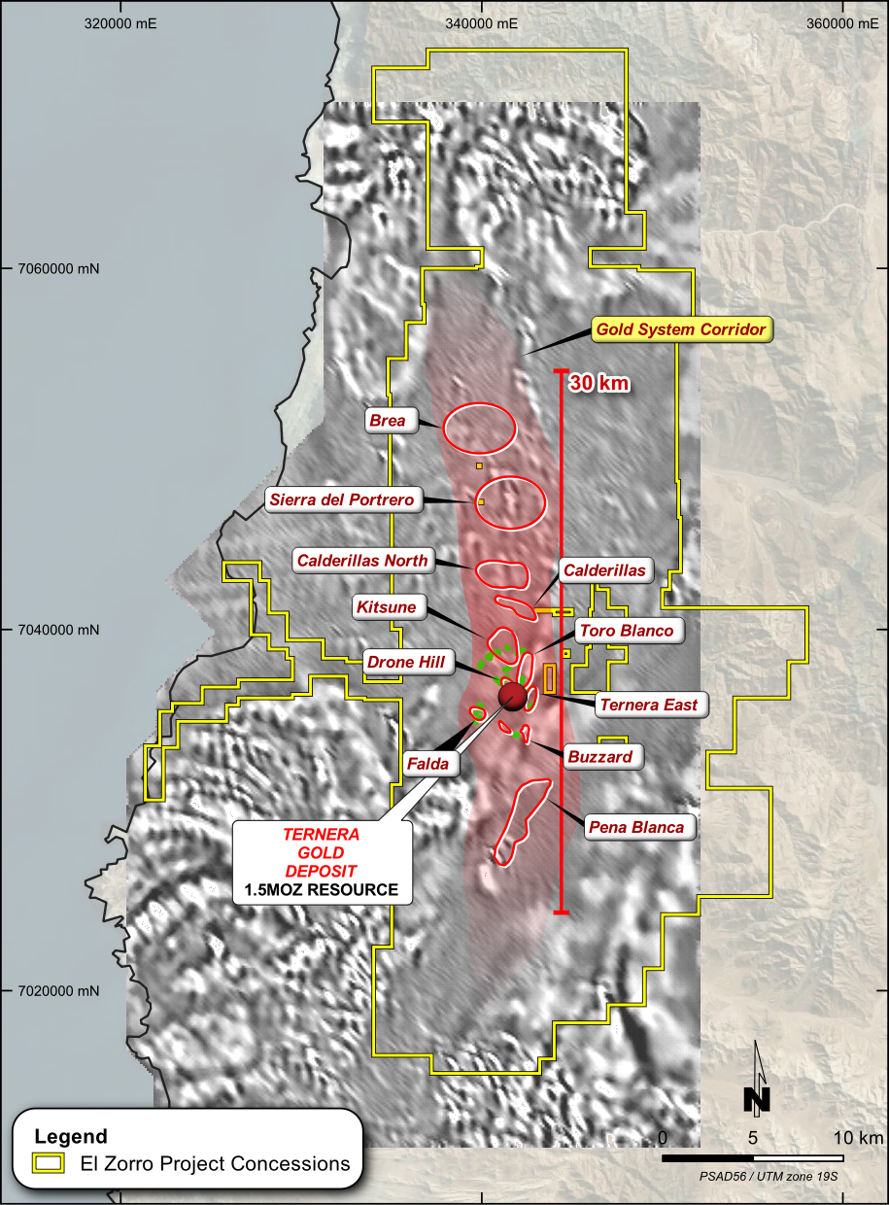
MAJOR NEW GOLD DEPOSIT IN CHILE
UNPARALLELED EXPLORATION UPSIDE
First Intrusive Related Gold System discovered in Chile.
Well defined “gold corridor” over 30km long.
3Moz Exploration Target at Ternera alone.
Current unconstrained MRE of 2Moz at Ternera.
Ternera open in all directions.
Testing of multiple drill-ready, near-deposit and district targets commencing Q4 2025.
District-wide target generation continues in parallel.
La Brea target to be drill tested in the coming weeks.
GOLD CORRIDOR
LA BREA
TERNERA
GOLD DEPOSIT
1.82MOZ RESOURCE
INVESTOR PRESENTATION |

Slide 16
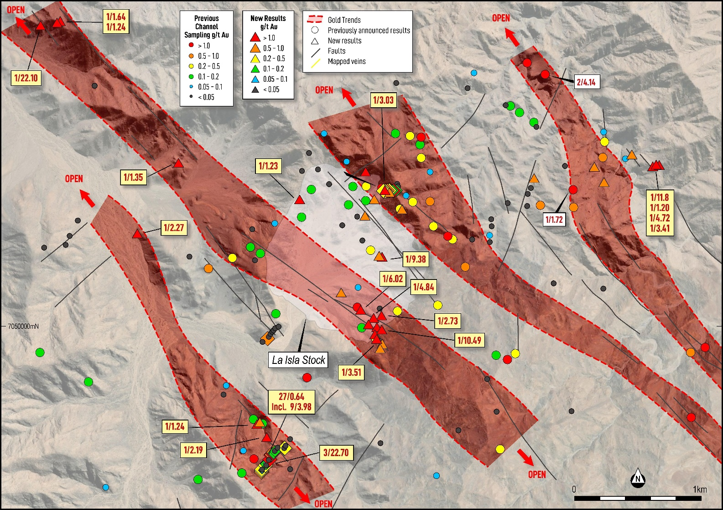
ADDITIONAL DISTRICT DISCOVERIES
La BREA HIGH PRIORITY TARGET TO BE DRILLED IN 2025
15km North of the 2Moz Ternera Deposit
Geological analogues to the Ternera Deposit
Four major northwest mineralised trends identified
Fault and alteration zones 4km long and 200 metre
Individual fault zones returned high-grade gold including:
  3m @ 22.70g/t Au (EZTR004827);
  9m @ 3.98g/t Au (EZTR004828);
  1m @ 9.32 g/t Au (EZTR004867);
  1m @ 22.10 g/t Au (EZTR005000);
  1m @ 11.80 g/t Au (EZTR005065);
  1m @ 9.38 g/t Au (EZTR005186);
  1m @ 10.45 g/t Au (EZTR005253); and
  4m @ 4.85 g/t Au (EZTR005259).
Refer Tesoro ASX release 10 July 2025..
El Zorro Gold Project: La Brea Target showing mapped structural and alteration zones with gold in red.
INVESTOR PRESENTATION |

Slide 17








A GOLDEN OPPORTUNITY
INVESTMENT HIGHLIGHTS
LARGE, HIGHLY PROSPECTIVE GOLD PROJECT
Located in Chile, unquestionably the premier location for building a new mine
2MOZ UNCONSTRAINED MINERAL RESOURCE
1.82Moz constrained with 62% classified as Indicated
EXCEPTIONAL METALLURGY FOR SIMPLE PROCESSING
Low-cost, well understood CIP process provides 95% gold recoveries
RESOURCE AND DISTRICT LEVEL GROWTH POTENTIAL
System with potential to comprise multiple discoveries
HIGHLY EXPERIENCED BOARD AND MANAGEMENT TEAM
Embedded local presence and deep Chilean expertise
PRE-FEASIBILITY STUDY
Builds on a solid base set for delivery MID 2026
INVESTOR PRESENTATION |

Slide 18

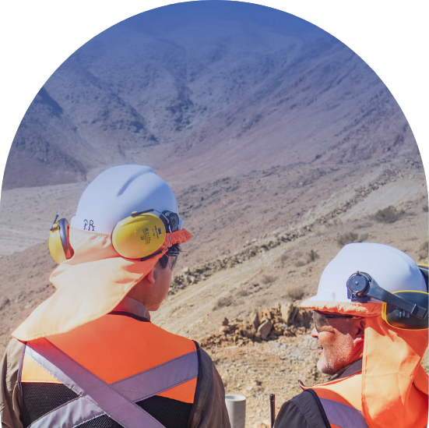
Tesoro Gold Limited
Level 39
152-158 St Georges Terrace
Perth, WA 600
+61 8 6383 7883
info@tesorogold.com.au
www.tesorogold.com.au
ASX:TSO | OTCQB:TSORF

Slide 19

WHY CHILE?
IT HAS ALL THE INGREDIENTS REQUIRED FOR GOLD MINE DEVELOPMENT
MINING POWERHOUSE
PREDICTABLE PERMITTING
Home to Anglo American , BHP, Barrick, Glencore, Kinross, Newmont, Rio Tinto.
Structured process, ~12 months average for approvals.
Strong institutional support for responsible mining.
2025 reforms cut timelines by 30–70%.
WORLD-CLASS GEOLOGY
#1 copper producer, #2 lithium producer, growing gold sector.
EXISTING INFRASTRUCTURE
Proven mineral endowment in the Coastal Cordillera.
Ports, power, services, and local engineering expertise.
Deep mining services ecosystem in-country.
PRO-INVESTMENT
US$56B in active foreign mining investment (2024).
27% corporate tax, no mining-specific royalties.
INVESTOR PRESENTATION |

Slide 20








LICENCE TO OPERATE
ENVIRONMENTAL AND SOCIAL STRATEGY
aligned to the United Nations Sustainable Development Goals with a commitment to ensuring exploration and operational activities generate positive sustainability outcomes
Health and safety | Occupational Health and Safety are fundamental responsibilities Tesoro has towards its workforce. Our strategies and practices are based on providing a safe workplace for all employees, suppliers and contractors.
Climate change | Total GHG emissions on a $ per value basis for newly mined gold is significantly lower than that for other major metals and mined products. Tesoro is committed to put in place a framework to ensure future mine developments are built and operated to support global greenhouse mitigation targets.
Environment | Tesoro applies leading exploration techniques, technology and practices to promote drilling efficiency and minimise environmental impacts. Furthermore, Tesoro is committed to continual improvement of its environmental performance through a robust environmental management program.
People and culture | Attracting, developing and retaining a diverse, inclusive and competent workforce is important to Tesoro and a key foundation to the company's policies and practices.
Community partnerships | Tesoro partners with the local and host communities of the Coastal Cordillera region of Chile to share value through the creation of local jobs and business opportunities.
Economic sustainability | Generating economic growth and value for all our investors, employees and stakeholders through successful exploration and investment in the Coastal Cordillera region of Chile.
INVESTOR PRESENTATION |

Slide 21
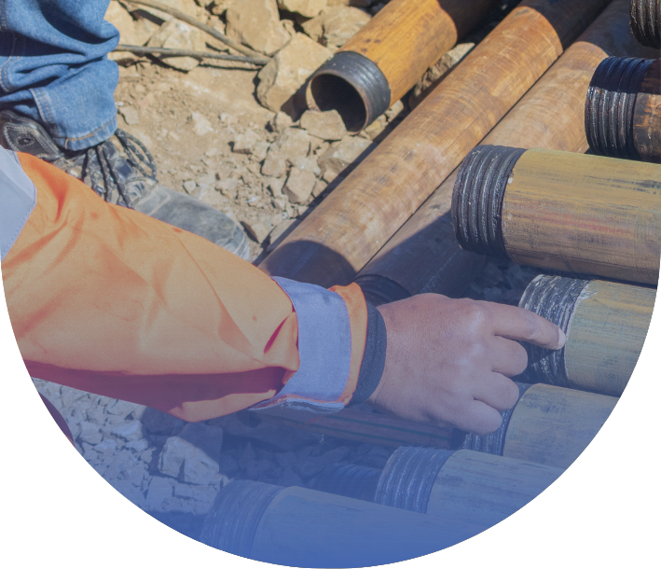
APPENDIX
ASX:TSO | OTCQB:TSORF
INVESTOR PRESENTATION |

Slide 22
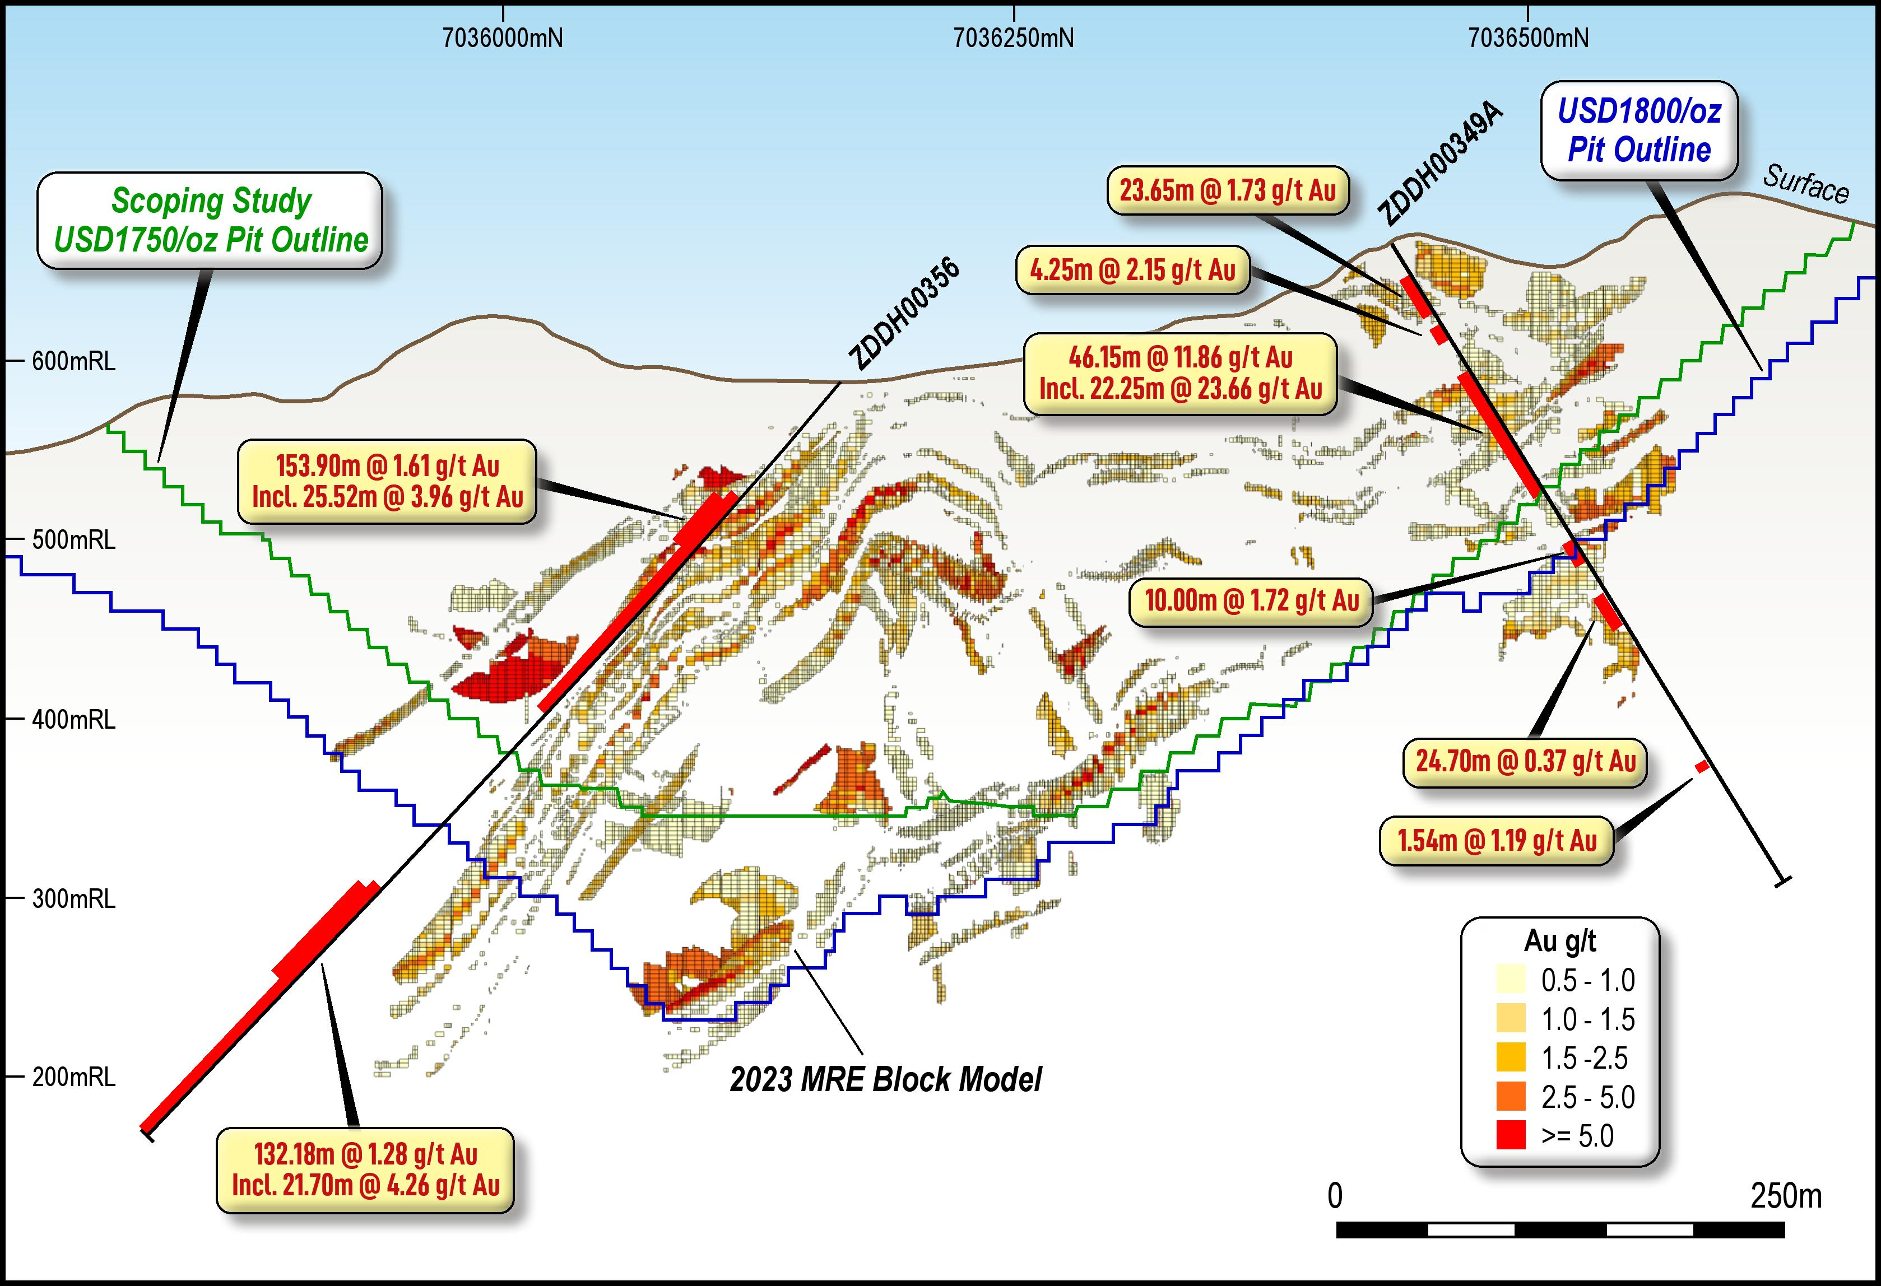
TERNERA | 2MOZ OF GOLD AND GROWING
A MAJOR NEW GOLD DEPOSIT IN CHILE¹
1.5Moz Deposit Chile’s first Intrusion-Related Gold System (IRGS)
TERNERA
Multiple mineralised drill intercepts outside the existing US$1,800/oz pit shell
Deposit is open in all directions
Significant potential for accelerated resource expansion
Current drilling programs will upgrade resource classification, grow resource and make new discoveries
Refer Tesoro ASX releases dated 11 May 2023, 17 January 2023 and 8 November 2022
Ternera Gold Deposit Block Model Long Section looking west: El Zorro Gold Project –recent results from ZDDH0349A significantly and ZDDH0356 highlighting growth potential outside of existing MRE - Refer ASX Announcements dated 28 October 2024 and 16 January 2025.
INVESTOR PRESENTATION |

Slide 23
APPENDIX A | TERNERA DEPOSIT
AUGUST 2025 MINERAL RESOURCE ESTIMATE¹
Constrained 1.82 Moz Au MRE: US$3,000/oz optimised pit shell and process recovery of 94.5%
Cut off | Indicated |  |  | Inferred |  |  | Total
Au g/t | Mt | Au g/t | Koz | Mt | Au g/t | Koz | Mt | Au g/t | Koz
2.00 | 3.5 | 3.55 | 394 | 2.5 | 3.54 | 280 | 5.9 | 3.54 | 673
1.00 | 10.5 | 2.08 | 705 | 7.9 | 2.04 | 520 | 18.5 | 2.06 | 1,225
0.70 | 17.5 | 1.58 | 891 | 13 | 1.57 | 657 | 30.5 | 1.58 | 1,547
0.30 | 31.8 | 1.10 | 1,128 | 26.1 | 1.03 | 863 | 58.1 | 1.07 | 1,992
0.20 | 33.8 | 1.05 | 1,144 | 28.7 | 0.96 | 885 | 62.5 | 1.01 | 2,028
Optimised Open Pit² | 31.8 | 1.10 | 1,123 | 19.5 | 1.11 | 692 | 51.2 | 1.1 | 1,816
Refer to the updated Mineral Resource Estimate in Tesoro’s ASX Announcement dated 4 August 2025. Tesoro Gold Limited confirms that it is not aware of any new information or data that materially affects the information included in that release. All material assumptions and technical parameters underpinning that release continue to apply and have not materially changed.
Open pit optimised at 0.3 g/t Au
INVESTOR PRESENTATION |

Slide 24
APPENDIX B: LISTED GOLD DEVELOPER COMPS
Listed companies with 1.5Moz Resource and scoping study
*Figures represent AuEq for MM8 and CEL
** USD figures converted at 0.65 FX rate (AUD:USD)

Slide 25
APPENDIX C: TSO RELATIVE VALUE
There is NO ASX listed company with ~2Moz and +100koz pa development asset that is capped less than $160m
EV/ Resources – gold peers
Undeveloped Australian and African peers trade at an average PEV/Resource of $94/oz
  Relative to TSO this would imply 7.7cps
African peers trade at average $85/oz on EV/ Resources.
  Relative to TSO this would imply 10.5cps
South American peers trade at average $85/oz on EV/ Resources.
  Relative to TSO this would imply 6.6cps
The lowest EV/Resource is TRE who are trading at $20.2/oz, marginally below TSO at $25/oz
This is before the updated Resource which should widen this valuation gap
African comps
Australian comps
South American comps
Source: Company reports / ASX announcements

Slide 26
APPENDIX D: TSO REALTIVE VALUE
There is NO ASX listed company with ~2Moz and +100koz pa that is capped less than $160m
P/NAV – gold peers
Undeveloped Australian peers trade at an average P/NAV of 0.35x
  Relative to TSO this would imply 5.5cps
African peers trade at higher level although distorted by RXR who are fully funded and in construction.
South American peers trade at average 1.75x P/NAV although both peers are contemplating a small scale start up to fund development of a large project.
The lowest P/NAV is TRE who are developing a project in Mali. Despite the quality of the Resource and location, TSO is only marginally above this level.
This is before the updated scoping study which should widen this valuation gap
The average market cap of gold developers with ~2Moz with a positive scoping study is $330m.
African comps
Australian comps
South American comps
Source: Company reports / ASX announcements

Slide 27
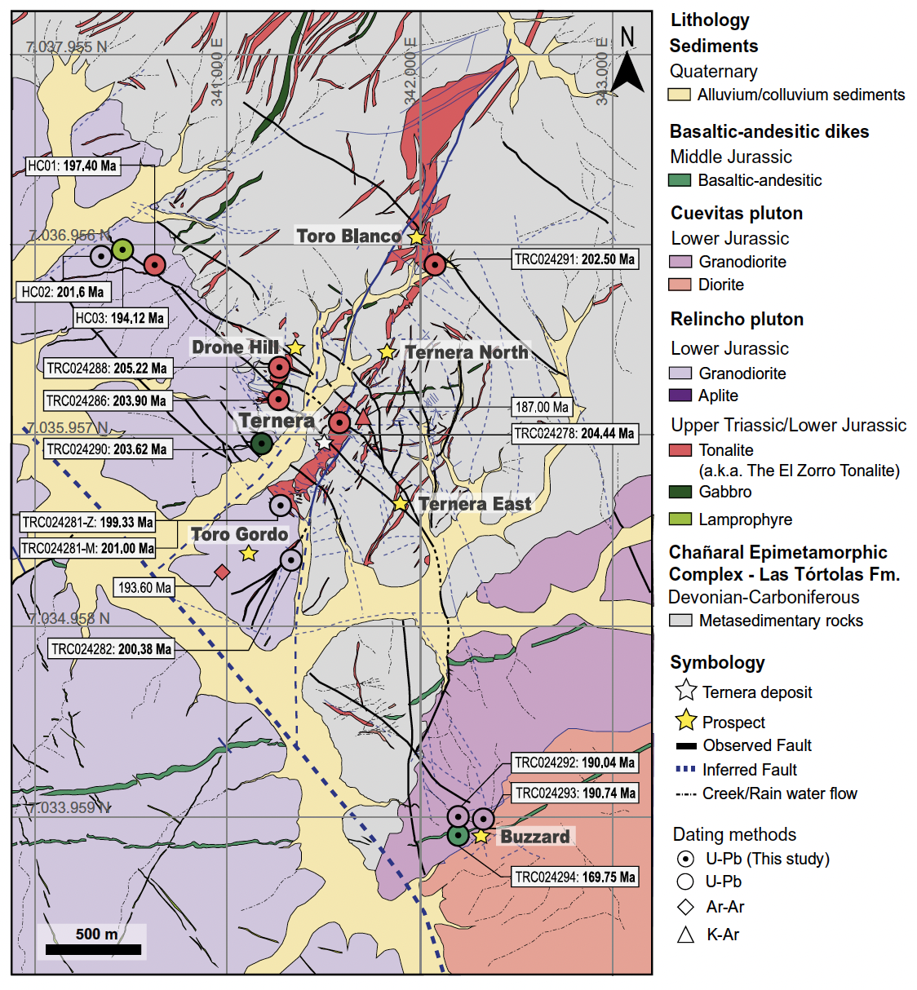
APPENDIX E: SIMPLIFIED TERNERA GEOLOGICAL MAP
INVESTOR PRESENTATION |

Slide 28
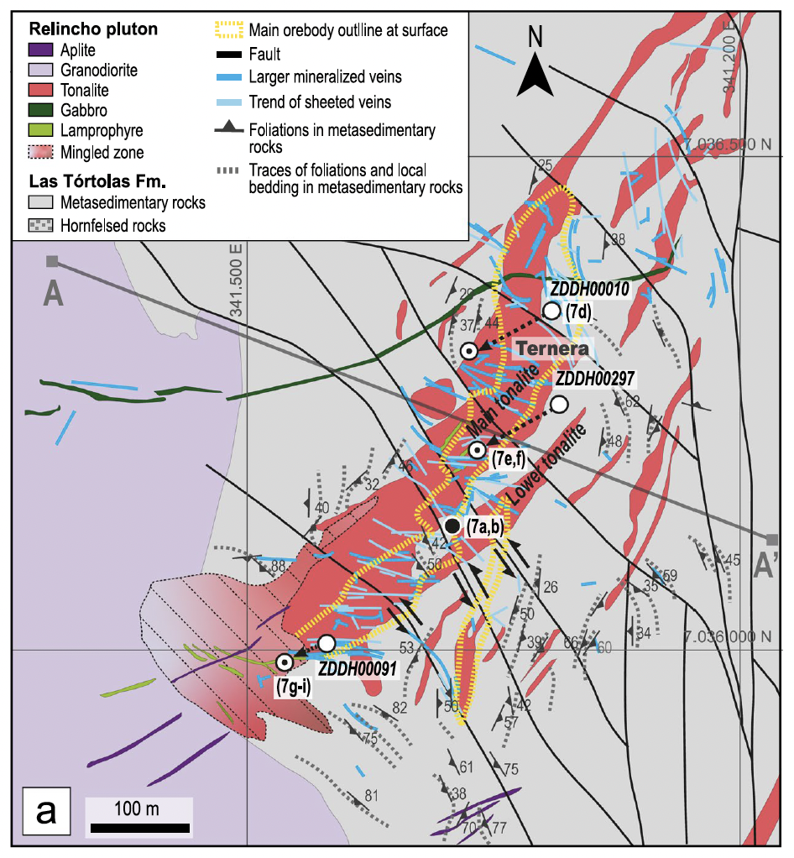
APPENDIX F: TERNERA GEOLOGICAL MAP
INVESTOR PRESENTATION |

Slide 29
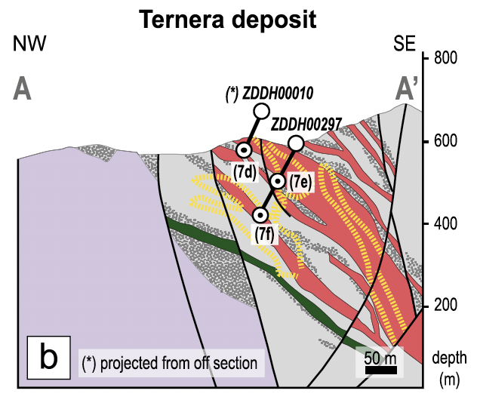
APPENDIX G: TERNERA CROSS SECTION
INVESTOR PRESENTATION |

Slide 30
MINING AND PROCESSING DETAIL
RELATIVELY LOW UPFRONT CAPITAL REQUIRED
SIMPLE CRUSH, GRAVITY AND CIP
Mill Throughput by Mineral Resource category
  Contract open pit mining with costs estimated using a 200-tonne diesel hydraulic excavator paired with a 120-tonne truck fleet
  Mine design incorporates staged pits, run-of-mine pads and waste dumps
  Open pit schedules were prepared for a three-stage development plan, targeting delivery of 3.0Mtpa of mill feed at the highest possible grades.
  Process plant design by GR Engineering and informed by three metallurgical test work programs at ALS Metallurgy in Perth.
Pit Development Plan At US$2,750 at 0.40g/t Au
 |  | Indicated |  | Inferred |  | Total |  | Ounces % |  | Ounces %
Pit | Tonnes | g/tAu | Ounces | Tonnes | g/tAu | Ounces | Tonnes | g/tAu | Ounces | Indicated | Inferred
Stage 1 | 13,045,495 | 1.03 | 433,868 | 923,114 | 1.25 | 37,205 | 13,968,609 | 1.25 | 471,073 | 92% | 8%
Stage 2 | 12,068,008 | 0.98 | 379,853 | 2,953,598 | 1.03 | 97,874 | 15,021,606 | 1.25 | 477,727 | 80% | 20%
Stage 3 | 4,175,920 | 0.95 | 127,975 | 7,552,567 | 1.05 | 256,023 | 11,728,487 | 2.25 | 383,998 | 33% | 67%
TOTAL | 29,289,423 | 1.00 | 941,696 | 11,429,280 | 1.06 | 391,102 | 40,718,703 | 1.02 | 1,332,798 | 71% | 29%
Refer to ASX announcement dated 11 September 2025. Tesoro Gold Limited confirms that it is not aware of any new information or data that materially affects the information included in that release. All material assumptions and technical parameters underpinning that release continue to apply and have not materially changed.
INVESTOR PRESENTATION |

Slide 31
DETAILED PHYSICAL OUTCOMES
INITIAL PROJECT DELIVERS 1.26 Moz GOLD PRODUCTION
Physicals (± 35%) | UoM | Outcome
Ore tonnage | Mt | 40.7
Gold grade | g/t | 1.02
Contained ounces | Moz | 1.33
Plant throughput | Mtpa | 3.0
Evaluation period (excluding pre-strip) | years | 13.5
Strip ratio | waste:ore | 8.0:1
Process gold recovery (life of mine average) | % | 94.5
Process production (total evaluation period) | Moz | 1.26
Process production (average annual steady state) | koz pa | 111
ANNUAL PRODUCTION OUNCES and head grade
Refer to ASX announcement dated 11 September 2025. Tesoro Gold Limited confirms that it is not aware of any new information or data that materially affects the information included in that release. All material assumptions and technical parameters underpinning that release continue to apply and have not materially changed.
INVESTOR PRESENTATION |

