Slide 1

MARATHON COPPER-PALLADIUM MINE
June 2026

Slide 2
Forward-looking statement
This presentation contains certain forward-looking information and forward-looking statements, as defined in applicable securities laws (collectively referred to herein as “forward-looking statements”). Forward-looking statements reflect current expectations or beliefs regarding future events or the Company’s future performance. All statements other than statements of historical fact are forward-looking statements. Often, but not always, forward-looking statements can be identified by the use of words such as “plans”, “expects”, “is expected”, “budget”, “scheduled”, “estimates”, “continues”, “forecasts”, “projects”, “predicts”, “intends”, “anticipates”, “targets” or “believes”, or variations of, or the negatives of, such words and phrases or state that certain actions, events or results “may”, “could”, “would”, “should”, “might” or “will” be taken, occur or be achieved, including statements relating to the Company’s Technical Report (as defined below) and results therefrom, mineral resource and reserve estimates, the timing of permitting and construction, the availability of sufficient financing to commence construction and the timing of such financing, proposed mine production plans, projected mining and process recovery rates (including mining dilution), estimates related to closure costs and requirements, metal prices (including the effects of supply demand imbalances on the metals the Company intends to produce) and other economic assumptions (including currency exchange rates), projected capital and operating costs, and AISC, financial or economic analysis estimates (including cash flow forecasts, NPVs, IRRs and payback periods), and mine life.
Although the Company believes that the expectations expressed in such statements are based on reasonable assumptions, such statements are not guarantees of future performance and actual results or developments may differ materially from those in the statements. There are certain factors that could cause actual results to differ materially from those in the forward-looking information. These include commodity price volatility, continued availability of capital and financing, uncertainties involved in interpreting geological data, increases in costs, environmental compliance and changes in environmental legislation and regulation, the Company’s relationships with First Nations communities, exploration successes, and general economic, market or business conditions, as well as those risk factors set out in the Company’s annual information form, the Technical Report that the Company filed in connection with the Feasibility Study Update and in the continuous disclosure documents filed by the Company on SEDAR at www.sedarplus.ca. Readers are cautioned that the foregoing list of factors is not exhaustive of the factors that may affect forward-looking statements. Accordingly, readers should not place undue reliance on forward-looking statements. The forward-looking statements in this presentation speak only as of the date of this presentation or as of the date or dates specified in such statements.
Forward-looking statements are based on a number of assumptions which may prove to be incorrect, including, but not limited to, assumptions relating to: the availability of financing for the Company’s operations; operating and capital costs; results of operations; the mine development and production schedule and related costs; the supply and demand for, and the level and volatility of commodity prices; timing of the receipt of regulatory and governmental approvals for development projects and other operations; the accuracy of mineral reserve and resource estimates, production estimates and capital and operating cost estimates; and general business and economic conditions.
Investors are cautioned that any such statements are not guarantees of future performance and actual results or developments may differ materially from those projected in the forward-looking information. For more information on the Company, investors are encouraged to review the Company’s public filings on SEDAR at www.sedarplus.ca. The Company disclaims any intention or obligation to update or revise any forward- looking information, whether as a result of new information, future events or otherwise, other than as required by law.
Technical Information
The scientific and technical information contained on slide 22 to 28 of this presentation was reviewed and approved by Daniel Janusauskas, P.Eng, Technical Services Manager of Generation PGM Inc., a wholly owned subsidiary of the Company, and a Qualified Person as defined by Canadian Securities Administrators’ National Instrument 43-101 - Standards of Disclosure for Mineral Projects. All other scientific and technical information in this presentation was reviewed and approved by Daniel Janusauskas, P.Eng, Technical Services Manager of Generation PGM Inc., a wholly owned subsidiary of the Company, and a Qualified Person as defined by Canadian Securities Administrators’ National Instrument 43-101 - Standards of Disclosure for Mineral Projects. For further information see the Technical Report entitled "Marathon Copper-Palladium Project - Feasibility Study Report Update", dated March 28, 2025, with an effective date of November 1, 2024, and filed under the Company’s profile on www.sedarplus.ca or on the Company’s website at https://genmining.com/projects/feasibility-study/ (the “Technical Report”).

Slide 3
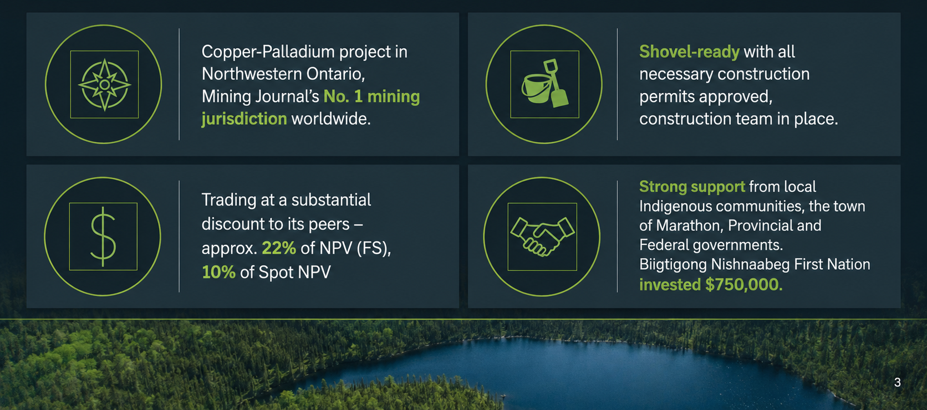
Value Proposition: Why Generation Mining

Slide 4
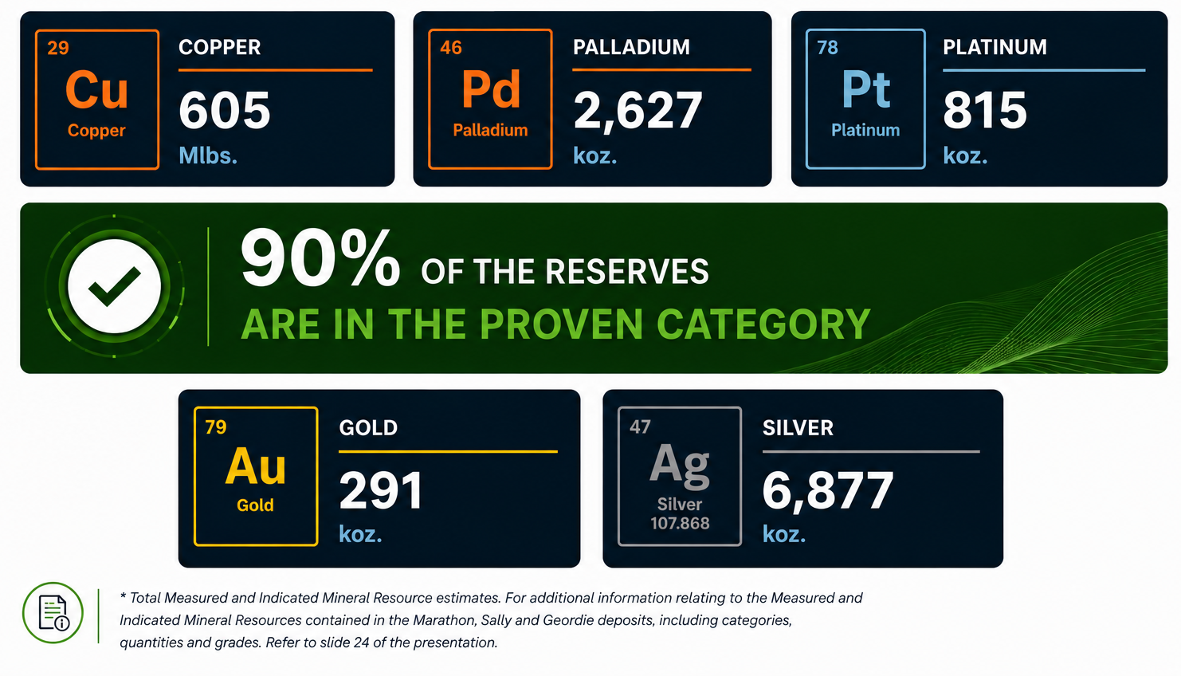
Polymetallic Resources and Reserves

Slide 5
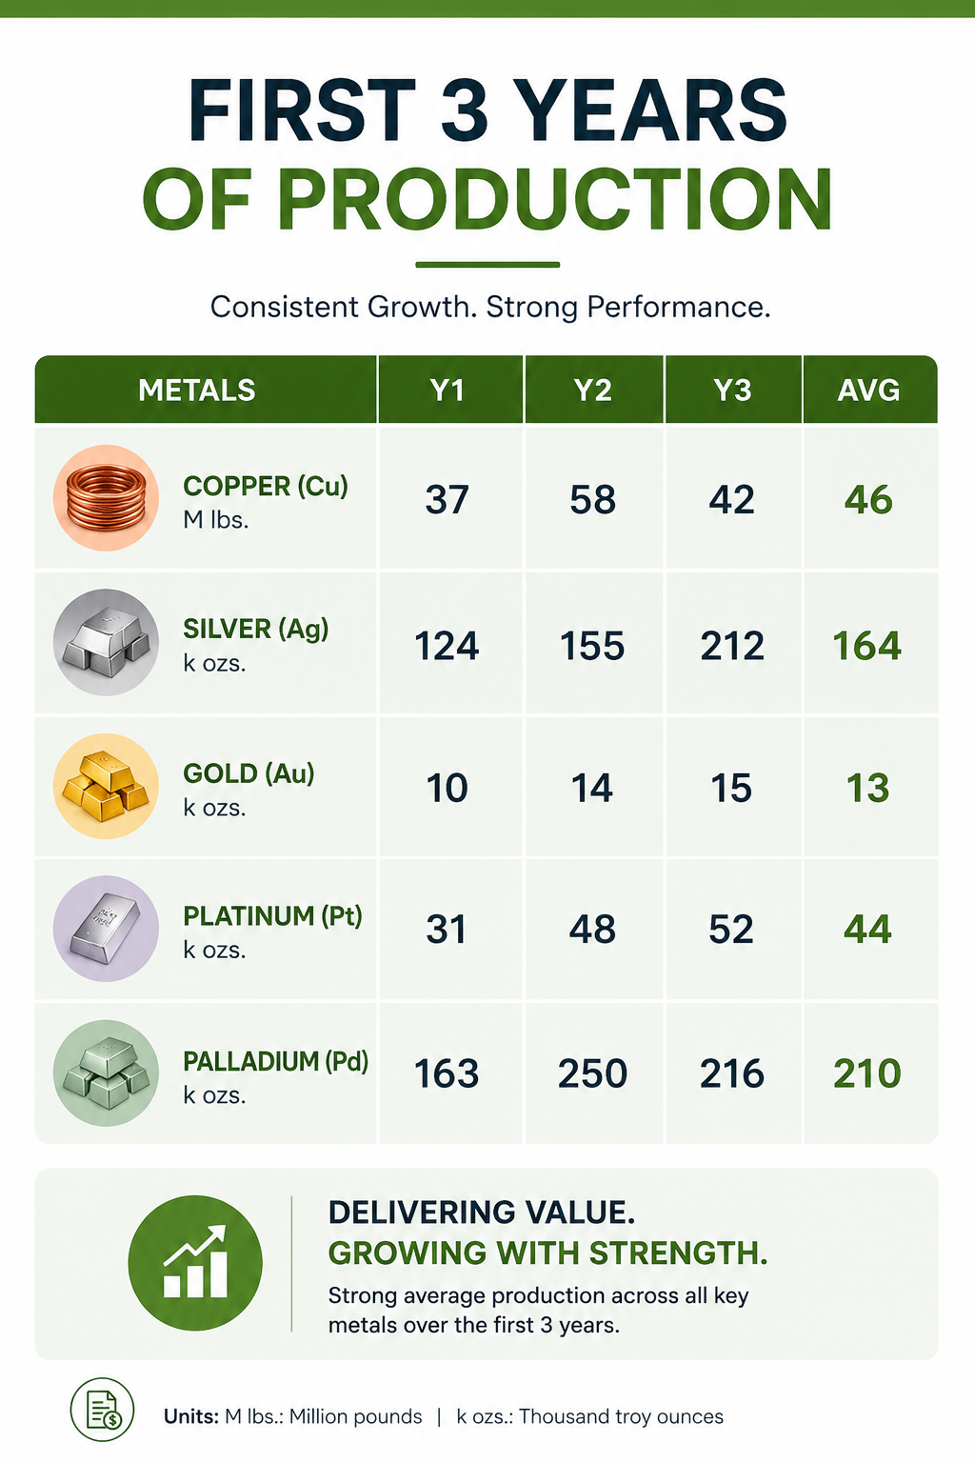
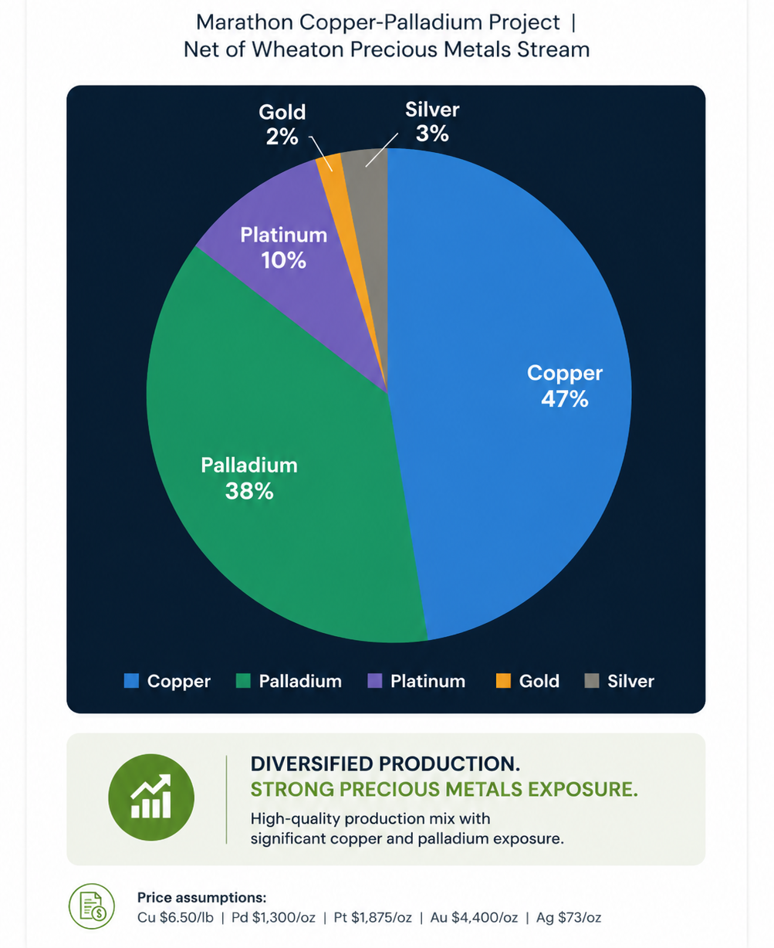
Revenue percentage by metal
*
*
* Net of stream to Wheaton Precious Metals

Slide 6
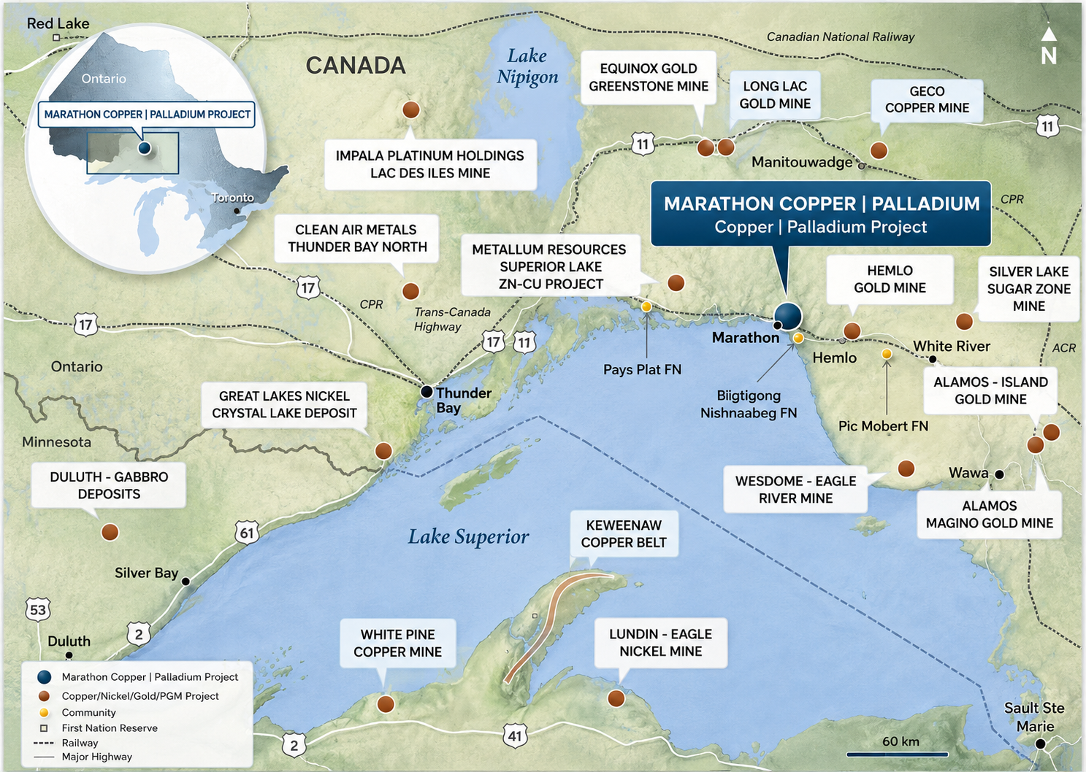
Active mines in northwestern Ontario
Hemlo Mining Corp:
Hemlo Gold Mine
(Formerly owned by Barrick)
Alamos Gold:
Magino & Island Gold Mines
Equinox Gold:
Greenstone Mine
Impala Platinum:
Lac Des Iles Mine
Wesdome:
Eagle River

Slide 7
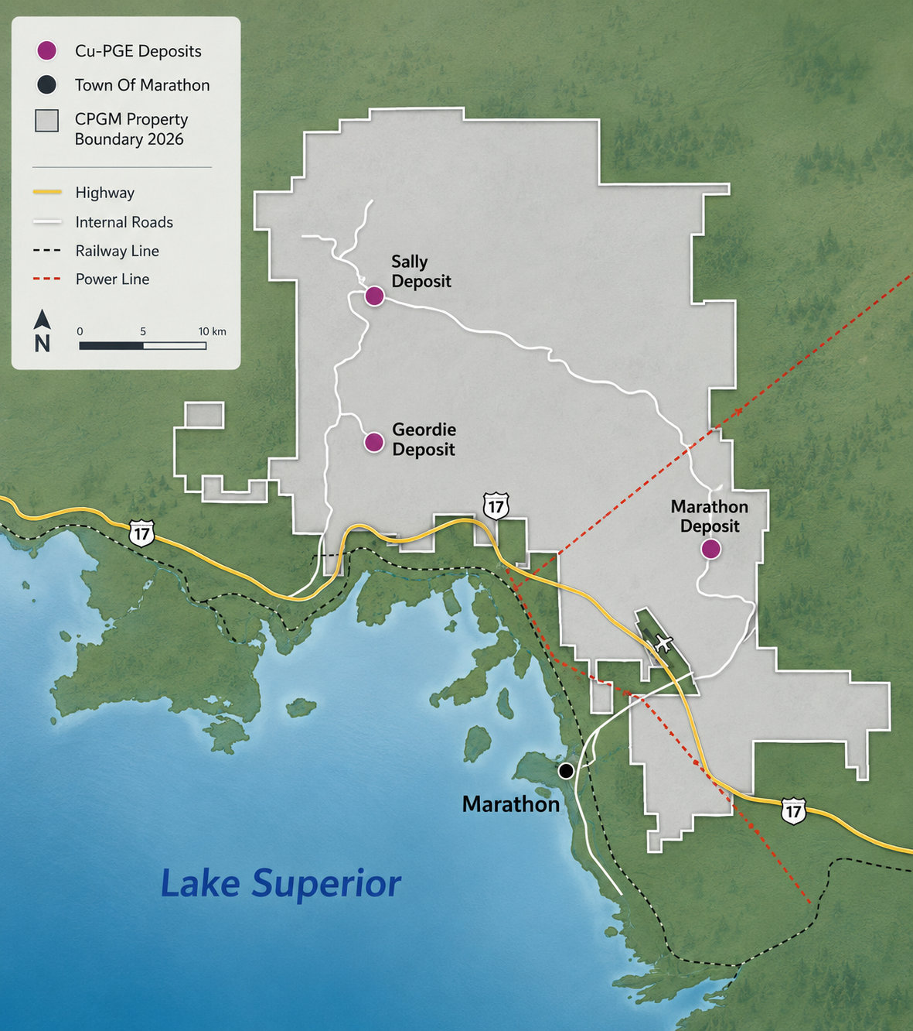

Excellent location and jurisdiction
Located on Trans-Canada Highway
Served by CPR main rail line
Main Marathon deposit is 10 km from Town of Marathon (~3,000 pop.)
New 230kV power line from Wawa to Thunder Bay crosses property
276 Bed Construction Camp (Option to own) in the Town
Numerous towns, Indigenous communities nearby available for the core workforce
Commercial airport next to the Marathon Deposit
Access to the Port of Marathon, which recently received $2 million from the province to revitalize the port

Slide 8
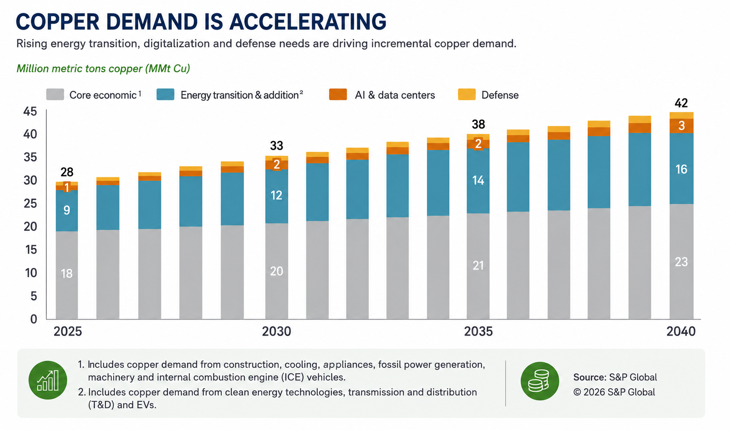
Global copper demand by sector

Slide 9
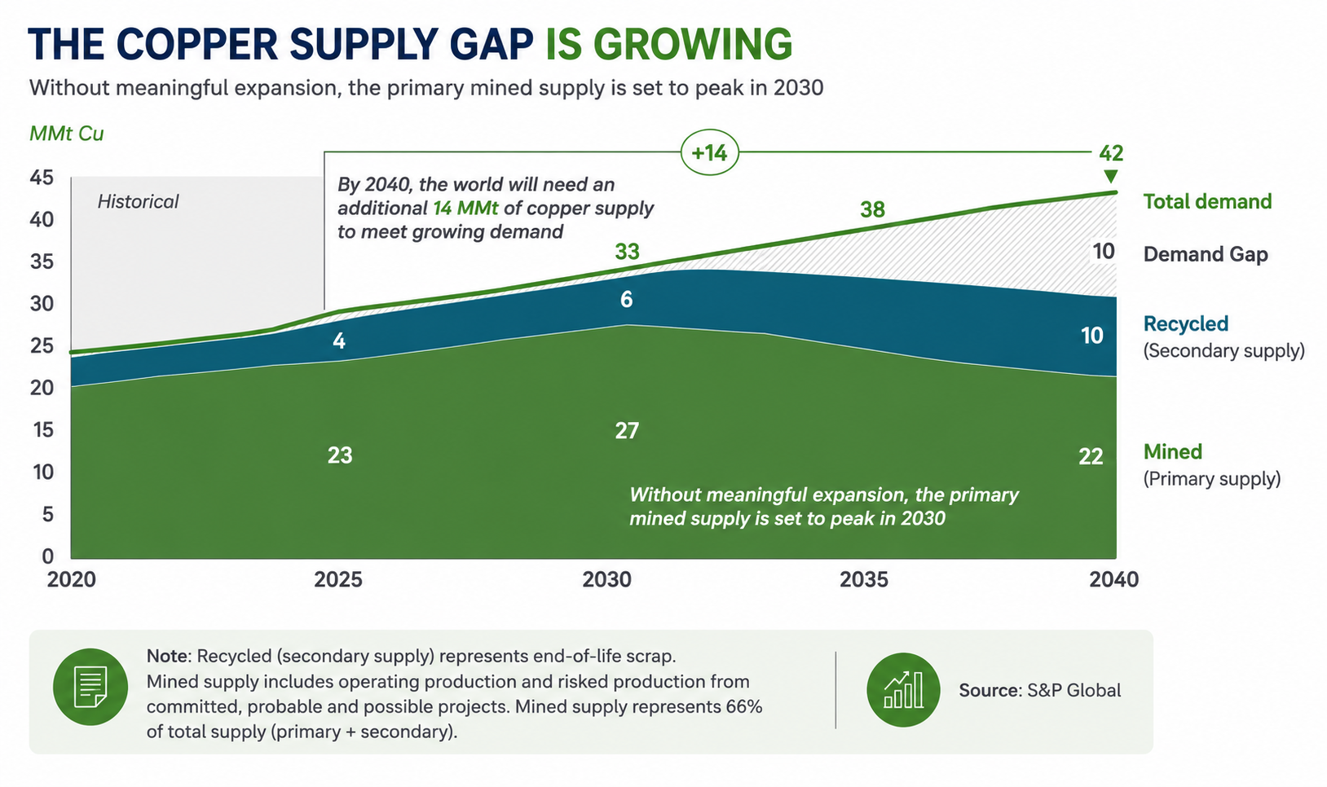
Copper demand growing at 3.5% per year

Slide 10
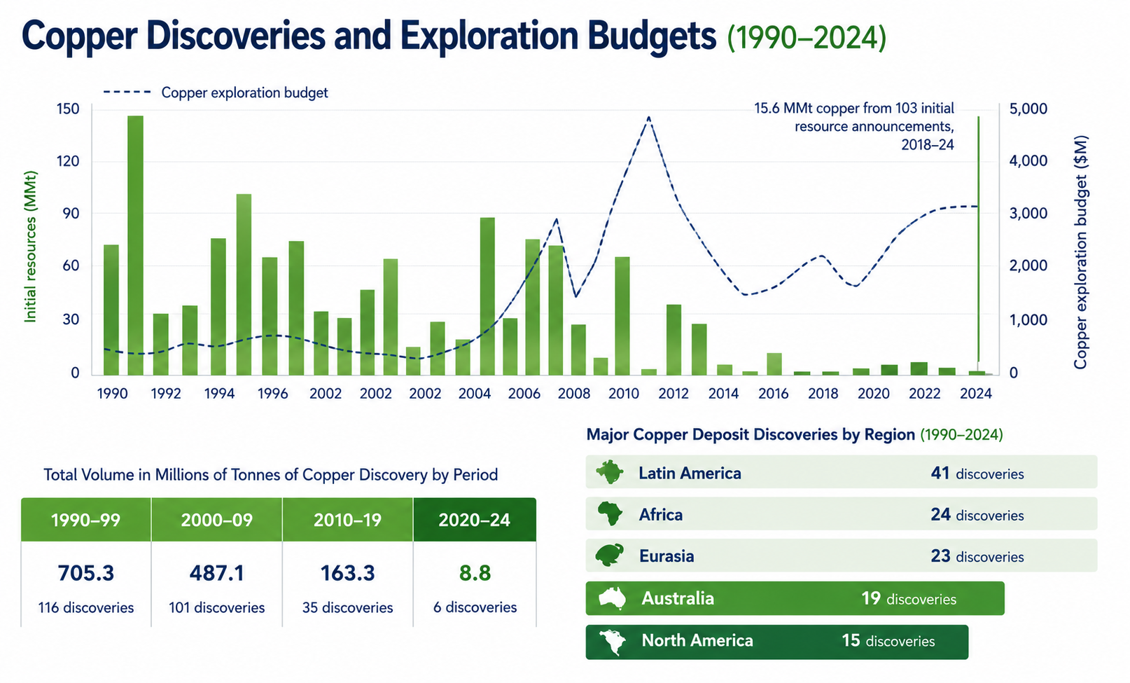
Global Copper Discoveries Since 1990-2024
Source: S&P Global

Slide 11
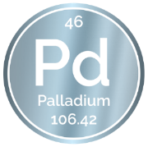
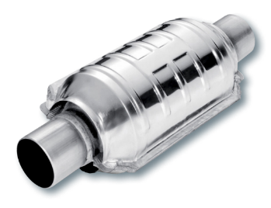
why Palladium is important for the future
Primary demand of platinum (Pd) is for catalytic converters.
Worldwide adoption of Hybrid Electric Vehicles is accelerating.
Hybrid Electric Vehicles use more palladium than traditional ICE vehicles
BYD – largest battery electric vehicle manufacture in the world - >50% of sales are hybrids.
High platinum prices accelerating return to palladium in autocatalysts -- 1M oz potential
Hybrid sales double that of EVs in the U.S., 30 times that in Japan (world's number two and three auto markets)
Significant geopolitical risk: 40% of mine supply comes from Russia, 35% from South Africa
Largest palladium ETF (PALL) had $100 million inflow in September

Slide 12
March 2025 Feasibility Study highlights ($CAD)
After-Tax NPV_{6%} |  | After-Tax IRR |  | Initial Capital⁴ |  | Payback Period
$1.07 Billion (FS) $2.2 Billion (Spot) |  | 28% (FS) 42% (Spot) |  | $992 Million CAD $703 Million USD |  | 1.9 years (FS) 1.3 years (Spot)
LOM Payable³ |  | Average Annual Production |  | AISC² |  | AISC Net of Byproducts
PdEq 4.11M oz CuEq 1.57B lb |  | Pd 168 koz Cu 42 Mlbs |  | US$781/PdEq oz. US$2.05/CuEq lb. |  | US$103 /Pd oz US($1.72 /Cu lb)
*For additional information see “Technical Information” on slide 2.
NOTES:
¹ Unless otherwise noted: Canadian $, economic analysis includes cash flow impacts of the WPM Stream. Feasibility Study metal prices assumptions – US$1,525 oz Pd, US$4.00/lb Cu, US$950/oz Pt, US$2,000/oz Au, and US$24/oz Ag, FX USD1:CAD1.35.
² For additional information on AISC and PdEq see news release entitled “Generation Mining Delivers Updated Feasibility Study for Canada's Next Critical Mineral Mine - the Marathon Palladium-Copper Project” dated March 31, 2023 and “non-IFRS Measures” in MD&A for the interim period ended March 31, 2024.
³ Copper Equivalent pounds (CuEq) uses the formula CuEq Mlbs. = PdEq koz. Copper Price $6.49 US$/lbs. | Silver Price $83.64 US$/oz. | Gold Price $4,678 US$/oz. | Platinum Price $2,116 US$/oz. | Palladium Price $1,489 US$/oz. FX USD1:CAD1.37.
⁴ Initial capital with equipment lease
Spot Prices as of May 12, 2026

Slide 13
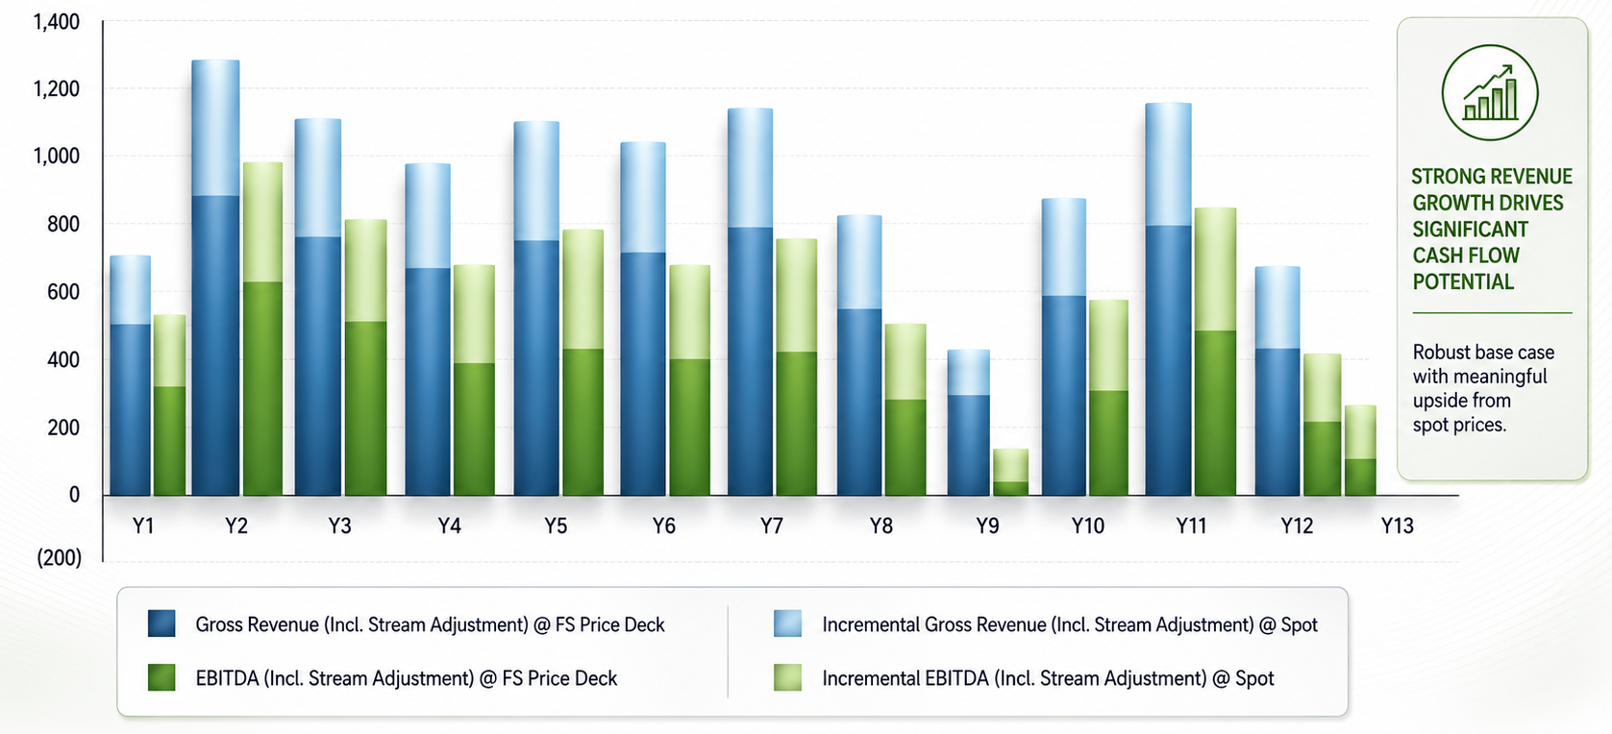
Revenue & EBITDA -- Feasibility & Spot Metal Prices
Spot Price Date: May 12, 2026

Slide 14
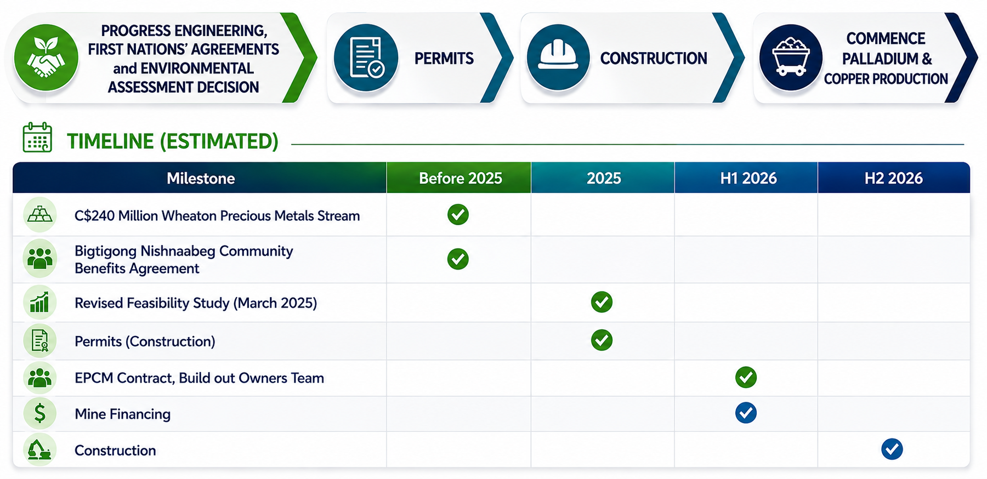
Advancing the Marathon
Project towards production

Slide 15
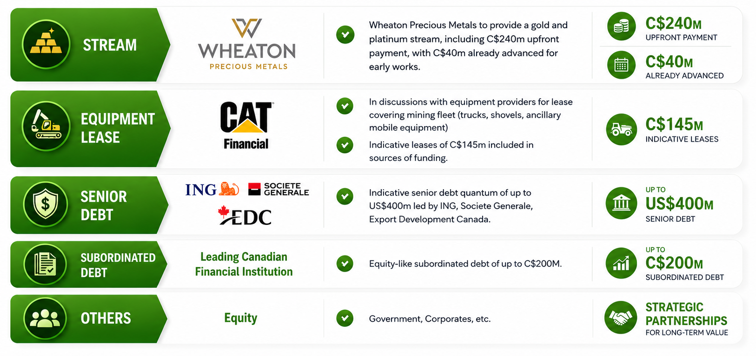
Sources of funding

Slide 16




Generation Mining Peer Positioning
Development Stage Comparables | P/NAV
Jurisdiction:
Tier 1 Jurisdiction: | ✓ | ✓ | ✓ | ✓ | ✓ | ✗ | ✓ | ✗ | ✓ | ✓ | ✓ | ✓ | ✓ | ✓
Feasibility Study: | ✓ | ✗ | ✗ | ✓ | ✗ | ✓ | ✗ | ✗ | ✗ | ✗ | ✓ | ✓ | ✗ | ✓
EA/Permitting: | ✓ | ✗ | ✗ | ✓ | ✗ | ✗ | ✗ | ✗ | ✗ | ✗ | ✓ | ✗ | ✗ | ✓
Source: Company Filings, Capital IQ
Note: P/NAV is based on street consensus estimates

Slide 17
Lassonde Curve – The discovery lifecycle
Funding risk
Technical risk
Exploration risk
High
value
Discovery
This is most likely the time when people outside of the mining industry hear of a new discovery while early speculators are looking to cash in.
There is a tipping point in exploration when drilling amounts to a real mineral discovery and excitement is at its peak.
Speculation
Operating Mine
Initial drill results provide some insight as to what truly lays beneath, but more work is necessary to define a mineable deposit.
Early speculators buy into the project.
The mine is now open, and the company can extract ore and generate cash flow. Risks remain, such as commodity price and management risk.
Digging In
Junior exploration companies are typically the first on the ground providing a geology concept with surface exploration.
Orphan Period
Institutional / Strategic Investment
Low
value
After initial excitement, proven discoveries require large amounts of capital for construction – but are not yet receiving cash flows from an operating mine.
This is the point when experienced mine developers and financiers invest directly to develop the project into an operating mine.
Timeline
4-5 years
1-2 years
2-3 years
2 years
1 year
Pre-discovery
Discovery
Feasibility
Development
Startup
Depletion

Slide 18


GENM Value proposition
Generation Mining | Foran mining
Location | Ontario, Canada | Saskatchewan, Canada
Project Name | Marathon Project | McIlvenna Bay
Stage | Permitted & Shovel Ready | In Construction
Commodities | Cu, Pd, Pt, Au, Ag | Cu, Zn, Au, Ag
Mine Life (Years) | 13 plus years | 18 years
NPV (last study) | C$1,070M | C$654M
NPV (approx. $5/lb. Cu) | C$1,365M | ~C$900M
IRR (%) | 29% | 23%
Payback (years) | Under 2 years | Over 4 years
Construction Capex (C$) | ~C$1.0 billion | ~C$1.1 billion
Average Annual Production | 120 million lbs. CuEq | 90 million lbs. CuEq
Enterprise Value (C$) | $225 Million | C$3.8 Billion (now owned by Eldorado Gold)
NPV at $5/lb. approximated based on Foran 2025 Technical Report
Foran construction capex based on May 2025 project restimate
Average annual production calculated based on technical report total metal sales divided by 17 year mine life (excluding tail year) calculated at technical report commodity prices
Information provided by BMO Bank of Montreal Capital Markets
*After tax
**US$1525 Palladium price
***US$4.27 Copper price
****estimated by GENM
Ivanhoe Electric used a 8% discount rate, Generation Mining used a 6% discount rate and Foran Mining used a 7% discount rate

Slide 19
Management team
JAMIE LEVY President, CEO & Director |  | RUBEN WALLIN P.Eng VP Sustainability
Mr. Levy is President, Chief Executive Officer and a director of the Company. Mr. Levy was President and CEO of Pine Point Mining, the predecessor to the Company, from 2013-18. Mr. Levy has approximately 22 years of experience in the mining industry. |  | Mr. Wallin has management experience in the areas of environment, permitting, Indigenous and community relations and government relations. Previously held positions at Placer Dome, De Beers Canada, Barrick, Osisko and Detour Gold. Formerly Vice President Environment and Sustainability for Detour Gold.
BRIAN JENNINGS CPA, CA, B.Sc Chief Financial Officer |  | RACHAEL PINEAULT EVP Corporate Affairs and Human Resources
Mr. Jennings is a Chartered Accountant and geologist with 30 years of experience as a senior financial executive and corporate restructuring specialist. He currently serves as Chief Financial Officer of the Company and Chairman of the Audit Committee of PMET Resources Inc., which is advancing a lithium project in Quebec. Over his career, he has held CFO roles at several public junior mining and technology companies and previously spent nine years with Ernst & Young as Vice-President of Corporate Restructuring, where he was involved in multiple high-profile Canadian restructurings. |  | Ms. Pineault has over 30 years of experience in Human Resources, Governance, and Sustainability within the mining industry. She has held senior roles at a number of mining companies, including Detour Gold, Kirkland Lake Gold, De Beers Canada and NexGold Mining. Ms. Pineault prioritizes strong partnerships with Indigenous communities and stakeholders, aligning responsible practices with corporate strategy.
CLINTON SWEMMER P.Eng PrEng (rsa) PMP MSAICE VP Projects |  | ERICH MEINTJES VP Engineering
Mr. Swemmer is an experienced project leader with more than 25 years of international experience in mining and engineering. He has led several multibillion-dollar developments across a range of commodities, with expertise in EPCM and EPC delivery models. His background includes permitting, execution planning, construction, and operations on projects such as Artemis's Blackwater mine, Kinross’s Round Mountain and Bald Mountain expansions, Norilsk’s nickel project in Botswana, Cerrado Golds projects in Argentina and Brazil and Silvercrest's project in Mexico. He has also held senior engineering and executive project roles at world-class engineering firms Ausenco, DRA, and Wood. |  | Mr. Meintjes is a mechanical engineer with an MBA who has been building mines worldwide for 27+ years. Former Senior VP, Engineering (EMEA) at DRA Global, he has served as Senior Project Manager at major mines covering the full lifecycle from design to commissioning, including operations owned by Glencore/Xstrata, Anglo Platinum, Impala Platinum, and Lonmin. He is known for strong technical governance, disciplined execution, and successful delivery of complex mining and processing facilities.

Slide 20
BOARD OF DIRECTORS / Technical Advisors
KERRY KNOLL Chairman of the Board |  | JAMIE LEVY President, CEO and Director
Mr. Knoll was a co-founder of Generation Mining and started several mining companies over the past four decades, including successful heap leach miner Wheaton River (which was also the parent of Wheaton Precious Metals), Thompson Creek, which became one of the world's largest primary molybdenum miners, and Glencairn Gold, which had three operating mines in Central America. |  | Mr. Levy is President, Chief Executive Officer and a director of the Company. Prior thereto, Mr. Levy held the position of President and Chief Executive Officer of Pine Point Mining Limited (“Pine Point”), the predecessor to the Company, since 2013. Mr. Levy has approximately 22 years of experience and exposure in the exploration and mining industry.
KYLE KUNTZ MBA / Director |  | STEPHEN REFORD BA.Sc, P.Eng / Director
Mr. Kuntz is an experienced mining executive with over ten years leading major North American projects. At Equinox Gold, he directs project development, having previously managed the Valentine Gold Project at Marathon Gold and Calibre Mining. He has held key positions at JDS Energy & Mining, Nuna Group, and Stantec, and is skilled in moving projects from feasibility to construction, focusing on management, engineering, procurement, and execution. |  | Mr. Reford was a director of Pine Point, the predecessor to the Company, since June 26, 2011. Mr. Reford is Senior Geophysicist & Head of Smart Geophysical Interpretation at Xcalibur Smart Mapping, and was formerly the President of Paterson, Grant & Watson Limited, a geophysical consulting company, from 2016 to 2025.
PHILLIP C. WALFORD P.Geo, P.Eng / Director |  | Paul McRae, B.A.Sc. Mining Engineer / Technical Advisor
Mr. Walford held the position of President and Chief Executive Officer of Marathon Gold Corporation from November 2010 to August 2019. Previously, he was a founder and President of Marathon PGM Corporation, at the time when that company owned Generation Mining’s Marathon Palladium-Copper Project. He guided Marathon PGM through advanced exploration until it was taken over by Stillwater Mining Company in 2010 for US$118 million. |  | Mr. McRae brings more than 40 years of technical, engineering, and construction management experience. He has delivered major mining projects on time and on budget across North America, Europe and Australia, including leadership roles on De Beers’ Victor Mine and Lundin Mining’s Eagle Mine.
REBECCA HUDSON CPA, CA, M.ACC / Director |  | Jeremy Wyeth B.A.Sc. Mining Engineer / Technical Advisor
Ms. Hudson is a Chartered Professional Accountant with over 25 years' experience in accounting and financial reporting, corporate finance, risk management, financial audit and corporate governance. Signature Resources Ltd., Energy Plug Technologies Corp., currently serves as the CFO of Restart Life Sciences Corp., and a private drilling company, Andean Drilling Services Inc. |  | Mr. Wyeth adds 40 years of experience in operations and project development. As Operations Director at AMEC/Wood, he oversaw numerous mining projects. He previously led the full development cycle of De Beers’ Victor Mine in Ontario—from prefeasibility through construction and commissioning—delivering the $1 billion project ahead of schedule and under budget.

Slide 21

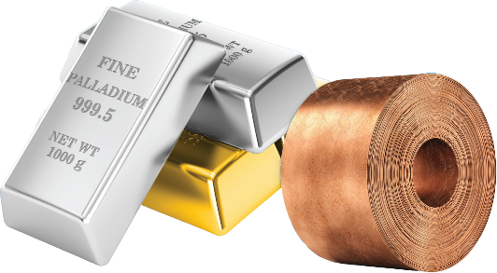
Corporate structure
Issued and Outstanding (March 30,2026) | 321,129,850
Warrants (Avg. Price $0.66) | 48,247,406
Options | 5,948,131
RSUs, DSUs and PSUs | 10,045,266
Fully Diluted | 385,370,653
Market Capitalization (June 15, 2026, at $0.62) | $200 Million
Cash (as of March 31, 2026) | Approx. $40 Million
Analyst Coverage
Pierre Vaillancourt
Ownership Breakdown
Sibanye Stillwater | 10%
Management/Directors | 5.3%
Eric Sprott | 5%
Wheaton Precious Metals | 5%
21

Slide 22
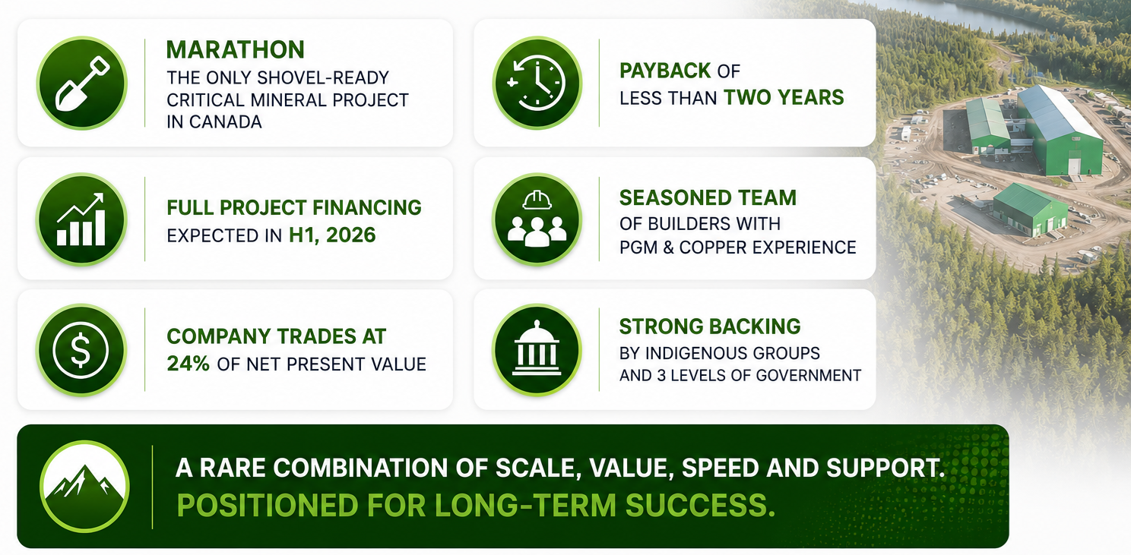
Why you should invest in generation mining

Slide 23
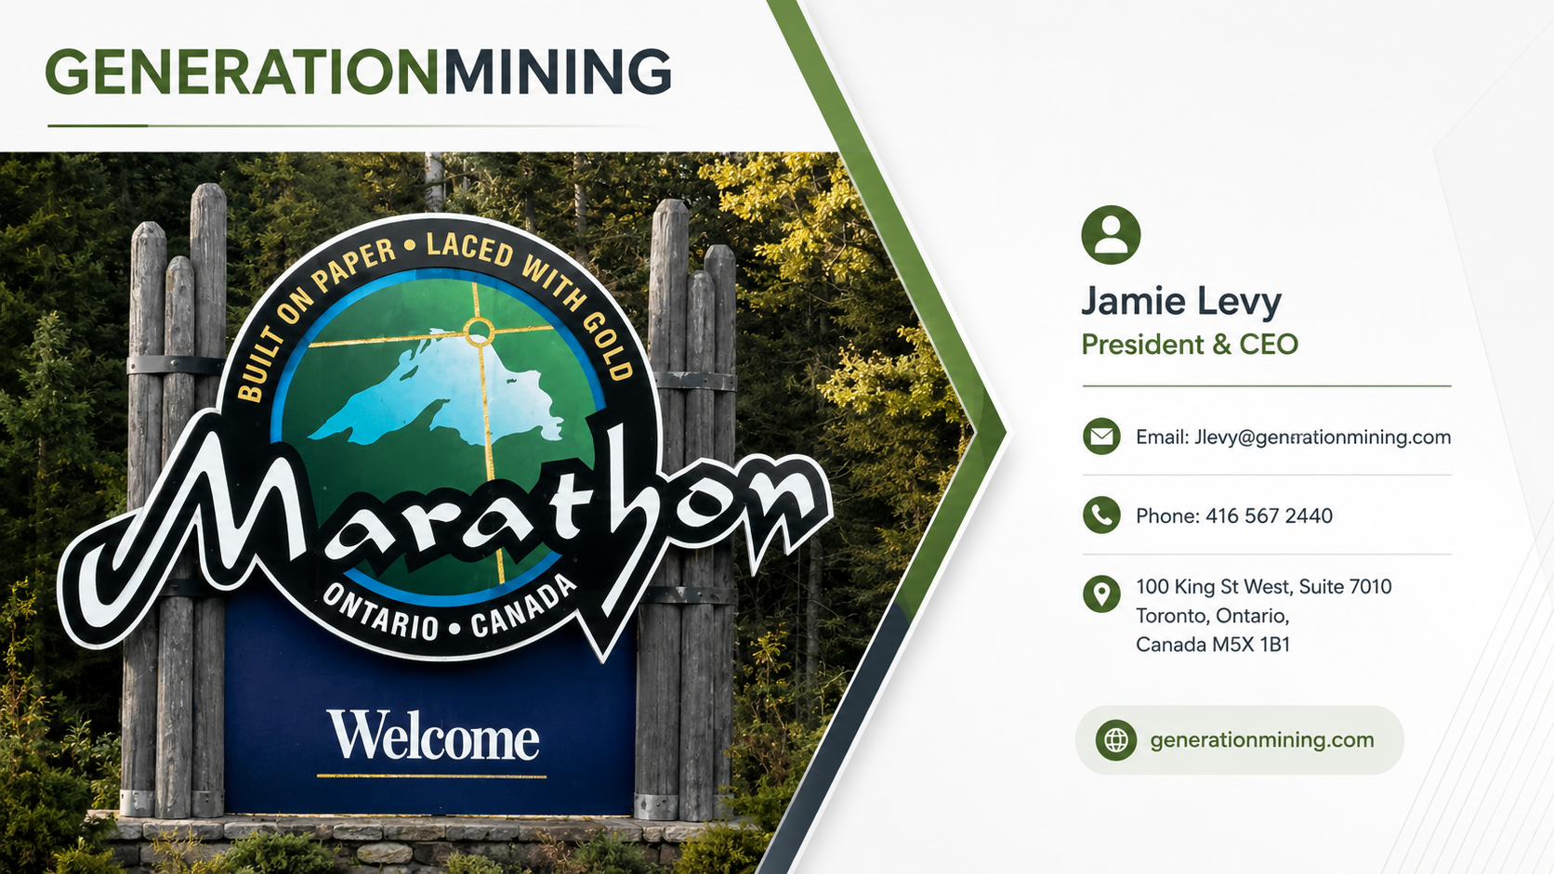

Slide 24

Appendix

Slide 25
Mineral RESOURCES AND RESERVES
Mineral Reserves (Marathon Deposit)
Classification | Tonnes | Pd |  | Cu |  | Pt |  | Au |  | Ag
 | Mt | g/t | koz | % | M lb | g/t | koz | g/t | koz | g/t | koz
Proven | 115.5 | 0.66 | 2,434 | 0.22 | 549 | 0.20 | 754 | 0.07 | 264 | 1.7 | 6,242
Probable | 12.7 | 0.47 | 193 | 0.20 | 56 | 0.15 | 61 | 0.06 | 26 | 1.6 | 635
Total P&P | 128.3 | 0.64 | 2,627 | 0.21 | 605 | 0.20 | 815 | 0.07 | 291 | 1.7 | 6,877
Mineral Resources (Total Site including Marathon Deposit + Geordie and Sally)
Classification | Tonnes | Pd |  | Cu |  | Pt |  | Au |  | Ag
 | Mt | g/t | koz | % | M lb | g/t | koz | g/t | koz | g/t | koz
Measured | 164.0 | 0.56 | 2,973 | 0.20 | 712 | 0.18 | 970 | 0.07 | 358 | 1.7 | 9,089
Indicated | 80.1 | 0.41 | 1,066 | 0.21 | 379 | 0.13 | 339 | 0.06 | 152 | 1.5 | 3,814
Meas. + Ind. | 244.1 | 0.51 | 4,039 | 0.20 | 1,091 | 0.17 | 1,309 | 0.06 | 510 | 1.6 | 12,903
Inferred | 29.8 | 0.39 | 370 | 0.22 | 147 | 0.10 | 94 | 0.05 | 44 | 1.4 | 1,374
Slide Notes
Mineral Resources are inclusive of Mineral Reserves. The above Mineral Resources and Reserves are based on the 2025 Feasibility Study Report Update issued on March 28, 2025 with an effective date of November 1, 2024. The report is filed under the Company’s profile on www.sedarplus.ca or on the Company’s website at https://genmining.com/projects/feasibility-study. See the accompanying notes on the subsequent slide

Slide 26
Mineral RESOURCES by Deposit
Mineral Resource Classification | Tonnes | Pd |  | Cu |  | Pt |  | Au |  | Ag
 | Mt | g/t | koz | % | M lbs | g/t | koz | g/t | koz | g/t | koz
Marathon Deposit
Measured | 164.0 | 0.56 | 2,973 | 0.20 | 712 | 0.18 | 970 | 0.07 | 358 | 1.7 | 9,089
Indicated | 38.1 | 0.39 | 476 | 0.18 | 153 | 0.13 | 159 | 0.06 | 71 | 1.6 | 1,896
Meas. + Ind. | 202.0 | 0.53 | 3,449 | 0.19 | 865 | 0.17 | 1,129 | 0.07 | 429 | 1.7 | 10,985
Inferred | 2.9 | 0.36 | 34 | 0.16 | 10 | 0.13 | 12 | 0.06 | 6 | 1.2 | 112
Geordie Deposit
Indicated | 17.3 | 0.56 | 312 | 0.35 | 133 | 0.04 | 20 | 0.05 | 25 | 2.4 | 1,351
Inferred | 12.9 | 0.51 | 212 | 0.28 | 80 | 0.03 | 12 | 0.03 | 14 | 2.4 | 982
Sally Deposit
Indicated | 24.8 | 0.35 | 278 | 0.17 | 93 | 0.2 | 160 | 0.07 | 56 | 0.7 | 567
Inferred | 14.0 | 0.28 | 124 | 0.19 | 57 | 0.15 | 70 | 0.05 | 24 | 0.6 | 280
Total Project
Measured | 164.0 | 0.56 | 2,973 | 0.20 | 712 | 0.18 | 970 | 0.07 | 358 | 1.7 | 9,089
Indicated | 80.1 | 0.41 | 1,066 | 0.21 | 379 | 0.13 | 339 | 0.06 | 152 | 1.5 | 3,814
Meas. + Ind. | 244.1 | 0.51 | 4,039 | 0.20 | 1,091 | 0.17 | 1,309 | 0.06 | 510 | 1.6 | 12,903
Inferred | 29.8 | 0.39 | 370 | 0.22 | 147 | 0.10 | 94 | 0.05 | 44 | 1.4 | 1,374
Slide Notes
Mineral Resources are inclusive of Mineral Reserves. The above Mineral Resources are based on the 2025 Feasibility Study Report Update issued on March 28, 2025 with an effective date of November 1, 2024. The report is filed under the Company’s profile on www.sedarplus.ca or on the Company’s website at https://genmining.com/projects/feasibility-study. See the accompanying notes on the subsequent slide

Slide 27
Mineral RESOURCES AND RESERVES notes
Mineral Reserves Notes:
The Mineral Reserves Estimate were prepared by Marc Schulte, P.Eng., who is also an independent Qualified Person, reported using the 2014 CIM Definition Standards, and have an effective date of November 1, 2024.
Mineral Reserves are a subset of the Measured and Indicated Mineral Resources Estimate that has an effective date of November 1, 2024. Inferred Class Resources are treated as waste.
Mineral Reserves are based on the Updated Marathon Project Feasibility Study mine plan.
Mineral Reserves are mined tonnes and grade, the reference point is the process plant feed at the primary crusher. Process plant feed tonnes and grade include consideration of mining operational dilution and recovery.
Mineral Reserves are reported at a cut-off grade of $16/t NSR and based on the following inputs:
  Effective metal prices of pit shell used for ultimate pit designs of US$1,144/oz Pd, US$3.0/lb Cu, US$713/oz Pt, US$1500/oz Au and US$18/oz Ag (Based on revenue factor 0.75), and an exchange rate of 1.35 C$:1.00 US$.
  NSR cut-off assumes Pd Price of US$1,525/oz, Cu price of US$4.00/lb, Pt Price of US$950/oz, Au price of US$2,000/oz, Ag price of US$24/oz, at an exchange rate of 0.74 US dollar per 1.00 Canadian dollar.
  Payable %'s of 95% for Pd, 96.5% for Cu, 93% for Pt, 93.5% for Au, 93.5% for Ag;
  Refining charges of US$24.5/oz for Pd, US$0.079/lb for Cu, US$24.5/oz for Pt, US$0.50/oz for Ag;
  Minimum deductions of 2.875 g/t for Pd, 1.1% for Cu, 2.875 g/t for Pt, 1.0 g/t for Au, 30.0 g/t for Ag;
  Treatment charges of US$79/t and transport and offsite costs of US$125/t concentrates, concentrate ratio of 90.9%;
  Metallurgical recoveries of 89.5% for Pd, 94.0% for Cu, 84.0% for Pt, 83.1% for Au, 68.0% for Ag
The cut-off grade covers processing costs of $8.27/t, general and administrative (G&A) costs of $2.63/t, sustaining and closure costs of $3.13/t, ore mining differential costs of $0.57/t, and stockpile rehandle costs of $1.40/t.
Numbers have been rounded, which may result in summation differences. Canadian Institute of Mining, Metallurgy and Petroleum (CIM) Definition Standards for Mineral Resources and Mineral Reserves (CIM (2014) definitions) were used for Mineral Reserve classification.
Mineral Resources Notes:
Mineral Resources were estimated using the Canadian Institute of Mining, Metallurgy and Petroleum (CIM), CIM Standards on Mineral Resources and Reserves, Definitions (2014) and Best Practices Guidelines (2019) prepared by the CIM Standing Committee on Reserve Definitions and adopted by CIM Council.
Mineral Resources that are not Mineral Reserves do not have demonstrated economic viability. The estimate of Mineral Resources may be materially affected by environmental, permitting, legal, marketing, or other relevant issues. Mineral Resources are reported inclusive of Mineral Reserves.
The Inferred Mineral Resource in this estimate has a lower level of confidence than that applied to an Indicated Mineral Resource and must not be converted to a Mineral Reserve. It is reasonably expected that the majority of the Inferred Mineral Resource could be upgraded to an Indicated Mineral Resource with continued exploration.
The Marathon Mineral Resource is reported within a constrained pit shell at a NSR cut-off value of $13.6/t.
Marathon NSR ($/t) = (Cu % x 111.49) + (Ag g/t x 0.73) + (Au g/t x 80.18) + (Pd g/t x 56.02) +(Pt g/t x 36.49) – 2.66
The Marathon Mineral Resource Estimate was based on metal prices of US$1,550/oz Pd, US$4.250/lb Cu, US$1,100/oz Pt, US$2,300/oz Au and US$27/oz Ag, and a C$:US$ exchange rate of C$1.35 to US$1.00.
The Sally and Geordie mineral resources are reported within a constraining pit shell at a NSR cut-off value of $13/t.
Sally and Geordie NSR ($/t) = (Ag g/t x 0.48) + (Au g/t x 42.14) + (Cu % x 73.27) + (Pd g/t x 50.50) + (Pt g/t x 25.07) – 2.62
The Sally and Geordie Mineral Resource Estimate was based on metal prices ofUS$1,600/oz Pd, US$3.00/lb Cu, US$900/oz Pt, US$1,500/oz Au and US$18/oz Ag, and a C$:US$ exchange rate of 1.30 C$ to 1.00 US$.
Numbers have been rounded, which may result in summation differences.

Slide 28
Generation Mining Peer Positioning
Comparable Property Production Positioning
Development Stage Assets | Average Annual Production
Company: | ATEX⁽¹⁾ Resources | Western Copper and Gold | Trilogy Metals | NorthIsle Copper and Gold | Arizona Sonoran | Ivanhoe Electric | Faraday Copper | Generation Mining | Marimaca Copper | Copper Fox Metals | Osisko⁽²⁾ Metals | Kutcho Copper | Foran Mining | New World Resources | Highland Copper | Surge Copper
Jurisdiction:
Tier 1 Jurisdiction: | ✗ | ✓ | ✓ | ✓ | ✓ | ✓ | ✓ | ✓ | ✗ | ✓ | ✓ | ✓ | ✓ | ✓ | ✓ | ✓
Feasibility Study: | ✗ | ✓ | ✓ | ✗ | ✗ | ✗ | ✗ | ✓ | ✓ | ✗ | ✗ | ✓ | ✓ | ✗ | ✓ | ✗
EA/Permitting: | ✗ | ✗ | ✓ | ✗ | ✗ | ✗ | ✗ | ✓ | ✗ | ✗ | ✗ | ✗ | ✓ | ✗ | ✓ | ✗
US$M Market Capitalization: | $996 | $684 | $636 | $601 | $917 | $2,234 | $600 | $171 | $972 | $290 | $579 | $53 | - | - | $97 | $139
Source: Company Filings
(1) ATEX Resources annual production figures based off street research (2) Osisko Metals annual production figures based off historical production at Gaspe

Slide 29
Metal Sensitivities
After-Tax NPV_{6%} Results |  | Palladium Price Sensitivity (US$/oz)
 |  | 800 | 1,000 | 1,250 | 1,500 | 1,525 | 1,750 | 2,000 | 2,200
Copper Price Sensitivity (US$/lb) | 2.50 | (291) | (9) | 308 | 612 | 643 | 916 | 1,214 | 1,466
 | 3.00 | (120) | 145 | 452 | 758 | 788 | 1,057 | 1,368 | 1,606
 | 3.50 | 41 | 296 | 598 | 899 | 929 | 1,211 | 1,509 | 1,746
 | 4.00 | 194 | 438 | 741 | 1,040 | 1,070 | 1,352 | 1,649 | 1,886
 | 4.50 | 337 | 582 | 883 | 1,195 | 1,225 | 1,492 | 1,788 | 2,023
 | 5.00 | 484 | 723 | 1,023 | 1,335 | 1,365 | 1,632 | 1,927 | 2,165
 | 5.50 | 625 | 866 | 1,178 | 1,475 | 1,505 | 1,771 | 2,067 | 2,306
After-Tax IRR Results |  | Palladium Price Sensitivity (US$/oz)
 |  | 800 | 1,000 | 1,250 | 1,500 | 1,525 | 1,750 | 2,000 | 2,200
Copper Price Sensitivity (US$/lb) | 2.50 | - | 5.7% | 13.5% | 19.9% | 20.5% | 25.5% | 30.7% | 34.5%
 | 3.00 | 2.8% | 9.6% | 16.4% | 22.4% | 23.0% | 27.8% | 32.7% | 36.4%
 | 3.50 | 7.0% | 12.9% | 19.2% | 24.8% | 25.4% | 30.0% | 34.7% | 38.3%
 | 4.00 | 10.5% | 15.8% | 21.7% | 27.1% | 27.6% | 32.1% | 36.6% | 40.1%
 | 4.50 | 13.6% | 18.5% | 24.1% | 29.3% | 29.8% | 34.1% | 38.5% | 41.9%
 | 5.00 | 16.4% | 21.0% | 26.4% | 31.4% | 31.9% | 36.0% | 40.3% | 43.6%
 | 5.50 | 19.0% | 23.5% | 28.6% | 33.4% | 33.8% | 37.8% | 42.1% | 45.3%
After-Tax Results | OPEX Sensitivity
 | +30% | +15% | 0% | -15% | -30%
NPV_{6%} ($M) | 669 | 871 | 1,070 | 1,282 | 1,479
Payback (yrs) | 2.3 | 2.1 | 1.9 | 1.8 | 1.6
IRR (%) | 21.2% | 24.6% | 27.6% | 30.5% | 33.1%
After-Tax Results | CAPEX Sensitivity
 | +30% | +15% | 0% | -15% | -30%
NPV_{6%} ($M) | 860 | 966 | 1,070 | 1,173 | 1,277
Payback (yrs) | 3.0 | 2.3 | 1.9 | 1.5 | 1.2
IRR (%) | 19.6% | 23.1% | 27.6% | 33.8% | 42.7%
After-Tax Results | FX Sensitivity
 | 1.25 | 1.30 | 1.35 | 1.40 | 1.45
NPV_{6%} ($M) | 840 | 955 | 1,070 | 1,199 | 1,313
Payback (yrs) | 2.2 | 2.0 | 1.9 | 1.9 | 1.6
IRR (%) | 23.7% | 25.7% | 27.6% | 29.5% | 31.3%

Slide 30
Marathon critical minerals Mine Plan
 | Units | 2025 TR
LOM Throughput
Peak Process Plant Throughput | TPD | 27,700
 | Mt/year | 10.1
Peak Mining Rate | Tpd | 164,000
 | Mt/year | 60
Mine Production (LOM)
Total Mined | Mt | 489.7
Total Waste Mined | Mt | 361.4
Total Ore Mined | Mt | 128.3
Strip Ratio | Waste:Ore | 2.8
Payable Metal (LOM)
Palladium | k oz | 2,161
Copper | M lbs | 532
Platinum | k oz | 488
Gold | k oz | 160
Silver | k oz | 3,051
Payable Metal (Pre-Prod + 3 Yrs of Operations)
Palladium | k oz | 720
Copper | M lbs | 151
Platinum | k oz | 156
Gold | k oz | 47
Silver | k oz | 591

Slide 31
Capex and Opex
Description | Units | Operating Cost
Mining^{(a)} | $/t processed | 12.93
Processing | $/t processed | 8.57
General & Administration | $/t processed | 2.62
Concentrate Transport Costs | $/t processed | 1.96
Treatment & Refining Charges | $/t processed | 2.38
Royalties | $/t processed | 0.10
Total Operating Costs | $/t processed | 28.56
Average Operating Cost | US$/oz PdEq^{(c)} | 663
Average All-in Sustaining Cost ^{(b)} | US$/oz PdEq^{(c)} | 781
Average Operating Cost | US$/lb CuEq^{(c)} | 1.74
Average All-in Sustaining Cost ^{(b)} | US$/lb CuEq^{(c)} | 2.05
Capital Area | 2025 FS ($M)
Mobile Equipment for Construction^{(a)} | 74
Processing Plant | 280
Infrastructure | 88
TSF, Water Management and Earthworks | 97
EPCM, General and Owners Cost | 198
Preproduction, Startup, Commissioning | 169
Contingency | 87
Initial Capital^{(b)} | 992
Preproduction revenue^{(b)} | (184)
Total | 809
Sustaining Capital | 565
Closure and Reclamation Costs | 72
Notes:
^{(a)} Mobile equipment acquired for Construction is presented as the cost of equipment deposits and lease payments during the construction and pre-production period. The remainder of the equipment leasing costs are incurred during operations and included in sustaining capital.
^{(b)} See Non-IFRS Financial Measures, below, for additional information on Initial Capital and Preproduction Revenue
Notes:
^{(a)} Mining cost per tonne mined is C$3.49/t .
^{(b)} All-in sustaining cost excludes the impact of the Wheaton PMPA.
^{(c)} See Non-IFRS Financial Measures, below, for additional information on Operating Costs, AISC, PdEq and CuEq.

Slide 32
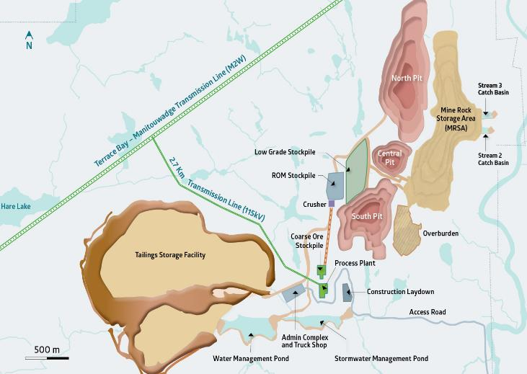
Project footprint and Mine plan
 | Units | 2025 TR
LOM Throughput
Peak Process Plant Throughput | tpd | 27,700
 | Mt/year | 10.1
Peak Mining Rate | tpd | 164,000
 | Mt/year | 60
Mine Production (LOM)
Total Mined | Mt | 489.7
Total Waste Mined | Mt | 361.4
Total Ore Mined | Mt | 128.3
Strip Ratio | waste:ore | 2.8
Payable Metal (LOM)
Palladium | k oz | 2,161
Copper | M lbs | 532
Platinum | k oz | 488
Gold | k oz | 160
Silver | k oz | 3,051
Payable Metal (Pre-Prod + 3 Yrs of Operations)
Palladium | k oz | 720
Copper | M lbs | 151
Platinum | k oz | 156
Gold | k oz | 47
Silver | k oz | 591

Slide 33
Processing and Metallurgy
Conventional processing plant flow sheet consisting of:
  Primary gyratory crusher
  Overland conveyor and crushed ore stockpile
  SAG-Ball Mills and Pebble crusher
  Regrind mill
  Rougher + cleaner flotation circuit
  Concentrate and tailings dewatering
  Concentrate storage
Will produce a copper-PGM concentrate; low in deleterious elements
Copper flotation kinetics very rapid; PGMs flotation slower than Cu but predictable

Slide 34
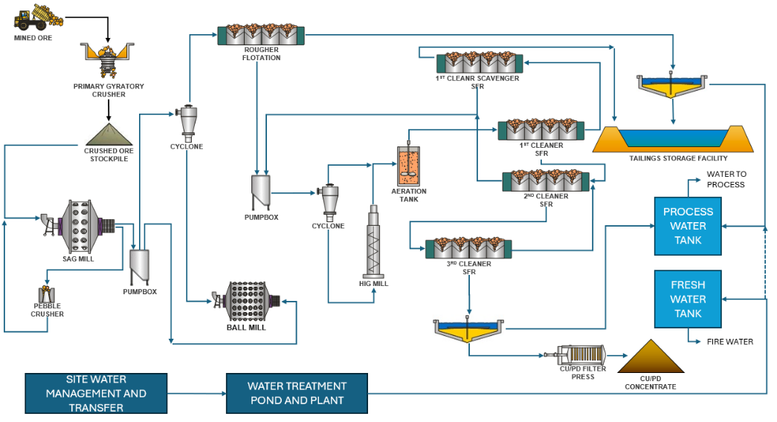
Processing Flow Diagram

