Slide 1
Investor Presentation
European Marketing
Jo Battershill – Managing Director
Date – March 2025

Slide 2
Important notices and disclaimer
You are advised to read the following carefully before making any use of the information contained in this presentation.
This presentation is dated 20 March 2025 (“Presentation”) and has been prepared by Silver Mines Limited (ACN 107 452 942) (ASX ticker SVL) (“Silver Mines” or the “Company”). This Presentation has been authorised for release to ASX by the Managing Director of the Company.
Summary information
The material contained in this Presentation is a summary and for information purposes only.
The information in this Presentation is general in nature and does not purport to be accurate nor complete, nor does it contain all of the information that an investor may require in evaluating a possible investment in the Company, nor does it contain all the information which would be required in a disclosure document or prospectus prepared in accordance with the requirements of the Corporations Act 2001 (Cth) (“Corporations Act”). It has been prepared by the Company with due care but no representation or warranty, express or implied, is provided in relation to the accuracy, reliability, fairness or completeness of the information, opinions or conclusions in this Presentation by the Company or any other party involved in its preparation.
Reliance should not be placed on information or opinions contained in this Presentation and, the Company does not have any obligation to finalise, correct or update the content of this Presentation. Certain data used in this Presentation may have been obtained from research, surveys or studies conducted by third parties, including industry or general publications.
To the maximum extent permitted by law, the Company is not responsible for updating, nor undertakes to update, this Presentation. It should be read in conjunction with the Company’s other periodic and continuous disclosure announcements lodged with the ASX, which are available at www.asx.com.au or at https://www.silvermines.com.au/news-announcements/.
Past performance
Past performance metrics and figures (including past share price performance of the Company), as well as any historic or pro forma financial information, that is included in this Presentation are provided for illustrative purposes only and should not be relied upon as (and is not) an indication of the Company’s views, or that of any other party involved in its preparation, on the Company’s future financial performance or condition or prospects. Investors should note that past performance of the Company, including in relation to the historical trading price of the Company’s shares, production, mineral resources and ore reserves, costs and other historical financial information cannot be relied upon as an indicator of (and provides no guidance, assurance or guarantee as to) future performance, including the future trading price of shares. The historical information included in this presentation is, or is based on, information that has previously been released to the market.
Forward-looking statements and forecasts
The material in this presentation contains certain forecasts and forward-looking information, including regarding possible or assumed future performance or potential growth of Silver Mines. Such information is not a guarantee of future performance and involves unknown risks and uncertainties, as well as other factors, many of which are beyond the control of Silver Mines. Actual results and developments may differ materially from those expressed or implied by these forward-looking statements depending on a variety of factors.
No representation or warranty, expressed or implied, is made or given by or on behalf of Silver Mines, any of Silver Mines’ directors, or any other person as to the accuracy or completeness or fairness of the information or opinions contained in this presentation and no responsibility or liability is accepted by any of them for such information or opinions or for any errors, omissions, misstatements, negligent or otherwise, or for any communication written or otherwise, contained or referred to in this presentation.
Investors are cautioned not to place undue reliance on such statements. The Company undertakes no obligation to update publicly or release any revisions to these forward-looking statements.
Accordingly, neither Silver Mines nor any of the Silver Mines directors, officers, employees, advisers, associated persons or subsidiary undertakings shall be liable for any direct, indirect or consequential loss or damage suffered by any person as a result of relying upon the statement or as a result of any admission in, or any document supplied with, this presentation or by any future communications in connection with such documents and any such liabilities are expressly disclaimed.
Not an offer
This Presentation is not an offer or invitation for subscription or purchase of, or a recommendation in relation to, securities in the Company and neither this Presentation nor anything contained in it shall form the basis of any contract or commitment. This Presentation is not a prospectus, product disclosure statement or other offering document under Australian law or any other law and will not be lodged with the Australian Securities and Investments Commission.

Slide 3
Important notices and disclaimer
JORC Code
It is a requirement of the ASX Listing Rules that the reporting of Ore Reserves and Mineral Resources in Australia comply with the Joint Ore Reserves Committee’s Australasian Code for Reporting of Mineral Resources and Ore Reserves ("JORC Code"). Investors outside Australia should note that while Ore Reserves and Mineral Resources estimates of the Company in this document comply with the JORC Code (such JORC Code-compliant Ore Reserves and Mineral Resources being "Ore Reserves" and "Mineral Resources" respectively), they may not comply with the relevant guidelines in other countries and, in particular, do not comply with (i) National Instrument 43-101 (Standards of Disclosure for Mineral Projects) of the Canadian Securities Administrators (the "Canadian NI 43-101 Standards"); or (ii) Item 1300 of Regulation S-K, which governs disclosures of mineral reserves in registration statements filed with the SEC. Information contained in this document describing mineral deposits may not be comparable to similar information made public by companies subject to the reporting and disclosure requirements of Canadian or US securities laws.
Mineral Resources and Ore Reserves
This Presentation contains estimates of the Company's Mineral Resources and Ore Reserves – refer to Appendix 1 and Appendix 2 in particular.
The information in this Presentation that relates to the Company’s Mineral Resources and Ore Reserves has been extracted from the Company's previous ASX announcements including:
ASX Announcement “Bowdens Silver Project Ore Reserves Increased to 71.7Moz Silver” dated 20 December 2024; and
ASX Announcement “Amendment to Announcement – Bowdens Silver Project Ore Reserves Increased to 71.7Moz Silver” dated 10 January 2025.
Copies of these announcements are available at www.asx.com.au or https://www.silvermines.com.au/news-announcements/. The Company confirms that it is not aware of any new information or data that materially affects the information included in those announcements and, in relation to the estimates of the Company’s Mineral Resources and Ore Reserves, that all material assumptions and technical parameters underpinning the estimates in the announcements continue to apply and have not materially changed. The Company confirms that the form and context in which the Competent Person's findings are presented have not been materially modified from those announcements.
Production Targets
The information in this Presentation that relates to Production Targets has been extracted from the Company's ASX Announcement “Bowdens Optimisation Study Outlines Robust, High Margin Silver Project” dated 20 December 2024.
A copy of this announcements is available at www.asx.com.au or https://www.silvermines.com.au/news-announcements/. The Company confirms that it is not aware of any new information or data that materially affects the information included in those announcements and, in relation to the Production Targets, that all material assumptions and technical parameters underpinning the estimates in the announcements continue to apply and have not materially changed. The Company confirms that the form and context in which the Competent Person's findings are presented have not been materially modified from that announcement. The Ore Reserves underpinning the production targets were prepared by a Competent Person in accordance with the JORC Code.
Exploration Results
The information in this presentation that relates to Exploration Results has been extracted from various Silver Mines ASX announcements and are available to view on the Company’s website at www.silvermines.com.au or through the ASX website at www.asx.com.au (using ticker code “SVL”). The Company confirms that it is not aware of any new information or data that materially affects the information included in the original market announcement. The Company confirms that the form and context in which the Competent Person’s findings are presented have not been materially modified from the original market announcement.
Silver Equivalents (AgEq)
Silver Equivalent references in this report are based on prices of US$27.50/oz Ag, US$2,950/t Zn, US$2,350/t Pb and US$2,200/oz Au with metallurgical recoveries of 86.2% Ag, 92.2% Zn, 84.7% Pb and 80% Au estimated from test work commissioned by Silver Mines Limited. Silver equivalent formulae AgEq = Ag + Pb*0.002612 + Zn*0.003569 + Au*74.25 with all metals stated in g/t. It is the Company’s opinion that all metals included in the equivalents calculations have a reasonable potential to be recovered and sold.
No liability
This Presentation has been prepared by the Company in good faith, based on information available to it, including information from third parties, and has not been independently verified. No representation or warranty is made as to the accuracy, completeness or reliability of the information.
To the maximum extent permitted by law, each of the Company and its related bodies corporate, and their respective its directors, employees, agents and advisers:
expressly disclaims any and all liability, including, without limitation, any liability arising out of fault or negligence, for any loss arising from the use of or reliance on information contained in this presentation including representations or warranties or in relation to the accuracy or completeness of the information, statements, opinions, forecasts, reports or other matters, express or implied, contained in, arising out of or derived from, or for omissions from, this presentation including, without limitation, any financial information, any estimates or projections and any other financial information derived therefrom, whether by way of negligence or otherwise; and
expressly excludes and disclaims all liabilities in respect of, makes no representations regarding, any part of this Presentation and make no representation or warranty as to the currency, accuracy, adequacy, reliability or completeness or fairness of any statements, estimates, options, conclusions or other information contained in this Presentation; and
expressly excludes and disclaim all liability, for any expenses, losses, damages or costs incurred by you as a result of the information in this Presentation being inaccurate or incomplete in any way for any reason, whether by negligence or otherwise.
Statements made and information presented in this Presentation are made and presented only as at the date of this Presentation, and is current as at the date of this Presentation (unless otherwise indicated). The information in this Presentation remains subject to change without notice.

Slide 4






Bowdens silver project Optimisation study highlights¹
Significant Reserves LOM ~72Moz Silver
Long Life Operation 16½ year mine life
Ore Reserves of 32.8Mt⁴ (28.1Mt in Optimisation)
Pre-Production Capital Costs A$331m (US$205m)
NPV and Payback Period NPV₅ A$359m (pre-tax) & 3.9 Years²
Conventional mining and processing
Single, high-grade silver concentrate with minor Zn & Pb
Low Cost – High Margin LOM AISC <A$25/oz (vs Spot³ A$53/oz)
Robust Operating Margin LOM Operating Margin A$948m²
Potential high-grade underground option
Significant leverage to silver price with >85% of revenue from silver²
Refer to Silver Mines Limited announcement ‘Bowdens Optimisation Study Outlines Robust, High Margin Silver Project’, 20 December 2024.
Financial estimates based on silver price assumption of US$29/oz, Zn at US$1.35/lb, Pb at US$1.05/lb and a AUDUSD FX forecast of 0.67.
Spot estimate based on silver price of US$33.45 and AUDUSD FX rate of 0.6310.
Refer to Appendices 1 & 2.

Slide 5



Silver Mines Limited corporate information
Directors
Capital Structure (ASX: SVL)
Keith Perrett | Non-Executive Chairman
Jonathan Battershill | Managing Director
Kristen Podagiel | Non-Executive Director
Rob Dennis | Non-Executive Director
 | AUD | USD
Shares on Issue (m) | 1,780 | 1,780
Share Price ($) ^{28 Mar 2025} | 0.10
Undiluted Market Capitalisation ($m) | 178.0 | 112.3
Cash ($m, as at end Dec 2024) | 27.1 | 17.1
Enterprise Value ($m) | 150.9 | 95.2
Listed Options
June 2026 - A$0.1196/sh | 90.6m
Trading History
Correlation = c.70%
Average daily volume of 4.9m shares
1,780m shares on issue
A$27m Cash
(as at 31 Dec 24)
32.2m Incentive Options & Rights

Slide 6

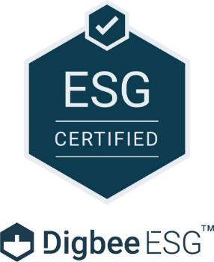
SILVER MINES LIMITED Environmental, Social and Governance
Strong commitments to ESG through collection of detailed baseline environmental and social information
Silver Mines Limited now Digbee ESG Certified
Governance policies ensure compliance with ASX corporate standards and promote a safe, non-discriminatory, diverse and inclusive workplace
Digbee ESG is the industry standard disclosure framework for the mining industry
Highly credible score of BBB reflecting robust process of technical design, environmental and social impact studies, assessment and consultation
Notes:
Silver Mines Limited now Digbee ESG Certified
Digbee ESG is the industry standard disclosure framework for the mining industry
Inaugural highly credible score of BBB reflecting a robust process of technical design, environmental and social impact studies, assessment and consultation
Governance policies ensure compliance with ASX corporate standards and promote a safe, non-discriminatory, diverse and inclusive workplace
The Company has demonstrated strong commitments to ESG through the collection of detailed baseline environmental and social information

Slide 7
Silver mines limited Bowdens silver project

Slide 8
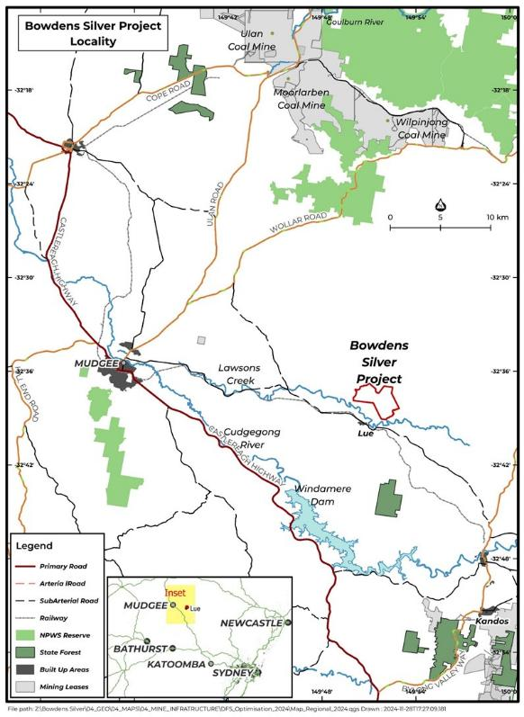
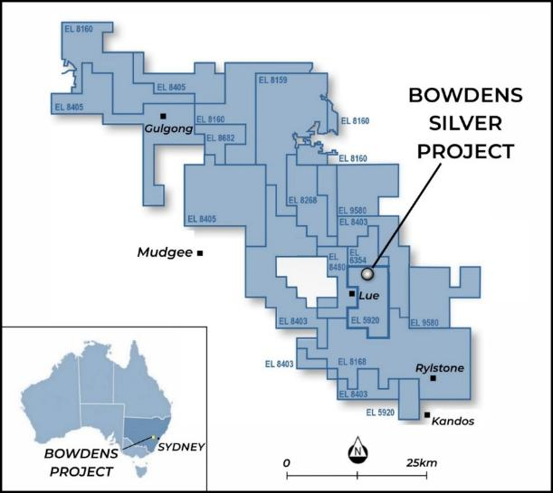
Bowdens silver project introduction
Bowdens Silver Project
Asset Location
Bowdens Silver Project located in central New South Wales, Australia
Project 100% owned, acquired by SVL in 2016
Bowdens is a low to intermediate sulphidation, epithermal deposit
Discovered by CRAE in 1989
Resource estimate of 180Moz Ag defined from 854 drill holes for over 161,000m of drilling

Slide 9
Bowdens Silver Project Overview
Highlights
Timeline of major milestones
The largest silver development project in Australia
100% owned asset located in NSW
Mineral Resource base of 180Moz silver (334Moz AgEq)
Ore Reserve of 71.7Moz for an operational life of 16½ years
Pre-production capital expenditure of A$331m
2.0Mtpa plant producing single high-grade Ag concentrate
LOM AISC forecast to be <A$25/oz (~US$16/oz)
High-grade mineralisation remains open at depth
Sept 2017
MRE update (163Moz Ag)
Jun 2018
Feasibility Study completed
Mar 2023
MRE update (189Moz Ag)
Aug 2024
Court of Appeal suspends the NSW approval consent
May 2018
Ore Reserve completed
(66Moz Ag)
May 2020
EIS completed; DA Submitted
Apr 2023
NSW State mine development approvals received
Dec 2024
MRE (180Moz Ag¹) &
ORE (71.7Moz Ag¹) update; Optimisation Study completed
Reserves and Resources^{(1 & 2)}
Tonnes | Tonnes | Grade |  |  |  | Contained Metal
 | Mt | Ag g/t | Zn % | Pb % | AgEq² g/t | Ag Moz | Zn kt | Pb kt | Au koz | AgEq² Moz
Ore Reserve | 32.8 | 68 | 0.38 | 0.30 | n/a | 71.7 | 123 | 96 | - | n/a
Mineral Resource | 180 | 31 | 0.39 | 0.28 | 58 | 180 | 696 | 501 | 426 | 334

Slide 10
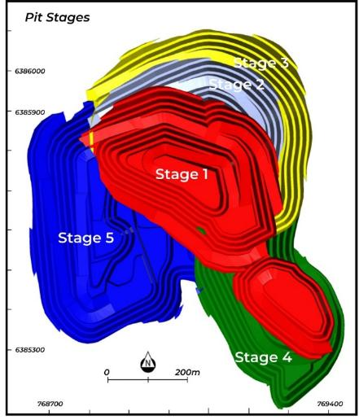
Bowdens Silver project open pit mining
Open Pit Design
Open Pit Mining Parameters¹
Conventional open pit - primary fleet of 1 excavator (200t) and 7 trucks (100t)
Five stage pit – 72.5% of tonnes in Stages I – IV. Stage V to commence in Yr-9
Primary mining activities are planned to be 7-days per week, dayshift only
Bench heights are planned at 5m
LOM strip ratio of 1.49:1.0 (total waste of 48.2Mt)
Mining rate limited to keep the low-grade stockpile to a maximum size of 2Mt
LOM mined grade of 71 g/t Ag based on A$30/t NSR cut-off
71.7Moz silver mined over 16-yrs
LOM open pit mining cost of A$7.12/t

Slide 11
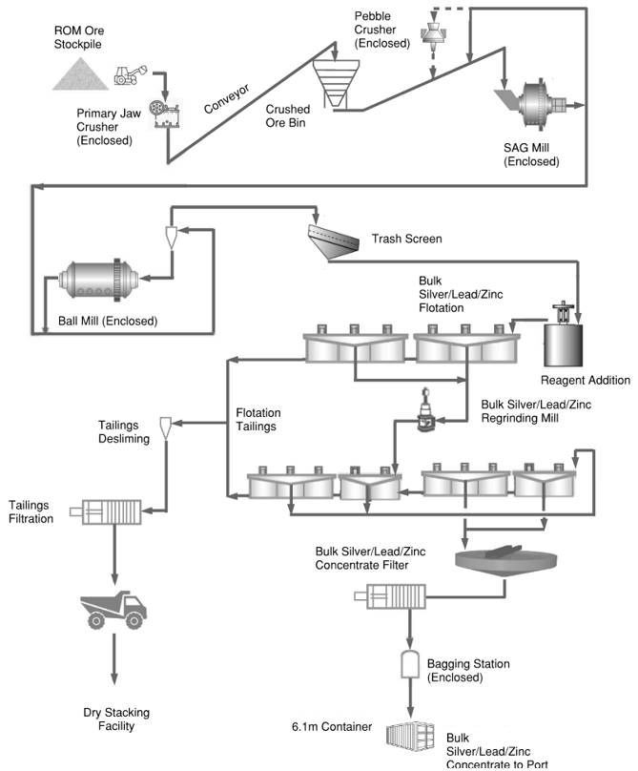
Bowdens Silver project conventional processing
Processing Parameters¹
Cyanide eliminated from the processing flow sheet
Processing scheduled at 2.0Mtpa via a conventional flow sheet
Single stage primary jaw crushing, two stage SAG and ball mill with pebble crusher
Rougher and scavenger flotation with concentrate regrind prior to cleaner flotation
Production of a high-grade, bulk silver, lead and zinc concentrate
Grind size optimised at p80 passing 106 µm – concentrate regrind to a p80 of 17µm
Silver recovery modelled at 82.7% (Zn at 88.7% and Pb at 82.7%)
Tailings are dewatered for dry stacking
LOM processing cost of A$20.78/t

Slide 12
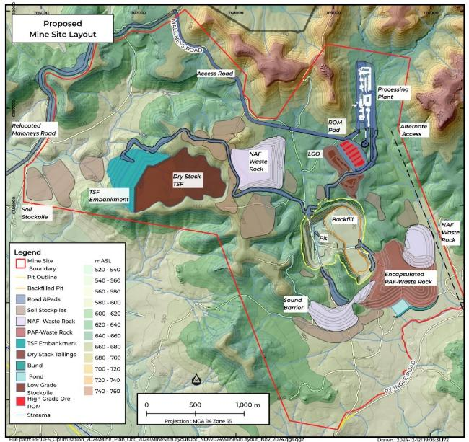
Bowdens Silver project SITE disturbance minimised
Site design optimised¹
Overall changes lead to significant reduction to the overall disturbance footprint
Open pit mine design now smaller with lower strip ratio
Day shift mining only potential to lower noise
The height of the Waste Rock Dump design has been lowered to reduce visual impacts
Tailings Storage Facility design has changed to Dry-Stack (dewatered), reducing disturbance footprint to less than 50% of original design
Dewatering of the tailings for dry stacking substantially reduces site water losses and seepage
Moving to single stream concentrate, removes Cyanide from the process plant and tails
No requirement for trucks to haul waste rock to the tailings site on public roads

Slide 13
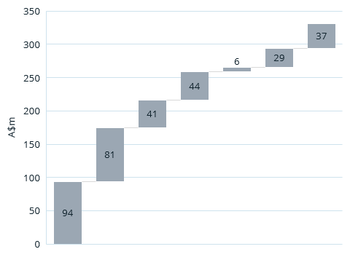
Bowdens Silver project cost summary¹
Pre-Production Capex Summary
AISC Summary
Cost Centre | A$/t Ore | A$/oz
Opex
Mining & Rehab | 18.73 | 10.45
Processing | 20.78 | 11.60
G & A | 5.65 | 3.15
Realisation¹ | 6.15 | 3.43
Royalties² | 4.41 | 2.46
By-products | (11.79) | (6.59)
Sub-total - Opex | 43.91 | 24.51
Sustaining
Plant | 0.39 | 0.22
Waste Management | 0.13 | 0.07
Sub-total - Sustaining | 0.53 | 0.29
LOM AISC | 44.45 | 24.81
Indirects
Site Infrastructure
Mobile Plant
Pre-Production
Process Plant
Waste Management
Off-site Infrastructure
1.Refer to Silver Mines Limited ASX announcement ‘Bowdens Optimisation Study Outlines Robust, High Margin Silver Project’, dated 20 December 2024

Slide 14
Bowdens Silver project Production schedule¹
Years 1 to 10 - Average 4.2Moz Ag at 83 g/t Ag
Average 2.7Moz Ag at 53 g/t Ag

Slide 15
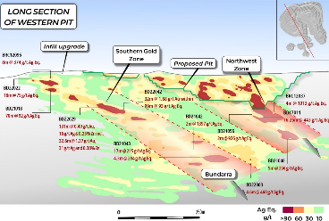
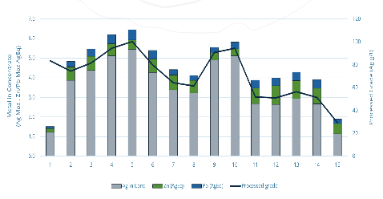
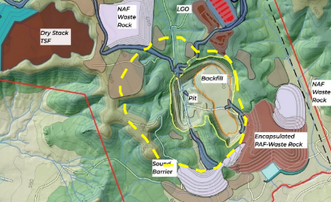
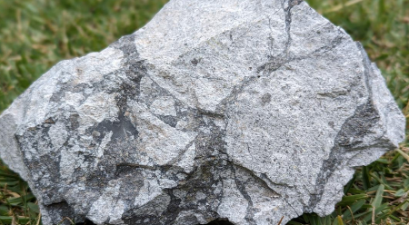
Bowdens Silver project project optionality
Mineralised system remains open beneath open pit design
6.0m @ 1251g/t AgEq¹
18.3m @ 443g/t AgEq²
8.0m @ 543g/t AgEq³
Potential high-grade underground option to supplement plant feed
Potential plant modifications
Plant expansion to lift throughput in Yr-6 or Yr-11
Ore-Sorting to lift grade in years 11 to 15. Test-work demonstrates validity on medium-grade ore
Further studies required on both options
Opportunity to expand the pit at higher silver prices⁴
There is a large remaining resource base outside the current reserve estimate
Whittle shells at 2.0x Revenue Factor shows significant potential upside to mine life
Assays from bulk samples highlight potential conservatism within the MRE⁵
High-grade results averaged 43% higher than block model grades
Results demonstrate potential for significant upside in Bowdens Silver mining scenarios
Notes:
Northwest Zone, Aegean and Bundarra Zones contains high-grade silver directly under the planned open-cut pit
Drilling demonstrates that the Northwest and Aegean Zones are likely to be connected
Bundarra Zone with greater base metal (zinc & lead) plus gold
Each of the three discoveries open in several directions
Greater gold tenor as drilling moves south and east of open-cut area
Potential open-pit expansion and potential underground development
Total Mineral Resource now 396 Moz AgE
Mineral Resource in Southern Gold Zone contains 190,000 ounces gold

Slide 16
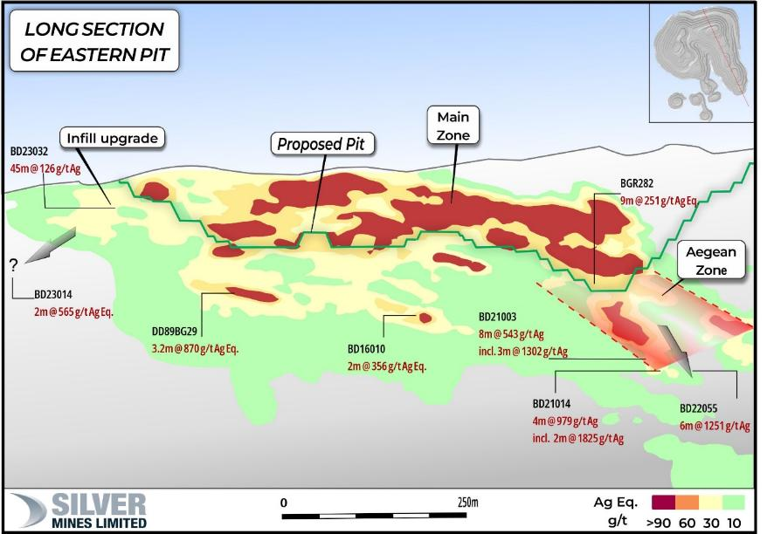
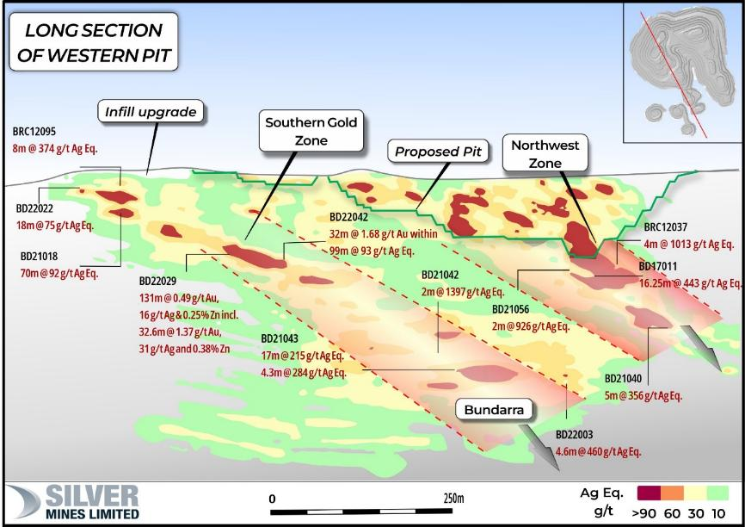
Bowdens Silver exploration strike and depth extensions
Notes:
Northwest Zone, Aegean and Bundarra Zones contains high-grade silver directly under the planned open-cut pit
Drilling demonstrates that the Northwest and Aegean Zones are likely to be connected
Bundarra Zone with greater base metal (zinc & lead) plus gold
Each of the three discoveries open in several directions
Greater gold tenor as drilling moves south and east of open-cut area
Potential open-pit expansion and potential underground development
Total Mineral Resource now 396 Moz AgE
Mineral Resource in Southern Gold Zone contains 190,000 ounces gold

Slide 17
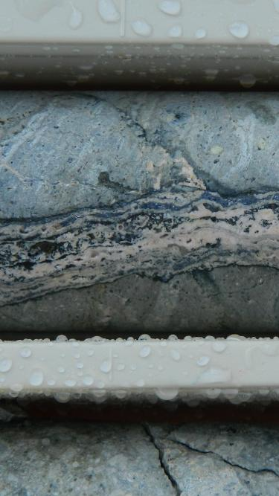
Bowdens Silver Project Key Conclusions
Largest silver development project in Australia
M&I Resource of 164 Moz Ag and Reserve of 71.7 Moz Ag
>85% of revenue from silver
Permitting activities remain ongoing
Optimisation Study completed in Dec-24²
16½ year mine life at 2Mtpa producing total of ~53Moz Ag
Pre-production capex of A$331m
Average output of 4.25Moz Ag p.a. in the first 10 years
AISC of <A$23/oz (~US$15/oz) over the first 10 years
LOM operating margin of A$948m
Pre-tax NPV₅ $359m
Profitability Index of 1.76x
Payback of 3.9 years
Considerable exploration potential
Large mineralised system remains open at depth
Gold and copper identified within the broader mineralised system
Assets located in a low-risk jurisdiction for mining development
Ready access to existing infrastructure
Substantial leverage to the silver price
Single open-cut mine with uncomplicated mining
Low strip ratio and standard metallurgy
Potential expansion opportunities from open pit and underground
Long mine life

Slide 18
Regional exploration A MAJOR mineralised SYSTEM

Slide 19
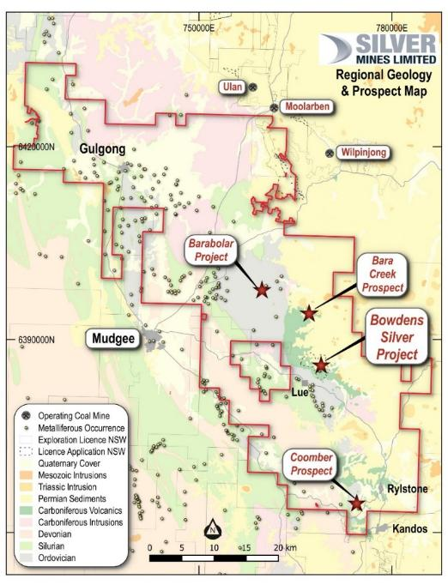
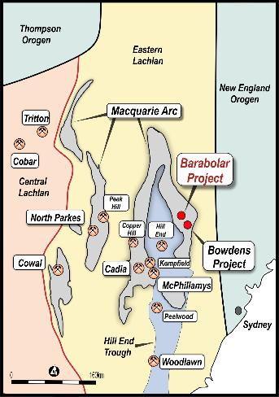
Bowdens Silver Project regional geology
Extensive tenement holding (2,115 km² = 521,000 acres)
100% controlled by Silver Mines
Wide range of prospective deposit types
Eastern limb of the Macquarie Arc
Mid-to late Carboniferous Rylstone Volcanics (325 – 315 Ma)
Overlain by the Permo-Triassic Sydney Basin sediments ( < 270 Ma)
Bowdens deposit low to intermediate sulphidation
Carbonate silver-base metal-gold epithermal system
Vein types: breccia, stringer, dissemined, banded and colloform
Mineralisation age is ~290 – 300 Ma
Notes:
Extensive tenement holding (2,115 km² = 521,000 acres) 100% controlled by Silver Mines.
Wide range of prospective deposit types over different time periods (Ordovician, Siluro-Devonian, Carboniferous and Permian).
Eastern limb of the Macquarie Arc has the potential for discovery of significant mineralisation.
Mid-Carboniferous Rylstone Volcanics (~325Ma) consisting of rhyolitic to dacitic pyroclastics, epiclastics and lavas with recently defined porphyritic intrusion within the deposit.
Overlain by the Permo-Triassic Sydney Basin sediments ( < 270 Ma).
The Bowdens deposit is a low to intermediate sulphidation, carbonate silver-base metal-gold epithermal system.
Vein types include – breccia, stringer, dissemination, banded and colloform textured veins.
Mineralisation age is ~321 Ma.
March 2023 Mineral Resource increased by 56% in total tonnes and 44% total silver equivalent ounces (compared to 2017 Mineral Resource).

Slide 20
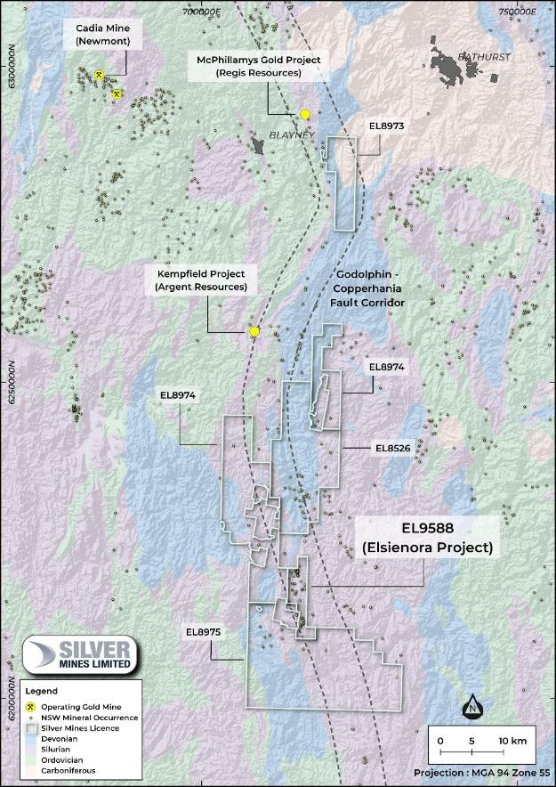






Silver mines limited TUENA GOLD PROJECT
Location South of Blayney, NSW
Limited modern drilling Best hit 4m @ 6.9g/t
Historic goldmine minimal work in modern era
Previously unrecorded historic workings identified
Geological analogies to McPhillamys Gold Project
Airborne magnetics & radiometrics completed on EL8526 & EL9588
929 km² of exploration licenses extending over 60km - all granted, all 100%
Notes:
Located south of Blayney in New South Wales
Historic goldfield with minimal exploration work in the modern era
Clear geological analogies to the McPhillamys Gold Project (2.0 Moz gold)
Mineral system and old gold workings extend over at least 6 kilometres of strike
Reconnaissance mapping is identifying previously unrecorded historic workings and shear zones with substantial width
Airborne magnetics and radiometrics survey completed
Tenement position expanded with 747 km² of exploration licenses, all granted, all 100%

Slide 21
Silver metal of innovation

Slide 22














Silver WHY SILVER?
Industrial
Monetary value and store of wealth
Highest electrical and themal conductivity of all metals
The best reflector of visible light
Global efforts to electrify and decarbonize will contribute to increased silver demand:
Solar powered renewable energy
Electric vehicles – solid state Ag-C batteries
Broadband cellular (5G)
Financial
Electrical
(21% of demand*)
Photovoltaics (19% of demand)
A safe haven in times of geopolitical risk
Portfolio diversification
Hedge against inflation
Jewellery
5G networks
A store of value and wealth for over 4,000 yrs
Universal recognition with good liquidity
A tangible asset
Batteries
Water purification
Notes:
Exxon Mobil Corp., Chevron Corp., Shell Plc, BP Plc, TotalEnergies Se, ConocoPhillips and Eni SpA?
Tongwei Co., GCL Technology Holdings Ltd., Xinte Energy Co., Longi Green Energy Technology Co., Trina Solar Co., JA Solar Technology Co., and Jinko Solar Co.
Recent study from School of Photovoltaic and Renewable Energy Engineering, UNSW, Australia shows that by 2050, 85-98% of current global silver reserves will have been consumed by photovoltaic technologies
Expect technological developments…
Still much to do to improve efficiency of PV’s
Overheating is the most important factor for the efficiency of the solar panel
Advancing efficiency of current PV’s could lead to silver loading going back up
Degradation rates of c.1% pa
However, there a number of groups working on replacing Ag with Cu

Slide 23
Silver solar leading the charge
PV sector consumed 19% of total supply in 2023
3 million solar panels are required to generate 1GW of energy
Solar capacity in China is now greater than the rest of the world combined
In 2023, China installed more solar panels than the US has in its history
Global install of solar was 30GW in 2013, with total capacity of 100GW
By 2023, installed capacity had grown 10x to 1TW with >200GW installed in 2023
Cost per watt has dropped 98% since 1998
The global solar industry is now valued at over $350bn pa and is still growing
Demand from solar forecast to grow 3x by 2030
75TW of capacity required to meet decarbonisation goals globally
100
Demand has surged despite thrifting
80
Moz
60
Index (2010=100)
40
20
0
Notes:
Recent study from School of Photovoltaic and Renewable Energy Engineering, UNSW, Australia…
Forecast that the PV industry will consume 20% of silver supply by 2027 (we jumped from 11% to 19% over the last year);
By 2050, 85-98% of current global reserves will be consumed by photovoltaic technologies.
Demand from solar forecast to grow 3x by 2030
In 2023, China installed more solar panels than the US has in its history
Global annual install of solar capacity was 30GW in 2013, with total installed capacity of 100GW
By 2023, installed capacity had grown 10x to 1TW with >200GW installed in 2023 alone
75TW of capacity required to meet decarbonisation goals globally (75x)
Solar Power’s Giants Are Providing More Energy Than Big Oil – Bloomberg recently completed an exercise comparing big oil and big solar.
Expect technological developments…
Still much to do to improve efficiency of PV’s
Overheating is the most important factor for the efficiency of the solar panel
Advancing efficiency of current PV’s could lead to silver loading going back up
Degradation rates of c.1% pa
However, there a number of groups working on replacing Ag with Cu

Slide 24
Silver Key statistics / supply & demand
~1,220M annual consumption
Deficit
Cumulative deficit of 543Moz 2021 – 2023
215Moz forecast in 2024
1,010
Industrial applications: electronics | solar | medicine | water purification | window manufacturing
~830M annual mine production
Silver price CAGR 7.8% since 2003 low vs US average annual CPI 2.5%
Five distinct periods of silver demand, three that are strengthening:
Monetary (2000 BC to 1936 AD)
Photographic (1900 – 1999)
Industrial (1940 to present)
Investment (2000 to present)
Energy (2010 to present)
82% of annual silver supply sourced from mining
87:1 silver : gold price ratio
(Long term average 60:1)
18% of annual silver supply sourced from recycling
1,195
7:1 silver : gold mine supply ratio
5:1 gold : silver
daily traded value ratio
Electrical/electronics 38%
Photovoltaics 30%
Other Uses 24%
Brazing Alloys 8%
Notes:
Do deficits matter ?
Deficit situation could ultimately play the same as the Palladium markets from 2012 through to 2021.
Palladium price showed no interest in 4-yrs of deficits from 2012, then ripped higher from 2016 – ultimately increasing 4.5x through to 2021
Identifiable above ground silver bullion stocks has fallen 26% in two years.
Interesting interplay between silver’s store of wealth and industrial metal
Gold silver ratios are an interesting point
If you were to use the variance between mine supply ratio and daily traded value ratio, and normalise them one way or the other, one could argue the silver price should be either $45/oz or $70/oz.
This would bring the price ratio back to 35:1 or 49:1
Either way, the silver price still has a lot of catching up to do when viewed against gold

Slide 26
appendix

Slide 27
APPENDIX 1: BOWDENS SILVER MINERAL RESOURCES (AS AT December 2024)
30 g/t Ag Eq Cut | Tonnes (Mt) | Silver Eq. (g/t) | Silver (g/t) | Zinc (%) | Lead (%) | Gold (g/t) | Silver (Moz) | Silver Eq. (Moz)
Measured | 100 | 65 | 42 | 0.37 | 0.27 | 0.03 | 135 | 207
Indicated | 43 | 52 | 21 | 0.41 | 0.28 | 0.11 | 30 | 71
Measured & Indicated | 143 | 61 | 36 | 0.38 | 0.27 | 0.06 | 164 | 278
Inferred | 36 | 48 | 14 | 0.42 | 0.32 | 0.14 | 16 | 55
Total | 179 | 58 | 31 | 0.39 | 0.28 | 0.07 | 180 | 334
The Bowdens Mineral Resource Estimate has been compiled by H&S Consultants Pty Ltd using Multiple Indicator Kriging and the reporting is compliant with the 2012 JORC Code and Guidelines. For full disclosures refer to the Silver Mines Limited announcement of 20 December 2024 (and the amendment to announcement 10 January 2025).
Bowdens Silver Mineral Resource Estimate reported to a 30g/t AgEq cut off extends from surface and is trimmed to above 300 metres RL, approximately 320 metres below surface, representing a potential target volume for future open-pit mining and expansion.
Bowdens’ silver equivalent (AgEq) assumes prices of US$27.50/oz silver, US$2,950/t zinc, US$2,350/t lead and US$2,200/oz gold with metallurgical recoveries of 86.2% silver, 92.2% zinc, 84.7% lead and 80% gold estimated from test work commissioned by Silver Mines Limited. AgEq formulae AgEq = Ag + Pb*0.002612 + Zn*0.003569 + Au*74.25 with all metals stated in g/t. It should be noted metal prices used in the Ore Reserve differ due to different timing of the Ore Reserve reporting.
In the Company’s opinion, the silver, zinc, lead and gold included in the metal equivalent calculations have a reasonable potential to be recovered and sold.
Stated Mineral Resources are partially inclusive of areas of the total Underground Mineral Resource Estimate at 150 g/t Silver Equivalent (AgEq) Cut-off Grade above 300mRL. See ASX announcement dated 5 September 2022.
Variability of summation may occur due to rounding.
Oxide and transitional material comprise 0.4% and 2.9% of the Resource tonnage, containing 1 Moz and 9 Moz AgEq respectively.

Slide 28
Appendix 2: Bowdens Silver Ore Reserve (as at December 2024)
 | Tonnes (Mt) | Silver (g/t) | Zinc (%) | Lead (% ) | Silver (Moz) | Zinc (kt) | Lead (kt)
Proved | 31.5 | 68.7 | 0.38 | 0.30 | 69.6 | 120.8 | 93.5
Probable | 1.3 | 50.6 | 0.19 | 0.16 | 2.1 | 2.5 | 2.0
Total | 32.8 | 68.0 | 0.38 | 0.29 | 71.7 | 123.3 | 95.6
Notes:
The Bowdens Reserve has been compiled by Resolve Mining Services and is based on the December 2024 Mineral Resource Estimate generated for Silver Mines by H & S Consultants Pty Ltd (see ASX announcement 20 December 2024). For full disclosures refer to the Silver Mines Limited announcement of 20 December 2024 (and the amendment to announcement 10 January 2025).
Ore Reserves are a subset of Mineral Resources.
Ore Reserves conform with and use the JORC Code 2012 definitions.
Ore Reserves are calculated using Silver, Lead and Zinc pricing of US$29/oz, US$1.05/lb and US$1.35/lb respectively
Ore Reserves are calculated using a Net Smelter Return cut-off grade of 27g/t Ag under these assumptions
Tonnages are reported including mining dilution
All figures are rounded to reflect appropriate levels of confidence which may result in apparent errors of summation.

