Slide 1
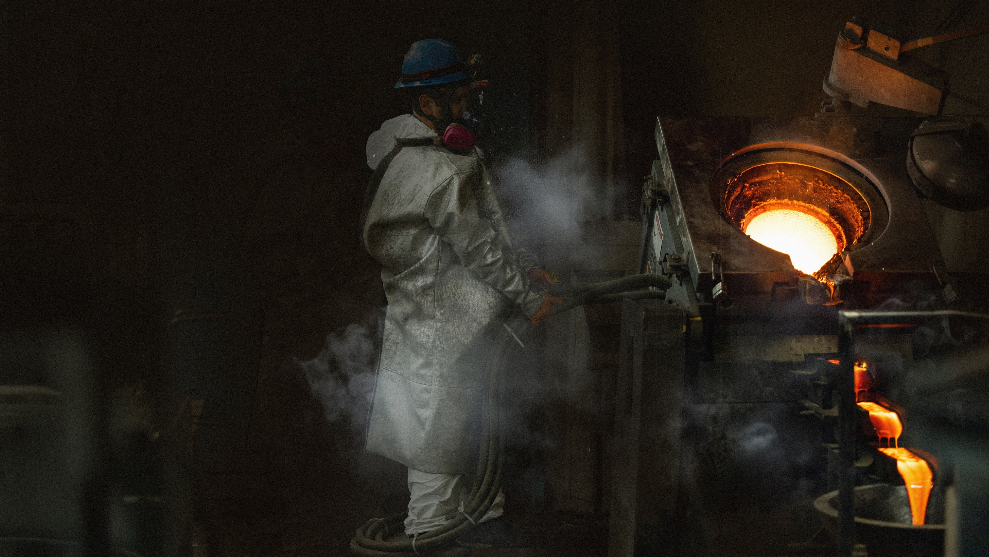

There’s no substitute
for silver
CORPORATE PRESENTATION
April 2, 2025

Slide 2
Forward Looking Statement
CAUTIONARY DISCLAIMER
Certain statements contained herein regarding First Majestic Silver Corp. (the “Company”) and its operations, including statements related to the Company’s 2025 production and cost guidance, constitute “forward-looking statements” within the meaning of Section 27A of the Securities Act of 1933, as amended, and Section 21E of the Securities Exchange Act of 1934, as amended, which are intended to be covered by the safe harbor created by such sections and other applicable laws and “forward-looking information” under applicable Canadian securities laws (collectively, “forward-looking statements”). These statements relate to future events or the future performance, business prospects or opportunities for First Majestic that are based on forecasts of future results, estimates of amounts not yet determinable and assumptions of management of First Majestic made in good faith in light of management’s experience and perceptions of historical trends, current conditions and expected future developments. Forward-looking statements include, but are not limited to, statements with respect to: closing of the transaction (the “Transaction”) with Gatos Silver, Inc. (“Gatos”) and the terms and timing related thereto, expected free cash flow from Gatos, expected value creation for shareholders, the future price of silver and other metals, the global supply and market for precious metals, revenue, the estimation of mineral reserves and resources, the realization of mineral reserve estimates, the timing and amount of estimated future production, life of mine estimates, recovery rates, costs of production (including cash costs and all-in sustaining costs), capital expenditures, margin estimates, costs and timing of the development of new deposits, exploration programs, the timing and payment of dividends, timing and possible outcomes of pending litigation and tax claims, the market for the Company’s shares and the Company’s ESG score performance. Assumptions may prove to be incorrect and actual results may differ materially from those anticipated. Consequently, guidance cannot be guaranteed. As such, investors are cautioned not to place undue reliance upon guidance and forward-looking statements as there can be no assurance that the plans, assumptions or expectations upon which they are placed will occur.
Generally, these forward-looking statements can be identified by the use of forward-looking terminology such as "plans", "expects" or "does not expect", "is expected", "budget", "scheduled", "estimates", "forecasts", "intends", "anticipates" or "does not anticipate", or "believes", or variations of such words and phrases or state that certain actions, events or results "may", "could", "would", "might" or "will be taken", "occur" or "be achieved". Actual results may vary from forward-looking statements. Forward-looking statements are subject to known and unknown risks, uncertainties and other factors that may cause the actual results, level of activity, performance or achievements of the Company to be materially different from those expressed or implied by such forward looking statements, including but not limited to: satisfaction and waiver of all applicable closing conditions for the Transaction on a timely basis or at all including, without limitation, receipt of all necessary shareholder, stock exchange and regulatory approvals or consents and lack of material changes with respect to the Company and Gatos and their respective businesses; the timing of the closing of the Transaction and the failure of the Transaction to close for any reason; the outcome of any legal proceedings; unanticipated difficulties or expenditures relating to the Transaction; risks relating to the value of the consideration to be issued in connection with the Transaction; the diversion of management time on pending Transaction-related issues; risks related to the integration of acquisitions; risks related to international operations; risks related to joint venture operations; fluctuations in security markets; the duration and effects of the COVID-19, and any other pandemics on operations and workforce, and the effects on global economies and society; general economic conditions including inflation risks; actual results of current exploration activities; actual results of current reclamation activities; reclamation expenses; conclusions of economic evaluations; changes in project parameters as plans continue to be refined; commodity prices; future demand for and prices of metals; possible variations in ore reserves, grade or recovery rates; actual performance and possible failure of plant, equipment or processes to operate as anticipated; availability of sufficient water for operating purposes; accidents, labour disputes and other risks of the mining industry; delays in obtaining governmental approvals or financing or in the completion of development or construction activities, changes in national and local government, legislation, taxation, controls, regulations and political or economic developments; operating or technical difficulties in connection with mining or development activities; risks and hazards associated with the business of mineral exploration, development and mining (including environmental hazards, industrial accidents, unusual or unexpected formations, pressures, cave-ins and flooding); risks relating to the credit worthiness or financial condition of suppliers, refiners and other parties with whom the Company does business; inability to obtain adequate insurance to cover risks and hazards; and the presence of laws and regulations that may impose restrictions on mining, including those currently enacted in Mexico; employee relations; relationships with and claims by local communities and indigenous populations; availability and increasing costs associated with mining inputs and labour; the speculative nature of mineral exploration and development, including the risks of obtaining necessary licenses, permits and approvals from government authorities; diminishing quantities or grades of mineral reserves as properties are mined; the Company’s title to properties, changes in climate conditions and extreme weather events, as well as those factors discussed in the section entitled "Description of the Business - Risk Factors" in the Company’s Annual Information Form for the year ended December 31, 2023, available on www.sedarplus.ca, and as an exhibit to its most recently filed Form 40-F on file with the United States Securities and Exchange Commission in Washington, D.C., which is available on EDGAR at www.sec.gov/edgar or on First Majestic’s website. Although the Company has attempted to identify important factors that could cause actual results to differ materially from those contained in forward-looking statements, there may be other factors that cause results not to be as anticipated, estimated or intended. The Company believes that the expectations reflected in these forward-looking statements are reasonable, however there can be no assurance that such statements will prove to be accurate, as actual results and future events could differ materially from those anticipated in such statements. Accordingly, readers should not place undue reliance on forward-looking statements. These statements speak only as of the date hereof. The Company does not undertake to update any forward-looking statements that are incorporated by reference herein, except in accordance with applicable securities laws.
The Company notes that changes in climate conditions could adversely affect the business and operations through shifting weather patterns, environmental incidents, and extreme weather events. This can include changes in snow and precipitation levels, extreme temperatures, changing sea levels and other weather events which can result in frozen conditions, flooding, droughts, or fires. Such conditions could directly or indirectly impact our operations by affecting the safety of our staff and the communities in which we operate, disrupting safe access to sites, damaging facilities and equipment, disrupting energy and water supply, creating labor and material shortages and can cause supply chain interruptions. There is no assurance that the Company will be able to successfully anticipate, respond to or manage risks associated with severe climate conditions. Any such disruptions could have an adverse effect on the Company’s operations, production, and financial results.
Certain Technical Information
Scientific and technical information regarding Gatos, its direct and indirect subsidiaries and affiliates and their respective businesses and properties are derived from disclosure documents publicly filed by Gatos including Gatos’ Annual Report on Form 10-K for the year ended December 31, 2023, filed with the SEC on February 20, 2024, as amended by Amendment No. 1 to such annual report filed with the SEC on May 6, 2024, at www.sec.gov/edgar. (the “Gatos Annual Report”) and the technical report entitled “Mineral Resource and Mineral Reserve Update, Los Gatos Joint Venture, Chihuahua Mexico” dated October 20, 2023 (the “Gatos Technical Report”), each of which are available on EDGAR at www.sec.gov/edgar or on SEDAR+ at www.sedarplus.com. The Gatos Technical Report was reviewed on behalf of the Company by Gonzalo Mercado, P.Geo. Internal QP for the Company. To the best of the Company’s knowledge, information and belief as of the date hereof there is no new material scientific and technical information that would make disclosure of the mineral resources or reserves inaccurate or misleading. The Company is not affirming or adopting any statements or reports attributed to Gatos (including prior mineral reserve and resource declaration) in this presentation or made by Gatos outside of this presentation.
Non-GAAP Financial Measures
This presentation includes reference to certain financial measures which are not standardized measures under the Company’s financial reporting framework. These measures include all-in sustaining costs (or “AISC”) per silver equivalent ounce, cash costs per silver equivalent ounce and free cash flow. The Company believes that these measures, together with measures determined in accordance with IFRS, provide investors with an improved ability to evaluate the underlying performance of the Company. These measures are widely used in the mining industry as a benchmark for performance but do not have any standardized meaning prescribed under IFRS, and therefore they may not be comparable to similar measures disclosed by other companies. The data is intended to provide additional information and should not be considered in isolation or as a substitute for measures of performance prepared in accordance with IFRS. For a complete description of how the Company calculates such measures and a reconciliation of certain measures to GAAP terms please see “Non-GAAP Measures” in the Company’s most recent management discussion and analysis filed on SEDAR+ at www.sedarplus.ca and EDGAR at www.sec.gov/edgar. Information regarding such measures with respect to Gatos, its direct and indirect subsidiaries and affiliates and their respective businesses and properties are derived from disclosure documents publicly filed by Gatos including the Gatos Annual Report. For a complete description of how Gatos calculates such measures with respect to the Los Gatos mine and a reconciliation of certain measures to US GAAP terms, please see “Non-GAAP Measures” in the Gatos Annual Report. The Company is not affirming or adopting any statements or reports attributed to Gatos regarding such measures in this presentation or made by Gatos outside of this presentation.

Slide 3




Introduction To Silver Basics
Silver is critical due to its unique properties, making a substitution is nearly impossible
Current silver to gold mine supply ratio 7:1
82% of forecasted annual silver supply is sourced from mining, 18% is sourced from recycling
Silver is the single most electrically conductive metal
Annual silver consumption is ~1,219M ounces compared to annual mine production of ~ 824M ounces
2024F demand by usages: 61% industrial fabrication, 17% coins & bars, 17% jewelry, 5% silverware
Source: Metals Focus, The Silver Institute

Slide 4
Global Silver Market Deficit
CONTINUED SILVER SUPPLY DEFICIT:
215Moz silver supply deficit estimated for 2024, and a 149Moz supply deficit forecast for 2025
2025 will be the 5th consecutive year of annual silver shortfall
Mined production and recycling are not keeping up with increasing annual silver demand
With industrial use continuing to grow, and a limited number of new mines coming online, the market will remain challenged to address demand
Five consecutive years of silver deficit
Source: Metals Focus, Silver Institute

Slide 5
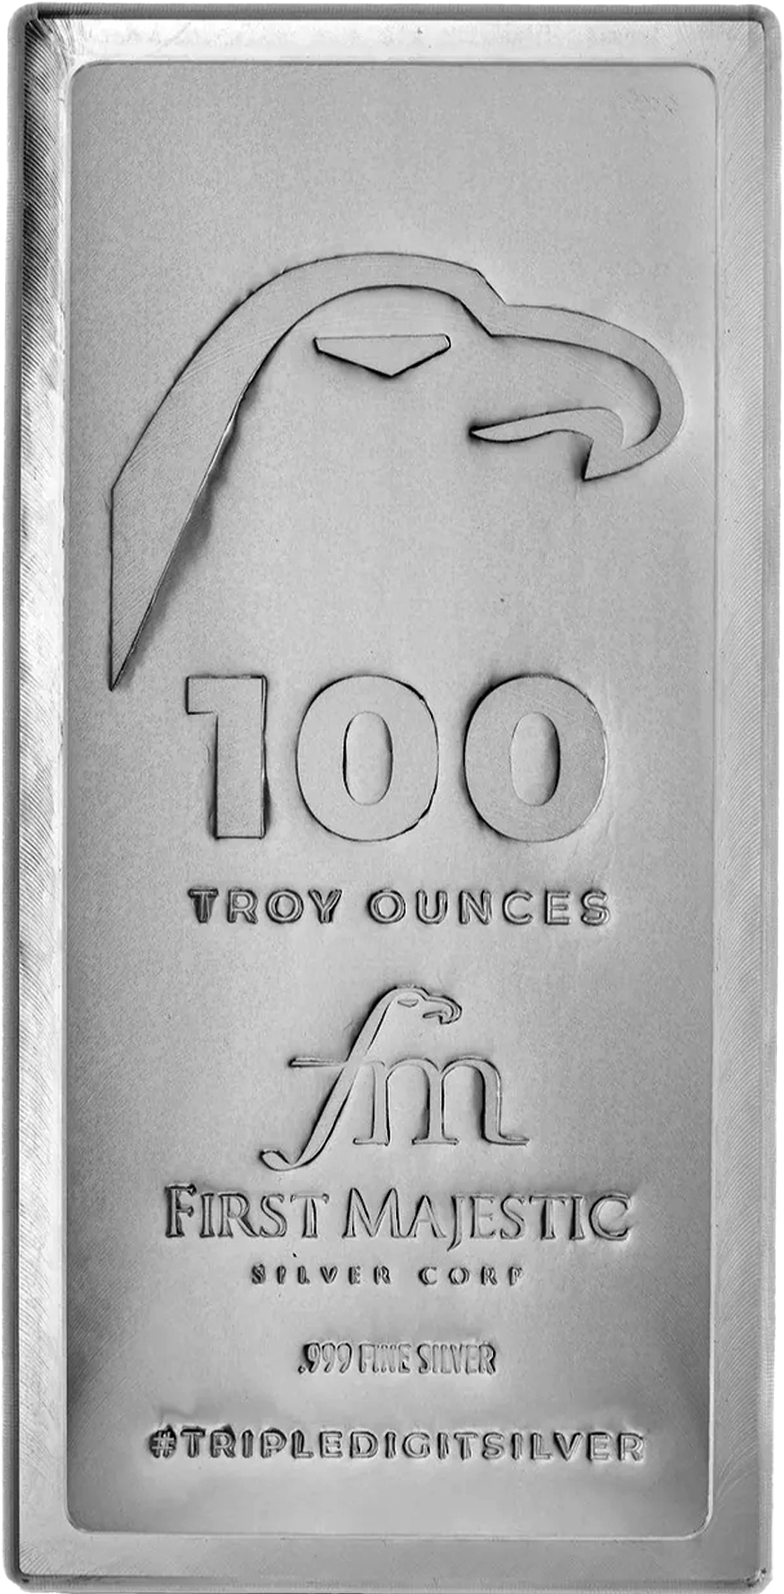
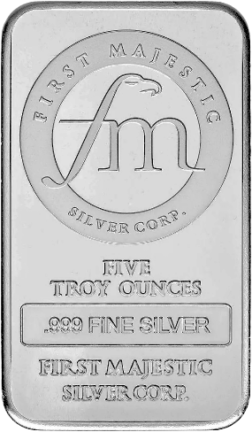
About the Company
Leverage to Silver
Multi Asset Producer
First Majestic
Goal
~51% of revenue from Silver (35% Gold)
Four producing underground mines in Mexico
Become the World’s Largest
Primary Silver Producer
North American Assets
First Mint Bullion Producer
>350,000 Ha of mining claims in two premier mining jurisdictions – Mexico and Nevada
Own and produce .999+ bullion at our minting facility, First Mint, LLC

Slide 6
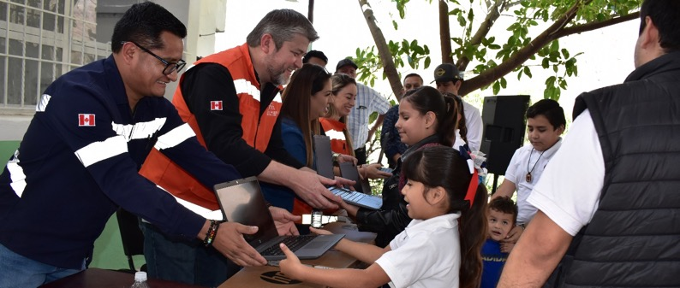
Sustainability Focus
Sustainalytics
ESG Risk Rating improved by 39% year over year
As of Q4 2024 our score of 30.4 is in the top 44% industry performance
S&P Global
2024 Corporate Sustainability Assessment ESG score improved to 37, well above the Metals & Mining industry average of 30
Sustainalytics
High
Measure of risk
Medium
Low
Negligible
S&P Global
Measure of performance
Industry Average
Donations of laptops and Starlink connectivity to San Dimas communities

Slide 7
2024 Production and Cost Performance
-8% since Q1’24

Slide 8
2025 Production & Cost Guidance
Operation | Silver Oz (M) | Gold Oz (k) | Lead Lbs (M) | Zinc Lbs (M) | Silver Eqv. Oz (M) | Cash Cost ($ per AgEq Oz) | AISC ($ per AgEq Oz)
Los Gatos, Mexico (70%) | 5.0 – 5.6 | 3 – 4 | 29 – 32 | 47 – 53 | 8.4 – 9.4 | 11.98 – 12.56 | 15.03 – 15.92
Santa Elena, Mexico | 1.6 – 1.8 | 71 – 79 | — | — | 7.7 – 8.6 | 14.91 – 15.71 | 18.60 – 19.79
San Dimas, Mexico | 4.3 – 4.8 | 55 – 61 | — | — | 9.0 – 10.1 | 13.28 – 14.04 | 17.86 – 19.09
La Encantada, Mexico | 2.7 – 3.1 | — | — | — | 2.7 – 3.1 | 20.16 – 21.32 | 25.30 – 26.98
Operations Total | 13.6 – 15.3 | 129 – 144 | 29 – 32 | 47 – 53 | 27.8 – 31.2 | $14.10 – $14.86 | $18.17 – $19.35
Corporate
Corp. G&A and Services | — | — | — | — | — | — | 1.72 – 1.92
Total Consolidated | 13.6 – 15.3 | 129 – 144 | 29 – 32 | 47 – 53 | 27.8 – 31.2 | $14.10 – $14.86 | $19.89 – $21.27
Certain amounts shown may not add exactly to the total amount due to rounding differences.
Metal price & FX assumptions for calculating equivalents are silver: $29.00/oz, gold: $2,500.00/oz, Lead: $0.95/lb, Zinc: $1.25/lb, and 19.5:1 MXN:USD.
2025E silver production expected to increase approximately 71%, at the mid-point of the guidance, compared to 2024

Slide 9
Capital Investments
2025E Capex Breakdown | Budget
U/G Development | $74M
Exploration | $49M
PP&E | $56M
Corporate Projects | $3M
TOTAL | $182M
$102M
Expansionary
+
Increased 2025E capital expenditures largely due to addition of expenditures at Cerro Los Gatos
First Majestic's future growth strategy is underpinned by continued exploration and development activities at Santa Elena, San Dimas and Cerro Los Gatos
$80M
Sustaining

Slide 10




Assets in the World’s Premier Silver Jurisdiction
THREE WORLD-CLASS SILVER MINING DISTRICTS WITH A MASSIVE 350,000-HECTARE LAND PACKAGE
Cerro Los Gatos (70%)
Chihuahua, Mexico
2024 Production: 15.6 Moz AgEq⁽¹⁾
2025E AISC: US$15.03 - $15.92 / oz AgEq
Producing Assets
Ag
Au
Zn
Pb
Cu
Development Assets
La Encantada
Coahuila, Mexico
2024 Production: 2.4 Moz AgEq
2024 AISC: US$28.31 / oz AgEq
Ag
Del Toro
Zacatecas, Mexico
Care & Maintenance
Ag
Corporate Office
British Columbia, Canada
Durango
Santa Elena
Sonora, Mexico
2024 Production: 10.3 Moz AgEq
2024 AISC: US$14.40 / oz AgEq
Ag
Au
Mexico City
First Mint Facility
Nevada, USA
San Dimas
Durango, Mexico
2024 Production: 8.8 Moz AgEq
2024 AISC: US$21.06 / oz AgEq
Ag
Au
Jerritt Canyon
Nevada, USA
Care & Maintenance
San Martin
Jalisco, Mexico
Care & Maintenance
Au
Ag
Source: Corporate disclosure
(1) Cerro Los Gatos shown on a 100% basis.

Slide 11
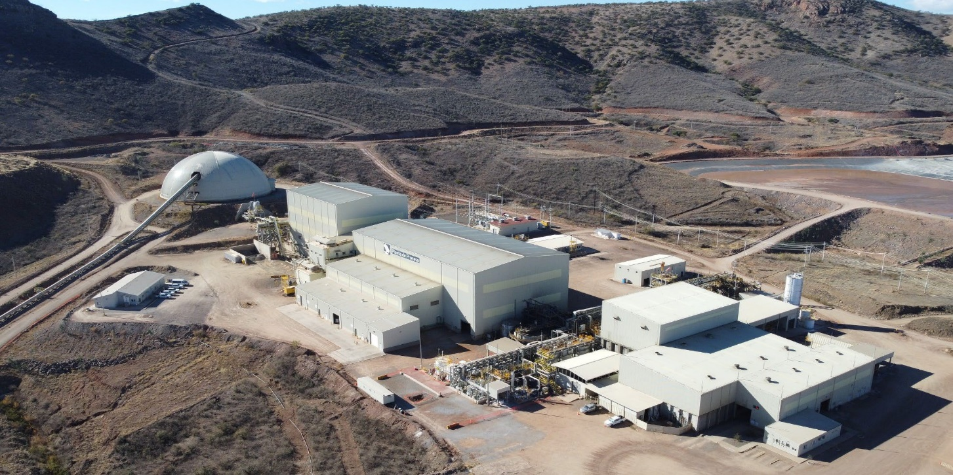
Cerro Los Gatos Silver Mine
103,000 Ha property located in Chihuahua, Mexico
High Ag-bearing Pb and Zn Concentrate producer
Low-cost, underground producing silver mine with robust exploration and development potential
Operating since 2019
Key position in an established silver district
Achieved record quarterly mill throughput dating back to Q1 2023
Over 103,000 hectares of mineral rights in a highly prospective and under-explored district with numerous silver-zinc-lead epithermal mineralized zones
76,000m of exploration drilling planned in 2025 targeting mineral expansion at Central Deep and South East zones
Modern, mechanized underground operation
Strong JV partner in Japan’s Dowa Metals & Mining Co., Ltd (30%)
Production (100% Basis) | Q4 2024 | Q3 2024 | Full Year 2024 | Full Year 2025E
Tonnes Milled (tpd) | 3,324 | 3,246 | 3,255 | 3,400
Silver (M oz) | 2.6 | 2.4 | 9.7 | 7.1 – 7.9
Silver Equivalent (M oz) | 4.2 | 3.8 | 15.6 | 12.0 – 13.4¹
Cash Costs / oz ($US) | N/A* | $12.13 | N/A* | $11.98 – $12.56
All-in Sustaining Costs / oz ($US) | N/A* | $16.13 | N/A* | $15.03 – $15.92
¹Includes 29 – 32 M lbs. Lead, 47 – 53 M lbs. Zinc, 5 – 6 k oz Gold
*Not reported. First Majestic acquired Gatos Silver on January 16, 2025

Slide 12
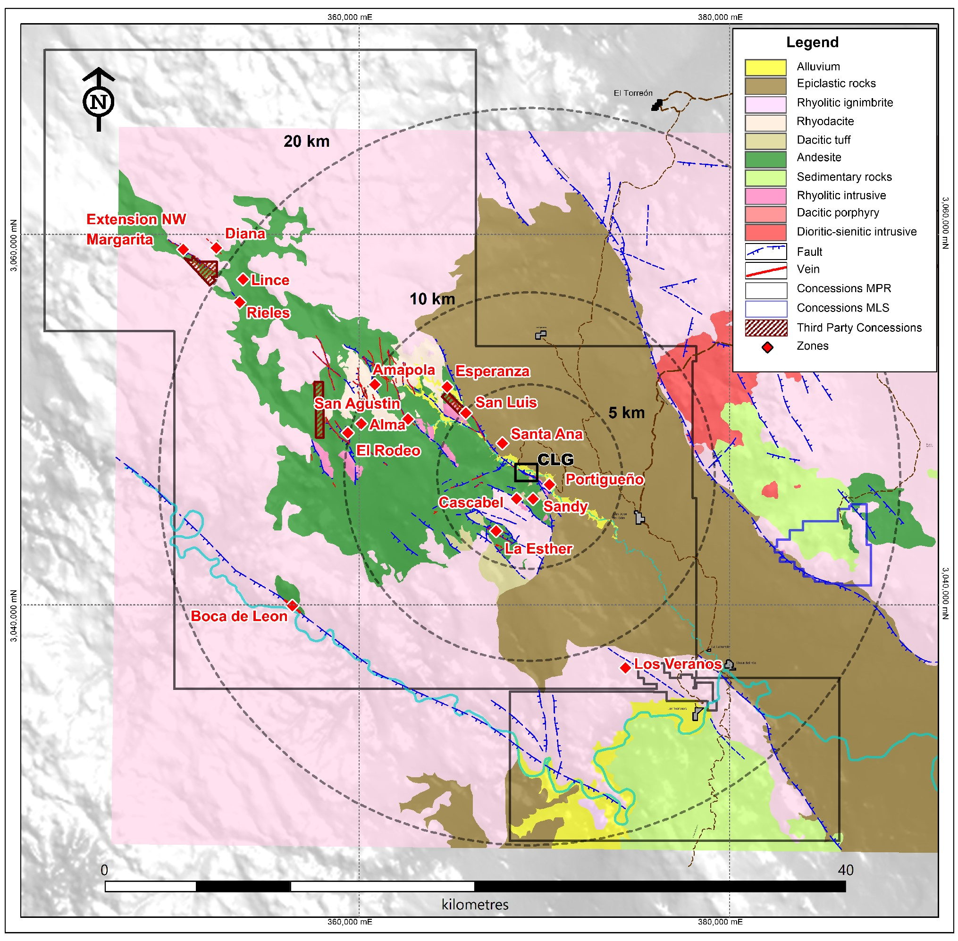
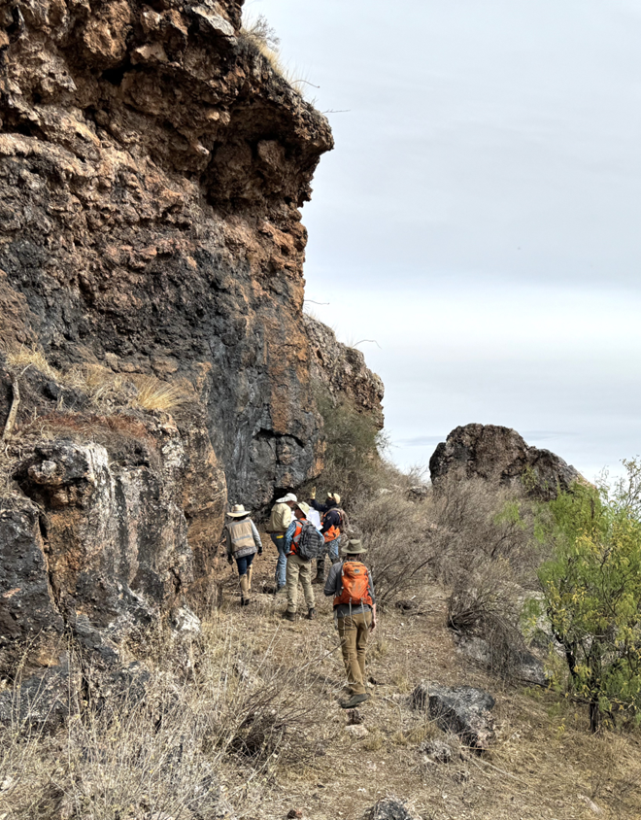
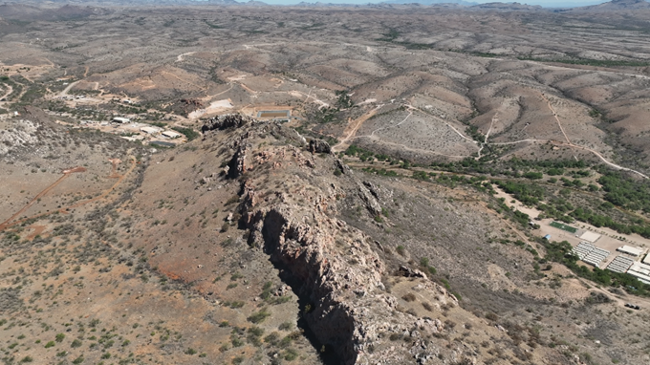
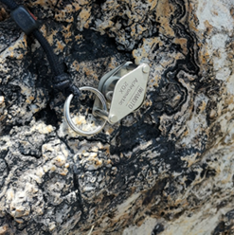
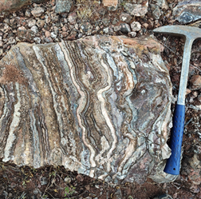
Cerro Los Gatos – Regional Potential
EXPLORATION UPSIDE
Large and continuous land package of prospective concessions ~103,000 ha
Continuing to expand the CLG orebody
Currently drilling multiple prospective targets within a 5km radius of the processing plant
Generative work at Lince & Los Veranos
Lince District
Portigueño Outcrop
NW View of CLG
Falla Roja Target
Cerro Los Gatos Operations
Typical Vein textures
Los Veranos District

Slide 13
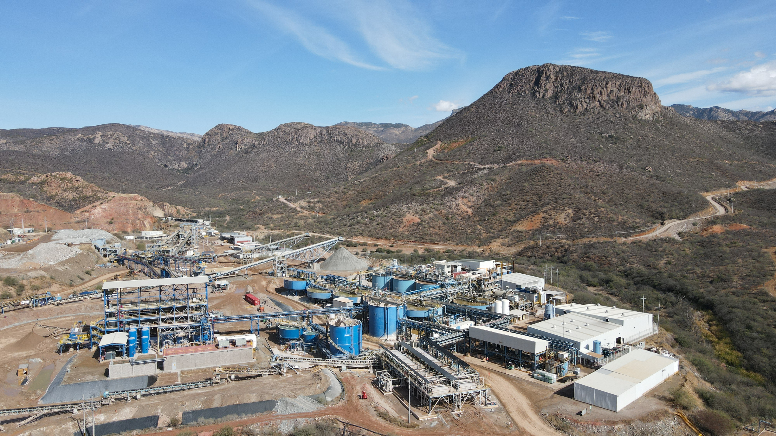
Santa Elena Silver / Gold Mine
102,000 Ha property located in Sonora, Mexico
100% Doré producer
Record production in 2024 of more than 10M AgEq oz
Exploration success at Navidad near the Ermitaño mine
57,000 m of drilling planned for 2025 including extension and infill at the Navidad discovery
New geologic understanding of district stratigraphy has brought to light large areas with exploration upside within a 5km radius of processing plant
Clean, low-cost 24MW LNG facility to power mine and plant operations
Continued strong metallurgical recoveries due to operational optimization of the dual circuit plant
Certified ISO 9001 Assay Lab on site, increasing reliability as well as reducing costs and allowing for faster assay turnaround times
Production | Q4 2024 | Q3 2024 | Full Year 2024 | Full Year 2025E
Tonnes Milled (tpd) | 2,987 | 2,856 | 2,774 | 3,100
Silver (k oz) | 406 | 376 | 1,514 | 1,600 – 1,800
Gold (k oz) | 27.2 | 27.4 | 104 | 71 – 79
Silver Equivalent (M oz) | 2.7 | 2.6 | 10.3 | 7.7 – 8.6
Cash costs / oz ($US) | $10.99 | $11.96 | $11.81 | $14.91 – $15.71
All-in Sustaining cost / oz ($US) | $13.54 | $14.38 | $14.40 | $18.60 – $19.79

Slide 14

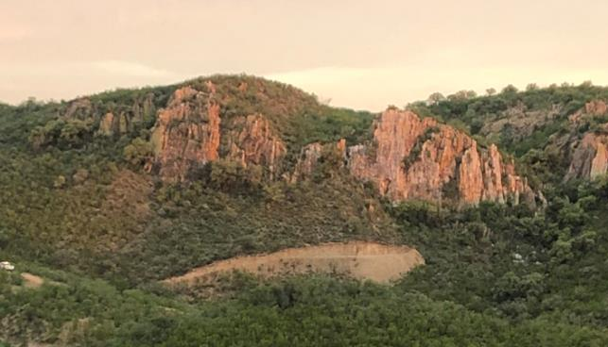
Santa Elena – Regional Potential
EXPLORATION UPSIDE
Las Chispas
Large and continuous land package consistent of 102,244 ha
Updated exploration guiding principle
Navidad Discovery adjacent to Ermitaño, July 2024
New vein systems identified (Navidad and Winter)
P&P: 38.2M AgEq oz @ 468 g/t AgEq
M&I: 52.0M AgEq oz @ 564g/t AgEq
Inferred: 41.2M AgEq oz @ 449 g/t AgEq
Vein outcropping at Ermitaño
Santa Elena
Processing Plant

Slide 15
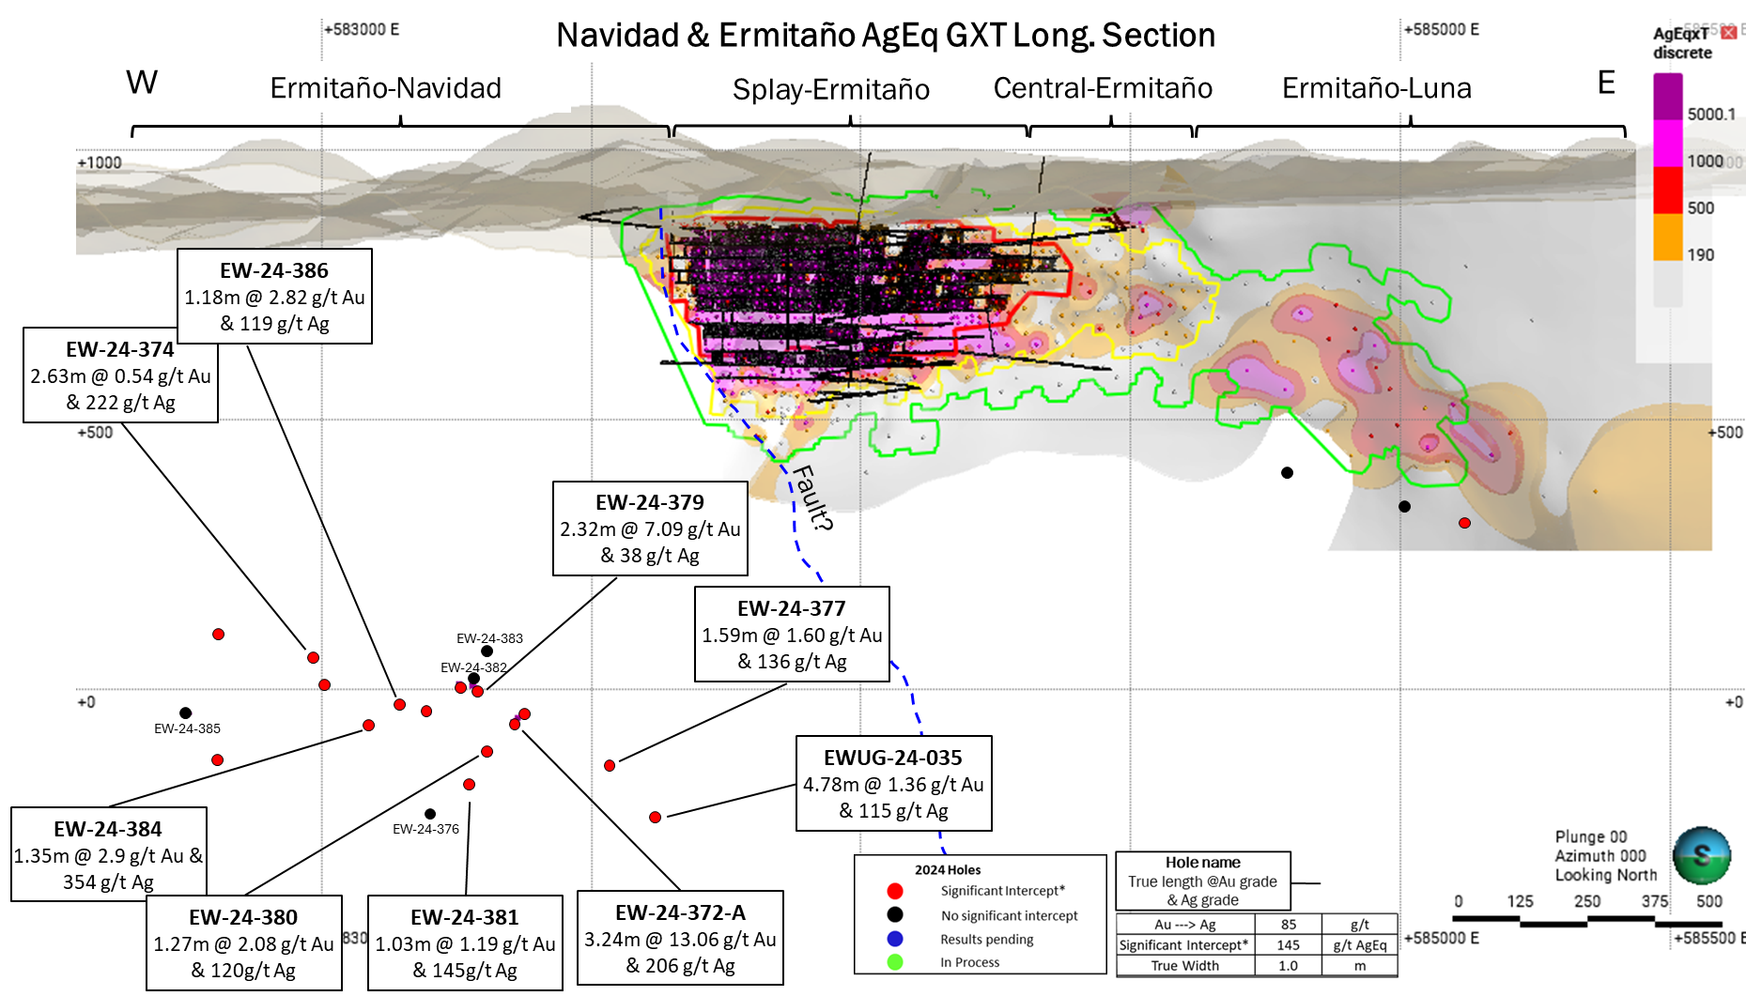
Mineralization Open to the East + Navidad Discovery
2025 drilling focused on testing continuity, extent & grade of Navidad / Winter mineralization
2024 drilling significantly expanded Navidad discovery; Mineralization occurs ~100m SW & ~300m below Ermitaño (previously reported ~500m SW & ~750m below)
Metallurgical testing demonstrated excellent recoveries:
>90% Au
>85% Ag
Navidad / Winter Vein System Discovery

Slide 16
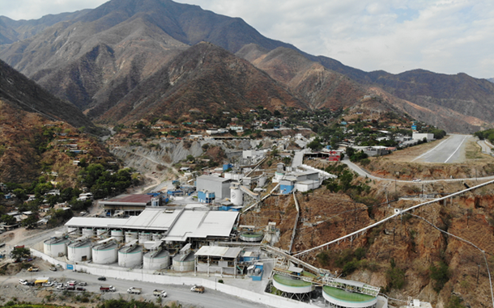
San Dimas Silver / Gold Mine
72,000 Ha located in Durango, Mexico
100% Doré producer
Historic production ~ +11M Au oz and +750M Ag oz
Approximately 50% of the power requirements provided by environmentally clean, low-cost hydroelectric power
Focused on improvements in dilution control from long hole stopping and cut and fill to increase head grades
2024 exploration highlights:
Significant silver and gold mineralization intersected in multiple veins
Successfully converted Inferred to Indicated Resources at the Perez and Sinaloa-Elia veins
Derisked mineralization for mining in 2025 & 2026
112,000 m of exploration drilling planned for 2025:
Targeting near mine and brownfield major ore controlling structures in the West, Central, and Sinaloa blocks
Production | Q4 2024 | Q3 2024 | Full Year 2024 | Full Year 2025E
Tonnes Milled (tpd) | 2,411 | 2,146 | 2,128 | 2,100
Silver (M oz) | 1.2 | 1.0 | 4.5 | 4.3 – 4.8
Gold (k oz) | 12 | 13 | 50 | 55 – 61
Silver Equivalent (M oz) | 2.2 | 2.1 | 8.8 | 9.0 – 10.1
Cash costs / oz ($US) | $15.14 | $16.50 | $16.01 | $13.28 – $14.04
All-in Sustaining cost / oz ($US) | $20.63 | $21.44 | $21.06 | $17.86 – $19.09

Slide 17
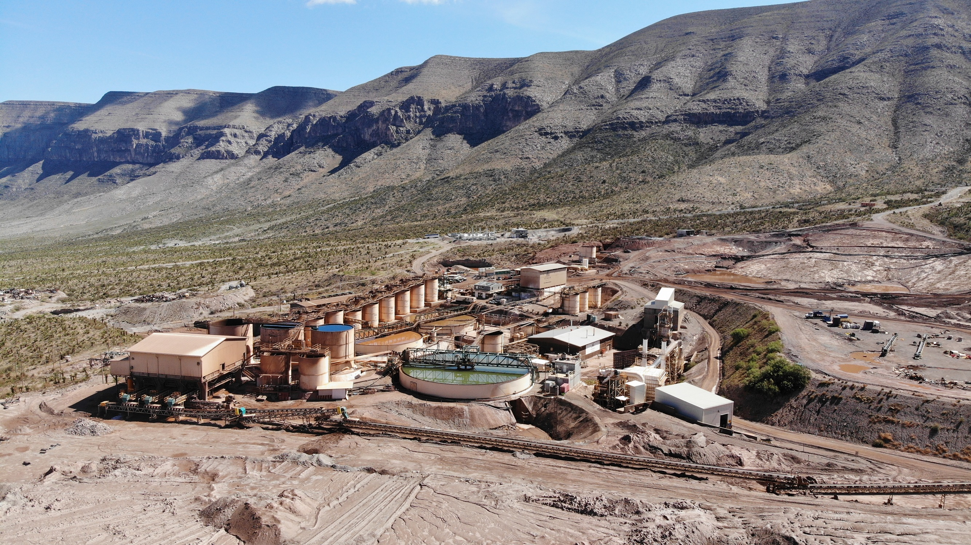
La Encantada Silver Mine
4,000 Ha property located in Coahuila, Mexico
100% Doré producer
Q4 2024 production increased 39% over Q3 2024
A return to normal operations and production levels expected in 2025
Natural gas generators currently supplying 90% of power requirements
Optimizing costs and improving efficiencies
Approximately 7,000 m of exploration drilling planned for 2025
Development of the Ojuelas and Milagros ore bodies planned for 2025 production
Production | Q4 2024 | Q3 2024 | Full Year 2024 | Full Year 2025E
Tonnes Milled (tpd) | 2,791 | 2,453 | 2,459 | 3,100
Silver (k oz) | 756 | 545 | 2,343 | 2,700 – 3,100
Cash costs / oz ($US) | $20.01 | $25.24 | $23.17 | $20.16 – $21.32
All-in Sustaining cost / oz ($US) | $25.34 | $30.10 | $28.31 | $25.30 – $26.98

Slide 18
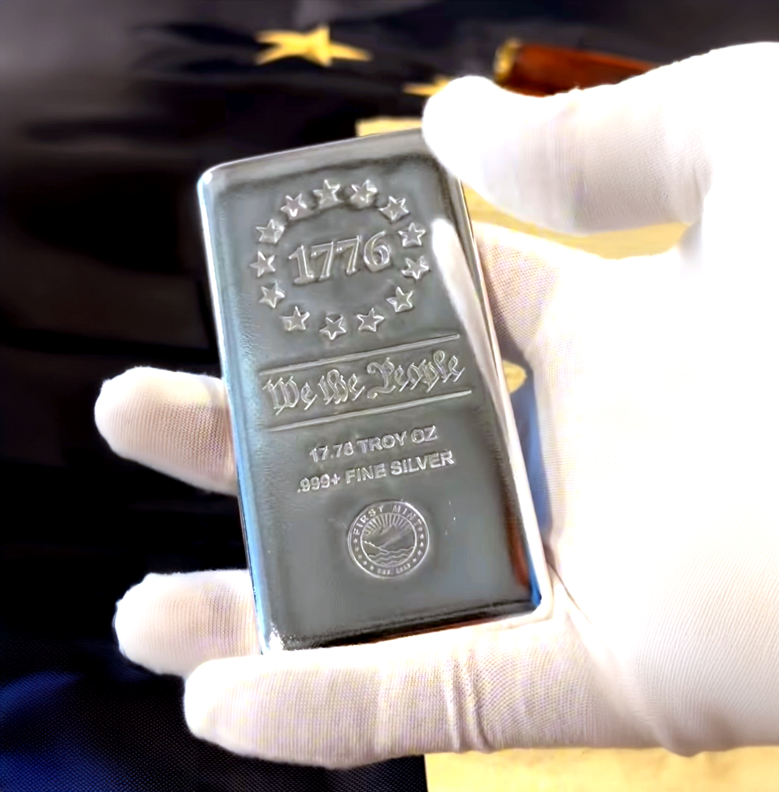
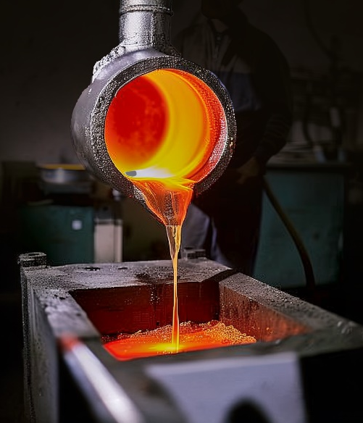

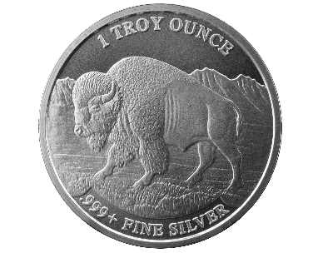

First Mint
FIRST, WE MINE. THEN WE MINT.
100% company-owned mint located in Nevada, United States
Commenced producing bullion in Q2 2024. Coins in Q3 2024
Production led by industry veterans with over 20 years of experience
High-efficiency production and state-of-the-art machinery consumes less electricity and emits no gases, making it significantly more sustainable compared to traditional minting processes
Vertically integrating minting process, controlling supply chain, eliminating middlemen, effectively capitalizing on strong investment demand for physical silver and capturing additional margin
Record quarterly sales in Q4-24 amounting to $9.1M

Slide 19
Financial Strength
AVAILABLE LIQUIDITY
$202.2M cash, excluding $106.1M of Restricted Cash
Total Working Capital of $224.5M inclusive of $49.8M of Marketable Securities, including:
5% interest in Metalla Royalty & Streaming
45% interest in Sierra Madre Gold & Silver
39% interest in Silver Storm Mining
Revolving Credit Facility of $175.0M ($139.6M undrawn)
Senior Convertible Debenture @ 0.375% in the amount of $230M
Working
Capital
$174.7M
Marketable
Securities
$49.8M
Revolving Credit Facility (Undrawn)
$139.6M
All amounts shown are in US dollars As of 12/31/2024

Slide 20
Shareholder Information
Capital Structure
Market Capitalization: | $3.5B USD / $4.9B CAD
Shares Outstanding: | 482M
3M Avg. Daily Volume (NYSE & TSX): | 20.1M Shares; ~$146M daily liquidity
Share Price: | $7.25 USD / $10.35 CAD
52 Week Low/High: | $4.43 / $8.42 USD | $6.23 / $11.58 CAD
Research Coverage
Bank of Montreal | Scotiabank
Cormark Securities | Toronto Dominion
H.C. Wainwright | National Bank Financial
As of 03/18/25
*All amounts are in U.S. dollars unless stated otherwise.
Top Shareholders | % S/O
The Electrum Group LLC | 9.4%
Van Eck (GDXJ & GDX) | 5.8%
Tidal Investments LLC | 3.6%
Municipal Employees’ Retirement System of Michigan | 3.3%
The Vanguard Group | 3.2%
Lingotto Investment Management LLP | 2.0%
D.E. Shaw & Co. | 1.9%
Citadel Advisors | 1.7%
Mirae Asset Global Investments | 1.6%
BlackRock Asset Management Canada Ltd. | 1.5%
Institutional
54%
Insiders / Mgt
1%
Retail
45%
As of 03/18/25
As of 03/18/25

Slide 21
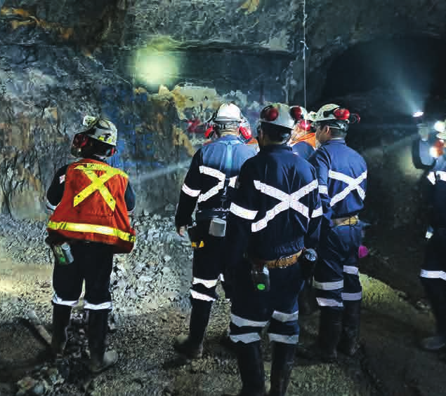
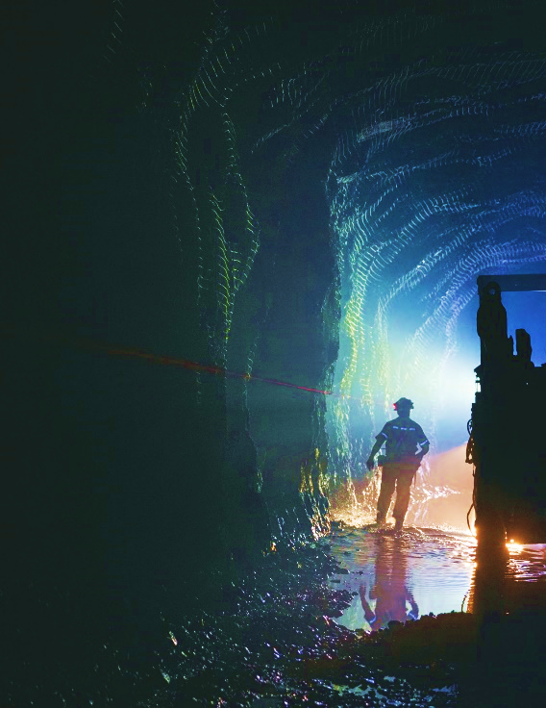
Dividend Policy
Under the Company’s dividend policy, the quarterly dividend per common share is targeted to equal approximately 1% of the Company’s revenues.
The Q4 2024 cash dividend of $0.0057 per share to be paid to holders of record of First Majestic as of close of business on February 28, 2025, was distributed on or about March 14, 2025.

Slide 22
Future Catalysts
Integration of Cerro Los Gatos Silver Mine into the First Majestic portfolio – three world class, district scale operations
Approximately 270,000 m of exploration planned in 2025 - West, Central & Sinaloa blocks, Ermitaño, Navidad, and more
Santa Elena’s high-grade discovery, Navidad (February 4, 2025):
EW-24-377: 7.1 g/t Au and 1,253 g/t Ag over 3.03 m
EW-24-372-A: 13.1 g/t Au and 205 g/t Ag over 3.24 m
San Dimas exploration highlights (January 23, 2025):
PE24_397: 10.0 g/t Au and 1,996 g/t Ag over 3.65 m
SIN24_120: 23.33 g/t Au and 1,045 g/t Ag over 1.31 m
Continued improvements in metallurgical recoveries through implementation of fine grinding and other R&D
Strengthening balance sheet & capital allocation
Higher Silver Prices!
Cerro Los Gatos Silver-Lead-Zinc Mine

Slide 23
Ten Rules of Silver
01
06
Silver is real money
Physical silver is a hard asset
02
07
Silver is cheaper to buy, but also practical when you need to sell
Silver is relatively inexpensive
03
08
Silver outperforms gold in bull markets
Silver inventories are falling
04
09
Industrial use for silver is growing
New supply is falling
05
10
World demand for silver is growing
The gold/silver ratio favors silver

Slide 24

Mining Forum Europe
April 2, 2025
1800 – 925 WEST GEORGIA ST, VANCOUVER,
BRITISH COLUMBIA, CANADA V6C3L2
CONTACT:
T.604.688.3033 / F.604.639.8873
INVESTOR RELATIONS / SUPPORT:
INFO@FIRSTMAJESTIC.COM
BULLION SALES:
CUSTOMERSUPPORT@FIRSTMINT.COM
CORPORATE PRESENTATION
TSX AG / NYSE AG / FSE FMV

