Slide 1

The new Nordic Gold developer
April 2026

Slide 2

Disclaimer
This management presentation (this "presentation") is dated April 8, 2026 and has been prepared by Goldsky Resources Corp. (formerly First Nordic Metals Corp.) ("Goldsky") based on information available to Goldsky at the time of preparing this presentation. This presentation has been prepared following Goldsky's entry into a definitive agreement with Agnico Eagle Sweden AB ("Agnico Sweden"), a wholly-owned subsidiary of Agnico Eagle Mines Limited ("Agnico Eagle", and together with Agnico Sweden, "Agnico"), pursuant to which Goldsky has agreed to acquire the remaining 55% interest in the Barsele Gold Project ("Barsele") in Sweden from Agnico (the "Transaction"), resulting in Goldsky consolidating 100% ownership of Barsele. As of the date hereof, the Transaction has not closed but is expected to close during Q2, 2026.
No representation or warranty, express or implied, is made as to the fairness, accuracy, completeness or correctness of the information, opinions and conclusions contained in this presentation.
To the maximum extent permitted by law, none of Goldsky or its directors, employees or agents, advisers, nor any other person accepts any liability, including, without limitation, any liability arising from fault or negligence on the part of any of them or any other person, for any loss arising from the use of this presentation or its contents or otherwise arising in connection with it.
Not an Offer
This presentation is not an offer, invitation, solicitation or other recommendation with respect to the subscription for, purchase or sale of any security, and neither this presentation nor anything in it shall form the basis of any contract or commitment whatsoever.
This presentation has been prepared in accordance with applicable Canadian securities laws and may not be released to US wire services or distributed in the United States. This presentation does not constitute an offer to sell, or a solicitation of an offer to buy, securities in the United States or any other jurisdiction. Any securities described in this presentation have not been, and will not be, registered under the US Securities Act of 1933, as amended (the “US Securities Act”) and may not be offered or sold in the United States except in transactions registered under the US Securities Act or exempt from, or not subject to, the registration of the US Securities Act and applicable US state securities laws.
Not Investment Advice
This presentation does not purport to be complete or to contain all of the information a reader may require about Goldsky following completion of the Transaction and its business or prospects. Neither Goldsky nor any of its representatives or affiliates make any representation or warranty as to the accuracy, reliability, reasonableness or completeness of this information and shall not have any liability for any representations regarding information contained in, or for any omission from, this presentation or any other written or oral communications transmitted to the reader except as required by law. The information contained in this presentation is not investment or financial product advice and is not intended to be used as the basis for making an investment decision. A reader is directed to all of Goldsky’s publicly filed documentation and information which can be found under its corporate profile on SEDAR+ at www.sedarplus.ca.
Confidentiality
Securities legislation in all provinces and territories of Canada prohibits unauthorized distribution of the information contained in this presentation. Each recipient of the information contained in this presentation will treat such information in a confidential manner and will not, directly or indirectly, disclose or permit its affiliates or representatives to disclose such information to any other person or reproduce this presentation, in whole or in part, without the prior written consent of Goldsky.
Technical Reports and Qualified Persons
This presentation includes disclosure of scientific and technical information concerning the Goldsky mineral projects from technical reports ("technical reports") prepared in accordance with Canadian NI 43-101 - Standards of Disclosure for Mineral Projects ("NI 43-101"). The technical reports, which are described below, are available on SEDAR+ (www.sedarplus.ca) under Goldsky’s profile or that of its wholly-owned subsidiaries, Mawson Finland Limited and Gold Line Resources Ltd., as applicable. Readers are cautioned to review the following technical reports in full:
For further information regarding the Barsele project, reference should be made to the following NI 43 - 101 technical report titled "Amended NI 43-101 Technical Report and Mineral Resource Estimate for the Barsele Project” with an effective date of February 21, 2019, and a signature date of December 16, 2020 prepared.
For further information regarding the Kylmäkangas project, reference should be made to the following NI 43-101 technical report titled "NI 43-101 technical report and mineral resource estimate for the Kylmäkangas Gold Project" with an effective date of July 25, 2022.
For further information regarding the Langtjärn project, reference should be made to the following NI 43-101 technical report titled "NI 43- 101 technical report and mineral resource estimate for the Längtjärn property" with an effective date of June 30, 2020.
For further information regarding the Rajapalot Gold -Cobalt project, reference should be made to the following NI 43-101 technical report titled “NI 43-101 Technical Report on a Preliminary Economic Assessment of the Rajapalot Gold-Cobalt Project, Finland” with an effective date of December 19, 2023.
The technical and scientific information in this presentation was reviewed, prepared, and approved by Benjamin Gelber, a practicing Professional Geologist (P.Geo) registered with Engineers & Geoscientists British Columbia (EGBC, Licence No. 3325), who is a “Qualified Person” as defined by NI 43-101. Mr. Gelber is independent of Goldsky within the meaning of NI 43-101.
Mineral Resources
This presentation contains references to estimates of mineral resources. The estimation of mineral resources is inherently uncertain and involves subjective judgments about many relevant factors. Mineral resources that are not mineral reserves do not have demonstrated economic viability. The accuracy of any such estimates is a function of the quantity and quality of available data, and of the assumptions made and judgments used in engineering and geological interpretation, which may prove to be unreliable and depend, to a certain extent, upon the analysis of drilling results and statistical inferences that may ultimately prove to be inaccurate. Mineral resource estimates may require re-estimation based on, among other things: (i) fluctuations in the price of gold, silver and other metals; (ii) results of drilling; (iii) results of metallurgical testing, process and other studies; (iv) changes to proposed mine plans; (v) the evaluation of mine plans subsequent to the date of any estimate; and (vi) the possible failure to receive required permits, approvals and licenses.
These mineral resource estimates include inferred mineral resources that are normally considered too speculative geologically to have economic considerations applied to them that would enable them to be categorized as mineral reserves. There is also no certainty that these inferred mineral resources will be converted to measured and indicated categories through further drilling, or into mineral reserves, once economic considerations are applied.
Forward-Looking Statements
Certain statements in this presentation are "forward-looking statements", including within the meaning of applicable laws. All statements other than statements of historical fact included in this presentation, including, statements regarding closing of the Transaction, future plans at Barsele, the effect of the Transaction on Goldsky's resources, gold grades, metallurgies, business, prospects, operations and future plans and objectives of Goldsky are forward - looking statements based on forecasts of future operational or financial results, estimates of amounts not yet determinable and assumptions of management that involve various risks and uncertainties, as well as Goldsky’s corporate strategies, including additional acquisitions, and plans for future exploration. Any statements that express or involve discussions with respect to predictions, expectations, beliefs, plans, projections, objectives, assumptions or future events or performance (often, but not always, using words or phrases such as "expects" or "does not expect", "is expected", "anticipates" or "does not anticipate", "plans", "estimates" or "intends", or stating that certain actions, events or results "may", "could", "would", "might", or "will" be taken, occur or be achieved) are not statements of historical fact and may be "forward-looking statements." Goldsky cautions that forward-looking statements involves known and unknown risks, uncertainties and other factors that may cause actual results, performance or achievements to be materially different from those expressed or implied by such information, including, but not limited to, failure to obtain the necessary regulatory and other approvals; gold and silver price volatility; fluctuations in foreign exchange rates and interest rates; the impact of any hedging activities; discrepancies between actual and estimated production, between actual and estimated reserves and resources or between actual and estimated metallurgical recoveries; capital expenditure requirements; and the success of exploration and permitting activities.
Although Goldsky has attempted to identify important factors that could cause actual results, performance or achievements to differ materially from those contained in forward-looking statements, there can be other factors that cause results, performance or achievements not to be as anticipated, estimated or intended. There can be no assurance that such information will prove to be accurate or that management's expectations or estimates of future developments, circumstances or results will materialize. Accordingly, readers should not place undue reliance on forward-looking statements. Subject to any continuing obligations under applicable law or any relevant stock exchange listing rules, in providing this information, Goldsky does not undertake any obligation to publicly update or revise any of the forward-looking statements or to advise of any change in events, conditions or circumstances.
Market Data
Market data and other statistical information used throughout this presentation are based on internal research by Goldsky, independent industry publications, government publications, reports by market research firms or their published independent sources. Industry publications, governmental publications, market research surveys and forecasts generally state that the information contained therein has been obtained from sources believed to be reliable. Although Goldsky believes such information is accurate and reliable, neither has independently verified any of the data from third party sources cited or used for industry estimates used in this presentation, nor has Goldsky ascertained the underlying economic assumptions relied upon therein. While Goldsky believe internal estimates are reliable, such estimates have not been verified by any independent sources, and Goldsky makes no representations as to the accuracy of such estimates.
1Gold equivalent calculation used for Oijärvi, Kylmäkangasproject:
AuEq. = Au grade + (Ag grade ∗(Ag price/Au price))
The prices are based on the May 31, 2022 Long-Term CIBC consensus pricing for precious metals of US$1,657/oz Au and US$21.52/oz Ag

Slide 3
Goldsky: A New Premier Gold Developer in the Nordics
Background on Goldsky's formation
H2 2025:
Merger agreed between First Nordic Metals and Mawson Finland
New management and board appointed with long track record of creating shareholder value
Darren Morcombe joins as special advisor and supports C$80m equity fundraising
Merged entities renamed Goldsky Resources
January - April 2026:
Goldsky announces transaction to become 100% owner of Barsele Gold Project, acquiring JV partner Agnico Eagle’s 55% interest
Agnico Eagle continues the partnership with a new 32.5% equity holding in Goldsky. The largest equity investment completed by Agnico Eagle
9 April 2026: Shareholders approve Barsele transaction
Goldsky launched following merger of First Nordic and Mawson Finland

Slide 4
The Transaction with Agnico Eagle, the 2nd largest gold producer globally
Key Terms
US$20m to be paid in cash to Agnico Eagle.
2% NSR with a buyback for US$50m.
Agnico Eagle becomes 32.5% shareholder in Goldsky – A significant endorsement of the asset, team and the largest equity stake in a mining company.
Agnico Eagle has the right to appoint up to 3 directors to the Goldsky board.
Technical support through a 9-month integration program and the formation of a joint technical committee.
Owning 100% of Barsele is a transformational acquisition for Goldsky

Slide 5

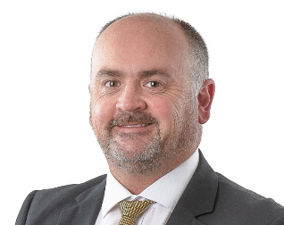
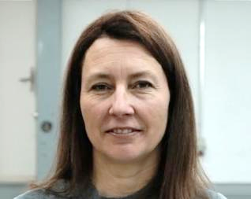
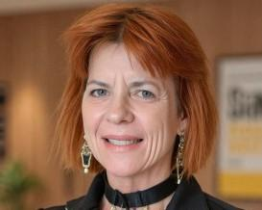
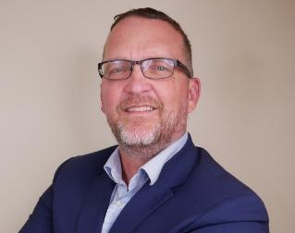
Executive leadership team with Proven Operational Experience
Russell Bradford
CEO & Exec. Director
+35 years of project management & operational experience
MD at Aston Minerals, merged with Torque Metals
Sr. VP at Galiano Gold.
GM at Mantra Resources (A$1B sale) & LionOre Mining ($7B sale)
Based in the UK
Brent Doster
CFO
+20 years of financial management and administration experience across the coal and gold sectors
Senior finance roles in publicly listed mining and mining services companies operating in Africa and internationally
Recently serves as Group CFO of Goldplat plc
Noora Ahola
Exec. Director & MD, Nordics
Forestry Engineer with a Masters Degree of Natural Resources and Landscape Management
CEO of Mawson Finland prior to the transaction
Expert in Nordic permitting and government project oversight with 25 years experience
Based in Finland
Karilyn Farmer
SVP, Exploration and Resource Development
Geologist, mining, construction, and strategy professional with +30 years global experience
FAusIMM and LORC Competent Person
Driven global success across energy, precious & base metals in more than 25 countries
Recently 9 years with McKinsey & Company
Neil MacRae
SVP, Corporate Development
Capital markets professional with 29 years’ experience in IR, commodities trading and corporate development
Previous IR roles with First Majestic Silver Corp, Sherwood Copper Corp (merged with Capstone in 2008), Farallon Mining Ltd. (sold to Nyrstar in 2011), NovaGold Resources Inc. and Santacruz Silver Mining Ltd

Slide 6
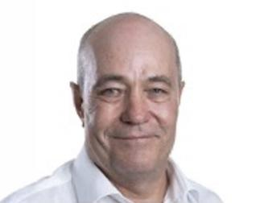
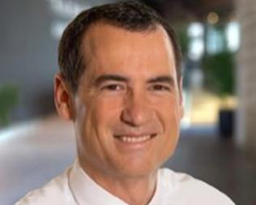
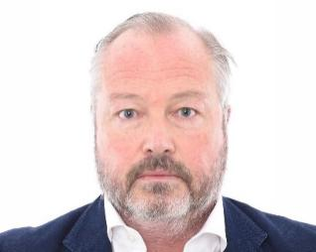
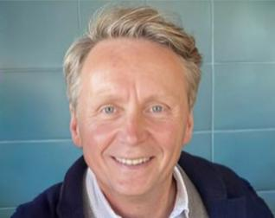
Strong board with Mine development capability
Peter Breese
Non-Exec Chairman
+35 years executive & operations experience
CEO of Galiano Gold, overseeing build of Asanko Gold Mine
CEO of Mantra Resources, acquired by ARMZ for A$1B in 2011
CEO of Norilsk Nickel
COO of LionOre Mining, acquired by Norilsk for C$7B
Marc Legault
Non-Exec. Director
3+40 year of experience in gold and base metals industry
Geologist and was also a P.Eng
34 years working with Agnico Eagle Mines on various exploration, operations, and management positions
Jeff Couch
Non-Exec.Director
London-based capital markets executive with deep experience in natural resources and emerging markets
CEO of Lydian Mining and Alufer Mining
Former Head of Investment Banking at BMO Capital Markets (Europe), with senior roles at Credit Suisse and Citigroup
Darren Morcombe
Special Advisor
+30 years of international experience in a variety of roles in the natural resource sector
Track record of success, deep involvement in Southern Cross Gold, & as advisor to Foran Mining (formerly CEO / Exec Chairman), while acting as Chairman & Founder of Springtide Capital

Slide 7



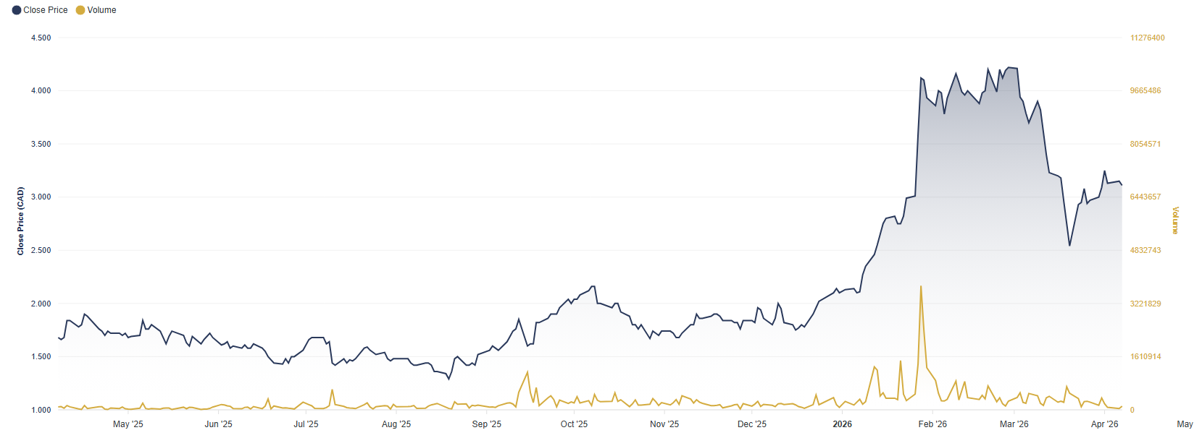
Corporate Highlights
Shareholding Structure after transaction
Shareholder Structure
Analyst Coverage
C$84M
Current Cash Position*
182,615,400
Shares
(Fully Diluted: 206,035,674)
C$554M
Market Capitalization
Listings:
TSXV and FNSE
*As announced on 16 December 2025
**Shares in issue post Agnico Eagle transaction 258,124,977

Slide 8

The Transaction Analysis - Transformational Transaction for Goldsky
Significant Re-Rate Potential to Peers
Accretive Transaction for Goldsky
 | Goldsky | Pro Forma Goldsky | Top-3 Peer Average
P/NAV | 0.34x | 0.30x | 0.43x
EV/M&I | $152 | $150 | $274
Barsele Project Ownership per Million Goldsky Shares
56% Accretive
Positioned to re-rate upon delivery of development catalysts
Significant Re-Rate Potential to Tier 1 Asset Peers
Shareholders of Goldsky increase their effective exposure to Barsele by 56%
Accretive on Barsele ownership and inherently all other metrics
Market Data as of: April 6, 2026

Slide 9
The Transaction Analysis - Pro Forma Positioning
Market Capitalization
Increased Capital Markets Presence with Significant Growth Potential
MI&I Resources
Peer Leading Resource Base
Market Data as of: April 6, 2026
Note: Resource equivalent calculations made at long-term broker consensus prices

Slide 10
The Transaction Analysis - Pro Forma Positioning
P/NAV Re-Rating Potential
Materially Accretive to Goldsky Shareholders, Positioning Pro Forma Goldsky for Re-Rating
EV/oz Re-Rating Potential
Remains Undervalued on an EV/oz Basis
Market Data as of: April 6, 2026
Note: Resource equivalent calculations made at long-term broker consensus prices

Slide 11
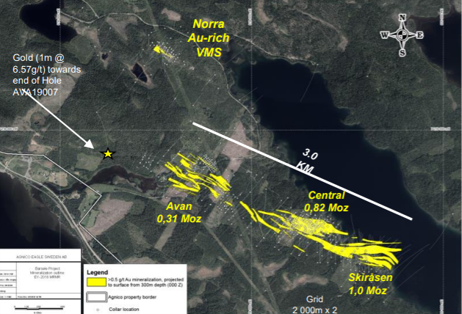
Barsele Gold Project - Sweden’s largest undeveloped gold deposit
Key Barsele Project Metrics
~25,000 ha within the Fennoscandian Shield, ~750 km north of Stockholm
Indicated and Inferred Resources: 36.4mt @1.89g/t for 2.1Moz Au.
Favorable geometry: 5-160m wide zones,
Metallurgy: simple free-milling metallurgy (93-96% recovery)
Nationally designated mining status
Awarded both exploration and exploitation permits
Current resource covers > 3.5km of lateral strike continuation
Goldsky becomes dedicated developer of the Barsele project

Slide 12
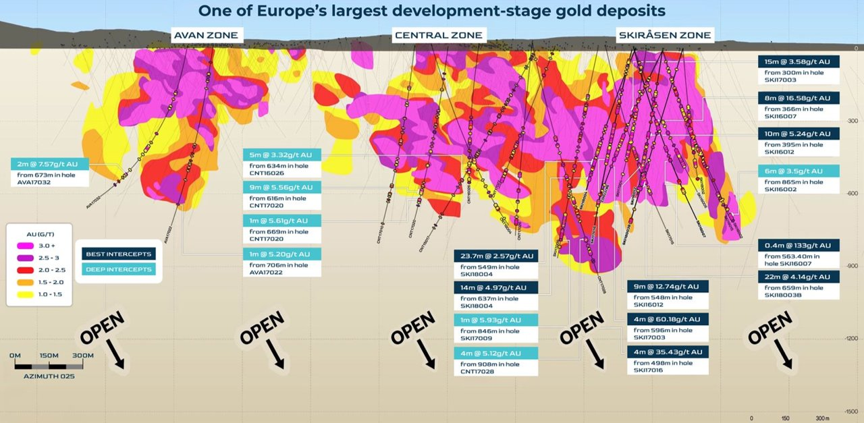
Barsele Gold Project - Significant potential at depth AND strike

Slide 13
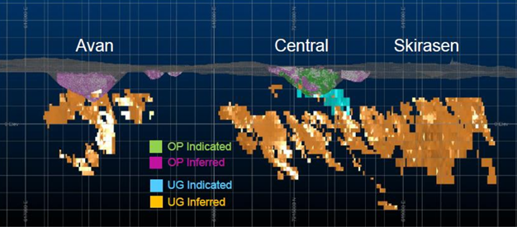
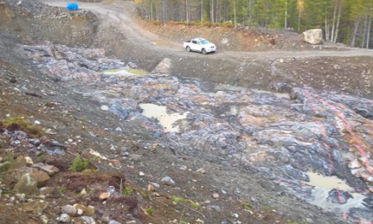
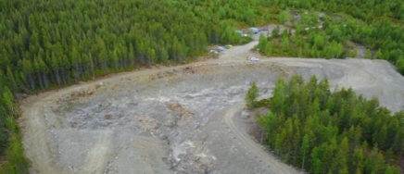
Barsele Gold Project - A mature project site
Historic Agnico exploration activity 2015-2025
174,509m drilled
478 holes drilled
12,2777 assays
58,487 soil samples
1,786 BOT holes
454m avg depth
2,639km ground Mag survey
In 2025 the joint venture undertook 3,500m drill program focused on in-fill and step out targets. Results pending
Significant historic work allows rapid advancement
Exposed mineralization

Slide 14
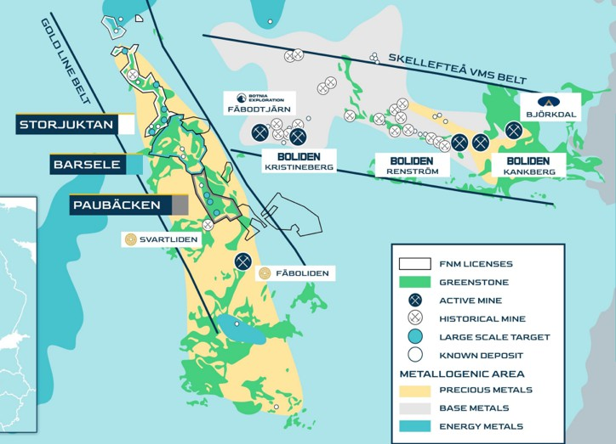
Barsele sits in the centre of Goldsky’s large licence area on Sweden’s Gold Line Belt
The Gold Line Belt | Multi-kilometer long Orogenic Gold System
Goldsky owns the licence’s immediately north and south of Barsele
The Paubäcken project is a 17,097 ha land package
2025 drilling program: 33 of 39 holes confirmed gold-bearing structures; VG in 7 holes
Aida zone included :
2.30 g/t Au over 9.2 m
, 2.59 g/t Au over 4.25 m
3.12 g/t Au over 5.10 m ,
4.83 g/t Au over 4.00 m,
11.42 g/t Au over 1.45m ,
1.17 g/t Au over 21.4m
4.69 g/t Au over 6.0m
2.80 g/t Au over 26.4m

Slide 15
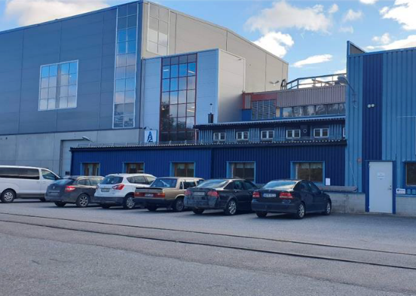
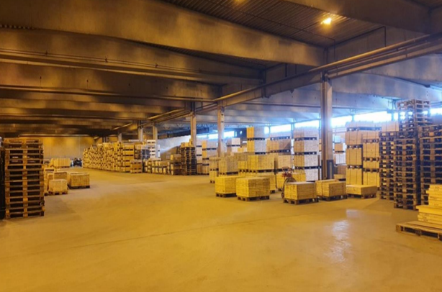
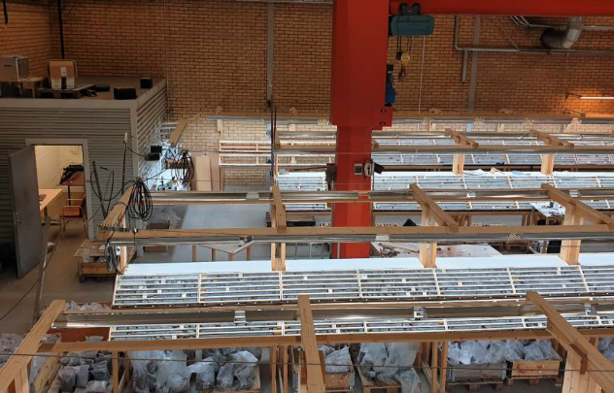
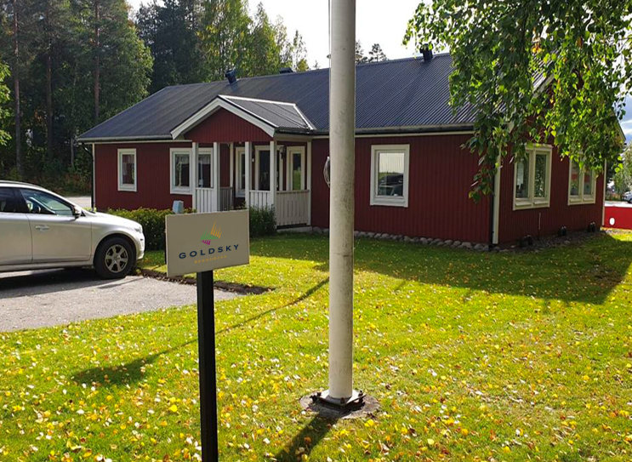
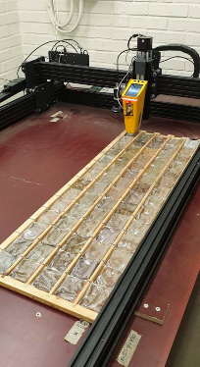
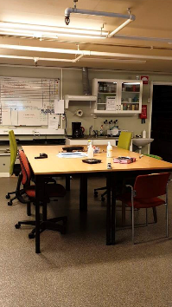
Barsele Gold Project - Project Facilities
Barsele storage facility and offices -5700m²
Core storage facility - 4558m²
Core logging facility
Admin office
XRF scanning facility
Office and lunch facility

Slide 16
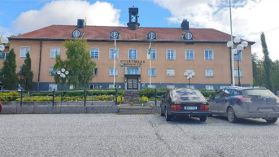
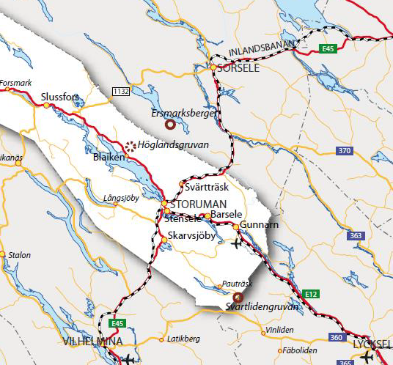
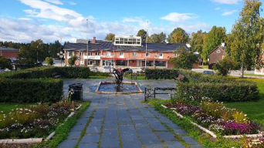
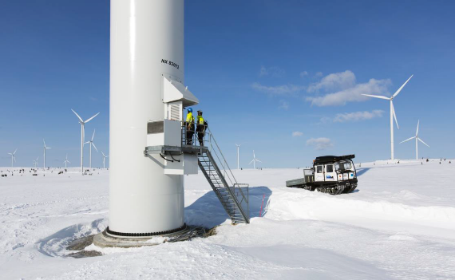
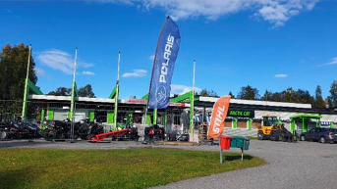
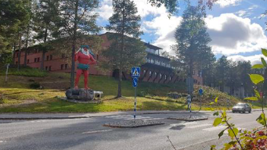
Barsele Gold Project - Location with excellent infrastructure
Storuman is located at an intersection between two European highways and two railroads
6000 inhabitants
Approx 750km north Stockholm
20km from Barsele project
Power generation – Hydro and wind at a significantly low cost of US2.6c /KWh

Slide 17
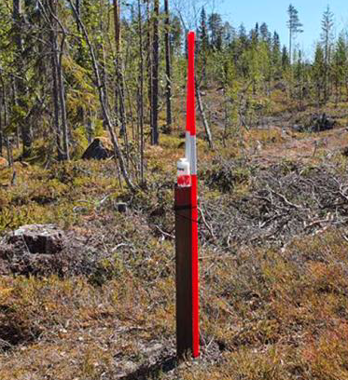
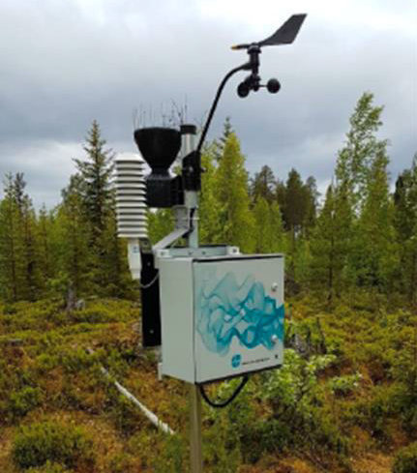

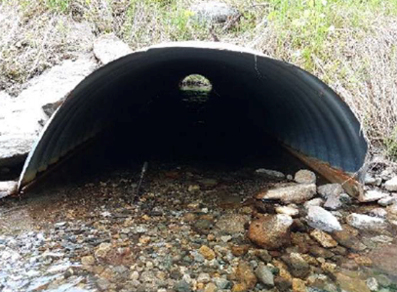
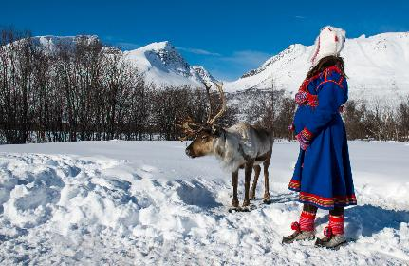
Barsele Gold Project - Environmental monitoring and community engagement
Water sampling, bird and nature surveys, environmental studies, fish studies, Geochemical studies
Archaeology study
Waterflow studies
Four Sami consultations annually

Slide 18
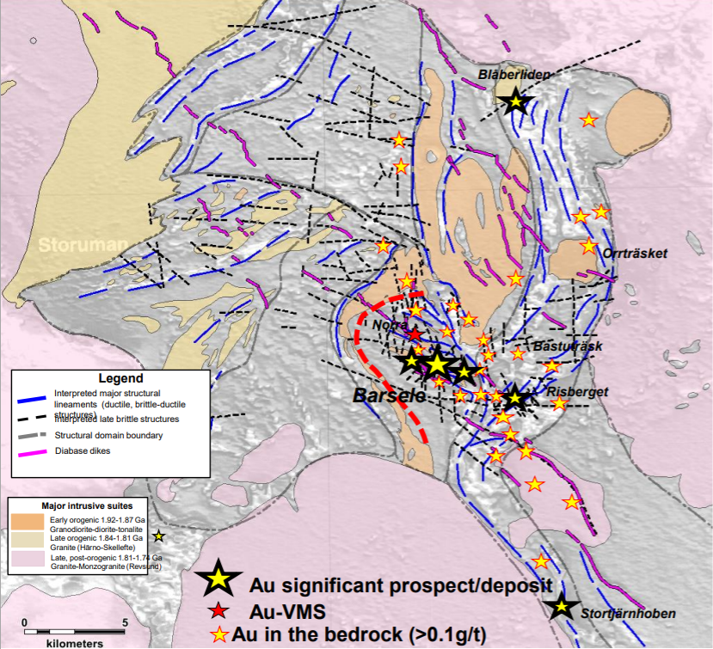
Exploration upside on the Barsele license area
Risberget Project
Located 10km south-east of Barsele resource
Hosted in volcano-sedimentary rocks
NE-SW trending structure and mineralisation open at depth
Mineralization in multiple lenses with thickness varying from 5m-160m
Results pending
Continued exploration drilling to continue in 2026’s drill program

Slide 19
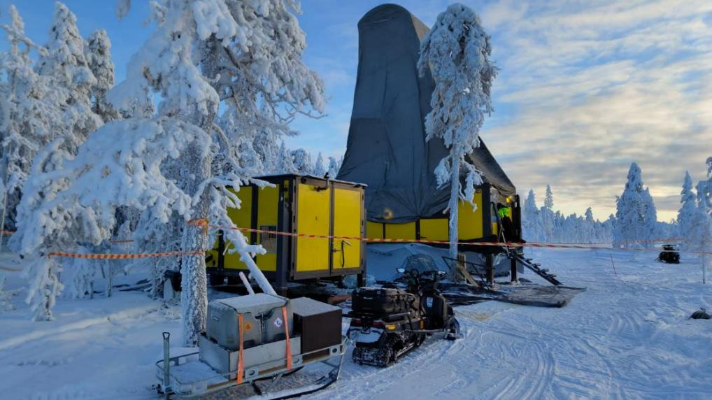
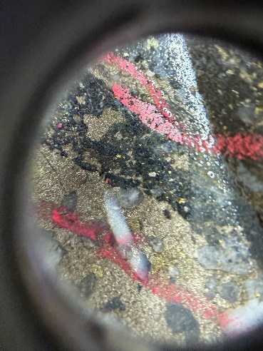
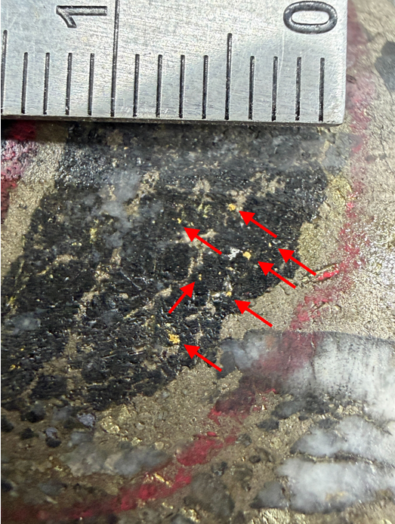
Rajapalot, Finland
Location and Scale
11,000 ha in Lapland, northern Finland,
35 km west-southwest of Rovaniemi
Commenced a 10,000m drill program to expand and further define the Rajapalot Au/Co deposit. Completed in March.
Updated 2023 PEA to be published in H2 2026
Drillhole photograph taken of visible gold on PAL 0406 from the Palokas mineralization at 111 m depth

Slide 20
Work schedule at Goldsky - 2026
 | Q2 | Q3 | Q4 | H1 2027
Close acquisition
Integration program
Data review and updates
Drill programme at Barsele
Commence PEA on Barsele
MRE Update: Barsele and Rajapalot

Slide 21
The Barsele project - NEW OWNERSHIP BRINGS NEW EXECUTION
Significant increase in project fund deployment - $30M IN 2026
Multi-rig drill program – 40-60,000m program to significantly increase the size and category
Assessment of all previous non reported drilling -2019-2025
Mine scheduling and design
Metallurgical flow sheet development
Commence a PEA assessment on the Barsele project – understand economics
Continued resource updates through-out 2026 to the market
Environmental monitoring to be used for an EIA work program
New ownership unlocks accelerated execution at Barsele through $30m drilling and study project development program for 2026.

Slide 22
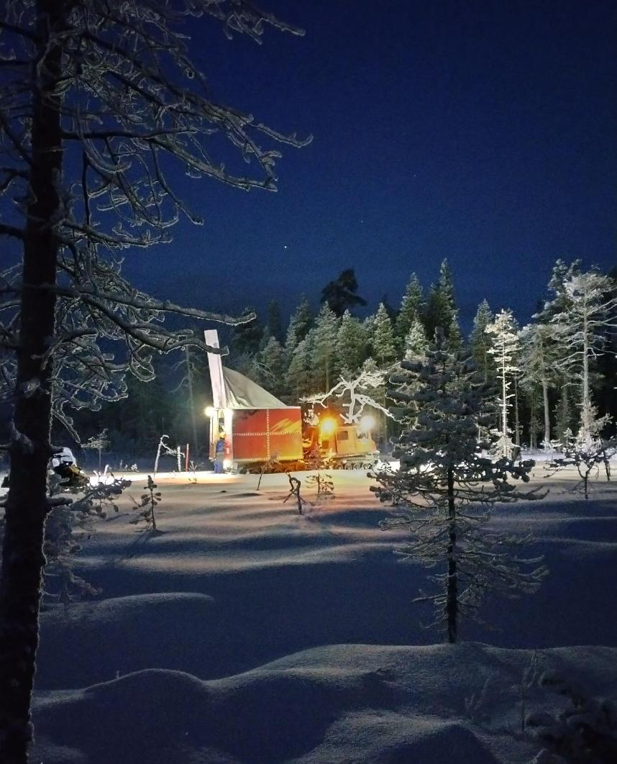
Summary
New Company with an integrated team led by proven mine development with previous experience building LionOre, Mantra, Asanko
Significant value to be unlocked at Barsele under Goldsky’s new 100% ownership and continued partnership
Fully funded with C$84m in treasury and supportive new investor base. Simplified ownership structure
Tier-1 jurisdictions: excellent infrastructure
Significant news flow expected in 2026 from all development activity and exploration .
New analyst coverage to be initiated

Slide 23
The new Nordic Gold developer
April 2026

