Slide 1
Australia's Next Standalone Gold Producer in the Heart of WA Goldfields
Investor Presentation
April 2026

Slide 2



Slide 3
Important disclaimers
Nature of Document
This Presentation is provided on the basis that neither the Company nor its respective officers, shareholders, related bodies, corporate, partners, affiliates, employees, representatives or advisers, make any representation or warranty (express or implied) as to the accuracy, reliability, relevance or completeness of the material it contains. Nothing contained in the Presentation is, or may be relied upon, as a promise, representation or warranty, whether as to the past or the future, and the Company hereby excludes all warranties that can be excluded by law.
The Presentation
The presentation contains ‘forward-looking statements’. By their nature, forward-looking statements involve known and unknown risks, uncertainties and other factors because they relate to events and depend on circumstances that may or may not occur in the future, and assumptions which may or may not prove to be correct (and may be beyond the Company’s ability to control or predict), any (or all) of which may cause the actual results or performance of the Company to be materially different from the results or performance expressed or implied by such forward-looking statements.
No representation is made that any forward-looking statement will come to pass, that any forecast result will be achieved, or that any assumption on which a forward-looking statement is based is reasonable. Forward-looking statements are made as at the date of this Presentation, and the Company disclaims any obligation or undertaking to release any update of, or revision to, any forward-looking statement contained in this Presentation.
Summary Information
The material contained in this Presentation is a summary and for information purposes only. The information in this Presentation is general in nature and does not purport to be accurate nor complete, nor does it contain all of the information that an investor may require in evaluating a possible investment in the Company, nor does it contain all the information which would be required in a disclosure document or prospectus prepared in accordance with the requirements of the Corporations Act 2001 (Cth) (Corporations Act). It has been prepared by the Company with due care but no representation or warranty, express or implied, is provided in relation to the accuracy, reliability, fairness or completeness of the information, opinions or conclusions in this Presentation by the Company or any other party involved in its preparation. Reliance should not be placed on information or opinions contained in this Presentation and, the Company does not have any obligation to finalise, correct or update the content of this Presentation. Certain data used in this Presentation may have been obtained from research, surveys or studies conducted by third parties, including industry or general publications.
To the maximum extent permitted by law, the Company is not responsible for updating, nor undertakes to update, this Presentation. It should be read in conjunction with the Company’s other periodic and continuous disclosure announcements lodged with the ASX, which are available at www.horizonminerals.com.au/announcements/.
Not an offer
The information contained in the Presentation is for information purposes only. The Presentation does not comprise a prospectus, product disclosure statement or other offering document under Australian law (and will not be lodged with the Australian Securities and Investments Commission) or any other law. The Presentation also does not constitute or form part of any invitation, offer for sale or subscription or any solicitation for any offer to buy or subscribe for any securities nor shall they or any part of them form the basis of or be relied upon in connection therewith or act as any inducement to enter into any contract or commitment with respect to securities. In particular, the Presentation does not constitute an offer to sell or a solicitation to buy, securities in the United States of America.
Not investment advice
The information contained in the Presentation is not investment or financial product advice and is not intended to be used as the basis for making an investment decision. Please note that, in providing the Presentation, the Company has not considered the objectives, financial position or needs of any particular recipient. The information contained in the Presentation is not a substitute for detailed investigation or analysis of any particular issue and does not purport to be all of the information that a person would need to make an assessment of the Company or its assets. Current and potential investors should seek independent advice before making any investment decisions in regard to the Company or its activities.
JORC Code
It is a requirement of the ASX Listing Rules that the reporting of ore reserves and mineral resources in Australia comply with the Joint Ore Reserves Committee’s Australasian Code for Reporting of Mineral Resources and Ore Reserves (JORC Code). Investors outside Australia should note that while Ore Reserve and Mineral Resource estimates of the Company in this presentation comply with the JORC Code (such JORC Code-compliant ore reserves and mineral resources being "Ore Reserves" and "Mineral Resources" respectively), they may not comply with the relevant guidelines in other countries and, in particular, do not comply with (i) National Instrument 43-101 (Standards of Disclosure for Mineral Projects) of the Canadian Securities Administrators (the "Canadian NI 43-101 Standards"); or (ii) Item 1300 of Regulation S-K, which governs disclosures of mineral reserves in registration statements filed with the US Securities and Exchange Commission. Information contained in this document describing mineral deposits may not be comparable to similar information made public by companies subject to the reporting and disclosure requirements of Canadian or US securities laws. You should not assume that quantities reported as “resources” will be converted to reserves under the JORC Code or any other reporting regime or that the Company will be able to legally and economically extract them.
Authorised for release to the ASX by the Board of Directors of Maritana Minerals Ltd.

Slide 4
Important disclaimers
Forward Looking and Cautionary Statement
As noted above, some statements in this Presentation regarding estimates or future events are forward looking statements.
They include indications of, and guidance on, future earnings, cash flow, costs and financial performance. Forward looking statements include, but are not limited to, statements preceded by words such as “planned”, “expected”, “projected”, “estimated”, “may”, “scheduled”, “intends”, “anticipates”, “believes”, “potential”, “could”, “nominal”, “conceptual” and similar expressions.
Forward looking statements, opinions and estimates included in this Presentation are based on assumptions and contingencies which are subject to change without notice, as are statements about market and industry trends, which are based on interpretations of current market conditions. Forward looking statements are provided as a general guide only and should not be relied on as a guarantee of future performance. Forward looking statements may be affected by a range of variables that could cause actual results to differ from estimated results, and may cause the Company’s actual performance and financial results in future periods to materially differ from any projections of future performance or results expressed or implied by such forward looking statements. These risks and uncertainties include but are not limited to liabilities inherent in mine development and production, geological, mining and processing technical problems, the inability to obtain any additional mine licenses, permits and other regulatory approvals required in connection with mining and third party processing operations, competition for among other things, capital, acquisition of reserves, undeveloped lands and skilled personnel, incorrect assessments of the value of acquisitions, changes in commodity prices and exchange rate, currency and interest fluctuations, various events which could disrupt operations and/or the transportation of mineral products, including labour stoppages and severe weather conditions, the demand for and availability of transportation services, the ability to secure adequate financing and management’s ability to anticipate and manage the foregoing factors and risks. There can be no assurance that forward looking statements will prove to be correct.
Statements regarding plans with respect to the Company’s mineral properties may contain forward looking statements in relation to future matters that can only be made where the Company has a reasonable basis for making those statements. The forward looking statements in this Presentation are based on current expectations, estimates, forecasts and projections about the Company and the industry in which it operates. They do, however, relate to future matters and are subject to various inherent risks and uncertainties. Actual events or results may differ materially from the events or results expressed or implied by any forward looking statements. The past performance of the Company is no guarantee of future performance. You are cautioned not to place undue reliance on any forward looking statement. The forward looking statements in this Presentation reflect views held only as at the date of this Presentation.
None of Maritana Minerals Limited or its directors, officers, employees, agents or contractors makes any representation or warranty (either expressed or implied) as to the accuracy or likelihood of fulfilment of any future looking statement, or any events or results expressed or implied in any forward looking statement, except to the extent required by law. The Company believes that it has a reasonable basis for making the forward looking statements in the Presentation, including with respect to any production targets and financial estimates, based on the information contained in this and previous ASX announcements.
Aspirational Statement
The Company’s vision to be a ~100kozpa producer in this presentation are aspirational statements (and not a production targets) and the Company does not have reasonable grounds to believe this can be achieved. These statements are of an aspiration nature as the vision to be a ~100kozpa producer is dependent on several factors including the exploration success, ore reserves and mineral resources definition, feasibility studies and development of an extended mine plan.
Mineral Resources and Ore Reserves
This Presentation contains estimates of the Company's Mineral Resources and Ore Reserves. Refer to Slide 24 to 26. The information in this Presentation that relates to the Company’s Mineral Resources and Ore Reserves has been extracted from the Company's previous ASX announcements including: 1. ASX Announcement “Gold Mineral Resources Update” dated 13 February 2026 and 2. ASX announcement “Gold Ore Reserve Update” dated 17 February 2026. Copies of these announcements are available at www .asx.com.au or horizonminerals.com.au/announcements. The Company confirms that it is not aware of any new information or data that materially affects the information included in those announcements and, in relation to the estimates of the Company’s Mineral Resources and Ore Reserves, that all material assumptions and technical parameters underpinning the estimates in the announcements continue to apply and have not materially changed. The Company confirms that the form and context in which the Competent Person's findings are presented have not been materially modified from those announcements.
Production Targets
This Presentation contains production targets and forecast financial information derived from those production targets (including in respect of all-in sustaining costs and capital costs). The information in this Presentation is underpinned by 17% Inferred and 73% Measured and Indicated Mineral Resources as detailed in the ASX Announcement "ASX Announcement “Studies Support Standalone Gold Development in WA Goldfields’” dated 17 February 2026. There is a low level of geological confidence associated with Inferred Mineral Resources and there is no certainty that further exploration work will result in the determination of Indicated Mineral Resources or that the production target itself will be realised. The stated production targets are based on the Company's current expectations of future results or events and should not be solely relied upon by investors when making investment decisions. Further evaluation work and appropriate studies are required to establish sufficient confidence that targets can be achieved. The Company confirms that it is not aware of any new information or data that materially affects the information included in the ASX announcements relating to the Company’s published production targets. All material assumptions and technical parameters underpinning the production targets or forecast financial information derived from production targets (as applicable) in the relevant ASX announcement continue to apply and have not materially changed.

Slide 5
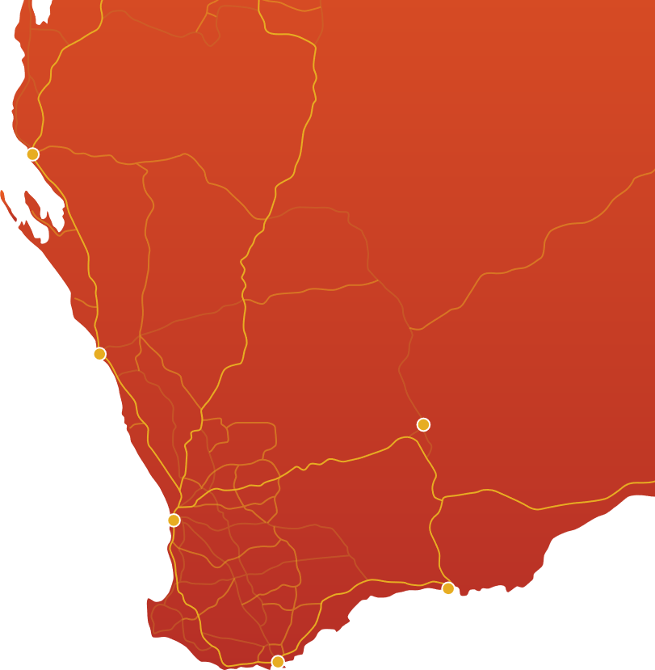





Investment proposition
Projects
An attractively priced West Australian gold developer with near-term growth
Regional Landholding
+1,150km²
Carnarvon
Mineral Resource Estimate1
1.9Moz 34.3Mt @ 1.7g/t Au
Studies support development of a gold operation producing +100koz p.a. from the refurbished Black Swan Processing Hub
20.2Moz Ag
104kt Zn
Black Swan Processing Hub
.
2.2Mtpa (currently in C&M) with pathway to refurbish / convert to gold processing
Expedited, low capital, hub-and-spoke model which leverages existing 100%-owned processing infrastructure – FEED Studies underway – Long lead items purchased
Geraldton
Targeting high-margin gold production from Black Swan starting in mid-2027
Kalgoorlie
1.9Moz¹ MRE with major drilling program underway – better definition & extension of mineable ounces & testing new regional targets
Perth
Esperance
Gold production from Black Swan Processing Hub fully funded²
Albany
1. Refer ASX Announcement “Gold Mineral Resources Update” dated 13 February 2026
2. Fully funded including existing cash, Placement proceeds (refer ASX Announcement 19 February 2026 Successful A$175M capital raising) and expected Share Purchase Plan proceeds

Slide 6
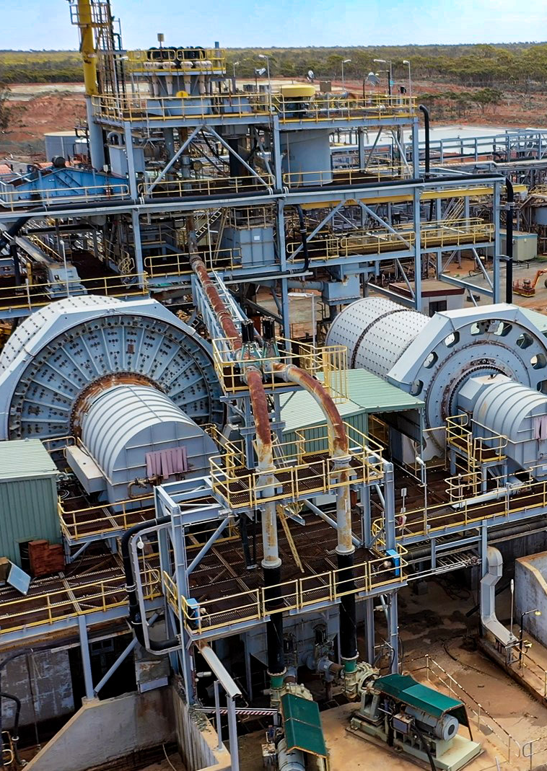
Positive Black Swan Study Results and Equity Raising
Fully funded to refurbish Black Swan Processing Hub and commence gold production
Positive Black Swan study results – a low capital intensity pathway to +100kozpa
Pre-production capital – A$160.5M & ~A$1,500/oz capital intensity
Payback – 18 months from plant commissioning¹
NPV / IRR – Project pre-tax NPV₈ ~A$631M & Project IRR 83%¹
Production – average ~102kozpa
Operating Cost – C1 A$2,852/oz & AISC A$3,353/oz
Fully funded to refurbish Black Swan plant and commence mining and gold production²
Two tranche, underwritten A$175M² Placement
Share Purchase Plan complete raising ~A$4.65M³
Expedited path to Black Swan first gold production mid-2027
Infrastructure – low risk entry to +100kozpa via existing plant (estimated replacement value +A$200M) & Kalgoorlie location
Approvals – major approvals in place with construction from mid-2026
Near term value accretive opportunities under assessment⁴
1. A$5,500/oz gold price
Fully funded including existing cash, Placement proceeds (refer ASX Announcement 19 February 2026 Successful A$175M capital raising) and expected Share Purchase Plan proceeds
Refer ASX Announcement 17 March 2026 - Results of Share Purchase Plan
4. The Company is considering accretive opportunities that may extend mine life and may include joint ventures, toll milling, ore purchase arrangements, asset purchases or other corporate transactions

Slide 7


Maritana Minerals – at a glance
An attractively priced West Australian gold developer with near-term growth potential
Capital structure | Units | Current
Share price | A$/sh | 0.895⁽¹⁾
Ordinary shares | M | 371.8⁽¹⁾
Options and performance rights | M | 4.5⁽¹⁾
Market capitalisation | A$M | 332.8
Cash and cash equivalents | A$M | 114.1⁽²⁾
Debt | A$M | Nil⁽²⁾
Share Trading & Price
Adjusted to match share structure and volume post 15-to-1 capital consolidation effective 9 December 2025
Research Coverage
Indicative Share Register
At 14 April 2026
At 6 March 2026. Excludes cash received from tranche 2 on 14 February 2026 of $118m (before costs). Excludes listed investments with a value of ~A$23.5M

Slide 8
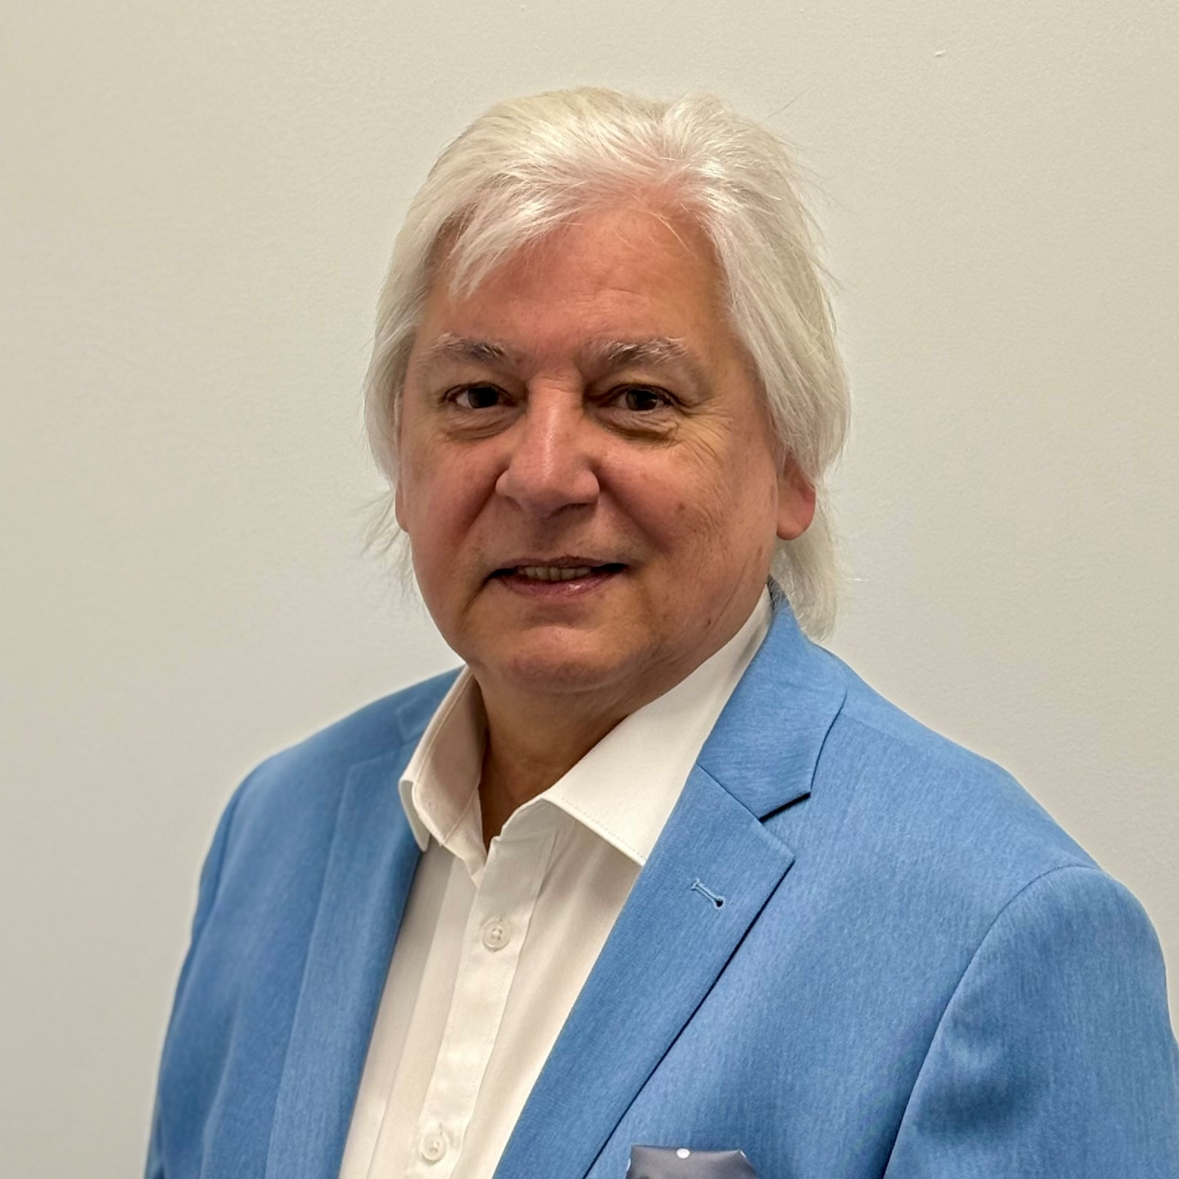
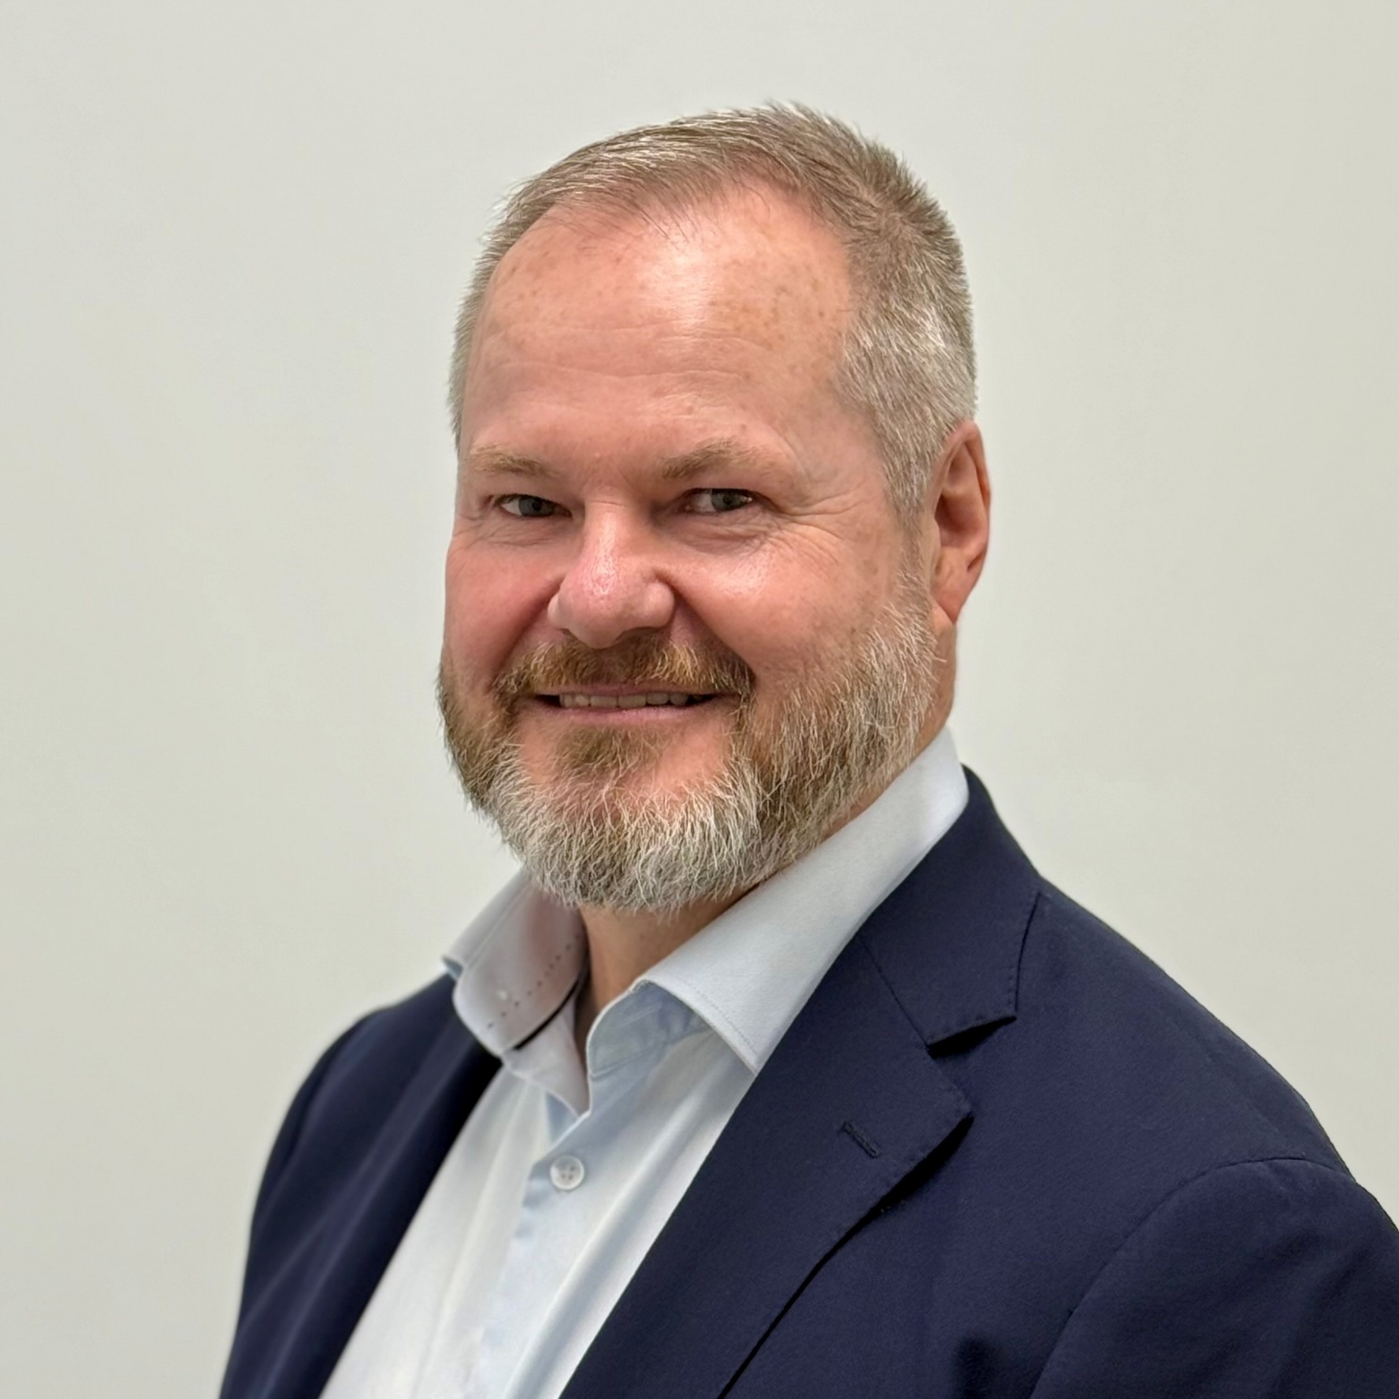
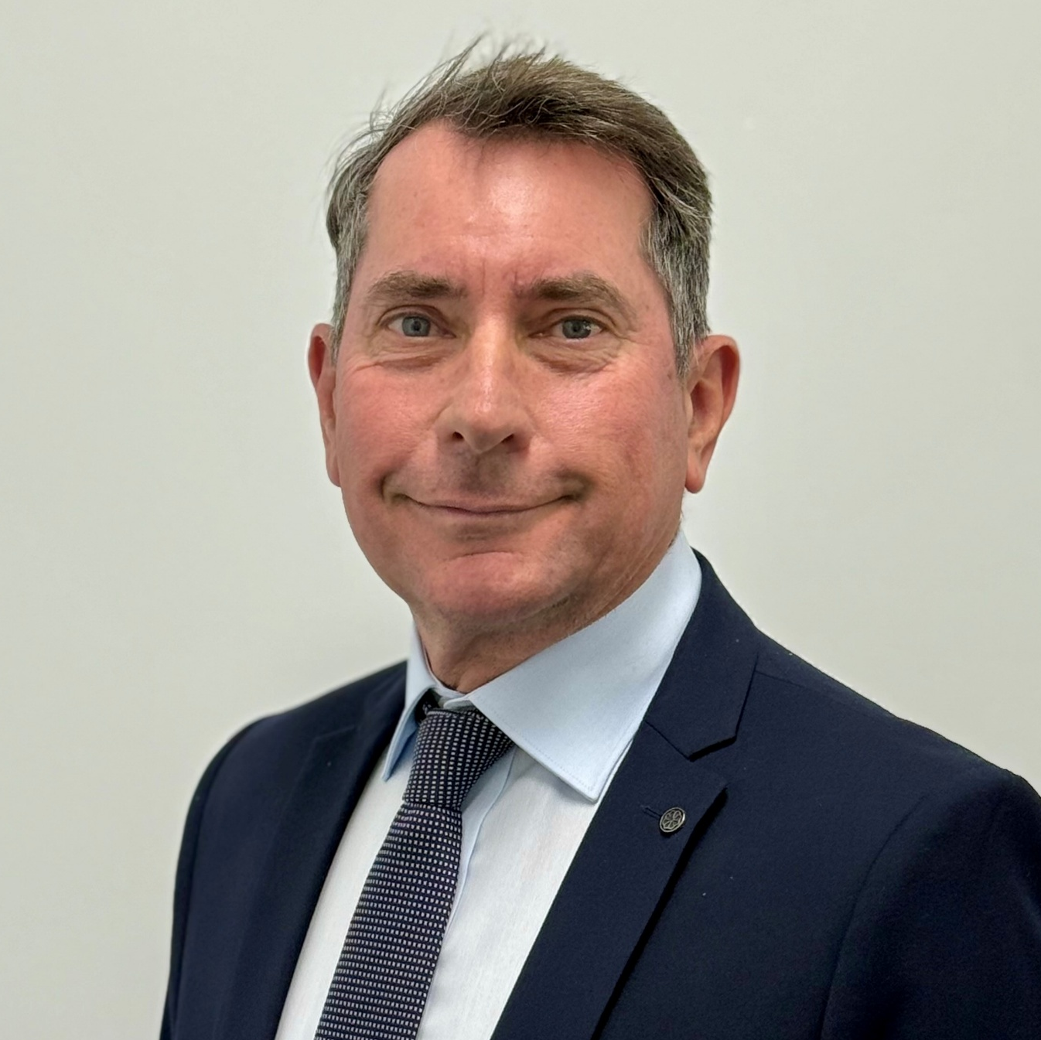







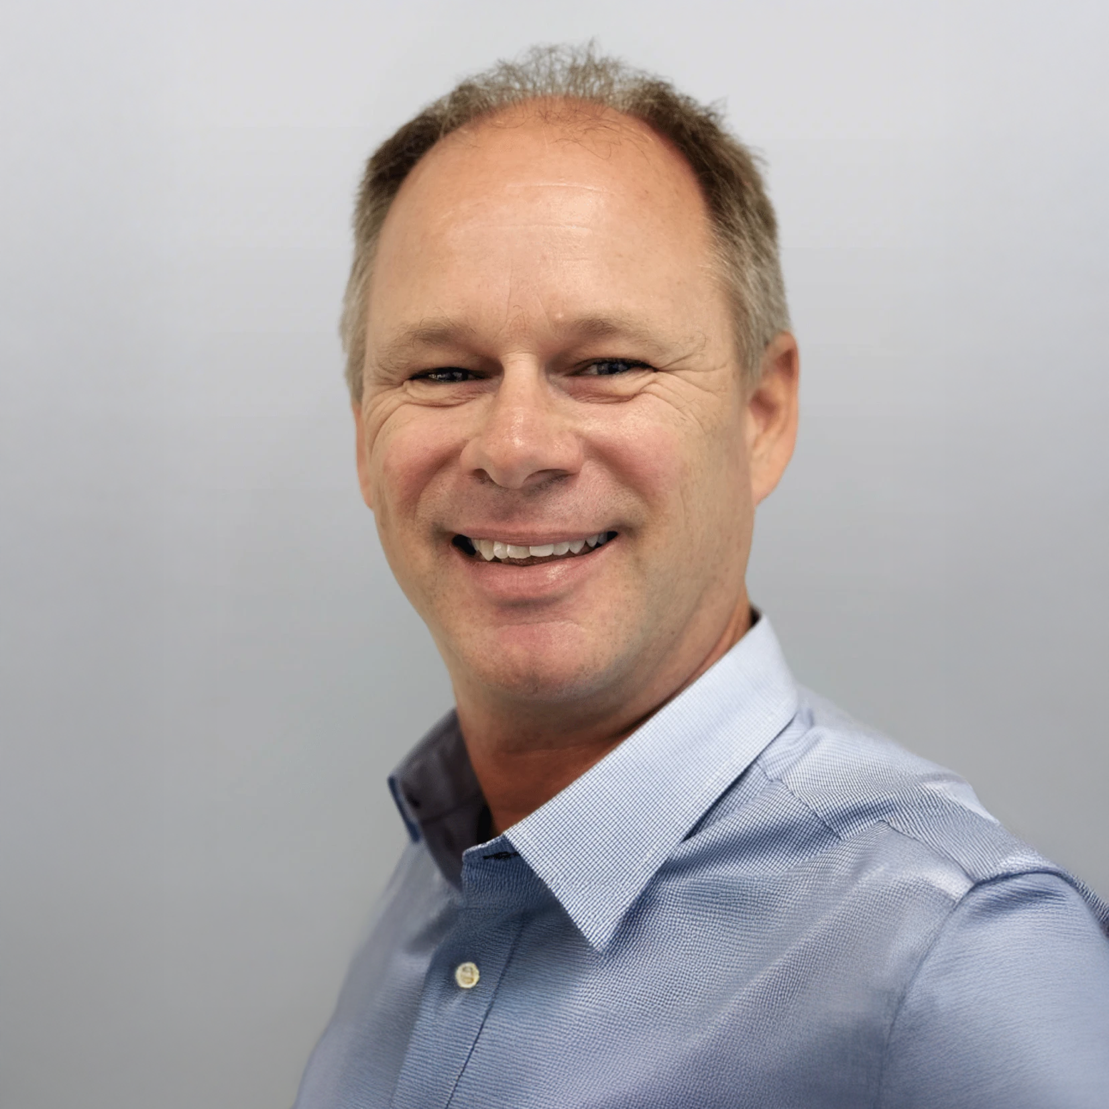

Maritana Minerals – Board and Management
Key experience in operations and value delivery
Ashok Parekh​ Non-Executive Chair
Grant Haywood Managing Director
Rob Waugh Non-Executive Director
Warren Hallam Non-Executive Director
Isabel Macchia Company Secretary
Brendan Shalders CFO & Joint CoSec
Christian Price
GM Corporate Development
Stephen Guy Chief Geologist
Adrianna Skok-Muir Group Mining Engineer
Doug Flanagan Project Director
Dirk Richards Project Manager

Slide 9
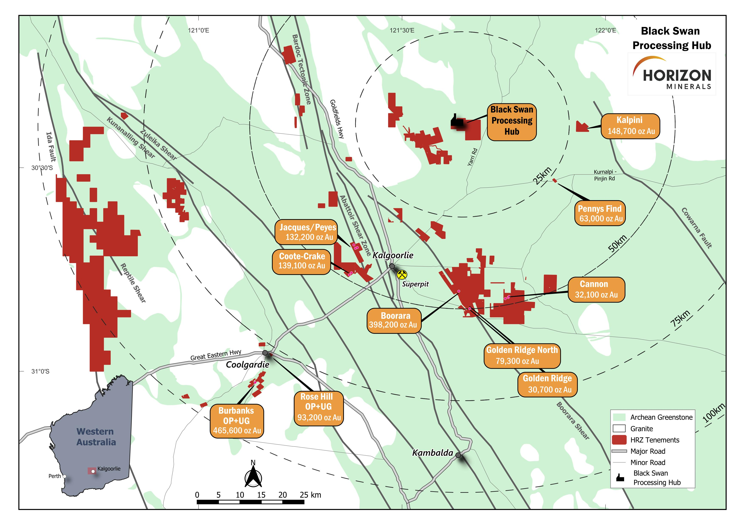

Project portfolio
Strategically constructed gold portfolio centered around major geological structures
Large 1,167km² land package in an attractive geological setting centred around Kalgoorlie / Coolgardie
1.9Moz Group Mineral Resource¹ (34.3Mt @ 1.7g/t Au) with ~50% contained within the cornerstone Burbanks and Boorara deposits
2.2Mtpa Black Swan processing plant – standalone processing hub to unlock the value of the significant resources base
Additional value and optionality from the high-grade Nimbus Silver-Zinc deposit (contains 20.2Moz Ag, 104kt Zn, and 77koz Au) located 44km from Black Swan
1. Refer ASX Announcement “Gold Mineral Resources Update” dated 13 February 2026

Slide 10
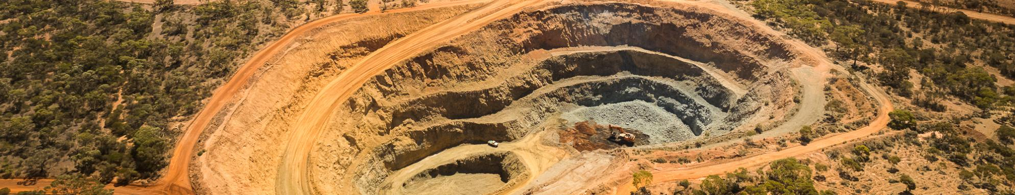





Our Strategy
An attractively priced West Australian gold developer with near-term growth
Now
Next 12 months
2027 onwards
P
Toll treatment complete
Ore stockpile established
Operational de-risking underway
Black Swan refurbishment and gold processing conversion
Mining commencement late 2026
Production
First Black Swan gold production by mid-2027
P
Grow Mineral Resources and drill test new exploration targets
Value accretive M&A
Growth
Upgrade and extend Mineral Resources
Extend initial +5 year mine life
Multiple individual PFS updates
Combined PFS update
Commence Nimbus Studies and drill plan
P
Black Swan Studies complete
FEED Studies underway
Complete Nimbus production at Black Swan Studies
Studies
All elements in place to support aspirational target to become a ~100kozpa GOLD producer*
*This is an aspirational statement (and not a production target), the Company does not yet have reasonable grounds to believe the vision can be achieved.
Refer to the Aspirational Statements section in the Disclaimers section of this presentation for further information.

Slide 11
Production Ready
A 1.9Moz Mineral Resource¹ with processing infrastructure and growth
1. Refer ASX Announcement “Gold Mineral Resources Update” dated 13 February 2026

Slide 12
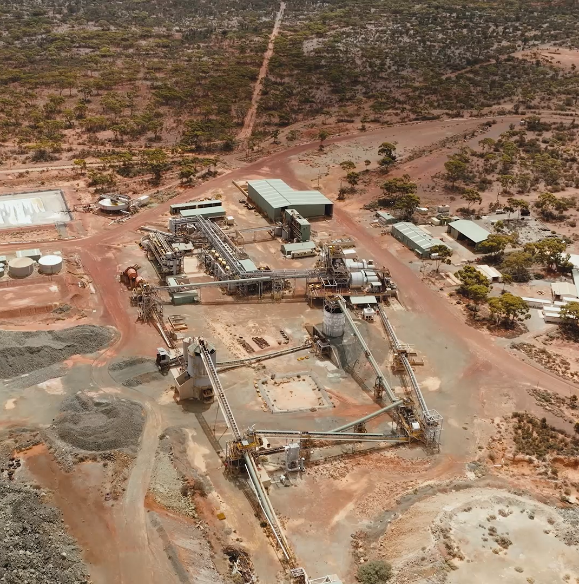
Black Swan Processing Hub¹
PROCESSING
Facilitates hub and spoke operating model
~50km northeast of Kalgoorlie
Comminution circuit suitable for gold processing after refurbishment and addition of a carbon in leach (CIL) circuit
Study fully utilises existing 2.2Mtpa processing capacity
Estimated replacement value of +A$200M
Capital cost estimate for Black Swan of A$101M ensures long-term reliability, flexibility and operability
New plant construction risk reduced & key permits in place
Provides a platform for potential regional consolidation
Refer ASX Announcement “Studies Support Standalone Gold Development in WA Goldfields’” dated 17 February 2026

Slide 13
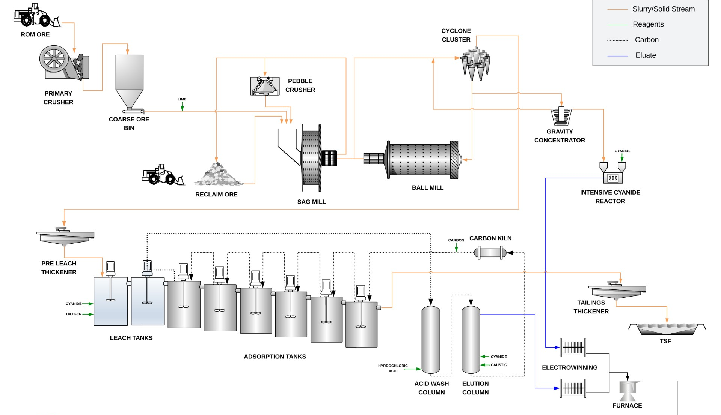


Black Swan Processing Hub
Existing flotation circuit and planned changes to facilitate gold production
REFURBISHMENT
FUTURE SULPHIDE CIRCUIT REFURBISHMENT OPTION
MOTORS - VSD
GOLD CONVERSION
LONG LEAD ITEMS ORDERED
Au

Slide 14
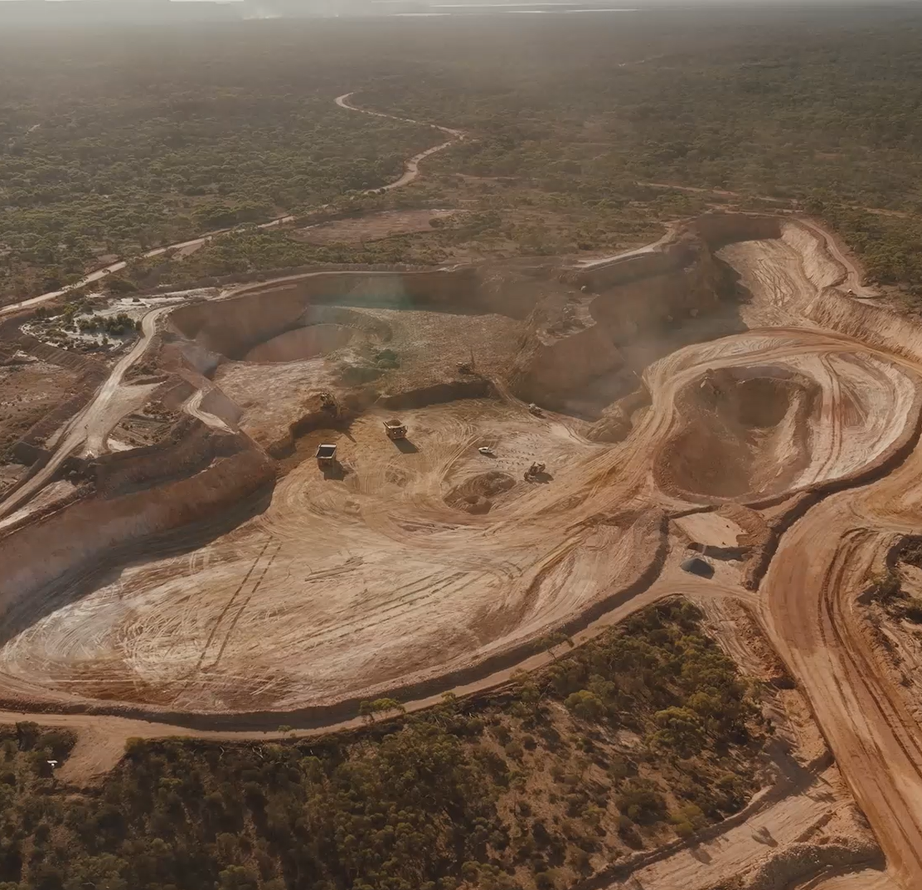
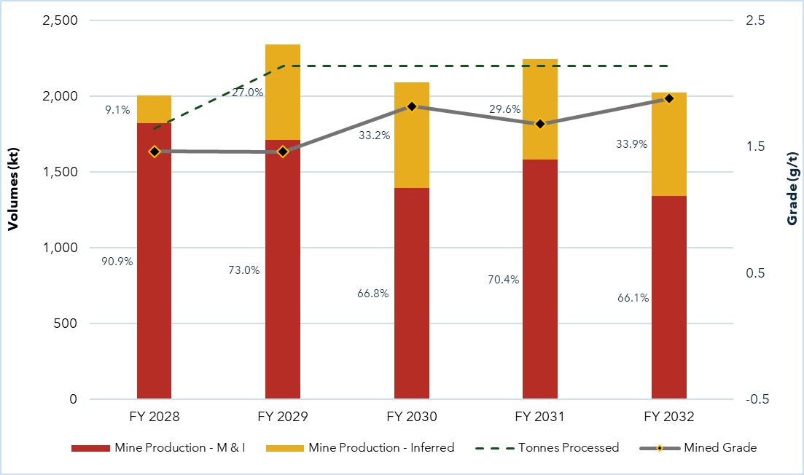
Production ramp-up
PRODUCTION
Cash flow and future baseload open pit feed
Boorara stockpile 460kt (14.2koz) – a de-risked startup
Baseload open pit feed with supplementary high grade underground sources
Early mine plan underpinned by high confidence Mineral Resources and Ore Reserves

Slide 15















Hub and Spoke Model producing 546koz in 5 years
Multiple ore sources feeding into the Black Swan Processing Hub¹
BOORARA S/P & OPEN PIT
BURBANKS OPEN PIT
64km
110km
Years 1 – 4 106.6koz
Years 2 – 5 128.8koz
48 - 80km
42 - 110km
CANNON AND PENNYS U/G
OTHER OPEN PIT AND U/G
BLACK SWAN PROCESSING HUB
Years 1 – 4 47.4koz
Years 3 – 5 212.1koz
90km
COOTE AND CRAKE OPEN PITS
Years 2 – 5 51.5koz
1. Refer ASX Announcement “Studies Support Standalone Gold Development in WA Goldfields” dated 17 February 2026

Slide 16




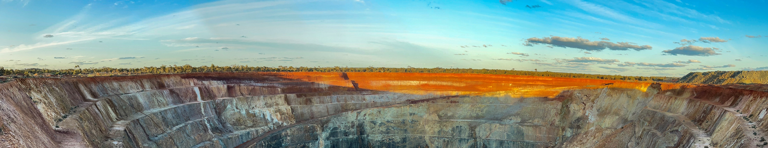

Benefits of the Black Swan refurbishment
Faster, cheaper & lower risk
Refurbishment¹
New Build²
~$100M
>$200M
Cost
12 months
18 – 24 months
Timeline
Major approvals in place
New permitting required
Approvals
Reduced environmental footprint
Sustainability
Higher future impact
1. As released to the ASX on 17 February 2026 “Studies Support Standalone Gold Development”
2. Based on the Astral Gold Mandilla Gold Project Pre-Feasibility Study released to the ASX on 25 June 2025

Slide 17
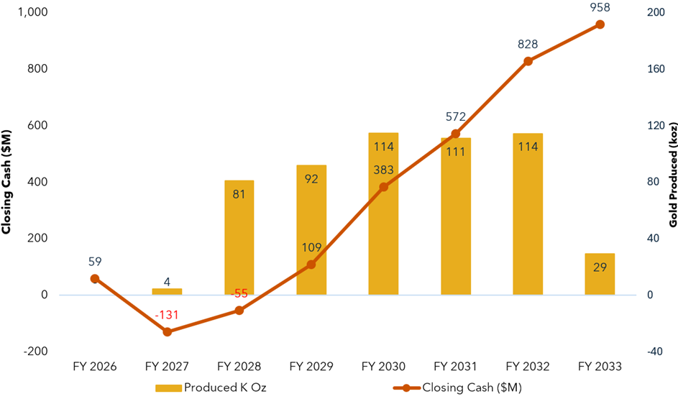
Study Outcomes - Robust economic outcomes
Strong cash generation and financial metrics
546koz gold production LOM
$131M maximum capital drawdown
C1 Cost A$2,852/oz¹
AISC A$3,353/oz¹
At a base case gold price of A$5,500/oz. At 9 March 2026 current Spot price is A$7,300/oz
Represents economics at a Project level and excludes corporate costs
From the start of commissioning

Slide 18

Key Milestones and Timing
Pathway to gold production from Black Swan Processing Hub
Area | Work Streams and Deliverables | CY 2026 |  |  |  | CY 2027
 |  | Q1 | Q2 | Q3 | Q4 | Q1 | Q2 | Q3 | Q4
Corporate | Lake Johnston and Phillips Find Cash
 | Equity Raise - A$175M + SPP
Development & Growth | Burbanks MRE Update
 | Resource Extension & Grade Control drilling
Mining & Operations | Boorara and Phillips Find Mining & Ore Stockpiling
 | Underground Mobilisation & Development
 | Underground High-Grade Ore Production
Black Swan Processing Hub | Black Swan Plant 2.2Mtpa Studies Complete
 | Front End Engineering Design (FEED)
 | Final Investment Decision (FID)
 | Black Swan Accommodation Construction
 | Black Swan Plant Construction
 | Black Swan Plant Commissioning
 | Black Swan Plant Gold Production

Slide 19
Project Upside
A 1.9Moz Mineral Resource¹ with processing infrastructure and growth
1. Refer ASX Announcement “Gold Mineral Resources Update” dated 13 February 2026

Slide 20
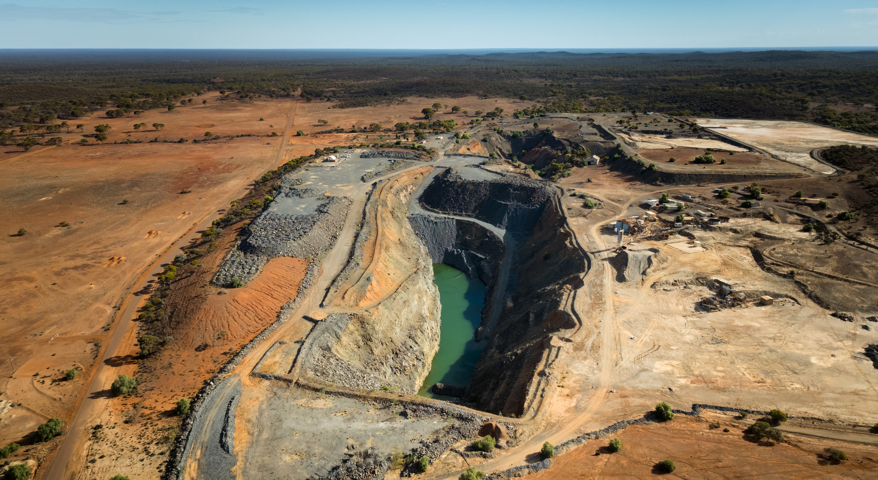
Burbanks high-grade underground mine
GROWTH
High-grade ore source not included in the current Black Swan studies & LOM
Located on a granted Mining Lease 9km south of Coolgardie, WA
Historic underground mining produced 324koz @ 22.7g/t Au
Large 465.5koz open pit and high-grade underground Mineral Resource³
Significant extension potential with only 30% of the upper 500m mineralised horizon tested to date¹
Results from ~30,000m drilling program include 0.96m @ 1,762g/t Au and 2m @ 235.7g/t Au²
Mineral Resource upgrade planned for mid-2026 before expected inclusion into the PFS and updated life of mine plan
Refer ASX Announcement (ASX:GRS) “Global Gold Resource Increases 57% to 520,134 oz” dated 5 July 2023 for all exploration details
Refer ASX announcements ‘Ultra High Grades Returned in Burbanks Phase 1 Drilling” dated 17 December 2025 and “Continued High Grade Success from Burbanks Phase 1 Drilling” dated 28 January 2026
Refer SX announcement (ASX:GRS) “High-Grade Intercepts Extends Potential at Burbanks” dated 5 October 2023

Slide 21
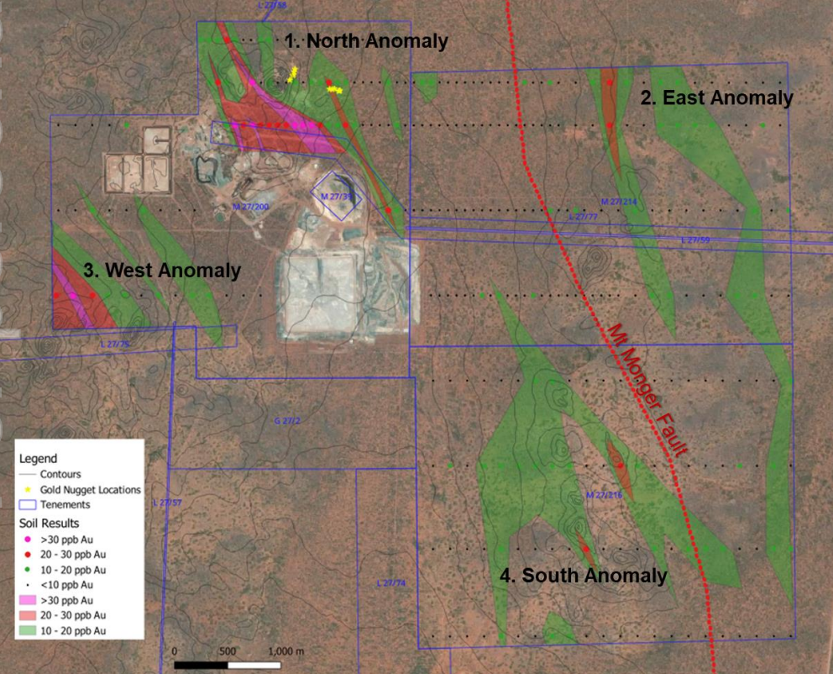
Black Swan exploration potential
GROWTH
Untested gold anomalies emerging adjacent to the process plant infrastructure
Previous exploration largely targeting nickel sulphide mineralisation – only 5% of drill assays have tested for gold
Target areas adjacent to the Mt Monger fault which is associated with several regional gold mining operations
Gold prospectivity of the Black Swan area demonstrated with drill intersections grading up to 6.41g/t Au¹
Numerous gold nuggets located¹
Identified a new 6.5km-long gold trend around Black Swan
Initial aircore 2,000m drill program planned for H1 2026
Refer ASX announcement (ASX:POS) "Gold Potential Builds at Black Swan" dated 24 September 2024

Slide 22
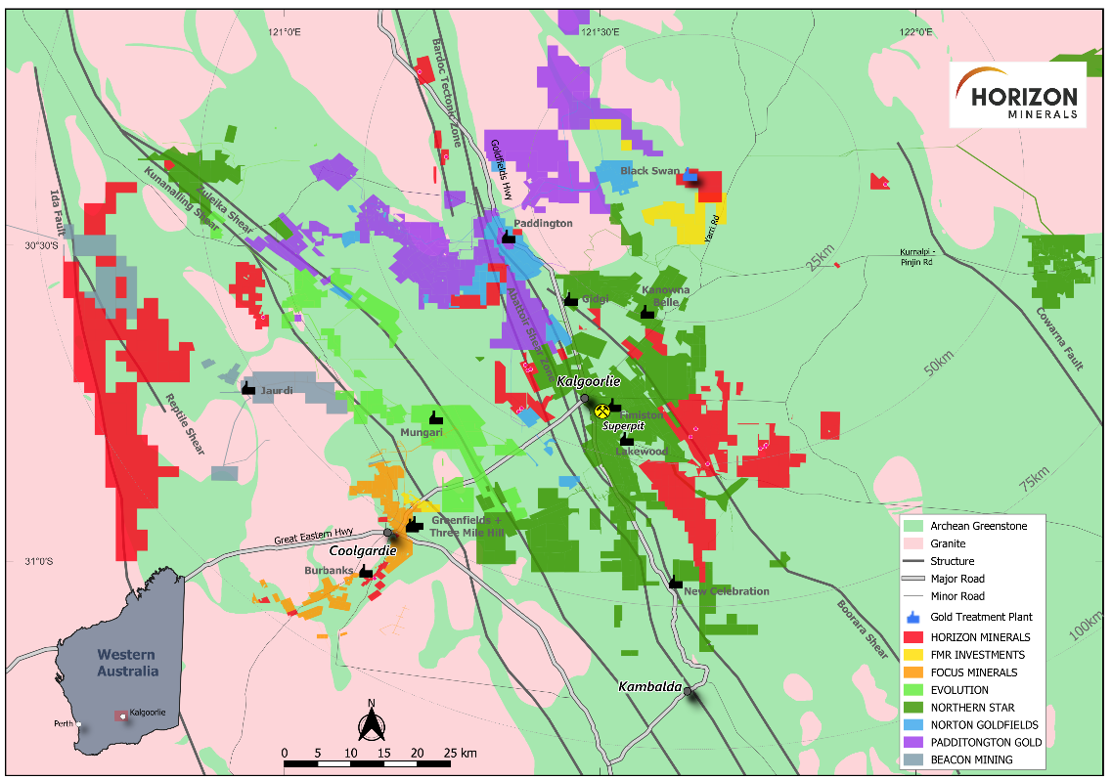
Platform for regional consolidation
GROWTH
Several deposits of gold deposits in region are without a clear processing solution
Non-producer access to third party gold processing in the Goldfields is becoming increasingly difficult
Conversion of a 2.2Mtpa processing facility to gold production has potential to unlock stranded gold resources in the region
Maritana will assess accretive opportunities to add to mine life:
Partnership opportunities – joint venture, toll milling, and ore purchase arrangements
Acquisitions – asset purchases or corporate transactions

Slide 23
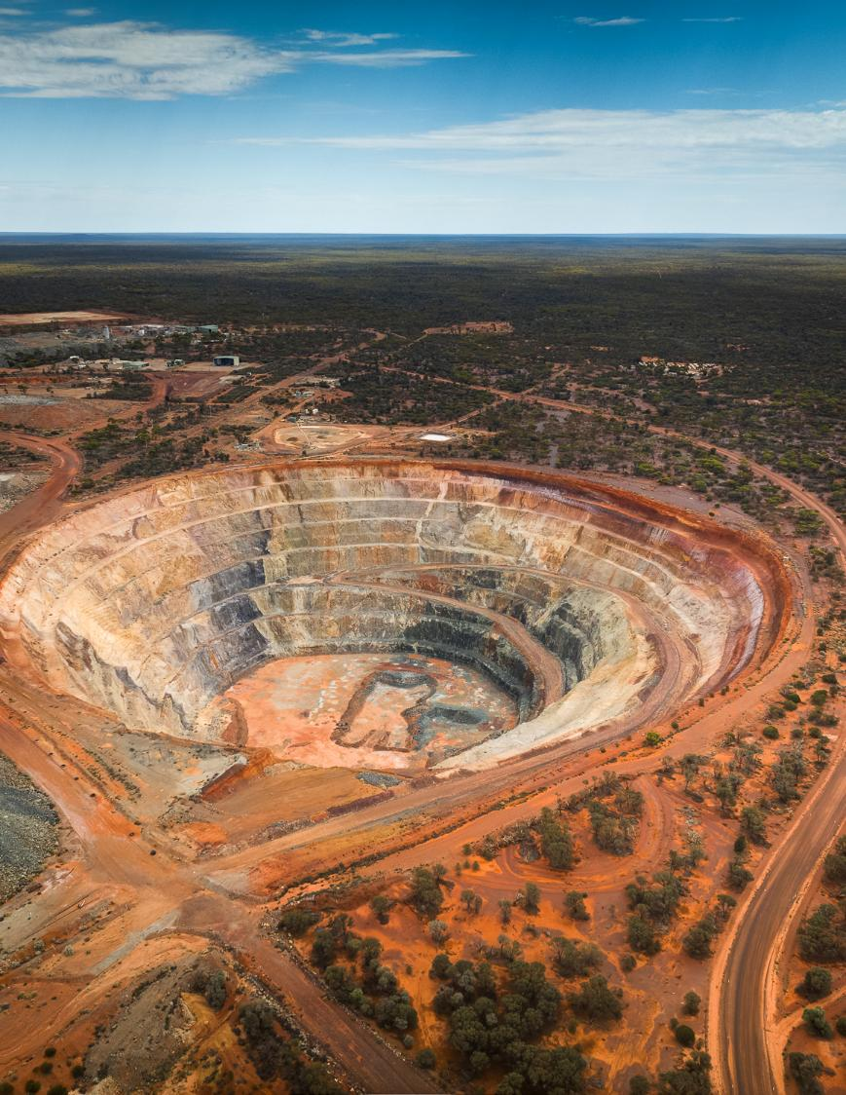








An Emerging Standalone Gold Producer
Clear and deliverable business plan to become a new standalone WA gold miner
Combination of 1.9Moz of Mineral Resource¹ and processing infrastructure
Ramp up of production aligned with strong gold price environment
Studies demonstrate a robust initial five year mine plan
Fully funded with an enhanced share register
Credible, low capex plan to standalone gold production by mid-2027
Highly experienced Board and Management with strong regional expertise
Attractive current valuation relative to peers, with growth and re-rating potential
Refer ASX Announcement “Gold Mineral Resources Update” dated 13 February 2026

Slide 24
Contact Us
Grant Haywood Managing Director and CEO
+61 (08) 9386 9534 admin@horizonminerals.com.au horizonminerals.com.au PO Box 1064 West Perth WA 6872

Slide 25
Mineral Resource¹ Estimate
Gold projects
Project | Measured |  |  | Indicated |  |  | Inferred |  |  | Total
 | kt | Au (g/t) | koz | kt | Au (g/t) | koz | kt | Au (g/t) | koz | kt | Au (g/t) | koz
Baden Powell |  |  |  |  |  |  | 596 | 1.20 | 23 | 596 | 1.20 | 23
Boorara | 753 | 1.21 | 29 | 6,485 | 1.28 | 266 | 2,549 | 1.26 | 103 | 9,787 | 1.27 | 398
Burbanks OP |  |  |  | 1,430 | 2.02 | 93 | 3,430 | 1.86 | 205 | 4,860 | 1.90 | 298
Burbanks UG |  |  |  | 122 | 4.26 | 17 | 1,070 | 4.39 | 151 | 1,193 | 4.38 | 168
Cannon |  |  |  | 185 | 4.80 | 29 | 47 | 2.28 | 3 | 232 | 4.29 | 32
Capricorn |  |  |  |  |  |  | 659 | 1.20 | 25 | 659 | 1.20 | 25
Coote |  |  |  |  |  |  | 2,321 | 0.86 | 64 | 2,321 | 0.86 | 64
Crake |  |  |  | 1,699 | 1.29 | 70 | 123 | 1.08 | 4 | 1,822 | 1.28 | 75
Golden Ridge |  |  |  | 476 | 1.82 | 28 | 52 | 1.71 | 3 | 527 | 1.81 | 31
Golden Ridge North |  |  |  | 1,511 | 0.86 | 42 | 1,021 | 1.14 | 37 | 2,532 | 0.97 | 79
Gordons Dam |  |  |  |  |  |  | 693 | 1.24 | 28 | 693 | 1.24 | 28
Jacques/Peyes |  |  |  | 996 | 2.54 | 81 | 856 | 1.85 | 51 | 1,852 | 2.22 | 132
Monument |  |  |  |  |  |  | 919 | 1.11 | 33 | 919 | 1.11 | 33
Phillips Find OP |  |  |  | 410 | 2.48 | 33 | 185 | 2.10 | 13 | 595 | 2.36 | 45
Phillips Find UG |  |  |  |  |  |  | 3 | 2.27 | 0 | 3 | 2.27 | 0
Rosehill (OP) | 194 | 1.96 | 12 | 92 | 2.05 | 6 |  |  |  | 287 | 1.99 | 18
Rosehill (UG) |  |  |  | 326 | 4.49 | 47 | 181 | 4.78 | 28 | 507 | 4.60 | 75
Pinner |  |  |  | 64 | 1.02 | 2 | 267 | 1.25 | 11 | 330 | 1.21 | 13
Kalpini |  |  |  | 1,768 | 2.04 | 116 | 591 | 1.72 | 33 | 2,359 | 1.96 | 149
Pennys Find |  |  |  | 305 | 5.19 | 51 | 123 | 3.02 | 12 | 429 | 4.57 | 63
Teal |  |  |  | 1,009 | 1.96 | 64 | 801 | 2.50 | 64 | 1,811 | 2.20 | 128
Grand Total | 947 | 1.36 | 41 | 16,879 | 1.74 | 944 | 16,489 | 1.68 | 892 | 34,315 | 1.70 | 1,878
.
Tonnages are dry metric tonnes. Minor discrepancies may occur due to rounding.

Slide 26
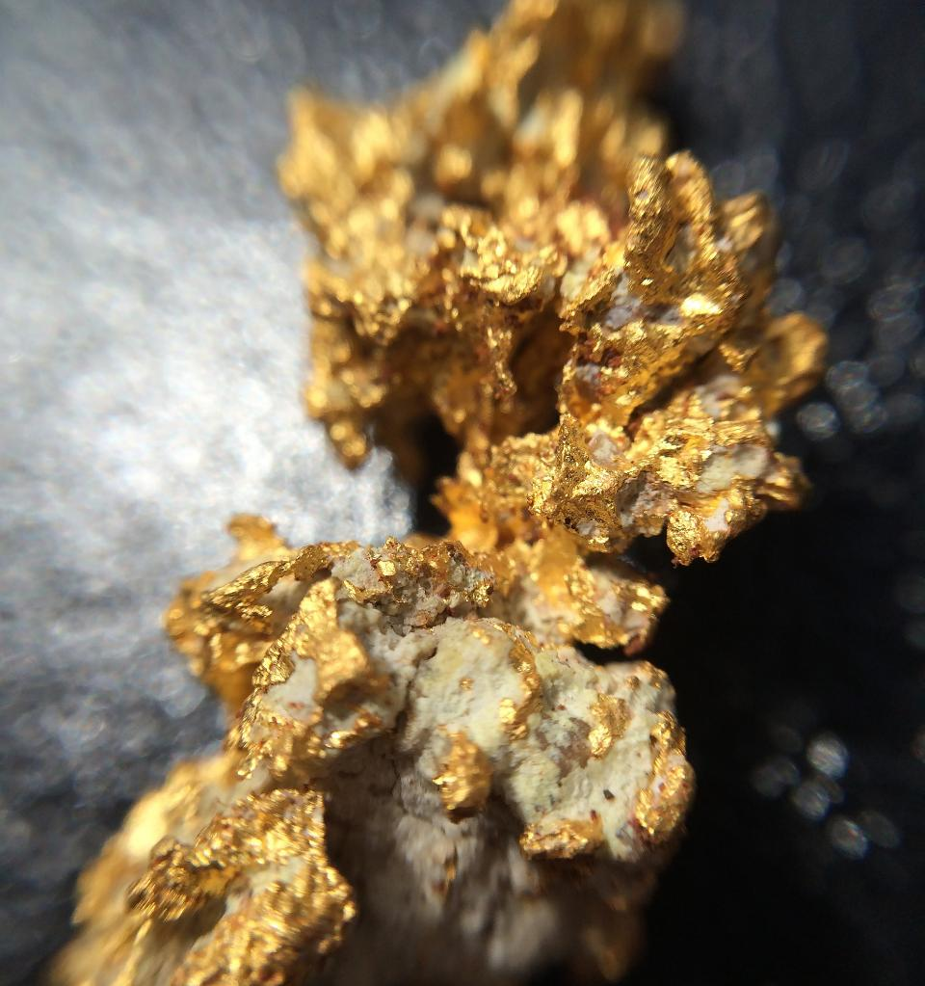
Ore Reserve¹ Estimate
Gold projects
MARITANA MINERALS GOLD ORE RESERVE SUMMARY
Project | Cutoff | Proven |  |  | Probable |  |  | Total
 | Au ppm | kt | Au g/t | Ounces | kt | Au g/t | Ounces | kt | Au g/t | Ounces
Boorara | 0.5 | 450 | 1.1 | 15,915 | 1680 | 1.21 | 65,357 | 2130 | 1.19 | 81,272
Cannon UG | 1 |  |  |  | 135 | 4.1 | 17,700 | 135 | 4.1 | 17,700
Pennys Find | 1.5 |  |  |  | 328 | 3.2 | 33,400 | 328 | 3.2 | 33,400
Kalpini | 0.5 |  |  |  | 867 | 1.69 | 47,203 | 867 | 1.69 | 47,203
Crake | 0.5 |  |  |  | 870 | 1.23 | 34,405 | 870 | 1.23 | 34,405
TOTAL |  | 450 | 1.1 | 15,915 | 4,330 |  | 198,065 | 4,330 | 1.54 | 213,980

Slide 27
Mineral Resource¹ Estimate
Nimbus silver-zinc project
Nimbus All Lodes (bottom cuts 12 g/t Ag, 0.5% Zn, 0.3g/t Au)
Category | Mt | Ag (g/t) | Au (g/t) | Zn (%) | Ag (Moz) | Au (kt) | Zn (kt)
Measured Resource | 3.62 | 102 | 0.09 | 1.2 | 11.9 | 10 | 45
Indicated Resource | 3.18 | 48 | 0.21 | 1.0 | 4.9 | 21 | 30
Inferred Resource | 5.28 | 20 | 0.27 | 0.5 | 3.4 | 46 | 29
Total Resource | 12.08 | 52 | 0.20 | 0.9 | 20.2 | 77 | 104
Nimbus high grade silver zinc resource (500g/t Ag bottom cut and 2,800g/t Ag top cut)
Category | Mt | Ag (g/t) | Zn (%) | Ag (Moz) | Zn (kt)
Measured Resource | - | - | - | - | -
Indicated Resource | 0.17 | 762 | 12.8 | 4.2 | 22
Inferred Resource | 0.09 | 797 | 13.0 | 2.2 | 11
Total Resource | 0.26 | 774 | 12.8 | 6.4 | 33

Slide 28
Mineral Resource & Ore Reserve disclosure
Confirmations
Maritana Gold Mineral Resources
The information in this report that relates to Maritana’s Mineral Resources estimates is extracted from and was originally reported in Maritana’s ASX announcements:
Project | Year | Confirmation Source
Baden Powell | 2022 | “Gold resources increase to 1.24moz”, dated 28 September 2022
Boorara | 2026 | “Gold Mineral Resources Update”, dated 13 February 2026
Burbanks OP | 2024 | “Group Mineral Resource Statement – Amended”, dated 1 August 2024
Burbanks UG | 2024 | “Group Mineral Resource Statement – Amended”, dated 1 August 2024
Cannon | 2022 | “Investor Presentation June 2022”, dated 31 May 2022
Capricorn | 2022 | “Gold resources increase to 1.24moz”, dated 28 September 2022
Coote | 2026 | “Gold Mineral Resources Update”, dated 13 February 2026
Crake | 2026 | “Gold Mineral Resources Update”, dated 13 February 2026
Golden Ridge | 2020 | “High Grade Drill results and Resource Update for Rose Hill”, dated 4 February 2020
Golden Ridge North | 2026 | “Gold Mineral Resources Update”, dated 13 February 2026
Gordons Dam | 2026 | “Gold Mineral Resources Update”, dated 13 February 2026
Jacques/Peyes | 2026 | “Gold Mineral Resources Update”, dated 13 February 2026
Monument | 2024 | “Group Mineral Resource Statement – Amended”, dated 1 August 2024
Phillips Find OP | 2026 | “Gold Mineral Resources Update”, dated 13 February 2026
Phillips Find UG | 2024 | “Group Mineral Resource Statement – Amended”, dated 1 August 2024
Rosehill (OP) | 2020 | “Rose Hill Firms as Quality High Grade Open Pit and Underground Satellite Gold Project”, dated 9 December 2020 “
Rosehill (UG) | 2020 | “Rose Hill Firms as Quality High Grade Open Pit and Underground Satellite Gold Project”, dated 9 December 2020 “
Pinner | 2024 | “Group Mineral Resource Statement – Amended”, dated 1 August 2024
Kalpini | 2026 | “Gold Mineral Resources Update”, dated 13 February 2026
Pennys Find | 2023 | “Pennys Find Resource Update”, dated 29 December 2023
Teal | 2018 | “Intermin’s Mineral Resources Grow 30% to over 560,000 Ounces” (ASX:IRC), dated 19 September 2018
each of which is available at www.asx.com.au. The Company confirms that it is not aware of any new information or data that materially affects the information included in the original market announcements and that all material assumptions and technical parameters underpinning the estimates in those announcements continue to apply and have not materially changed. The Company confirms that the form and context of the Competent Person’s findings in relation to those Mineral Resources estimates have not been materially modified from the original market announcements. Since the original reporting Boorara and Phillips Find have been depleted for production to June 30, 2025. Crake, Coote, Golden Ridge North, Kalpini, Jacques-Peyes and Gordons Dam have been re-reported at the lower cutoff grade of 0.5 g/t Au.

Slide 29
Mineral Resource & Ore Reserve disclosure
Confirmations
Non-gold Mineral Resources
The information is this Presentation that relates to Maritana's exploration results and Mineral Resources estimates was originally reported in Maritana's ASX announcement: "Nimbus Silver Update" (Nimbus, Nimbus Exploration Target) 28 August 2024 which is available at www.asx.com.au.
Maritana confirms that the form and context of the Competent Person's findings in relation to those Mineral Resources estimates have not been materially modified from the original market announcements.
Competent Persons Statement (Resources)
The revised Mineral Resource Estimates reports were undertaken, or supervised, by Mr Stephen Godfrey, Resource Development Manager with Maritana Minerals Limited. Mr Godfrey is a Fellow of the Australasian Institute of Mining and Metallurgy (FAusIMM #110542) and a Member of the Australian Institute of Geoscientists (MAIG #3993). Mr Godfrey has sufficient experience that is relevant to the style of mineralisation, type of deposit under consideration and to the activity that they are undertaking to qualify as a Competent Persons as defined in the 2012 edition of the ‘Australasian Code for Reporting of Exploration, Results, Mineral Resource and Ore Reserves’. Mr Godfrey considers all resources to be current and relevant to Maritana’s ongoing plans.
Gold Ore Reserves
The information in this report that relates to Maritana’s Mineral Resources estimates is extracted from and was originally reported in Maritana’s ASX announcements:
Competent Person Statement (Reserves)
The revised Mineral Resource Reserve Estimates reports were undertaken, or supervised, by Mr Franz Charles Schlosser, who is a full-time employee of Mining Plus Pty Ltd. Mr Schlosser is a Fellow and Chartered Professional of the Australasian Institute of Mining and Metallurgy. Mr Schlosser has sufficient experience that is relevant to the style of mineralisation, type of deposit under consideration and to the activity that they are undertaking to qualify as a Competent Persons as defined in the 2012 edition of the ‘Australasian Code for Reporting of Exploration, Results, Mineral Resource and Ore Reserves’. Mr Schlosser considers the Boorara, Crake and Kalpini Ore Reserves to be true and consents to their inclusion in this document.
Project | Year | Confirmation Source
Boorara | 2026 | “Gold Ore Reserve Update”, dated 17 February 2026
Cannon UG | 2022 | “Positive Results for Cannon Underground Gold Project and Feasibility Study Update” dated 29 March 2022
Pennys Find | 2024 | “Penny’s Find Pre-Feasibility Study and Ore Reserve” dated 18 December 2024
Kalpini | 2026 | “Gold Ore Reserve Update”, dated 17 February 2026
Crake | 2026 | “Gold Ore Reserve Update”, dated 17 February 2026
Grand Total

